Slide 1
CSE 473 Markov Decision Processes
Dan Weld
Many slides from Chris Bishop, Mausam, Dan Klein,
Stuart Russell, Andrew Moore & Luke Zettlemoyer

Slide 2
Overview
  Introduction & Agents
  Search, Heuristics & CSPs
  Adversarial Search
  Logical Knowledge Representation
  Planning & MDPs
  Reinforcement Learning
  Uncertainty & Bayesian Networks
  Machine Learning
  NLP & Special Topics

Slide 3
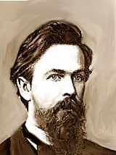
MDPs
Markov Decision Processes
  Planning Under Uncertainty
  Mathematical Framework
  Bellman Equations
  Value Iteration
  Real-Time Dynamic Programming
  Policy Iteration
  Reinforcement Learning
Andrey Markov
(1856-1922)

Slide 4
Planning Agent
Static vs. Dynamic
Environment
Fully
vs.
Partially
Observable
Deterministic
vs.
Stochastic
What action next?
Perfect
vs.
Noisy
Instantaneous
vs.
Durative
Percepts
Actions

Slide 5
Review: Expectimax
What if we don’t know what the result of an action will be? E.g.,
  In solitaire, next card is unknown
  In pacman, the ghosts act randomly
max
Can do expectimax search
  Max nodes as in minimax search
  Chance nodes, like min nodes, except the outcome is uncertain - take average (expectation) of children
  Calculate expected utilities
chance
10
4
5
7
Today, we formalize as an Markov Decision Process
  Handle intermediate rewards & infinite plans
  More efficient processing

Slide 6
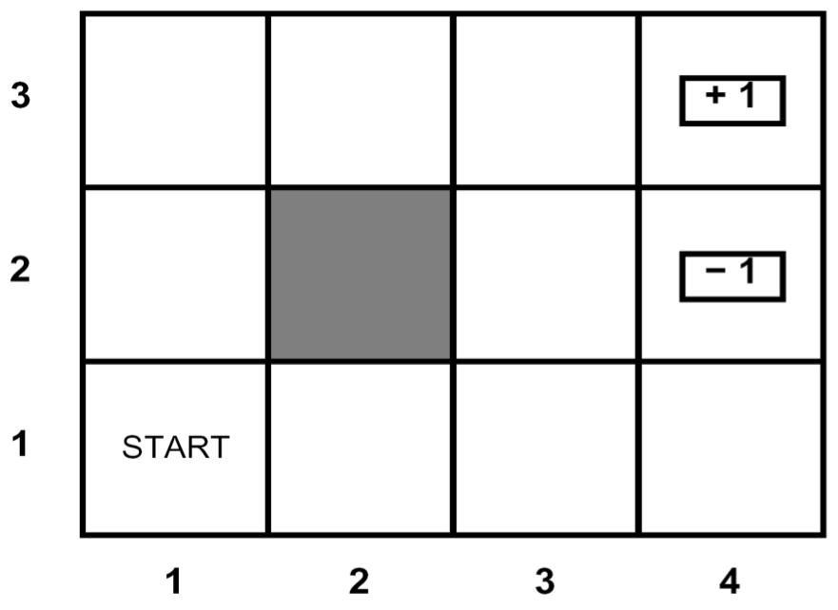
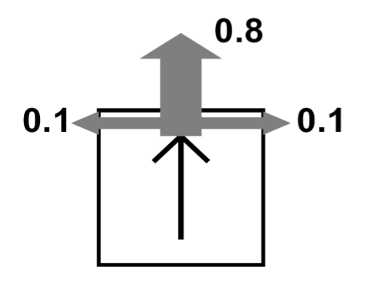
Grid World
Walls block the agent’s path
Agent’s actions may go astray:
  80% of the time, North action takes the agent North
  (assuming no wall)
  10% - actually go West
  10% - actually go East
  If there is a wall in the chosen direction, the agent stays put
Small “living” reward each step
Big rewards come at the end
Goal: maximize sum of rewards

Slide 7
Markov Decision Processes
An MDP is defined by:
  A set of states s ∈ S
  A set of actions a ∈ A
  A transition function T(s,a,s’)
    Prob that a from s leads to s’
    i.e., P(s’ | s,a)
    Also called “the model”
  A reward function R(s, a, s’)
    Sometimes just R(s) or R(s’)
  A start state (or distribution)
  Maybe a terminal state
MDPs: non-deterministic search
  Reinforcement learning: MDPs where we don’t know the transition or reward functions

Slide 8
Axioms of Probability Theory
All probabilities between 0 and 1
Probability of truth and falsity
P(true) = 1 P(false) = 0.
The probability of disjunction is:
A ∧ B
A
B

Slide 9
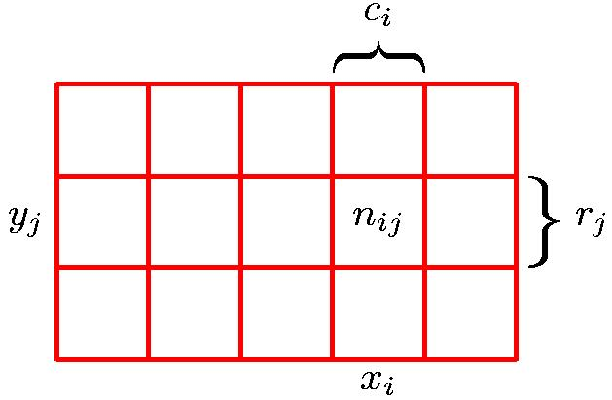
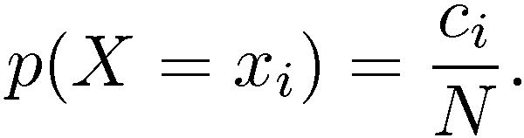
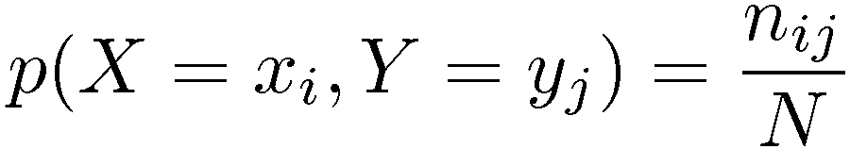
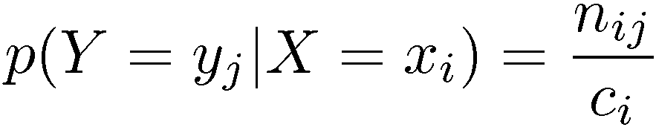
Terminology
Marginal Probability
Conditional Probability
Joint Probability
X value is given

Slide 10
Conditional Probability
P(A | B) is the probability of A given B
Assumes:
  B is all and only information known.
Defined by:
A ∧ B
A
B
10
Notes:
10

Slide 11
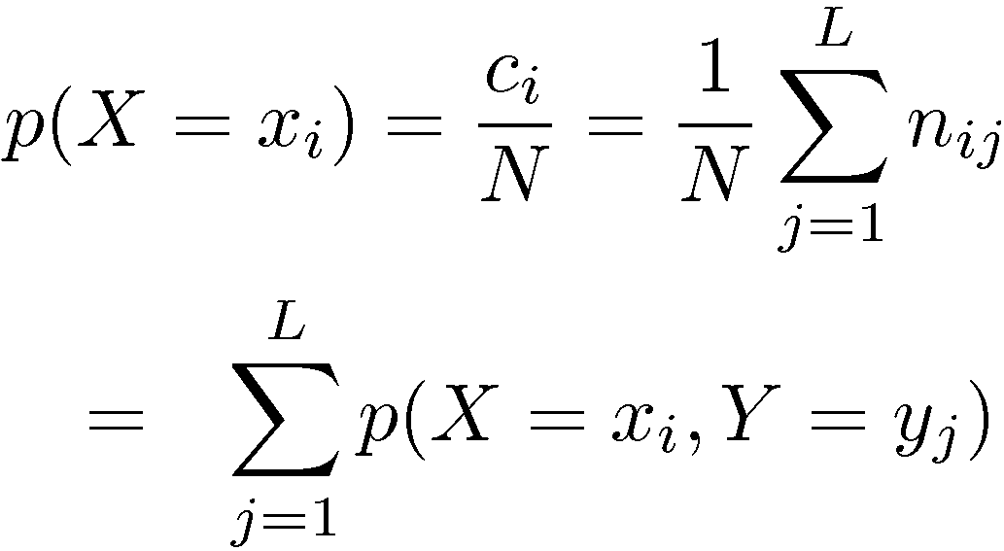
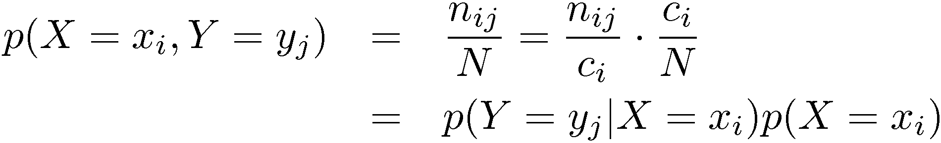
Probability Theory
Sum Rule
Product Rule

Slide 12
Independence
A and B are independent iff:
Therefore, if A and B are independent:
These constraints logically equivalent

Slide 13
Independence
P(A∧B) = P(A)P(B)
A
A ∧ B
B
True
© Daniel S. Weld
13

Slide 14
Conditional Independence
A&B not independent, since P(A|B) < P(A)
A
A ∧ B
B
True
© Daniel S. Weld
14

Slide 15
Conditional Independence
But: A&B are made independent by ¬C
A
A ∧ B
A∧C
P(A|¬C) =
P(A|B,¬C)
B
True
C
B ∧ C
© Daniel S. Weld
15

Slide 16

What is Markov about MDPs?
Andrey Markov (1856-1922)
“Markov” generally means that
  conditioned on the present state,
  the future is independent of the past
For Markov decision processes, “Markov” means:

Slide 17
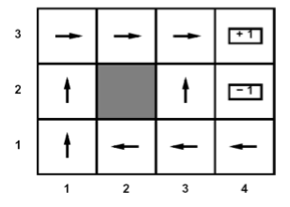
Solving MDPs
In deterministic single-agent search problems, want an optimal plan, or sequence of actions, from start to a goal
In an MDP, we want an optimal policy π*: S → A
  A policy π gives an action for each state
  An optimal policy maximizes expected utility if followed
  Defines a reflex agent
Optimal policy when R(s, a, s’) = -0.03 for all non-terminals s

Slide 18
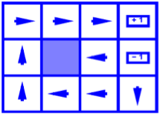
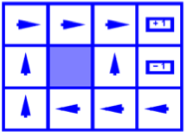
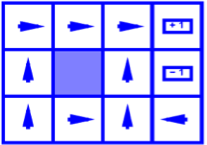
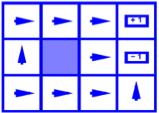
Example Optimal Policies
R(s) = -0.01
R(s) = -0.03
R(s) = -0.4
R(s) = -2.0

Slide 19
Example: High-Low
Three card types: 2, 3, 4
  Infinite deck, twice as many 2’s
Start with 3 showing
After each card, you say “high” or “low”
New card is flipped
  If you’re right, you win the points shown on the new card
  Ties are no-ops (no reward)-0
  If you’re wrong, game ends
3
4
2
2
Differences from expectimax problems:
  #1: get rewards as you go
  #2: you might play forever!

Slide 20
High-Low as an MDP
States:
  2, 3, 4, done
Actions:
  High, Low
Model: T(s, a, s’):
  P(s’=4 | 4, Low) =
  P(s’=3 | 4, Low) =
  P(s’=2 | 4, Low) =
  P(s’=done | 4, Low) = 0
  P(s’=4 | 4, High) = 1/4
  P(s’=3 | 4, High) = 0
  P(s’=2 | 4, High) = 0
  P(s’=done | 4, High) = 3/4
  …
Rewards: R(s, a, s’):
  Number shown on s’ if s’<s ∧ a=“high” …
  0 otherwise
Start: 3
1/4
1/4
3
4
1/2
2
2

Slide 21
Search Tree: High-Low
3
Low
High
3
3
, Low
, High
T = 0.5, R = 2
T = 0.25, R = 3
T = 0, R = 4
T = 0.25, R = 0
2
3
4
High
Low
High
Low
High
Low

Slide 22
MDP Search Trees
Each MDP state gives an expectimax-like search tree
s
s is a state
a
(s, a) is a q-state
s, a
(s,a,s’) called a transition
T(s,a,s’) = P(s’|s,a)
R(s,a,s’)
s,a,s’
s’

Slide 23
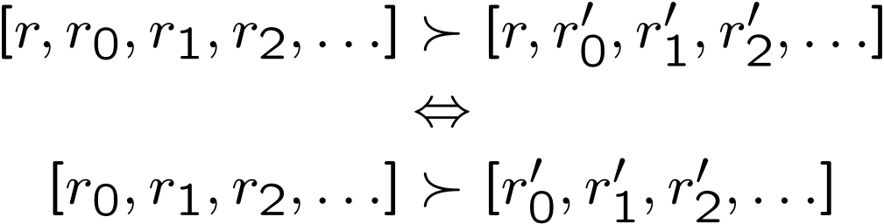
Utilities of Sequences
In order to formalize optimality of a policy, need to understand utilities of sequences of rewards
Typically consider stationary preferences:
Theorem: only two ways to define stationary utilities
  Additive utility:
  Discounted utility:

Slide 24
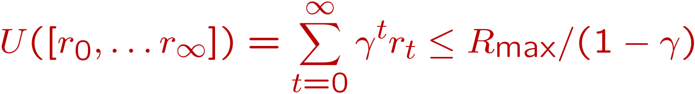
Infinite Utilities?!
Problem: infinite state sequences have infinite rewards
Solutions:
  Finite horizon:
    Terminate episodes after a fixed T steps (e.g. life)
    Gives nonstationary policies (π depends on time left)
  Absorbing state: guarantee that for every policy, a terminal state will eventually be reached (like “done” for High-Low)
  Discounting: for 0 < γ < 1
    Smaller γ means smaller “horizon” – shorter term focus

Slide 25



Discounting
Typically discount rewards by γ < 1 each time step
  Sooner rewards have higher utility than later rewards
  Also helps the algorithms converge

Slide 26
Recap: Defining MDPs
Markov decision processes:
  States S
  Start state s₀
  Actions A
  Transitions P(s’|s, a)
    aka T(s,a,s’)
  Rewards R(s,a,s’) (and discount γ)
MDP quantities so far:
  Policy, π = Function that chooses an action for each state
  Utility (aka “return”) = sum of discounted rewards
s
a
s, a
s,a,s’
s’

Slide 27
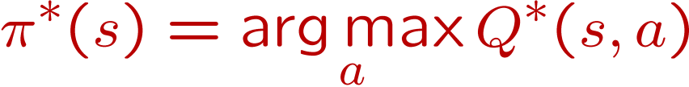
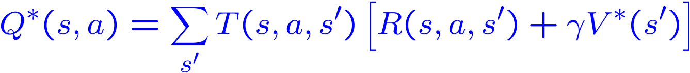

Solving MDPs
We want to find the optimal policy π*
Proposal 1: modified expectimax search, starting from each state s:
s
a
s, a
s,a,s’
s’

Slide 28
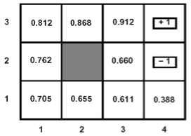
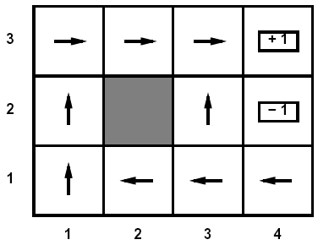
Optimal Utilities
Define the value of a state s:
  V*(s) = expected utility starting in s and acting optimally
Define the value of a q-state (s,a):
  Q*(s,a) = expected utility starting in s, taking action a and thereafter acting optimally
Define the optimal policy:
  π*(s) = optimal action from state s
s
a
s, a
s,a,s’
s’

Slide 29
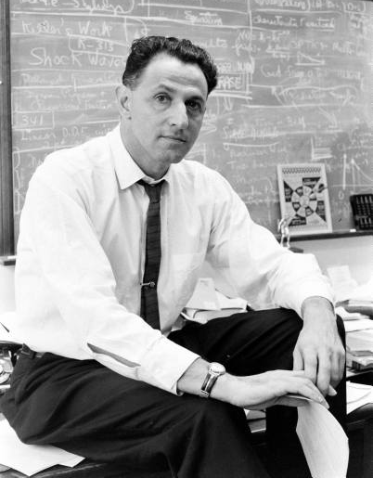
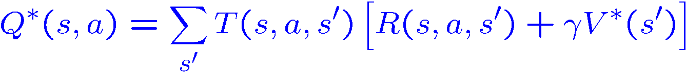
The Bellman Equations
Definition of “optimal utility” leads to a simple one-step look-ahead relationship between optimal utility values:
(1920-1984)
s
a
s, a
s,a,s’
s’

Slide 30
Why Not Search Trees?
Why not solve with expectimax?
Problems:
  This tree is usually infinite (why?)
  Same states appear over and over (why?)
  We would search once per state (why?)
Idea: Value iteration
  Compute optimal values for all states all at once using successive approximations
  Will be a bottom-up dynamic program similar in cost to memoization
  Do all planning offline, no replanning needed!

Slide 31
Value Estimates
Calculate estimates V_{k}*(s)
  The optimal value considering only next k time steps (k rewards)
  As k→∞ ∞, V_{k} approaches the optimal value
  Why:
    If discounting, distant rewards become negligible
    If terminal states reachable from everywhere, fraction of episodes not ending becomes negligible
    Otherwise, can get infinite expected utility and then this approach actually won’t work

Slide 32
Value Iteration
Idea:
  Start with V₀*(s) = 0, which we know is right (why?)
  Given V_{i}*, calculate the values for all states for depth i+1:
  This is called a value update or Bellman update
  Repeat until convergence
Theorem: will converge to unique optimal values
  Basic idea: approximations get refined towards optimal values
  Policy may converge long before values do

Slide 33






Example: Bellman Updates
Example: γ=0.9, living reward=0, noise=0.2
?
?
?
?
?
?
?
?
?
Notes:
first point: why all zeros and one ? (because you can find actions that guarentee you wont get the -1 and you are taking a max!)

Slide 34




Example: Value Iteration
V₁
V₂
Information propagates outward from terminal states and eventually all states have correct value estimates

Slide 35
Example: Value Iteration

Slide 36

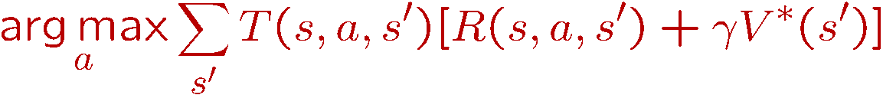
Practice: Computing Actions
Which action should we chose from state s:
  Given optimal values Q?
  Given optimal values V?
  Lesson: actions are easier to select from Q’s!

Slide 37

Convergence
Define the max-norm:
Theorem: For any two approximations U and V
  I.e. any distinct approximations must get closer to each other, so, in particular, any approximation must get closer to the true U and value iteration converges to a unique, stable, optimal solution
Theorem:
  I.e. once the change in our approximation is small, it must also be close to correct

Slide 38
Value Iteration Complexity
Problem size:
  |A| actions and |S| states
Each Iteration
  Computation: O(|A|⋅|S|²)
  Space: O(|S|)
Num of iterations
  Can be exponential in the discount factor γ

Slide 40
Bellman Equations for MDP₂
<S, A, Pr, R, s_{0,} γ>
Define V*(s) {optimal value} as the maximum expected discounted reward from this state.
V* should satisfy the following equation:

Slide 41
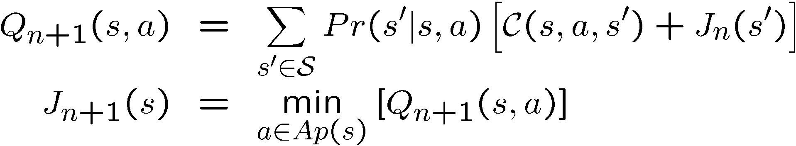
Bellman Backup (MDP₂)
Given an estimate of V* function (say V_{n})
Backup V_{n} function at state s
  calculate a new estimate (V_{n+1}) :
Q_{n+1}(s,a) : value/cost of the strategy:
  execute action a in s, execute π_{n} subsequently
  π_{n} = argmax_{a∈Ap(s)}Q_{n}(s,a)
R
V
γ
V
ax

Slide 42
Bellman Backup
max
Q₁(s,a₁) = 2 + γ 0
~ 2
Q₁(s,a₂) = 5 + γ 0.9£ 1
+ γ 0.1£ 2
~ 6.1
Q₁(s,a₃) = 4.5 + γ 2
~ 6.5
a_{greedy} = a₃
s₁
a₁
V₀= 0
2
V₁= 6.5
(γ∼1)
s₀
5
a₂
4.5
s₂
0.9
V₀= 1
a₃
0.1
s₃
V₀= 2

Slide 43
Value iteration [Bellman’57]
assign an arbitrary assignment of V₀ to each state.
repeat
  for all states s
    compute V_{n+1}(s) by Bellman backup at s.
until max_{s} |V_{n+1}(s) – V_{n}(s)| < ε
Iteration n+1
Residual(s)

Slide 44
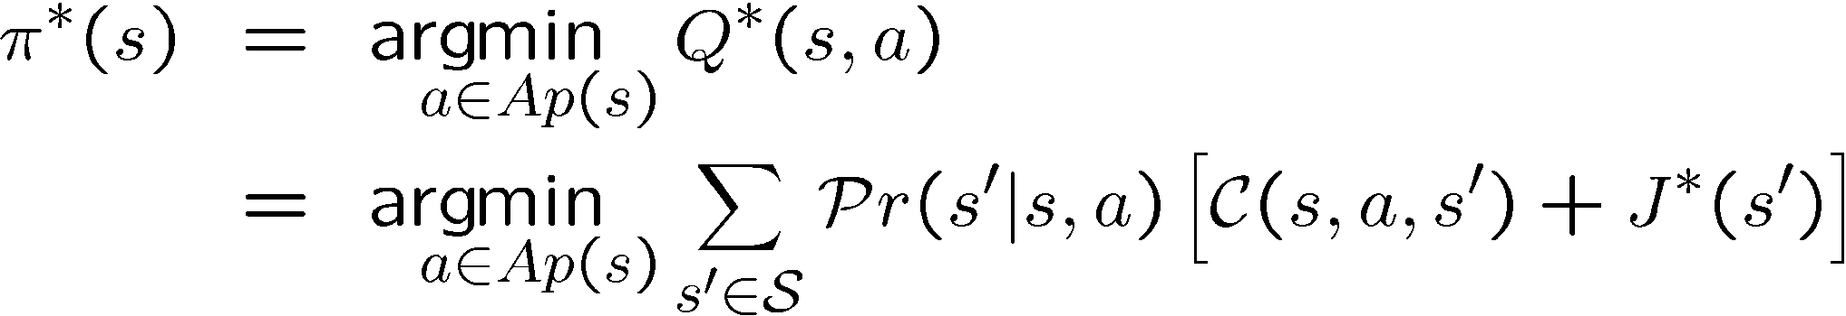
Policy Computation
Optimal policy is stationary and time-independent.
  for infinite/indefinite horizon problems
ax
ax
V
R
γ

Slide 45
Asynchronous Value Iteration
States may be backed up in any order
  instead of an iteration by iteration
As long as all states backed up infinitely often
  Asynchronous Value Iteration converges to optimal

Slide 46
Asynch VI: Prioritized Sweeping
Why backup a state if values of successors same?
Prefer backing a state
  whose successors had most change
Priority Queue of (state, expected change in value)
Backup in the order of priority
After backing a state update priority queue
  for all predecessors

Slide 47
Asynch VI: Real Time Dynamic Programming
[Barto, Bradtke, Singh’95]
Trial: simulate greedy policy starting from start state;
perform Bellman backup on visited states
RTDP: repeat Trials until value function converges

Slide 48
RTDP Trial
Q_{n+1}(s₀,a)
V_{n}
a_{greedy} = a₂
Min
V_{n}
?
a₁
V_{n}
Goal
a₂
V_{n+1}(s₀)
s₀
?
V_{n}
a₃
?
V_{n}
V_{n}
V_{n}

Slide 49
Comments
Properties
  if all states are visited infinitely often then V_{n} → V*
Advantages
  Anytime: more probable states explored quickly
Disadvantages
  complete convergence can be slow!

Slide 50
Review: Expectimax
What if we don’t know what the result of an action will be? E.g.,
  In solitaire, next card is unknown
  In minesweeper, mine locations
  In pacman, the ghosts act randomly
max
Can do expectimax search
  Chance nodes, like min nodes, except the outcome is uncertain
  Calculate expected utilities
  Max nodes as in minimax search
  Chance nodes take average (expectation) of value of children
chance
10
4
5
7
Today, we’ll learn how to formalize the underlying problem as a Markov Decision Process

Slide 51
Grid World
The agent lives in a grid
Walls block the agent’s path
The agent’s actions do not always go as planned:
80% of the time, the action North takes the agent North
(if there is no wall there)
10% of the time, North takes the agent West; 10% East
If there is a wall in the direction the agent would have been taken, the agent stays put
Small “living” reward each step
Big rewards come at the end
Goal: maximize sum of rewards

Slide 52
Markov Decision Processes
An MDP is defined by:
  A set of states s ∈ S
  A set of actions a ∈ A
  A transition function T(s,a,s’)
    Prob that a from s leads to s’
    i.e., P(s’ | s,a)
    Also called the model
  A reward function R(s, a, s’)
    Sometimes just R(s) or R(s’)
  A start state (or distribution)
  Maybe a terminal state
MDPs: non-deterministic search problems
  Reinforcement learning: MDPs where we don’t know the transition or reward functions

Slide 53
What is Markov about MDPs?
Andrey Markov (1856-1922)
“Markov” generally means that given the present state, the future and the past are independent
For Markov decision processes, “Markov” means:

Slide 54
Solving MDPs
In deterministic single-agent search problems, want an optimal plan, or sequence of actions, from start to a goal
In an MDP, we want an optimal policy π*: S → A
  A policy π gives an action for each state
  An optimal policy maximizes expected utility if followed
  Defines a reflex agent
Optimal policy when R(s, a, s’) = -0.03 for all non-terminals s

Slide 55
Example Optimal Policies
R(s) = -0.01
R(s) = -0.03
R(s) = -0.4
R(s) = -2.0

Slide 56
Example: High-Low
Three card types: 2, 3, 4
Infinite deck, twice as many 2’s
Start with 3 showing
After each card, you say “high” or “low”
New card is flipped
If you’re right, you win the points shown on the new card
Ties are no-ops
If you’re wrong, game ends
3
4
2
2
Differences from expectimax problems:
  #1: get rewards as you go
  #2: you might play forever!

Slide 57
High-Low as an MDP
States: 2, 3, 4, done
Actions: High, Low
Model: T(s, a, s’):
  P(s’=4 | 4, Low) = 1/4
  P(s’=3 | 4, Low) = 1/4
  P(s’=2 | 4, Low) = 1/2
  P(s’=done | 4, Low) = 0
  P(s’=4 | 4, High) = 1/4
  P(s’=3 | 4, High) = 0
  P(s’=2 | 4, High) = 0
  P(s’=done | 4, High) = 3/4
  …
Rewards: R(s, a, s’):
  Number shown on s’ if s ≠ s’
  0 otherwise
Start: 3
3
4
2
2

Slide 58
Search Tree: High-Low
3
Low
High
3
3
, Low
, High
T = 0.5, R = 2
T = 0.25, R = 3
T = 0, R = 4
T = 0.25, R = 0
2
3
4
High
Low
High
Low
High
Low

Slide 59
MDP Search Trees
Each MDP state gives an expectimax-like search tree
s
s is a state
a
(s, a) is a q-state
s, a
(s,a,s’) called a transition
T(s,a,s’) = P(s’|s,a)
R(s,a,s’)
s,a,s’
s’

Slide 60
Utilities of Sequences
In order to formalize optimality of a policy, need to understand utilities of sequences of rewards
Typically consider stationary preferences:
Theorem: only two ways to define stationary utilities
  Additive utility:
  Discounted utility:

Slide 61
Infinite Utilities?!
Problem: infinite state sequences have infinite rewards
Solutions:
  Finite horizon:
    Terminate episodes after a fixed T steps (e.g. life)
    Gives nonstationary policies (π depends on time left)
  Absorbing state: guarantee that for every policy, a terminal state will eventually be reached (like “done” for High-Low)
  Discounting: for 0 < γ < 1
    Smaller γ means smaller “horizon” – shorter term focus

Slide 62
Discounting
Typically discount rewards by γ < 1 each time step
  Sooner rewards have higher utility than later rewards
  Also helps the algorithms converge

Slide 63
Recap: Defining MDPs
Markov decision processes:
  States S
  Start state s₀
  Actions A
  Transitions P(s’|s,a) (or T(s,a,s’))
  Rewards R(s,a,s’) (and discount γ)
MDP quantities so far:
  Policy = Choice of action for each state
  Utility (or return) = sum of discounted rewards
s
a
s, a
s,a,s’
s’

Slide 64
Solving MDPs
We want to find the optimal policy π*
Proposal 1: modified expectimax search, starting from each state s:
s
a
s, a
s,a,s’
s’

Slide 65
Optimal Utilities
Define the value of a state s:
  V*(s) = expected utility starting in s and acting optimally
Define the value of a q-state (s,a):
  Q*(s,a) = expected utility starting in s, taking action a and thereafter acting optimally
Define the optimal policy:
  π*(s) = optimal action from state s
s
a
s, a
s,a,s’
s’

Slide 66
The Bellman Equations
Definition of “optimal utility” leads to a simple one-step lookahead relationship amongst optimal utility values:
Formally:
s
a
s, a
s,a,s’
s’

Slide 67
Why Not Search Trees?
Why not solve with expectimax?
Problems:
  This tree is usually infinite (why?)
  Same states appear over and over (why?)
  We would search once per state (why?)
Idea: Value iteration
  Compute optimal values for all states all at once using successive approximations
  Will be a bottom-up dynamic program similar in cost to memoization
  Do all planning offline, no replanning needed!

Slide 68
Value Estimates
Calculate estimates V_{k}*(s)
  The optimal value considering only next k time steps (k rewards)
  As k → ∞, it approaches the optimal value
  Why:
    If discounting, distant rewards become negligible
    If terminal states reachable from everywhere, fraction of episodes not ending becomes negligible
    Otherwise, can get infinite expected utility and then this approach actually won’t work

Slide 69
Value Iteration
Idea:
  Start with V₀*(s) = 0, which we know is right (why?)
  Given V_{i}*, calculate the values for all states for depth i+1:
  This is called a value update or Bellman update
  Repeat until convergence
Theorem: will converge to unique optimal values
  Basic idea: approximations get refined towards optimal values
  Policy may converge long before values do

Slide 70
Example: Bellman Updates
Example: γ=0.9, living reward=0, noise=0.2
?
?
?
?
?
?
?
?
?
Notes:
first point: why all zeros and one ? (because you can find actions that guarentee you wont get the -1 and you are taking a max!)

Slide 71
Example: Value Iteration
V₁
V₂
Information propagates outward from terminal states and eventually all states have correct value estimates

Slide 72
Example: Value Iteration

Slide 73
Practice: Computing Actions
Which action should we chose from state s:
  Given optimal values Q?
  Given optimal values V?
  Lesson: actions are easier to select from Q’s!

Slide 74
Convergence
Define the max-norm:
Theorem: For any two approximations U and V
  I.e. any distinct approximations must get closer to each other, so, in particular, any approximation must get closer to the true U and value iteration converges to a unique, stable, optimal solution
Theorem:
  I.e. once the change in our approximation is small, it must also be close to correct

Slide 75
Value Iteration Complexity
Problem size:
  |A| actions and |S| states
Each Iteration
  Computation: O(|A|⋅|S|²)
  Space: O(|S|)
Num of iterations
  Can be exponential in the discount factor γ

Slide 76
Recap: MDPs
Markov decision processes:
  States S
  Actions A
  Transitions P(s’|s,a) (or T(s,a,s’))
  Rewards R(s,a,s’) (and discount γ)
  Start state s₀
Quantities:
  Returns = sum of discounted rewards
  Values = expected future returns from a state (optimal, or for a fixed policy)
  Q-Values = expected future returns from a q-state (optimal, or for a fixed policy)
s
a
s, a
s,a,s’
s’

Slide 77
Utilities for Fixed Policies
Another basic operation: compute the utility of a state s under a fix (general non-optimal) policy
Define the utility of a state s, under a fixed policy π:
  V^{π}(s) = expected total discounted rewards (return) starting in s and following π
Recursive relation (one-step look-ahead / Bellman equation):
s
π(s)
s, π(s)
s, π(s),s’
s’

Slide 78

Policy Evaluation
How do we calculate the V’s for a fixed policy?
Idea one: modify Bellman updates
Idea two: it’s just a linear system, solve with Matlab (or whatever)

Slide 79
Policy Iteration
Problem with value iteration:
  Considering all actions each iteration is slow: takes |A| times longer than policy evaluation
  But policy doesn’t change each iteration, time wasted
Alternative to value iteration:
  Step 1: Policy evaluation: calculate utilities for a fixed policy (not optimal utilities!) until convergence (fast)
  Step 2: Policy improvement: update policy using one-step lookahead with resulting converged (but not optimal!) utilities (slow but infrequent)
  Repeat steps until policy converges
Notes:
This is policy iteration
It’s still optimal!
Can converge faster under some conditions

Slide 80
Policy Iteration
Policy evaluation: with fixed current policy π, find values with simplified Bellman updates:
  Iterate until values converge
Policy improvement: with fixed utilities, find the best action according to one-step look-ahead

Slide 81
Policy Iteration Complexity
Problem size:
  |A| actions and |S| states
Each Iteration
  Computation: O(|S|³ + |A|⋅|S|²)
  Space: O(|S|)
Num of iterations
  Unknown, but can be faster in practice
  Convergence is guaranteed

Slide 82
Comparison
In value iteration:
  Every pass (or “backup”) updates both utilities (explicitly, based on current utilities) and policy (possibly implicitly, based on current policy)
In policy iteration:
  Several passes to update utilities with frozen policy
  Occasional passes to update policies
Hybrid approaches (asynchronous policy iteration):
  Any sequences of partial updates to either policy entries or utilities will converge if every state is visited infinitely often

