Slide 1
CSE 473 Automated Planning
Dan Weld
(With slides by UW AI faculty & Dana Nau
I have a plan - a plan that cannot possibly fail.
- Inspector Clousseau
Notes:
A handful of GENERAL SEARCH TECHNIQUES lie at the heart of practically all work in AI
We will encounter the SAME PRINCIPLES again and again in this course, whether we are talking about
GAMES
LOGICAL REASONING
MACHINE LEARNING
These are principles for SEARCHING THROUGH A SPACE OF POSSIBLE SOLUTIONS to a problems.

Slide 2
Logistics
HW1 due in one week (Fri 5/4)
Parts due in between:
Monday draft answer to problem 1
Wed give feedback on another person’s answer

Slide 3
Overview
Introduction & Agents
Search, Heuristics & CSPs
Adversarial Search
Logical Knowledge Representation
Planning & MDPs
Reinforcement Learning
Uncertainty & Bayesian Networks
Machine Learning
NLP & Special Topics

Slide 4
Today’s Topics
Logic for specifying planning domains
Planning graph for computing heuristics
Compiling planning to SAT

Slide 5
Planning
Given
a logical description of the initial situation,
a logical description of the goal conditions, and
a logical description of a set of possible actions,
Find
a sequence of actions (a plan of actions) that brings us from the initial situation to a situation in which the goal conditions hold.

Slide 6
Simplifying Assumptions
Environment
Static
vs.
Dynamic
Instantaneous
vs.
Durative
Deterministic
vs.
Stochastic
Fully Observable
vs.
Partially
Observable
Perfect
vs.
Noisy
What action next?
Percepts
Actions

Slide 7
Classical Planning
Simplifying assumptions
Atomic time
Agent is omniscient (no sensing necessary).
Agent is sole cause of change
Actions have deterministic effects
STRIPS representation
World = set of true propositions (conjunction)
Actions:
Precondition: (conjunction of positive literals, no functions)
Effects (conjunction of literals, no functions)
Goal = conjunction of positive literals
on(A,B) ∧ on(B, C)

Slide 8
Classical Operators
c
unstack(x,y)
Precond: on(x,y), clear(x), handempty
Effects: ¬on(x,y), ¬clear(x), ¬handempty, holding(x), clear(y)
a
b
c
stack(x,y)
Precond: holding(x), clear(y)
Effects: ¬holding(x), ¬clear(y), on(x,y), clear(x), handempty
a
b
c
pickup(x)
Precond: ontable(x), clear(x), handempty
Effects: ¬ontable(x), ¬clear(x), ¬handempty, holding(x)
a
b
c
b
putdown(x)
Precond: holding(x)
Effects: ¬holding(x), ontable(x), clear(x), handempty
a
c
a
b
Dana Nau: This work is licensed under a Creative Commons License.

Slide 9
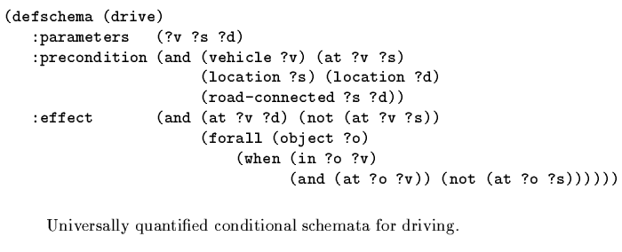
Driving
Static facts

Slide 10
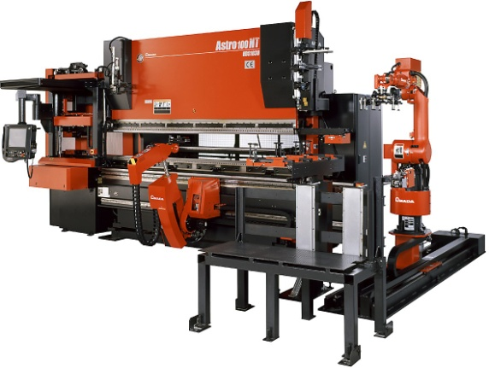
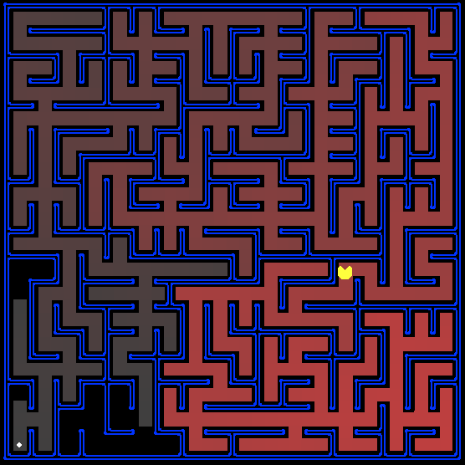
Planning vs. Problem-Solving ?
Basic difference: Explicit, logic-based representation
States/Situations: descriptions of the world by logical formulae → agent can explicitly reason about the world.
Goal conditions as logical formulae vs. goal test (black box) → agent can reflect on its goals.
Operators/Actions: Transformations on logical formulae → agent can reason about the effects of actions
by inspecting the definition of its operators.
s₅
location 1
location 2
Dana Nau: This work is licensed under a Creative Commons License.

Slide 11
Forward World-Space Search
Initial
State
C
Goal
State
A
B
C
A
A
B
B
C
B
C
A

Slide 12
Heuristics for State-Space Search
Count number of false goal propositions in current state
Admissible?
NO
Subgoal independence assumption:
Cost of solving conjunction is sum of cost of solving each subgoal independently
Optimistic: ignores negative interactions
Pessimistic: ignores redundancy
Admissible? No
Can you make this admissible?

Slide 13
Heuristic Generation II
unstack(x,y)
Precond: on(x,y), clear(x), handempty
Effects: ¬on(x,y), ¬clear(x), ¬handempty, holding(x), clear(y)
stack(x,y)
Precond: holding(x), clear(y)
Effects: ¬holding(x), ¬clear(y), on(x,y), clear(x), handempty
Delete preconditions
Solve relaxed planning problem
Admissable?
pickup(x)
Precond: ontable(x), clear(x), handempty
Effects: ¬ontable(x), ¬clear(x), ¬handempty, holding(x)
putdown(x)
Precond: holding(x)
Effects: ¬holding(x), ontable(x), clear(x), handempty
Dana Nau: This work is licensed under a Creative Commons License.

Slide 14
Heuristic Generation III
unstack(x,y)
Precond: on(x,y), clear(x), handempty
Effects: ¬on(x,y), ¬clear(x), ¬handempty, holding(x), clear(y)
stack(x,y)
Precond: holding(x), clear(y)
Effects: ¬holding(x), ¬clear(y), on(x,y), clear(x), handempty
Delete negative effects
Solve relaxed planning problem
Admissable?
pickup(x)
Precond: ontable(x), clear(x), handempty
Effects: ¬ontable(x), ¬clear(x), ¬handempty, holding(x)
putdown(x)
Precond: holding(x)
Effects: ¬holding(x), ontable(x), clear(x), handempty
Dana Nau: This work is licensed under a Creative Commons License.

Slide 15
Planning Graph: Basic idea
Construct a planning graph: encodes constraints on possible plans
Use this planning graph to compute an informative heuristic (Forward A*)
Planning graph can be built for each problem in polynomial time

Slide 16
The Planning Graph
propositions
propositions
propositions
propositions
level P0
actions
level P1
actions
level P2
actions
level P3
level A1
level A2
level A3
…
…
…
Note: a few noops missing for clarity

Slide 17
Planning Graphs
Planning graphs consists of a seq of levels that correspond to time steps in the plan.
Level 0 is the initial state.
Each level consists of a set of literals and a set of actions that represent what might be possible at that step in the plan
Might be is the key to efficiency
Records only a restricted subset of possible negative interactions among actions.

Slide 18
Planning Graphs
Alternate levels
Literals = all those that could be true at that time step, depending upon the actions executed at preceding time steps.
Actions = all those actions that could have their preconditions satisfied at that time step, depending on which of the literals actually hold.
…
…
…

Slide 19
PG Example
Init(Have(Cake))
Goal(Have(Cake) ∧ Eaten(Cake))
Action(Eat(Cake), PRECOND: Have(Cake)
EFFECT: ¬Have(Cake) ∧ Eaten(Cake))
Action(Bake(Cake), PRECOND: ¬ Have(Cake)
EFFECT: Have(Cake))

Slide 20
PG Example
Create level 0 from initial problem state.

Slide 21
Graph Expansion
Proposition level 0
initial conditions
Action level i
no-op for each proposition at level i-1
action for each operator instance whose
preconditions exist at level i-1
Proposition level i
effects of each no-op and action at level i
0
i-1
i
i+1
…
…
…
…
No-op-action(P), PRECOND: P
EFFECT: P
Have a no-op action for each ground fact

Slide 22
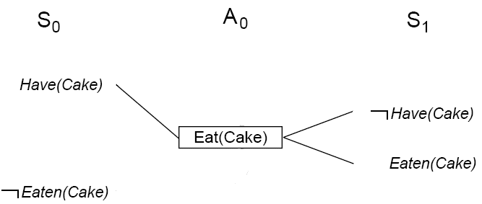
PG Example
Add all applicable actions.
Add all effects to the next state.

Slide 23
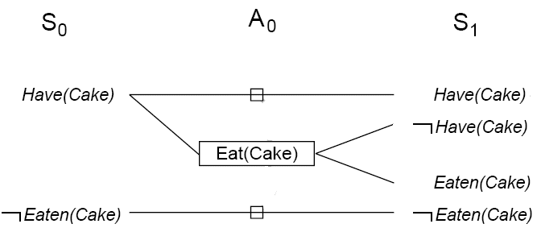
PG Example
Add persistence actions (aka no-ops) to map all literals in state S_{i} to state S_{i+1}.

Slide 24
Mutual Exclusion
Two actions are mutex if
one clobbers the other’s effects or preconditions
they have mutex preconditions
Two propositions are mutex if
one is the negation of the other
p
¬p

Slide 25
Mutual Exclusion
Two actions are mutex if
one clobbers the other’s effects or preconditions
they have mutex preconditions
Two proposition are mutex if
one is the negation of the other
all ways of achieving them are mutex
p
¬p

Slide 26
Mutual Exclusion
p
¬p
Two actions are mutex if
they have mutex preconditions
one clobbers the other’s preconditions or effects
Two proposition are mutex if
one is the negation of the other
all ways of achieving them are mutex
p
¬p
p
p
¬p
¬p

Slide 27
Mutual Exclusion
Light-fuse(match, bomb)
Precond: lit(match), holding(bomb)
Effects: will-explode(bomb)
Extinguish(match)
Precond: lit(match)
Effects: ¬lit(match)
p
¬p

Slide 28
If Result of N>1 Actions is Ambiguous…
Environment
Mark
Them
Mutex
Instantaneous
vs.
Durative
What action next?
Actions

Slide 29
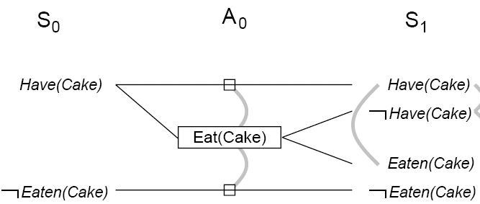
PG Example
Identify mutual exclusions between actions and literals based on potential conflicts.

Slide 30
Mutual exclusion
A mutex relation holds between two actions when:
Inconsistent effects: one action negates the effect of another.
Interference: one of the effects of one action is the negation of a precondition of the other.
Competing needs: one of the preconditions of one action is mutually exclusive with the precondition of the other.
A mutex relation holds between two literals when:
one is the negation of the other OR
each possible action pair that could achieve the literals is mutex (inconsistent support).

Slide 31
Cake example
Level S₁ contains all literals that might result from picking any subset of actions in A₀
Conflicts between literals that can’t occur together (as a consequence of selection action) are represented by mutex links.
S1 defines multiple states and the mutex links are the constraints that define this set of states.

Slide 32
Cake example
Repeat process until graph levels off:
two consecutive levels are identical, or
contain the same amount of literals (explanation follows later)

Slide 33
Cake example

Slide 34
Observation 1
p
¬q
¬r
p
q
¬q
¬r
p
q
¬q
r
¬r
p
q
¬q
r
¬r
A
A
A
B
B
Literals monotonically increase
(always carried forward by no-ops)

Slide 35
Observation 2
p
¬q
¬r
p
q
¬q
¬r
p
q
¬q
r
¬r
p
q
¬q
r
¬r
A
A
A
B
B
Actions monotonically increase

Slide 36
Observation 3
p
q
r
…
p
q
r
…
p
q
r
…
A
mutex relationships between literals monotonically decrease

Slide 37
Observation 4
A
A
A
p
q
…
p
q
r
s
…
p
q
r
s
…
p
q
r
s
…
B
B
B
C
C
C
Mutex relationships between actions monotonically decrease

Slide 38
Observation 5
Planning Graph ‘levels off’.
After some time k, all levels are identical
Because it’s a finite space & montonicity

Slide 39
Properties of Planning Graph
If goal is absent from last level?
Then goal cannot be achieved!
If there exists a plan to achieve goal?
Then goal is present in the last level &
No mutexes between conjuncts
If goal is present in last level (w/ no mutexes) ?
There still may not exist any viable plan

Slide 40
Heuristics based on Planning Graph
Construct planning graph starting from s
h(s) = level at which goal appears non-mutex
Admissible?
YES

Slide 41
Planning Graph is Optimistic
Suppose you want to prepare a surprise dinner for your sleeping sweetheart
s₀ = {garbage, cleanHands, quiet}
g = {dinner, present, ¬garbage}
Action Preconditions Effects
cook() cleanHands dinner
wrap() quiet present
carry() none ¬garbage, ¬cleanHands
dolly() none ¬garbage, ¬quiet
Also have persistence actions: one for each literal

Slide 42
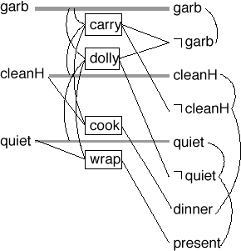
Example (continued)
state-level 0
action-level 1
state-level 1
Recall the goal is
{¬garbage, dinner, present}
Note that in state-level 1,
All of them are there
None are mutex with each other
Thus, there’s a chance that a plan exists
But no actual plan does…
Pairwise, the goals are consistent
But no consistent way to achieve all three
Planning graph ~ k consistency
But with no fixed limit on k
¬dinner
¬dinner
¬present
¬present
Dana Nau: This work is licensed under a Creative Commons License.

Slide 43
Fast-Forward (FF)
Fastest classical planner ~2009
State space local search
Guided by relaxed planning graph
Full best-first search to escape plateaus
A few other bells and whistles…
Initial
State
C
Goal
State
A
B
C
A
A
B
B
C
C
B
A

Slide 44
Today’s Topics
Logic for specifying planning domains
Planning graph for computing heuristics
Compiling planning to SAT

Slide 45
SATPlan: Planning as SAT
Formulate the planning problem in propositional logic
Assume that the plan has k actions
Create a binary variable for each possible action a:
Action(a,i) (TRUE if action a is used at step i)
Create variables for each proposition that can hold at different points in time:
Proposition(p,i) (TRUE if proposition p holds at step i)

Slide 46
Constraints
XOR: Only one action can be executed at each time step
At least one action must be executed at each time step
Constraints describing effects of actions
Action(a,i) → prec(a,i-1); Action(a,i) → eff(a,i)
Maintain action: if an action does not change a prop p, then maintain action for proposition p is true
Action(maint_p,i) → Action(a1,i) v Action(a2,i)… [for all a_{i} that don’t effect p]
A proposition is true at step i only if some action (possibly a maintain action) made it true
Constraints for initial state and goal state

Slide 47
Compilation to SAT
Init state
Actions
Goal
?
→

Slide 48
The Idea
Suppose a plan of length n exists
Encode this hypothesis in SAT
Init state true at t₀
Goal true at T_{n}
Actions imply effects, etc
Look for satisfying assignment
Decode into plan
RISC: The Revolutionary Excitement

Slide 49
Axioms
Axiom | Description / Example
Init | The initial state holds at t=0
Goal | The goal holds at t=2n
A ⇒ P, E | Paint(A,Red,t) ⇒ Block(A, t-1) Paint(A,Red,t) ⇒ Color(A, Red, t+1)
Frame | Classical / Explanatory
At-least-one | Act1(…, t) ∨ Act2(…, t) ∨ …
Exclude | ¬Act1(…, t) ∨ ¬Act2(…, t)

Slide 50
Space of Encodings
Action Representations
Regular
Simply-Split
Overloaded-Split
Bitwise
Frame Axioms
Classical
Explanitory

Slide 51
Frame Axioms
Classical
∀P, A, t if P@t-1 ∧
A@t ∧
A doesn’t affect P
then P@t+1
Explanatory
∀P, A, t if P@t-1 ∧ ¬P@t+1
then A₁@t ∨ A₂@t ∨ …
forall A_{i} that do affect P

Slide 52
Action Representation
Representation | One Propositional Variable per | Example
more
vars
Regular | fully-instantiated action | Paint-A-Red, Paint-A-Blue, Move-A-Table
Simply-split | fully-instantiated action’s argument | Paint-Arg1-A ∧ Paint-Arg2-Red
Overloaded-split | fully-instantiated argument | Act-Paint ∧ Arg1-A ∧ Arg2-Red
Bitwise | Binary encodings of actions | Bit1 ∧ ~Bit2 ∧ Bit3
Paint-A-Red = 5
more
clses

Slide 53
Optimization 1: Factored Splitting
- use partially-instantiated actions
HasColor-A-Blue-(t-1) ^ Paint-Arg1-B-t ^
Paint-Arg2-Red-t ⇒ HasColor-A-Blue-(t+1)
Explanatory Frames
factored
unfactored
Simple | Overloaded
Variables
Clauses
Literals
.46 | .69
.30 | .50
.20 | .38

Slide 54
Optimization 2: Types
A type is a fluent which no actions affects.
type interference
prune impossible operator instantiations
type elimination
Type opts
No type opts
Literals
Regular | Simple | Overloaded | Bitwise
Classical
Explanatory
.27 | .39 | .34 | .30
.10 | .97 | .67 | .74

Slide 56
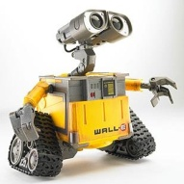
Fluent
Ground literal whose truth value may change over time
Eg, at(robbie, location5)
Not robot(robbie)
Move
loc5
loc7
loc5
loc7
T0
T1

Slide 57
Encoding Fluents in Logic
at(robbie, location7, time1)
loc5
loc7
loc5
loc7
T0
T1

Slide 58
Encoding Initial Conditions & Goals
Suppose we only cared about 1-step plans
State desired end conditions:
Φ = at(robbie, loc5, time0) ∧ at(robbie, loc7, time1)
Is Φ satisfiable?
Is P∧ Q satisfiable?
loc5
loc7
loc5
loc7
T0
T1

Slide 59
Encoding Action Effects in Logic
move(r, l1, l2)
Precond: robot(r), at(r,l1), …
Effects: at(r,l2)
∀r, l1, l2, t move(r,l1,l2,t) => at(r, l2, t+1)
∀r, l1, l2, t move(r,l1,l2,t) => at(r, l, t)
¬move(r,l1,l2,t) ∨ at(r, l, t)
Move
loc5
loc7
loc5
loc7
T1
T2

Slide 60
Compiling to Propositional Logic
move(r, l1, l2)
Precond: robot(r), at(r,l1), …
Effects: at(r,l2)
∀r, l1, l2, t move(r,l1,l2,t) => at(r, l2, t+1)
Infinite worlds: impossible
But suppose only 2 robots (robbie, sue), 2 locations, 1 action time
move(robbie,loc5,loc7,1) => at(robbie, loc7, 2) ∧
move(robbie,loc7,loc5,1) => at(robbie, loc5, 2) ∧
move(sue,loc5,loc7,1) => at(sue, loc7, 2) ∧
move(sue,loc7,loc5,1) => at(sue, loc5, 2)

Slide 61
Overall Approach
A bounded planning problem is a pair (P,n):
P is a planning problem; n is a positive integer
Any solution for P of length n is a solution for (P,n)
Planning algorithm:
Do iterative deepening like we did with Graphplan:
for n = 0, 1, 2, …,
encode (P,n) as a satisfiability problem Φ
if Φ is satisfiable, then
From the set of truth values that satisfies Φ, a solution plan can be constructed, so return it and exit
Dana Nau: This work is licensed under a Creative Commons License.

Slide 62
The Planning Graph
propositions
propositions
propositions
propositions
level P0
actions
level P1
actions
level P2
actions
level P3
level A1
level A2
level A3
…
…
…
Note: a few noops missing for clarity

Slide 63
Notation
Need to encode ground atoms into propositions
For set-theoretic planning we encoded atoms into propositions by rewriting them as shown here:
Atom: at(r1,loc1)
Proposition: at-r1-loc1
For planning as satisfiability we’ll do the same thing
But we won’t bother to do a syntactic rewrite
Just use at(r1,loc1) itself as the proposition
Also, we’ll write plans starting at a₀ rather than a₁
π = ⟨a₀, a₁, …, a_{n–1}⟩
Dana Nau: This work is licensed under a Creative Commons License.

Slide 64
Fluents
If π = ⟨a₀, a₁, …, a_{n–1}⟩ is a solution for (P,n), it generates these states:
s₀, s₁ = γ (s₀,a₀), s₂ = γ (s₁,a₁), …, s_{n} = γ (s_{n–1}, a_{n–1})
Fluent: proposition saying a particular atom is true in a particular state
at(r1,loc1,i) is a fluent that’s true iff at(r1,loc1) is in s_{i}
We’ll use l_{i} to denote the fluent for literal l in state s_{i}
e.g., if l = at(r1,loc1)
then l_{i} = at(r1,loc1,i)
a_{i} is a fluent saying that a is the i’th step of π
e.g., if a = move(r1,loc2,loc1)
then a_{i} = move(r1,loc2,loc1,i)
Dana Nau: This work is licensed under a Creative Commons License.

Slide 65
Encoding Planning Problems
Encode (P,n) as a formula Φ such that
π = ⟨a₀, a₁, …, a_{n–1}⟩ is a solution for (P,n) if and only if
Φ can be satisfied in a way that makes the fluents a₀, …, a_{n–1} true
Let
A = {all actions in the planning domain}
S = {all states in the planning domain}
L = {all literals in the language}
Φ is the conjunct of many other formulas …
Dana Nau: This work is licensed under a Creative Commons License.

Slide 66
Formulas in Φ
Formula describing the initial state:
/\{l₀ | l ∈ s₀} ∧ /\{¬l₀ | l ∈ L – s₀ }
Formula describing the goal:
/\{l_{n} | l ∈ g⁺} ∧ /\{¬l_{n} | l ∈ g–}
For every action a in A, formulas describing what changes a would make if it were the i’th step of the plan:
a_{i} ⇒ /\{p_{i} | p ∈ Precond(a)} ∧ /\ {e_{i+1} | e ∈ Effects(a)}
Complete exclusion axiom:
For all actions a and b, formulas saying they can’t occur at the same time
¬ a_{i} ∨ ¬ b_{i}
this guarantees there can be only one action at a time
Is this enough?
Dana Nau: This work is licensed under a Creative Commons License.

Slide 67
Frame Axioms
Frame axioms:
Formulas describing what doesn’t change between steps i and i+1
Several ways to write these
One way: explanatory frame axioms
One axiom for every literal l
Says that if l changes between s_{i} and s_{i+1},
then the action at step i must be responsible:
(¬l_{i} ∧ l_{i+1} ⇒ V_{a in A}{a_{i} | l ∈ effects⁺(a)})
∧ (l_{i} ∧ ¬l_{i+1} ⇒ V_{a in A}{a_{i} | l ∈ effects–(a)})
Dana Nau: This work is licensed under a Creative Commons License.

Slide 68
Example
Planning domain:
one robot r1
two adjacent locations l1, l2
one operator (move the robot)
Encode (P,n) where n = 1
Initial state: {at(r1,l1)}
Encoding: at(r1,l1,0) ∧ ¬at(r1,l2,0)
Goal: {at(r1,l2)}
Encoding: at(r1,l2,1) ∧ ¬at(r1,l1,1)
Operator: see next slide
Dana Nau: This work is licensed under a Creative Commons License.

Slide 69
Example (continued)
Operator: move(r,l,l’)
precond: at(r,l)
effects: at(r,l’), ¬at(r,l)
Encoding:
move(r1,l1,l2,0) ⇒ at(r1,l1,0) ∧ at(r1,l2,1) ∧ ¬at(r1,l1,1)
move(r1,l2,l1,0) ⇒ at(r1,l2,0) ∧ at(r1,l1,1) ∧ ¬at(r1,l2,1)
move(r1,l1,l1,0) ⇒ at(r1,l1,0) ∧ at(r1,l1,1) ∧ ¬at(r1,l1,1)
move(r1,l2,l2,0) ⇒ at(r1,l2,0) ∧ at(r1,l2,1) ∧ ¬at(r1,l2,1)
move(l1,r1,l2,0) ⇒ …
move(l2,l1,r1,0) ⇒ …
move(l1,l2,r1,0) ⇒ …
move(l2,l1,r1,0) ⇒ …
How to avoid generating the last four actions?
Assign data types to the constant symbols like we did for state-variable representation
contradictions (easy to detect)
nonsensical
Dana Nau: This work is licensed under a Creative Commons License.

Slide 70
Example (continued)
Locations: l1, l2
Robots: r1
Operator: move(r : robot, l : location, l’ : location)
precond: at(r,l)
effects: at(r,l’), ¬at(r,l)
Encoding:
move(r1,l1,l2,0) ⇒ at(r1,l1,0) ∧ at(r1,l2,1) ∧ ¬at(r1,l1,1)
move(r1,l2,l1,0) ⇒ at(r1,l2,0) ∧ at(r1,l1,1) ∧ ¬at(r1,l2,1)
Dana Nau: This work is licensed under a Creative Commons License.

Slide 71
Example (continued)
Complete-exclusion axiom:
¬move(r1,l1,l2,0) ∨ ¬move(r1,l2,l1,0)
Explanatory frame axioms:
¬at(r1,l1,0) ∧ at(r1,l1,1) ⇒ move(r1,l2,l1,0)
¬at(r1,l2,0) ∧ at(r1,l2,1) ⇒ move(r1,l1,l2,0)
at(r1,l1,0) ∧ ¬at(r1,l1,1) ⇒ move(r1,l1,l2,0)
at(r1,l2,0) ∧ ¬at(r1,l2,1) ⇒ move(r1,l2,l1,0)
Dana Nau: This work is licensed under a Creative Commons License.

Slide 72
Extracting a Plan
Suppose we find an assignment of truth values that satisfies Φ.
This means P has a solution of length n
For i=1,…,n, there will be exactly one action a such that a_{i} = true
This is the i’th action of the plan.
Example (from the previous slides):
Φ can be satisfied with move(r1,l1,l2,0) = true
Thus ⟨move(r1,l1,l2,0)⟩ is a solution for (P,0)
It’s the only solution - no other way to satisfy Φ
Dana Nau: This work is licensed under a Creative Commons License.

Slide 73
Planning
How to find an assignment of truth values that satisfies Φ?
Use a satisfiability algorithm
Example: the Davis-Putnam algorithm
First need to put Φ into conjunctive normal form
e.g., Φ = D ∧ (¬D ∨ A ∨ ¬B) ∧ (¬D ∨ ¬A ∨ ¬B) ∧ (¬D ∨ ¬A ∨ B) ∧ A
Write Φ as a set of clauses (disjuncts of literals)
Φ = {{D}, {¬D, A, ¬B}, {¬D, ¬A, ¬B}, {¬D, ¬A, B}, {A}}
Two special cases:
If Φ = ∅ then Φ is always true
If Φ = {…, ∅, …} then Φ is always false (hence unsatisfiable)
Dana Nau: This work is licensed under a Creative Commons License.

