Slide 1
CSE 473 Automated Planning
Dan Weld
(With slides by UW AI faculty & Dana Nau
I have a plan - a plan that cannot possibly fail.
- Inspector Clousseau
Notes:
A handful of GENERAL SEARCH TECHNIQUES lie at the heart of practically all work in AI
We will encounter the SAME PRINCIPLES again and again in this course, whether we are talking about
GAMES
LOGICAL REASONING
MACHINE LEARNING
These are principles for SEARCHING THROUGH A SPACE OF POSSIBLE SOLUTIONS to a problems.

Slide 2
Popular Application

Slide 3
Overview
Introduction & Agents
Search, Heuristics & CSPs
Adversarial Search
Logical Knowledge Representation
Planning & MDPs
Reinforcement Learning
Uncertainty & Bayesian Networks
Machine Learning
NLP & Special Topics

Slide 4
Planning & Logic
Actions specified using first-order logic
Planning implemented using SAT solver
E.g., DPLL or WalkSAT
Also an example of solving FOL using propositional SAT

Slide 5
Logistics
PS2 due today
HW1 due in one week
Parts due in between:
Friday written problem
Monday feedback on another person’s answer
Wed revise your answer

Slide 6
Planning
Given
a logical description of the initial situation,
a logical description of the goal conditions, and
a logical description of a set of possible actions,
Find
a sequence of actions (a plan of actions) that brings us from the initial situation to a situation in which the goal conditions hold.

Slide 7
Example: BlocksWorld
A
C
B
A
B
C

Slide 8
Planning Input: State Variables/Propositions
on-table(a)
Types: block --- a, b, c
(on-table a) (on-table b) (on-table c)
(clear a) (clear b) (clear c)
(arm-empty)
(holding a) (holding b) (holding c)
(on a b) (on a c) (on b a) (on b c) (on c a) (on c b)
(on-table ?b); clear (?b)
(arm-empty); holding (?b)
(on ?b1 ?b2)
No. of state variables =16
No. of states = 2¹⁶
No. of reachable states = ?

Slide 9
Planning Input: Actions
pickup a b, pickup a c, …
place a b, place a c, …
pickup-table a, pickup-table b, …
place-table a, place-table b, …
pickup ?b1 ?b2
place ?b1 ?b2
pickup-table ?b
place-table ?b
Total: 6 + 6 + 3 + 3 = 18 “ground” actions
Total: 4 action schemata

Slide 10
Planning Input: Actions (contd)
:action pickup ?b1 ?b2
:precondition
(on ?b1 ?b2)
(clear ?b1)
(arm-empty)
:effect
(holding ?b1)
(not (on ?b1 ?b2))
(clear ?b2)
(not (arm-empty))
:action pickup-table ?b
:precondition
(on-table ?b)
(clear ?b)
(arm-empty)
:effect
(holding ?b)
(not (on-table ?b))
(not (arm-empty))

Slide 11
Planning Input: Initial State
C
A
B
(on-table a) (on-table b)
(arm-empty)
(clear c) (clear b)
(on c a)
All other propositions false
not mentioned → assumed false
“Closed world assumption”

Slide 12
Planning Input: Goal
A
B
C
D
(on-table c) AND (on b c) AND (on a b)
Is this a state?
In planning a goal is a set of states
Like the goal test in problem solving search
But specified declaratively (in logic) rather than with code

Slide 13
Planning vs. Problem-Solving ?
Basic difference: Explicit, logic-based representation
States/Situations: descriptions of the world by logical formulae → agent can explicitly reason about the world.
Goal conditions as logical formulae vs. goal test (black box) → agent can reflect on its goals.
Operators/Actions: Transformations on logical formulae → agent can reason about the effects of actions
by inspecting the definition of its operators.

Slide 14
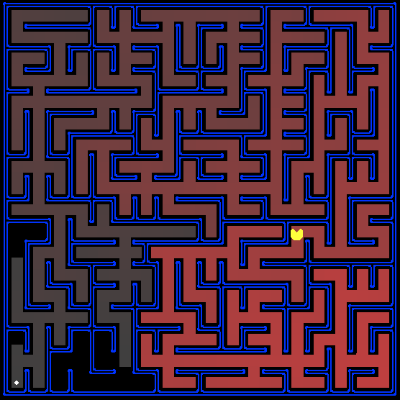
One Planner Solves Many Domains “no code required”
s₅
C
A
B
location 1
location 2
Dana Nau: This work is licensed under a Creative Commons License.

Slide 15
Specifying a Planning Problem
Description of initial state of world
Set of propositions
Description of goal:
E.g., Logical conjunction
Any world satisfying conjunction is a goal
Description of available actions

Slide 16
Classical Planning
Simplifying assumptions
Atomic time
Agent is omniscient (no sensing necessary).
Agent is sole cause of change
Actions have deterministic effects
STRIPS representation
World = set of true propositions (conjunction)
Actions:
Precondition: (conjunction of positive literals, no functions)
Effects (conjunction of literals, no functions)
Goal = conjunction of positive literals
on(A,B) ∧ on(B, C)

Slide 17
Planning as Search
Forward Search in ? Space
World State Space
start from start state; look for a state with goal property
dfs/bfs
A*
Backward Search in ? Space
Subgoal Space
start from goal conjunction; look for subgoal that holds in initial state
dfs/bfs/A*
Local Search in ? Space
Plan Space

Slide 18
Forward World-Space Search
Initial
State
C
Goal
State
A
B
C
A
A
B
B
C
B
C
A

Slide 19
Forward State-Space Search
Initial state: set of positive ground literals
CWA: literals not appearing are false
Actions:
applicable if preconditions satisfied
add positive effect literals
remove negative effect literals
Goal test: does state logically satisfy goal?
Step cost: typically 1

Slide 20
Complexity of Planning
Size of Search Space
Size of the world state space
Size of World state space
exponential in problem representation
What to do?
Informative heuristic that can be computed in polynomial time!

Slide 21
Heuristics for State-Space Search
Count number of false goal propositions in current state
Admissible?
NO
Subgoal independence assumption:
Cost of solving conjunction is sum of cost of solving each subgoal independently
Optimistic: ignores negative interactions
Pessimistic: ignores redundancy
Admissible? No
Can you make this admissible?

Slide 22
Heuristics for State Space Search (contd)
Delete all preconditions from actions, solve easy relaxed problem, use length
Admissible?
YES
:action pickup-table ?b
:precondition (and (on-table ?b)
(clear ?b)
(arm-empty))
:effect (and (holding ?b)
(not (on-table ?b))
(not (arm-empty)))

Slide 23
Backward Subgoal-Space Search
Regression planning
Problem: Need to find predecessors of state
Problem: Many possible goal states are equally acceptable.
From which one does one search?
A
B
C
D
E
D
A
B
C
E
Initial State is completely defined
* * *
A
B
D
C
D
C
E
A
B
E

Slide 24
Regression
Let G be a goal specified in logic
Regressing a goal, G, thru an action, A yields the weakest precondition G’
Such that: if G’ is true before A is executed
G is guaranteed to be true afterwards
A
G’
precond
effect
G
Represents a set of world states
Represents a set of world states

Slide 25
Regression Example
A
G’
precond
G
effect
C
A
A
:action pickup-table ?x
:precondition
(on-table ?x)
(clear ?x)
(arm-empty)
:effect
(holding ?x)
(not (on-table ?x))
(not (arm-empty))
B
C
B
(and (clear C)
(on-table C)
(arm-empty)
(on A B))
(and (holding C)
(on A B))
Remove positive effects
Add preconditions for A

Slide 26
Planning Graph: Basic idea
Construct a planning graph: encodes constraints on possible plans
Use this planning graph to compute an informative heuristic (Forward A*)
Planning graph can be built for each problem in polynomial time

Slide 27
The Planning Graph
propositions
propositions
propositions
propositions
level P0
actions
level P1
actions
level P2
actions
level P3
level A1
level A2
level A3
…
…
…
Note: a few noops missing for clarity

Slide 28
Regression search
States
Operators
Initial State
Goal

Slide 29
Planning Graphs
Planning graphs consists of a seq of levels that correspond to time steps in the plan.
Level 0 is the initial state.
Each level consists of a set of literals and a set of actions that represent what might be possible at that step in the plan
Might be is the key to efficiency
Records only a restricted subset of possible negative interactions among actions.

Slide 30
Planning Graphs
Alternate levels
Literals = all those that could be true at that time step, depending upon the actions executed at preceding time steps.
Actions = all those actions that could have their preconditions satisfied at that time step, depending on which of the literals actually hold.
…
…
…

Slide 31
PG Example
Init(Have(Cake))
Goal(Have(Cake) ∧ Eaten(Cake))
Action(Eat(Cake), PRECOND: Have(Cake)
EFFECT: ¬Have(Cake) ∧ Eaten(Cake))
Action(Bake(Cake), PRECOND: ¬ Have(Cake)
EFFECT: Have(Cake))

Slide 32
PG Example
Create level 0 from initial problem state.

Slide 33
Graph Expansion
Proposition level 0
initial conditions
Action level i
no-op for each proposition at level i-1
action for each operator instance whose
preconditions exist at level i-1
Proposition level i
effects of each no-op and action at level i
0
i-1
i
i+1
…
…
…
…
No-op-action(P), PRECOND: P
EFFECT: P
Have a no-op action for each ground fact

Slide 34
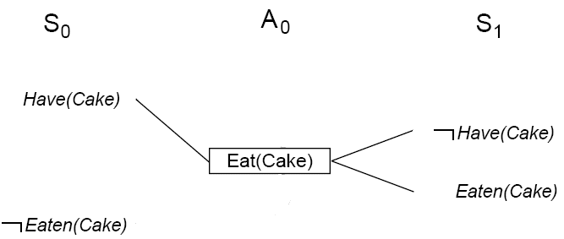
PG Example
Add all applicable actions.
Add all effects to the next state.

Slide 35
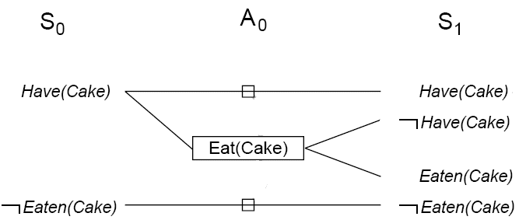
PG Example
Add persistence actions (aka no-ops) to map all literals in state S_{i} to state S_{i+1}.

Slide 36
Mutual Exclusion
p
¬p
Two actions are mutex if
one clobbers the other’s effects or preconditions
they have mutex preconditions
Two proposition are mutex if
one is the negation of the other
all ways of achieving them are mutex
p
¬p
p
¬p

Slide 37
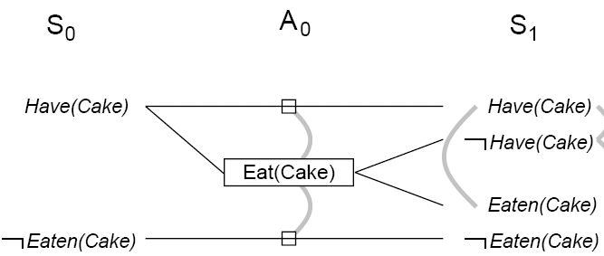
PG Example
Identify mutual exclusions between actions and literals based on potential conflicts.

Slide 38
Mutual exclusion
A mutex relation holds between two actions when:
Inconsistent effects: one action negates the effect of another.
Interference: one of the effects of one action is the negation of a precondition of the other.
Competing needs: one of the preconditions of one action is mutually exclusive with the precondition of the other.
A mutex relation holds between two literals when:
one is the negation of the other OR
each possible action pair that could achieve the literals is mutex (inconsistent support).

Slide 39
Cake example
Level S₁ contains all literals that might result from picking any subset of actions in A₀
Conflicts between literals that can not occur together (as a consequence of the selection action) are represented by mutex links.
S1 defines multiple states and the mutex links are the constraints that define this set of states.

Slide 40
Cake example
Repeat process until graph levels off:
two consecutive levels are identical, or
contain the same amount of literals (explanation follows later)

Slide 41
Cake example

Slide 42
Dinner Date
Initial Conditions: (:and (cleanHands) (quiet))
Goal: (:and (noGarbage) (dinner) (present))
Actions:
(:operator carry :precondition
:effect (:and (noGarbage) (:not (cleanHands)))
(:operator dolly :precondition
:effect (:and (noGarbage) (:not (quiet)))
(:operator cook :precondition (cleanHands)
:effect (dinner))
(:operator wrap :precondition (quiet)
:effect (present))

Slide 43
Planning Graph
cleanH
quiet
noGarb
cleanH
quiet
dinner
present
carry
dolly
cook
wrap
0 Prop 1 Action 2 Prop 3 Action 4 Prop

Slide 44
Are there any exclusions?
cleanH
quiet
noGarb
cleanH
quiet
dinner
present
carry
dolly
cook
wrap
¬cleanH
¬quiet
0 Prop 1 Action 2 Prop 3 Action 4 Prop

Slide 45
Observation 1
p
¬q
¬r
p
q
¬q
¬r
p
q
¬q
r
¬r
p
q
¬q
r
¬r
A
A
A
B
B
Propositions monotonically increase
(always carried forward by no-ops)

Slide 46
Observation 2
p
¬q
¬r
p
q
¬q
¬r
p
q
¬q
r
¬r
p
q
¬q
r
¬r
A
A
A
B
B
Actions monotonically increase

Slide 47
Observation 3
p
q
r
…
p
q
r
…
p
q
r
…
A
Proposition mutex relationships monotonically decrease

Slide 48
Observation 4
A
A
A
p
q
…
p
q
r
s
…
p
q
r
s
…
p
q
r
s
…
B
B
B
C
C
C
Action mutex relationships monotonically decrease

Slide 49
Observation 5
Planning Graph ‘levels off’.
After some time k all levels are identical
Because it’s a finite space, the set of literals never decreases and mutexes don’t reappear.

Slide 50
Properties of Planning Graph
If goal is absent from last level?
Then goal cannot be achieved!
If there exists a plan to achieve goal?
Then goal is present in the last level &
No mutexes between conjuncts
If goal is present in last level (w/ no mutexes) ?
There still may not exist any viable plan

Slide 51
Heuristics based on Planning Graph
Construct planning graph starting from s
h(s) = level at which goal appears non-mutex
Admissible?
YES
Relaxed Planning Graph Heuristic
Remove negative preconditions build plan. graph
Use heuristic as above
Admissible? YES
More informative? NO
Speed: FASTER

Slide 52
FF
Topmost classical planner until 2009
State space local search
Guided by relaxed planning graph
Full best-first seach to escape plateaus
A few other bells and whistles…

Slide 53
SATPlan: Planning as SAT
Formulate the planning problem in propositional logic
Assume that the plan has k actions
Create a binary variable for each possible action a:
Action(a,i) (TRUE if action a is used at step i)
Create variables for each proposition that can hold at different points in time:
Proposition(p,i) (TRUE if proposition p holds at step i)

Slide 54
Constraints
XOR: Only one action can be executed at each time step
At least one action must be executed at each time step
Constraints describing effects of actions
Action(a,i) → prec(a,i-1); Action(a,i) → eff(a,i)
Maintain action: if an action does not change a prop p, then maintain action for proposition p is true
Action(maint_p,i) → Action(a1,i) v Action(a2,i)… [for all a_{i} that don’t effect p]
A proposition is true at step i only if some action (possibly a maintain action) made it true
Constraints for initial state and goal state

Slide 55
Planning Summary
Problem solving algorithms that operate on explicit propositional representations of states and actions.
Make use of domain-independent heuristics.
STRIPS: restrictive propositional language
Heuristic search
forward (progression)
backward (regression) search [didn’t cover]
Local search FF [didn’t cover]

Slide 56
Generative Planning
Input
Description of (initial state of) world (in some KR)
Description of goal (in some KR)
Description of available actions (in some KR)
Output
Controller
E.g. Sequence of actions
E.g. Plan with loops and conditionals
E.g. Policy = f: states -> actions

Slide 57
Input Representation
Description of initial state of world
E.g., Set of propositions:
((block a) (block b) (block c) (on-table a) (on-table b) (clear a) (clear b) (clear c) (arm-empty))
Description of goal: i.e. set of worlds or ??
E.g., Logical conjunction
Any world satisfying conjunction is a goal
(and (on a b) (on b c)))
Description of available actions

Slide 58
Classical Planning
Environment
Static
Instantaneous
Deterministic
Perfect
Fully Observable
Full
I = initial state G = goal state
(prec)
O_{i}
(effects)
[ I ]
O_{i}
O_{j}
O_{k}
O_{m}
[ G ]

Slide 59
Compilation to SAT
Init state
Actions
Goal
?
→

Slide 60
The Idea
Suppose a plan of length n exists
Encode this hypothesis in SAT
Init state true at t₀
Goal true at T_{n}
Actions imply effects, etc
Look for satisfying assignment
Decode into plan
RISC: The Revolutionary Excitement

Slide 61
Axioms
Axiom | Description / Example
Init | The initial state holds at t=0
Goal | The goal holds at t=2n
A ⇒ P, E | Paint(A,Red,t) ⇒ Block(A, t-1) Paint(A,Red,t) ⇒ Color(A, Red, t+1)
Frame | Classical / Explanatory
At-least-one | Act1(…, t) ∨ Act2(…, t) ∨ …
Exclude | ¬Act1(…, t) ∨ ¬Act2(…, t)

Slide 62
Space of Encodings
Action Representations
Regular
Simply-Split
Overloaded-Split
Bitwise
Frame Axioms
Classical
Explanitory

Slide 63
Frame Axioms
Classical
∀P, A, t if P@t-1 ∧
A@t ∧
A doesn’t affect P
then P@t+1
Explanatory
∀P, A, t if P@t-1 ∧ ¬P@t+1
then A₁@t ∨ A₂@t ∨ …
forall A_{i} that do affect P

Slide 64
Action Representation
Representation | One Propositional Variable per | Example
more
vars
Regular | fully-instantiated action | Paint-A-Red, Paint-A-Blue, Move-A-Table
Simply-split | fully-instantiated action’s argument | Paint-Arg1-A ∧ Paint-Arg2-Red
Overloaded-split | fully-instantiated argument | Act-Paint ∧ Arg1-A ∧ Arg2-Red
Bitwise | Binary encodings of actions | Bit1 ∧ ~Bit2 ∧ Bit3
Paint-A-Red = 5
more
clses

Slide 65
Optimization 1: Factored Splitting
- use partially-instantiated actions
HasColor-A-Blue-(t-1) ^ Paint-Arg1-B-t ^
Paint-Arg2-Red-t ⇒ HasColor-A-Blue-(t+1)
Explanatory Frames
factored
unfactored
Simple | Overloaded
Variables
Clauses
Literals
.46 | .69
.30 | .50
.20 | .38

Slide 66
Optimization 2: Types
A type is a fluent which no actions affects.
type interference
prune impossible operator instantiations
type elimination
Type opts
No type opts
Literals
Regular | Simple | Overloaded | Bitwise
Classical
Explanatory
.27 | .39 | .34 | .30
.10 | .97 | .67 | .74

