Slide 1
CSE 473 Propositional Logic SAT Algorithms
Dan Weld
(With some slides from Mausam, Stuart Russell, Dieter Fox, Henry Kautz, Min-Yen Kan…)
Irrationally held truths may be more harmful than reasoned errors.
- Thomas Huxley (1825-1895)
Notes:
A handful of GENERAL SEARCH TECHNIQUES lie at the heart of practically all work in AI
We will encounter the SAME PRINCIPLES again and again in this course, whether we are talking about
GAMES
LOGICAL REASONING
MACHINE LEARNING
These are principles for SEARCHING THROUGH A SPACE OF POSSIBLE SOLUTIONS to a problems.

Slide 2
Overview
Introduction & Agents
Search, Heuristics & CSPs
Adversarial Search
Logical Knowledge Representation
Planning & MDPs
Reinforcement Learning
Uncertainty & Bayesian Networks
Machine Learning
NLP & Special Topics

Slide 3
Propositional Logic
Syntax
Atomic sentences: P, Q, …
Connectives: ∧ , ∨, ¬, ⇒
Semantics
Truth Tables
Inference
Modus Ponens
Resolution
DPLL
GSAT
Complexity

Slide 4
Semantics
Syntax: which arrangements of symbols are legal
(Def “sentences”)
Semantics: what the symbols mean in the world
(Mapping between symbols and worlds)
Inference
Sentences
Sentences
Representation
Semantics
Semantics
World
Facts
Facts

Slide 5
Truth tables for connectives

Slide 6
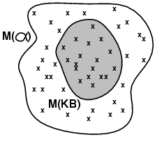
Models
Logicians often think in terms of models, which are formally structured worlds with respect to which truth can be evaluated
In propositional case, each model = truth assignment
Set of models can be enumerated in a truth table
We say m is a model of a sentence α if α is true in m
M(α) is the set of all models of α
Then KB ╞ α iff M(KB) ⊆ M(α)
E.g. KB = (P∨Q) ∧(¬P ∨ R) α = (P∨R)
How to check?
One way is to enumerate all elements in the truth table – slow ☹

Slide 7
Satisfiability, Validity, & Entailment
S is satisfiable if it is true in some world
S is unsatisfiable if it is false all worlds
S is valid if it is true in all worlds
S1 entails S2 if wherever S1 is true S2 is also true

Slide 8
Types of Reasoning (Inference)
Deduction (showing entailment, |=)
S = question
Prove that KB |= S
Two approaches:
Rules to derive new formulas from old (inference)
Show (KB ∧ ¬ S) is unsatisfiable
Model Finding (showing satisfiability)
S = description of problem
Show S is satisfiable
A kind of constraint satisfaction

Slide 9
Propositional Logic: Inference Algorithms
}
Backward & Forward Chaining
Resolution (Proof by Contradiction)
Exhaustive Enumeration
DPLL (Davis, Putnam Loveland & Logemann)
GSAT
Deduction
}
Model
Finding

Slide 10
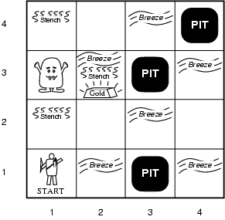
Wumpus World
Performance measure
Gold: +1000, death: -1000
-1 per step, -10 for using the arrow
Environment
Squares adjacent to wumpus are smelly
Squares adjacent to pit are breezy
Glitter iff gold is in the same square
Shooting kills wumpus if you are facing it
Shooting uses up the only arrow
Grabbing picks up gold if in same square
Releasing drops the gold in same square
Sensors: Stench, Breeze, Glitter, Bump, Scream
Actuators: Left turn, Right turn, Forward, Grab, Release, Shoot

Slide 11
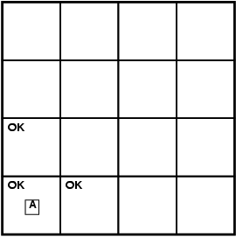
Exploring a wumpus world
2
1
[1,2]
1
2
3
4

Slide 12
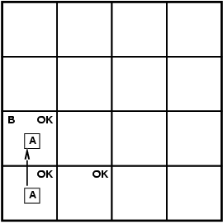
Exploring a wumpus world
2
1
[1,2]
1
2
3
4

Slide 13
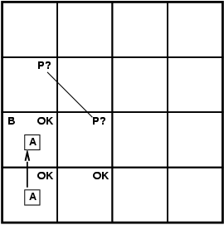
Exploring a wumpus world
2
1
[1,2]
1
2
3
4

Slide 14
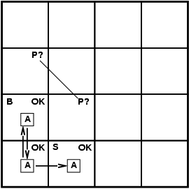
Exploring a wumpus world
2
1
[1,2]
1
2
3
4

Slide 15
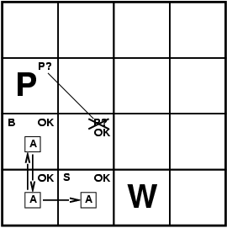
Exploring a wumpus world
2
1
[1,2]
1
2
3
4

Slide 16
Exploring a wumpus world
2
1
[1,2]
1
2
3
4

Slide 17
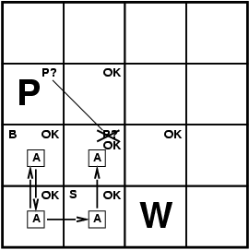
Exploring a wumpus world
2
1
[1,2]
1
2
3
4

Slide 18
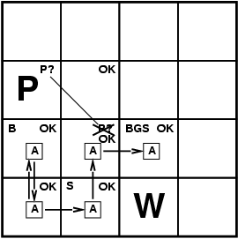
Exploring a wumpus world
2
1
[1,2]
1
2
3
4

Slide 19
Wumpus world sentences: KB
Let P_{i,j} be true if there is a pit in [i, j].
Let B_{i,j} be true if there is a breeze in [i, j].
KB:
¬ P_{1,1}
¬B_{1,1}
"Pits cause breezes in adjacent squares"
B_{1,1} ⇔ (P_{1,2} ∨ P_{2,1})
B_{2,1} ⇔ (P_{1,1} ∨ P_{2,2} ∨ P_{3,1})

Slide 20
Full Encoding of Wumpus World
In propositional logic:
¬P_{1,1}
¬W_{1,1}
B_{x,y} ⇔ (P_{x,y+1} ∨ P_{x,y-1} ∨ P_{x+1,y} ∨ P_{x-1,y})
S_{x,y} ⇔ (W_{x,y+1} ∨ W_{x,y-1} ∨ W_{x+1,y} ∨ W_{x-1,y})
W_{1,1} ∨ W_{1,2} ∨ … ∨ W_{4,4}
¬W_{1,1} ∨ ¬W_{1,2}
¬W_{1,1} ∨ ¬W_{1,3}
…
⇒ 64 distinct proposition symbols, 155 sentences

Slide 21
Model Finding
Find an assignments to variables that makes a formula true
Note: this is a kind of CSP, right?
α = ¬P₁₂ (ie “[1,2] is safe”)

Slide 22
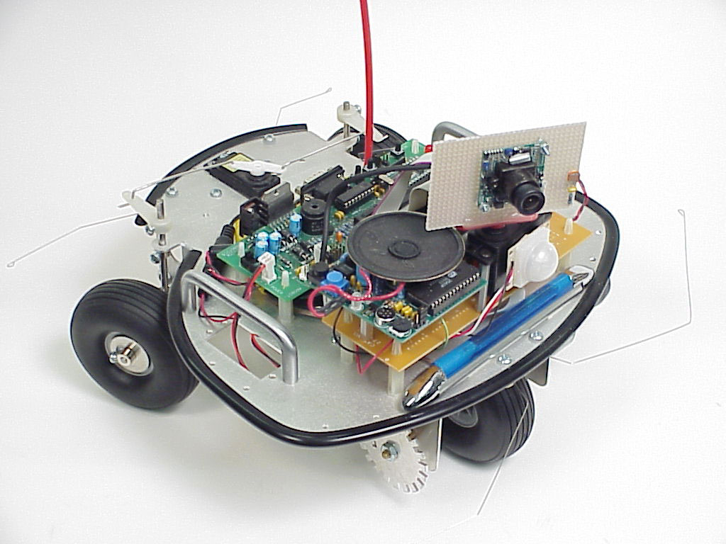
State Estimation
Maintaining a KB which records what you know about the (partially observed) world state
Prop logic
First order logic
Probabilistic encodings

Slide 24
Propositional Logic: Inference Algorithms
}
Backward & Forward Chaining
Resolution (Proof by Contradiction)
Exhaustive Enumeration
DPLL (Davis, Putnam Loveland & Logemann)
GSAT
Deduction
}
Model
Finding

Slide 25
Inference 3: Model Enumeration
for (m in truth assignments){
if (m makes Φ true)
then return “Sat!”
}
return “Unsat!”

Slide 26
Model Checking: Truth tables for inference
alpha_1 = not P_{12} (“[1,2] is safe”)

Slide 27
Inference 4: DPLL (Enumeration of Partial Models) [Davis, Putnam, Loveland & Logemann 1962] Version 1
dpll_1(pa){
if (pa makes F false) return false;
if (pa makes F true) return true;
choose P in F;
if (dpll_1(pa ∪ {P=0})) return true;
return dpll_1(pa ∪ {P=1});
}
Returns true if F is satisfiable, false otherwise

Slide 28
DPLL Version 1
(a ∨ b ∨ c)
(a ∨ ¬b)
(a ∨ ¬c)
(¬a ∨ c)

Slide 29
DPLL Version 1
a
(a ∨ b ∨ c)
(a ∨ ¬b)
(a ∨ ¬c)
(¬a ∨ c)

Slide 30
DPLL Version 1
a
(F ∨ b ∨ c)
F
(F ∨ ¬b)
(F ∨ ¬c)
(T ∨ c)

Slide 31
DPLL Version 1
a
(F ∨ F ∨ c)
F
(F ∨ T)
b
F
(F ∨ ¬c)
(T ∨ c)

Slide 32
DPLL Version 1
a
(F ∨ F ∨ F)
F
(F ∨ T)
b
F
(F ∨ T)
(T ∨ F)
c
F

Slide 33
DPLL Version 1
a
F
F
T
b
F
T
T
c
F

Slide 34
DPLL Version 1
a
(a ∨ b ∨ c)
F
(a ∨ ¬b)
b
F
(a ∨ ¬c)
(¬a ∨ c)
c
F

Slide 35
DPLL Version 1
a
(a ∨ b ∨ c)
(a ∨ ¬b)
b
b
(a ∨ ¬c)
c
(¬a ∨ c)
c

Slide 36
DPLL as Search
Search Space?
Algorithm?

Slide 37
Improving DPLL

Slide 38
Improving DPLL

Slide 39
Improving DPLL

Slide 40
Representing Formulae
CNF = Conjunctive Normal Form
Conjunction (∧) of Disjunctions (∨)
Represent as set of sets
((A, B), ( ¬A, C), (¬C))
(( ¬A), (A))
(())
((A))
()

Slide 41
DPLL version 2
dpll_2(F, literal){
remove clauses containing literal
if (F contains no clauses)return true;
shorten clauses containing ¬literal
if (F contains empty clause) return false;
choose V in F;
if (dpll_2(F, ¬V))return true;
return dpll_2(F, V);
}
Partial assignment corresponding to a node is the set of chosen literals on the path from the root to the node

Slide 42
DPLL Version 2
a
(a ∨ b ∨ c)
(a ∨ ¬b)
(a ∨ ¬c)
(¬a ∨ c)

Slide 43
DPLL Version 2
a
(F ∨ b ∨ c)
F
(F ∨ ¬b)
(F ∨ ¬c)
(T ∨ c)

Slide 44
DPLL Version 2
a
(b ∨ c)
F
(¬b)
(¬c)

Slide 45
DPLL Version 2
a
F
(F ∨ c)
(T)
b
F
(¬c)

Slide 46
DPLL Version 2
a
(c)
F
b
F
(¬c)

Slide 47
DPLL Version 2
a
(F)
F
b
F
(T)
c
F

Slide 48
DPLL Version 2
Empty clause!
a
()
F
b
F
c
F

Slide 49
DPLL Version 2
a
(F ∨ F ∨ F)
F
(F ∨ T)
b
(F ∨ T)
(T ∨ F)
c

Slide 50
DPLL Version 2
a
F
F
T
b
T
T
c

Slide 51
DPLL Version 2
a
(a ∨ b ∨ c)
(a ∨ ¬b)
b
(a ∨ ¬c)
(¬a ∨ c)
c

Slide 52
Benefit
Can backtrack before getting to leaf

Slide 53
Structure in Clauses
Unit Literals
A literal that appears in a singleton clause
{{¬b c}{¬c}{a ¬b e}{d b}{e a ¬c}}
Might as well set it true! And simplify
{{¬b} {a ¬b e}{d b}}
{{d}}
Pure Literals
A symbol that always appears with same sign
{{a ¬b c} {¬c d ¬e} {¬a ¬b e}{d b} {e a ¬c}}
Might as well set it true! And simplify
{{a ¬b c} {¬a ¬b e} {e a ¬c}}

Slide 54
In Other Words
May view this as adding constraint propagation techniques into play

Slide 55
In Other Words
May view this as adding constraint propagation techniques into play

Slide 56
DPLL (previous version) Davis – Putnam – Loveland – Logemann
dpll(F, literal){
remove clauses containing literal
if (F contains no clauses) return true;
shorten clauses containing ¬literal if (F contains empty clause) return false;
if (F contains a unit or pure L) return dpll(F, L);
choose V in F;
if (dpll(F, ¬V))return true;
return dpll(F, V);
}

Slide 57
DPLL (for real!) Davis – Putnam – Loveland – Logemann
dpll(F, literal){
remove clauses containing literal
if (F contains no clauses) return true;
shorten clauses containing ¬literal if (F contains empty clause) return false;
if (F contains a unit or pure L) return dpll(F, L);
choose V in F;
if (dpll(F, ¬V))return true;
return dpll(F, V);
}

Slide 58
DPLL (for real)
a
(a ∨ b ∨ c)
(a ∨ ¬b)
b
c
(a ∨ ¬c)
(¬a ∨ c)
c

Slide 59
Compare with DPLL Version 1
a
(a ∨ b ∨ c)
(a ∨ ¬b)
b
b
(a ∨ ¬c)
c
(¬a ∨ c)
c

Slide 60
DPLL (for real!) Davis – Putnam – Loveland – Logemann
dpll(F, literal){
remove clauses containing literal
if (F contains no clauses) return true;
shorten clauses containing ¬literal if (F contains empty clause) return false;
if (F contains a unit or pure L) return dpll(F, L);
choose V in F;
if (dpll(F, ¬V))return true;
return dpll(F, V);
}
Where could we use a heuristic to further improve performance?

Slide 61
Heuristic Search in DPLL
Heuristics are used in DPLL to select a (non-unit, non-pure) proposition for branching
Idea: identify a most constrained variable
Likely to create many unit clauses
MOM’s heuristic:
Most occurrences in clauses of minimum length

Slide 62
Success of DPLL
1962 – DPLL invented
1992 – 300 propositions
1997 – 600 propositions (satz)
Additional techniques:
Learning conflict clauses at backtrack points
Randomized restarts
2002 (zChaff) 1,000,000 propositions – encodings of hardware verification problems

Slide 63
Other Ideas?
How else could we solve SAT problems?

Slide 64
WalkSat (Take 1)
Local search (Hill Climbing + Random Walk) over space of complete truth assignments
With prob p: flip any variable in any unsatisfied clause
With prob (1-p): flip best variable in any unsat clause
best = one which minimizes #unsatisfied clauses

Slide 65
Refining Greedy Random Walk
Each flip
makes some false clauses become true
breaks some true clauses, that become false
Suppose s1→s2 by flipping x. Then:
#unsat(s2) = #unsat(s1) – make(s1,x) + break(s1,x)
Idea 1: if a choice breaks nothing, it’s likely good!
Idea 2: near the solution, only the break count matters
– the make count is usually 1

Slide 66
Walksat (Take 2)
state = random truth assignment;
while ! GoalTest(state) do
clause := random member { C | C is false in state };
for each x in clause do compute break[x];
if exists x with break[x]=0 then var := x;
else
with probability p do
var := random member { x | x is in clause };
else
var := arg x min { break[x] | x is in clause };
endif
state[var] := 1 – state[var];
end
return state;
Put everything inside of a restart loop.
Parameters: p, max_flips, max_runs

Slide 67
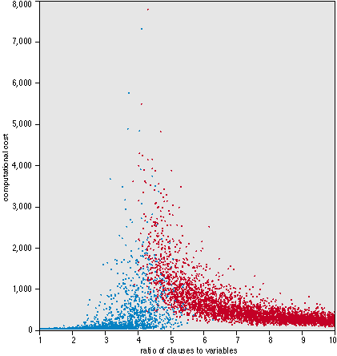
Random 3-SAT
Random 3-SAT
sample uniformly from space of all possible 3-clauses
n variables, l clauses
Which are the hard instances?
around l/n = 4.3

Slide 68
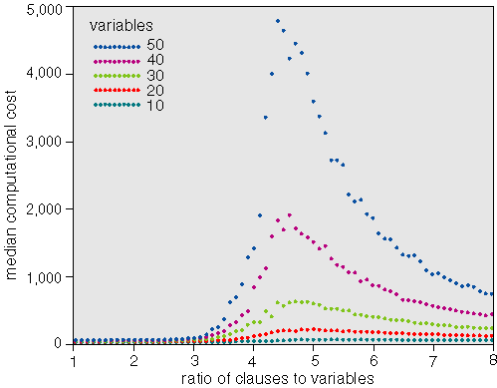
Random 3-SAT
Varying problem size, n
Complexity peak appears to be largely invariant of algorithm
backtracking algorithms like Davis-Putnam
local search procedures like GSAT
What’s so special about 4.3?

Slide 69
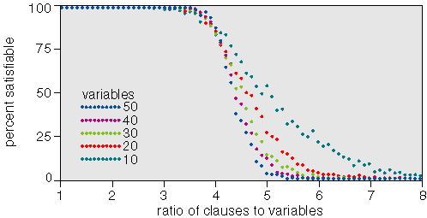
Random 3-SAT
Complexity peak coincides with solubility transition
l/n < 4.3 problems under-constrained and SAT
l/n > 4.3 problems over-constrained and UNSAT
l/n=4.3, problems on “knife-edge” between SAT and UNSAT

Slide 70
Special Syntactic Forms
General Form:
((q∧¬ r) → s)) ∧ ¬ (s ∧ t)
Conjunction Normal Form (CNF)
(¬ q ∨ r ∨ s ) ∧ (¬ s ∨ ¬ t)
Set notation: { (¬ q, r, s ), (¬ s, ¬ t) }
empty clause () = false
Binary clauses: 1 or 2 literals per clause
(¬ q ∨ r) (¬ s ∨ ¬ t)
Horn clauses: 0 or 1 positive literal per clause
(¬ q ∨ ¬ r ∨ s ) (¬ s ∨ ¬ t)
(q∧r) → s (s∧t) → false
Notes:
Before going into some specific proof systems, let us
define some important special syntactic forms of
sentences in propositional logic.

Slide 71
Prop. Logic Themes
Expressiveness
Expressive but awkward
No notion of objects, properties, or relations
Number of propositions is fixed
Tractability
NP in general
Completeness / speed tradeoff
Horn clauses, binary clauses

