Slide 1
To do
Check slides for next lecture and move some to this lecture.
Consider eliminating resolution
Simplify discussion of inference – just talk about SAT and explain how to use to do entailment broadly speaking (not just in terms of resolution
Make sure using minimal number of terms, model, satisfies, etc

Slide 2
CSE 473 Logic in AI
Dan Weld
(With some slides from Mausam, Stuart Russell, Dieter Fox, Henry Kautz…)
There is nothing so powerful as truth, and often nothing so strange.
- Daniel Webster (1782-1852)
Notes:
A handful of GENERAL SEARCH TECHNIQUES lie at the heart of practically all work in AI
We will encounter the SAME PRINCIPLES again and again in this course, whether we are talking about
GAMES
LOGICAL REASONING
MACHINE LEARNING
These are principles for SEARCHING THROUGH A SPACE OF POSSIBLE SOLUTIONS to a problems.

Slide 3
Overview
Introduction & Agents
Search, Heuristics & CSPs
Adversarial Search
Logical Knowledge Representation
Planning & MDPs
Reinforcement Learning
Uncertainty & Bayesian Networks
Machine Learning
NLP & Special Topics

Slide 4
KR Hypothesis
Any intelligent process will have ingredients that
We as external observers interpret as knowledge
This knowledge plays a formal, causal & essential role in guiding the behavior
- Brian Smith (paraphrased)

Slide 5
Some KR Languages
Propositional Logic
Predicate Calculus
Frame Systems
Rules with Certainty Factors
Bayesian Belief Networks
Influence Diagrams
Semantic Networks
Concept Description Languages
Non-monotonic Logic

Slide 6
Knowledge Representation
represent knowledge in a manner that facilitates inferencing (i.e. drawing conclusions) from knowledge.
Typically based on
Logic
Probability
Logic and Probability

Slide 7
Basic Idea of Logic
By starting with true assumptions, you can deduce true conclusions.
Notes:
But what is TRUTH?

Slide 8
Truth
Francis Bacon (1561-1626)
No pleasure is comparable to the standing upon the vantage-ground of truth.
Thomas Henry Huxley (1825-1895)
Irrationally held truths may be more harmful than reasoned errors.
John Keats (1795-1821)
Beauty is truth, truth beauty; that is all ye know on earth, and all ye need to know.
Blaise Pascal (1623-1662)
We know the truth, not only by the reason, but also by the heart.
François Rabelais (c. 1490-1553)
Speak the truth and shame the Devil.
Daniel Webster (1782-1852)
There is nothing so powerful as truth, and often nothing so strange.

Slide 9
Knowledge bases
Knowledge base = set of sentences in a formal language
Declarative approach to building an agent (or other system):
Tell it what it needs to know
Then it can Ask itself what to do - answers should follow from the KB
Agents can be viewed at the knowledge level
i.e., what they know, regardless of how implemented
Or at the implementation level
i.e., data structures in KB and algorithms that manipulate them

Slide 10
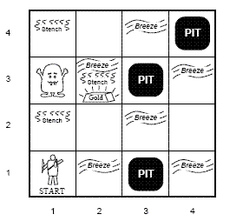
When Useful

Slide 11
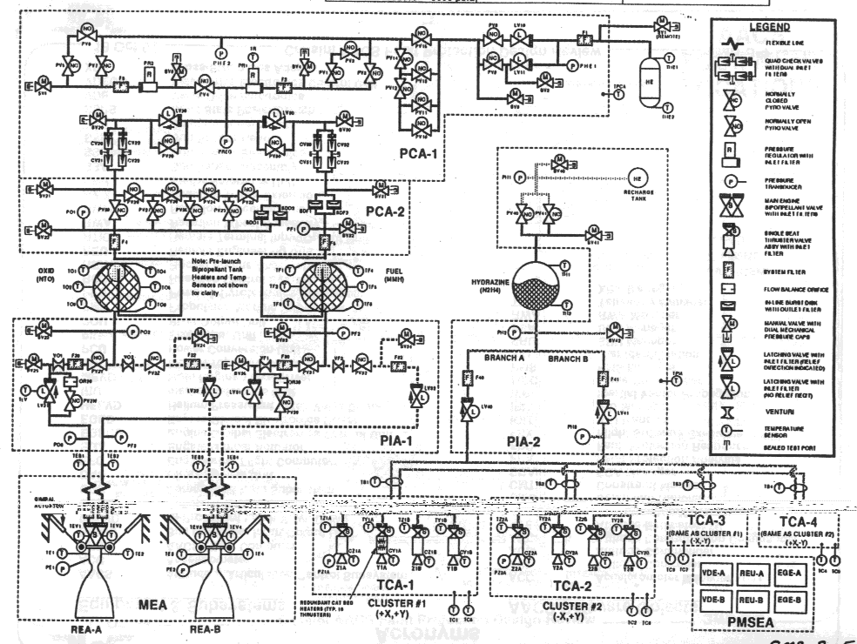
Deep Space One
Autonomous diagnosis & repair “Remote Agent”
Compiled schematic to 7,000 var SAT problem
Started: January 1996
Launch: October 15th, 1998
Experiment: May 17-21

Slide 12
Muddy Children Problem
Mom to N children “Don’t get dirty”
While playing, K≥1 get mud on forehead
Father: “Some of you are dirty!”
Father: “Raise your hand if you are dirty”
Noone raises hand
Father: “Raise your hand if you are dirty”
Noone raises hand
…
Father: “Raise your hand if you are dirty”
All dirty children raise hand
}
K-1 times

Slide 13
Components of KR
Syntax: defines the sentences in the language
Semantics: defines the “meaning” of sentences
Inference Procedure
Algorithm
Sound?
Complete?
Complexity
Knowledge Base

Slide 14
Propositional Logic
Syntax
Atomic sentences: P, Q, …
Connectives: ∧ , ∨, ¬, ⇒
Semantics
Truth Tables
Inference
Modus Ponens
Resolution
DPLL
GSAT
Complexity

Slide 15
Propositional Logic: Syntax
Atoms
P, Q, R, …
Literals
P, ¬P
Sentences
Any literal is a sentence
If S is a sentence
Then (S ∧ S) is a sentence
Then (S ∨ S) is a sentence
Conveniences
P → Q same as ¬P ∨ Q

Slide 16
Semantics
Syntax: which arrangements of symbols are legal
(Def “sentences”)
Semantics: what the symbols mean in the world
(Mapping between symbols and worlds)
Inference
Sentences
Sentences
Representation
Semantics
Semantics
World
Facts
Facts

Slide 17
Propositional Logic: SEMANTICS
“Interpretation” (or “possible world”)
Assignment to each variable either T or F
Assignment of T or F to each connective via defns
Q
Q
T
F
T
F
T
T
F
T
T
T
P
P
F
F
F
F
T
F
P ∧ Q P ∨ Q

Slide 18
Satisfiability, Validity, & Entailment
S is satisfiable if it is true in some world
S is unsatisfiable if it is false all worlds
S is valid if it is true in all worlds
S1 entails S2 if wherever S1 is true S2 is also true

Slide 19
Examples
P → Q
X → X
S ∧ (W ∧ ¬S)
T ∨ ¬T

Slide 20
Notation
⇒
⊃
→
⎟−
⎟=
}
Implication (syntactic symbol)
Inference
Proves: S1 |-_{i} S2 if inference algo, i, says `S2’ from S1
Entails: S1 |= S2 if wherever S1 is true S2 is also true
Entailment

Slide 21
Notation
⇒
⊃
→
⎟−
⎟=
}
Implication (syntactic symbol)
Inference
Proves: S1 |-_{i} S2 if inference algo, i, says `S2’ from S1
Entails: S1 |= S2 if wherever S1 is true S2 is also true
Entailment
Sound
Complete ⎟= implies ⎟−
⎟− → ⎟=
⎟= → ⎟−

Slide 22
Resolution
If the unicorn is mythical, then it is immortal, but if it is not mythical, it is a reptile. If the unicorn is either immortal or a reptile, then it is horned.
(¬ R ∨ H)
(¬I ∨ H)
M = mythical
I = immortal
R = reptile
H = horned
(M ∨ R)
(¬ M ∨ I)
Notes:
M=>I (~M v I)
~M=>(~I & A) (M V ~I)
(M v A)
(I v A)=>H (~I v H)
(~A v H)
Conclude: H (~H)

Slide 23
Prop. Logic: Knowledge Engr
1) One of the women is a biology major
2) Lisa is not next to Dave in the ranking
3) Dave is immediately ahead of Jim
4) Jim is immediately ahead of a bio major
5) Mary or Lisa is ranked first
1. Choose Vocabulary
Universe: Lisa, Dave, Jim, Mary
LD = “Lisa is immediately ahead of Dave”
D = “Dave is a Bio Major”
2. Choose initial sentences (wffs)

Slide 24
Reasoning Tasks
Model finding
KB = background knowledge
S = description of problem
Show (KB ∧ S) is satisfiable
A kind of constraint satisfaction
Deduction
S = question
Prove that KB |= S
Two approaches:
Rules to derive new formulas from old (inference)
Show (KB ∧ ¬ S) is unsatisfiable

Slide 25
Special Syntactic Forms
General Form:
((q∧¬ r) → s)) ∧ ¬ (s ∧ t)
Conjunction Normal Form (CNF)
(¬ q ∨ r ∨ s ) ∧ (¬ s ∨ ¬ t)
Set notation: { (¬ q, r, s ), (¬ s, ¬ t) }
empty clause () = false
Binary clauses: 1 or 2 literals per clause
(¬ q ∨ r) (¬ s ∨ ¬ t)
Horn clauses: 0 or 1 positive literal per clause
(¬ q ∨ ¬ r ∨ s ) (¬ s ∨ ¬ t)
(q∧r) → s (s∧t) → false
Notes:
Before going into some specific proof systems, let us
define some important special syntactic forms of
sentences in propositional logic.

Slide 26
Propositional Logic: Inference A mechanical process for computing new sentences
Backward & Forward Chaining
Resolution (Proof by Contradiction)
GSAT
Davis Putnam

Slide 27
Inference 1: Forward Chaining
Forward Chaining Based on rule of modus ponens
If know P1, …, Pn & know (P1 ∧... ∧ Pn ) → Q
Then can conclude Q
Backward Chaining: search
start from the query and go backwards

Slide 28
Analysis
Sound?
Complete?
If KB has only Horn clauses & query is a single literal
Forward Chaining is complete
Runs linear in the size of the KB
Can you prove
{ } |= Q ∨ ¬Q

Slide 29
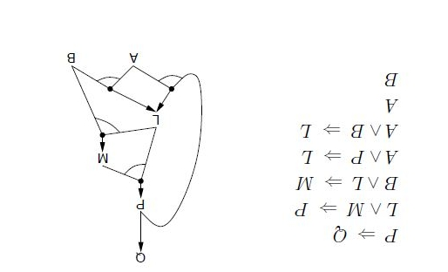
Example
1
2
2
2
2

Slide 30
Example
1
2
2
1
1

Slide 31
Example
1
2
1
1
0

Slide 32
Example
1
2
1
1
0

Slide 33
Example
1
1
0
1
0

Slide 34
Example
1
1
0
1
0

Slide 35
Example
1
0
0
1
0

Slide 36
Example
0
0
0
0
0

Slide 37
Example
0
0
0
0
0

Slide 38
Propositional Logic: Inference A mechanical process for computing new sentences
Backward & Forward Chaining
Resolution (Proof by Contradiction)
GSAT
Davis Putnam

Slide 39
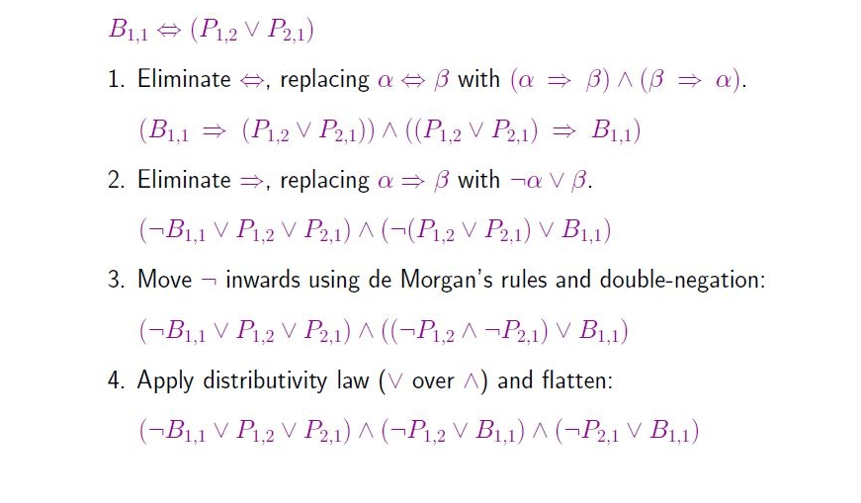
Conversion to CNF

Slide 40
Inference 2: Resolution [Robinson 1965]
{ (p ∨ α), (¬ p ∨ β ∨ γ) } |-_{R} (α ∨ β ∨ γ)
Correctness
If S1 |-_{R} S2 then S1 |= S2
Refutation Completeness:
If S is unsatisfiable then S |-_{R} ()
Notes:
A completely mechanical process!
Rules for deriving new sentences from old.
Example: P, P=>Q, |- Q
“Symbol Pushing”.

Slide 41
Resolution
If the unicorn is mythical, then it is immortal, but if it is not mythical, it is a reptile. If the unicorn is either immortal or a reptile, then it is horned.
Prove: the unicorn is horned.
(¬ R ∨ H)
(¬ H)
(¬I ∨ H)
M = mythical
I = immortal
R = reptile
H = horned
(M ∨ R)
(¬R)
(¬I)
(¬ M ∨ I)
(M)
(¬ M)
()
Notes:
M=>I (~M v I)
~M=>(~I & A) (M V ~I)
(M v A)
(I v A)=>H (~I v H)
(~A v H)
Conclude: H (~H)

Slide 42
Resolution as Search
States?
Operators

Slide 43
Model Finding
Find assignments to variables that makes a formula true
a CSP

Slide 44
Inference 3: Model Enumeration
for (m in truth assignments){
if (m makes Φ true)
then return “Sat!”
}
return “Unsat!”

Slide 45
Inference 4: DPLL (Enumeration of Partial Models) [Davis, Putnam, Loveland & Logemann 1962] Version 1
dpll_1(pa){
if (pa makes F false) return false;
if (pa makes F true) return true;
choose P in F;
if (dpll_1(pa ∪ {P=0})) return true;
return dpll_1(pa ∪ {P=1});
}
Returns true if F is satisfiable, false otherwise

Slide 46
DPLL Version 1
(a ∨ b ∨ c)
(a ∨ ¬b)
(a ∨ ¬c)
(¬a ∨ c)

Slide 47
DPLL Version 1
a
(a ∨ b ∨ c)
F
(a ∨ ¬b)
(a ∨ ¬c)
(¬a ∨ c)

Slide 48
DPLL Version 1
a
(F ∨ b ∨ c)
F
(F ∨ ¬b)
(F ∨ ¬c)
(T ∨ c)

Slide 49
DPLL Version 1
a
(F ∨ F ∨ c)
F
(F ∨ T)
b
(F ∨ ¬c)
(T ∨ c)

Slide 50
DPLL Version 1
a
(F ∨ F ∨ F)
F
(F ∨ T)
b
(F ∨ T)
(T ∨ F)
c

Slide 51
DPLL Version 1
a
F
F
T
b
T
T
c

Slide 52
DPLL Version 1
a
(a ∨ b ∨ c)
(a ∨ ¬b)
b
(a ∨ ¬c)
(¬a ∨ c)
c

Slide 53
DPLL Version 1
a
(a ∨ b ∨ c)
(a ∨ ¬b)
b
b
(a ∨ ¬c)
c
(¬a ∨ c)
c

Slide 54
DPLL as Search
Search Space?
Algorithm?

Slide 55
Improving DPLL

Slide 56
Improving DPLL

Slide 57
Improving DPLL

Slide 58
DPLL version 2
dpll_2(F, literal){
remove clauses containing literal
if (F contains no clauses)return true;
shorten clauses containing ¬literal
if (F contains empty clause) return false;
choose V in F;
if (dpll_2(F, ¬V))return true;
return dpll_2(F, V);
}
Partial assignment corresponding to a node is the set of chosen literals on the path from the root to the node

Slide 59
DPLL Version 2
a
(F ∨ b ∨ c)
F
(F ∨ ¬b)
(F ∨ ¬c)
(T ∨ c)

Slide 60
DPLL Version 2
a
(b ∨ c)
(¬b)
(¬c)

Slide 61
DPLL Version 2
a
(F ∨ c)
(T)
b
(¬c)

Slide 62
DPLL Version 2
a
(c)
b
(¬c)

Slide 63
DPLL Version 2
a
(F)
b
(T)
c

Slide 64
DPLL Version 2
Empty clause!
a
()
b
c

Slide 65
DPLL Version 2
a
(F ∨ F ∨ F)
F
(F ∨ T)
b
(F ∨ T)
(T ∨ F)
c

Slide 66
DPLL Version 2
a
F
F
T
b
T
T
c

Slide 67
DPLL Version 2
a
(a ∨ b ∨ c)
(a ∨ ¬b)
b
(a ∨ ¬c)
(¬a ∨ c)
c

Slide 68
Benefit
Can backtrack before getting to leaf

Slide 69
Structure in Clauses
Unit Literals
A literal that appears in a singleton clause
{{¬b c}{¬c}{a ¬b e}{d b}{e a ¬c}}
Might as well set it true! And simplify
{{¬b} {a ¬b e}{d b}}
{{d}}
Pure Literals
A symbol that always appears with same sign
{{a ¬b c} {¬c d ¬e} {¬a ¬b e}{d b} {e a ¬c}}
Might as well set it true! And simplify
{{a ¬b c} {¬a ¬b e} {e a ¬c}}

Slide 70
In Other Words
May view this as adding constraint propagation techniques into play

Slide 71
In Other Words
May view this as adding constraint propagation techniques into play

Slide 72
DPLL (previous version) Davis – Putnam – Loveland – Logemann
dpll(F, literal){
remove clauses containing literal
if (F contains no clauses) return true;
shorten clauses containing ¬literal if (F contains empty clause) return false;
if (F contains a unit or pure L) return dpll(F, L);
choose V in F;
if (dpll(F, ¬V))return true;
return dpll(F, V);
}

Slide 73
DPLL (for real!) Davis – Putnam – Loveland – Logemann
dpll(F, literal){
remove clauses containing literal
if (F contains no clauses) return true;
shorten clauses containing ¬literal if (F contains empty clause) return false;
if (F contains a unit or pure L) return dpll(F, L);
choose V in F;
if (dpll(F, ¬V))return true;
return dpll(F, V);
}

Slide 74
DPLL (for real)
a
(a ∨ b ∨ c)
(a ∨ ¬b)
b
c
(a ∨ ¬c)
(¬a ∨ c)
c

Slide 75
DPLL (for real!) Davis – Putnam – Loveland – Logemann
dpll(F, literal){
remove clauses containing literal
if (F contains no clauses) return true;
shorten clauses containing ¬literal if (F contains empty clause) return false;
if (F contains a unit or pure L) return dpll(F, L);
choose V in F;
if (dpll(F, ¬V))return true;
return dpll(F, V);
}
Where could we use a heuristic to further improve performance?

Slide 76
Heuristic Search in DPLL
Heuristics are used in DPLL to select a (non-unit, non-pure) proposition for branching
Idea: identify a most constrained variable
Likely to create many unit clauses
MOM’s heuristic:
Most occurrences in clauses of minimum length

Slide 77
Success of DPLL
1962 – DPLL invented
1992 – 300 propositions
1997 – 600 propositions (satz)
Additional techniques:
Learning conflict clauses at backtrack points
Randomized restarts
2002 (zChaff) 1,000,000 propositions – encodings of hardware verification problems

Slide 78
WalkSat (Take 1)
Local search (Hill Climbing + Random Walk) over space of complete truth assignments
With prob p: flip any variable in any unsatisfied clause
With prob (1-p): flip best variable in any unsat clause
best = one which minimizes #unsatisfied clauses
SAT encodings of N-Queens, scheduling
Best algorithm for random K-SAT
Best DPLL: 700 variables
Walksat: 100,000 variables

Slide 79
Refining Greedy Random Walk
Each flip
makes some false clauses become true
breaks some true clauses, that become false
Suppose s1→s2 by flipping x. Then:
#unsat(s2) = #unsat(s1) – make(s1,x) + break(s1,x)
Idea 1: if a choice breaks nothing, it is very likely to be a good move
Idea 2: near the solution, only the break count matters
– the make count is usually 1

Slide 80
Walksat (Take 2)
state = random truth assignment;
while ! GoalTest(state) do
clause := random member { C | C is false in state };
for each x in clause do compute break[x];
if exists x with break[x]=0 then var := x;
else
with probability p do
var := random member { x | x is in clause };
else
var := arg x min { break[x] | x is in clause };
endif
state[var] := 1 – state[var];
end
return state;
Put everything inside of a restart loop.
Parameters: p, max_flips, max_runs

Slide 81
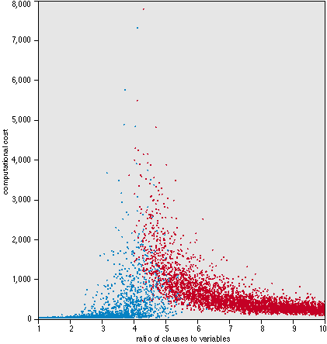
Random 3-SAT
Random 3-SAT
sample uniformly from space of all possible 3-clauses
n variables, l clauses
Which are the hard instances?
around l/n = 4.3

Slide 82
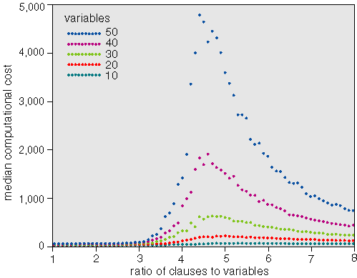
Random 3-SAT
Varying problem size, n
Complexity peak appears to be largely invariant of algorithm
backtracking algorithms like Davis-Putnam
local search procedures like GSAT
What’s so special about 4.3?

Slide 83
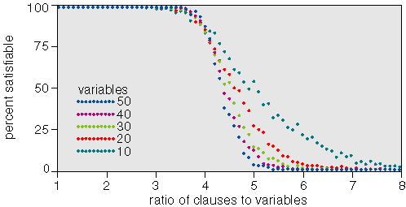
Random 3-SAT
Complexity peak coincides with solubility transition
l/n < 4.3 problems under-constrained and SAT
l/n > 4.3 problems over-constrained and UNSAT
l/n=4.3, problems on “knife-edge” between SAT and UNSAT

Slide 84
Prop. Logic Themes
Expressiveness
Expressive but awkward
No notion of objects, properties, or relations
Number of propositions is fixed
Tractability
NP in general
Completeness / speed tradeoff
Horn clauses, binary clauses

