Slide 1
CSE 473: Artificial Intelligence
Constraint Satisfaction
Daniel Weld
Slides adapted from Dan Klein, Stuart Russell, Andrew Moore & Luke Zettlemoyer

Slide 2
Recap: Search Problem
States
configurations of the world
Successor function:
function from states to lists of triples
(state, action, cost)
Start state
Goal test

Slide 3
General Tree Search Paradigm
function tree-search(root-node)
fringe ← successors(root-node)
while ( notempty(fringe) )
{node ← remove-first(fringe)
state ← state(node)
if goal-test(state) return solution(node)
fringe ← insert-all(successors(node),fringe) }
return failure
end tree-search
Fringe managed as
Stack
Queue
Priority Queue
Depth first
Breadth first
Best first, uniform cost, greedy, A*

Slide 4
Space of Search Strategies
Systematic / Stochastic
(“Local”)
√
√
√
Fri
Fri
Blind Search
DFS, BFS, IDS
Informed Search
Uniform cost, greedy, A*, IDA*
Constraint Satisfaction
Backtracking=DFS, FC, k-consistency
Adversary Search

Slide 5
Constraint Satisfaction
Kind of search in which
States are factored into sets of variables
Search = assigning values to these variables
Goal test is encoded with constraints
→ Gives structure to search space
→ Exploration of one part informs others
Backtracking-style algorithms work
But other techniques add speed
Propagation
Variable ordering
Preprocessing

Slide 6
Example: N-Queens
Formulation as search
States
Operators
Start State
Goal Test

Slide 7
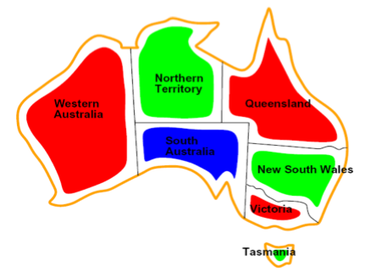
Constraint Satisfaction Problems
Standard search problems:
State is a “black box”: arbitrary data structure
Goal test: any function over states
Successor function can be anything
Constraint satisfaction problems (CSPs):
A special subset of search problems
State is defined by variables X_{i} with values from a domain D (often D depends on i)
Goal test is a set of constraints specifying allowable combinations of values for subsets of variables
Simple example of a formal representation language
Allows more powerful search algorithms

Slide 8
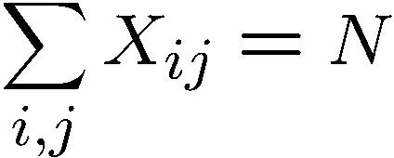
Example: N-Queens
CSP Formulation 1:
Variables:
Domains:
Constraints
X_{ij} + X_{ik} ≤ 1
X_{ij} + X_{kj} ≤ 1
X_{ij} + X_{i+k,j+k} ≤ 1
X_{ij} + X_{i+k,j-k} ≤ 1

Slide 9
Example: N-Queens
CSP Formulation 1:
Variables:
Domains:
Constraints

Slide 10
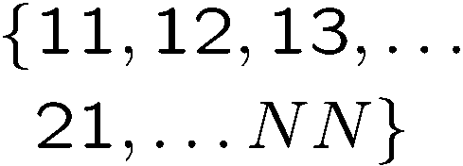
Example: N-Queens
Formulation 1.5:
Variables:
Domains:
Constraints:
… there’s an even better way! What is it?

Slide 11
Example: N-Queens
Formulation 2:
Variables:
Domains:
Constraints:
Implicit:
-or-
Explicit:

Slide 12
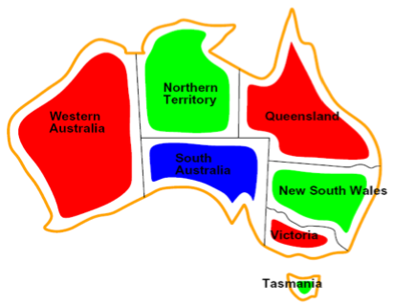
Example: Map-Coloring
Variables:
Domain:
Constraints: adjacent regions must have different colors
Solutions are assignments satisfying all constraints, e.g.:

Slide 13
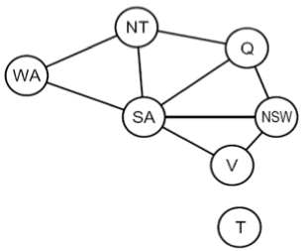
Constraint Graphs
Binary CSP: each constraint relates (at most) two variables
Binary constraint graph: nodes are variables, arcs show constraints
General-purpose CSP algorithms use the graph structure to speed up search. E.g., Tasmania is an independent subproblem!

Slide 14
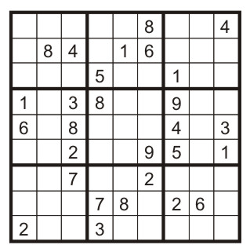
Example: Sudoku
Variables:
Domains:
Constraints:
Each (open) square
{1,2,…,9}
9-way alldiff for each column
9-way alldiff for each row
9-way alldiff for each region

Slide 15
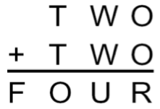
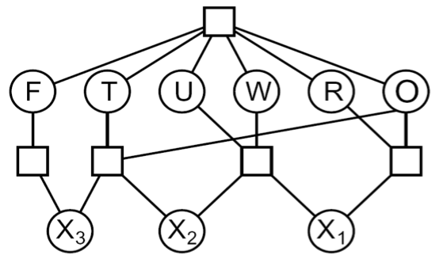
Example: Cryptarithmetic
Variables (circles):
Domains:
Constraints (boxes):
Notes:
0=7, R=4, W=6, U=2, T=8, F=1; 867 + 867 = 1734

Slide 16
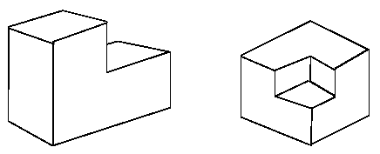
Example: The Waltz Algorithm
The Waltz algorithm is for interpreting line drawings of solid polyhedra
An early example of a computation posed as a CSP
Look at all intersections
Adjacent intersections impose constraints on each other
?

Slide 17
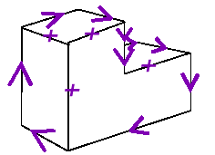
Waltz on Simple Scenes
Assume all objects:
Have no shadows or cracks
Three-faced vertices
“General position”: no junctions change with small movements of the eye.
Then each line on image is one of the following:
Boundary line (edge of an object) (→) with right hand of arrow denoting “solid” and left hand denoting “space”
Interior convex edge (+)
Interior concave edge (-)

Slide 18
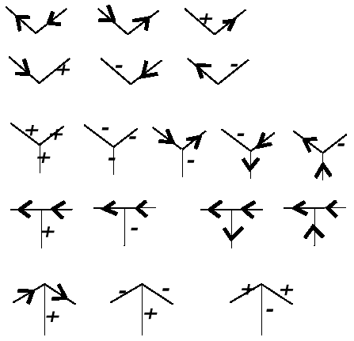
Legal Junctions
Only certain junctions are physically possible
How can we formulate a CSP to label an image?
Variables: vertices
Domains: junction labels
Constraints: both ends of a line should have the same label
x
(x,y) in
,
, …
y

Slide 19
Varieties of CSPs
Discrete Variables
Finite domains
Size d means O(d^{n}) complete assignments
E.g., Boolean CSPs, including Boolean satisfiability (NP-complete)
Infinite domains (integers, strings, etc.)
E.g., job scheduling, variables are start/end times for each job
Linear constraints solvable, nonlinear undecidable
Continuous variables
E.g., start/end times for Hubble Telescope observations
Linear constraints solvable in polynomial time by LP methods

Slide 20
Varieties of Constraints
Varieties of Constraints
Unary constraints involve a single variable (equiv. to shrinking domains):
Binary constraints involve pairs of variables:
Higher-order constraints involve 3 or more variables:
e.g., cryptarithmetic column constraints
Preferences (soft constraints):
E.g., red is better than green
Often representable by a cost for each variable assignment
Gives constrained optimization problems
(We’ll ignore these until we get to Bayes’ nets)

Slide 21
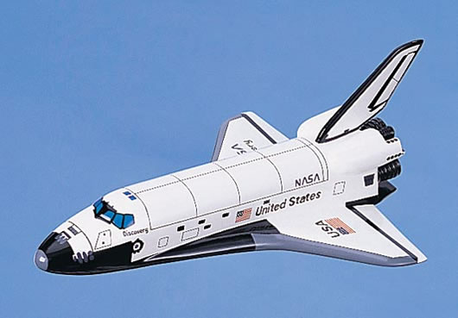
Real-World CSPs
Assignment problems: e.g., who teaches what class
Timetabling problems: e.g., which class is offered when and where?
Hardware configuration
Gate assignment in airports
Transportation scheduling
Factory scheduling
Fault diagnosis
… lots more!
Many real-world problems involve real-valued variables…

Slide 22
Standard Search Formulation
Standard search formulation of CSPs (incremental)
Start with straightforward approach, then improve
States are defined by the values assigned so far
Initial state: the empty assignment, {}
Successor function: assign a value to an unassigned variable
Goal test: the current assignment is complete and satisfies all constraints

Slide 23
Search Methods
What does BFS do?
What does DFS do?

Slide 24
DFS, and BFS would be much worse!

Slide 25
Backtracking Search
Idea 1: Only consider a single variable at each point
Variable assignments are commutative, so fix ordering
I.e., [WA = red then NT = green] same as [NT = green then WA = red]
Only need to consider assignments to a single variable at each step
How many leaves are there?
Idea 2: Only allow legal assignments at each point
I.e. consider only values which do not conflict previous assignments
Might have to do some computation to figure out whether a value is ok
“Incremental goal test”
Depth-first search for CSPs with these two improvements is called backtracking search (useless name, really)
Backtracking search is the basic uninformed algorithm for CSPs
Can solve n-queens for n ≈ 25

Slide 26
Backtracking Search
What are the choice points?

Slide 27
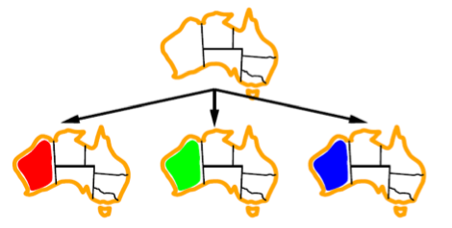
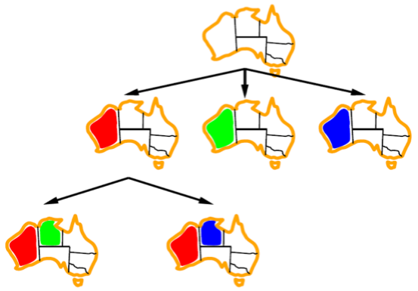
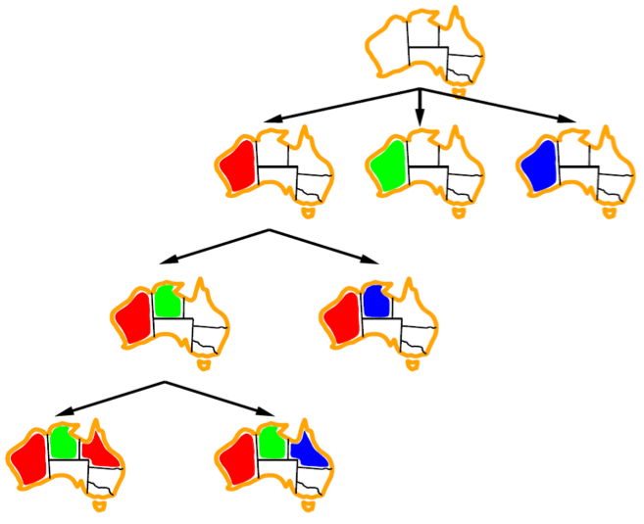
Backtracking Example

Slide 28
Backtracking

Slide 29
Are we done?

Slide 30
Improving Backtracking
General-purpose ideas give huge gains in speed
Ordering:
Which variable should be assigned next?
In what order should its values be tried?
Filtering: Can we detect inevitable failure early?
Structure: Can we exploit the problem structure?

Slide 31
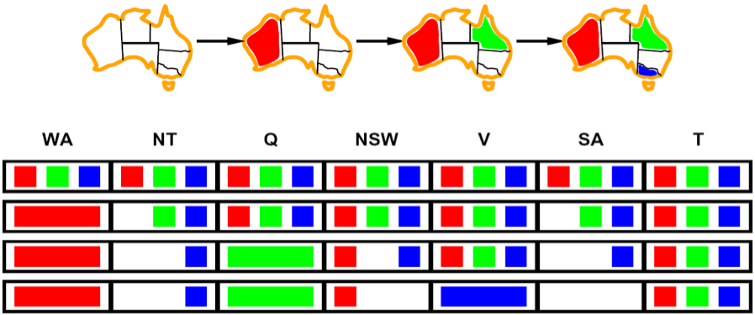
Forward Checking
NT
Q
WA
SA
NSW
V
Idea: Keep track of remaining legal values for unassigned variables (using immediate constraints)
Idea: Terminate when any variable has no legal values

Slide 32
Forward Checking

Slide 33
Are We Done?

Slide 34
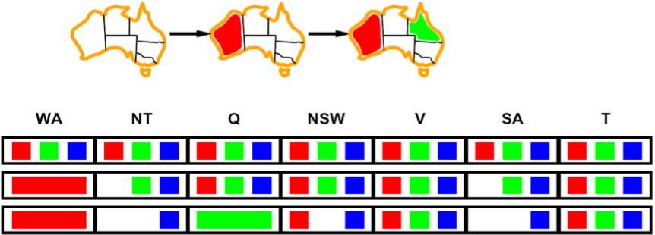
Constraint Propagation
NT
Q
WA
SA
NSW
V
Forward checking propagates information from assigned to adjacent unassigned variables, but doesn't detect more distant failures:
NT and SA cannot both be blue!
Why didn’t we detect this yet?
Constraint propagation repeatedly enforces constraints (locally)

Slide 35
Arc Consistency
NT
Q
WA
SA
NSW
V
Simplest form of propagation makes each arc consistent
X → Y is consistent iff for every value x there is some allowed y
If X loses a value, neighbors of X need to be rechecked!
Arc consistency detects failure earlier than forward checking
What’s the downside of arc consistency?
Can be run as a preprocessor or after each assignment

Slide 36
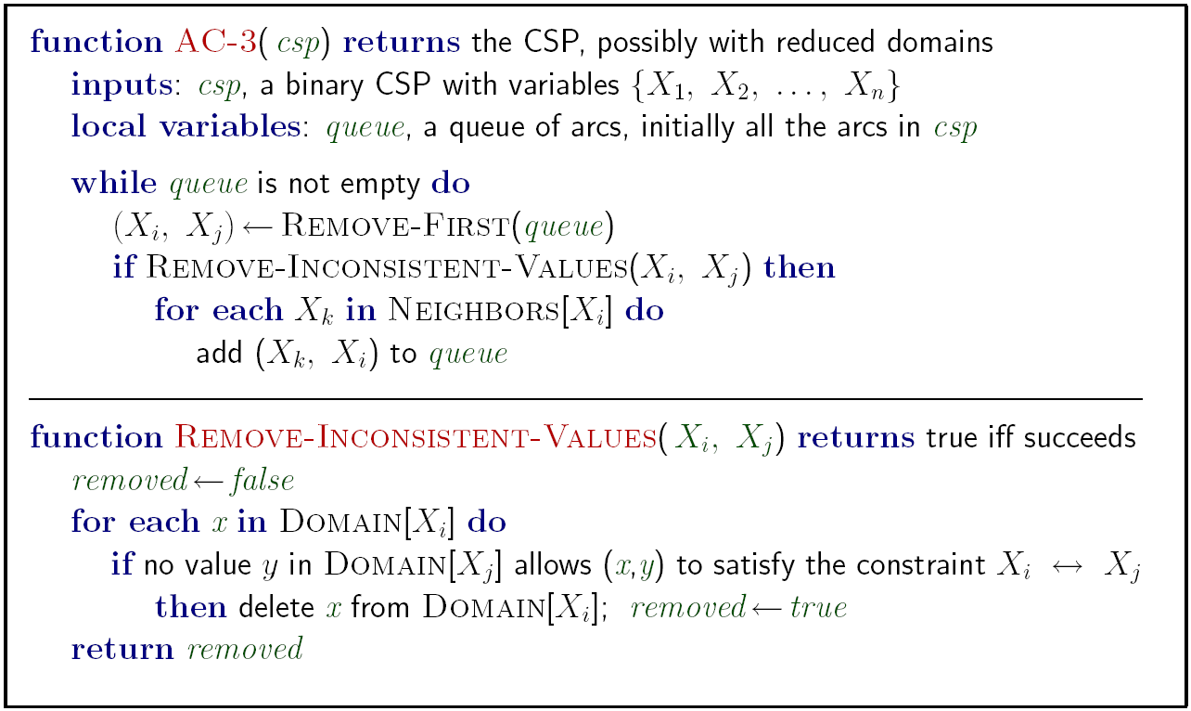
Arc Consistency
Runtime: O(n²d³), can be reduced to O(n²d²)
… but detecting all possible future problems is NP-hard – why?
[demo: arc consistency animation]

Slide 37
Constraint Propagation

Slide 38
Are We Done?

Slide 39
Limitations of Arc Consistency
After running arc consistency:
Can have one solution left
Can have multiple solutions left
Can have no solutions left (and not know it)
What went wrong here?

Slide 40
K-Consistency*
Increasing degrees of consistency
1-Consistency (Node Consistency): Each single node’s domain has a value which meets that node’s unary constraints
2-Consistency (Arc Consistency): For each pair of nodes, any consistent assignment to one can be extended to the other
K-Consistency: For each k nodes, any consistent assignment to k-1 can be extended to the k^{th} node.
Higher k more expensive to compute
(You need to know the k=2 algorithm)

Slide 41
Strong K-Consistency
Strong k-consistency: also k-1, k-2, … 1 consistent
Claim: strong n-consistency means we can solve without backtracking!
Why?
Choose any assignment to any variable
Choose a new variable
By 2-consistency, there is a choice consistent with the first
Choose a new variable
By 3-consistency, there is a choice consistent with the first 2
…
Lots of middle ground between arc consistency and n-consistency! (e.g. path consistency)

Slide 42
Ordering: Minimum Remaining Values
Minimum remaining values (MRV):
Choose the variable with the fewest legal values
Why min rather than max?
Also called “most constrained variable”
“Fail-fast” ordering

Slide 43
Ordering: Degree Heuristic
Tie-breaker among MRV variables
Degree heuristic:
Choose the variable participating in the most constraints on remaining variables
Why most rather than fewest constraints?

Slide 44
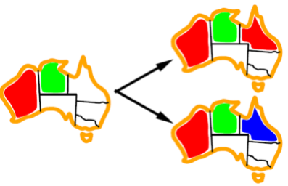
Ordering: Least Constraining Value
Given a choice of variable:
Choose the least constraining value
The one that rules out the fewest values in the remaining variables
Note that it may take some computation to determine this!
Why least rather than most?
Combining these heuristics makes 1000 queens feasible

Slide 45
Propagation with Ordering

Slide 46
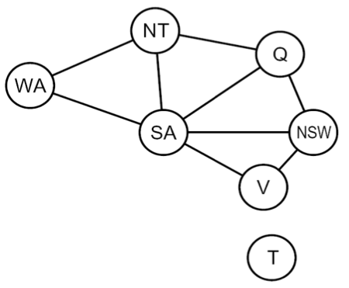
Problem Structure
Tasmania and mainland are independent subproblems
Identifiable as connected components of constraint graph
Suppose each subproblem has c variables out of n total
Worst-case solution cost is O((n/c)(d^{c})), linear in n
E.g., n = 80, d = 2, c =20
2⁸⁰ = 4 billion years at 10 million nodes/sec
(4)(2²⁰) = 0.4 seconds at 10 million nodes/sec

Slide 47
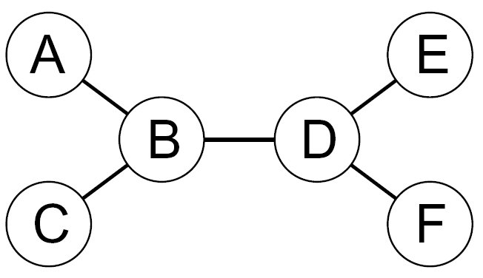
Tree-Structured CSPs
Choose a variable as root, order
variables from root to leaves such
that every node's parent precedes
it in the ordering
For i = n : 2, apply RemoveInconsistent(Parent(X_{i}),X_{i})
For i = 1 : n, assign X_{i} consistently with Parent(X_{i})
Runtime: O(n d²)

Slide 48
Tree-Structured CSPs
Theorem: if the constraint graph has no loops, the CSP can be solved in O(n d²) time!
Compare to general CSPs, where worst-case time is O(d^{n})
This property also applies to logical and probabilistic reasoning: an important example of the relation between syntactic restrictions and the complexity of reasoning.

Slide 49
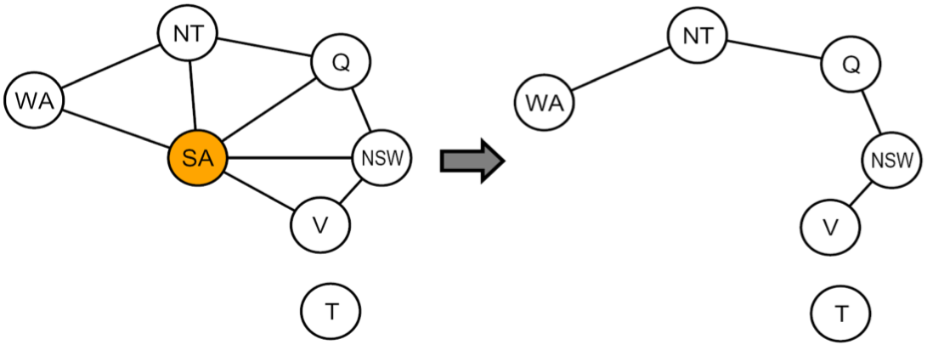
Nearly Tree-Structured CSPs
Conditioning: instantiate a variable, prune its neighbors' domains
Cutset conditioning: instantiate (in all ways) a set of variables such that the remaining constraint graph is a tree
Cutset size c gives runtime O( (d^{c}) (n-c) d² ), very fast for small c

Slide 50
Iterative Algorithms for CSPs
Greedy and local methods typically work with “complete” states, i.e., all variables assigned
To apply to CSPs:
Allow states with unsatisfied constraints
Operators reassign variable values
Variable selection: randomly select any conflicted variable
Value selection by min-conflicts heuristic:
Choose value that violates the fewest constraints
I.e., hill climb with h(n) = total number of violated constraints

Slide 51
Example: 4-Queens
States: 4 queens in 4 columns (4⁴ = 256 states)
Operators: move queen in column
Goal test: no attacks
Evaluation: h(n) = number of attacks

Slide 52
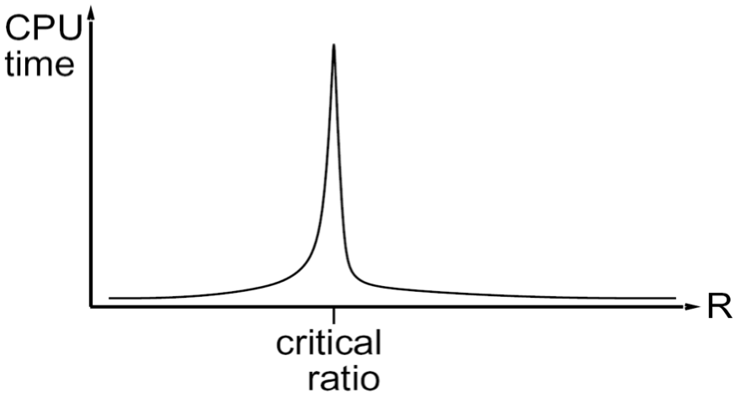
Performance of Min-Conflicts
Given random initial state, can solve n-queens in almost constant time for arbitrary n with high probability (e.g., n = 10,000,000)
The same appears to be true for any randomly-generated CSP except in a narrow range of the ratio
Notes:
3-Sat 4.2

Slide 53
Summary
CSPs are a special kind of search problem:
States defined by values of a fixed set of variables
Goal test defined by constraints on variable values
Backtracking = depth-first search with one legal variable assigned per node
Variable ordering and value selection heuristics help significantly
Forward checking prevents assignments that guarantee later failure
Constraint propagation (e.g., arc consistency) does additional work to constrain values and detect inconsistencies
The constraint graph representation allows analysis of problem structure
Tree-structured CSPs can be solved in linear time
Iterative min-conflicts is usually effective in practice

Slide 54
Chinese Food as Search?
States?
Operators?
Start state?
Goal states?
Partially specified meals
Add, remove, change dishes
Null meal
Meal meeting certain conditions (rating?)

Slide 55
Factoring States
Rather than state = meal
Model state’s (independent) parts, e.g.
Suppose every meal for n people
Has n dishes plus soup
Soup =
Meal 1 =
Meal 2 =
…
Meal n =
Or… physical state =
X coordinate =
Y coordinate =

Slide 56
Chinese Constraint Network
Must be
Hot&Sour
Soup
No
Peanuts
Chicken
Dish
Appetizer
Total Cost
< $30
Pork Dish
No
Peanuts
Vegetable
Not Both
Spicy
Seafood
Rice
Not
Chow Mein

Slide 57
CSPs in the Real World
Scheduling space shuttle repair
Airport gate assignments
Transportation Planning
Supply-chain management
Computer configuration
Diagnosis
UI optimization
Etc...

Slide 58
Classroom Scheduling
Variables?
Domains (possible values for variables)?
Constraints?

Slide 59
CSP as a search problem?
What are states?
(nodes in graph)
What are the operators?
(arcs between nodes)
Initial state?
Goal test?
Q
Q
Q

Slide 60
Crosswords

