Slide 1
CSE 473: Artificial Intelligence Spring 2012
Heuristics & Pattern Databases for Search
Dan Weld
With many slides from
Dan Klein, Richard Korf, Stuart Russell, Andrew Moore, & UW Faculty
Notes:
Change the three pac man slides so students can see each one in turn and then decide which is which

Slide 2
Recap: Search Problem
States
configurations of the world
Successor function:
function from states to lists of (state, action, cost) triples
Start state
Goal test

Slide 3
General Tree Search Paradigm
function tree-search(root-node)
fringe ← successors(root-node)
while ( notempty(fringe) )
{node ← remove-first(fringe)
state ← state(node)
if goal-test(state) return solution(node)
fringe ← insert-all(successors(node),fringe) }
return failure
end tree-search

Slide 4
Extra Work?
Failure to detect repeated states can cause exponentially more work (why?)

Slide 5
General Graph Search Paradigm
function tree-search(root-node)
fringe ← successors(root-node)
explored ← empty
while ( notempty(fringe) )
{node ← remove-first(fringe)
state ← state(node)
if goal-test(state) return solution(node)
explored ← insert(node,explored)
fringe ← insert-all(successors(node),fringe, if node not in explored)
}
return failure
end tree-search

Slide 6
Some Hints
Graph search is almost always better than tree search (when not?)
Implement your closed list as a dict or set!
Nodes are conceptually paths, but better to represent with a state, cost, last action, and reference to the parent node

Slide 7
Informed (Heuristic) Search
Idea: be smart
about what paths
to try.

Slide 8
Blind Search vs. Informed Search
What’s the difference?
How do we formally specify this?
A node is selected for expansion based on an evaluation function that estimates cost to goal.

Slide 9
Best-First Search
Use an evaluation function f(n) for node n.
Always choose the node from fringe that has the lowest f value.
Fringe = priority queue
3
5
1
4
6

Slide 10
Uniform Cost Search
f(n) = cost from root
The good: UCS is complete and optimal!
The bad:
Explores options in every “direction”
No information about goal location
…
c ≤ 1
c ≤ 2
c ≤ 3
Start
Goal

Slide 11
Greedy Search
f(n) = estimate of cost from n to goal
A common case:
Takes you straight to the (wrong) goal
Worst-case: like a badly-guided DFS
b
…
b
…
Notes:
For any search problem, you know the goal. Now, you have an idea of how far away you are from the goal.

Slide 12
A* search
f(n) = estimated total cost of path thru n to goal
f(n) = g(n) + h(n)
g(n) = cost so far to reach n
h(n) = estimated cost from n to goal
(satisfying some important conditions)

Slide 13
Admissible heuristics
A heuristic h(n) is admissible if for every node n,
h(n) ≤ h*(n), where h*(n) is the true cost to reach the goal state from n.
An admissible heuristic never overestimates the cost to reach the goal, i.e., it is optimistic
Example: h_{SLD}(n) (never overestimates the actual road distance)
Theorem: If h(n) is admissible, A* using TREE-SEARCH is optimal

Slide 14
Consistent Heuristics
h(n) is consistent if
for every node n
for every successor n´ due to legal action a
h(n) <= c(n,a,n´) + h(n´)
Every consistent heuristic is also admissible.
Theorem: If h(n) is consistent, A* using GRAPH-SEARCH is optimal
n
h(n)
c(n,a,n´)
h(n´)
n´
G

Slide 15
When should A* terminate?
Should we stop when we enqueue a goal?
2
A
2
h = 2
S
h = 3
G
h = 0
B
3
2
h = 1
No: only stop when we dequeue a goal

Slide 16
Optimality of A*: Blocking
Notation:
g(n) = cost to node n
h(n) = estimated cost from n to the nearest goal (heuristic)
f(n) = g(n) + h(n) = estimated total cost via n
G*: a lowest cost goal node
G: another goal node
…

Slide 17
Optimality of A*: Blocking
Proof:
What could go wrong?
We’d have to have to pop a suboptimal goal G off the fringe before G*
…
This can’t happen:
For all nodes n on the best path to G*
f(n) < f(G)
So, G* will be popped before G

Slide 18
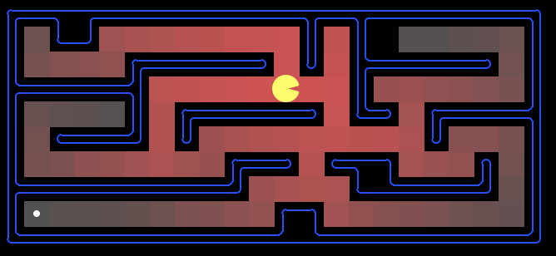
Which Algorithm?
18

Slide 19
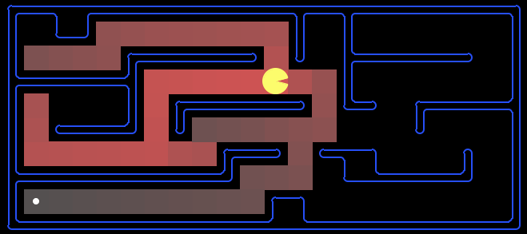
Which Algorithm?

Slide 20
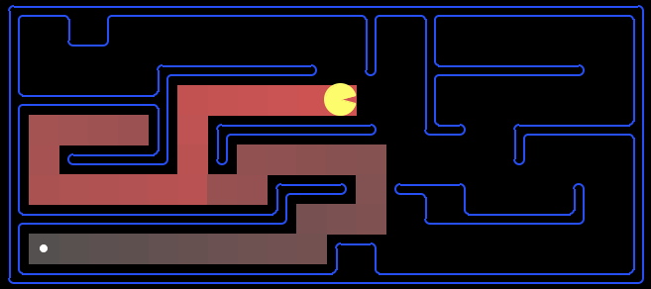
Which Algorithm?

Slide 21
Which Algorithm?
Uniform cost search (UCS):
21

Slide 22
Which Algorithm?
A*, Manhattan Heuristic:

Slide 23
Which Algorithm?
Best First / Greedy, Manhattan Heuristic:

Slide 24
Properties of A*
Uniform-Cost
A*
b
b
…
…

Slide 25
UCS vs A* Contours
Uniform-cost expanded in all directions
A* expands mainly toward the goal, but does hedge its bets to ensure optimality
Start
Goal
Start
Goal
Notes:
python pacman.py -p SearchAgent -l contoursMaze --frameTime -1 -a heuristic=manhattanHeuristic,fn=astar

Slide 26
Iterative-Deepening A*
Like iterative-deepening depth-first, but...
Depth bound modified to be an f-limit
Start with f-limit = h(start)
Prune any node if f(node) > f-limit
Next f-limit = min-cost of any node pruned
e
FL=21
FL=15
a
d
f
b
c

Slide 27
IDA* Analysis
Complete & Optimal (ala A*)
Space usage ∝ depth of solution
Each iteration is DFS - no priority queue!
# nodes expanded relative to A*
Depends on # unique values of heuristic function
In 8 puzzle: few values ⇒ close to # A* expands
In traveling salesman: each f value is unique
⇒ 1+2+…+n = O(n²) where n=nodes A* expands
if n is too big for main memory, n² is too long to wait!
Generates duplicate nodes in cyclic graphs

Slide 28
Forgetfulness
A* used exponential memory
How much does IDA* use?
During a run?
In between runs?

Slide 29
SMA*
Use all available memory
Start like A*
When memory is full…
Erase node with highest f-value
First, backup parent with this f-value
So… parent knows cost-bound on best child

Slide 30
Alternative Approach to Finite Memory…
Optimality is nice to have, but…

Slide 31
Depth-First Branch & Bound
Single DF search
→ uses linear space
Keep track of best solution so far
If f(n) = g(n)+h(n) ≥ cost(best-soln)
Then prune n
Requires
Finite search tree, or
Good upper bound on solution cost
Generates duplicate nodes in cyclic graphs
Tradeoff:
Prune space, but…
Must apply test to each node
Adapted from Richard Korf presentation

Slide 32
Beam Search
Idea
Best first but only keep N best items on priority queue
Evaluation
Complete?
Time Complexity?
Space Complexity?
No
O(b^d)
O(b + N)

Slide 33
Hill Climbing
“Gradient ascent”
Idea
Always choose best child; no backtracking
Beam search with |queue| = 1
Problems?
Local maxima
Plateaus
Diagonal ridges

Slide 34
Randomizing Hill Climbing
Randomly disobeying heuristic
Random restarts
( heavy tailed distributions )
→ Local Search

Slide 35
Simulated Annealing
Objective: avoid local minima
Technique:
For the most part use hill climbing
When no improvement possible
Choose random neighbor
Let Δ be the decrease in quality
Move to neighbor with probability e ^{-Δ-/T}
Reduce “temperature” (T) over time
Pros & cons
Optimal?
If T decreased slowly enough, will reach optimal state
Widely used
See also WalkSAT
temp

Slide 36
Heuristics
It’s what makes search actually work

Slide 37
Admissable Heuristics
f(x) = g(x) + h(x)
g: cost so far
h: underestimate of remaining costs
Where do heuristics come from?

Slide 38
Relaxed Problems
Derive admissible heuristic from exact cost of a solution to a relaxed version of problem
For transportation planning, relax requirement that car has to stay on road → Euclidean dist
For blocks world, distance = # move operations heuristic = number of misplaced blocks
What is relaxed problem?
# out of place = 2, true distance to goal = 3
Cost of optimal soln to relaxed problem ≤ cost of optimal soln for real problem

Slide 39
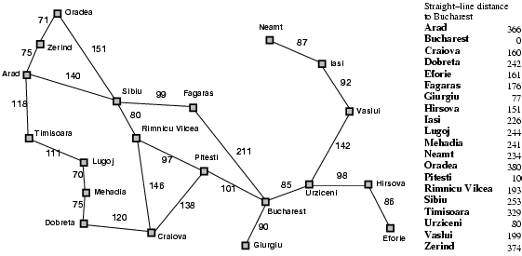
What’s being relaxed?

Slide 40
Example: Pancake Problem
Action: Flip over the
top n pancakes
Cost: Number of pancakes flipped
Notes:
Gates, W. and Papadimitriou, C., "Bounds for Sorting by Prefix Reversal.", Discrete Mathematics. 27, 47-57, 1979.

Slide 41
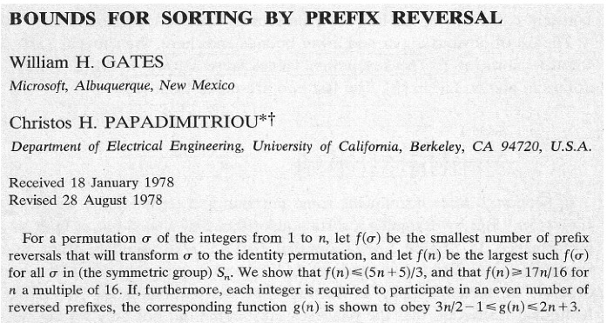
Example: Pancake Problem
Notes:
Gates, W. and Papadimitriou, C., "Bounds for Sorting by Prefix Reversal.", Discrete Mathematics. 27, 47-57, 1979.

Slide 42
Example: Pancake Problem
State space graph with costs as weights
4
2
3
2
3
4
3
4
2
3
2
2
4
3
3
Notes:
A* expanded 8100 ; Path cost = 33
UCS expanded 25263 . Path cost = 33
Greedy expanded 10 . Path cost = 41
[0, 7, 5, 3, 2, 1, 4, 6]
(7, 0, 5, 3, 2, 1, 4, 6)
(6, 4, 1, 2, 3, 5, 0, 7)
(3, 2, 1, 4, 6, 5, 0, 7)
(1, 2, 3, 4, 6, 5, 0, 7)
(5, 6, 4, 3, 2, 1, 0, 7)
(6, 5, 4, 3, 2, 1, 0, 7)
(0, 1, 2, 3, 4, 5, 6, 7)

Slide 43
Example: Heuristic Function
Heuristic: the largest pancake that is still out of place
3
h(x)
4
3
4
3
0
4
4
3
4
4
2
3
Notes:
A* expanded 8100 ; Path cost = 33
UCS expanded 25263 . Path cost = 33
Greedy expanded 10 . Path cost = 41
[0, 7, 5, 3, 2, 1, 4, 6]
(7, 0, 5, 3, 2, 1, 4, 6)
(6, 4, 1, 2, 3, 5, 0, 7)
(3, 2, 1, 4, 6, 5, 0, 7)
(1, 2, 3, 4, 6, 5, 0, 7)
(5, 6, 4, 3, 2, 1, 0, 7)
(6, 5, 4, 3, 2, 1, 0, 7)
(0, 1, 2, 3, 4, 5, 6, 7)

Slide 44
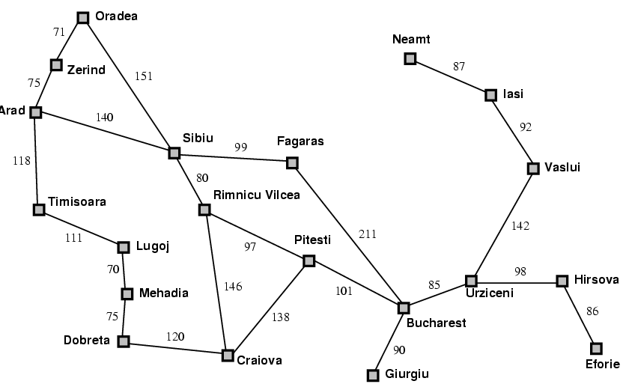
Traveling Salesman Problem
What can be
Relaxed?

Slide 45
Heuristics for eight puzzle
7 2 3
1 2 3
5 1 6
4 5 6
→
8 3
7 8
start
goal
What can we relax?

Slide 46
Importance of Heuristics
7 2 3
4 1 6
h1 = number of tiles in wrong place
8 5
D IDS A*(h1) A*(h2)
2 10 6 6
4 112 13 12
6 680 20 18
8 6384 39 25
10 47127 93 39
12 364404 227 73
14 3473941 539 113
18 3056 363
24 39135 1641

Slide 47
Importance of Heuristics
7 2 3
4 1 6
h1 = number of tiles in wrong place
h2 = Σ distances of tiles from correct loc
8 5
D IDS A*(h1) A*(h2)
2 10 6 6
4 112 13 12
6 680 20 18
8 6384 39 25
10 47127 93 39
12 364404 227 73
14 3473941 539 113
18 3056 363
24 39135 1641
Decrease effective branching factor

Slide 48
Combining Admissible Heuristics
Can always take max
Adding does not preserve admissibility in general

Slide 49
Performance of IDA* on 15 Puzzle
Random 15 puzzle instances were first solved optimally using IDA* with Manhattan distance heuristic (Korf, 1985).
Optimal solution lengths average 53 moves.
400 million nodes generated on average.
Average solution time is about 50 seconds on current machines.

Slide 50
Limitation of Manhattan Distance
To solve a 24-Puzzle instance, IDA* with Manhattan distance would take about 65,000 years on average.
Assumes that each tile moves independently
In fact, tiles interfere with each other.
Accounting for these interactions is the key to more accurate heuristic functions.

Slide 51
Example: Linear Conflict
3
1
1
3
Manhattan distance is 2+2=4 moves

Slide 52
Example: Linear Conflict
3
1
1
3
Manhattan distance is 2+2=4 moves

Slide 53
Example: Linear Conflict
3
1
3
1
Manhattan distance is 2+2=4 moves

Slide 54
Example: Linear Conflict
3
1
3
1
Manhattan distance is 2+2=4 moves

Slide 55
Example: Linear Conflict
3
1
3
1
Manhattan distance is 2+2=4 moves

Slide 56
Example: Linear Conflict
1
3
1
3
Manhattan distance is 2+2=4 moves

Slide 57
Example: Linear Conflict
1
3
1
3
Manhattan distance is 2+2=4 moves, but linear conflict adds 2 additional moves.

Slide 58
Linear Conflict Heuristic
Hansson, Mayer, and Yung, 1991
Given two tiles in their goal row, but reversed in position, additional vertical moves can be added to Manhattan distance.
Still not accurate enough to solve 24-Puzzle
We can generalize this idea further.

Slide 59
Pattern Database Heuristics
Culberson and Schaeffer, 1996
A pattern database is a complete set of such positions, with associated number of moves.
e.g. a 7-tile pattern database for the Fifteen Puzzle contains 519 million entries.

Slide 60
Heuristics from Pattern Databases
5
10
14
7
1
2
3
8
3
6
1
4
5
6
7
15
12
9
8
9
10
11
2
11
4
13
12
13
14
15
31 moves is a lower bound on the total number of moves needed to solve this particular state.

Slide 61
Precomputing Pattern Databases
Entire database is computed with one backward breadth-first search from goal.
All non-pattern tiles are indistinguishable, but all tile moves are counted.
The first time each state is encountered, the total number of moves made so far is stored.
Once computed, the same table is used for all problems with the same goal state.

Slide 62
Combining Multiple Databases
5
10
14
7
1
2
3
8
3
6
1
4
5
6
7
15
12
9
8
9
10
11
2
11
4
13
12
13
14
15
31 moves needed to solve red tiles
22 moves need to solve blue tiles
Overall heuristic is maximum of 31 moves

Slide 63
Additive Pattern Databases
Culberson and Schaeffer counted all moves needed to correctly position the pattern tiles.
In contrast, we count only moves of the pattern tiles, ignoring non-pattern moves.
If no tile belongs to more than one pattern, then we can add their heuristic values.
Manhattan distance is a special case of this, where each pattern contains a single tile.

Slide 64
Example Additive Databases
1
2
3
4
5
6
7
8
9
10
11
12
13
15
14
The 7-tile database contains 58 million entries. The 8-tile database contains 519 million entries.

Slide 65
Computing the Heuristic
5
10
14
7
1
2
3
8
3
6
1
4
5
6
7
15
12
9
8
9
10
11
2
11
4
13
12
13
14
15
20 moves needed to solve red tiles
25 moves needed to solve blue tiles
Overall heuristic is sum, or 20+25=45 moves

Slide 66
Drawbacks of Standard Pattern DBs
Since we can only take max
Diminishing returns on additional DBs
Would like to be able to add values
Adapted from Richard Korf presentation

Slide 67
Disjoint Pattern DBs
1 2 3 4
5 6 7 8
Partition tiles into disjoint sets
For each set, precompute table
E.g. 8 tile DB has 519 million entries
And 7 tile DB has 58 million
During search
Look up heuristic values for each set
Can add values without overestimating!
Manhattan distance is a special case of this idea where each set is a single tile
9 10 11 12
13 14 15
Adapted from Richard Korf presentation

Slide 68
Performance
15 Puzzle: 2000x speedup vs Manhattan dist
IDA* with the two DBs shown previously solves 15 Puzzles optimally in 30 milliseconds
24 Puzzle: 12 million x speedup vs Manhattan
IDA* can solve random instances in 2 days.
Requires 4 DBs as shown
Each DB has 128 million entries
Without PDBs: 65,000 years
Adapted from Richard Korf presentation

