Slide 1
Serial protocols
RS-232 (IEEE standard)
  serial protocol for point-to-point, low-cost, low-speed applications for PCs
I2C (Philips) TWI (Atmel)
  up to 400Kbits/sec, serial bus for connecting multiple components
Ethernet (popularized by Xerox)
  most popular local area network protocol with distributed arbitration
IrDA (Infrared Data Association)
  up to 115kbps wireless serial (Fast IrDA up to 4Mbs)
Firewire (Apple – now IEEE1394)
  12.5-50Mbytes/sec, consumer electronics (video cameras, TVs, audio, etc.)
SPI (Motorola)
  10Mbits/sec, commonly used for microcontroller to peripheral connections
USB (Intel – followed by USB-2)
  12-480Mbits/sec, isochronous transfer, desktop devices
Bluetooth (Ericsson – cable replacement)
  700Kbits/sec, multiple portable devices, special support for audio

Slide 2
RS-232 (standard serial line)
Point-to-point, full-duplex
Synchronous or asynchronous
Flow control
Variable baud (bit) rates
Cheap connections (low-quality and few wires)
Variations: parity bit; 1.5 or 2 stop bits (not common)
At 9600 baud, each bit (start, data, stop) lasts 1/9600s
start bit
(always low)
8 data
bits
parity
bit
stop bit
(always high)

Slide 3
RS-232 HW
all wires active low
Spec:
"0" = -3v to -15v
"1" = +3v to +15v
Reality: even more variability
PC serial port: +5 and –9
special driver chips (eg Max 232)
generate high /-ve voltages from 5v or 3v
Often you see “TTL level serial,” between chips or boards,
+5v and 0v or
+3.3v and 0v
Often implemented as “virtual COMM” port over USB, e.g. FTDI chip
Connector: DB-9 (old school)
Wires (Spec):
TxD – transmit data
TxC – transmit clock
RTS – request to send
CTS – clear to send
RxD – receive data
RxC – receive clock
DSR – data set ready
DTR – data terminal ready
Ground
Wires (Typical)
TxD, RxD, GND

Slide 4
Transfer modes
Synchronous
  clock signal wire is used by both receiver and sender to sample data
Asynchronous
  no clock signal in common
  data must be oversampled (16x is typical) to find bit boundaries
Flow control
  handshaking signals to control rate of transfer

Slide 6
Electric Field Sensing
Use software to make sensitive measurements
Case study: electric field sensing
You will build an electric field sensor in lab
  Non-contact hand measurement (like magic!)
  Software (de)-modulation for very sensitive measurements
  Same basic measurement technique used in accelerometers, etc
  Good intro to principles of radio
  We will get signal-to-noise gain by software operations
We will need
  some basic electronics
  some math facts
  some signal processing

Slide 7
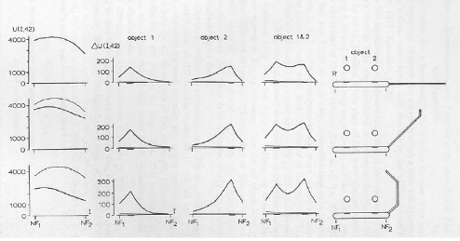
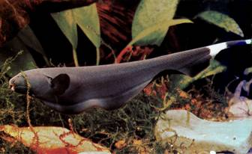
Electrosensory Fish
Weakly electric fish generate and sense electric fields
Measure conductivity “images”
Frequency range .1Hz – 10KHz
Tail curling for active scan
Black ghost knife fish
(Apteronotus albifrons)
Continuous wave, 1KHz
W. Heiligenberg. Studies of Brain Function, Vol. 1:
Principles of Electrolocation and Jamming Avoidance
Springer-Verlag, New York, 1977.

Slide 8
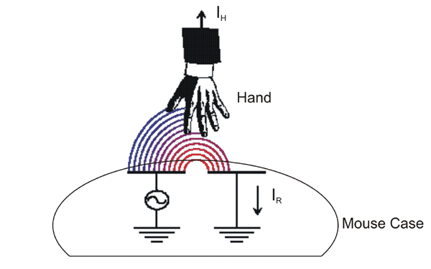
Electric Field Sensing for input devices

Slide 9
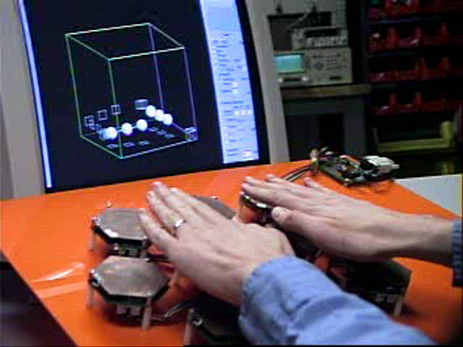
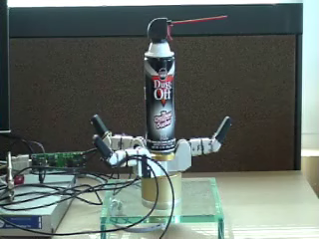
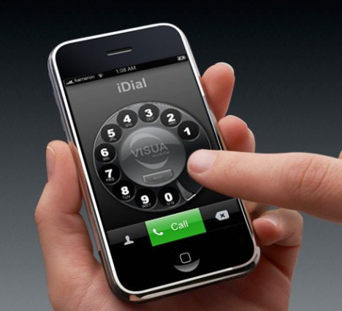
Cool stuff you can do with E-Field sensing

Slide 10
Basic electronics
Voltage sources, current sources, and Ohm’s law
AC signals
Resistance, capacitance, inductance, impedance
Op amps
  Comparator
  Current (“transimpedance”) amplifier
  Inverting amplifier
  Differentiator
  Integrator
  Follower

Slide 11
Voltage & Current sources
“Voltage source”
  Example: microcontroller output pin
  Provides defined voltage (e.g. 5V)
  Provides current too, but current depends on load (resistance)
  Imagine a control system that adjusts current to keep voltage fixed
“Current source”
  Example: some transducers
  Provides defined current
  Voltage depends on load
Ohm’s law (V=IR) relates voltage, current, and load (resistance)

Slide 12
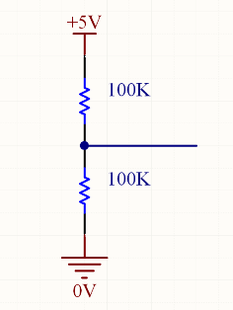
Ohm’s law and voltage divider
Need 3 physics facts:
1. Ohm’s law: V=IR (I=V/R)
  Microcontroller output pin at 5V, 100K load ➔ I=5V/100K = 50μA
  Microcontroller output pin at 5V, 200K load ➔ I=5V/200K = 25μA
  Microcontroller output pin at 5V, 1K load ➔ I=5V/1K = 5mA
2. Resistors in series add
3. Current is conserved (“Kirchoff’s current law”)
Voltage divider
Lump 2 series resistors together (200K)
Find current through both: I=5V/200K=25μA
Now plug this I into V_{d}=IR for 2nd resistor
V_{d}=25μA * 100K = 25*10⁻⁶ * 10⁵ = 2.5V
General voltage divider formula: V_{d}=VR₂/(R₁+R₂)
V_{d}=?

Slide 13
Capacitor
Apply a voltage
Creates difference in charge between two plates
➔ Q = CV
If you change the voltage, the charge on the plates changes…apply an AC (continuously changing) voltage, get continuously changing charge == AC current

Slide 14
Time domain capacitor behavior
“5RC rule”: a cap charges/
decays to within 1% of its
final value within 5 RC time
constants

Slide 15
Capacitor charge/discharge
e-cap.html

Slide 16
Applications of capacitors
Energy
  Supercaps ~1F
  electrolytics (polarized [+-] leads! don’t hook them up backward or the smoke will escape!) ~10uF-100uF
Power supply filtering
  10uF-100uF electrolytic
“AC coupling” between amp stages
“Bypass”
  0.1uF ceramic or polyester, one per chip, shunts noise to ground
Timing and waveform generation [“delay circuits”]
Hi/low pass filtering
Differentiation (AoE 1.14) / integration (AoE 1.15)

Slide 17
Operational amplifiers
Amplify voltages (increase voltage)
Turn weak (“high impedance”) signal into robust (“low impedance”) signal by adding current (and thus power)
Perform mathematical operations on signals (in analog)
  E.g. sum, difference, differentiation, integration, etc
Originally analog computing building blocks!

Slide 18
Operational amplifier (as comparator)
e-opamp.html

Slide 19
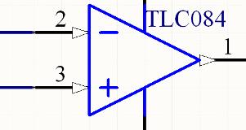
Op Amp Behavior
Op amp has two inputs, +ve & -ve.
  Rule 1: Inputs are “sense only”…no current goes into the inputs
It amplifies the difference between these inputs
With a feedback network in place, it tries to ensure:
  Rule 2: Voltage on inputs is equal
    ensuring this is what the op-amp does!
    as if inputs are shorted together…“virtual short”
    more common term is “virtual ground,” but this is less accurate
Using rules 1 and 2 we can understand what op amps do

Slide 20
Comparator
+15V
V-
V_{out}
V+
Used in earlier ADC examples
No feedback (so Rule 2 won’t apply)
V_{out} = T{g*(V₊ - V₋)} [g big, say 10⁶]
  T{ } means threshold s.t. V_{out} doesn’t exceed rails
In practice
  V₊ > V₋ ➔ V_{out} = +15
  V₊ < V₋ ➔ V_{out} = -15
-15V

Slide 21
Op amp with feedback
e-opampfeedback.html

Slide 22
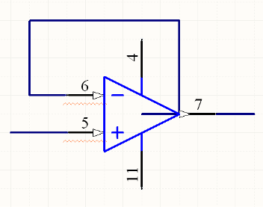
Follower
Because of direct connection, V- = V_{out}
Rule 2➔V- = V+, so
V_{out} = V_{in}
V_{out}
V_{in}
No current into inputs
V- = V+

Slide 23
Follower
e-amp-follower-outputimped.html

Slide 24
End of lecture

Slide 25
Op Amp Behavior
Op amp has two inputs, +ve & -ve.
  Rule 1: Inputs are “sense only”…no current goes into the inputs
It amplifies the difference between these inputs
With a feedback network in place, it tries to ensure:
  Rule 2: Voltage on inputs is equal
    ensuring this is what the op-amp does!
    as if inputs are shorted together…“virtual short”
    more common term is “virtual ground,” but this is less accurate
Using rules 1 and 2 we can understand what op amps do

Slide 26
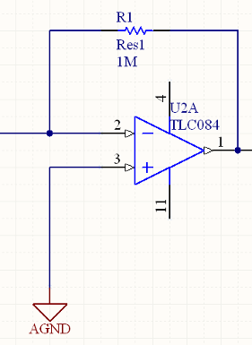
Transimpedance amp
Produces output voltage proportional to input current
AGND = V+ = 0V
By 2, V- = V+, so V- = 0V
Suppose I_{in} = 1μA
By 1, no current enters inverting input
All current must go through R1
V_{out}-V- = -1μA * 10⁶ Ω
⎝V_{out} = -1V
Generally, V_{out} = - I_{in} * R1
V-
I_{in}
V_{out}
V+
No current into inputs
V- = V+

Slide 27
Transimpedance amp (current to voltage)
e-itov.html

Slide 28
Inverting op amp
e-amp-invert.html

Slide 29
Inverting op amp

Slide 30
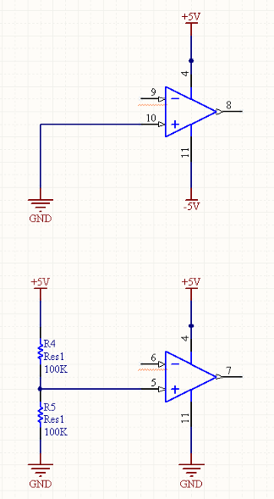
Op Amp power supply
Dual rail: 2 pwr supplies, +ve & -ve
  Can handle negative voltages
  “old school”
Single supply op amps
  Signal must stay positive
  Use Vcc/2 as “analog ground”
  Becoming more common now, esp in battery powered devices
  Sometimes good idea to buffer output of voltage divider with a follower
Ground
0V
Dual rail op-amp
2.5V
“analog
ground”
Single supply op-amp

Slide 31
End of basic electronics

Slide 32
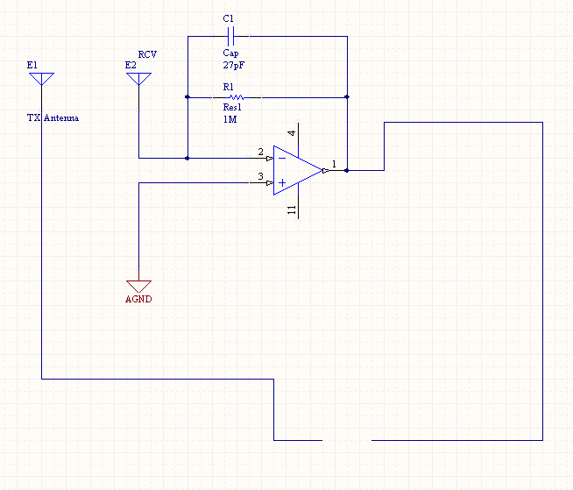
Electric Field Sensing circuit
For nsamps desired integration
Assume square wave TX (+1, -1)
After signal conditioning, signal goes direct to ADC
Acc = sum_i T_i * R_i ➔
  When TX high, acc = acc + sample
  When TX low, acc = acc - sample
+1
-1
Square wave
out
Microcontroller
ADC
IN

Slide 33
E-Field lab pseudo-code
// Set P1.0 as output
// Set ADC0 as input; configure ADC
NSAMPS = 200; // Try different values of NSAMPS //Look at SNR/update rate tradeoff
acc = 0; // acc should be a 16 bit variable
For (i=0; i<NSAMPS; i++) {
SET P1.0 HIGH
acc = acc + ADCVALUE
SET P1.0 LOW
acc = acc - ADCVALUE
}
Return acc
Why is this implementing inner product correlation? Imagine unrolling the loop.
We’ll write ADC₁, ADC₂, ADC₃, … for the 1st, 2nd, 3rd, … ADCVALUE
acc = ADC₁ – ADC₂ + ADC₃ – ADC₄ + ADC₅ – ADC₆ +…
acc = +1*ADC₁ + -1*ADC₂ + +1*ADC₃ + -1*ADC₄ +…
acc = C₁*ADC₁ + C₂*ADC₂ + C₃*ADC₃ + C₄*ADC₄ + …
where C_{i} is the ith sample of the carrier
acc = <C,ADC> Inner product of the carrier vector with the ADC sample vector
Vectors bold, blue

Slide 34
Vectors!
Think of a signal as a vector of samples
Vector lives in a vector space, defined by bases
Same vector can be represented in different bases
A vector v can be projected onto various basis vectors to find out “how much” of each basis vector is in v
<1,2>
<2.236,0>
v
v
Vector v in some basis
Vector v in another basis
Length:
Sqrt(1²+2²)=2.236
Length:
Sqrt(2.236²)=2.236

Slide 35
Vectors and modulation
S’pose m and n are orthogonal unit vectors.
Then inner products (dot products) are
<m,m>=1 <n,n>=1
<m,n>=<n,m>=0
Can interpret inner product as projection of vector 1 (“v1”) onto vector 2 (“v2”)…in other words, inner product of v1 and v2 tells us “how much of vector 1 is there in the direction of vector 2.”
Vectors: bold blue
Scalars: not
If a channel lets me send 2 orthogonal vectors through it, then
I can send two independent messages. Say I need to send two numbers, a
and b…I can send am+bn through the channel.
At the receive side I get am+bn
Now I project onto m and onto n to get back the numbers:
<am+bn, m>=<am,m> + <bn, m>=a+0=a
<am+bn, n>=<am,n> + <bn, n>=0+b=b
The initial multiplication is modulation; the projection to separate the signals
is demodulation. Each channel sharing scheme⬅➔a set of basis vectors.

Slide 37
Physical set up for multiplexed sensing
TX
Electrode
RCV
Electrode
TX
Electrode
Amp
Micro
We can measure multiple sense channels simultaneously, sharing 1
RCV electrode, amp, and ADC!
Choice of TX wave forms determines multiplexing method:
  TDMA --- Time division: TXs take turns
  FDMA --- Frequency division: TXs use different frequencies
  CDMA ---- Code division: TXs use different coded waveforms
In all cases, what makes it work is ~orthogonality of the TX waveforms!

Slide 38
Review
a
c
c
=
<
C
A
D
C
>
;
Where C is the carrier vector and ADC is the vector of samples.
Let’s write out ADC:
A
D
C
=
h
C
w
h
e
r
e
h
(
h
a
n
d
)
i
s
s
e
n
s
e
d
v
a
l
u
e
a
n
d
h
C
m
e
a
n
s
s
c
a
l
a
r
h
£
v
e
c
t
o
r
C
a
c
c
=
<
C
h
C
>
;
=
h
<
C
C
>
;
=
h
i
f
<
C
C
>
=
1
;

Slide 39
Multi-access communication / sensing
Abstract view
Suppose we have two carriers, C¹ and C²
And suppose they are orthogonal, so that < C¹, C² >=0
The received signal is
A
D
C
=
h
1
C
1
+
h
2
C
2
Let’s demodulate with C¹:
a
c
c
=
<
C
1
A
D
C
>
1
;
1
1
2
2
=
<
C
h
C
+
h
C
>
1
;
1
1
1
2
2
=
<
C
h
C
>
+
<
C
h
C
>
1
;
1
1
2
;
1
2
=
h
<
C
C
>
+
h
<
C
C
>
1
;
;
=
h
i
f
<
C
1
C
1
>
=
1
a
n
d
<
C
1
C
2
>
=
0
;
;

Slide 40
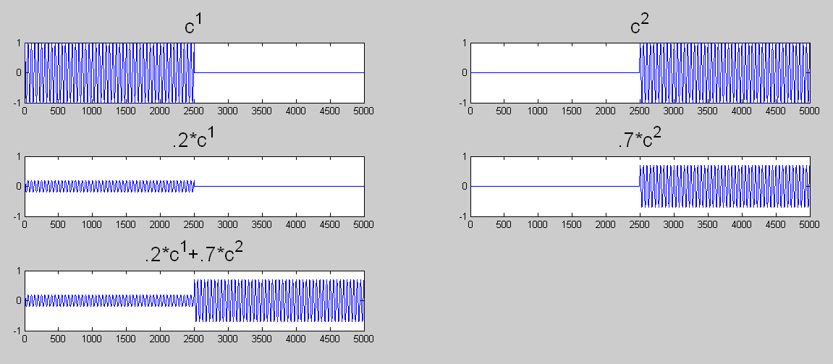
TDMA
Abstract view
Verify that
<C¹,C²>=0
Modulated
carriers
Sum of
modulated
carriers
<C¹, .2C¹ +.7C²>=
<C¹, .2C¹> +<C¹,.7C²>=
.2 <C¹, C¹> + 0
Horizontal axis: time
Vertical axis: amplitude (arbitrary units)

Slide 41
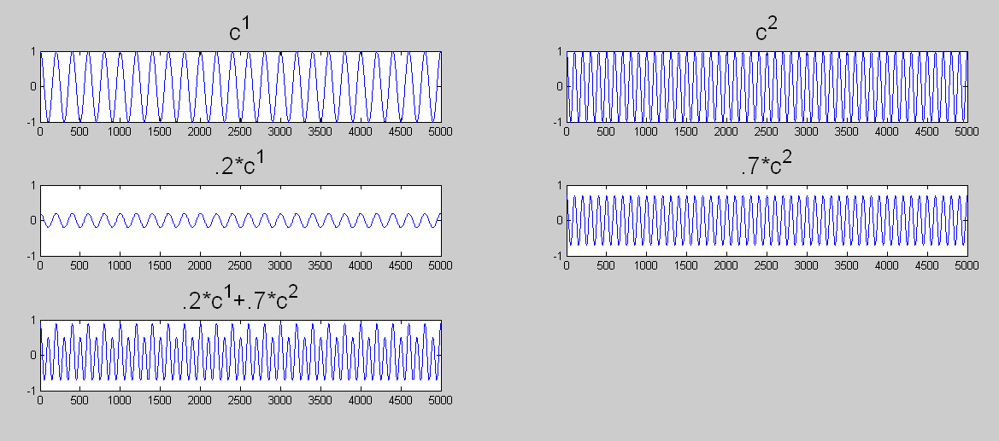
FDMA
Abstract view
>> n1=sum(c1 .* c1)
n1 = 2.5000e+003
>> n2=sum(c2 .* c2)
n2 = 2.5000e+003
>> n12=sum(c1 .* c2)
n12 = -8.3900e-013
>> rcv = .2*c1 + .7*c2;
>> sum(c1/n1 .* rcv)
ans = 0.2000
>> sum(c2/n2 .* rcv)
ans = 0.7000
Horizontal axis: time
Vertical axis: amplitude (arbitrary units)

Slide 42
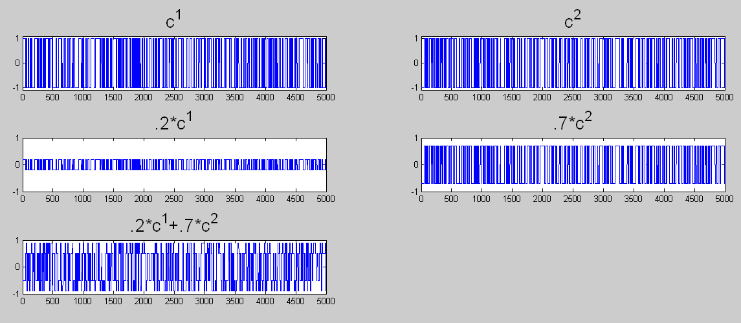
CDMA
S’pose we pick random carriers: c1 = 2*(rand(1,500)>0.5)-1;
>> n1=sum(c1 .* c1)
n1 = 5000
>> n2=sum(c2 .* c2)
n2 = 5000
>> n12=sum(c1 .* c2)
n12 = -360
>> rcv = .2*c1 + .7*c2;
>> sum(c1/n1 .* rcv)
ans = 0.1496
>> sum(c2/n2 .* rcv)
ans = 0.6856
Horizontal axis: time
Vertical axis: amplitude (arbitrary units)
Note: Random carriers here consist of 500 rand values repeated
10 times each for better display

Slide 43
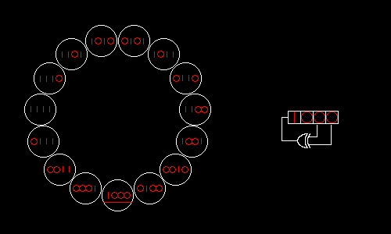
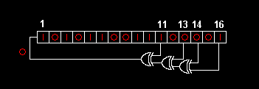
LFSRs (Linear Feedback Shift Registers)
The right way to generate pseudo-random carriers for CDMA
A simple pseudo-random number generator
  Pick a start state, iterate
Maximum Length LFSR visits all states before repeating
  Based on primitive polynomial…iterating LFSR equivalent to multiplying by generator for group
  Can analytically compute auto-correlation
This form of LFSR is easy to compute in HW (but not as nice in SW)
  Extra credit: there is another form that is more efficient in SW
Totally uniform auto-correlation
Image source: wikipedia
Image source: wikipedia

Slide 44
LFSR TX
8 bit LFSR with taps at 3,4,5,7 (counting from 0). Known to be maximal.
for (k=0;k<3;k++) { // k indexes the 4 LFSRs
low=0;
if(lfsr[k]&8) // tap at bit 3
low++; // each addition performs XOR on low bit of low
if(lfsr[k]&16) // tap at bit 4
low++;
if(lfsr[k]&32) // tap at bit 5
low++;
if(lfsr[k]&128) // tap at bit 7
low++;
low&=1; // keep only the low bit
lfsr[k]<<=1; // shift register up to make room for new bit
lfsr[k]&=255; // only want to use 8 bits (or make sure lfsr is 8 bit var)
lfsr[k]|=low; // OR new bit in
}
OUTPUT_BIT(TX0,lfsr[0]&1); // Transmit according to LFSR states
OUTPUT_BIT(TX1,lfsr[1]&1);
OUTPUT_BIT(TX2,lfsr[2]&1);
OUTPUT_BIT(TX3,lfsr[3]&1);

Slide 45
LFSR demodulation
meas=READ_ADC(); // get sample…same sample will be processed in different ways
for(k=0;k<3;k++) {
if(lfsr[k]&1) // check LFSR state
accum[k]+=meas; // make sure accum is a 16 bit variable!
else
accum[k]-=meas;
}

Slide 46
LFSR state sequence
>> lfsr1(1:255)
ans =
2 4 8 17 35 71 142 28 56 113 226 196 137 18
37 75 151 46 92 184 112 224 192 129 3 6 12 25
50 100 201 146 36 73 147 38 77 155 55 110 220 185
114 228 200 144 32 65 130 5 10 21 43 86 173 91
182 109 218 181 107 214 172 89 178 101 203 150 44 88
176 97 195 135 15 31 62 125 251 246 237 219 183 111
222 189 122 245 235 215 174 93 186 116 232 209 162 68
136 16 33 67 134 13 27 54 108 216 177 99 199 143
30 60 121 243 231 206 156 57 115 230 204 152 49 98
197 139 22 45 90 180 105 210 164 72 145 34 69 138
20 41 82 165 74 149 42 84 169 83 167 78 157 59
119 238 221 187 118 236 217 179 103 207 158 61 123 247
239 223 191 126 253 250 244 233 211 166 76 153 51 102
205 154 53 106 212 168 81 163 70 140 24 48 96 193
131 7 14 29 58 117 234 213 170 85 171 87 175 95
190 124 249 242 229 202 148 40 80 161 66 132 9 19
39 79 159 63 127 255 254 252 248 240 225 194 133 11
23 47 94 188 120 241 227 198 141 26 52 104 208 160
64 128 1

Slide 47
LFSR output
>> c1(1:255) (EVEN LFSR STATE ➔ -1, ODD LFSR STATE➔ +1)
ans =
-1 -1 -1 1 1 1 -1 -1 -1 1 -1 -1 1 -1
1 1 1 -1 -1 -1 -1 -1 -1 1 1 -1 -1 1
-1 -1 1 -1 -1 1 1 -1 1 1 1 -1 -1 1
-1 -1 -1 -1 -1 1 -1 1 -1 1 1 -1 1 1
-1 1 -1 1 1 -1 -1 1 -1 1 1 -1 -1 -1
-1 1 1 1 1 1 -1 1 1 -1 1 1 1 1
-1 1 -1 1 1 1 -1 1 -1 -1 -1 1 -1 -1
-1 -1 1 1 -1 1 1 -1 -1 -1 1 1 1 1
-1 -1 1 1 1 -1 -1 1 1 -1 -1 -1 1 -1
1 1 -1 1 -1 -1 1 -1 -1 -1 1 -1 1 -1
-1 1 -1 1 -1 1 -1 -1 1 1 1 -1 1 1
1 -1 1 1 -1 -1 1 1 1 1 -1 1 1 1
1 1 1 -1 1 -1 -1 1 1 -1 -1 1 1 -1
1 -1 1 -1 -1 -1 1 1 -1 -1 -1 -1 -1 1
1 1 -1 1 -1 1 -1 1 -1 1 1 1 1 1
-1 -1 1 -1 1 -1 -1 -1 -1 1 -1 -1 1 1
1 1 1 1 1 1 -1 -1 -1 -1 1 -1 1 1
1 1 -1 -1 -1 1 1 -1 1 -1 -1 -1 -1 -1
-1 -1 1

Slide 48
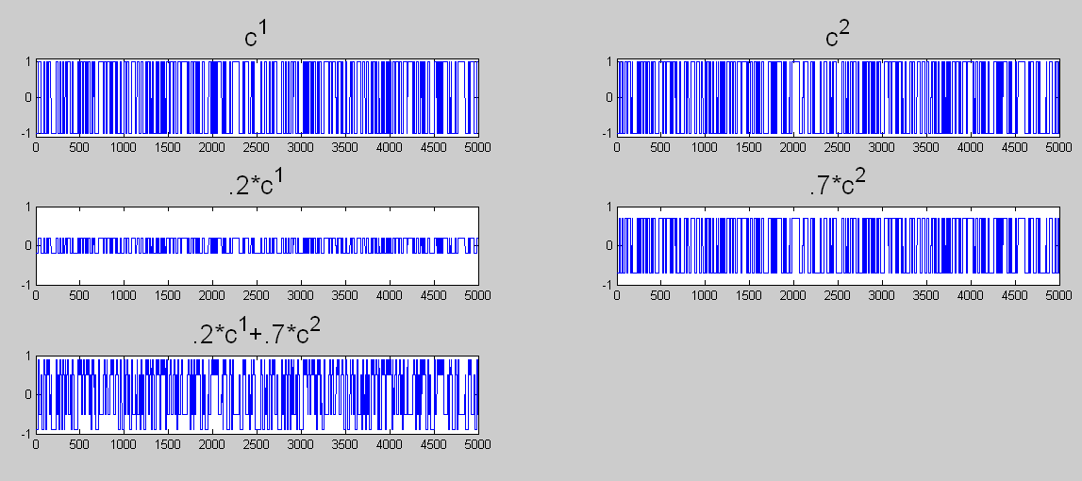
CDMA by LFSR
>> n1 = sum(c1.*c1)
n1 = 5000
>> n2 = sum(c2.*c2)
n2 = 5000
>> n12 = sum(c1.*c2)
n12 = -60
>> rcv = .2 *c1 + .7*c2;
>> sum(c1/n1 .* rcv)
ans = 0.1916
>> sum(c2/n2 .* rcv)
ans = 0.6976
Note: CDMA carriers here consist of 500 pseudorandom values repeated
10 times each for better display

Slide 49
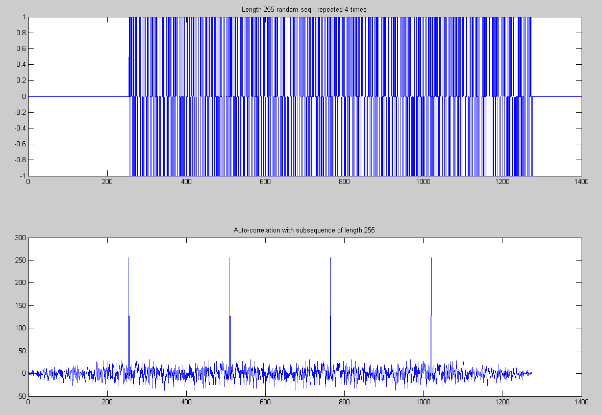
Autocorrelation of pseudo-random (non-LFSR) sequence of length 255
PR seq
Generated
w/ Matlab
rand cmd

Slide 50
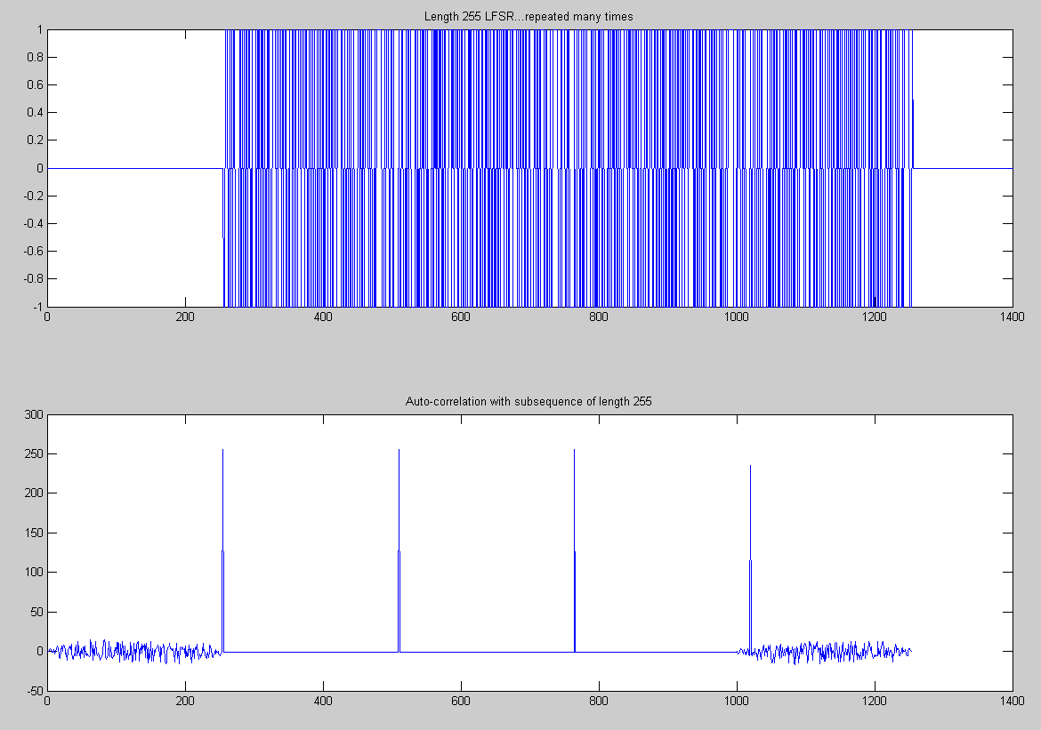
Autocorrelation (full length 255 seq)
-1

Slide 51

Autocorrelation (length 254 sub-seq)
0 or -2

Slide 52
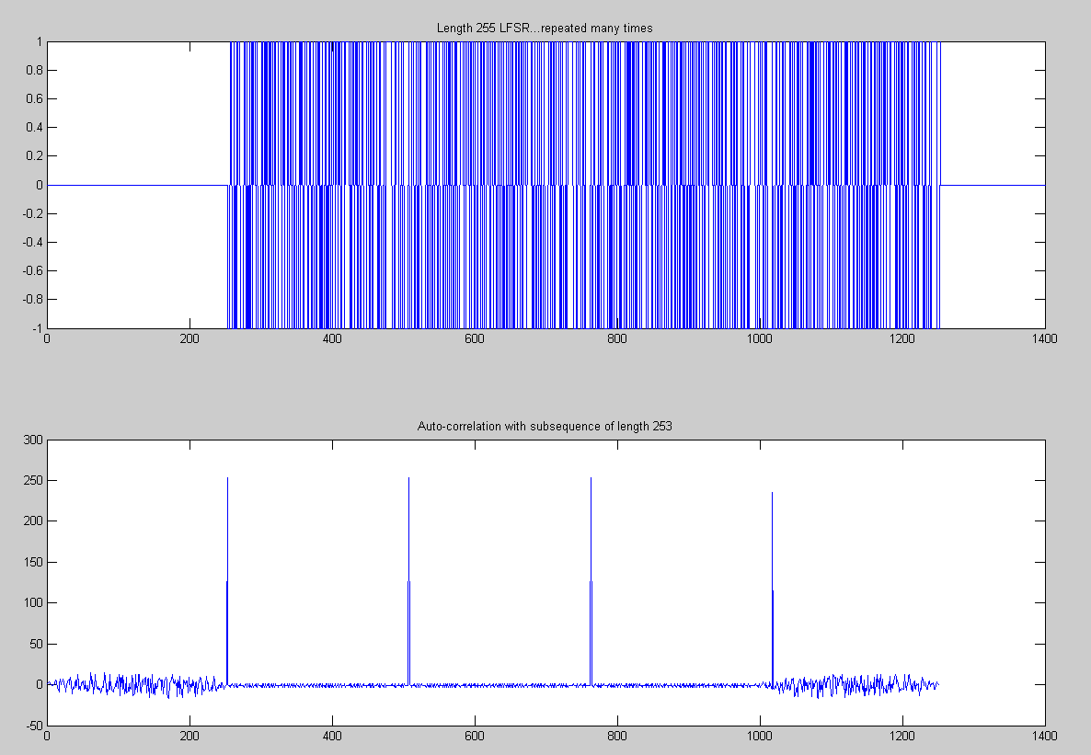
Autocorrelation (length 253 sub-seq)
1,-1, or -3

Slide 53
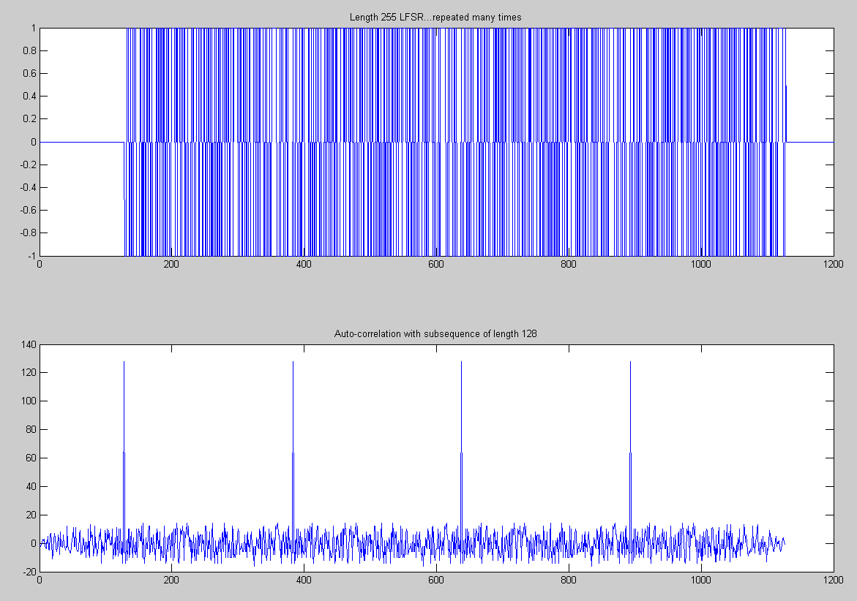
Autocorrelation (length 128 sub-seq)

Slide 54
More on CDMA & LFSRs
Other places where DSSS is used
  802.11b, GPS
Terminology
  Symbols: data
  Chips: single carrier value
  Varying number of chips per symbol varies data rate…when SNR is lower, increase number of chips per symbol to improve robustness and decrease data rate
  Interference: one channel impacting another
  Noise (from outside)

Slide 55
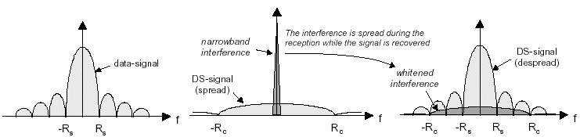
Visualizing DSSS
https://www.okob.net/texts/mydocuments/80211physlayer/images/dsss_interf.gif

Slide 56
Practical DSSS radios
DSSS radio communication systems in practice use the pseudo-random code to modulate a sinusoidal carrier (say 2.4GHz)
This spreads the energy somewhat around the original carrier, but doesn’t distribute it uniformly over all bands, 0-2.4GHz
Amount of spreading is determined by chip time (smallest time interval)

Slide 58
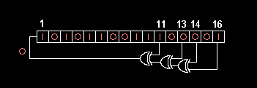
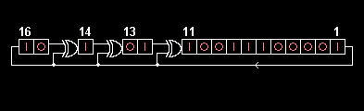
LFSRs…one more thing…
“Fibonacci”
“Standard”
“Many to one”
“External XOR”
LFSR
“Galois”
“One to many”
“Internal XOR”
LFSR
Faster in SW!!
Note: In a HW implementation, if you have XOR gates with as many inputs as you want, then the upper configuration is just as fast as the lower. If you only have 2 input XOR gates, then the lower implementation is faster in HW since the XORs can occur in parallel.

Slide 59
Advantage of Galois LFSR in SW
“Galois”
“Internal XOR”
“One to many”
LFSR
Faster in SW because XOR can happen word-wise (vs the multiple bit-wise tests
that the Fibonacci configuration needs)
#include <stdint.h>
uint16_t lfsr = 0xACE1u;
unsigned int period = 0;
do {
unsigned lsb = lfsr & 1; /* Get lsb (i.e., the output bit). */
lfsr >>= 1; /* Shift register */
if (lsb == 1) /* Only apply toggle mask if output bit is 1. */
lfsr ^= 0xB400u; /* Apply toggle mask, value has 1 at bits corresponding
* to taps, 0 elsewhere. */
++period;
} while(lfsr != 0xACE1u);

Slide 60
LFSR in a single line of C code!
#include <stdint.h>
uint16_t lfsr = 0xACE1u;
unsigned period = 0;
do { /* taps: 16 14 13 11; char. poly: x^16+x^14+x^13+x^11+1 */
lfsr = (lfsr >> 1) ^ (-(lfsr & 1u) & 0xB400u);
++period;
} while(lfsr != 0xACE1u);
NB: The minus above is two’s complement negation…here the result is all zeros or all ones…that is ANDed that with the tap mask…this ends up doing the same job as the conditional from the previous implementation. Once the mask is ready, it is XORed to the LFSR

Slide 61
Some polynomials for Max. Length LFSRs
Bits | Feedback polynomial | Period
n |  | 2^{n} − 1
2 | x² + x + 1 | 3
3 | x³ + x² + 1 | 7
4 | x⁴ + x³ + 1 | 15
5 | x⁵ + x³ + 1 | 31
6 | x⁶ + x⁵ + 1 | 63
7 | x⁷ + x⁶ + 1 | 127
8 | x⁸ + x⁶ + x⁵ + x⁴ + 1 | 255
9 | x⁹ + x⁵ + 1 | 511
10 | x¹⁰ + x⁷ + 1 | 1023
11 | x¹¹ + x⁹ + 1 | 2047
12 | x¹² + x¹¹ + x¹⁰ + x⁴ + 1 | 4095
13 | x¹³ + x¹² + x¹¹ + x⁸ + 1 | 8191
14 | x¹⁴ + x¹³ + x¹² + x² + 1 | 16383
15 | x¹⁵ + x¹⁴ + 1 | 32767
16 | x¹⁶ + x¹⁴ + x¹³ + x¹¹ + 1 | 65535
17 | x¹⁷ + x¹⁴ + 1 | 131071
18 | x¹⁸ + x¹¹ + 1 | 262143
19 | x¹⁹ + x¹⁸ + x¹⁷ + x¹⁴ + 1 | 524287

Slide 63
More on why modulation is useful
Discussed channel sharing already
Now: noise immunity

Slide 64
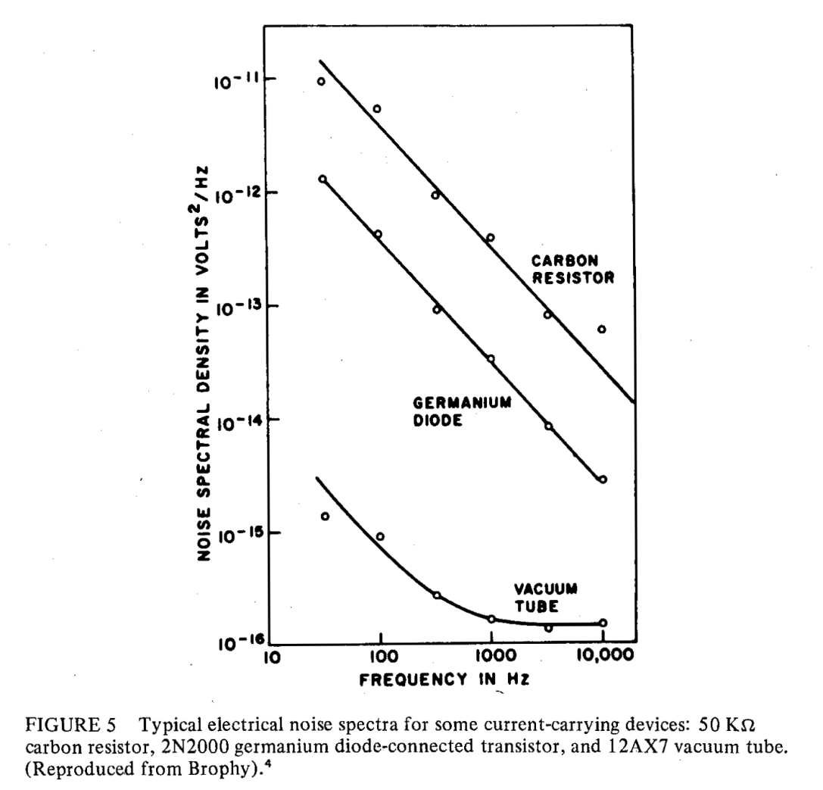
Noise
Why modulated sensing?
Johnson noise
  Broadband thermal noise
Shot noise
  Individual electrons…not usually a problem
“1/f” “flicker” “pink” noise
  Worse at lower frequencies
  ➔ do better if we can move to higher frequencies
60Hz pickup
From W.H. Press, “Flicker noises in
astronomy and elsewhere,” Comments
on astrophysics 7: 103-119. 1978.

Slide 65
Modulation
What is it?
  In music, changing key
  In old time radio, shifting a signal from one frequency to another
  Ex: voice (10kHz “baseband” sig.) modulated up to 560kHz at radio station
  Baseband voice signal is recovered when radio receiver demodulates
  More generally, modulation schemes allow us to use analog channels to communicate either analog or digital information
    Amplitude Modulation (AM), Frequency Modulation (FM), Frequency hopping spread spectrum (FHSS), direct sequence spread spectrum (DSSS), etc
What is it good for?
  Sensitive measurements
    Sensed signal more effectively shares channel with noise ➔ better SNR
  Channel sharing: multiple users can communicate at once
    Without modulation, there could be only one radio station in a given area
    One radio can chose one of many channels to tune in (demodulate)
  Faster communication
    Multiple bits share the channel simultaneously ➔ more bits per sec
    “Modem” == “Modulator-demodulator”

Slide 66
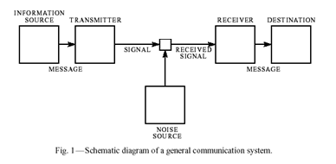
Modulation --- A software perspective
Shannon
Q: What determines number of messages we can send through a channel (or extract from a sensor, or from a memory)?
A: The number of inputs we can reliably distinguish when we make a measurement at the output

Slide 67
Other applications of modulation

Slide 68
Other applications of modulation / demodulation or correlation computations
These are extremely useful algorithmic techniques that are not commonly taught or are scattered in computer science
Amplitude-modulated sensing (what we’ve been doing)
  Also known as synchronous detection
Ranging (GPS, sonar, laser rangefinders)
Analog RF Communication (AM radio, FM radio)
Digital Communication (modem==modulator demodulator)
Data hiding (digital watermarking / steganography)
Fiber Fingerprinting (biometrics more generally)
Pattern recognition (template matching, simple gesture rec)

Slide 69

Data hiding
“Modulation and Information Hiding in Images,” Joshua R. Smith and Barrett O. Comiskey. Presented at the Workshop on Information Hiding, Isaac Newton Institute, University of Cambridge, UK, May 1996; Springer-Verlag Lecture Notes in Computer Science Vol. 1174, pp 207-226.

Slide 70
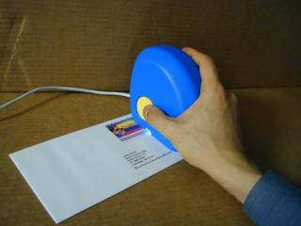
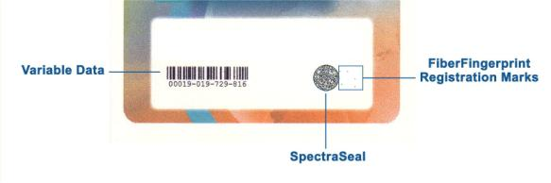
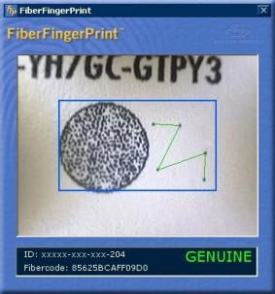
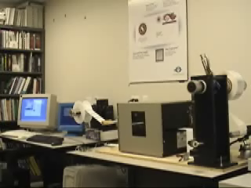
FiberFingerprint
FiberFingerprint Identification
Proceedings of the Third Workshop on Automatic Identification, Tarrytown, NY, March 2002
E. Metois, P. Yarin, N. Salzman, J.R. Smith
Key in this application: remove DC component before correlating

Slide 71
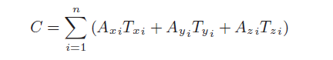
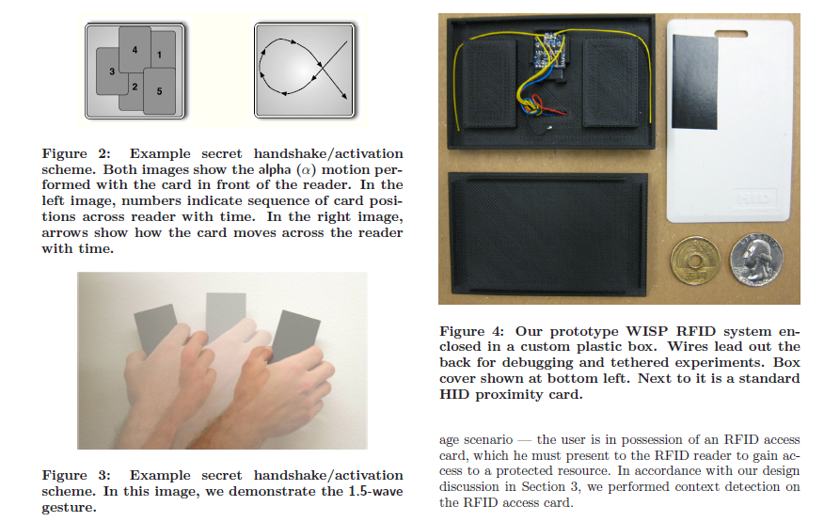
Gesture recognition by cross-correlation of sensor data with a template
“RFIDs and Secret Handshakes: Defending Against Ghost-and-Leech Attacks and Unauthorized Reads with Context-Aware Communications,”
A. Czeskis, K. Koscher, J.R. Smith, and T. Kohno
15th ACM Conference on Computer and Communications Security (CCS), Alexandria, VA. October 27-31, 2008

Slide 72
Limitations
TX and RCV need common time-scale (or length scale)
  Will not recognize a gesture being performed at a different speed than the template
Except in sensing (synchronous detection) applications, need to synchronize TX and RX…this is a search that can take time

Slide 73
End of section

