Slide 1
CSE 461: Review
Chunjong Park

Slide 2
Internet Reference Model - Layering
The classic OSI model has seven layers
In practice, there are more like four
Application
Transport
Network
Link
Application-specific data
HTTP, SMTP, P0P (project 0)
Move data between applications anywhere on the Internet.
UDP, TCP
Move data from one machine to another, anywhere on the Internet.
IP
Move data between nodes that can hear each other’s transmissions.
Ethernet, WiFi

Slide 3
Encapsulation/Decapsulation
source
message
M
application
transport
network
link
physical
segment
H_{t}
M
H_{t}
datagram
H_{n}
H_{n}
H_{t}
M
frame
H_{l}
H_{n}
H_{t}
M
link
physical
switch
destination
H_{n}
H_{t}
M
network
link
physical
H_{n}
H_{t}
M
M
application
transport
network
link
physical
H_{l}
H_{n}
H_{t}
M
H_{t}
M
H_{n}
H_{t}
M
H_{l}
H_{n}
H_{t}
M
router

Slide 4
Application Layer - DNS
Built on UDP messages, port 53
Names ←→ Addresses
Resolution
Iterative vs recursive
Cache

Slide 5
Application Layer - HTTP
Static vs Dynamic Web pages
URL structures
Browser steps:
Resolve the server name to an IP address (DNS)
Set up a TCP connection to the server
Send HTTP request for the page
Wait for and then read HTTP response
(Assuming no errors) Process response data and render page
Clean up any idle TCP connections
HTTP methods
HTTP response codes
HTTP 1.0 vs HTTP 1.1 vs HTTP 2.0

Slide 6
Transport
 | Reliable | Unreliable
Packets |  | Datagrams (UDP)
Bytestream | Streams(TCP)
TCP | UDP
Streams | Datagrams
Connections | Connectionless
Bytes are delivered to receiving app reliably (once, and in order) | Packets may be lost, reordered, duplicated (but not corrupted)
Arbitrary length content | Fixed maximum datagram size
Connection latency | No delay
Segment delivery latency (“nagling”) | Datagram is sent now
Flow control matches sender’s rate to receiver’s capability | No flow control (can lead to many lost datagrams)
Congestion control matches sender’s rate to network’s capability | No congestion control (can lead to many lost datagrams)

Slide 7
Transport – Mux/demux – UDP
DatagramSocket serverSocket = new DatagramSocket
(6428);
DatagramSocket mySocket2 = new DatagramSocket
(9157);
DatagramSocket mySocket1 = new DatagramSocket (5775);
application
application
P1
application
P3
P4
transport
transport
network
transport
network
link
network
link
physical
link
physical
physical
source port: 6428
dest port: 9157
source port: ?
dest port: ?
source port: 9157
dest port: 6428
source port: ?
dest port: ?

Slide 8
Transport – Mux/demux –TCP
threaded server
application
application
application
P4
P3
P3
P2
transport
transport
network
transport
network
link
network
link
physical
link
physical
server: IP address B
physical
host: IP address A
source IP,port: B,80
dest IP,port: A,9157
host: IP address C
source IP,port: C,5775
dest IP,port: B,80
source IP,port: A,9157
dest IP, port: B,80
source IP,port: C,9157
dest IP,port: B,80

Slide 9
Transport – TCP
Reliable transfer – retransmission
Stop-and-wait
Sliding windows
Go-Back-N
Selective Repeat

Slide 10
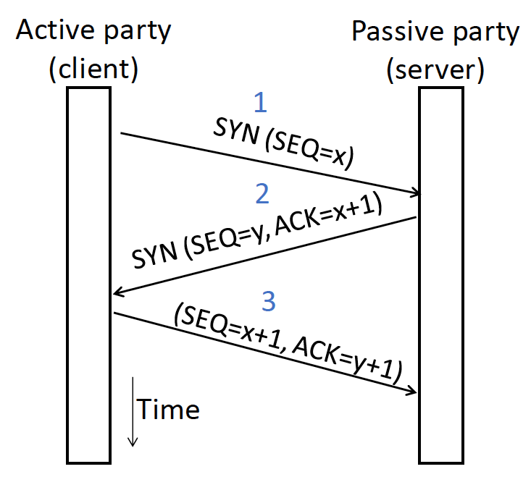
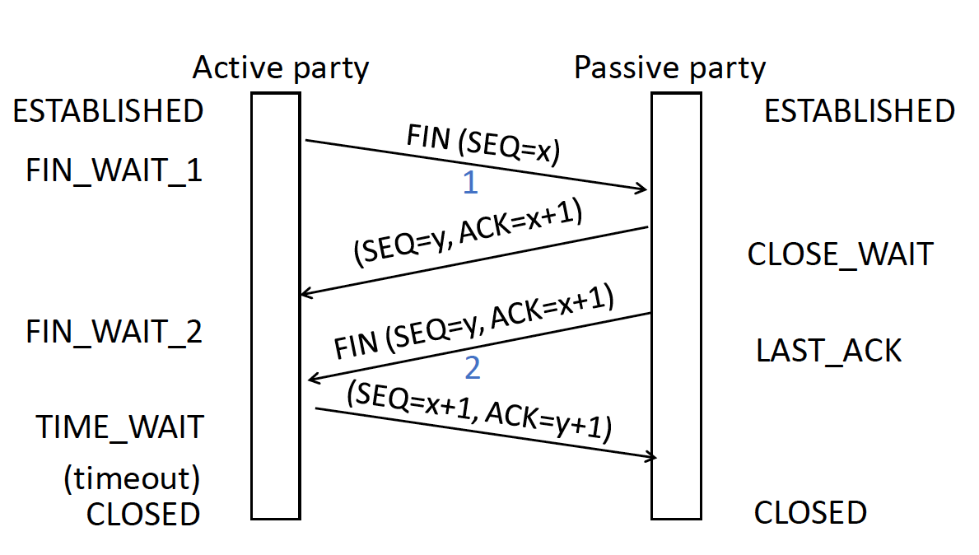
Transport – TCP
Connection establishment
Flow control
Sliding windows
Connection teardown

Slide 11
Transport – TCP Congestion Control
Fairness vs. efficiency
AIMD
Congestion signals
Signal | Example Protocol | Pros / Cons
Packet loss (RTO, DupACK) | TCP NewReno Cubic TCP (Linux) | Hard to get wrong Hear about congestion late
Packet delay | Compound TCP (Windows) | Hear about congestion early Need to infer congestion
Router indication | TCPs with Explicit Congestion Notification | Hear about congestion early Require router support

Slide 12
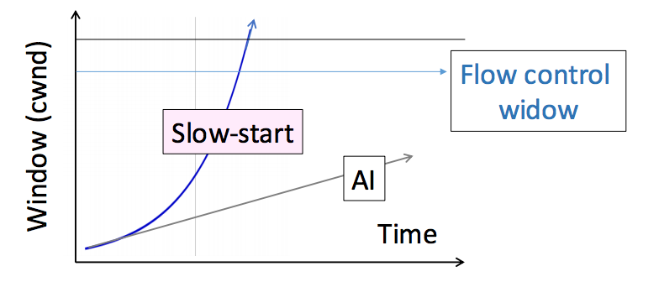
Transport – TCP Congestion Control – SS
We want to quickly near the right rate, cwnd_{IDEAL}, but it varies greatly
Slow Start solution
Start by doubling cwnd every RTT
Exponential growth (1, 2, 4, 8, 16, …)
Start slow, quickly reach large values

Slide 13
Transport – TCP Congestion Control
Fast recovery
Network-Side Congestion Control
Random Early Detection
Explicit Congestion Notification

Slide 14
Network
How to deliver packets globally
Scaling
Hierarchy, in the form of prefixes
Heterogeneity
IP for internetworking
Bandwidth Control
Lowest-cost routing

Slide 15
Network
Network service models
Datagrams (packets), virtual circuits
IP (Internet Protocol)
Internetworking
Forwarding (Longest Matching Prefix)
Helpers: ARP and DHCP
Fragmentation and MTU discovery
Errors: ICMP (traceroute!)
IPv6, scaling IP to the world
NAT, and “middleboxs”
Routing Algorithms

Slide 16
Network – Datagrams vs Virtual Circuits
Datagrams: packets contain a destination address; each router uses it to forward packets, maybe on different paths
Virtual circuits: Packets contain a short label (unique on a link) to identify the circuit
Issue | Datagrams | Virtual Circuits
Setup phase | Not needed | Required
Router state | Per destination | Per connection
Addresses | Packet carries full address | Packet carries short label
Routing | Per packet | Per circuit
Failures | Easier to mask | Difficult to mask
Quality of service | Difficult to add | Easier to add

Slide 17
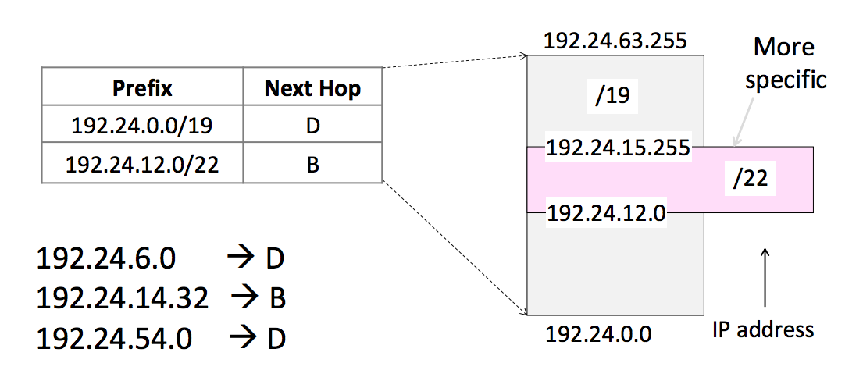
Network – IP Prefix/Forwarding
IP prefix: “IP address/length”
128.13.0.0/16 is 128.13.0.0 to 128.13.255.255
Longest Matching Prefix

Slide 18
Network – Routing
Routing versus Forwarding
Forwarding is the process of sending a packet on its way
Routing is the process of deciding in which direction to send traffic

Slide 19
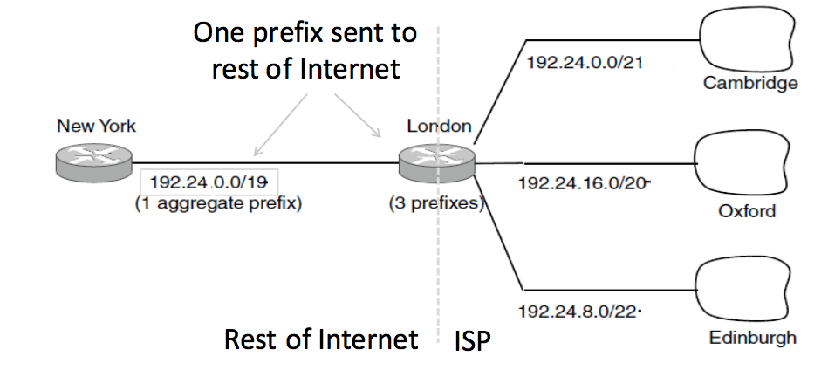
Network – Subnet/Aggregation

Slide 20
Link

Slide 21
Link – Error detection and correction
Hamming Distance
Distance is the number of bit flips needed to change D1 to D2
Hamming distance of a coding is the minimum distance between any pair of valid codewords
Error detection:
For a coding of distance d+1, up to d errors will always be detected
Parity bit
Cyclic Redundancy Check (CRC)
Error correction
For a coding of distance 2d+1, up to d errors can always be corrected
map to the closest valid codeword (there can be only one)

Slide 22
Link – ARQ
ARQ often used when errors are common or must be corrected
E.g., WiFi, and TCP
Rules at sender and receiver:
Receiver automatically acknowledges correct frames with an ACK
Sender automatically resends after a timeout, until an ACK is received
Should retransmissions occur at link layer
Depends on expected error rate
Think of them as a performance optimization (relative to just leaving it to TCP) when they’re implemented
Because latencies are typically small(ish) and tightly bounded on a single link
Timeout estimation is simpler
Less motivation to use sliding window, rather than stop-and-wait

Slide 23
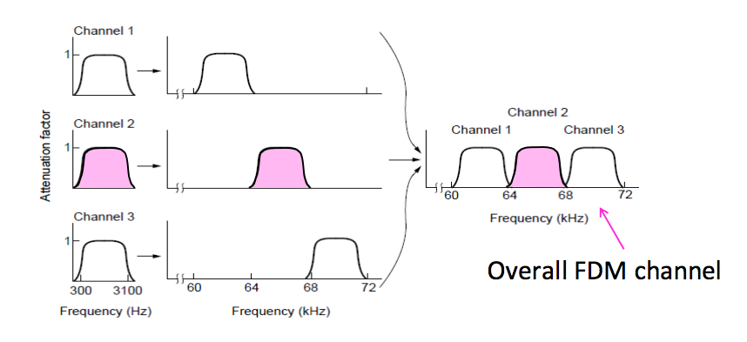
Link – Multiple Access
TDM
Users take turns on a fixed schedule
FDM
Put different users on different frequency bands

Slide 24
Link – Multiple Access
TDM
Users take turns on a fixed schedule
FDM
Put different users on different frequency bands

Slide 25
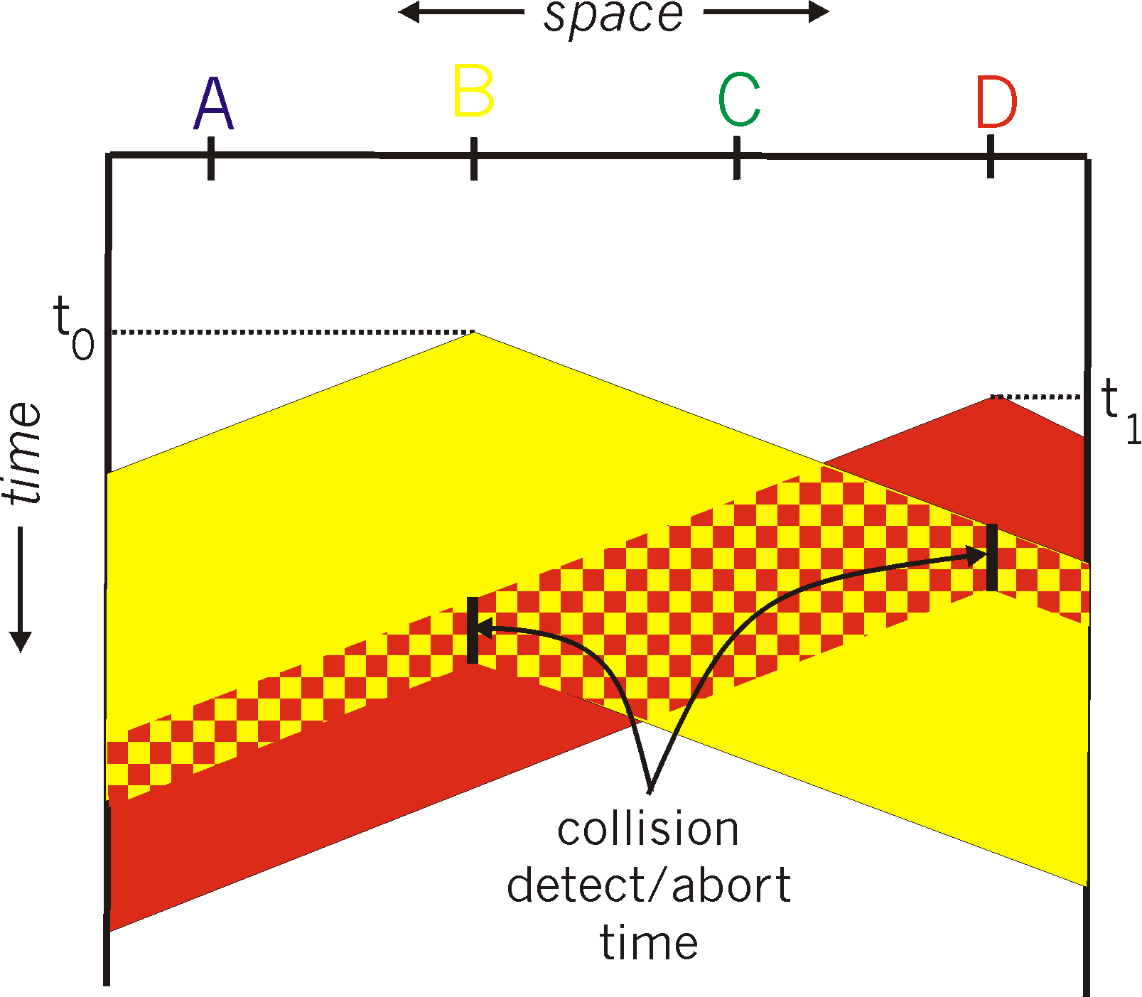
Link – Ethernet – CSMA/CD
Collision detection
spatial layout of nodes

Slide 26
Link – CSMA/CD
1. NIC receives datagram from network layer, creates frame
2. If NIC senses channel idle, starts frame transmission. If NIC senses channel busy, waits until channel idle, then transmits.
3. If NIC transmits entire frame without detecting another transmission, NIC is done with frame !
4. If NIC detects another transmission while transmitting, aborts and sends jam signal
5. After aborting, NIC enters binary (exponential) backoff:
after mth collision, NIC chooses K at random from {0,1,2, …, 2^{m}-1}. NIC waits K·512 bit times, returns to Step 2
longer backoff interval with more collisions

Slide 27
Wireless
Multiple wireless senders and receivers create additional problems (beyond multiple access):
A
B
C
C
A’s signal
strength
C’s signal
strength
B
A
Hidden terminal problem
B, A hear each other
B, C hear each other
A, C can not hear each other means A, C unaware of their interference at B
space
Signal attenuation:
B, A hear each other
B, C hear each other
A, C can not hear each other interfering at B

Slide 28
Link – CSMA/CA
A
B
AP
RTS(B)
RTS(A)
reservation collision
RTS(A)
CTS(A)
CTS(A)
DATA (A)
defer
time
ACK(A)
ACK(A)

Slide 29
Real-world scenario

Slide 30
A day in the life: scenario
browser
DNS server
Comcast network
68.80.0.0/13
school network
68.80.2.0/24
web page
web server
Google’s network
64.233.160.0/19
64.233.169.105

Slide 31
A day in the life… connecting to the Internet
DHCP
DHCP
UDP
IP
Eth
Phy
connecting laptop needs to get its own IP address, addr of first-hop router, addr of DNS server: use DHCP
DHCP
DHCP
DHCP
DHCP
DHCP request encapsulated in UDP, encapsulated in IP, encapsulated in 802.3 Ethernet
DHCP
DHCP
UDP
IP
Eth
Phy
DHCP
DHCP
DHCP
DHCP
router
(runs DHCP)
Ethernet frame broadcast (dest: FFFFFFFFFFFF) on LAN, received at router running DHCP server
Ethernet demuxed to IP demuxed, UDP demuxed to DHCP

Slide 32
A day in the life… connecting to the Internet
DHCP
DHCP
UDP
IP
Eth
Phy
DHCP server formulates DHCP ACK containing client’s IP address, IP address of first-hop router for client, name & IP address of DNS server
DHCP
DHCP
DHCP
encapsulation at DHCP server, frame forwarded (switch learning) through LAN, demultiplexing at client
DHCP
DHCP
UDP
IP
Eth
Phy
DHCP
DHCP
DHCP
router
(runs DHCP)
DHCP
DHCP client receives DHCP ACK reply
Client now has IP address, knows name & addr of DNS
server, IP address of its first-hop router

Slide 33
A day in the life… ARP (before DNS, before HTTP)
DNS
UDP
IP
Eth
Phy
before sending HTTP request, need IP address of www.google.com: DNS
DNS
DNS
DNS
ARP
ARP query
DNS query created, encapsulated in UDP, encapsulated in IP, encapsulated in Eth. To send frame to router, need MAC address of router interface: ARP
ARP
ARP reply
Eth
Phy
router
(runs DHCP)
ARP query broadcast, received by router, which replies with ARP reply giving MAC address of router interface
client now knows MAC address of first hop router, so can now send frame containing DNS query

Slide 34
A day in the life… using DNS
DNS
UDP
IP
Eth
Phy
DNS
DNS server
DNS
UDP
IP
Eth
Phy
DNS
DNS
DNS
DNS
DNS
DNS
DNS
DNS
Comcast network
68.80.0.0/13
IP datagram forwarded from campus network into comcast network, routed (tables created by RIP, OSPF, IS-IS and/or BGP routing protocols) to DNS server
router
(runs DHCP)
IP datagram containing DNS query forwarded via LAN switch from client to 1st hop router
demux’ed to DNS server
DNS server replies to client with IP address of www.google.com

Slide 35
A day in the life…TCP connection carrying HTTP
HTTP
HTTP
TCP
IP
Eth
Phy
SYNACK
SYN
SYNACK
SYN
SYNACK
SYN
SYN
to send HTTP request, client first opens TCP socket to web server
router
(runs DHCP)
TCP SYN segment (step 1 in 3-way handshake) inter-domain routed to web server
TCP
IP
Eth
Phy
SYNACK
SYN
SYNACK
SYN
SYNACK
SYNACK
SYN
web server responds with TCP SYNACK (step 2 in 3-way handshake)
web server
64.233.169.105
TCP connection established!

Slide 36
A day in the life… HTTP request/reply
HTTP
HTTP
TCP
IP
Eth
Phy
web page finally (!!!) displayed
HTTP
HTTP
HTTP
HTTP
HTTP
HTTP
HTTP
HTTP
HTTP request sent into TCP socket
router
(runs DHCP)
IP datagram containing HTTP request routed to www.google.com
HTTP
HTTP
TCP
IP
Eth
Phy
HTTP
HTTP
HTTP
web server responds with HTTP reply (containing web page)
HTTP
web server
64.233.169.105
IP datagram containing HTTP reply routed back to client

