Slide 1
CSE 461
MIDTERM REVIEW

Slide 2
NETWORK LAYERS & ENCAPSULATION
Application
Application
Transport
Transport
Network
Network
Data Link/ Physical
Data Link/ Physical

Slide 3
APPLICATION LAYER
Application
Application
Used by applications
Protocol is arbitrary

Slide 4
TRANSPORT LAYER
Transport
Transport
Involves packaging of data for transport
UDP/TCP and ports

Slide 5
NETWORK LAYERS & ENCAPSULATION
Network
Network
Handles issues related to routing on the network
Data treated as packets

Slide 6
DATA LINK/PHYSICAL LAYERS
Data Link/ Physical
Data Link/ Physical
Data link layer
Puts data onto the actual line
Error-correcting codes to account for line noise are in the data link layer
At this level, data consists of frames
Physical layer
Actual electrical or wireless oscillations

Slide 7
ADDRESSING
MAC addresses
IP addresses
Ports
Sockets (file descriptors)

Slide 8
MAC ADDRESSES
48-bit
Identify instance of specific network interface hardware

Slide 9
IP ADDRESSES
32-bit (in IPv4) or 128-bit (in IPv6)
Identify a host on a network
Can change dynamically

Slide 10
PORTS
16-bit
Identify communication channels on a specific host
Often map to applications

Slide 11
SOCKETS
Programming interface for networking
Most common implementation is Berkeley sockets
Allows data to be sent with file descriptor-like structures

Slide 12
UDP VS. TCP
UDP | TCP
Unreliable | Reliable
Connection-less | Connection-oriented
No acknowledgements | Acknowledgements
No flow control | Sliding window
No sequence numbers | Sequence numbers

Slide 13
TELNET VS. FTP
Telnet | FTP
Used for sending text data; originally for remote login into a server | Used for sending files
Data transfer and control on same channel | Separate channels for control and data transfer; control channel uses Telnet
Uses TCP | Also uses TCP
Once connected, server and client essentially the same | Server and client behave very differently
Not secure; largely replaced by SSH | Not secure; somewhat replaced by SFTP

Slide 14
METRICS
Bandwidth
Latency
Throughput, goodput
Channel utilization
Shannon’s theorem
Nyquist rate

Slide 15
FREQUENCY & BANDWIDTH
Frequency: rate of an oscillation
Bandwidth: measures the width of a range of frequencies
Bandwidth = freq_{upper} - freq_{lower}
Human hearing bandwidth: ~20kHz (20kHz - 20 Hz)
“Bandwidth” and “bitrate” are often used interchangeably; this is a different definition
Bonus Question: what’s the frequency range and bandwidth of 802.11 b/g?
2.4 GHz to 2.5 GHz; 100 MHz

Slide 16
LATENCY
Time between source and destination
Shortest possible latency bounded by c
Ping can measure round-trip latency

Slide 17
THROUGHPUT & GOODPUT
Throughput: measures how much data can be sent in a given time period (a.k.a. bitrate)
E.g., 100 Gbps
Bits that you can send (i.e., put onto the wire) per amount of time
Goodput: excludes protocol bits and retransmitted data packets
What factors might cause goodput < throughput?
Protocol overhead
Dropped or corrupted packets
Flow control

Slide 18
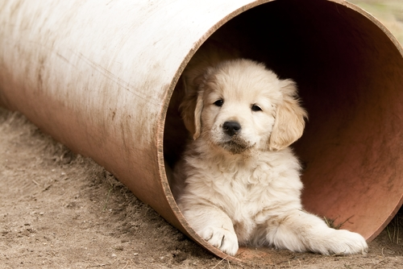
CHANNEL UTILIZATION
Calculates how much of the channel is being used
Percent of the time the channel is in use
(sent data size) / ((channel bitrate) * (round-trip latency))

Slide 19
SHANNON THEOREM
Tells about maximum bitrate in the presence of noise
Capacity = bandwidth * log₂(1 + signal/noise)
C = B log₂(1 + S/N)
What are the implications of this?

Slide 20
NYQUIST RATE
To recover a waveform, the sampling rate must be at least two times the highest frequency
Telephone sampling rate is 8kHz; what are the implications of this?
What sampling rate would be required to recover all frequencies audible by humans? (Up to 20kHZ)
Audio CDs use 44.1kHz sampling rates for this reason

Slide 21
HTTP
HTTP 1.0
Initial connection over TCP acts as a preamble
Content-length can designate payload end
Bad for streaming
Put the content-length in the end of the payload → hard to cache on the receiver side
Caching used heavily
HTTP 1.1
Data comes as a stream, chunked into defined lengths (tokenized)
Connections are reused, reducing overhead
Some pipelining possible, but limited
HTTP 2.0
Reduces latency through header compression
Allows asynchronous sending/multiplexing over a single TCP connection
Fixed the head-of-line blocking problem in HTTP 1.x

Slide 22
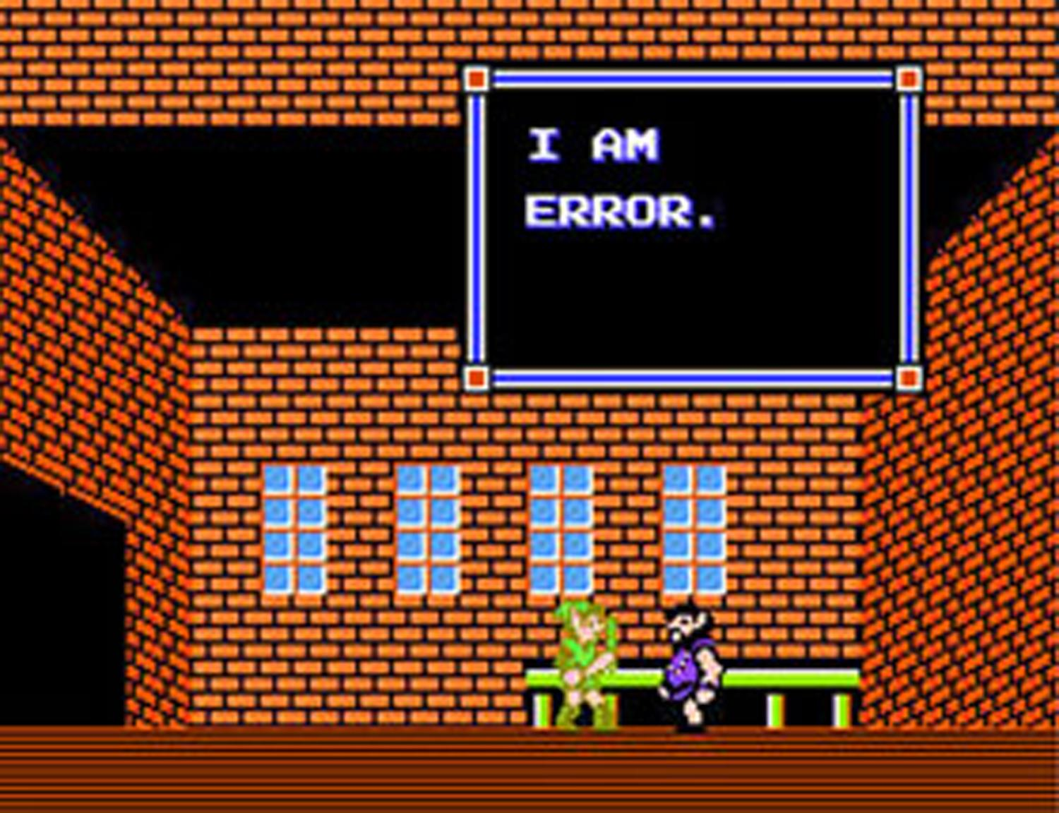
ERROR HANDLING / Integrity
Parity bits
Checksums
CRCs

Slide 23
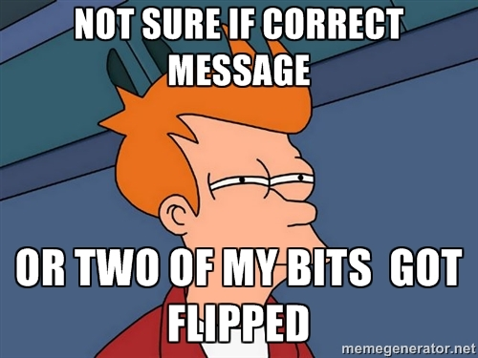
PARITY BITS
Bits check parity on a set of bits
Even parity: bits add to 0
Odd parity: bits add to 1
Multiple parity bits (on odd bits/ on even bits, etc.) can increase effectiveness

Slide 24
CHECKSUMS & CRCS
Checksums:
Adds all words in data as unsigned numbers, allowing to overflow
Sum was then compared to check data integrity
CRCS:
Specific type of checksum that uses polynomial division
Both are integrity checks using a fixed size of data

Slide 25
OTHER TOPICS
DNS
Find the IP address for a URL
UDP is typically used when packet size is smaller than 512 bytes
Typosquatting: register a wrong address for phishing www.yaho.com
Denial of service: overloading DNS servers → unable to resolve URLs
Registrar hacking: company’s name servers that supply IP info are hacked → traffic redirected
DNS hijacking: DNS servers maliciously return incorrect translations
DNS cache poisoning: caches are supposed to expire. Altering the cache data returns incorrect translations

Slide 26
ADDITIONAL STUDY SUGGESTIONS
Read through your project 0 & 1 code and diagram what it’s doing
Review HW problems; do similar problems
Watch David Wetherall’s Coursera course videos (link)
Review old midterms
Available on CSE site (but cover somewhat different material than what ours will)

Slide 27
ANY QUESTIONS?

