Slide 1
Final Review!

Slide 2
So how’s it all work?
I boot my machine
I open my browser and type www.google.com
The page loads
What all just happened?

Slide 3
My Computer Booted
My wifi wants to connect me to a network
It has to find a wifi network in range
It has to connect to that Access Point and successfully share a wifi channel/environment
MAC and Collision Resolution (RTS, CTS)

Slide 4
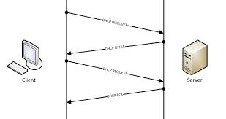
My Computer Found the Router
Now I need an IP Address
DHCP Lease for an IP from the router
I ask for an IP
Router gives an IP
I tell it I will use that IP
It says Okay

Slide 5
I type google.com
I want to make a TCP socket to send data there: can I?
No, I need an IP:Port to connect a socket, not a name
Make a DNS query to some nameserver to give me the IP that goes with google.com (173.194.33.99)
How do I know that IP?
Ideas?

Slide 6
I make my request
Formulate a valid HTTP GET request to get 173.194.33.99
Make a TCP socket that connects out to that IP on port 80.
My router is NATing, what happens?
It maps my IP and port on the LAN side to some port on the WAN side
Alters my outgoing packet’s source IP and port accordingly

Slide 7
I’m still making my request
I’m using wifi to get the router
The router is connected to a cable-modem via Ethernet
The cable-modem is connected to my ISP network via coaxial cable
My ISP connects to 173.194.33.99 via fiber-optic links
Does any of this matter?
Yes and No

Slide 8
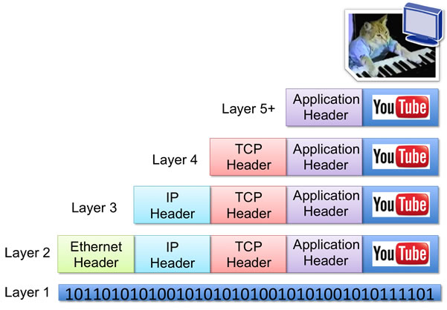
Encapsulation
I’m making a browser application connection
It’s built on a TCP stream
The TCP stream using IP routing to go from me to 173.194.33.99
The IP packet needs a wifi/ethernet/cable/fiber-optic header on it for each hop

Slide 9
My connection gets there!
Have to make a TCP connection before sending any data
3-Way TCP handshake of:
Syn (x) ->
<- SynAck(y, x+1)
Ack (y+1) ->
Now I can finally send my data packet!

Slide 10
My data arrives
173.194.33.99 finally gets my HTTP request
What does it have to do?
Process request, possibly do server-side computation, then send me the webpage
It makes the same crazy trip back, including getting retransformed by the NAT router to reach me
May or may not need to then send more GET requests in response to get other portions of the page

Slide 11
Whew. Glad that all works all the time…
What if my signal got distorted in the air, or on one of the wires?
Error-Correcting Codes
What if one packet takes a slow route and the next takes a fast route?
TCP automatically reorders correctly: UDP not so much
What if my packet gets dropped somewhere?
ACKs ensure delivery
Link-Layer ACKs sometimes used for high-loss mediums (wifi) to speed up recovery

Slide 12
What Else Might’ve Happened?
My browser already has google.com cached, I just show that
Some caching proxy is between me and 173.194.33.99 and responds to my request mid-route, rather than forwarding it to the real 173.194.33.99
I (or my router!) use Tor so I go hopping through three other nodes before exiting to go get 173.194.33.99’s page

Slide 13
How did my router get me the data?
It needs to know who to route to on the wifi-layer to put the correct address on its packet
Uses ARP to look up my MAC address from my IP address and routes my packets to me by addressing it to my MAC address

Slide 14
Where did the projects fit in?
Project 0
Understanding how to get the basic names for networked items: IP and port
Project 1
Essentially a simple DNS service, letting you specify some destination by a more convenient name and add some useful abstraction
Project 2
Get to know HTTP requests, and how a program can ‘invisibly’ stand in the middle of a network connection
Project 3
Understand routing and the complexities associated with creating routes as well as running multiple streams over independent connections

Slide 15
Other Thoughts?
What makes network/distributed programming different from standard local programming?
What are some traps to watch out for?
Why do we need so many threads all the time?
Who should be doing computation in a web app?
How about a peer-to-peer system?
Notes:
Threads. Lots of threads.
If you’re building a web-app, how do you decide what to do client-side vs. server-side?

