Slide 1
Overview of the Link Layer

Slide 2
Where we are in the Course
Moving on to the Link Layer!
Application
Transport
Network
Link
Physical

Slide 3
Scope of the Link Layer
Concerns how to transfer messages over one or more connected links
  Messages are frames, of limited size
  Builds on the physical layer
Frame
Notes:
Icon from Cisco icon library

Slide 4
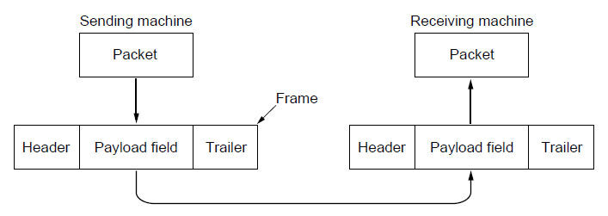
In terms of layers …
Network
Link
Virtual data path
Physical
Actual data path
Notes:
Figure from CN5E slides #3-4

Slide 5
In terms of layers
Network
Link
Virtual data path
Physical
Actual data path
Notes:
Figure from CN5E slides #3-4

Slide 6
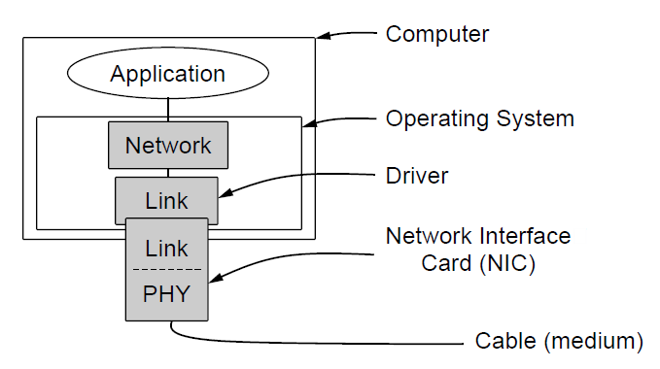
Typical Implementation of Layers
Notes:
CN5E slides #3-22

Slide 7
Topics
Framing
  Delimiting start/end of frames
Error detection and correction
  Handling errors
Retransmissions
  Handling loss
Multiple Access
  802.11, classic Ethernet
Switching
  Modern Ethernet
Later

Slide 8
Framing (§3.1.2)

Slide 9
Topic
The Physical layer gives us a stream of bits. How do we interpret it as a sequence of frames?
Um?
…10110 …
Notes:
Icons from cisco icon library

Slide 10
Framing Methods
We’ll look at:
  Byte count »
  Byte stuffing »
  Bit stuffing »
In practice, the physical layer often helps to identify frame boundaries
  E.g., Ethernet, 802.11

Slide 11
Byte Count
First try:
  Let’s start each frame with a length field!
  It’s simple, and hopefully good enough …

Slide 12
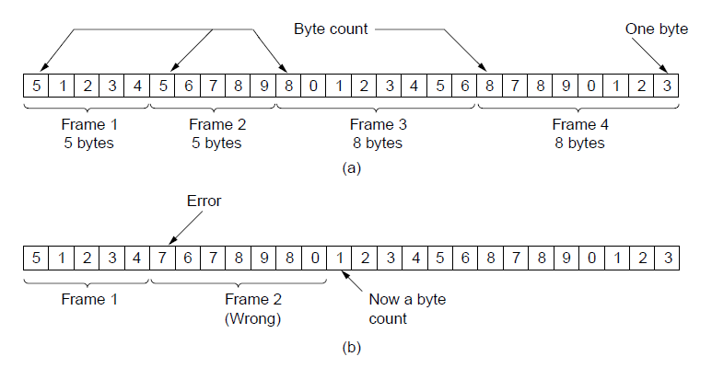
Byte Count (2)
How well do you think it works?
Notes:
CN5E slides #3-7

Slide 13
Byte Count (3)
Difficult to re-synchronize after framing error
  Want an easy way to scan for a start of frame
Notes:
CN5E slides #3-7

Slide 14
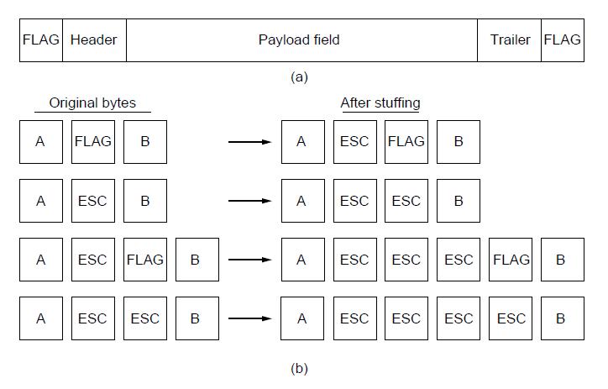
Byte Stuffing
Better idea:
  Have a special flag byte value that means start/end of frame
  Replace (“stuff”) the flag inside the frame with an escape code
  Complication: have to escape the escape code too!
Notes:
CN5E slides #3-8

Slide 15
Byte Stuffing (2)
Rules:
  Replace each FLAG in data with ESC FLAG
  Replace each ESC in data with ESC ESC
Notes:
CN5E slides #3-8

Slide 16
Byte Stuffing (3)
Now any unescaped FLAG is the start/end of a frame
Notes:
CN5E slides #3-8

Slide 17
Bit Stuffing
Can stuff at the bit level too
  Assume a flag has six consecutive 1s
  On transmit, after five 1s in the data, insert a 0
  On receive, a 0 after five 1s is deleted

Slide 18
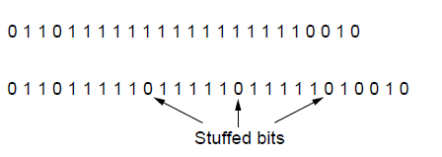
Bit Stuffing (2)
Example:
Data bits
Transmitted bits
with stuffing
Notes:
CN5E slides #3-9

Slide 19
Bit Stuffing (3)
So how does it compare with byte stuffing?
Data bits
Transmitted bits
with stuffing
Notes:
CN5E slides #3-9

Slide 20
Link Example: PPP over SONET
PPP is Point-to-Point Protocol
Widely used for link framing
  E.g., it is used to frame IP packets that are sent over SONET optical links
Notes:
CN5E slides #3-42

Slide 21
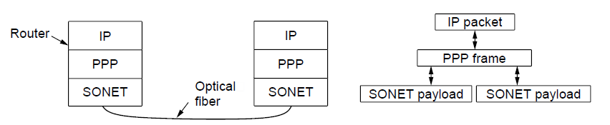
Link Example: PPP over SONET (2)
Think of SONET as a bit stream, and PPP as the framing that carries an IP packet over the link
PPP frames may be split over SONET payloads
Protocol stacks
Notes:
CN5E slides #3-42

Slide 22
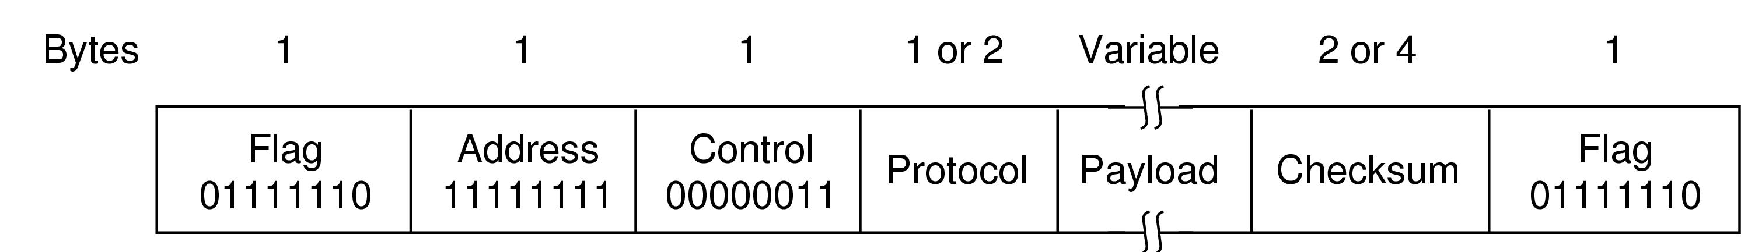
Link Example: PPP over SONET (3)
Framing uses byte stuffing
  FLAG is 0x7E and ESC is 0x7D. To stuff (unstuff) a byte, add (remove) ESC, and XOR byte with 0x20
Notes:
CN5E slides #3-42. Give examples of escape.

Slide 23
Error Coding Overview (§3.2)

Slide 24
Topic
Some bits will be received in error due to noise. What can we do?
  Detect errors with codes »
  Correct errors with codes »
  Retransmit lost frames
Reliability is a concern that cuts across the layers – we’ll see it again
Later
Notes:
Icons from cisco icon library

Slide 25
Problem – Noise may flip received bits
1
1
1
Signal
0
0
0
0
0
Slightly
Noisy
1
1
1
0
0
0
0
0
Very
noisy
1
1
1
0
0
0
0
0

Slide 26
Approach – Add Redundancy
Error detection codes
  Add check bits to the message bits to let some errors be detected
Error correction codes
  Add more check bits to let some errors be corrected
Key issue is now to structure the code to detect many errors with few check bits and modest computation

Slide 27
Motivating Example
A simple code to handle errors:
  Send two copies! Error if different.
How good is this code?
  How many errors can it detect/correct?
  How many errors will make it fail?
Notes:
Draw example of coded message. 2 errors can fool it

Slide 28
Motivating Example (2)
We want to handle more errors with less overhead
  Will look at better codes; they are applied mathematics
  But, they can’t handle all errors
  And they focus on accidental errors (will look at secure hashes later)
Notes:
2 errors can fool it -- weak

Slide 29
Using Error Codes
Codeword consists of D data plus R check bits (=systematic block code)
Sender:
  Compute R check bits based on the D data bits; send the codeword of D+R bits
Data bits
Check bits
D
R=fn(D)

Slide 30
Using Error Codes (2)
Receiver:
  Receive D+R bits with unknown errors
  Recompute R check bits based on the D data bits; error if R doesn’t match R’
Data bits
Check bits
D
R’
=?
R=fn(D)
Notes:
Note error may be in data or check bits

Slide 31
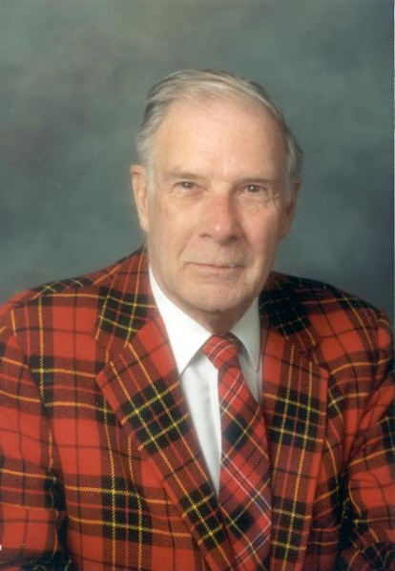
R.W. Hamming (1915-1998)
Much early work on codes:
  “Error Detecting and Error Correcting Codes”, BSTJ, 1950
See also:
  “You and Your Research”, 1986
Source: IEEE GHN, © 2009, IEEE
Notes:
Source: IEEE GHN, http://www.ieeeghn.org/wiki/index.php/File:Richard_Hamming_1598.jpg, Image policy: http://www.ieeeghn.org/wiki/index.php/IEEE_GHN_image_policy

Slide 32
Intuition for Error Codes
For D data bits, R check bits:
Randomly chosen codeword is unlikely to be correct; overhead is low
All
codewords
Correct
codewords

Slide 33
Hamming Distance
Distance is the number of bit flips needed to change D₁ to D₂
Hamming distance of a code is the minimum distance between any pair of codewords
Notes:
Use 0 -> 000 and 1 -> 111 as an example

Slide 34
Hamming Distance (2)
Error detection:
  For a code of distance d+1, up to d errors will always be detected
Notes:
Use 000, 111 code to show error detection

Slide 35
Hamming Distance (3)
Alternatively, error correction:
  For a code of distance 2d+1, up to d errors can always be corrected
Notes:
Use 000, 111 code to show error correction

Slide 36
Error Detection (§3.2.2)

Slide 37
Topic
Some bits may be received in error due to noise. How do we detect this?
  Parity »
  Checksums »
  CRCs »
Detection will let us fix the error, for example, by retransmission (later).
Notes:
Icons from cisco icon library

Slide 38
Simple Error Detection – Parity Bit
Take D data bits, add 1 check bit that is the sum of the D bits
  Sum is modulo 2 or XOR
Notes:
Give example for 7 data bits

Slide 39
Parity Bit (2)
How well does parity work?
  What is the distance of the code?
  How many errors will it detect/correct?
What about larger errors?
Notes:
Give example for 7 data bits

Slide 40
Checksums
Idea: sum up data in N-bit words
  Widely used in, e.g., TCP/IP/UDP
Stronger protection than parity
1500 bytes
16 bits

Slide 41
Internet Checksum
Sum is defined in 1s complement arithmetic (must add back carries)
  And it’s the negative sum
“The checksum field is the 16 bit one's complement of the one's complement sum of all 16 bit words …” – RFC 791
Notes:
Give example of 5 and -5 in 1s and 2s complement

Slide 42
Internet Checksum (2)
Sending:
Arrange data in 16-bit words
Put zero in checksum position, add
Add any carryover back to get 16 bits
Negate (complement) to get sum
0001
f203
f4f5
f6f7
+(0000)
------
2ddf0
ddf0
+ 2
------
ddf2
220d
Notes:
Work through example

Slide 43
Internet Checksum (3)
Sending:
Arrange data in 16-bit words
Put zero in checksum position, add
Add any carryover back to get 16 bits
Negate (complement) to get sum
0001
f203
f4f5
f6f7
+(0000)
------
2ddf0
ddf0
+ 2
------
ddf2
220d

Slide 44
Internet Checksum (4)
Receiving:
Arrange data in 16-bit words
Checksum will be non-zero, add
Add any carryover back to get 16 bits
Negate the result and check it is 0
0001
f203
f4f5
f6f7
+ 220d
------
2fffd
fffd
+ 2
------
ffff
0000
Notes:
Work through example

Slide 45
Internet Checksum (5)
Receiving:
Arrange data in 16-bit words
Checksum will be non-zero, add
Add any carryover back to get 16 bits
Negate the result and check it is 0
0001
f203
f4f5
f6f7
+ 220d
------
2fffd
fffd
+ 2
------
ffff
0000

Slide 46
Internet Checksum (6)
How well does the checksum work?
  What is the distance of the code?
  How many errors will it detect/correct?
What about larger errors?
Notes:
Dist is 2, so fooled by 2 errors. But handles bursts up to 16 errors for a 16 bit checksum, and large errors ½^16

Slide 47
Cyclic Redundancy Check (CRC)
Even stronger protection
  Given n data bits, generate k check bits such that the n+k bits are evenly divisible by a generator C
Example with numbers:
  n = 302, k = one digit, C = 3
Notes:
Work though example: remainder is 2, need to add 1 to be divisible, so checksum is 1

Slide 48
CRCs (2)
The catch:
  It’s based on mathematics of finite fields, in which “numbers” represent polynomials
  e.g, 10011010 is x⁷ + x⁴ + x³ + x¹
What this means:
  We work with binary values and operate using modulo 2 arithmetic

Slide 49
CRCs (2)
Send Procedure:
Extend the n data bits with k zeros
Divide by the generator value C
Keep remainder, ignore quotient
Adjust k check bits by remainder
Receive Procedure:
Divide and check for zero remainder

Slide 50
CRCs (3)
Data bits:
1101011111
Check bits:
C(x)=x⁴+x¹+1
C = 10011
k = 4
  1 0 0 1 1 1 1 0 1 0 1 1 1 1 1
Notes:
Work it through …

Slide 51
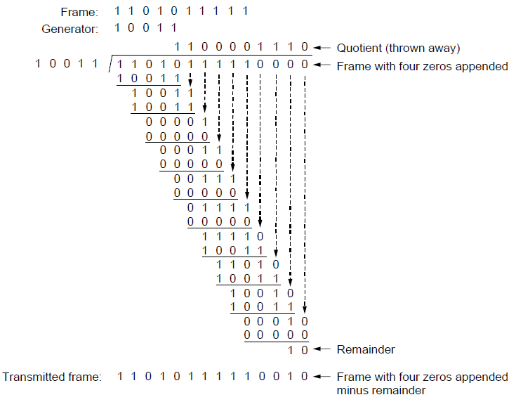
CRCs (3)
Notes:
CN5E slides #3-19

Slide 52
CRCs (4)
Protection depend on generator
  Standard CRC-32 is 10000010 01100000 10001110 110110111
Properties:
  HD=4, detects up to triple bit errors
  Also odd number of errors
  And bursts of up to k bits in error
  Not vulnerable to systematic errors like checksums

Slide 53
Error Detection in Practice
CRCs are widely used on links
  Ethernet, 802.11, ADSL, Cable …
Checksum used in Internet
  IP, TCP, UDP … but it is weak
Parity
  Is little used

Slide 54
Announcements
Hints for Project 1
Next assignment: Wireshark lab
Midterm date: Feb 8th
Coursera Quizes

Slide 55
Error Correction (§3.2.3)

Slide 56
Topic
Some bits may be received in error due to noise. How do we fix them?
  Hamming code »
  Other codes »
And why should we use detection when we can use correction?
Notes:
Icons from cisco icon library

Slide 57
Why Error Correction is Hard
If we had reliable check bits we could use them to narrow down the position of the error
  Then correction would be easy
But error could be in the check bits as well as the data bits!
  Data might even be correct

Slide 58
Intuition for Error Correcting Code
Suppose we construct a code with a Hamming distance of at least 3
  Need ≥3 bit errors to change one valid codeword into another
  Single bit errors will be closest to a unique valid codeword
If we assume errors are only 1 bit, we can correct them by mapping an error to the closest valid codeword
  Works for d errors if HD ≥ 2d 1

Slide 59
Intuition (2)
Visualization of code:
Valid
codeword
A
Error
codeword
B

Slide 60
Intuition (3)
Visualization of code:
Valid
codeword
Single
bit error
from A
A
Three bit
errors to
get to B
Error
codeword
B

Slide 61
Hamming Code
Gives a method for constructing a code with a distance of 3
  Uses k check bits for 2^{k-1} data bits
  Put check bits in positions p that are powers of 2, starting with position 1
  Check bit in position p is parity of positions with a p term in their values
Plus an easy way to correct [soon]

Slide 62
Hamming Code (2)
Example: data=0101, 3 check bits
  7 bit code, check bit positions 1, 2, 4
  Check 1 covers positions 1, 3, 5, 7
  Check 2 covers positions 2, 3, 6, 7
  Check 4 covers positions 4, 5, 6, 7
_ _ _ _ _ _ _
1 2 3 4 5 6 7
Notes:
Fill in data, compute parity bits, add them in, draw arrow

Slide 63
Hamming Code (3)
Example: data=0101, 3 check bits
  7 bit code, check bit positions 1, 2, 4
  Check 1 covers positions 1, 3, 5, 7
  Check 2 covers positions 2, 3, 6, 7
  Check 4 covers positions 4, 5, 6, 7
0 1 0 0 1 0 1
p₁= 0+1+1 = 0, p₂= 0+0+1 = 1, p₄= 1+0+1 = 0
1 2 3 4 5 6 7

Slide 64
Hamming Code (4)
To decode:
  Recompute check bits (with parity sum including the check bit)
  Arrange as a binary number
  Value (syndrome) tells error position
  Value of zero means no error
  Otherwise, flip bit to correct

Slide 65
Hamming Code (5)
Example, continued
0 1 0 0 1 0 1
p₁= p₂=
p₄=
Syndrome =
Data =
1 2 3 4 5 6 7

Slide 66
Hamming Code (6)
Example, continued
0 1 0 0 1 0 1
p₁= 0+0+1+1 = 0, p₂= 1+0+0+1 = 0,
p₄= 0+1+0+1 = 0
Syndrome = 000, no error
Data = 0 1 0 1
1 2 3 4 5 6 7

Slide 67
Hamming Code (7)
Example, continued
0 1 0 0 1 1 1
p₁= p₂=
p₄=
Syndrome =
Data =
1 2 3 4 5 6 7

Slide 68
Hamming Code (8)
Example, continued
0 1 0 0 1 1 1
p₁= 0+0+1+1 = 0, p₂= 1+0+1+1 = 1,
p₄= 0+1+1+1 = 1
Syndrome = 1 1 0, flip position 6
Data = 0 1 0 1 (correct after flip!)
1 2 3 4 5 6 7

Slide 69
Other Error Correction Codes
Codes used in practice are much more involved than Hamming
Convolutional codes (§3.2.3)
  Take a stream of data and output a mix of the recent input bits
  Makes each output bit less fragile
  Decode using Viterbi algorithm (which can use bit confidence values)

Slide 70
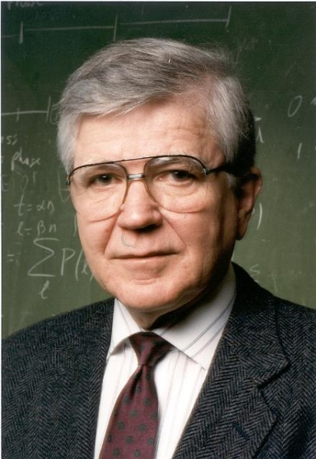
Other Codes (2) – LDPC
Low Density Parity Check (§3.2.3)
  LDPC based on sparse matrices
  Decoded iteratively using a belief propagation algorithm
  State of the art today
Invented by Robert Gallager in 1963 as part of his PhD thesis
  Promptly forgotten until 1996 …
Source: IEEE GHN, © 2009, IEEE
Notes:
Source IEEE GHN, http://www.ieeeghn.org/wiki/index.php/Oral-History:Robert_Gallager. Image policy: http://www.ieeeghn.org/wiki/index.php/IEEE_GHN_image_policy

Slide 71
Detection vs. Correction
Which is better will depend on the pattern of errors. For example:
  1000 bit messages with a bit error rate (BER) of 1 in 10000
Which has less overhead?

Slide 72
Detection vs. Correction
Which is better will depend on the pattern of errors. For example:
  1000 bit messages with a bit error rate (BER) of 1 in 10000
Which has less overhead?
  It depends! We need to know more about the errors

Slide 73
Detection vs. Correction (2)
Assume bit errors are random
  Messages have 0 or maybe 1 error
Error correction:
  Need ~10 check bits per message
  Overhead:
Error detection:
  Need ~1 check bits per message plus 1000 bit retransmission 1/10 of the time
  Overhead:

Slide 74
Detection vs. Correction (3)
Assume errors come in bursts of 100
  Only 1 or 2 messages in 1000 have errors
Error correction:
  Need >>100 check bits per message
  Overhead:
Error detection:
  Need 32? check bits per message plus 1000 bit resend 2/1000 of the time
  Overhead:

Slide 75
Detection vs. Correction (4)
Error correction:
  Needed when errors are expected
  Or when no time for retransmission
Error detection:
  More efficient when errors are not expected
  And when errors are large when they do occur

Slide 76
Error Correction in Practice
Heavily used in physical layer
  Convolutional codes widely used in practice
  LDPC is the future, used for demanding links like 802.11, DVB, WiMAX, LTE, power-line, …
Error detection (w/ retransmission) is used in the link layer and above for residual errors
Also used in the application layer
  With an erasure error model
  E.g., Reed-Solomon (CDs, DVDs, etc.)

Slide 77
Retransmissions (ARQ) (§3.3)

Slide 78
Topic
Two strategies to handle errors:
Detect errors and retransmit frame (Automatic Repeat reQuest, ARQ)
Correct errors with an error correcting code
Done this
Notes:
Mention: or combinations of 1 and 2

Slide 79
ARQ
ARQ often used when errors are common or must be corrected
  E.g., WiFi, and TCP (later)
Rules at sender and receiver:
  Receiver automatically acknowledges correct frames with an ACK
  Sender automatically resends after a timeout, until an ACK is received

Slide 80
ARQ (2)
Normal operation (no loss)
Sender
Receiver
Frame
Time
Timeout
ACK

Slide 81
ARQ (3)
Loss and retransmission
Sender
Receiver
Frame
X
Time
Timeout
Frame
ACK

Slide 82
So What’s Tricky About ARQ?
Two non-trivial issues:
  How long to set the timeout? »
  How to avoid accepting duplicate frames as new frames »
Want performance in the common case and correctness always

Slide 83
Timeouts
Timeout should be:
  Not too big (link goes idle)
  Not too small (spurious resend)
Fairly easy on a LAN
  Clear worst case, little variation
Fairly difficult over the Internet
  Much variation, no obvious bound
  We’ll revisit this with TCP (later)

Slide 84
Duplicates
What happens if an ACK is lost?
Sender
Receiver
Frame
Timeout
X
ACK
New
Frame?
Notes:
Fill in figure

Slide 85
Duplicates (2)
What happens if an ACK is lost?
Sender
Receiver
Frame
Timeout
X
ACK
Frame
New
Frame??
New
Frame?
ACK

Slide 86
Duplicates (3)
Or the timeout is early?
Sender
Receiver
Frame
Timeout
ACK
New
Frame?
Notes:
Fill in

Slide 87
Duplicates (4)
Or the timeout is early?
Sender
Receiver
Frame
Timeout
ACK
Frame
New
Frame??
New
Frame?
ACK

Slide 88
Sequence Numbers
Frames and ACKs must both carry sequence numbers for correctness
To distinguish the current frame from the next one, a single bit (two numbers) is sufficient
  Called Stop-and-Wait

Slide 89
Stop-and-Wait
In the normal case:
Sender
Receiver
Time

Slide 90
Stop-and-Wait (2)
In the normal case:
Sender
Receiver
Frame 0
ACK 0
Time
Timeout
Frame 1
ACK 1

Slide 91
Stop-and-Wait (3)
With ACK loss:
Sender
Receiver
Frame 0
Timeout
X
ACK 0
New
Frame?

Slide 92
Stop-and-Wait (4)
With ACK loss:
Sender
Receiver
Frame 0
Timeout
X
ACK 0
Frame 0
It’s a
Resend!
New
Frame?
ACK 0

Slide 93
Stop-and-Wait (5)
With early timeout:
Sender
Receiver
Frame 0
Timeout
ACK 0
New
Frame?

Slide 94
Stop-and-Wait (6)
With early timeout:
Sender
Receiver
Frame 0
Timeout
ACK 0
Frame 0
It’s a
Resend
New
Frame?
OK …
ACK 0

Slide 95
Limitation of Stop-and-Wait
It allows only a single frame to be outstanding from the sender:
  Good for LAN, not efficient for high BD
Ex: R=1 Mbps, D = 50 ms
  How many frames/sec? If R=10 Mbps?

Slide 96
Sliding Window
Generalization of stop-and-wait
  Allows W frames to be outstanding
  Can send W frames per RTT
  Various options for numbering frames/ACKs and handling loss
    Will look at along with TCP (later)

Slide 97
Multiplexing(§2.5.3, 2.5.4)

Slide 98
Topic
Multiplexing is the network word for the sharing of a resource
Classic scenario is sharing a link among different users
  Time Division Multiplexing (TDM) »
  Frequency Division Multiplexing (FDM) »

Slide 99
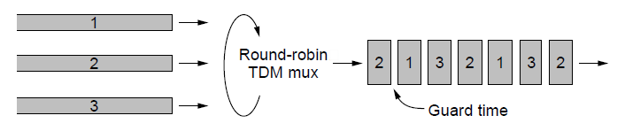
Time Division Multiplexing (TDM)
Users take turns on a fixed schedule
2
2
2
2
Notes:
CN5E slides #2-38

Slide 100
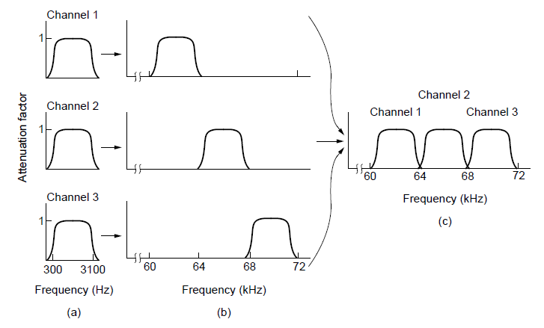
Frequency Division Multiplexing (FDM)
Put different users on different frequency bands
Overall FDM channel
Notes:
CN5E slides #2-36

Slide 101
TDM versus FDM
In TDM a user sends at a high rate a fraction of the time; in FDM, a user sends at a low rate all the time
Rate
TDM
Time
FDM

Slide 102
TDM versus FDM (2)
In TDM a user sends at a high rate a fraction of the time; in FDM, a user sends at a low rate all the time
Rate
TDM
Time
FDM

Slide 103
TDM/FDM Usage
Statically divide a resource
  Suited for continuous traffic, fixed number of users
Widely used in telecommunications
  TV and radio stations (FDM)
  GSM (2G cellular) allocates calls using TDM within FDM

Slide 104
Multiplexing Network Traffic
Network traffic is bursty
  ON/OFF sources
  Load varies greatly over time
Rate
Time
Rate
Time

Slide 105
Multiplexing Network Traffic (2)
Network traffic is bursty
  Inefficient to always allocate user their ON needs with TDM/FDM
Rate
R
Time
Rate
R
Time

Slide 106


Multiplexing Network Traffic (3)
Multiple access schemes multiplex users according to their demands – for gains of statistical multiplexing
Two users, each need R
Together they need R’ < 2R
Rate
R
Rate
R’<2R
Time
Rate
R
Time
Time

Slide 107
Multiple Access
We will look at two kinds of multiple access protocols
Randomized. Nodes randomize their resource access attempts
  Good for low load situations
Contention-free. Nodes order their resource access attempts
  Good for high load or guaranteed quality of service situations

Slide 108
Randomized Multiple Access (§4. 2.1-4.2.2, 4.3.1-4.3.3)

Slide 109
Topic
How do nodes share a single link? Who sends when, e.g., in WiFI?
  Explore with a simple model
Assume no-one is in charge; this is a distributed system
Notes:
Icon from Cisco icon library.

Slide 110
Topic (2)
We will explore random multiple access control (MAC) protocols
  This is the basis for classic Ethernet
  Remember: data traffic is bursty
Busy!
Zzzz..
Ho hum
Notes:
Icon from Cisco icon library.

Slide 111

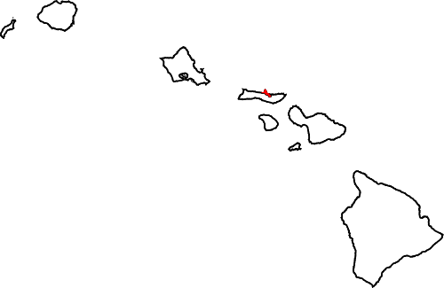

ALOHA Network
Seminal computer network connecting the Hawaiian islands in the late 1960s
  When should nodes send?
  A new protocol was devised by Norm Abramson …
Hawaii
Notes:
Map from wikipedia commons, public domain. Radio from openclipart.org

Slide 112
ALOHA Protocol
Simple idea:
  Node just sends when it has traffic.
  If there was a collision (no ACK received) then wait a random time and resend
That’s it!

Slide 113
ALOHA Protocol (2)
Some frames will be lost, but many may get through…
Good idea?
Notes:
From CN5E figures #4-2

Slide 114
ALOHA Protocol (3)
Simple, decentralized protocol that works well under low load!
Not efficient under high load
  Analysis shows at most 18% efficiency
  Improvement: divide time into slots and efficiency goes up to 36%
We’ll look at other improvements

Slide 115
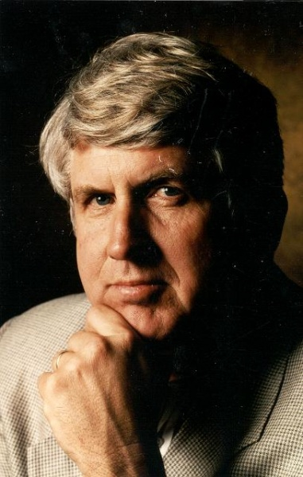
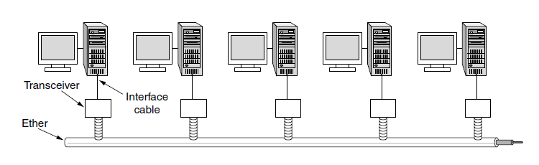
Classic Ethernet
ALOHA inspired Bob Metcalfe to invent Ethernet for LANs in 1973
  Nodes share 10 Mbps coaxial cable
  Hugely popular in 1980s, 1990s
: © 2009 IEEE
Notes:
Photo from IEEE GHN. Figure from CN5E slides #4-22

Slide 116
CSMA (Carrier Sense Multiple Access)
Improve ALOHA by listening for activity before we send (Doh!)
  Can do easily with wires, not wireless
So does this eliminate collisions?
  Why or why not?

Slide 117
CSMA (2)
Still possible to listen and hear nothing when another node is sending because of delay
CSMA is a good defense against collisions only when BD is small

Slide 118
CSMA (3)
Still possible to listen and hear nothing when another node is sending because of delay
CSMA is a good defense against collisions only when BD is small
X

Slide 119
CSMA/CD (with Collision Detection)
Can reduce the cost of collisions by detecting them and aborting (Jam) the rest of the frame time
  Again, we can do this with wires
Jam!
X X X X X X X X
Jam!

Slide 120
CSMA/CD Complications
Want everyone who collides to know that it happened
  Time window in which a node may hear of a collision is 2D seconds
X

Slide 121
CSMA/CD Complications (2)
Impose a minimum frame size that lasts for 2D seconds
  So node can’t finish before collision
  Ethernet minimum frame is 64 bytes
X

Slide 122
CSMA “Persistence”
What should a node do if another node is sending?
Idea: Wait until it is done, and send
What now?

Slide 123
CSMA “Persistence” (2)
Problem is that multiple waiting nodes will queue up then collide
  More load, more of a problem
Now!
Uh oh
Now!

Slide 124
CSMA “Persistence” (3)
Intuition for a better solution
  If there are N queued senders, we want each to send next with probability 1/N
Send p=½
Whew
Send p=½

Slide 125
Binary Exponential Backoff (BEB)
Cleverly estimates the probability
  1st collision, wait 0 or 1 frame times
  2nd collision, wait from 0 to 3 times
  3rd collision, wait from 0 to 7 times …
BEB doubles interval for each successive collision
  Quickly gets large enough to work
  Very efficient in practice

Slide 126
Classic Ethernet, or IEEE 802.3
Most popular LAN of the 1980s, 1990s
  10 Mbps over shared coaxial cable, with baseband signals
  Multiple access with “1-persistent CSMA/CD with BEB”
Notes:
Figure from CN5E slides #4-22

Slide 127
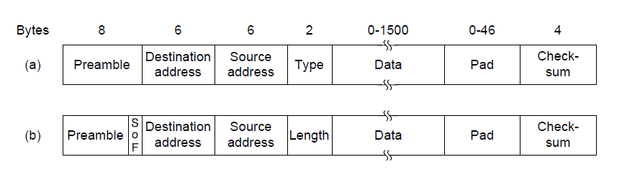
Ethernet Frame Format
Has addresses to identify the sender and receiver
CRC-32 for error detection; no ACKs or retransmission
Start of frame identified with physical layer preamble
Packet from Network layer (IP)
Notes:
Figure derived from CN5E slides #4-23

Slide 128
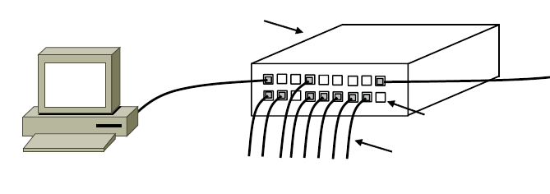
Modern Ethernet
Based on switches, not multiple access, but still called Ethernet
  We’ll get to it in a later segment
Switch
Switch ports
Twisted pair
Notes:
Figure from CN5E #4-27

Slide 129
Wireless Multiple Access (§4.2.5, 4.4)

Slide 130

Topic
How do wireless nodes share a single link? (Yes, this is WiFi!)
  Build on our simple, wired model
Send?
Send?
Notes:
Icon from Cisco icon library. AP from pixabay.

Slide 131

Wireless Complications
Wireless is more complicated than the wired case (Surprise!)
  Nodes may have different areas of coverage – doesn’t fit Carrier Sense »
  Nodes can’t hear while sending – can’t Collision Detect »
≠ CSMA/CD
Notes:
Icon from Cisco icon library. AP from pixabay.

Slide 132
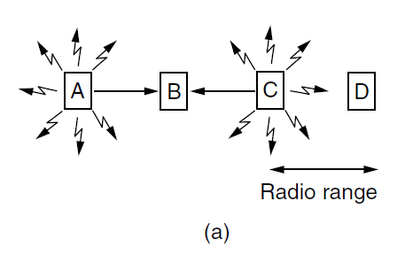
Different Coverage Areas
Wireless signal is broadcast and received nearby, where there is sufficient SNR
Notes:
CN5E slides #4-18

Slide 133
Hidden Terminals
Nodes A and C are hidden terminals when sending to B
  Can’t hear each other (to coordinate) yet collide at B
  We want to avoid the inefficiency of collisions
Notes:
CN5E slides #4-18

Slide 134
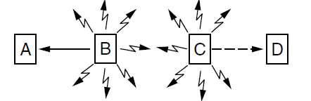
Exposed Terminals
B and C are exposed terminals when sending to A and D
  Can hear each other yet don’t collide at receivers A and D
  We want to send concurrently to increase performance
Notes:
CN5E slides #4-18

Slide 135
Nodes Can’t Hear While Sending
With wires, detecting collisions (and aborting) lowers their cost
More wasted time with wireless
Wired
Collision
Wireless
Collision
Resend
Resend
X
XXXXXXXXX
X
Time
XXXXXXXXX

Slide 136
Possible Solution: MACA
MACA uses a short handshake instead of CSMA (Karn, 1990)
  802.11 uses a refinement of MACA (later)
Protocol rules:
  A sender node transmits a RTS (Request-To-Send, with frame length)
  The receiver replies with a CTS (Clear-To-Send, with frame length)
  Sender transmits the frame while nodes hearing the CTS stay silent
  Collisions on the RTS/CTS are still possible, but less likely

Slide 137
MACA – Hidden Terminals
A→B with hidden terminal C
  A sends RTS, to B
A
B
C
D
Notes:
CN5E slides #4-18

Slide 138
MACA – Hidden Terminals (2)
A→B with hidden terminal C
  B sends CTS, to A, and C too
RTS
A
B
C
D
Notes:
CN5E slides #4-18

Slide 139
MACA – Hidden Terminals (3)
A→B with hidden terminal C
  B sends CTS, to A, and C too
Alert!
RTS
A
B
C
D
CTS
CTS
Notes:
CN5E slides #4-18

Slide 140
MACA – Hidden Terminals (4)
A→B with hidden terminal C
  A sends frame while C defers
Quiet...
Frame
Notes:
CN5E slides #4-18

Slide 141
MACA – Exposed Terminals
B→A, C→D as exposed terminals
  B and C send RTS to A and D
A
B
C
D
Notes:
CN5E slides #4-18

Slide 142
MACA – Exposed Terminals (2)
B→A, C→D as exposed terminals
  A and D send CTS to B and C
RTS
RTS
A
B
C
D
Notes:
CN5E slides #4-18

Slide 143
MACA – Exposed Terminals (3)
B→A, C→D as exposed terminals
  A and D send CTS to B and C
All OK
All OK
RTS
RTS
A
B
C
D
CTS
CTS
Notes:
CN5E slides #4-18

Slide 144
MACA – Exposed Terminals (4)
B→A, C→D as exposed terminals
  A and D send CTS to B and C
Frame
Frame
A
B
C
D
Notes:
CN5E slides #4-18

Slide 145
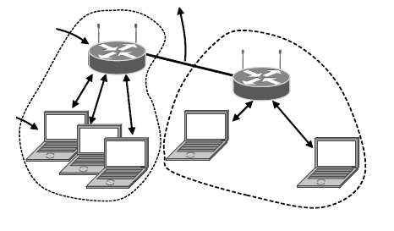
802.11, or WiFi
Very popular wireless LAN started in the 1990s
Clients get connectivity from a (wired) AP (Access Point)
It’s a multi-access problem ☺
Various flavors have been developed over time
  Faster, more features
To Network
Access
Point
Client
Notes:
CN5E slides #4-32

Slide 146
802.11 Physical Layer
Uses 20/40 MHz channels on ISM bands
  802.11b/g/n on 2.4 GHz
  802.11 a/n on 5 GHz
OFDM modulation (except legacy 802.11b)
  Different amplitudes/phases for varying SNRs
  Rates from 6 to 54 Mbps plus error correction
  802.11n uses multiple antennas; see “802.11 with Multiple Antennas for Dummies”
Notes:
Figure from CN5E slides #4-22

Slide 147
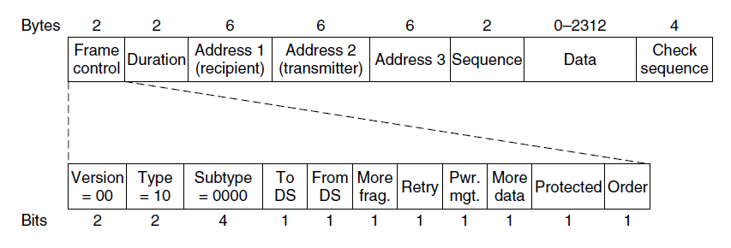
802.11 Link Layer
Multiple access uses CSMA/CA (next); RTS/CTS optional
Frames are ACKed and retransmitted with ARQ
Funky addressing (three addresses!) due to AP
Errors are detected with a 32-bit CRC
Many, many features (e.g., encryption, power save)
Packet from Network layer (IP)
Notes:
CN5E slides #4-38

Slide 148
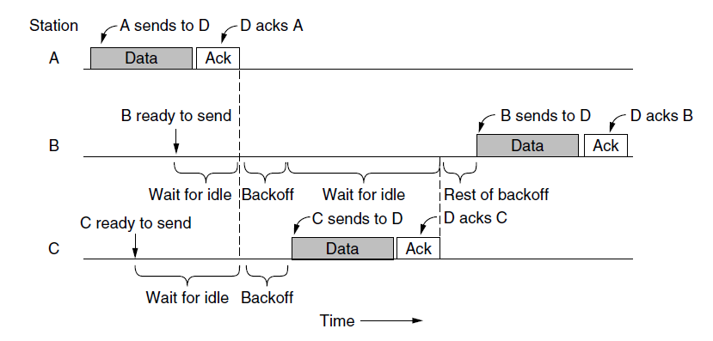
802.11 CSMA/CA for Multiple Access
Sender avoids collisions by inserting small random gaps
  E.g., when both B and C send, C picks a smaller gap, goes first
Send?
Send?
Time

Slide 149
The Future of 802.11 (Guess)
Likely ubiquitous for Internet connectivity
  Greater diversity, from low- to high-end devices
Innovation in physical layer drives speed
  And power-efficient operation too
More seamless integration of connectivity
  Too manual now, and limited (e.g., device-to-device)

Slide 150
Contention-Free Multiple Access (§4.2.3)

Slide 151

Topic
A new approach to multiple access
  Based on turns, not randomization
2
3
1
4
Notes:
Icon from Cisco icon library. AP from pixabay.

Slide 152
Issues with Random Multiple Access
CSMA is good under low load:
  Grants immediate access
  Little overhead (collisions)
But not so good under high load:
  High overhead (expect collisions)
  Access time varies (lucky/unlucky)
We want to do better under load!

Slide 153
Turn-Taking Multiple Access Protocols
They define an order in which nodes get a chance to send
  Or pass, if no traffic at present
We just need some ordering …
  E.g., Token Ring »
  E.g., node addresses

Slide 154
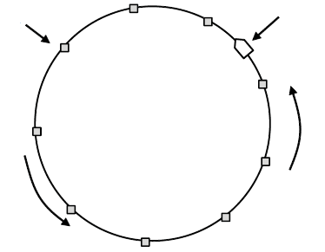
Token Ring
Arrange nodes in a ring; token rotates “permission to send” to each node in turn
Node
Token
Direction of
transmission

Slide 155
Turn-Taking Advantages
Fixed overhead with no collisions
  More efficient under load
Regular chance to send with no unlucky nodes
  Predictable service, easily extended to guaranteed quality of service

Slide 156
Turn-Taking Disadvantages
Complexity
  More things that can go wrong than random access protocols!
    E.g., what if the token is lost?
  Higher overhead at low load

Slide 157
Turn-Taking in Practice
Regularly tried as an improvement offering better service
  E.g., qualities of service
But random multiple access is hard to beat
  Simple, and usually good enough
  Scales from few to many nodes

Slide 158
Announcements
Wireshark homework due on Friday, come to office hours if you have questions
No class on Friday
Material for next week’s exam: everything including next topic on switches, spanning tree

Slide 159
LAN Switches (§4.x)

Slide 160
Topic
How do we connect nodes with a switch instead of multiple access
  Uses multiple links/wires
  Basis of modern (switched) Ethernet
Switch
Notes:
Icon from Cisco icon library.

Slide 161
Switched Ethernet
Hosts are wired to Ethernet switches with twisted pair
  Switch serves to connect the hosts
  Wires usually run to a closet
Switch
Switch ports
Twisted pair
Notes:
CN5E slides #4-27

Slide 162
What’s in the box?
Remember from protocol layers:
Hub, or
repeater
Physical
Physical
All look like this:
Switch
Link
Link
Network
Network
Router
Link
Link

Slide 163
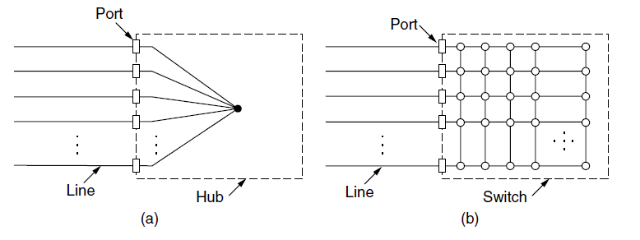
Inside a Hub
All ports are wired together; more convenient and reliable than a single shared wire
↔
Notes:
CN5e slides #4-26

Slide 164
Inside a Switch
Uses frame addresses to connect input port to the right output port; multiple frames may be switched in parallel
Fabric
. . .
Notes:
CN5e slides #4-26

Slide 165
Inside a Switch (2)
Port may be used for both input and output (full-duplex)
  Just send, no multiple access protocol
1
2
1 → 4
and
2 → 3
3
. . .
4
Notes:
CN5e slides #4-26

Slide 166
Inside a Switch (3)
Need buffers for multiple inputs to send to one output
Input
. . .
Output
. . .
. . .
. . .
Fabric
Output Buffer
Input Buffer
Notes:
CN5e slides #4-26

Slide 167
Inside a Switch (4)
Sustained overload will fill buffer and lead to frame loss
Loss!
XXX
Input
. . .
Output
. . .
. . .
. . .
Fabric
Output Buffer
Input Buffer
Notes:
CN5e slides #4-26

Slide 168
Advantages of Switches
Switches and hubs have replaced the shared cable of classic Ethernet
  Convenient to run wires to one location
  More reliable; wire cut is not a single point of failure that is hard to find
Switches offer scalable performance
  E.g., 100 Mbps per port instead of 100 Mbps for all nodes of shared cable / hub

Slide 169
Switch Forwarding
Switch needs to find the right output port for the destination address in the Ethernet frame. How?
  Want to let hosts be moved around readily; don’t look at IP
Ethernet Frame
Source
. . .
. . .
. . .
. . .
Destination
Notes:
CN5e slides #4-26

Slide 170
Backward Learning
Switch forwards frames with a port/address table as follows:
  To fill the table, it looks at the source address of input frames
  To forward, it sends to the port, or else broadcasts to all ports

Slide 171
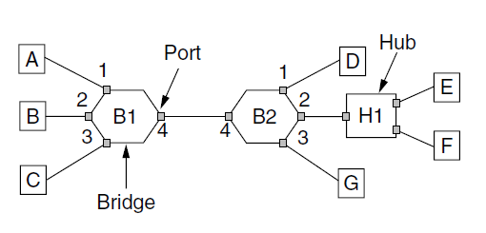
Backward Learning (2)
1: A sends to D
Address | Port
A
B
C
D
D
Switch
Notes:
CN5E slides #4-57

Slide 172
Backward Learning (3)
2: D sends to A
Address | Port
A | 1
B
C
D
D
Switch
Notes:
CN5E slides #4-57

Slide 173
Backward Learning (4)
3: D sends to A
Address | Port
A | 1
B
C
D | 4
D
Switch
Notes:
CN5E slides #4-57

Slide 174
Backward Learning (5)
3: D sends to A
Address | Port
A | 1
B
C
D | 4
D
Switch
Notes:
CN5E slides #4-57

Slide 175
Learning with Multiple Switches
Just works with multiple switches and a mix of hubs, assuming no loops in the topology, E.g., A sends to D
Switch
Notes:
CN5E slides #4-57

Slide 176
Learning with Multiple Switches (2)
Just works with multiple switches and a mix of hubs assuming no loops, e.g., A sends to D then D sends to A
Switch
Notes:
CN5E slides #4-57

Slide 177
Switch Spanning Tree (§4.x)

Slide 178
Topic
How can we connect switches in any topology so they just work
  This is part 2 of switched Ethernet
Loops – yikes!
Notes:
Icon from Cisco icon library.

Slide 179
Problem – Forwarding Loops
May have a loop in the topology
  Redundancy in case of failures
  Or a simple mistake
Want LAN switches to “just work”
  Plug-and-play, no changes to hosts
  But loops cause a problem …
Redundant
Links

Slide 180
Forwarding Loops (2)
Suppose the network is started and A sends to F. What happens?
A
B
C
Left / Right
D
E
F

Slide 181
Forwarding Loops (3)
Suppose the network is started and A sends to F. What happens?
  A → C → B, D-left, D-right
  D-left → C-right, E, F
  D-right → C-left, E, F
  C-right → D-left, A, B
  C-left → D-right, A, B
  D-left → …
  D-right → …
A
B
C
Left / Right
D
E
F

Slide 182
Spanning Tree Solution
Switches collectively find a spanning tree for the topology
  A subset of links that is a tree (no loops) and reaches all switches
  Then switches forward as normal on the spanning tree
  Broadcasts will go up to the root of the tree and down all the branches

Slide 183
Spanning Tree (2)
Topology
One ST
Another ST

Slide 184
Spanning Tree (3)
Topology
One ST
Another ST
Root

Slide 185
Spanning Tree Algorithm
Rules of the distributed game:
  All switches run the same algorithm
  They start with no information
  Operate in parallel and send messages
  Always search for the best solution
Ensures a highly robust solution
  Any topology, with no configuration
  Adapts to link/switch failures, …

Slide 186
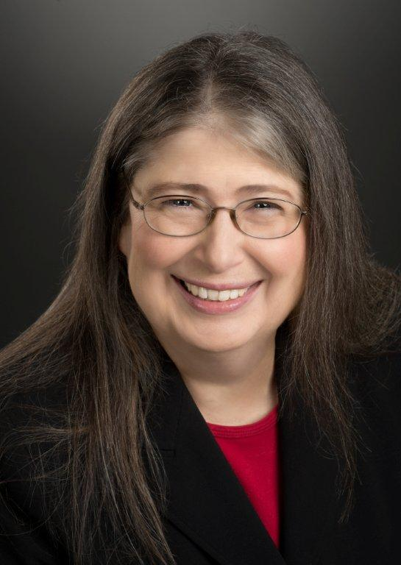
Radia Perlman (1952–)
Key early work on routing protocols
  Routing in the ARPANET
  Spanning Tree for switches (next)
  Link-state routing (later)
Now focused on network security
Notes:
Yes. You have my permission to use Algorhyme, and here is a picture of me that I prefer.
Radia
On Sun, Jan 13, 2013 at 4:20 AM, David Wetherall<djw@cs.washington.edu> wrote:
Hi Radia,
Happy New Year to you, and I hope you're well.
I'm in Barcelona with my family on a sabbatical -- wonderful city -- and also helping with a massive open online networking course hosted on Coursera.
I'd like to include your algorhyme and a picture of you (please don't be shy!) in a future lecture. Do I have your permission for the algorhyme, and is there a photo you'd prefer for which you could give me permissions? There is a public domain photo at http://en.wikipedia.org/wiki/File:Radia_Perlman_2009.jpg which looks good to me.
Cheers,
David

Slide 187
Spanning Tree Algorithm (2)
Outline:
  Elect a root node of the tree (switch with the lowest address)
  Grow tree as shortest distances from the root (using lowest address to break distance ties)
  Turn off ports for forwarding if they aren’t on the spanning tree

Slide 188
Spanning Tree Algorithm (3)
Details:
  Each switch initially believes it is the root of the tree
  Each switch sends periodic updates to neighbors with:
    Its address, address of the root, and distance (in hops) to root
  Switches favors ports with shorter distances to lowest root
    Uses lowest address as a tie for distances
Hi, I’m C, the root is A, it’s 2 hops away
or (C, A, 2)
C

Slide 189
Spanning Tree Example
1st round, sending:
  A sends (A, A, 0) to say it is root
  B, C, D, E, and F do likewise
1st round, receiving:
  A still thinks is it (A, A, 0)
  B still thinks (B, B, 0)
  C updates to (C, A, 1)
  D updates to (D, C, 1)
  E updates to (E, A, 1)
  F updates to (F, B, 1)
A,A,0
B,B,0
C,C,0
D,D,0
E,E,0
F,F,0

Slide 190
Spanning Tree Example (2)
2nd round, sending
  Nodes send their updated state
2nd round receiving:
  A remains (A, A, 0)
  B updates to (B, A, 2) via C
  C remains (C, A, 1)
  D updates to (D, A, 2) via C
  E remains (E, A, 1)
  F remains (F, B, 1)
A,A,0
B,B,0
C,A,1
D,C,1
E,A,1
F,B,1

Slide 191
Spanning Tree Example (3)
3rd round, sending
  Nodes send their updated state
3rd round receiving:
  A remains (A, A, 0)
  B remains (B, A, 2) via C
  C remains (C, A, 1)
  D remains (D, A, 2) via C-left
  E remains (E, A, 1)
  F updates to (F, A, 3) via B
A,A,0
B,A,2
C,A,1
D,A,2
E,A,1
F,B,1

Slide 192
Spanning Tree Example (4)
4th round
  Steady-state has been reached
  Nodes turn off forwarding that is not on the spanning tree
Algorithm continues to run
  Adapts by timing out information
  E.g., if A fails, other nodes forget it, and B will become the new root
A,A,0
B,A,2
C,A,1
D,A,2
E,A,1
F,A,3

Slide 193
Spanning Tree Example (5)
Forwarding proceeds as usual on the ST
Initially D sends to F:
And F sends back to D:
A,A,0
B,A,2
C,A,1
D,A,2
E,A,1
F,A,3

Slide 194
Spanning Tree Example (6)
Forwarding proceeds as usual on the ST
Initially D sends to F:
  D → C-left
  C → A, B
  A → E
  B → F
And F sends back to D:
  F → B
  B → C
  C → D
  (hm, not such a great route)
A,A,0
B,A,2
C,A,1
D,A,2
E,A,1
F,A,3

Slide 195
Algorhyme (Radia Perlman, 1985)
I think that I shall never see
A graph more lovely than a tree.
A tree whose crucial property
Is loop-free connectivity.
A tree that must be sure to span
So packets can reach every LAN.
First, the root must be selected.
By ID, it is elected.
Least-cost paths from root are traced.
In the tree, these paths are placed.
A mesh is made by folks like me,
Then bridges find a spanning tree.

