Slide 1
Overview of the Physical Layer

Slide 2
Where we are in the Course
Beginning to work our way up starting with the Physical layer
Application
Transport
Network
Link
Physical

Slide 3
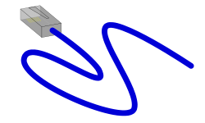

Scope of the Physical Layer
Concerns how signals are used to transfer message bits over a link
  Wires etc. carry analog signals
  We want to send digital bits
10110…
…10110
Signal

Slide 4
Topics
Properties of media
  Wires, fiber optics, wireless
Simple signal propagation
  Bandwidth, attenuation, noise
Modulation schemes
  Representing bits, noise
Fundamental limits
  Nyquist, Shannon

Slide 5
Simple Link Model
We’ll end with abstraction of a physical channel
  Rate (or bandwidth, capacity, speed) in bits/second
  Delay in seconds, related to length
Other important properties:
  Whether the channel is broadcast, and its error rate
Message
Delay D, Rate R

Slide 6
Message Latency
Latency is the delay to send a message over a link
  Transmission delay: time to put M-bit message “on the wire”
  Propagation delay: time for bits to propagate across the wire
  Combining the two terms we have:

Slide 7
Message Latency (2)
Latency is the delay to send a message over a link
  Transmission delay: time to put M-bit message “on the wire”
    T-delay = M (bits) / Rate (bits/sec) = M/R seconds
  Propagation delay: time for bits to propagate across the wire
    P-delay = Length / speed of signals = L/⅔c = D seconds
  Combining the two terms we have: Latency = M/R + D

Slide 8
Metric Units
The main prefixes we use:
Use powers of 10 for rates, 2 for storage
  1 Mbps = 1,000,000 bps, 1 KB = 1024 bytes
“B” is for bytes, “b” is for bits
Prefix | Exp. | prefix | exp.
K(ilo) | 10³ | m(illi) | 10⁻³
M(ega) | 10⁶ | μ(micro) | 10⁻⁶
G(iga) | 10⁹ | n(ano) | 10⁻⁹
Notes:
From CN5E Slides #1-42

Slide 9
Latency Examples
“Dialup” with a telephone modem:
  D = 5ms, R = 56 kbps, M = 1250 bytes
Broadband cross-country link:
  D = 50ms, R = 10 Mbps, M = 1250 bytes

Slide 10
Latency Examples (2)
“Dialup” with a telephone modem:
  D = 5ms, R = 56 kbps, M = 1250 bytes
  L = 5ms + (1250 x 8)/(56 x 10³) sec = 184ms!
Broadband cross-country link:
  D = 50ms, R = 10 Mbps, M = 1250 bytes
  L = 50ms + (1250 x 8) / (10 x 10⁶) sec = 51ms
A long link or a slow rate means high latency
  Often, one delay component dominates

Slide 11
Bandwidth-Delay Product
Messages take space on the wire!
The amount of data in flight is the bandwidth-delay (BD) product
  Measure in bits, or in messages
  Small for LANs, big for “long fat” pipes

Slide 12


Bandwidth-Delay Example
Fiber at home, cross-country
  R=40 Mbps, D=50ms
  BD = 40 x 50 x 10³ bits
  = 250 KB
That’s quite a lot of data “in the network”!
110101000010111010101001011
Notes:
AU outline, book from openclipart.org

Slide 13
Media (Wires, etc.) (§2.2, 2.3)

Slide 14
Types of Media
Media propagate signals that carry bits of information
We’ll look at some common types:
  Wires »
  Fiber (fiber optic cables) »
  Wireless »

Slide 15
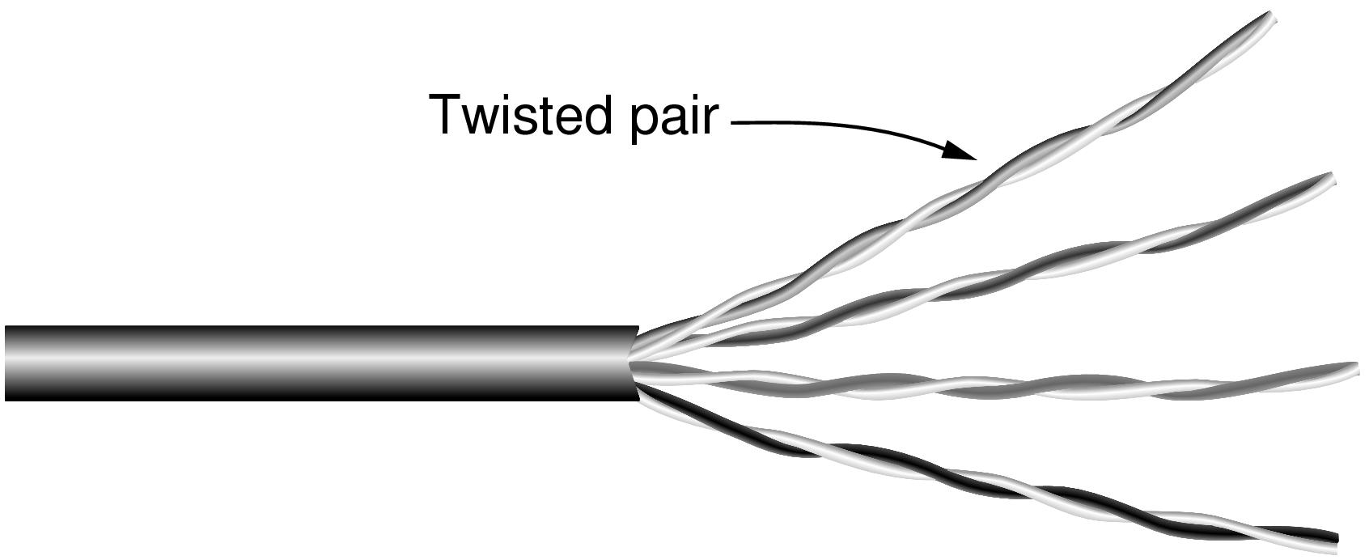
Wires – Twisted Pair
Very common; used in LANs and telephone lines
  Twists reduce radiated signal
Category 5 UTP cable with four twisted pairs
Notes:
Twisted pair from CN5E slides 2#9

Slide 16
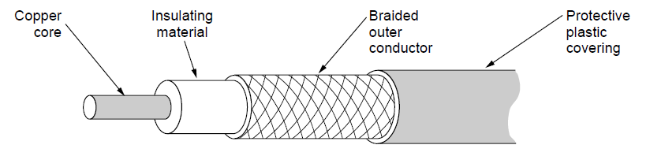
Wires – Coaxial Cable
Also common. Better shielding for better performance
Other kinds of wires too: e.g., electrical power
Notes:
Coaxial cable from CN5E slides #2-11

Slide 17


Fiber
Long, thin, pure strands of glass
  Enormous bandwidth over long distances
Optical fiber
Light source
(LED, laser)
Light trapped by
total internal reflection
Photo-detector
Notes:
Flashlight from openclipart.org

Slide 18
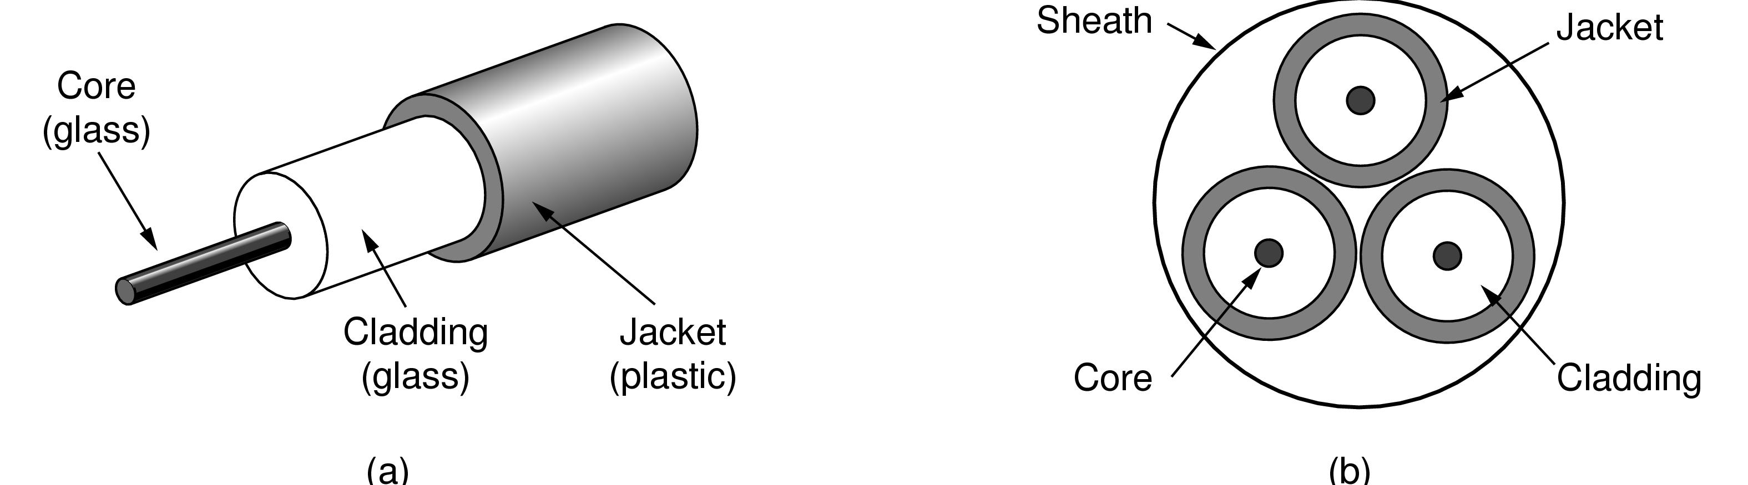
Fiber (2)
Two varieties: multi-mode (shorter links, cheaper) and single-mode (up to ~100 km)
One fiber
Fiber bundle in a cable
Notes:
Figures from CN5E slides #2-13

Slide 19

Wireless
Sender radiates signal over a region
  In many directions, unlike a wire, to potentially many receivers
  Nearby signals (same freq.) interfere at a receiver; need to coordinate use
Notes:
Radio icon from openclipart.org, laptop icon from Cisco icon library

Slide 20
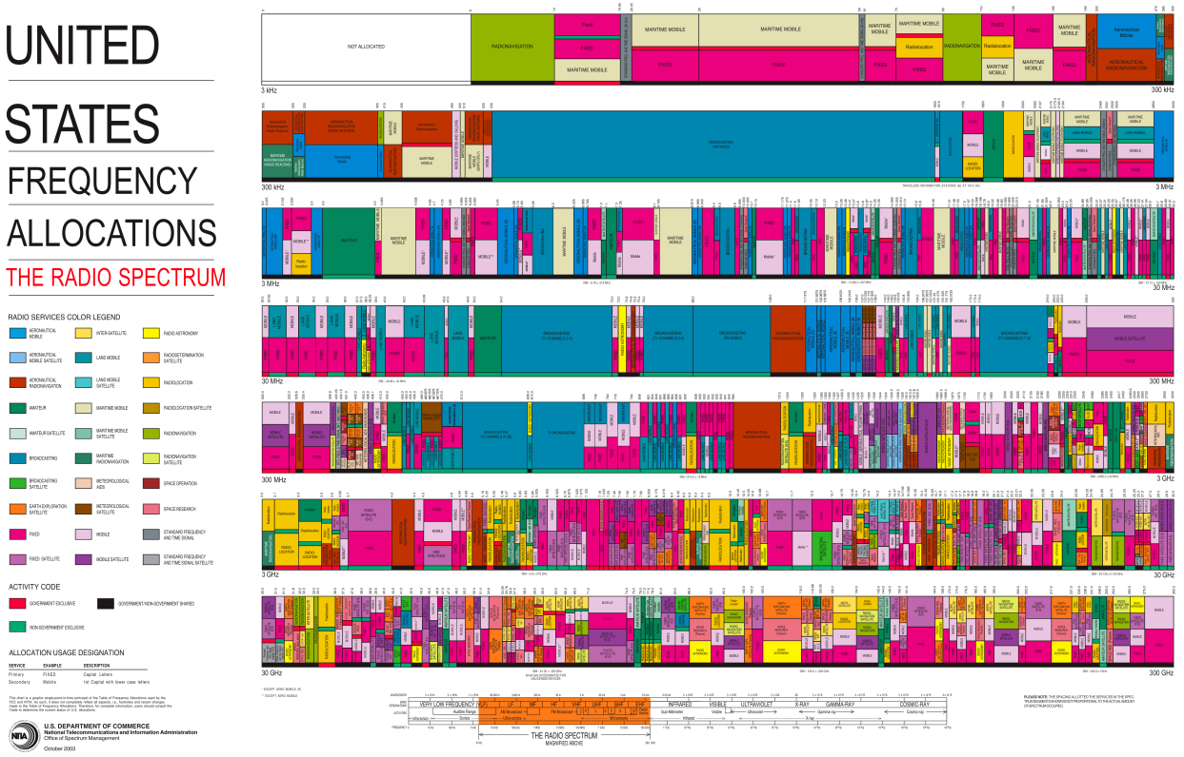
WiFi
WiFi
Notes:
Chart from http://www.ntia.doc.gov/page/2011/united-states-frequency-allocation-chart, public domain

Slide 21
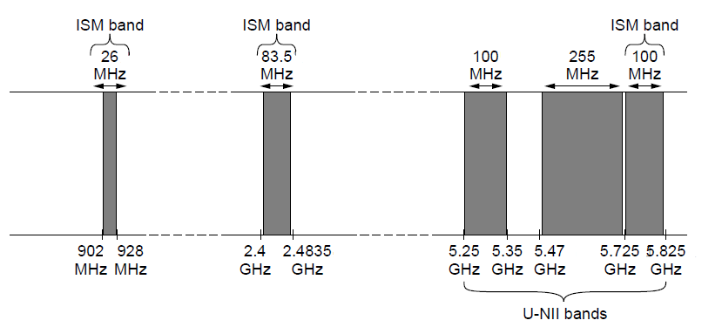
Wireless (2)
Microwave, e.g., 3G, and unlicensed (ISM) frequencies, e.g., WiFi, are widely used for computer networking
802.11
b/g/n
802.11a/g/n
Notes:
Figure from CN5E slide #2-20

Slide 22
Signals (§2.2)

Slide 23
Topic
Analog signals encode digital bits. We want to know what happens as signals propagate over media
Signal
10110…
…10110
Notes:
Laptop from Cisco Icon library

Slide 24
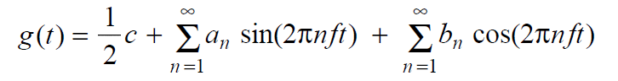
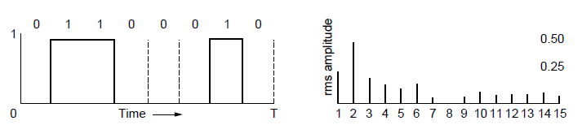
Frequency Representation
A signal over time can be represented by its frequency components (called Fourier analysis)
=
amplitude
Signal over time
weights of harmonic frequencies
Notes:
Figures from CN5e slides #2-4

Slide 25
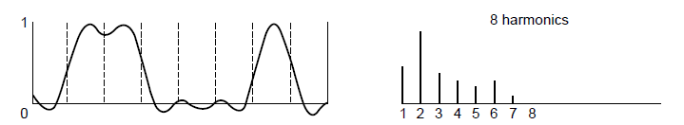
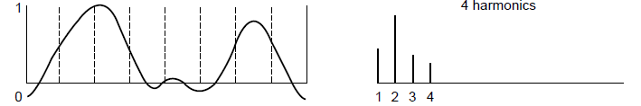
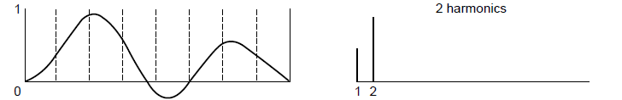
Effect of Less Bandwidth
Less bandwidth degrades signal (less rapid transitions)
Lost!
Bandwidth
Lost!
Lost!
25
Notes:
Ask which signal we’d like to get out? (middle) Figures from CN5e slides #2-4

Slide 26
Signals over a Wire
What happens to a signal as it passes over a wire?
  The signal is delayed (propagates at ⅔c)
  The signal is attenuated (goes for m to km)
  Noise is added to the signal (later, causes errors)
  Frequencies above a cutoff are highly attenuated
EE: Bandwidth = width of frequency band, measured in Hz
CS: Bandwidth = information carrying capacity, in bits/sec
Notes:
Write c = speed of light

Slide 27
Signals over a Wire (2)
Example:
1: Attenuation:
Sent signal
2: Bandwidth:
3: Noise:

Slide 28
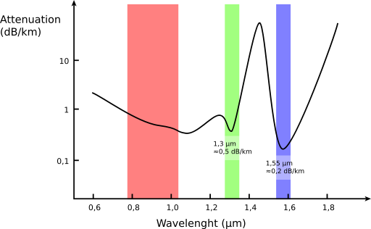
Signals over Fiber
Light propagates with very low loss in three very wide frequency bands
  Use a carrier to send information
Attenuation
(dB/km
By SVG: Sassospicco Raster: Alexwind, CC-BY-SA-3.0, via Wikimedia Commons
Wavelength (μm)

Slide 29
Signals over Wireless (§2.2)
Signals transmitted on a carrier frequency
Travel at speed of light, spread out and attenuate faster than 1/dist²
Multiple signals on the same frequency interfere at a receiver
Other effects are highly frequency dependent, e.g., multipath at microwave frequencies

Slide 30
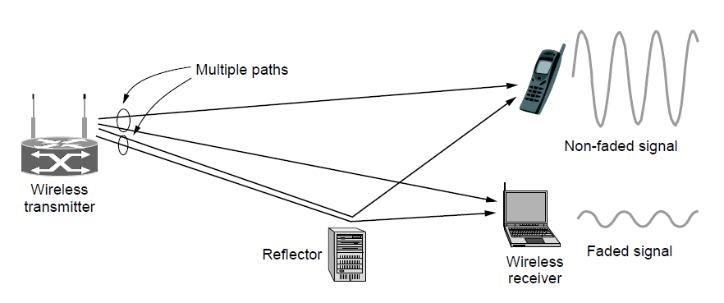
Wireless Multipath
Signals bounce off objects and take multiple paths
  Some frequencies attenuated at receiver, varies with location
  Messes up signal; handled with sophisticated methods (§2.5.3)
Notes:
CN5E slides #2-23. Show constructive / destructive interference

Slide 31
Modulation (§2.5)

Slide 32
Topic
We’ve talked about signals representing bits. How, exactly?
  This is the topic of modulation
Signal
10110…
…10110
Notes:
Laptop from Cisco Icon library

Slide 33
A Simple Modulation
Let a high voltage (+V) represent a 1, and low voltage (-V) represent a 0
  This is called NRZ (Non-Return to Zero)
Bits
0
0
1
0
1
1
1
1
0
1
0
0
0
0
1
0
+V
NRZ
-V

Slide 34
A Simple Modulation (2)
Let a high voltage (+V) represent a 1, and low voltage (-V) represent a 0
  This is called NRZ (Non-Return to Zero)
Bits
0
0
1
0
1
1
1
1
0
1
0
0
0
0
1
0
+V
NRZ
-V

Slide 35
Many Other Schemes
Can use more signal levels, e.g., 4 levels is 2 bits per symbol
Practical schemes are driven by engineering considerations
  E.g., clock recovery »
Notes:
Draw in a 4-level signal next to a 2-level one

Slide 36
Clock Recovery
Um, how many zeros was that?
  Receiver needs frequent signal transitions to decode bits
Several possible designs
  E.g., Manchester coding and scrambling (§2.5.1)
1 0 0 0 0 0 0 0 0 0 … 0

Slide 37
Clock Recovery – 4B/5B
Map every 4 data bits into 5 code bits with a transition that are sent
  0000 → 11110, 0001 → 01001, 1110 → 11100, … 1111 → 11101
  Has at most 3 zeros in a row

Slide 38
Clock Recovery – 4B/5B (2)
4B/5B code for reference:
  0000→11110, 0001→01001, 1110→11100, … 1111→11101
Message bits: 1 1 1 1 0 0 0 0 0 0 0 1
Coded Bits:
Signal:

Slide 39
Passband Modulation
What we have seen so far is baseband modulation for wires
  Signal is sent directly on a wire
These signals do not propagate well on fiber / wireless
  Need to send at higher frequencies
Passband modulation carries a signal by modulating a carrier

Slide 40
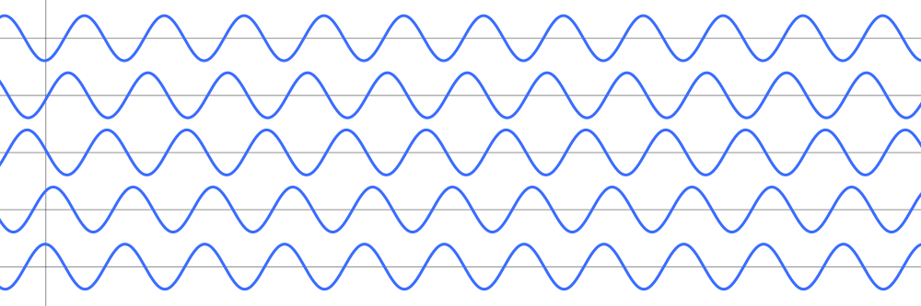
Passband Modulation (2)
Carrier is simply a signal oscillating at a desired frequency:
We can modulate it by changing:
  Amplitude, frequency, or phase

Slide 41
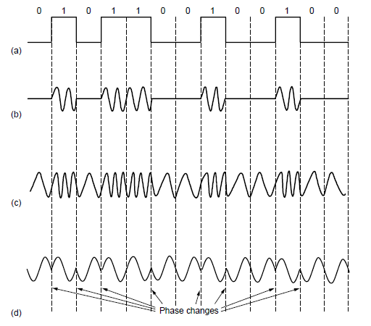
Passband Modulation (3)
NRZ signal of bits
Amplitude shift keying
Frequency shift keying
Phase shift keying
Notes:
Figure derived from CN5E figures #2-23. Write “baseband” under NRZ.

Slide 42
Fundamental Limits (§2.2)

Slide 43
Topic
How rapidly can we send information over a link?
  Nyquist limit (~1924) »
  Shannon capacity (1948) »
Practical systems are devised to approach these limits

Slide 44
Key Channel Properties
The bandwidth (B), signal strength (P), and noise strength (N)
  B limits the rate of transitions
  P and N limit how many signal levels we can distinguish
Bandwidth B
Signal P,
Noise N

Slide 45
Nyquist Limit
The maximum symbol rate is 2B
Thus if there are V signal levels, ignoring noise, the maximum bit rate is:
1 0 1 0 1 0 1 0 1 0 1 0 1 0 1 0 1 0 1

Slide 46
Nyquist Limit
The maximum symbol rate is 2B
Thus if there are V signal levels, ignoring noise, the maximum bit rate is:
1 0 1 0 1 0 1 0 1 0 1 0 1 0 1 0 1 0 1
R = 2B log₂V bits/sec

Slide 47
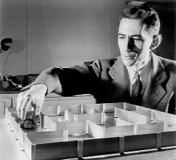
Claude Shannon (1916-2001)
Father of information theory
  “A Mathematical Theory of Communication”, 1948
Fundamental contributions to digital computers, security, and communications
Electromechanical mouse that “solves” mazes!
Credit: Courtesy MIT Museum
Notes:
Hi,
This photo is negative number CES 7 in our collection. We allow free use of our images at 72dpi and under 730px/side for educational purposes, as long as proper credit is given; if the image below is suitable for your needs, please use it with the credit line "Courtesy MIT Museum".
http://webmuseum.mit.edu/images/DIAmed/C/CES_7.jpg
Additional photos of Claude Shannon in our collection may be viewed here:
http://webmuseum.mit.edu/detail.php?t=people&type=all&f=&s=shannon&record=2
and more information on the maze being demonstrated in the photo is available here:
http://museum.mit.edu/150/20
Please let me know if there's anything else I can do to help!
Best regards,
Ariel Weinberg
Curatorial Associate, Science & Technology Collections
MIT Museum, Building N52
265 Massachusetts Avenue
Cambridge MA 02139-4307
tel: 617-253-3378 fax: 617-253-8994
http://web.mit.edu/museum
On Jan 10, 2013, at 12:21 PM, Mary Anne Hansen wrote:
> Hello Professor,
>
> The image in question does not belong to the News Office.
>
> By way of this email, I am forwarding your request to my colleague Ariel Weinberg,
> Curatorial Associate at the MIT Museum who may be able to assist you.
>
> Best regards,
> Mary Anne Hansen
> Senior Administrative Assistant
> MIT News Office, 11-400
> 617-253-8608
>
> From: David Wetherall <djw@cs.washington.edu>
> Date: Thursday, January 10, 2013 11:48 AM
> To: "newsoffice@MIT.EDU" <newsoffice@MIT.EDU>
> Subject: permissions request
>
> Hi,
>
> I am a professor teaching a massive free online course on Coursera (https://www.coursera.org/course/comnetworks). I came across your article on the Shannon limit:
>
> http://web.mit.edu/newsoffice/2010/explained-shannon-0115.html
>
> I'm asking for permission to reuse the photo in my videos and slides, which will be posted online.
>
> Please let me know how to proceed.
>
> Thank you,
>
> David

Slide 48
Shannon Limit
How many levels we can distinguish depends on P/N
  Or SNR, the Signal-to-Noise Ratio
  Note noise is random, hence some errors
SNR given on a log-scale in deciBels:
  SNR_{dB} = 10log₁₀(P/N)
P+N
0
N
1
2
3
Notes:
Go over examples

Slide 49
Shannon Limit (2)
Shannon limit is for capacity (C), the maximum information carrying rate of the channel:
C = B log₂(1 + P/(BN)) bits/sec

Slide 50

Putting it all together – DSL
DSL (Digital Subscriber Line, see §2.6.3) is widely used for broadband; many variants offer 10s of Mbps
  Reuses twisted pair telephone line to the home; it has up to ~2 MHz of bandwidth but uses only the lowest ~4 kHz
Notes:
Draw lines to home, say rate depends on dist/quality
Home from openclipart.org, building from cisco icon library.

Slide 51
DSL (2)
DSL uses passband modulation
  Separate bands for upstream and downstream (larger)
  Modulation called QAM varies both amplitude and phase
  High SNR, up to 15 bits/symbol, low SNR only 1 bit/symbol
Voice
Up to 1 Mbps
Up to 8 Mbps
Basic
ADSL:
0-4
kHz
Freq.
26 – 138
kHz
Up to 1104 kHz
Telephone
Upstream
Downstream

Slide 52
Wired/Wireless Perspective
Wires, and Fiber
  Engineer link to have requisite SNR and B
  Can fix data rate
Wireless
  Given B, but SNR varies greatly, e.g., up to 60 dB!
  Can’t design for worst case, must adapt data rate

Slide 53
Wired/Wireless Perspective (2)
Wires, and Fiber
  Engineer link to have requisite SNR and B
  Can fix data rate
Wireless
  Given B, but SNR varies greatly, e.g., up to 60 dB!
  Can’t design for worst case, must adapt data rate
Engineer SNR for data rate
Adapt data rate to SNR

