Slide 1
Shyam Gollakota
Slides from David Wetherall, Arvind Krishnamurthy, John Zahorjan

Slide 2
The Main Point
To learn how the Internet works »
  What really happens when you “browse the web”?
  What are TCP/IP, DNS, HTTP, NAT, VPNs, 802.11 etc. anyway?
To learn the fundamentals of computer networks

Slide 3
Why learn about the Internet?
Curiosity »
Impact on our world »
Job prospects!

Slide 4
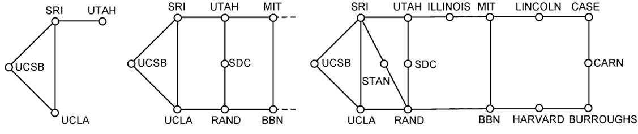
From this experimental network …
ARPANET ~1970
(a) Dec. 1969. (b) July 1970. (c) March 1971.
Notes:
Figure taken from CN5E Figures Ch 1 #28

Slide 5
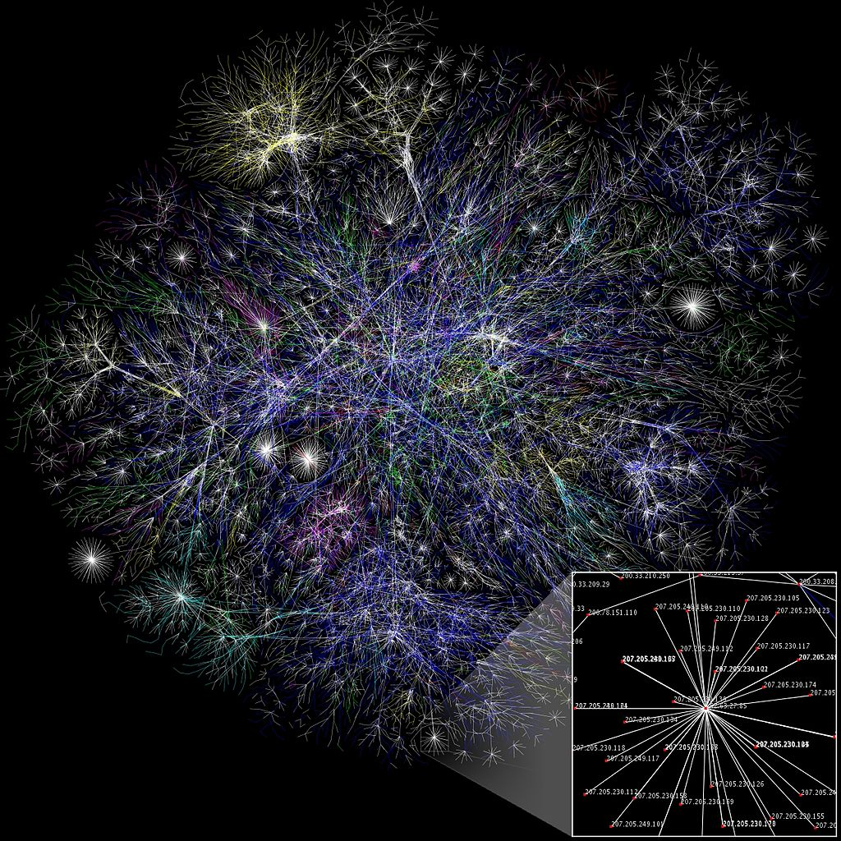
To this!
Internet ~2005
An everyday institution used at work, home, and on-the-go
Visualization contains millions of links
Attribution: By The Opte Project [CC-BY-2.5], via Wikimedia Commons

Slide 6
Question
What do you think are the issues that one has to tackle to grow from a small network to an extremely large network?

Slide 7




Internet – Societal Impact
An enabler of societal change
  Easy access to knowledge
  Electronic commerce
  Personal relationships
  Discussion without censorship
Notes:
Logos as trademark fair usage

Slide 8




Internet – Economic impact
An engine of economic growth
  Advertising-sponsored search
  “Long tail” online stores
  Online marketplaces
  Crowdsourcing
Notes:
Logos as trademark fair usage

Slide 9
The Main Point (2)
To learn how the Internet works
To learn the fundamentals of computer networks
  What hard problems must they solve?
  What design strategies have proven valuable?

Slide 10
Why learn the Fundamentals?
Apply to all computer networks
Intellectual interest »
Change / reinvention »

Slide 11
Fundamentals – Intellectual Interest
Example key problem: Reliability!
  Any part of the Internet might fail
  Messages might be corrupted
  So how do we provide reliability?

Slide 12
Fundamentals – Intellectual Interest (2)
Key problem | Example solutions
Reliability despite failures | Codes for error detection/correction (§3.2, 3.3) Routing around failures (§5.2)
Network growth and evolution | Addressing (§5.6) and naming (§7.1) Protocol layering (§1.3)
Allocation of resources like bandwidth | Multiple access (§4.2) Congestion control (§5.3, 6.3)
Security against various threats | Confidentiality of messages (§8.2, 8.6) Authentication of communicating parties (§8.7)
Notes:
Table taken from CN5E Slides Ch 1 #18.

Slide 13
Fundamentals – Reinvention
The Internet is constantly being re-invented!
  Growth over time and technology trends drive upheavals in Internet design and usage »
Today’s Internet is different from yesterday’s
  And tomorrow’s will be different again
  But the fundamentals remain the same

Slide 14
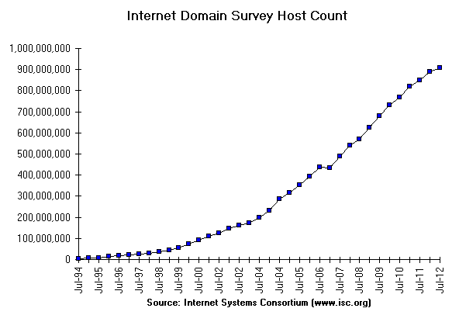
Fundamentals – Reinvention (2)
At least a billion Internet hosts and growing …
Notes:
Graph from http://www.isc.org/solutions/survey with permission via http://www.isc.org/solutions/survey/faq:
Can I have permission to reproduce your data or charts?
You have permission to reproduce our data provided that you mention the source as "Source: Internet Systems Consortium, Inc. (http://www.isc.org/)". However you must ask our permission to publish derivative works based on our data. In those cases you must say your data or charts are "Based on data from Internet Systems Consortium, Inc. (http://www.isc.org/)"

Slide 15
Fundamentals – Reinvention (3)
Examples of upheavals in the past 1-2 decades
Growth / Tech Driver | Upheaval
Emergence of the web | Content Distribution Networks
Digital songs/videos | Peer-to-peer file sharing
Falling cost/bit | Voice-over-IP calling
Many Internet hosts | IPv6
Wireless advances | Mobile devices

Slide 16
Not a Course Goal
To learn IT job skills
  How to configure equipment
    e.g., Cisco certifications
  But course material is relevant, and we use hands-on tools

Slide 17
Course Mechanics
Course Administration
  Everything you need to know will soon be on the course web page:
  http://www.cs.washington.edu/461/
Teaching Assistants:
  Pei-an Lee
  Isaac Ackerman

Slide 18
Course Logistics
Reading
Projects/Homeworks: 60%
Mid-term/final: 40%

Slide 19
Uses of Networks (§1.1)

Slide 20
Example Uses of Networks
Work:
  Email, file sharing, printing, …
Home:
  Movies / songs, news, calls / video / messaging, e-commerce, …
Mobile:
  Calls / texts, games, videos, maps, information access …

Slide 21
Example Uses of Networks
Work:
  Email, file sharing, printing, …
Home:
  Movies / songs, news, calls / video / messaging, e-commerce, …
Mobile:
  Calls / texts, games, videos, maps, information access …
What do these uses tell us about why we build networks?

Slide 22
For User Communication
From the telephone onwards:
  VoIP (voice-over-IP)
  Video conferencing
  Instant messaging
  Social networking
What is the metric we need to be optimizing for these uses?

Slide 23
For Resource Sharing
Many users may access the same underlying resource
  E.g., 3D printer, search index, machines in the cloud
More cost effective than dedicated resources per user
  Even network links are shared via statistical multiplexing »

Slide 24
Statistical Multiplexing
Sharing of network bandwidth between users according to the statistics of their demand
  (Multiplexing just means sharing)
  Useful because users are mostly idle and their traffic is bursty
Key question:
  How much does it help?

Slide 25

Statistical Multiplexing (2)
Example: Users in an ISP network
  Network has 100 Mbps (units of bandwidth)
  Each user subscribes to 5 Mbps, for videos
  But a user is active only 50% of the time …
How many users can the ISP support?
  With dedicated bandwidth for each user:
  Probability all bandwidth is used:
5
. . .
100
ISP
5
5
Notes:
User icon public domain from openclipart.org or pixabay or wikimedia commons

Slide 26
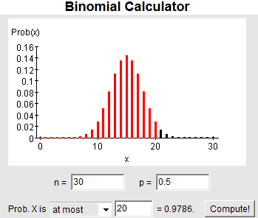
Statistical Multiplexing (3)
With 30 users, still unlikely (2% chance) to need more than 100 Mbps!
  Binomial probabilities
Can serve more users with the same size network
  Statistical multiplexing gain is 30/20 or 1.5X
  But may get unlucky; users will have degraded service
Notes:
Screenshot of using binomial applet

Slide 27
For Content Delivery
Same content is delivered to many users
  Videos (large), songs, apps and upgrades, web pages, …
What is the metric that we want to optimize in such cases?

Slide 28
Content Delivery (2)
Sending content from the source to 4 users takes 4 x 3 = 12 “network hops” in the example
User
. . .
Source
User
Notes:
Go over paths
Icons from Cisco icon library, http://www.cisco.com/web/about/ac50/ac47/2.html. “Cisco icons are globally recognized and generally accepted as standard for network icon topologies. You may use them freely, but you may not alter them.”

Slide 29
Content Delivery (3)
But sending content via replicas takes only 4 + 2 = 6 “network hops”
User
. . .
Source
Replica
User
Notes:
Circle replica
Icons from Cisco icon library, http://www.cisco.com/web/about/ac50/ac47/2.html. “Cisco icons are globally recognized and generally accepted as standard for network icon topologies. You may use them freely, but you may not alter them.”

Slide 30
Network Components (§1.2)

Slide 31
Parts of a Network
app
router
link
host
Notes:
Icons from Cisco icon library, http://www.cisco.com/web/about/ac50/ac47/2.html. “Cisco icons are globally recognized and generally accepted as standard for network icon topologies. You may use them freely, but you may not alter them.”

Slide 32
Component Names
Component | Function | Example
Application, or app, user | Uses the network | Skype, iTunes, Amazon
Host, or end-system, edge device, node, source, sink | Supports apps | Laptop, mobile, desktop
Router, or switch, node, intermediate system, … | Relays messages between links | Access point, cable/DSL modem
Link, or channel | Connects nodes | Wires, wireless

Slide 33
Types of Links
Full-duplex
  Bidirectional
Half-duplex
  Bidirectional
Simplex
  unidirectional
Notes:
Draw links

Slide 34

Wireless Links
Message is broadcast
  Received by all nodes in range
  Not a good fit with our model
Notes:
AP from pixabay.com.
Icons from Cisco icon library, http://www.cisco.com/web/about/ac50/ac47/2.html. “Cisco icons are globally recognized and generally accepted as standard for network icon topologies. You may use them freely, but you may not alter them.”

Slide 35
Example Networks
WiFi (802.11)
Enterprise / Ethernet
ISP (Internet Service Provider)
Cable / DSL
Mobile phone / cellular (2G, 3G, 4G)
Bluetooth
Telephone
Satellite ...

Slide 36
Network names by scale
Scale | Type | Example
Vicinity | PAN (Personal Area Network) | Bluetooth (e.g., headset)
Building | LAN (Local Area Network) | WiFi, Ethernet
City | MAN (Metropolitan Area Network) | Cable, DSL
Country | WAN (Wide Area Network) | Large ISP
Planet | The Internet (network of all networks) | The Internet!
Notes:
Underline PAN / LAN / MAN / WAN terms.
Table derived from CN5E Slides Ch 1 #7

Slide 37
Internetworks
An internetwork, or internet, is what you get when you join networks together
  Just another network
The Internet (capital “I”) is the internet we all use

Slide 38
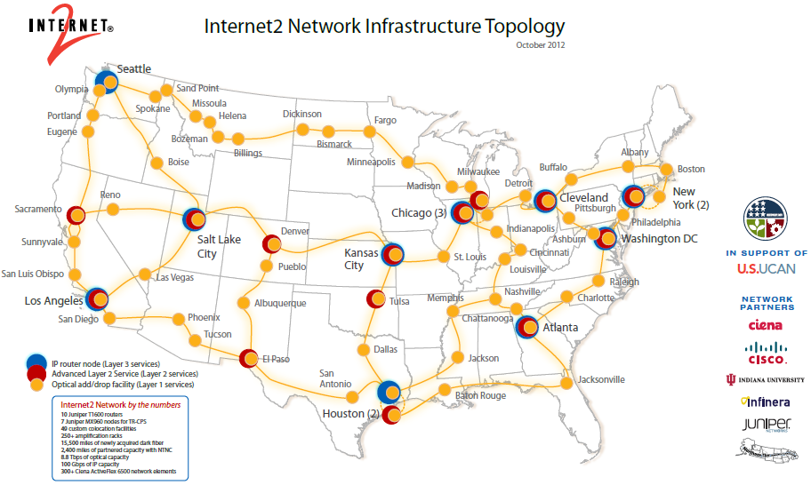
Source: Internet2
Notes:
Hello David,
It is fine to use the maps for this course. Thank you for letting us know.
Best regards,
Beth
Beth Miller,
Marketing Communications Manager
Internet2
beth@internet2.edu
(734)352-7044
Visit our website: www.internet2.edu
Follow us on Twitter: www.twitter.com/internet2
Find us on Facebook: www.internet2.edu/facebook
Begin forwarded message:
From: David Wetherall <djw@cs.washington.edu>
Date: November 15, 2012 8:59:05 AM EST
To: info@internet2.edu
Subject: permission request
Hello,
I would like permission to reprint the Internet2 network topology map given at
http://www.internet2.edu/pubs/Internet2-Network-Infrastructure-Topology.pdf
as part the course "Introduction to Computer Networks" by Arvind Krishnamurthy, David Wetherall and John Zahorjan. This course will be offered beginning January 2013 on the Coursera platform for massive open online courses.
I am making this request because Coursera is a commercial platform and thus not covered by your "non-commercial permission". However, the course is public and free to students.
Please let me know how to proceed. Thank you,
David

Slide 39
Key Interfaces
Between (1) apps and network, and (2) network components
  More formal treatment later on
app
host
Notes:
Draw and number interfaces 1 and 2.
Icons from Cisco icon library, http://www.cisco.com/web/about/ac50/ac47/2.html. “Cisco icons are globally recognized and generally accepted as standard for network icon topologies. You may use them freely, but you may not alter them.”

Slide 40
Key Interfaces (2)
Network-application interfaces define how apps use the network
  Sockets are widely used in practice
app
host
Notes:
Icons from Cisco icon library, http://www.cisco.com/web/about/ac50/ac47/2.html. “Cisco icons are globally recognized and generally accepted as standard for network icon topologies. You may use them freely, but you may not alter them.”

Slide 41
Key Interfaces (3)
Network-network interfaces define how nodes work together
  Traceroute can peek in the network
app
host
Notes:
Icons from Cisco icon library, http://www.cisco.com/web/about/ac50/ac47/2.html. “Cisco icons are globally recognized and generally accepted as standard for network icon topologies. You may use them freely, but you may not alter them.”

