Slide 1
Topic
How do nodes share a single link? Who sends when, e.g., in WiFI?
  Explore with a simple model
Assume no-one is in charge; this is a distributed system
Notes:
Icon from Cisco icon library.

Slide 2
Topic (2)
We will explore random multiple access control (MAC) protocols
  This is the basis for classic Ethernet
  Remember: data traffic is bursty
Busy!
Zzzz..
Ho hum
Notes:
Icon from Cisco icon library.

Slide 3

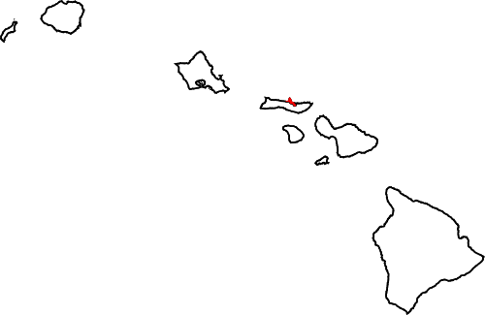

ALOHA Network
Seminal computer network connecting the Hawaiian islands in the late 1960s
  When should nodes send?
  A new protocol was devised by Norm Abramson …
Hawaii
Notes:
Map from wikipedia commons, public domain. Radio from openclipart.org

Slide 4
ALOHA Protocol
Simple idea:
  Node just sends when it has traffic.
  If there was a collision (no ACK received) then wait a random time and resend
That’s it!

Slide 5
ALOHA Protocol (2)
Some frames will be lost, but many may get through…
Good idea?
Notes:
From CN5E figures #4-2

Slide 6
ALOHA Protocol (3)
Simple, decentralized protocol that works well under low load!
Not efficient under high load
  Analysis shows at most 18% efficiency
  Improvement: divide time into slots and efficiency goes up to 36%
We’ll look at other improvements

Slide 7
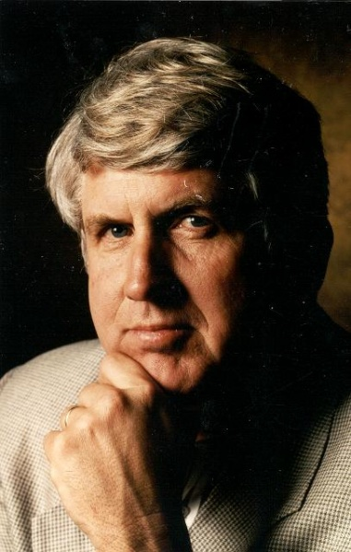
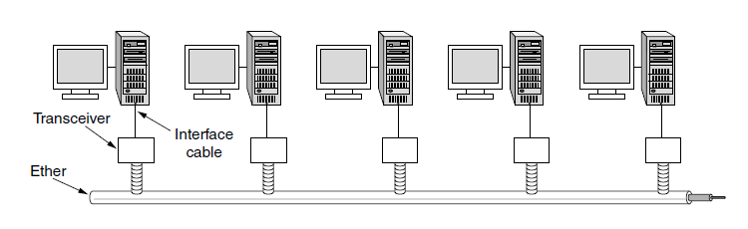
Classic Ethernet
ALOHA inspired Bob Metcalfe to invent Ethernet for LANs in 1973
  Nodes share 10 Mbps coaxial cable
  Hugely popular in 1980s, 1990s
: © 2009 IEEE
Notes:
Photo from IEEE GHN. Figure from CN5E slides #4-22

Slide 8
CSMA (Carrier Sense Multiple Access)
Improve ALOHA by listening for activity before we send (Doh!)
  Can do easily with wires, not wireless
So does this eliminate collisions?
  Why or why not?

Slide 9
CSMA (2)
Still possible to listen and hear nothing when another node is sending because of delay

Slide 10
CSMA (3)
CSMA is a good defense against collisions only when BD is small
X

Slide 11
CSMA/CD (with Collision Detection)
Can reduce the cost of collisions by detecting them and aborting (Jam) the rest of the frame time
  Again, we can do this with wires
Jam!
X X X X X X X X
Jam!

Slide 12
CSMA/CD Complications
Want everyone who collides to know that it happened
  Time window in which a node may hear of a collision is 2D seconds
X

Slide 13
CSMA/CD Complications (2)
Impose a minimum frame size that lasts for 2D seconds
  So node can’t finish before collision
  Ethernet minimum frame is 64 bytes
X

Slide 14
CSMA “Persistence”
What should a node do if another node is sending?
Idea: Wait until it is done, and send
What now?

Slide 15
CSMA “Persistence” (2)
Problem is that multiple waiting nodes will queue up then collide
  More load, more of a problem
Now!
Uh oh
Now!

Slide 16
CSMA “Persistence” (3)
Intuition for a better solution
  If there are N queued senders, we want each to send next with probability 1/N
Send p=½
Whew
Send p=½

Slide 17
Binary Exponential Backoff (BEB)
Cleverly estimates the probability
  1st collision, wait 0 or 1 frame times
  2nd collision, wait from 0 to 3 times
  3rd collision, wait from 0 to 7 times …
BEB doubles interval for each successive collision
  Quickly gets large enough to work
  Very efficient in practice

Slide 18
Classic Ethernet, or IEEE 802.3
Most popular LAN of the 1980s, 1990s
  10 Mbps over shared coaxial cable, with baseband signals
  Multiple access with “1-persistent CSMA/CD with BEB”
Notes:
Figure from CN5E slides #4-22

Slide 19
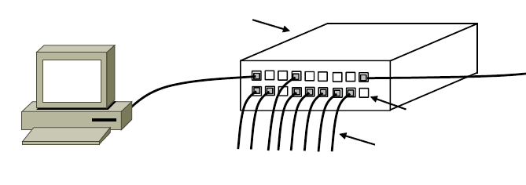
Modern Ethernet
Based on switches, not multiple access, but still called Ethernet
  We’ll get to it in a later segment
Switch
Switch ports
Twisted pair
Notes:
Figure from CN5E #4-27

Slide 20
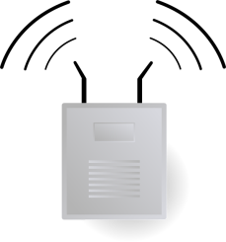
Topic
How do wireless nodes share a single link? (Yes, this is WiFi!)
  Build on our simple, wired model
Send?
Send?
Notes:
Icon from Cisco icon library. AP from pixabay.

Slide 21

Wireless Complications
Wireless is more complicated than the wired case (Surprise!)
  Nodes may have different areas of coverage – doesn’t fit Carrier Sense »
  Nodes can’t hear while sending – can’t Collision Detect »
≠ CSMA/CD
Notes:
Icon from Cisco icon library. AP from pixabay.

Slide 22
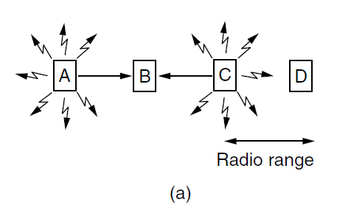
Different Coverage Areas
Wireless signal is broadcast and received nearby, where there is sufficient SNR
Notes:
CN5E slides #4-18

Slide 23
Hidden Terminals
Nodes A and C are hidden terminals when sending to B
  Can’t hear each other (to coordinate) yet collide at B
  We want to avoid the inefficiency of collisions
Notes:
CN5E slides #4-18

Slide 24
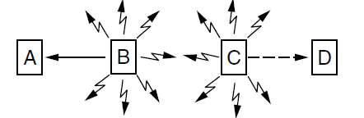
Exposed Terminals
B and C are exposed terminals when sending to A and D
  Can hear each other yet don’t collide at receivers A and D
  We want to send concurrently to increase performance
Notes:
CN5E slides #4-18

Slide 25
Nodes Can’t Hear While Sending
With wires, detecting collisions (and aborting) lowers their cost
More wasted time with wireless
Wired
Collision
Wireless
Collision
Resend
Resend
X
XXXXXXXXX
X
Time
XXXXXXXXX

Slide 26
Possible Solution: MACA
MACA uses a short handshake instead of CSMA (Karn, 1990)
  802.11 uses a refinement of MACA (later)
Protocol rules:
  A sender node transmits a RTS (Request-To-Send, with frame length)
  The receiver replies with a CTS (Clear-To-Send, with frame length)
  Sender transmits the frame while nodes hearing the CTS stay silent
  Collisions on the RTS/CTS are still possible, but less likely

Slide 27
MACA – Hidden Terminals
A→B with hidden terminal C
  A sends RTS, to B
A
B
C
D
Notes:
CN5E slides #4-18

Slide 28
MACA – Hidden Terminals (2)
A→B with hidden terminal C
  B sends CTS, to A, and C too
RTS
A
B
C
D
Notes:
CN5E slides #4-18

Slide 29
MACA – Hidden Terminals (3)
A→B with hidden terminal C
  B sends CTS, to A, and C too
Alert!
RTS
A
B
C
D
CTS
CTS
Notes:
CN5E slides #4-18

Slide 30
MACA – Hidden Terminals (4)
A→B with hidden terminal C
  A sends frame while C defers
Quiet...
Frame
Notes:
CN5E slides #4-18

Slide 31
MACA – Exposed Terminals
B→A, C→D as exposed terminals
  B and C send RTS to A and D
A
B
C
D
Notes:
CN5E slides #4-18

Slide 32
MACA – Exposed Terminals (2)
B→A, C→D as exposed terminals
  A and D send CTS to B and C
RTS
RTS
A
B
C
D
Notes:
CN5E slides #4-18

Slide 33
MACA – Exposed Terminals (3)
B→A, C→D as exposed terminals
  A and D send CTS to B and C
All OK
All OK
RTS
RTS
A
B
C
D
CTS
CTS
Notes:
CN5E slides #4-18

Slide 34
MACA – Exposed Terminals (4)
B→A, C→D as exposed terminals
  A and D send CTS to B and C
Frame
Frame
A
B
C
D
Notes:
CN5E slides #4-18

Slide 35
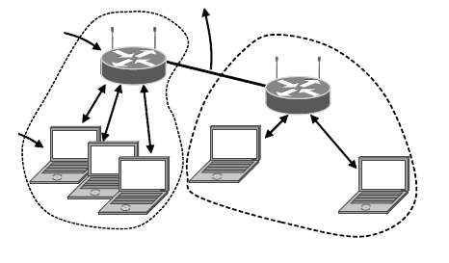
802.11, or WiFi
Very popular wireless LAN started in the 1990s
Clients get connectivity from a (wired) AP (Access Point)
It’s a multi-access problem ☺
Various flavors have been developed over time
  Faster, more features
To Network
Access
Point
Client
Notes:
CN5E slides #4-32

Slide 36
802.11 Physical Layer
Uses 20/40 MHz channels on ISM bands
  802.11b/g/n on 2.4 GHz
  802.11 a/n on 5 GHz
OFDM modulation (except legacy 802.11b)
  Different amplitudes/phases for varying SNRs
  Rates from 6 to 54 Mbps plus error correction
  802.11n uses multiple antennas; see “802.11 with Multiple Antennas for Dummies”
Notes:
Figure from CN5E slides #4-22

Slide 37
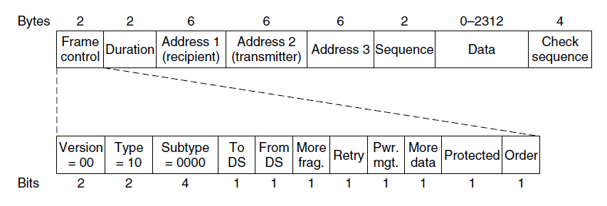
802.11 Link Layer
Multiple access uses CSMA/CA (next); RTS/CTS optional
Frames are ACKed and retransmitted with ARQ
Funky addressing (three addresses!) due to AP
Errors are detected with a 32-bit CRC
Many, many features (e.g., encryption, power save)
Packet from Network layer (IP)
Notes:
CN5E slides #4-38

Slide 38
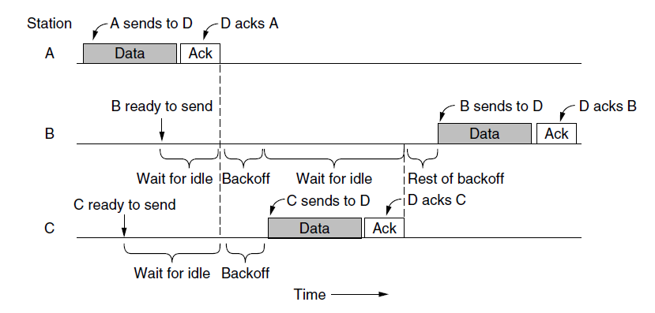
802.11 CSMA/CA for Multiple Access
Sender avoids collisions by inserting small random gaps
  E.g., when both B and C send, C picks a smaller gap, goes first
Send?
Send?
Time

Slide 39
The Future of 802.11 (Guess)
Likely ubiquitous for Internet connectivity
  Greater diversity, from low- to high-end devices
Innovation in physical layer drives speed
  And power-efficient operation too
More seamless integration of connectivity
  Too manual now, and limited (e.g., device-to-device)

Slide 40
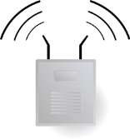
Topic
A new approach to multiple access
  Based on turns, not randomization
2
3
1
4
Notes:
Icon from Cisco icon library. AP from pixabay.

Slide 41
Issues with Random Multiple Access
CSMA is good under low load:
  Grants immediate access
  Little overhead (few collisions)
But not so good under high load:
  High overhead (expect collisions)
  Access time varies (lucky/unlucky)
We want to do better under load!

Slide 42
Turn-Taking Multiple Access Protocols
They define an order in which nodes get a chance to send
  Or pass, if no traffic at present
We just need some ordering …
  E.g., Token Ring »
  E.g., node addresses

Slide 43
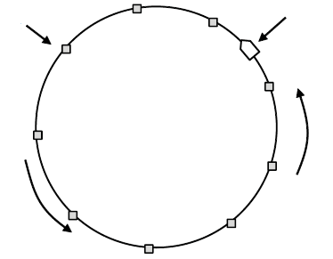
Token Ring
Arrange nodes in a ring; token rotates “permission to send” to each node in turn
Node
Token
Direction of
transmission

Slide 44
Turn-Taking Advantages
Fixed overhead with no collisions
  More efficient under load
Regular chance to send with no unlucky nodes
  Predictable service, easily extended to guaranteed quality of service

Slide 45
Turn-Taking Disadvantages
Complexity
  More things that can go wrong than random access protocols!
    E.g., what if the token is lost?
  Higher overhead at low load

Slide 46
Turn-Taking in Practice
Regularly tried as an improvement offering better service
  E.g., qualities of service
But random multiple access is hard to beat
  Simple, and usually good enough
  Scales from few to many nodes

