Slide 1
Error Detection (§3.2.2)

Slide 2
Topic
Some bits may be received in error due to noise. How do we detect this?
Parity »
Checksums »
CRCs »
Detection will let us fix the error, for example, by retransmission (later).
Notes:
Icons from cisco icon library

Slide 3
Simple Error Detection – Parity Bit
Take D data bits, add 1 check bit that is the sum of the D bits
Sum is modulo 2 or XOR
Notes:
Give example for 7 data bits

Slide 4
Parity Bit (2)
How well does parity work?
What is the distance of the code?
How many errors will it detect/correct?
What about larger errors?
Notes:
Give example for 7 data bits

Slide 5
Checksums
Idea: sum up data in N-bit words
Widely used in, e.g., TCP/IP/UDP
Stronger protection than parity
1500 bytes
16 bits

Slide 6
Internet Checksum
Sum is defined in 1s complement arithmetic (must add back carries)
And it’s the negative sum
“The checksum field is the 16 bit one's complement of the one's complement sum of all 16 bit words …” – RFC 791
Notes:
Give example of 5 and -5 in 1s and 2s complement

Slide 7
Internet Checksum (2)
Sending:
Arrange data in 16-bit words
Put zero in checksum position, add
Add any carryover back to get 16 bits
Negate (complement) to get sum
0001
f203
f4f5
f6f7
+(0000)
------
2ddf0
ddf0
+ 2
------
ddf2
220d
Notes:
Work through example

Slide 8
Internet Checksum (3)
Sending:
Arrange data in 16-bit words
Put zero in checksum position, add
Add any carryover back to get 16 bits
Negate (complement) to get sum
0001
f203
f4f5
f6f7
+(0000)
------
2ddf0
ddf0
+ 2
------
ddf2
220d

Slide 9
Internet Checksum (4)
Receiving:
Arrange data in 16-bit words
Checksum will be non-zero, add
Add any carryover back to get 16 bits
Negate the result and check it is 0
0001
f203
f4f5
f6f7
+ 220d
------
2fffd
fffd
+ 2
------
ffff
0000
Notes:
Work through example

Slide 10
Internet Checksum (5)
Receiving:
Arrange data in 16-bit words
Checksum will be non-zero, add
Add any carryover back to get 16 bits
Negate the result and check it is 0
0001
f203
f4f5
f6f7
+ 220d
------
2fffd
fffd
+ 2
------
ffff
0000

Slide 11
Internet Checksum (6)
How well does the checksum work?
What is the distance of the code?
How many errors will it detect/correct?
What about larger errors?
Notes:
Dist is 2, so fooled by 2 errors. But handles bursts up to 16 errors for a 16 bit checksum, and large errors ½^16

Slide 12
Cyclic Redundancy Check (CRC)
Even stronger protection
Given n data bits, generate k check bits such that the n+k bits are evenly divisible by a generator C
Example with numbers:
n = 302, k = one digit, C = 3
Notes:
Work though example: remainder is 2, need to add 1 to be divisible, so checksum is 1

Slide 13
CRCs (2)
The catch:
It’s based on mathematics of finite fields, in which “numbers” represent polynomials
e.g, 10011010 is x⁷ + x⁴ + x³ + x¹
What this means:
We work with binary values and operate using modulo 2 arithmetic

Slide 14
CRCs (3)
Send Procedure:
Extend the n data bits with k zeros
Divide by the generator value C
Keep remainder, ignore quotient
Adjust k check bits by remainder
Receive Procedure:
Divide and check for zero remainder

Slide 15
CRCs (4)
Data bits:
1101011111
Check bits:
C(x)=x⁴+x¹+1
C = 10011
k = 4
1 0 0 1 1 1 1 0 1 0 1 1 1 1 1
Notes:
Work it through …

Slide 16
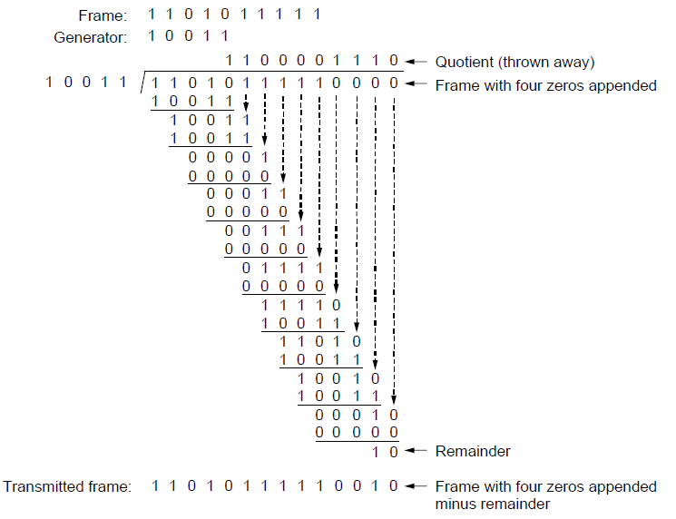
CRCs (5)
Notes:
CN5E slides #3-19

Slide 17
CRCs (6)
Protection depend on generator
Standard CRC-32 is 10000010 01100000 10001110 110110111
Properties:
HD=4, detects up to triple bit errors
Also odd number of errors
And bursts of up to k bits in error
Not vulnerable to systematic errors like checksums

Slide 18
Error Detection in Practice
CRCs are widely used on links
Ethernet, 802.11, ADSL, Cable …
Checksum used in Internet
IP, TCP, UDP … but it is weak
Parity
Is little used

Slide 19
Topic
Some bits may be received in error due to noise. How do we fix them?
Hamming code »
Other codes »
And why should we use detection when we can use correction?
Notes:
Icons from cisco icon library

Slide 20
Why Error Correction is Hard
If we had reliable check bits we could use them to narrow down the position of the error
Then correction would be easy
But error could be in the check bits as well as the data bits!
Data might even be correct

Slide 21
Intuition for Error Correcting Code
Suppose we construct a code with a Hamming distance of at least 3
Need ≥3 bit errors to change one valid codeword into another
Single bit errors will be closest to a unique valid codeword
If we assume errors are only 1 bit, we can correct them by mapping an error to the closest valid codeword
Works for d errors if HD ≥ 2d + 1

Slide 22
Intuition (2)
Visualization of code:
Valid
codeword
A
Error
codeword
B

Slide 23
Intuition (3)
Visualization of code:
Valid
codeword
Single
bit error
from A
A
Three bit
errors to
get to B
Error
codeword
B

Slide 24
Hamming Code
Gives a method for constructing a code with a distance of 3
Uses n = 2^{k} – k – 1, e.g., n=4, k=3
Put check bits in positions p that are powers of 2, starting with position 1
Check bit in position p is parity of positions with a p term in their values
Plus an easy way to correct [soon]

Slide 25
Hamming Code (2)
Example: data=0101, 3 check bits
7 bit code, check bit positions 1, 2, 4
Check 1 covers positions 1, 3, 5, 7
Check 2 covers positions 2, 3, 6, 7
Check 4 covers positions 4, 5, 6, 7
_ _ _ _ _ _ _
1 2 3 4 5 6 7
Notes:
Fill in data, compute parity bits, add them in, draw arrow

Slide 26
Hamming Code (3)
Example: data=0101, 3 check bits
7 bit code, check bit positions 1, 2, 4
Check 1 covers positions 1, 3, 5, 7
Check 2 covers positions 2, 3, 6, 7
Check 4 covers positions 4, 5, 6, 7
0 1 0 0 1 0 1
p₁= 0+1+1 = 0, p₂= 0+0+1 = 1, p₄= 1+0+1 = 0
1 2 3 4 5 6 7

Slide 27
Hamming Code (4)
To decode:
Recompute check bits (with parity sum including the check bit)
Arrange as a binary number
Value (syndrome) tells error position
Value of zero means no error
Otherwise, flip bit to correct

Slide 28
Hamming Code (5)
Example, continued
0 1 0 0 1 0 1
p₁= p₂=
p₄=
Syndrome =
Data =
1 2 3 4 5 6 7

Slide 29
Hamming Code (6)
Example, continued
0 1 0 0 1 0 1
p₁= 0+0+1+1 = 0, p₂= 1+0+0+1 = 0,
p₄= 0+1+0+1 = 0
Syndrome = 000, no error
Data = 0 1 0 1
1 2 3 4 5 6 7

Slide 30
Hamming Code (7)
Example, continued
0 1 0 0 1 1 1
p₁= p₂=
p₄=
Syndrome =
Data =
1 2 3 4 5 6 7

Slide 31
Hamming Code (8)
Example, continued
0 1 0 0 1 1 1
p₁= 0+0+1+1 = 0, p₂= 1+0+1+1 = 1,
p₄= 0+1+1+1 = 1
Syndrome = 1 1 0, flip position 6
Data = 0 1 0 1 (correct after flip!)
1 2 3 4 5 6 7

Slide 32
Other Error Correction Codes
Codes used in practice are much more involved than Hamming
Convolutional codes (§3.2.3)
Take a stream of data and output a mix of the recent input bits
Makes each output bit less fragile
Decode using Viterbi algorithm (which can use bit confidence values)

Slide 33
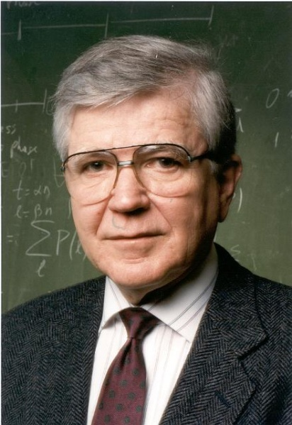
Other Codes (2) – LDPC
Low Density Parity Check (§3.2.3)
LDPC based on sparse matrices
Decoded iteratively using a belief propagation algorithm
State of the art today
Invented by Robert Gallager in 1963 as part of his PhD thesis
Promptly forgotten until 1996 …
Source: IEEE GHN, © 2009 IEEE
Notes:
Source IEEE GHN, http://www.ieeeghn.org/wiki/index.php/Oral-History:Robert_Gallager. Image policy: http://www.ieeeghn.org/wiki/index.php/IEEE_GHN_image_policy

Slide 34
Detection vs. Correction
Which is better will depend on the pattern of errors. For example:
1000 bit messages with a bit error rate (BER) of 1 in 10000
Which has less overhead?

Slide 35
Detection vs. Correction
Which is better will depend on the pattern of errors. For example:
1000 bit messages with a bit error rate (BER) of 1 in 10000
Which has less overhead?
It still depends! We need to know more about the errors

Slide 36
Detection vs. Correction (2)
Assume bit errors are random
Messages have 0 or maybe 1 error
Error correction:
Need ~10 check bits per message
Overhead:
Error detection:
Need ~1 check bits per message plus 1000 bit retransmission 1/10 of the time
Overhead:

Slide 37
Detection vs. Correction (3)
Assume errors come in bursts of 100
Only 1 or 2 messages in 1000 have errors
Error correction:
Need >>100 check bits per message
Overhead:
Error detection:
Need 32? check bits per message plus 1000 bit resend 2/1000 of the time
Overhead:

Slide 38
Detection vs. Correction (4)
Error correction:
Needed when errors are expected
Or when no time for retransmission
Error detection:
More efficient when errors are not expected
And when errors are large when they do occur

Slide 39
Error Correction in Practice
Heavily used in physical layer
LDPC is the future, used for demanding links like 802.11, DVB, WiMAX, LTE, power-line, …
Convolutional codes widely used in practice
Error detection (w/ retransmission) is used in the link layer and above for residual errors
Correction also used in the application layer
Called Forward Error Correction (FEC)
Normally with an erasure error model
E.g., Reed-Solomon (CDs, DVDs, etc.)

