Slide 1
Network Layer Overview

Slide 2
Where we are in the Course
Starting the Network Layer!
  Builds on the link layer. Routers send packets over multiple networks
Application
Transport
Network
Link
Physical

Slide 3
Why do we need a Network layer?
We can already build networks with links and switches and send frames between hosts …

Slide 4
Shortcomings of Switches
Don’t scale to large networks
  Blow up of routing table, broadcast
Table for all destinations in the world!
Broadcast new destinations to the whole world!

Slide 5

Shortcomings of Switches (2)
Don’t work across more than one link layer technology
  Hosts on Ethernet + 3G + 802.11 …
Can we play too?
Go away!

Slide 6
Shortcomings of Switches (3)
Don’t give much traffic control
  Want to plan routes / bandwidth
That was lame.

Slide 7
Network Layer Approach
Scaling:
  Hierarchy, in the form of prefixes
Heterogeneity:
  IP for internetworking
Bandwidth Control:
  Lowest-cost routing
  Later QOS (Quality of Service)

Slide 8
Topics
Network service models
  Datagrams (packets), virtual circuits
IP (Internet Protocol)
  Internetworking
  Forwarding (Longest Matching Prefix)
  Helpers: ARP and DHCP
  Fragmentation and MTU discovery
  Errors: ICMP (traceroute!)
IPv6, the future of IP
NAT, a “middlebox”
Routing algorithms
This
time
Next
time

Slide 9
Routing vs. Forwarding
Routing is the process of deciding in which direction to send traffic
  Network wide (global) and expensive
Which way?
Which way?
Which way?

Slide 10
Routing vs. Forwarding (2)
Forwarding is the process of sending a packet on its way
  Node process (local) and fast
Forward!
packet

Slide 11
Topic
What kind of service does the Network layer provide to the Transport layer?
  How is it implemented at routers?
Service? What’s he talking about?
Notes:
Icon from Cisco icon library.

Slide 12


Two Network Service Models
Datagrams, or connectionless service
  Like postal letters
  (This one is IP)
Virtual circuits, or connection-oriented service
  Like a telephone call
Notes:
Icons

Slide 13
Store-and-Forward Packet Switching
Both models are implemented with store-and-forward packet switching
  Routers receive a complete packet, storing it temporarily if necessary before forwarding it onwards
  We use statistical multiplexing to share link bandwidth over time

Slide 14
Store-and-Forward (2)
Switching element has internal buffering for contention
Input
. . .
Output
. . .
. . .
. . .
Fabric
Output Buffer
Input Buffer

Slide 15
Store-and-Forward (3)
Simplified view with per port output buffering
  Buffer is typically a FIFO (First In First Out) queue
  If full, packets are discarded (congestion, later)
Router
Router
=
Queued
Packets
(FIFO) Queue

Slide 16
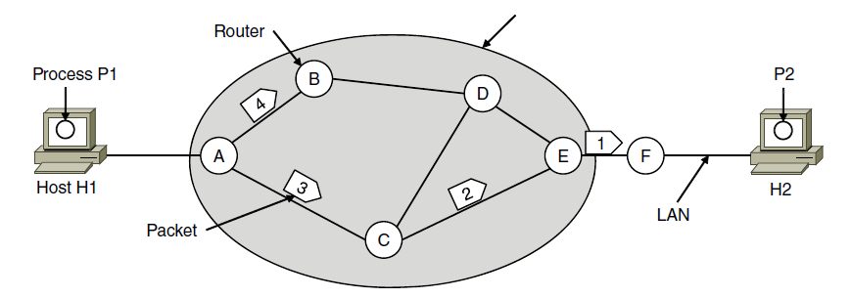
Datagram Model
Packets contain a destination address; each router uses it to forward each packet, possibly on different paths
ISP’s equipment
Notes:
CN5E slides #5-5

Slide 17
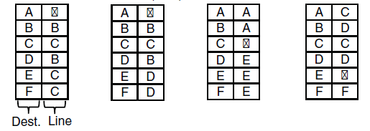
Datagram Model (2)
Each router has a forwarding table keyed by address
  Gives next hop for each destination address; may change
A’s table (initially) A’s table (later) C’s Table E’s Table
B
B
Notes:
CN5E slides #5-5

Slide 18
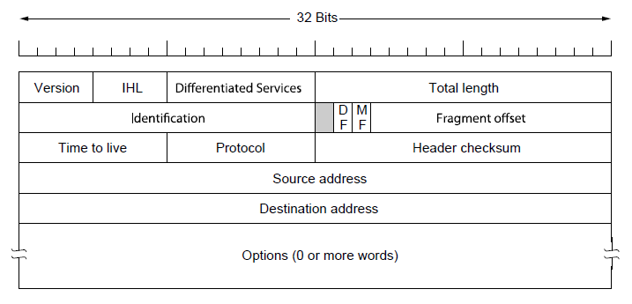
IP (Internet Protocol)
Network layer of the Internet, uses datagrams (next)
  IPv4 carries 32 bit addresses on each packet (often 1.5 KB)
Payload (e.g., TCP segment)
Notes:
CN5E slides #5-62

Slide 19
Virtual Circuit Model
Three phases:
  Connection establishment, circuit is set up
    Path is chosen, circuit information stored in routers
  Data transfer, circuit is used
    Packets are forwarded along the path
  Connection teardown, circuit is deleted
    Circuit information is removed from routers
Just like a telephone circuit, but virtual in the sense that no bandwidth need be reserved; statistical sharing of links

Slide 20
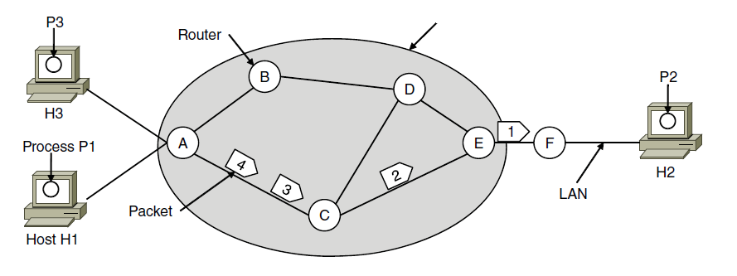
Virtual Circuits (2)
Packets only contain a short label to identify the circuit
  Labels don’t have any global meaning, only unique for a link
ISP’s equipment
Notes:
CN5E slides #5-6

Slide 21

Virtual Circuits (3)
Each router has a forwarding table keyed by circuit
  Gives output line and next label to place on packet
Circuit #1
H1
1
F
A’s table C’s Table E’s Table
5
5
H3
1
F
Circuit #2

Slide 22
Virtual Circuits (4)
Each router has a forwarding table keyed by circuit
  Gives output line and next label to place on packet
Circuit #1
H1
1
5
1
1
F
A’s table C’s Table E’s Table
5
5
H3
1
2
2
2
F
Circuit #2

Slide 23
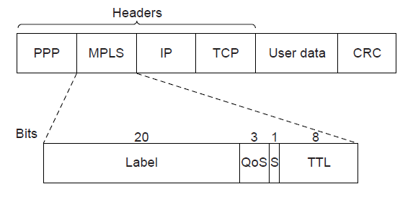
MPLS (Multi-Protocol Label Switching, §5.6.5)
A virtual-circuit like technology widely used by ISPs
  ISP sets up circuits inside their backbone ahead of time
  ISP adds MPLS label to IP packet at ingress, undoes at egress
Notes:
CN5E slides #5-75

Slide 24
Datagrams vs Virtual Circuits
Complementary strengths
Issue | Datagrams | Virtual Circuits
Setup phase | Not needed | Required
Router state | Per destination | Per connection
Addresses | Packet carries full address | Packet carries short label
Routing | Per packet | Per circuit
Failures | Easier to mask | Difficult to mask
Quality of service | Difficult to add | Easier to add

Slide 25

Topic
How do we connect different networks together?
  This is called internetworking
  We’ll look at how IP does it
Hi there!
Hi yourself

Slide 26
How Networks May Differ
Basically, in a lot of ways:
  Service model (datagrams, VCs)
  Addressing (what kind)
  QOS (priorities, no priorities)
  Packet sizes
  Security (whether encrypted)
Internetworking hides the differences with a common protocol. (Uh oh.)

Slide 27
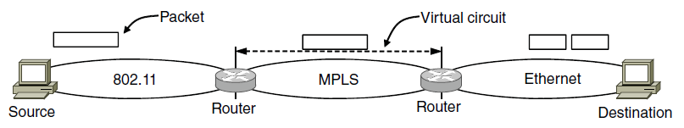
Connecting Datagram and VC networks
An example to show that it’s not so easy
  Need to map destination address to a VC and vice-versa
  A bit of a “road bump”, e.g., might have to set up a VC
Bump!
Bump!
Notes:
CN5E #5-53

Slide 28
Internet Reference Model
IP is the “narrow waist” of the Internet
  Supports many different links below and apps above
4. Application
SMTP
HTTP
RTP
DNS
3. Transport
TCP
UDP
2. Internet
IP
Ethernet
3G
1. Link
Cable
DSL
802.11

Slide 29
IP as a Lowest Common Denominator
Suppose only some networks support QOS or security etc.
  Difficult for internetwork to support
Pushes IP to be a “lowest common denominator” protocol
  Asks little of lower-layer networks
  Gives little as a higher layer service

Slide 30
IPv4 (Internet Protocol)
Various fields to meet straightforward needs
  Version, Header (IHL) and Total length, Protocol, and Header Checksum
Payload (e.g., TCP segment)
Notes:
CN5E slides #5-62

Slide 31
IPv4 (2)
Network layer of the Internet, uses datagrams
  Provides a layer of addressing above link addresses (next)
Payload (e.g., TCP segment)
Notes:
CN5E slides #5-62

Slide 32
IPv4 (3)
Some fields to handle packet size differences (later)
  Identification, Fragment offset, Fragment control bits
Payload (e.g., TCP segment)
Notes:
CN5E slides #5-62

Slide 33
IPv4 (4)
Other fields to meet other needs (later, later)
  Differentiated Services, Time to live (TTL)
Later, with QOS
Later, with ICMP
Payload (e.g., TCP segment)
Notes:
CN5E slides #5-62

Slide 34
Topic
How do routers forward packets?
  We’ll look at how IP does it
  (We’ll cover routing later)
Forward!
packet
Notes:
Icon from Cisco icon library.

Slide 35
Recap
We want the network layer to:
  Scale to large networks
    Using addresses with hierarchy
  Support diverse technologies
    Internetworking with IP
  Use link bandwidth well
    Lowest-cost routing
This
lecture
More
later
Next
time

Slide 36
IP Addresses
IPv4 uses 32-bit addresses
  Later we’ll see IPv6, which uses 128-bit addresses
Written in “dotted quad” notation
  Four 8-bit numbers separated by dots
8 bits
8 bits
8 bits
8 bits
aaaaaaaabbbbbbbbccccccccdddddddd ↔ A.B.C.D
00010010000111110000000000000001 ↔

Slide 37
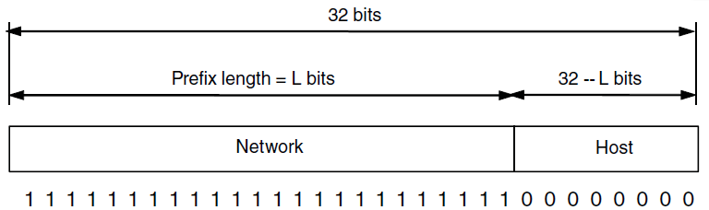
IP Prefixes
Addresses are allocated in blocks called prefixes
  Addresses in an L-bit prefix have the same top L bits
  There are 2^{32-L} addresses aligned on 2^{32-L} boundary
Notes:
CN5E slides #5-63

Slide 38
IP Prefixes (2)
Written in “IP address/length” notation
  Address is lowest address in the prefix, length is prefix bits
  E.g., 128.13.0.0/16 is 128.13.0.0 to 128.13.255.255
  So a /24 (“slash 24”) is 256 addresses, and a /32 is one address
000100100001111100000000xxxxxxxx ↔
↔ 128.13.0.0/16
Notes:
CN5E slides #5-63

Slide 39
Classful IP Addressing
Originally, IP addresses came in fixed size blocks with the class/size encoded in the high-order bits
  They still do, but the classes are now ignored
0
8
16
24
32 bits
0
10
110
Class A, 2²⁴ addresses
Class B, 2¹⁶ addresses
Class C, 2⁸ addresses
Network portion
Host portion

Slide 40
IP Forwarding
All addresses on one network belong to the same prefix
Node uses a table that lists the next hop for prefixes
Prefix | Next Hop
192.24.0.0/19 | D
192.24.12.0/22 | B
A
D
B
C

Slide 41
Longest Matching Prefix
Prefixes in the table might overlap!
  Combines hierarchy with flexibility
Longest matching prefix forwarding rule:
  For each packet, find the longest prefix that contains the destination address, i.e., the most specific entry
  Forward the packet to the next hop router for that prefix

Slide 42
Longest Matching Prefix (2)
192.24.63.255
More
specific
Prefix | Next Hop
192.24.0.0/19 | D
192.24.12.0/22 | B
/19
192.24.15.255
/22
192.24.12.0
192.24.6.0 →
192.24.14.32 →
192.24.54.0 →
192.24.0.0
IP address

Slide 43
Host/Router Distinction
In the Internet:
  Routers do the routing, know which way to all destinations
  Hosts send remote traffic (out of prefix) to nearest router
Not for my network? Send it to the router
It’s my job to know which way to go …

Slide 44
Host Forwarding Table
Give using longest matching prefix
  0.0.0.0/0 is a default route that catches all IP addresses
Prefix | Next Hop
My network prefix | Send to that IP
0.0.0.0/0 | Send to my router

Slide 45
Flexibility of Longest Matching Prefix
Can provide default behavior, with less specifics
  To send traffic going outside an organization to a border router
Can special case behavior, with more specifics
  For performance, economics, security, …

Slide 46
Performance of Longest Matching Prefix
Uses hierarchy for a compact table
  Relies on use of large prefixes
Lookup more complex than table
  Used to be a concern for fast routers
  Not an issue in practice these days

Slide 47
Topic
Filling in the gaps we need to make for IP forwarding work in practice
  Getting IP addresses (DHCP) »
  Mapping IP to link addresses (ARP) »
What’s my IP?
What link layer address do I use?
Notes:
Icon from Cisco icon library.

Slide 48
Getting IP Addresses
Problem:
  A node wakes up for the first time …
  What is its IP address? What’s the IP address of its router? Etc.
  At least Ethernet address is on NIC
Hey, where am I?

Slide 49
Getting IP Addresses (2)
Manual configuration (old days)
  Can’t be factory set, depends on use
A protocol for automatically configuring addresses (DHCP) »
  Shifts burden from users to IT folk
What’s my IP?
Use A.B.C.D

Slide 50
DHCP
DHCP (Dynamic Host Configuration Protocol), from 1993, widely used
It leases IP address to nodes
Provides other parameters too
  Network prefix
  Address of local router
  DNS server, time server, etc.

Slide 51
DHCP Protocol Stack
DHCP is a client-server application
  Uses UDP ports 67, 68
DHCP
UDP
IP
Ethernet

Slide 52
DHCP Addressing
Bootstrap issue:
  How does node send a message to DHCP server before it is configured?
Answer:
  Node sends broadcast messages that delivered to all nodes on the network
  Broadcast address is all 1s
  IP (32 bit): 255.255.255.255
  Ethernet (48 bit): ff:ff:ff:ff:ff:ff

Slide 53
DHCP Messages
Client
Server
One link
Notes:
Icons from cisco icon library

Slide 54
DHCP Messages (2)
Client
Server
discover
Broadcast
offer
request
ack
Notes:
Icons from cisco icon library

Slide 55
DHCP Messages (3)
To renew an existing lease, an abbreviated sequence is used:
  request, followed by ack
Protocol also supports replicated servers for reliability

Slide 56
Sending an IP Packet
Problem:
  A node needs Link layer addresses to send a frame over the local link
  How does it get the destination link address from a destination IP address?
Uh oh …
My IP is 1.2.3.4
Notes:
Icons from cisco icon library

Slide 57
ARP (Address Resolution Protocol)
Node uses to map a local IP address to its Link layer addresses
Link layer
Source
Ethernet
Dest.
Ethernet
Source IP
Dest.
IP
Payload …
From
NIC
From
DHCP
From ARP

Slide 58
ARP Protocol Stack
ARP sits right on top of link layer
  No servers, just asks node with target IP to identify itself
  Uses broadcast to reach all nodes
ARP
Ethernet

Slide 59
ARP Messages
Node
Target
One link
Notes:
Icons from cisco icon library

Slide 60
ARP Messages (2)
Node
Target
request
Broadcast
Who has IP 1.2.3.4?
reply
I do at 1:2:3:4:5:6
Notes:
Icons from cisco icon library

Slide 61
Discovery Protocols
Help nodes find each other
  There are more of them!
    E.g., zeroconf, Bonjour
Often involve broadcast
  Since nodes aren’t introduced
  Very handy glue
Notes:
Icons from cisco icon library

