Slide 1
Topic
How to set the timeout for sending a retransmission
  Adapting to the network path
Lost?
Network
Notes:
CN5E slides #5-10

Slide 2

Retransmissions
With sliding window, the strategy for detecting loss is the timeout
  Set timer when a segment is sent
  Cancel timer when ack is received
  If timer fires, retransmit data as lost
Retransmit!
Notes:
Stopwatch from openclipart.org

Slide 3
Timeout Problem
Timeout should be “just right”
  Too long wastes network capacity
  Too short leads to spurious resends
  But what is “just right”?
Easy to set on a LAN (Link)
  Short, fixed, predictable RTT
Hard on the Internet (Transport)
  Wide range, variable RTT

Slide 4
Example of RTTs
BCN→SEA→BCN
Round Trip Time (ms)
Seconds

Slide 5
Example of RTTs (2)
BCN→SEA→BCN
Variation due to queuing at routers, changes in network paths, etc.
Round Trip Time (ms)
Propagation (+transmission) delay ≈ 2D
Seconds

Slide 6
Example of RTTs (3)
Timer too high!
Need to adapt to the network conditions
Round Trip Time (ms)
Timer too low!
Seconds

Slide 7
Adaptive Timeout
Keep smoothed estimates of the RTT (1) and variance in RTT (2)
  Update estimates with a moving average
  SRTT_{N+1} = 0.9*SRTT_{N} + 0.1*RTT_{N+1}
  Svar_{N+1} = 0.9*Svar_{N} + 0.1*|RTT_{N+1}– SRTT_{N+1}|
Set timeout to a multiple of estimates
  To estimate the upper RTT in practice
  TCP Timeout_{N} = SRTT_{N} + 4*Svar_{N}

Slide 8
Example of Adaptive Timeout
RTT (ms)
SRTT
Svar
Seconds

Slide 9
Example of Adaptive Timeout (2)
Early
timeout
Timeout (SRTT + 4*Svar)
RTT (ms)
Seconds

Slide 10
Adaptive Timeout (2)
Simple to compute, does a good job of tracking actual RTT
  Little “headroom” to lower
  Yet very few early timeouts
Turns out to be important for good performance and robustness

Slide 11

Topic
How TCP works!
  The transport protocol used for most content on the Internet
We ♥ TCP/IP!
We love TCP/IP!
We love TCP/IP!
We love TCP/IP!
TCP
TCP
TCP
Network
Notes:
Icons from cisco icon library, openclipart.org

Slide 12
TCP Features
A reliable bytestream service »
Based on connections
Sliding window for reliability »
  With adaptive timeout
Flow control for slow receivers
Congestion control to allocate network bandwidth
This
time
Next
time

Slide 13
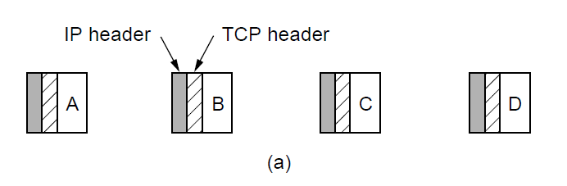
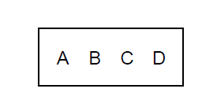
Reliable Bytestream
Message boundaries not preserved from send() to recv()
  But reliable and ordered (receive bytes in same order as sent)
Sender
Receiver
Four segments, each with 512 bytes of data and carried in an IP packet
2048 bytes of data delivered to app in a single recv() call
Notes:
CN5E slides #6-48

Slide 14
Reliable Bytestream (2)
Bidirectional data transfer
  Control information (e.g., ack) piggybacks on data segments in reverse direction
ack b→a
ack a→b
data a→b
A
B
data b→a
Notes:
CN5E slides #6-48

Slide 15
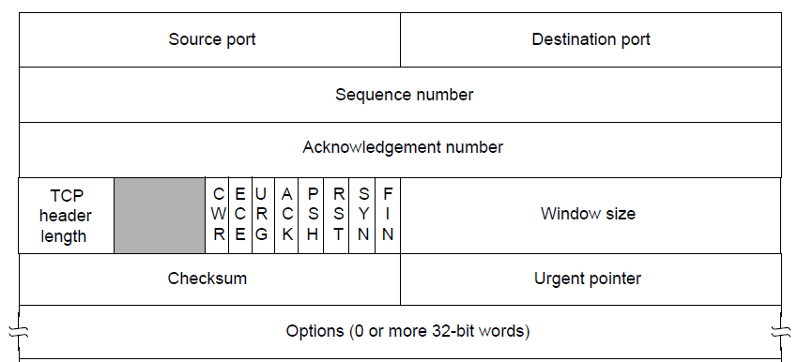
TCP Header (1)
Ports identify apps (socket API)
  16-bit identifiers
Notes:
CN5E slides #6-49

Slide 16
TCP Header (2)
seq/ack used for sliding window
  Selective Repeat, with byte positions
Notes:
CN5E slides #6-49

Slide 17
TCP Sliding Window – Receiver
Cumulative ack tells next expected byte sequence number (“LAS+1”)
Optionally, selective acks (SACK) give hints for receiver buffer state
  List up to 3 ranges of received bytes
ack up to 100 and 200-299

Slide 18
TCP Sliding Window – Sender
Uses an adaptive retransmission timeout to resend data from LAS+1
Uses heuristics to infer loss quickly and resend to avoid timeouts
  “Three duplicate acks” treated as loss
ack 100, 200-299
ack 100, 200-399
ack 100, 200-499
ack 100
Sender decides 100-199 is lost

Slide 19
TCP Header (4)
Window size for flow control
  Relative to ack, and in bytes
Notes:
CN5E slides #6-49

Slide 20
Other TCP Details
Many, many quirks you can learn about its operation
  But they are the details
Biggest remaining mystery is the workings of congestion control
  We’ll tackle this next!

Slide 21
Where we are in the Course
More fun in the Transport Layer!
  The mystery of congestion control
  Depends on the Network layer too
Application
Transport
Network
Link
Physical

Slide 22

Topic
Understanding congestion, a “traffic jam” in the network
  Later we will learn how to control it
What’s the hold up?
Network
Notes:
CN5E slides #5-10

Slide 23
Nature of Congestion
Routers/switches have internal buffering for contention
Input
. . .
Output
. . .
. . .
. . .
Fabric
Output Buffer
Input Buffer

Slide 24

Nature of Congestion (2)
Simplified view of per port output queues
  Typically FIFO (First In First Out), discard when full
Router
Router
=
Queued
Packets
(FIFO) Queue

Slide 25
Nature of Congestion (3)
Queues help by absorbing bursts when input > output rate
But if input > output rate persistently, queue will overflow
  This is congestion
Congestion is a function of the traffic patterns – can occur even if every link have the same capacity

Slide 26
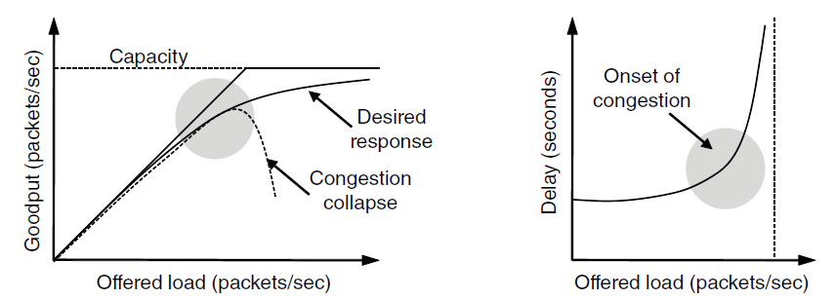
Effects of Congestion
What happens to performance as we increase the load?

Slide 27

Effects of Congestion (2)
What happens to performance as we increase the load?

Slide 28

Effects of Congestion (3)
As offered load rises, congestion occurs as queues begin to fill:
  Delay and loss rise sharply with more load
  Throughput falls below load (due to loss)
  Goodput may fall below throughput (due to spurious retransmissions)
None of the above is good!
  Want to operate network just before the onset of congestion

Slide 29
Bandwidth Allocation
Important task for network is to allocate its capacity to senders
  Good allocation is efficient and fair
Efficient means most capacity is used but there is no congestion
Fair means every sender gets a reasonable share the network

Slide 30
Bandwidth Allocation (2)
Key observation:
  In an effective solution, Transport and Network layers must work together
Network layer witnesses congestion
  Only it can provide direct feedback
Transport layer causes congestion
  Only it can reduce offered load

Slide 31
Bandwidth Allocation (3)
Why is it hard? (Just split equally!)
  Number of senders and their offered load is constantly changing
  Senders may lack capacity in different parts of the network
  Network is distributed; no single party has an overall picture of its state

Slide 32
Bandwidth Allocation (4)
Solution context:
  Senders adapt concurrently based on their own view of the network
  Design this adaption so the network usage as a whole is efficient and fair
  Adaption is continuous since offered loads continue to change over time

Slide 33

Topic
What’s a “fair” bandwidth allocation?
  The max-min fair allocation
Notes:
CN5E slides #5-10

Slide 34
Recall
We want a good bandwidth allocation to be fair and efficient
  Now we learn what fair means
Caveat: in practice, efficiency is more important than fairness

Slide 35
Efficiency vs. Fairness
Cannot always have both!
  Example network with traffic A→B, B→C and A→C
  How much traffic can we carry?
A
B
C
1
1

Slide 36
Efficiency vs. Fairness (2)
If we care about fairness:
  Give equal bandwidth to each flow
  A→B: ½ unit, B→C: ½, and A→C, ½
  Total traffic carried is 1 ½ units
A
B
C
1
1

Slide 37
Efficiency vs. Fairness (3)
If we care about efficiency:
  Maximize total traffic in network
  A→B: 1 unit, B→C: 1, and A→C, 0
  Total traffic rises to 2 units!
A
B
C
1
1

Slide 38
The Slippery Notion of Fairness
Why is “equal per flow” fair anyway?
  A→C uses more network resources (two links) than A→B or B→C
  Host A sends two flows, B sends one
Not productive to seek exact fairness
  More important to avoid starvation
  “Equal per flow” is good enough

Slide 39
Generalizing “Equal per Flow”
Bottleneck for a flow of traffic is the link that limits its bandwidth
  Where congestion occurs for the flow
  For A→C, link A–B is the bottleneck
A
B
C
1
10
Bottleneck

Slide 40
Generalizing “Equal per Flow” (2)
Flows may have different bottlenecks
  For A→C, link A–B is the bottleneck
  For B→C, link B–C is the bottleneck
  Can no longer divide links equally …
A
B
C
1
10

Slide 41
Max-Min Fairness
Intuitively, flows bottlenecked on a link get an equal share of that link
Max-min fair allocation is one that:
  Increasing the rate of one flow will decrease the rate of a smaller flow
  This “maximizes the minimum” flow

Slide 42
Max-Min Fairness (2)
To find it given a network, imagine “pouring water into the network”
  Start with all flows at rate 0
  Increase the flows until there is a new bottleneck in the network
  Hold fixed the rate of the flows that are bottlenecked
  Go to step 2 for any remaining flows

Slide 43
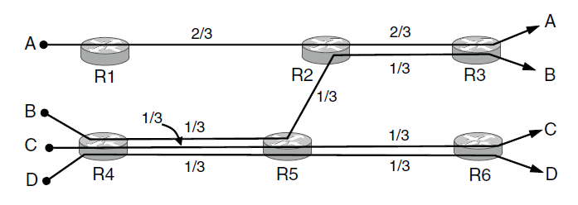
Max-Min Example
Example: network with 4 flows, links equal bandwidth
  What is the max-min fair allocation?

Slide 44
Max-Min Example (2)
When rate=1/3, flows B, C, and D bottleneck R4—R5
  Fix B, C, and D, continue to increase A
Bottleneck

Slide 45
Max-Min Example (3)
When rate=2/3, flow A bottlenecks R2—R3. Done.
Bottleneck
Bottleneck

Slide 46
Max-Min Example (4)
End with A=2/3, B, C, D=1/3, and R2—R3, R4—R5 full
  Other links have extra capacity that can’t be used
, linksxample: network with 4 flows, links equal bandwidth
  What is the max-min fair allocation?

Slide 47
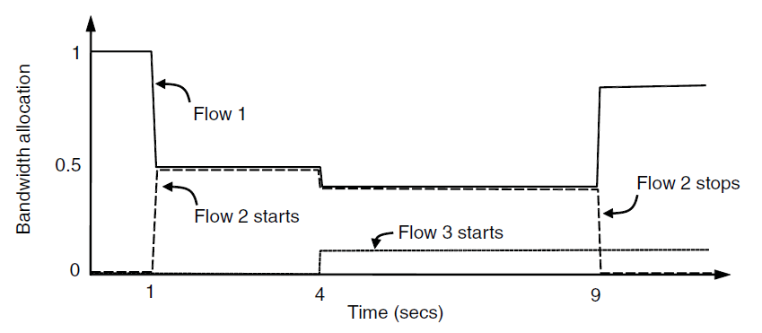
Adapting over Time
Allocation changes as flows start and stop
Time
Notes:
CN5E slides #6-31

Slide 48
Adapting over Time (2)
Flow 1 slows when Flow 2 starts
Flow 1 speeds up when Flow 2 stops
Flow 3 limit is elsewhere
Time
Notes:
CN5E slides #6-31

