Slide 1
Topic
The sliding window algorithm
  Pipelining and reliability
  Building on Stop-and-Wait
Yeah!
Network
Notes:
CN5E slides #5-10

Slide 2
Recall
ARQ with one message at a time is Stop-and-Wait (normal case below)
Sender
Receiver
Frame 0
ACK 0
Time
Timeout
Frame 1
ACK 1

Slide 3
Limitation of Stop-and-Wait
It allows only a single message to be outstanding from the sender:
  Fine for LAN (only one frame fit)
  Not efficient for network paths with BD >> 1 packet

Slide 4
Limitation of Stop-and-Wait (2)
Example: R=1 Mbps, D = 50 ms
  RTT (Round Trip Time) = 2D = 100 ms
  How many packets/sec?
  What if R=10 Mbps?

Slide 5
Sliding Window
Generalization of stop-and-wait
  Allows W packets to be outstanding
  Can send W packets per RTT (=2D)
  Pipelining improves performance
  Need W=2BD to fill network path

Slide 6
Sliding Window (2)
What W will use the network capacity?
Ex: R=1 Mbps, D = 50 ms
Ex: What if R=10 Mbps?

Slide 7
Sliding Window (3)
Ex: R=1 Mbps, D = 50 ms
  2BD = 10⁶ b/sec x 100. 10⁻³ sec = 100 kbit
  W = 2BD = 10 packets of 1250 bytes
Ex: What if R=10 Mbps?
  2BD = 1000 kbit
  W = 2BD = 100 packets of 1250 bytes

Slide 8
Sliding Window Protocol
Many variations, depending on how buffers, acknowledgements, and retransmissions are handled
Go-Back-N »
  Simplest version, can be inefficient
Selective Repeat »
  More complex, better performance

Slide 9
Sliding Window – Sender
Sender buffers up to W segments until they are acknowledged
  LFS=last frame sent, LAR=last ack rec’d
  Sends while LFS – LAR ≤ W
Sliding
Window
W=5
Available
5
6
7
..
2
3
4
5
2
3
..
3
..
Acked
Unacked
Unavailable
..
LAR
LFS
seq. number

Slide 10
Sliding Window – Sender (2)
Transport accepts another segment of data from the Application ...
  Transport sends it (as LFS–LAR → 5)
W=5
5
6
7
..
2
3
4
5
..
Acked
Unacked
4
2
3
..
3
..
Unavailable
LAR
LFS
seq. number

Slide 11
Sliding Window – Sender (3)
Next higher ACK arrives from peer…
  Window advances, buffer is freed
  LFS–LAR → 4 (can send one more)
W=5
Available
5
6
7
2
3
4
5
..
Acked
2
Unacked
..
2
3
..
3
..
Unavail.
LAR
LFS
seq. number

Slide 12
Sliding Window – Go-Back-N
Receiver keeps only a single packet buffer for the next segment
  State variable, LAS = last ack sent
On receive:
  If seq. number is LAS+1, accept and pass it to app, update LAS, send ACK
  Otherwise discard (as out of order)

Slide 13
Sliding Window – Selective Repeat
Receiver passes data to app in order, and buffers out-of-order segments to reduce retransmissions
ACK conveys highest in-order segment, plus hints about out-of-order segments
TCP uses a selective repeat design; we’ll see the details later

Slide 14
Sliding Window – Selective Repeat (2)
Buffers W segments, keeps state variable, LAS = last ack sent
On receive:
  Buffer segments [LAS+1, LAS+W]
  Pass up to app in-order segments from LAS+1, and update LAS
  Send ACK for LAS regardless

Slide 15
Sliding Window – Retransmissions
Go-Back-N sender uses a single timer to detect losses
  On timeout, resends buffered packets starting at LAR+1
Selective Repeat sender uses a timer per unacked segment to detect losses
  On timeout for segment, resend it
  Hope to resend fewer segments

Slide 16
Sequence Numbers
Need more than 0/1 for Stop-and-Wait …
  But how many?
For Selective Repeat, need W numbers for packets, plus W for acks of earlier packets
  2W seq. numbers
  Fewer for Go-Back-N (W+1)
Typically implement seq. number with an N-bit counter that wraps around at 2^{N}—1
  E.g., N=8: …, 253, 254, 255, 0, 1, 2, 3, …

Slide 17
Sequence Time Plot
Transmissions
(at Sender)
Seq. Number
Acks
(at Receiver)
Delay (=RTT/2)
Time

Slide 18
Sequence Time Plot (2)
Go-Back-N scenario
Seq. Number
Time

Slide 19
Sequence Time Plot (3)
Retransmissions
Loss
Seq. Number
Timeout
Time

Slide 20
Topic
Adding flow control to the sliding window algorithm
  To slow the over-enthusiastic sender
Please slow down!
Network
Notes:
CN5E slides #5-10

Slide 21

Problem
Sliding window uses pipelining to keep the network busy
  What if the receiver is overloaded?
Arg …
Streaming video
Big Iron
Wee Mobile
Notes:
Icons from pixabay

Slide 22
Sliding Window – Receiver
Consider receiver with W buffers
  LAS=last ack sent, app pulls in-order data from buffer with recv() call
Sliding
Window
W=5
5
6
7
5
5
5
5
5
2
3
..
3
..
Finished
Acceptable
Too high
..
LAS
seq. number

Slide 23
Sliding Window – Receiver (2)
Suppose the next two segments arrive but app does not call recv()
W=5
Acceptable
..
5
6
7
5
5
5
5
5
2
3
..
3
Finished
Too high
..
LAS
seq. number
Notes:
Draw in scenario

Slide 24
Sliding Window – Receiver (3)
Suppose the next two segments arrive but app does not call recv()
  LAS rises, but we can’t slide window!
W=5
Acceptable
5
6
7
4
5
5
5
5
5
2
3
..
3
..
Finished
4
..
Acked
Too high
LAS
seq. number

Slide 25
Sliding Window – Receiver (4)
If further segments arrive (even in order) we can fill the buffer
  Must drop segments until app recvs!
W=5
Nothing
Acceptable
5
4
4
5
6
7
4
4
4
..
Finished
5
5
5
5
2
3
..
3
..
Acked
Acked
Too high
LAS
seq. number

Slide 26
Sliding Window – Receiver (5)
App recv() takes two segments
  Window slides (phew)
W=5
Acceptable
5
6
7
5
5
4
4
4
..
Finished
5
5
5
2
3
..
3
..
Acked
Too high
LAS
seq. number

Slide 27
Flow Control
Avoid loss at receiver by telling sender the available buffer space
  win=#Acceptable, not W (from LAS)
W=5
Acceptable
5
6
7
4
5
5
5
5
5
2
3
..
3
..
Finished
4
..
Acked
Too high
LAS
seq. number

Slide 28
Flow Control (2)
Sender uses the lower of the sliding window and flow control window (win) as the effective window size
WIN=3
5
6
7
4
5
5
5
5
5
2
3
..
3
..
Finished
4
..
Acked
Too high
LAS
seq. number

Slide 29
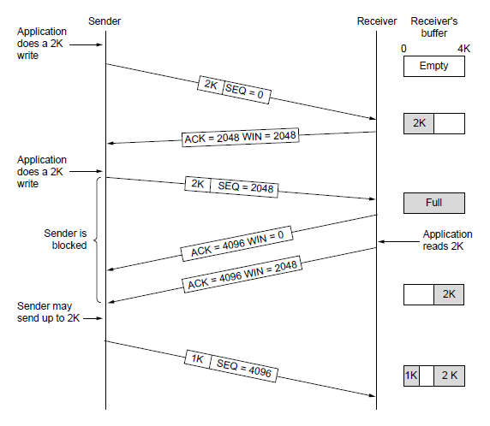
Flow Control (3)
TCP-style example
  seq/ack sliding window
  Flow control with win
  seq + length < ack+win
  4KB buffer at receiver
  Circular buffer of bytes
Notes:
CN5E slides #6-53

