Slide 1
Hierarchical Routing (§5.2.6)

Slide 2
Topic
How to scale routing with hierarchy in the form of regions
  Route to regions, not individual nodes
To the West!
West
East
Destination
Notes:
CN5E slides #5-10

Slide 3
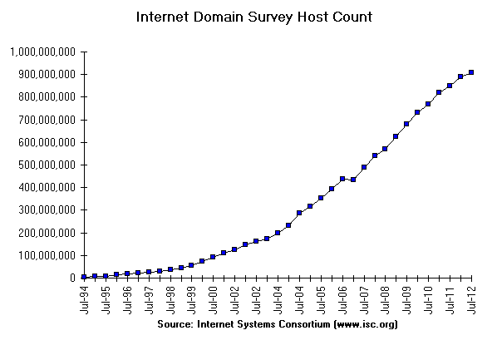
Internet Growth
At least a billion Internet hosts and growing …
Notes:
Graph from http://www.isc.org/solutions/survey with permission via http://www.isc.org/solutions/survey/faq:
Can I have permission to reproduce your data or charts?
You have permission to reproduce our data provided that you mention the source as "Source: Internet Systems Consortium, Inc. (http://www.isc.org/)". However you must ask our permission to publish derivative works based on our data. In those cases you must say your data or charts are "Based on data from Internet Systems Consortium, Inc. (http://www.isc.org/)"

Slide 4
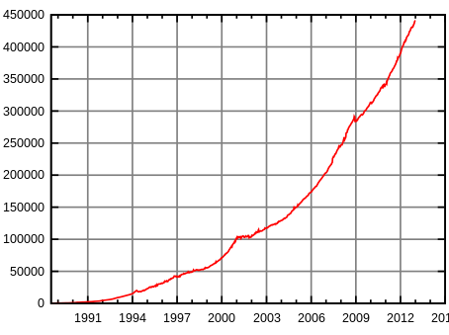
Internet Routing Growth
Internet growth translates into routing table growth (even using prefixes) …
Ouch!
Number of IP Prefixes
Year
Source: By Mro (Own work), CC-BY-SA-3.0 , via Wikimedia Commons

Slide 5
Impact of Routing Growth
Forwarding tables grow
  Larger router memories, may increase lookup time
Routing messages grow
  Need to keeps all nodes informed of larger topology
Routing computation grows
  Shortest path calculations grow faster than the size of the network

Slide 6
Techniques to Scale Routing
IP prefixes
  Route to blocks of hosts
Network hierarchy
  Route to network regions
IP prefix aggregation
  Combine, and split, prefixes
Last
time
This
time
Next
time

Slide 7
Hierarchical Routing
Introduce a larger routing unit
  IP prefix (hosts) ← from one host
  Region, e.g., ISP network
Route first to the region, then to the IP prefix within the region
  Hide details within a region from outside of the region

Slide 8
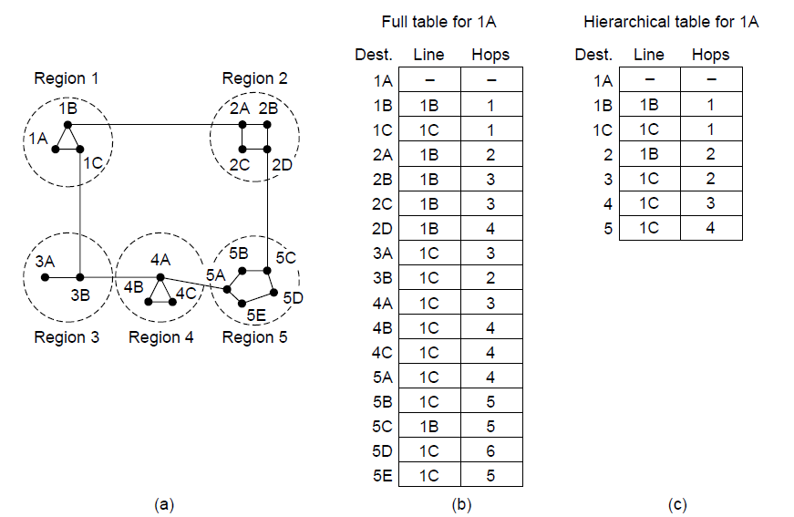
Hierarchical Routing (2)
Notes:
Draw route from 1A to 5C

Slide 9
Hierarchical Routing (3)
Notes:
Draw route from 1A to 5C

Slide 10
Hierarchical Routing (4)
Penalty is longer paths
1C is best route to region 5, except for destination 5C
Notes:
Draw route from 1A to 5C

Slide 11
Observations
Outside a region, nodes have one route to all hosts within the region
  This gives savings in table size, messages and computation
However, each node may have a different route to an outside region
  Routing decisions are still made by individual nodes; there is no single decision made by a region

Slide 12
Topic
How to help scale routing by adjusting the size of IP prefixes
  Split (subnets) and join (aggregation)
I’m the whole region
IP1 /18
1
IP2 /18
Region
IP /16
2
IP3 /18
3
Notes:
CN5E slides #5-10

Slide 13
Recall
IP addresses are allocated in blocks called IP prefixes, e.g., 18.31.0.0/16
  Hosts on one network in same prefix
A “/N” prefix has the first N bits fixed and contains 2^{32-N} addresses
  E.g., a “/24” has 256 addresses
Routers keep track of prefix lengths
  Use it as part of longest prefix matching

Slide 14
Recall (2)
IP addresses are allocated in blocks called IP prefixes, e.g., 18.31.0.0/16
  Hosts on one network in same prefix
A “/N” prefix has the first N bits fixed and contains 2^{32-N} addresses
  E.g., a “/24” has 256 addresses
Routers keep track of prefix lengths
  Use it as part of longest prefix matching
Routers can change prefix lengths without affecting hosts

Slide 15
Prefixes and Hierarchy
IP prefixes already help to scale routing, but we can go further
  We can use a less specific (larger) IP prefix as a name for a region
I’m the whole region
IP1 /18
1
IP2 /18
2
Region
IP /16
IP3 /18
3

Slide 16
Subnets and Aggregation
Two use cases for adjusting the size of IP prefixes; both reduce routing table
Subnets
  Internally split one large prefix into multiple smaller ones
Aggregation
  Externally join multiple smaller prefixes into one large prefix

Slide 17
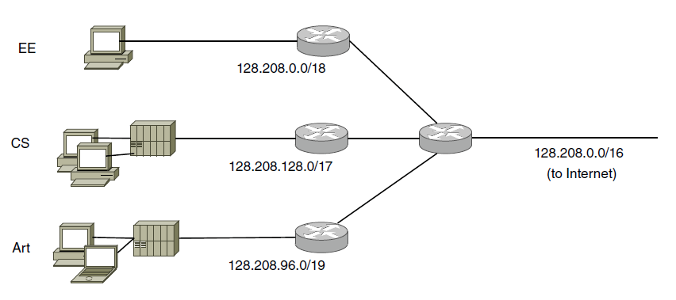
Subnets
Internally split up one IP prefix
One prefix sent to rest of Internet
16K
8K
32K addresses
4K
Company
Rest of Internet
Notes:
CN5E #5-64

Slide 18
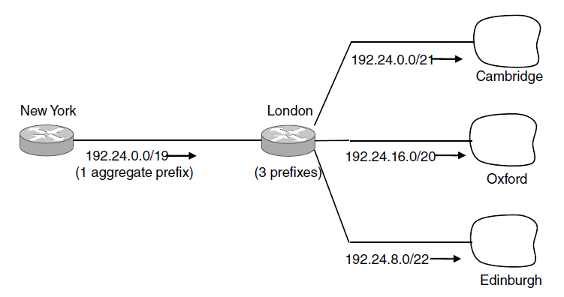
Aggregation
Externally join multiple separate IP prefixes
One prefix sent to rest of Internet
\
Rest of Internet
ISP
Notes:
CN5E slides #5-65

Slide 19
Topic
How to route with multiple parties, each with their own routing policies
  This is Internet-wide BGP routing
Source
ISP B
ISP A
ISP C
Destination
Notes:
CN5E slides #5-10

Slide 20
Structure of the Internet
Networks (ISPs, CDNs, etc.) group hosts as IP prefixes
Networks are richly interconnected, often using IXPs
Prefix B1
Prefix D1
Prefix C1
ISP B
CDN D
IXP
CDN C
Prefix E1
IXP
Prefix A1
Net E
IXP
IXP
Net F
ISP A
Prefix E2
Prefix A2
Prefix F1

Slide 21
Internet-wide Routing Issues
Two problems beyond routing within an individual network
Scaling to very large networks
  Techniques of IP prefixes, hierarchy, prefix aggregation
Incorporating policy decisions
  Letting different parties choose their routes to suit their own needs
Yikes!

Slide 22
Effects of Independent Parties
Each party selects routes to suit its own interests
  e.g, shortest path in ISP
What path will be chosen for A2→B1 and B1→A2?
  What is the best path?
ISP A
ISP B
Prefix A1
Prefix B1
Prefix A2
Prefix B2

Slide 23
Effects of Independent Parties (2)
Selected paths are longer than overall shortest path
  And symmetric too!
This is a consequence of independent goals and decisions, not hierarchy
ISP A
ISP B
Prefix A1
Prefix B1
Prefix A2
Prefix B2

Slide 24
Routing Policies
Capture the goals of different parties – could be anything
  E.g., Internet2 only carries non-commercial traffic
Common policies we’ll look at:
  ISPs give transit service to customers
  ISPs give peer service to each other

Slide 25
Routing Policies – Transit
One party (customer) gets transit service from another party (ISP)
  ISP accepts traffic for customer from the rest of Internet
  ISP sends traffic from customer to the rest of Internet
  Customer pays ISP for the privilege
ISP
Rest of
Internet
Customer 1
Non-
customer
Customer 2

Slide 26
Routing Policies – Peer
Both party (ISPs in example) get peer service from each other
  Each ISP accepts traffic from the other ISP only for their customers
  ISPs do not carry traffic to the rest of the Internet for each other
  ISPs don’t pay each other
ISP A
ISP B
Customer A1
Customer B1
Customer A2
Customer B2

Slide 27
Routing with BGP (Border Gateway Protocol)
BGP is the interdomain routing protocol used in the Internet
  Path vector, a kind of distance vector
Prefix B1
Prefix F1 via ISP B, Net F at IXP
ISP B
Prefix A1
IXP
ISP A
Net F
Prefix A2
Prefix F1

Slide 28
Routing with BGP (2)
Different parties like ISPs are called AS (Autonomous Systems)
Border routers of ASes announce BGP routes to each other
Route announcements contain an IP prefix, path vector, next hop
  Path vector is list of ASes on the way to the prefix; list is to find loops
Route announcements move in the opposite direction to traffic

Slide 29
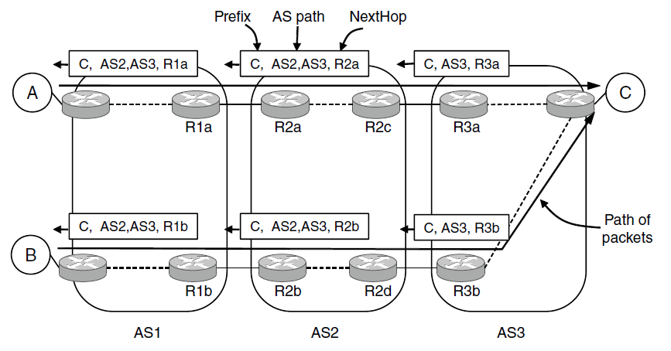
Routing with BGP (3)
Prefix
Notes:
CN5E slides #5-82

Slide 30
Routing with BGP (4)
Policy is implemented in two ways:
Border routers of ISP announce paths only to other parties who may use those paths
  Filter out paths others can’t use
Border routers of ISP select the best path of the ones they hear in any, non-shortest way

Slide 31
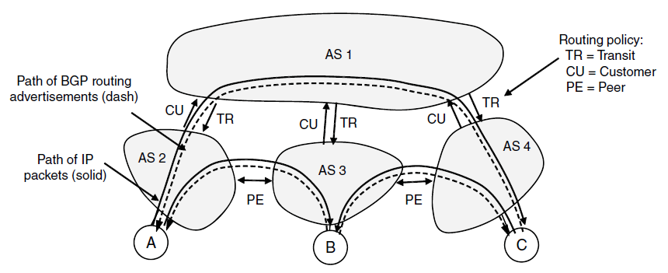
Routing with BGP (5)
transit: AS1 says [B, (AS1, AS3)], [C, (AS1, AS4)] to AS2
Notes:
CN5E slides #5-81

Slide 32
Routing with BGP (6)
customer (other side of transit): AS2 says [A, (AS2)] to AS1
Notes:
CN5E slides #5-81

Slide 33
Routing with BGP (7)
peer: AS2 says [A, (AS2)] to AS3, AS3 says [B, (AS3)] to AS2
Notes:
CN5E slides #5-81

Slide 34
Routing with BGP (8)
AS2 hears two routes to B (via AS1, AS3) and chooses AS3 (Free!)
Notes:
CN5E slides #5-81

Slide 35
BGP Thoughts
Much more beyond basics to explore!
Policy is a substantial factor
  Can we even be independent decisions will be sensible overall?
Other important factors:
  Convergence effects
  How well it scales
  Integration with intradomain routing
  And more …

