Slide 1
Helping IP with ARP, DHCP (§5.6.4)

Slide 2
Topic
Filling in the gaps we need to make for IP forwarding work in practice
  Getting IP addresses (DHCP) »
  Mapping IP to link addresses (ARP) »
What’s my IP?
What link layer address do I use?
Notes:
Icon from Cisco icon library.

Slide 3
Getting IP Addresses
Problem:
  A node wakes up for the first time …
  What is its IP address? What’s the IP address of its router? Etc.
  At least Ethernet address is on NIC
Hey, where am I?

Slide 4
Getting IP Addresses (2)
Manual configuration (old days)
  Can’t be factory set, depends on use
A protocol for automatically configuring addresses (DHCP) »
  Shifts burden from users to IT folk
What’s my IP?
Use A.B.C.D

Slide 5
DHCP
DHCP (Dynamic Host Configuration Protocol), from 1993, widely used
It leases IP address to nodes
Provides other parameters too
  Network prefix
  Address of local router
  DNS server, time server, etc.

Slide 6
DHCP Protocol Stack
DHCP is a client-server application
  Uses UDP ports 67, 68
DHCP
UDP
IP
Ethernet

Slide 7
DHCP Addressing
Bootstrap issue:
  How does node send a message to DHCP server before it is configured?
Answer:
  Node sends broadcast messages that delivered to all nodes on the network
  Broadcast address is all 1s
  IP (32 bit): 255.255.255.255
  Ethernet (48 bit): ff:ff:ff:ff:ff:ff

Slide 8
DHCP Messages
Client
Server
One link
Notes:
Icons from cisco icon library

Slide 9
DHCP Messages (2)
Client
Server
discover
Broadcast
offer
request
ack
Notes:
Icons from cisco icon library

Slide 10
DHCP Messages (3)
To renew an existing lease, an abbreviated sequence is used:
  request, followed by ack
Protocol also supports replicated servers for reliability

Slide 11
Sending an IP Packet
Problem:
  A node needs Link layer addresses to send a frame over the local link
  How does it get the destination link address from a destination IP address?
Uh oh …
My IP is 1.2.3.4
Notes:
Icons from cisco icon library

Slide 12
ARP (Address Resolution Protocol)
Node uses to map a local IP address to its Link layer addresses
Link layer
Source
Ethernet
Dest.
Ethernet
Source IP
Dest.
IP
Payload …
From
NIC
From
DHCP
From ARP

Slide 13
ARP Protocol Stack
ARP sits right on top of link layer
  No servers, just asks node with target IP to identify itself
  Uses broadcast to reach all nodes
ARP
Ethernet

Slide 14
ARP Messages
Node
Target
One link
Notes:
Icons from cisco icon library

Slide 15
ARP Messages (2)
Node
Target
request
Broadcast
Who has IP 1.2.3.4?
reply
I do at 1:2:3:4:5:6
Notes:
Icons from cisco icon library

Slide 16
Discovery Protocols
Help nodes find each other
  There are more of them!
    E.g., zeroconf, Bonjour
Often involve broadcast
  Since nodes aren’t introduced
  Very handy glue
Notes:
Icons from cisco icon library

Slide 17
Topic
What happens when something goes wrong during forwarding?
  Need to be able to find the problem
What happened?
Yikes!
XXXXXXX

Slide 18
Internet Control Message Protocol
ICMP is a companion protocol to IP
  They are implemented together
  Sits on top of IP (IP Protocol=1)
Provides error report and testing
  Error is at router while forwarding
  Also testing that hosts can use

Slide 19
ICMP Errors
When router encounters an error while forwarding:
  It sends an ICMP error report back to the IP source address
  It discards the problematic packet; host needs to rectify
Oh, now I see …
Report then toss it!
XXXXXXX
ICMP report

Slide 20
ICMP Message Format
Each ICMP message has a Type, Code, and Checksum
Often carry the start of the offending packet as payload
Each message is carried in an IP packet
Notes:
Draw ICMP message format

Slide 21
ICMP Message Format (2)
Each ICMP message has a Type, Code, and Checksum
Often carry the start of the offending packet as payload
Each message is carried in an IP packet
Portion of offending packet,
starting with its IP header
Src=router, Dst=A
Protocol = 1
Type=X, Code=Y
Src=A, Dst=B
XXXXXXXXXXXXXXX
IP header
ICMP header
ICMP data

Slide 22
Example ICMP Messages
Name | Type / Code | Usage
Dest. Unreachable (Net or Host) | 3 / 0 or 1 | Lack of connectivity
Dest. Unreachable (Fragment) | 3 / 4 | Path MTU Discovery
Time Exceeded (Transit) | 11 / 0 | Traceroute
Echo Request or Reply | 8 or 0 / 0 | Ping
Testing, not a forwarding error: Host sends Echo Request, and destination responds with an Echo Reply

Slide 23
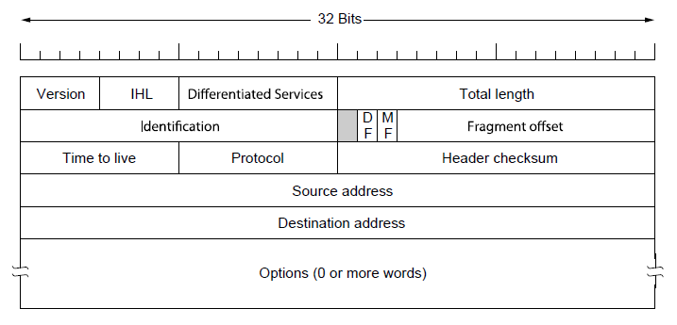
Traceroute
IP header contains TTL (Time to live) field
  Decremented every router hop, with ICMP error if it hits zero
  Protects against forwarding loops

Slide 24
Traceroute (2)
Traceroute repurposes TTL and ICMP functionality
  Sends probe packets increasing TTL starting from 1
  ICMP errors identify routers on the path
Local
Host
. . .
Remote
Host
1 hop
2 hops
3 hops
N-1 hops
N hops
Notes:
Icons from Cisco icon library, http://www.cisco.com/web/about/ac50/ac47/2.html.

Slide 25

Topic
IP version 6, the future of IPv4 that is now (still) being deployed
Why do I want IPv6 again?

Slide 26
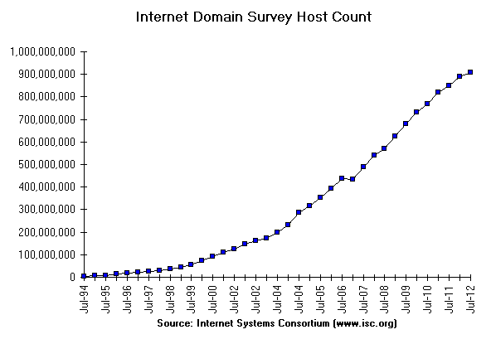
Internet Growth
At least a billion Internet hosts and growing …
And we’re using 32-bit addresses!
Notes:
Graph from http://www.isc.org/solutions/survey with permission via http://www.isc.org/solutions/survey/faq:
Can I have permission to reproduce your data or charts?
You have permission to reproduce our data provided that you mention the source as "Source: Internet Systems Consortium, Inc. (http://www.isc.org/)". However you must ask our permission to publish derivative works based on our data. In those cases you must say your data or charts are "Based on data from Internet Systems Consortium, Inc. (http://www.isc.org/)"

Slide 27

The End of New IPv4 Addresses
Now running on leftover blocks held by the regional registries; much tighter allocation policies
Exhausted
on 4/11
and 9/12!
ARIN
(US, Canada)
APNIC
(Asia Pacific)
ISPs
Companies
IANA
(All IPs)
RIPE
(Europe)
LACNIC
(Latin Amer.)
Exhausted
on 2/11!
AfriNIC
(Africa)
End of the world ? 12/21/12?
Notes:
Icon from openclipart

Slide 28
IP Version 6 to the Rescue
Effort started by the IETF in 1994
  Much larger addresses (128 bits)
  Many sundry improvements
Became an IETF standard in 1998
  Nothing much happened for a decade
  Hampered by deployment issues, and a lack of adoption incentives
  Big push ~2011 as exhaustion looms

Slide 29
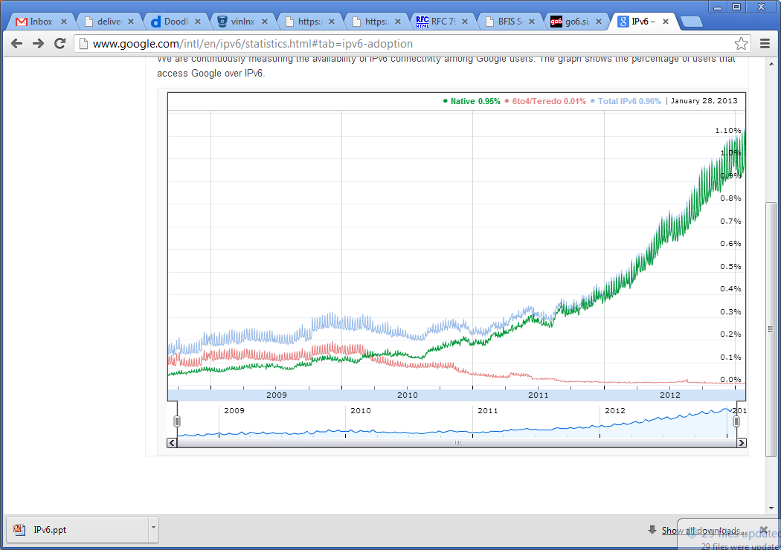

IPv6 Deployment
Time for
growth!
Percentage of users accessing Google via IPv6
Source: Google IPv6 Statistics, 30/1/13
Notes:
Graph from google public data graph, icon from isoc

Slide 30
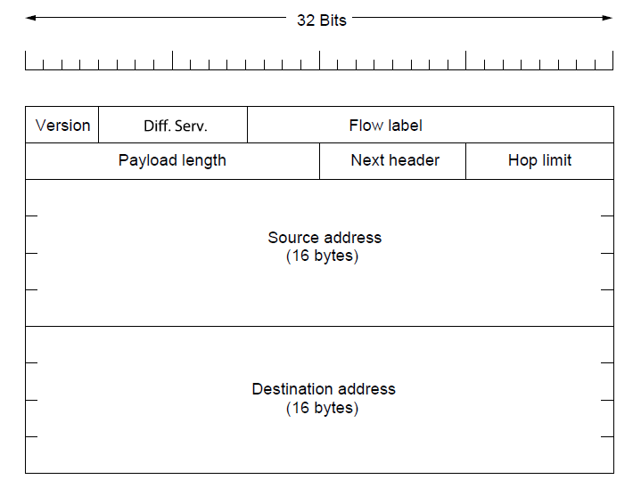
IPv6
Features large addresses
  128 bits, most of header
New notation
  8 groups of 4 hex digits (16 bits)
  Omit leading zeros, groups of zeros
32 bits
  Ex: 2001:0db8:0000:0000:0000:ff00:0042:8329
→
Notes:
CN5E slides #5-71

Slide 31
IPv6 (2)
32 bits
Lots of other, smaller changes
  Streamlined header processing
  Flow label to group of packets
  Better fit with “advanced” features (mobility, multicasting, security)
Notes:
CN5E slides #5-71

Slide 32
IPv6 Transition
The Big Problem:
  How to deploy IPv6?
  Fundamentally incompatible with IPv4
Dozens of approaches proposed
  Dual stack (speak IPv4 and IPv6)
  Translators (convert packets)
  Tunnels (carry IPv6 over IPv4) »

Slide 33
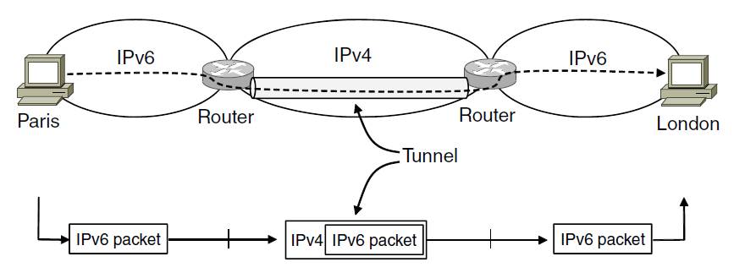
Tunneling
Native IPv6 islands connected via IPv4
  Tunnel carries IPv6 packets across IPv4 network
Notes:
CN5E slides #5-54

Slide 34
Tunneling (2)
Tunnel acts as a single link across IPv4 network
User
Tunnel
User

Slide 35
Tunneling (3)
Tunnel acts as a single link across IPv4 network
  Difficulty is to set up tunnel endpoints and routing
User
Tunnel
User
IPv6
IPv6
IPv6
IPv6
IPv6
IPv6
IPv4
IPv4
Link
Link
Link
Link
Link
Link
Native IPv6
Native IPv4
Native IPv6

Slide 36
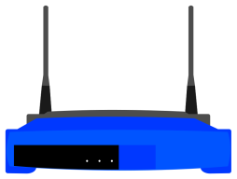
Topic
What is NAT (Network Address Translation)? How does it work?
  NAT is widely used at the edges of the network, e.g., homes
I’m a NAT box too!
Internet
Notes:
Icon from openclipart

Slide 37
Layering Review
Remember how layering is meant to work?
  “Routers don’t look beyond the IP header.” Well …
App
App
Router
TCP
TCP
IP
IP
IP
IP
IP
IP
802.11
802.11
Ethernet
802.11
Ethernet
802.11

Slide 38
Middleboxes
Sit “inside the network” but perform “more than IP” processing on packets to add new functionality
  NAT box, Firewall / Intrusion Detection System
App
Middlebox
App
TCP
App / TCP
TCP
IP
IP
IP
IP
IP
IP
802.11
802.11
Ethernet
802.11
Ethernet
802.11

Slide 39
Middleboxes (2)
Advantages
  A possible rapid deployment path when there is no other option
  Control over many hosts (IT)
Disadvantages
  Breaking layering interferes with connectivity; strange side effects
  Poor vantage point for many tasks

Slide 40
NAT (Network Address Translation) Box
NAT box connects an internal network to an external network
  Many internal hosts are connected using few external addresses
  Middlebox that “translates addresses”
Motivated by IP address scarcity
  Controversial at first, now accepted

Slide 41
NAT (2)
Common scenario:
  Home computers use “private” IP addresses
  NAT (in AP/firewall) connects home to ISP using a single external IP address
Unmodified computers at home
Looks like one
computer outside
ISP
NAT box

Slide 42
How NAT Works
Keeps an internal/external table
  Typically uses IP address + TCP port
  This is address and port translation
Need ports to make mapping 1-1 since there are fewer external IPs
What host thinks
What ISP thinks
Internal IP:port | External IP : port
192.168.1.12 : 5523 | 44.25.80.3 : 1500
192.168.1.13 : 1234 | 44.25.80.3 : 1501
192.168.2.20 : 1234 | 44.25.80.3 : 1502

Slide 43
How NAT Works (2)
Internal → External:
  Look up and rewrite Source IP/port
External
destination
IP=X, port=Y
Internal
source
Internal IP:port | External IP : port
192.168.1.12 : 5523 | 44.25.80.3 : 1500
Src =
NAT box
Src =
Dst =
Dst =

Slide 44
How NAT Works (3)
External → Internal
  Look up and rewrite Destination IP/port
External
source
IP=X, port=Y
Internal
destination
Internal IP:port | External IP : port
192.168.1.12 : 5523 | 44.25.80.3 : 1500
Src =
NAT box
Src =
Dst =
Dst =

Slide 45
How NAT Works (4)
Need to enter translations in the table for it to work
  Create external name when host makes a TCP connection
External
destination
IP=X, port=Y
Internal
source
Internal IP:port | External IP : port
192.168.1.12 : 5523
Src =
NAT box
Src =
Dst =
Dst =

Slide 46
NAT Downsides
Connectivity has been broken!
  Can only send incoming packets after an outgoing connection is set up
  Difficult to run servers or peer-to-peer apps at home
Doesn’t work so well when there are no connections (UDP apps)
Breaks apps that unwisely expose their IP addresses (FTP)

Slide 47
NAT Upsides
Relieves much IP address pressure
  Many home hosts behind NATs
Easy to deploy
  Rapidly, and by you alone
Useful functionality
  Firewall, helps with privacy
Kinks will get worked out eventually
  “NAT Traversal” for incoming traffic

