Slide 1
Topic
How do we connect nodes with a switch instead of multiple access
  Uses multiple links/wires
  Basis of modern (switched) Ethernet
Switch
Notes:
Icon from Cisco icon library.

Slide 2
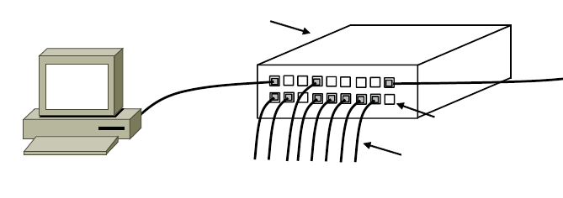
Switched Ethernet
Hosts are wired to Ethernet switches with twisted pair
  Switch serves to connect the hosts
  Wires usually run to a closet
Switch
Switch ports
Twisted pair
Notes:
CN5E slides #4-27

Slide 3
What’s in the box?
Remember from protocol layers:
Hub, or
repeater
Physical
Physical
All look like this:
Switch
Link
Link
Network
Network
Router
Link
Link

Slide 4
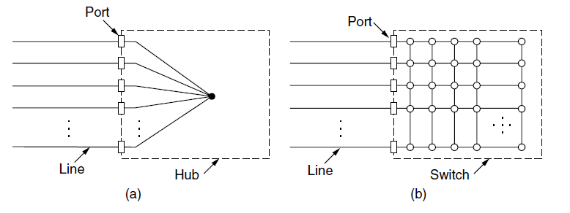
Inside a Hub
All ports are wired together; more convenient and reliable than a single shared wire
↔
Notes:
CN5e slides #4-26

Slide 5
Inside a Switch
Uses frame addresses to connect input port to the right output port; multiple frames may be switched in parallel
Fabric
. . .
Notes:
CN5e slides #4-26

Slide 6
Inside a Switch (2)
Port may be used for both input and output (full-duplex)
  Just send, no multiple access protocol
1
2
1 → 4
and
2 → 3
3
. . .
4
Notes:
CN5e slides #4-26

Slide 7
Inside a Switch (3)
Need buffers for multiple inputs to send to one output
Input
. . .
Output
. . .
. . .
. . .
Fabric
Output Buffer
Input Buffer
Notes:
CN5e slides #4-26

Slide 8
Inside a Switch (4)
Sustained overload will fill buffer and lead to frame loss
Loss!
XXX
Input
. . .
Output
. . .
. . .
. . .
Fabric
Output Buffer
Input Buffer
Notes:
CN5e slides #4-26

Slide 9
Advantages of Switches
Switches and hubs have replaced the shared cable of classic Ethernet
  Convenient to run wires to one location
  More reliable; wire cut is not a single point of failure that is hard to find
Switches offer scalable performance
  E.g., 100 Mbps per port instead of 100 Mbps for all nodes of shared cable / hub

Slide 10
Switch Forwarding
Switch needs to find the right output port for the destination address in the Ethernet frame. How?
  Want to let hosts be moved around readily; don’t look at IP
Ethernet Frame
Source
. . .
. . .
. . .
. . .
Destination
Notes:
CN5e slides #4-26

Slide 11
Backward Learning
Switch forwards frames with a port/address table as follows:
  To fill the table, it looks at the source address of input frames
  To forward, it sends to the port, or else broadcasts to all ports

Slide 12
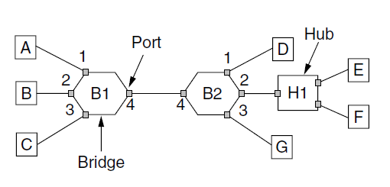
Backward Learning (2)
1: A sends to D
Address | Port
A
B
C
D
D
Switch
Notes:
CN5E slides #4-57

Slide 13
Backward Learning (3)
2: D sends to A
Address | Port
A | 1
B
C
D
D
Switch
Notes:
CN5E slides #4-57

Slide 14
Backward Learning (4)
3: A sends to D
Address | Port
A | 1
B
C
D | 4
D
Switch
Notes:
CN5E slides #4-57

Slide 15
Backward Learning (5)
3: A sends to D
Address | Port
A | 1
B
C
D | 4
D
Switch
Notes:
CN5E slides #4-57

Slide 16
Learning with Multiple Switches
Just works with multiple switches and a mix of hubs assuming no loops, e.g., A sends to D then D sends to A
Switch
Notes:
CN5E slides #4-57

Slide 17
Learning with Multiple Switches (2)
Just works with multiple switches and a mix of hubs assuming no loops, e.g., A sends to D then D sends to A
Switch
Notes:
CN5E slides #4-57

Slide 18
Learning with Multiple Switches (3)
Just works with multiple switches and a mix of hubs assuming no loops, e.g., A sends to D then D sends to A
Switch
Notes:
CN5E slides #4-57

Slide 19
Topic
How can we connect switches in any topology so they just work
  This is part 2 of switched Ethernet
Loops – yikes!
Notes:
Icon from Cisco icon library.

Slide 20
Backward Learning
Switch forwards frames with a port/address table as follows:
  To fill the table, it looks at the source address of input frames
  To forward, it sends to the port, or else broadcasts to all ports

Slide 21
Problem – Forwarding Loops
May have a loop in the topology
  Redundancy in case of failures
  Or a simple mistake
Want LAN switches to “just work”
  Plug-and-play, no changes to hosts
  But loops cause a problem …
Redundant
Links

Slide 22
Forwarding Loops (2)
Suppose the network is started and A sends to F. What happens?
A
B
C
Left / Right
D
E
F

Slide 23
Forwarding Loops (3)
Suppose the network is started and A sends to F. What happens?
  A → C → B, D-left, D-right
  D-left → C-right, E, F
  D-right → C-left, E, F
  C-right → D-left, A, B
  C-left → D-right, A, B
  D-left → …
  D-right → …
A
B
C
Left / Right
D
E
F

Slide 24
Spanning Tree Solution
Switches collectively find a spanning tree for the topology
  A subset of links that is a tree (no loops) and reaches all switches
  They switches forward as normal on the spanning tree
  Broadcasts will go up to the root of the tree and down all the branches

Slide 25
Spanning Tree (2)
Topology
One ST
Another ST

Slide 26
Spanning Tree (3)
Topology
One ST
Another ST
Root

Slide 27
Spanning Tree Algorithm
Rules of the distributed game:
  All switches run the same algorithm
  They start with no information
  Operate in parallel and send messages
  Always search for the best solution
Ensures a highly robust solution
  Any topology, with no configuration
  Adapts to link/switch failures, …

Slide 28
Spanning Tree Algorithm (2)
Outline:
  Elect a root node of the tree (switch with the lowest address)
  Grow tree as shortest distances from the root (using lowest address to break distance ties)
  Turn off ports for forwarding if they aren’t on the spanning tree

Slide 29
Spanning Tree Algorithm (3)
Details:
  Each switch initially believes it is the root of the tree
  Each switch sends periodic updates to neighbors with:
    Its address, address of the root, and distance (in hops) to root
  Switches favors ports with shorter distances to lowest root
    Uses lowest address as a tie for distances
Hi, I’m C, the root is A, it’s 2 hops away
or (C, A, 2)
C

Slide 30
Spanning Tree Example
1st round, sending:
  A sends (A, A, 0) to say it is root
  B, C, D, E, and F do likewise
1st round, receiving:
  A still thinks is it (A, A, 0)
  B still thinks (B, B, 0)
  C updates to (C, A, 1)
  D updates to (D, C, 1)
  E updates to (E, A, 1)
  F updates to (F, B, 1)
A,A,0
B,B,0
C,C,0
D,D,0
E,E,0
F,F,0

Slide 31
Spanning Tree Example (2)
2nd round, sending
  Nodes send their updated state
2nd round receiving:
  A remains (A, A, 0)
  B updates to (B, A, 2) via C
  C remains (C, A, 1)
  D updates to (D, A, 2) via C
  E remains (E, A, 1)
  F remains (F, B, 1)
A,A,0
B,B,0
C,A,1
D,C,1
E,A,1
F,B,1

Slide 32
Spanning Tree Example (3)
3rd round, sending
  Nodes send their updated state
3rd round receiving:
  A remains (A, A, 0)
  B remains (B, A, 2) via C
  C remains (C, A, 1)
  D remains (D, A, 2) via C-left
  E remains (E, A, 1)
  F updates to (F, A, 3) via B
A,A,0
B,A,2
C,A,1
D,A,2
E,A,1
F,B,1

Slide 33
Spanning Tree Example (4)
4th round
  Steady-state has been reached
  Nodes turn off forwarding that is not on the spanning tree
Algorithm continues to run
  Adapts by timing out information
  E.g., if A fails, other nodes forget it, and B will become the new root
A,A,0
B,A,2
C,A,1
D,A,2
E,A,1
F,A,3

Slide 34
Spanning Tree Example (5)
Forwarding proceeds as usual on the ST
Initially D sends to F:
And F sends back to D:
A,A,0
B,A,2
C,A,1
D,A,2
E,A,1
F,A,3

Slide 35
Spanning Tree Example (6)
Forwarding proceeds as usual on the ST
Initially D sends to F:
  D → C-left
  C → A, B
  A → E
  B → F
And F sends back to D:
  F → B
  B → C
  C → D
  (hm, not such a great route)
A,A,0
B,A,2
C,A,1
D,A,2
E,A,1
F,A,3

Slide 36
Where we are in the Course
Starting the Network Layer!
  Builds on the link layer. Routers send packets over multiple networks
Application
Transport
Network
Link
Physical

Slide 37
Why do we need a Network layer?
We can already build networks with links and switches and send frames between hosts …

Slide 38
Shortcomings of Switches
Don’t scale to large networks
  Blow up of routing table, broadcast
Table for all destinations in the world!
Broadcast new destinations to the whole world!

Slide 39

Shortcomings of Switches (2)
Don’t work across more than one link layer technology
  Hosts on Ethernet + 3G + 802.11 …
Can we play too?
Go away!

Slide 40
Shortcomings of Switches (3)
Don’t give much traffic control
  Want to plan routes / bandwidth
That was lame.

Slide 41
Network Layer Approach
Scaling:
  Hierarchy, in the form of prefixes
Heterogeneity:
  IP for internetworking
Bandwidth Control:
  Lowest-cost routing
  Later QOS (Quality of Service)

Slide 42
Topics
Network service models
  Datagrams (packets), virtual circuits
IP (Internet Protocol)
  Internetworking
  Forwarding (Longest Matching Prefix)
  Helpers: ARP and DHCP
  Fragmentation and MTU discovery
  Errors: ICMP (traceroute!)
IPv6, the future of IP
NAT, a “middlebox”
Routing algorithms
This
time
Next
time

Slide 43
Routing vs. Forwarding
Routing is the process of deciding in which direction to send traffic
  Network wide (global) and expensive
Which way?
Which way?
Which way?

Slide 44
Routing vs. Forwarding (2)
Forwarding is the process of sending a packet on its way
  Node process (local) and fast
Forward!
packet

