Slide 1
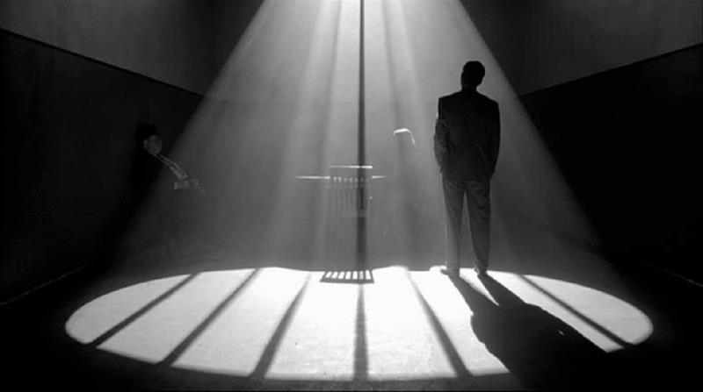
Cinematography (Lighting)

Slide 2
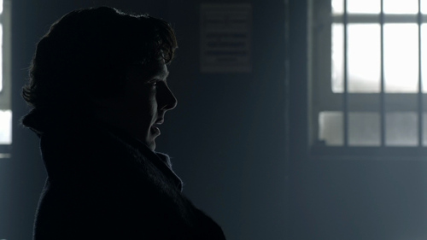
Why is lighting important?
-Adds depth and richness to the story and visual experience.
- It is overall part of cinematography to captivate the audience by emphasizing the action and setting the mood.
-Less about simply illuminating to make it so the viewer can see what’s happening, or make it look pretty.
1. Light directs the viewer’s eye, enhances
mood, atmosphere and drama.
2. Creates depth
3. Conveys time of day and season.
4. Reveals character’s personality and situation.
5. Compliments the composition.

Slide 3
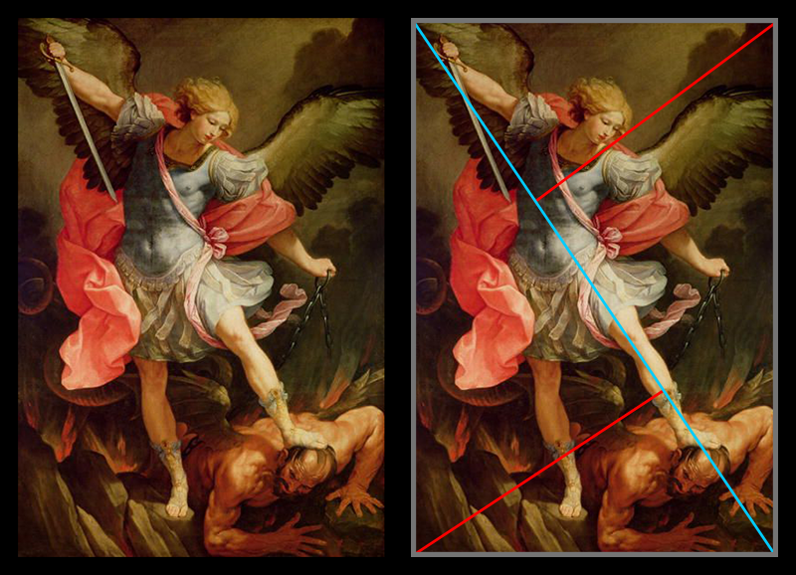
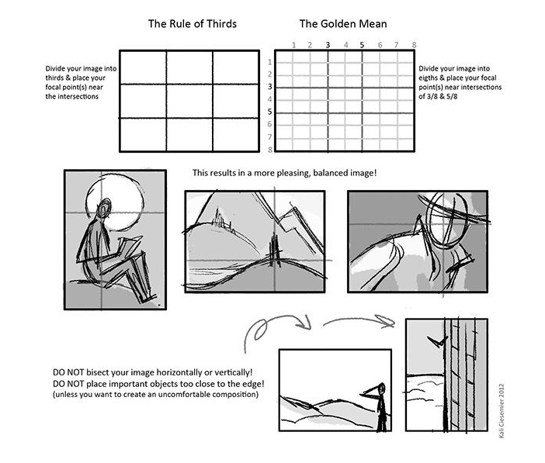
COMPOSITION
Composition for visual art: -A way of organizing or arranging elements within an image to convey the main idea or goal of the work, as well as direct the viewer’s eye around the image to the main subject (focal point). -Helps the subject, mood and or action to be easily understood and aesthetically pleasing to the viewer.
More examples of composition

Slide 4
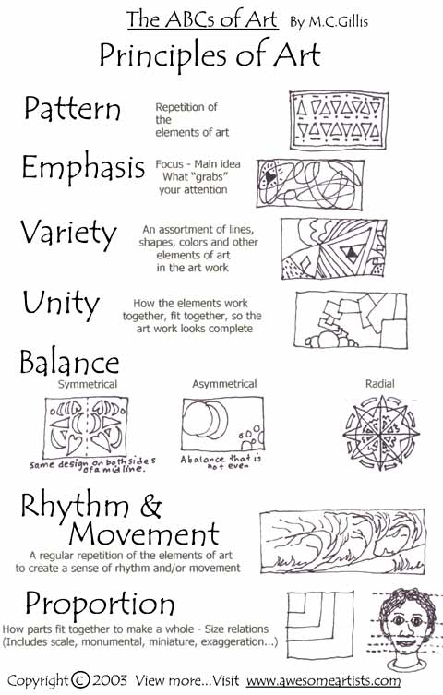
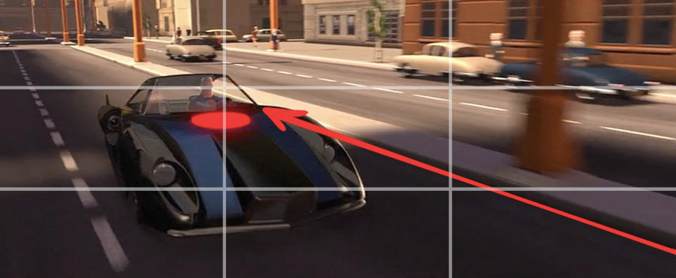
COMPOSITION
-Composition provides structure to the layout and the way the subject is presented along with unity so that everything feels like it belongs together.
-There are a group of visual principles that support
a well developed composition.
-They’re not considered rules, but are good
guidelines in developing an image that’s easy to
understand and aesthetically pleasing. Examples of Visual Principles: Balance, Emphasis, Harmony, Movement, Pattern,
Rhythm, Tension, Unity, Variety, ect.
-Light will greatly influence these principles of
composition.

Slide 5
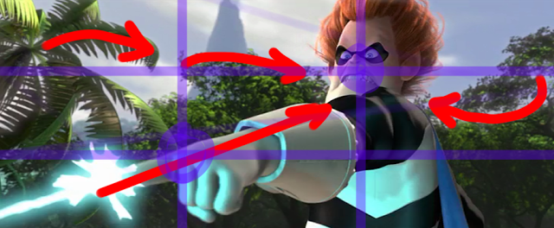
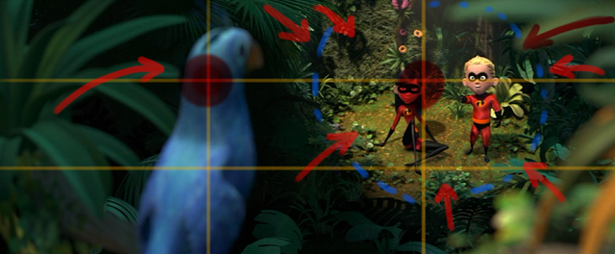
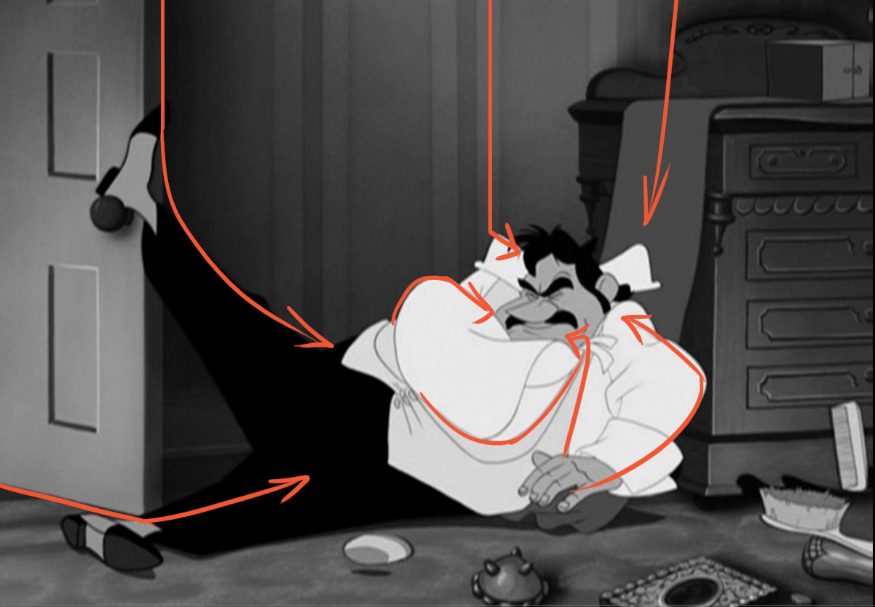
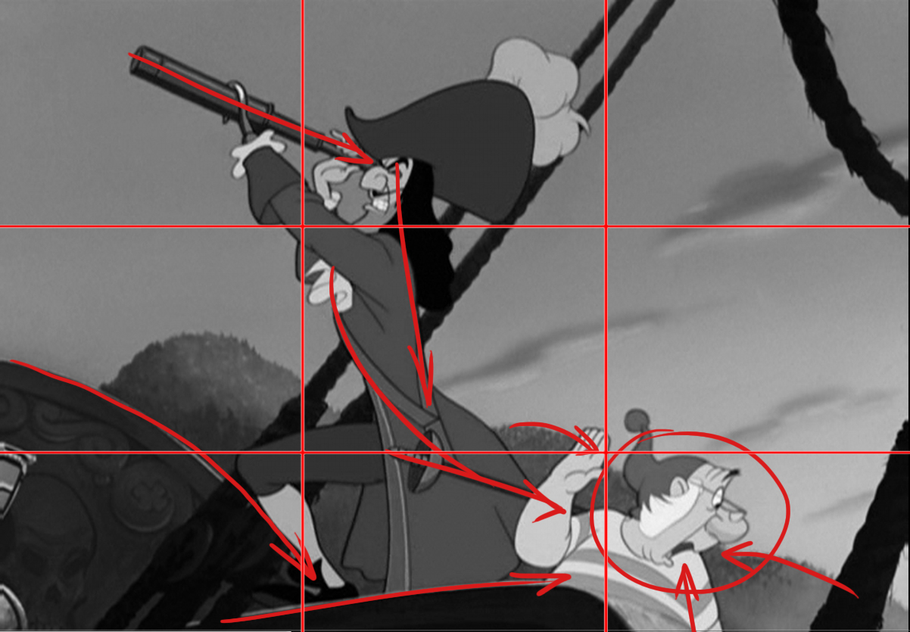
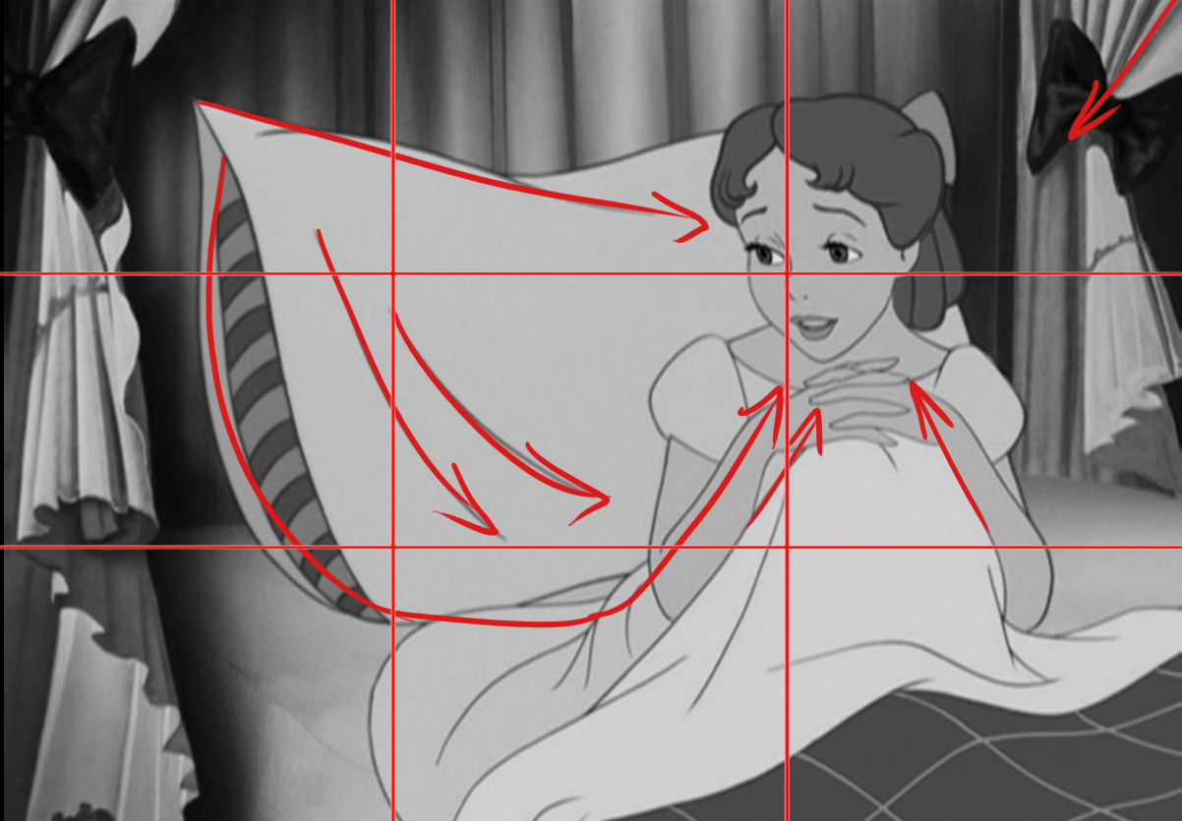
In a good composition
The viewer’s eye should easily be directed around the image to the focal point.
-The primary objective is to show the viewer where to look at. -Shots are quick and for effective storytelling, lighting must be done well to quickly allow the audience to see the key story elements in each shot.
Peter Pan Composition Analysis: Link

Slide 6
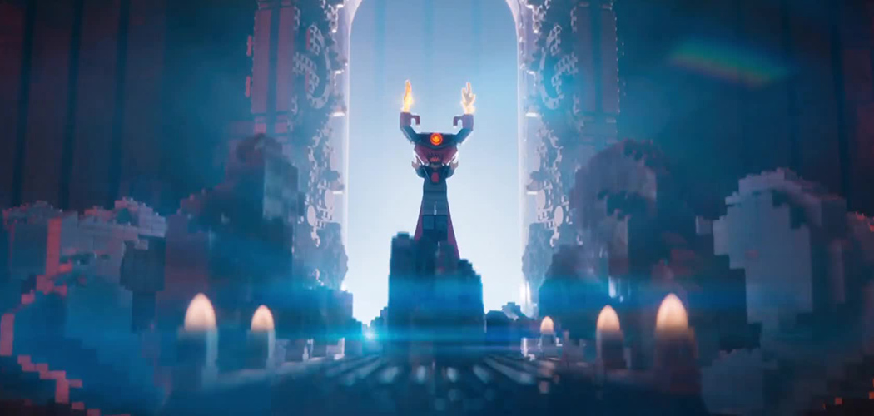
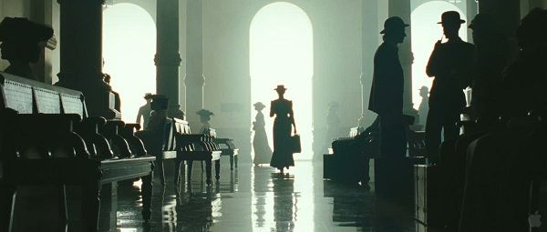
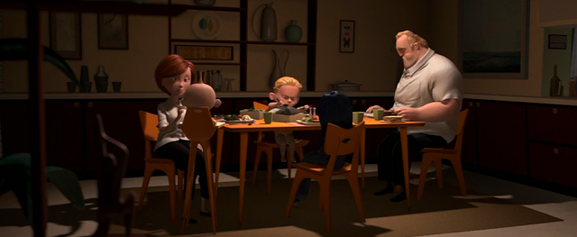
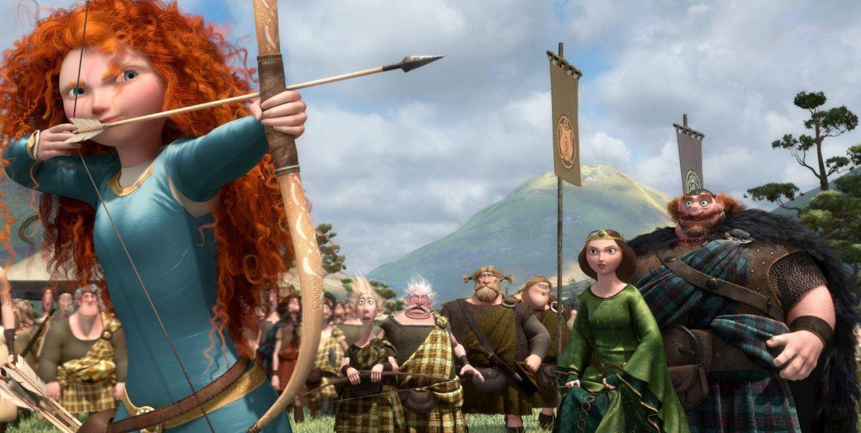
Contrast is used in an image to help create focal points
Also creates interest to the scene.
Contrast: A range of blacks and whites in the image, or darkness and brightness. High contrast: Has strong, bold colors and textures, with dark shadows and bright highlights. Low contrast has little difference between lights and darks making an image flat or dull.

Slide 7
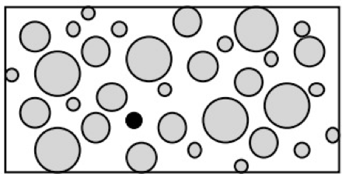
High contrast Eyes are attracted to high contrast areas, or they’re attracted to greater differences between elements such as color, value, size or texture. Your eye will be attracted to a dark dot (a dark value) among many white dots for example.

Slide 8
Or a small white dot (a light value) surrounded by black (a dark value)
]

Slide 9
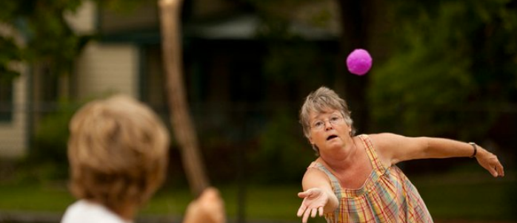
When you add color, eye is attracted to color than neutral. More saturation, the more attention it gets. Complementary colors that are directed across from each other in the color wheel create a high level of contrast. (Red & Green, Blue & Orange, Yellow & Purple)

Slide 10
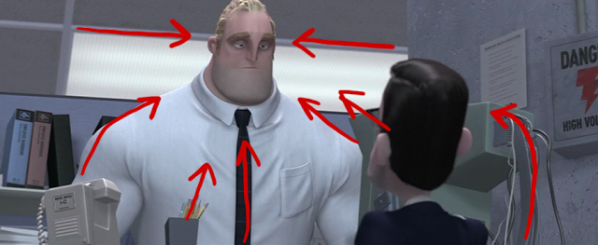
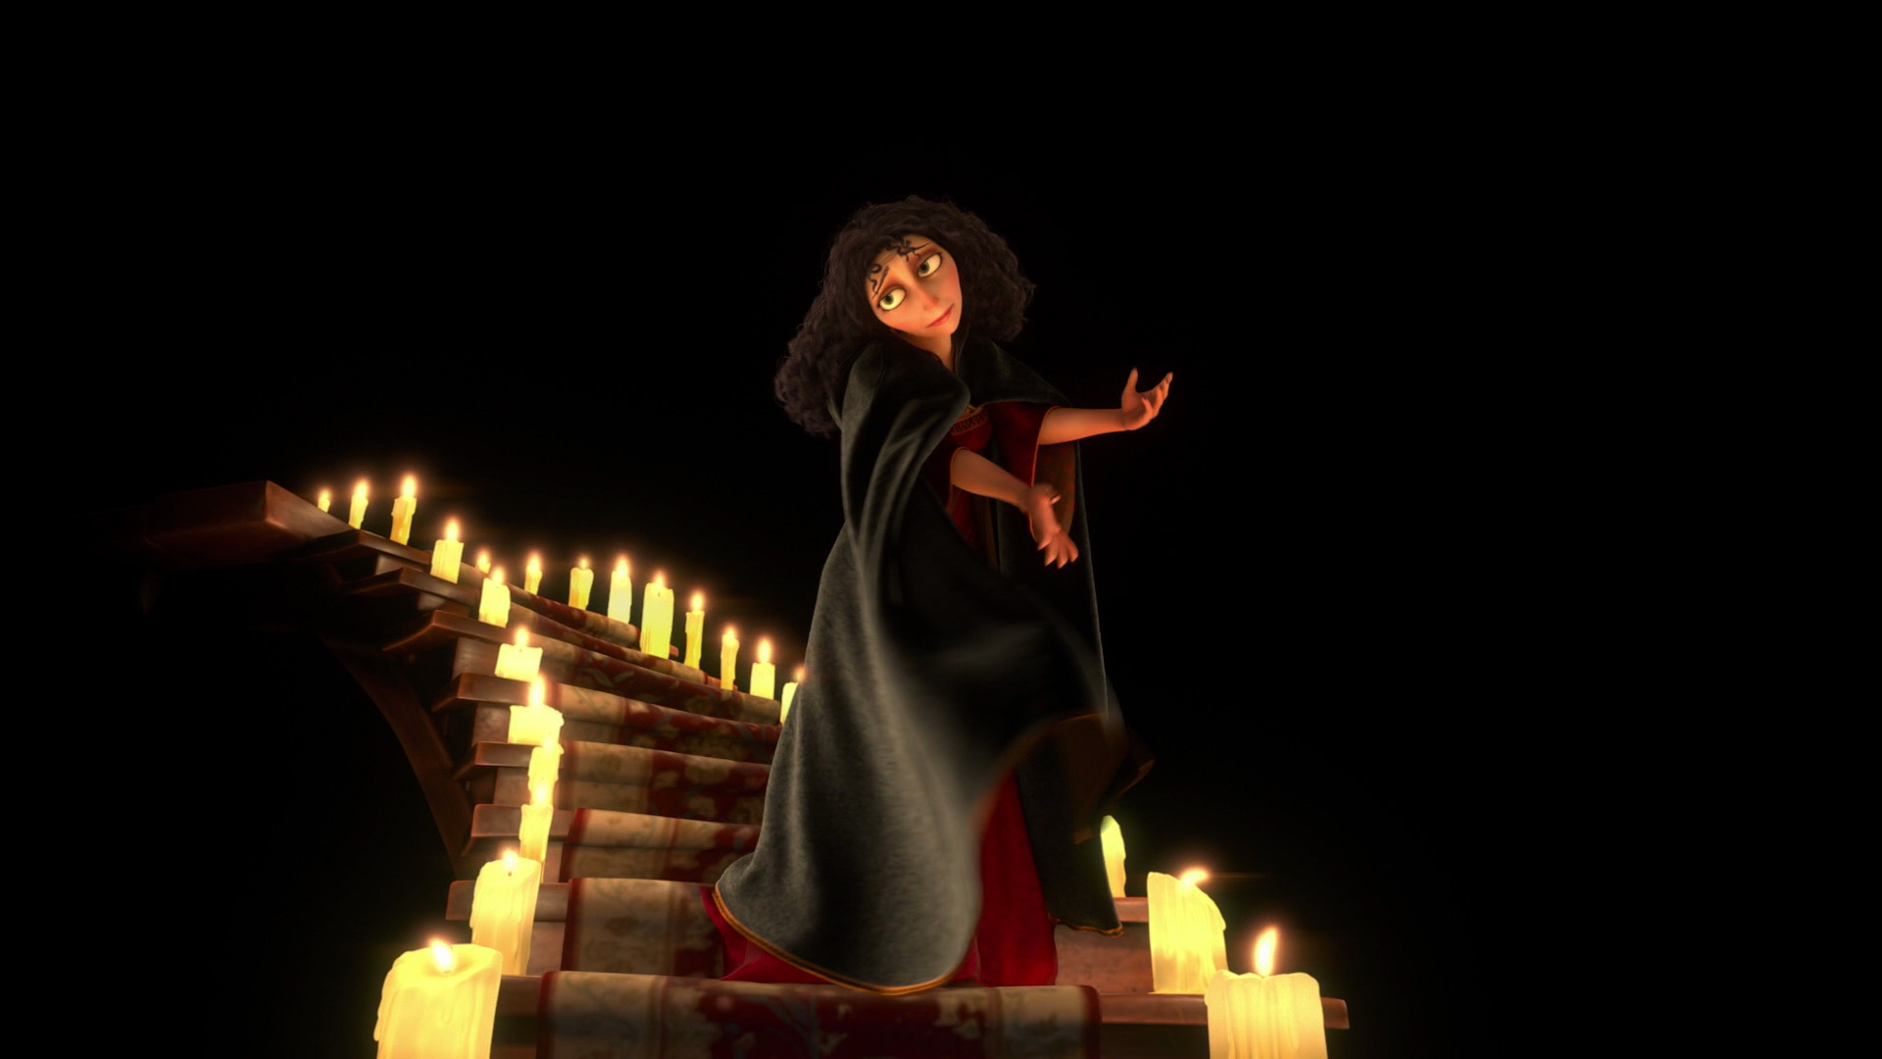
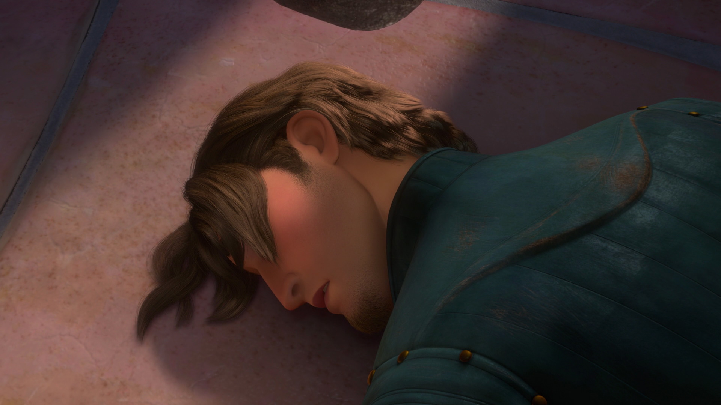
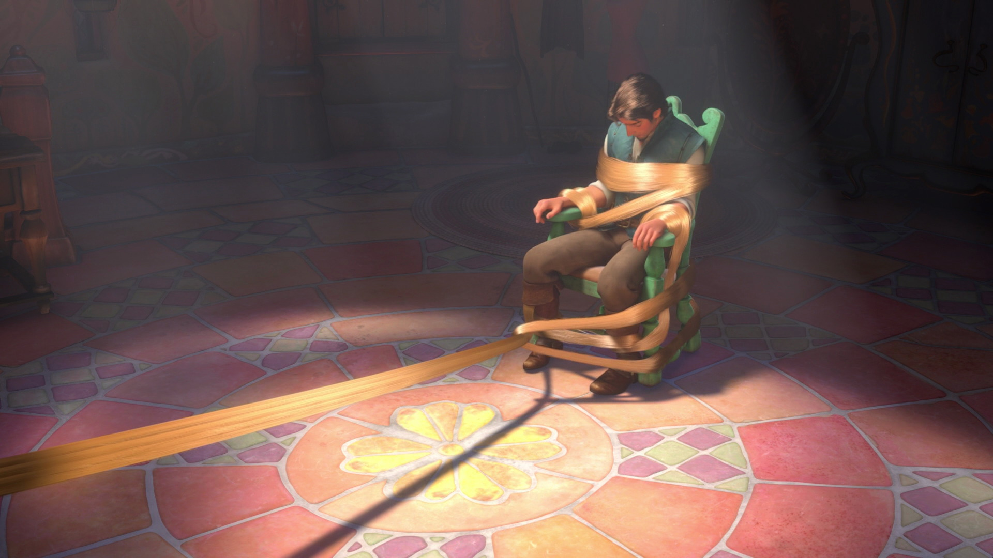
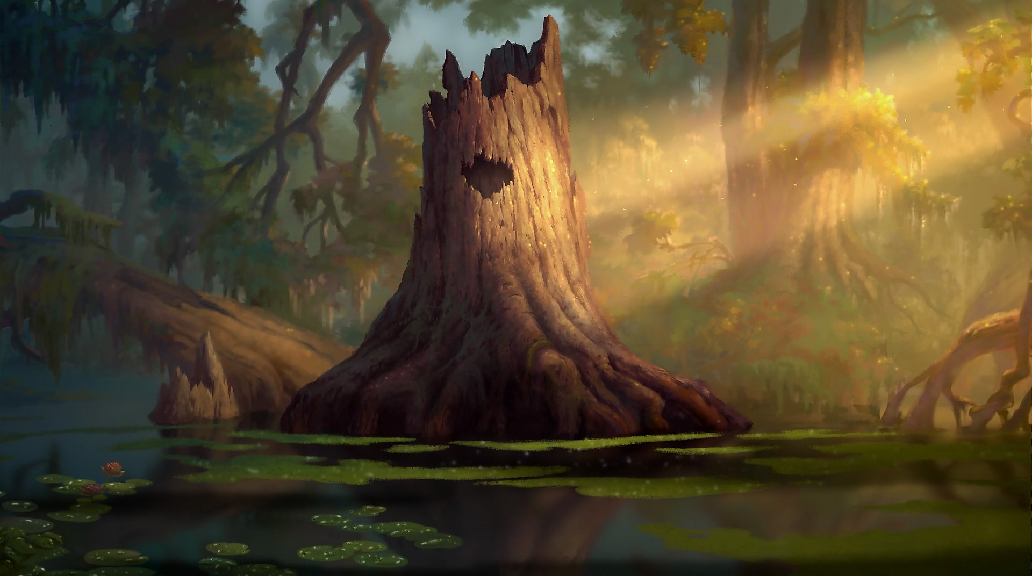
Light Directs the Eyes Light creates lines, contours and shapes to direct the eye in the composition.
-The viewer’s eye can be led by creating
lines and contours from angles of shadows, highlighting edges of a subject or allowing edges to blend with the background.

Slide 11
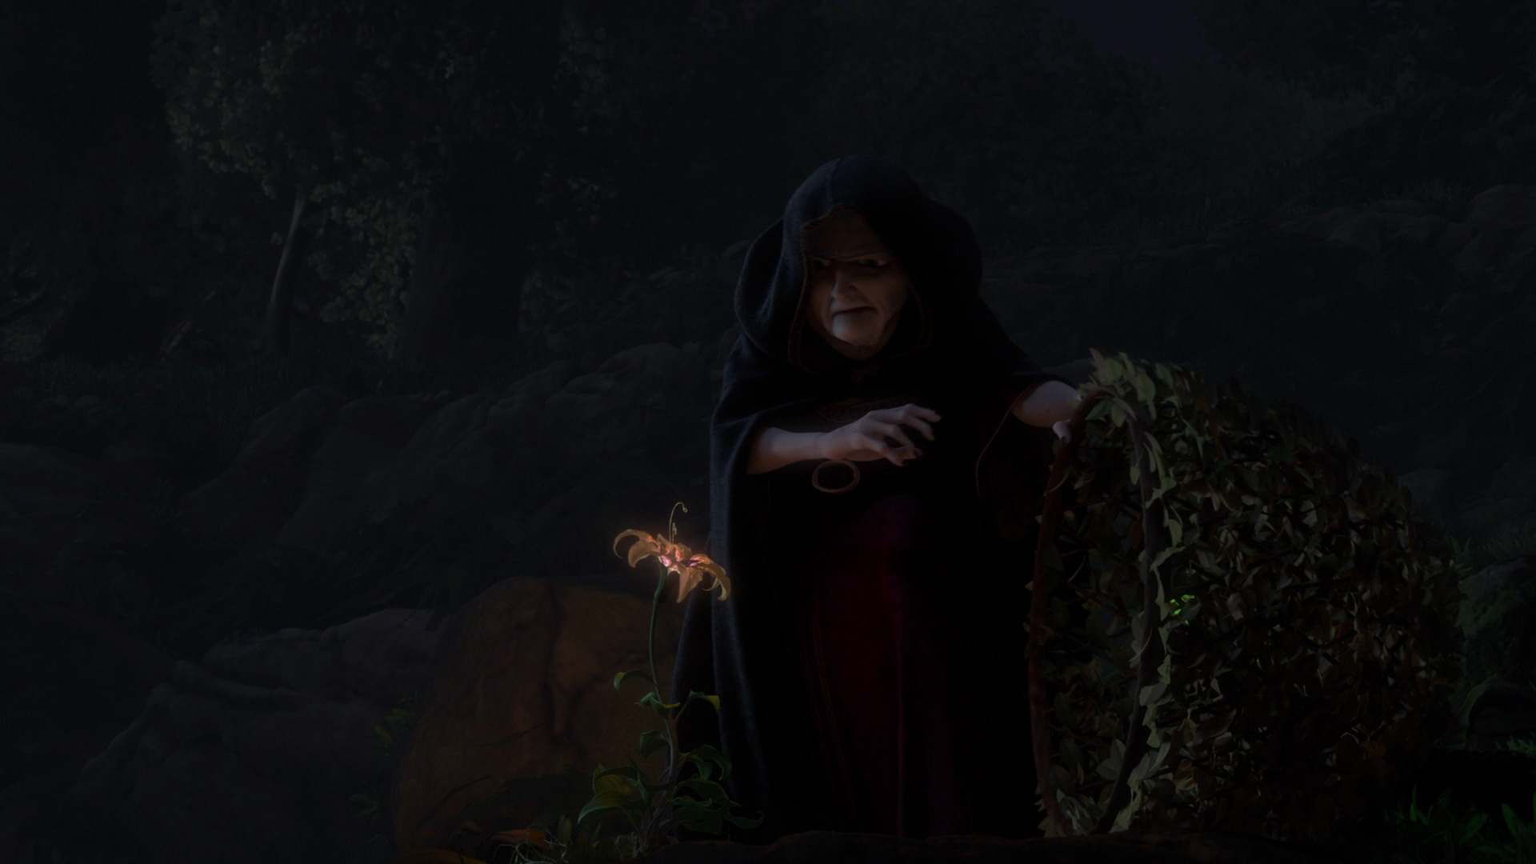

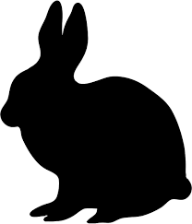

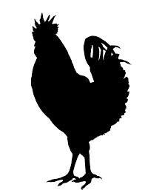
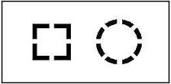
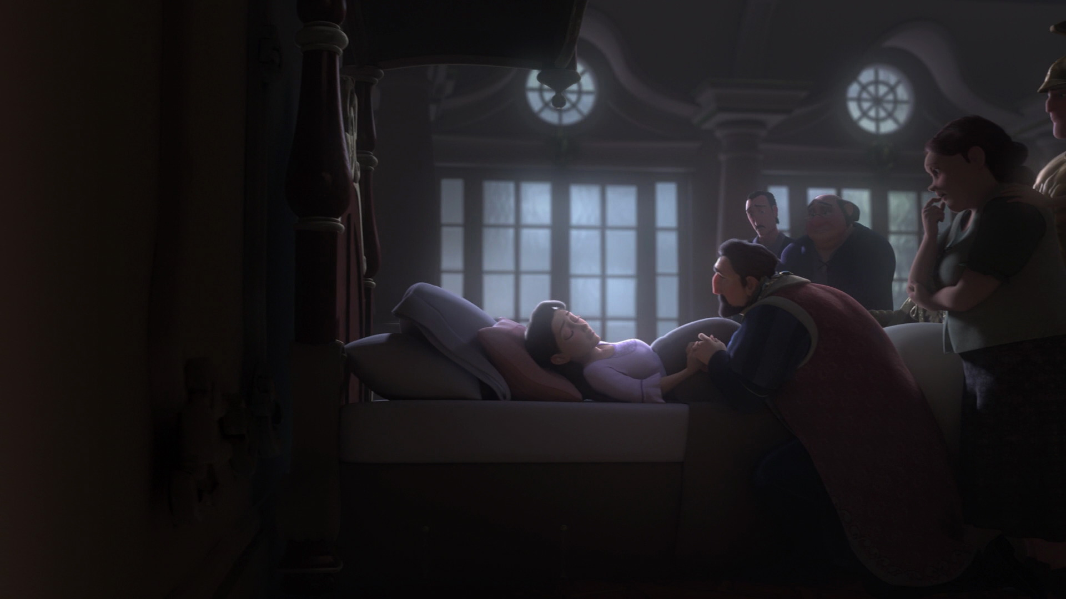
Shapes -The brain is good at recognizing shapes with minimal information, especially when the shape is familiar to the viewer.
-Hinting at a shape with minimal light activates the viewer’s imagination and they become more engaged.
-Creates mood, mystery and suspense.

Slide 12
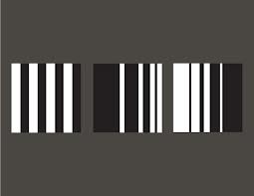
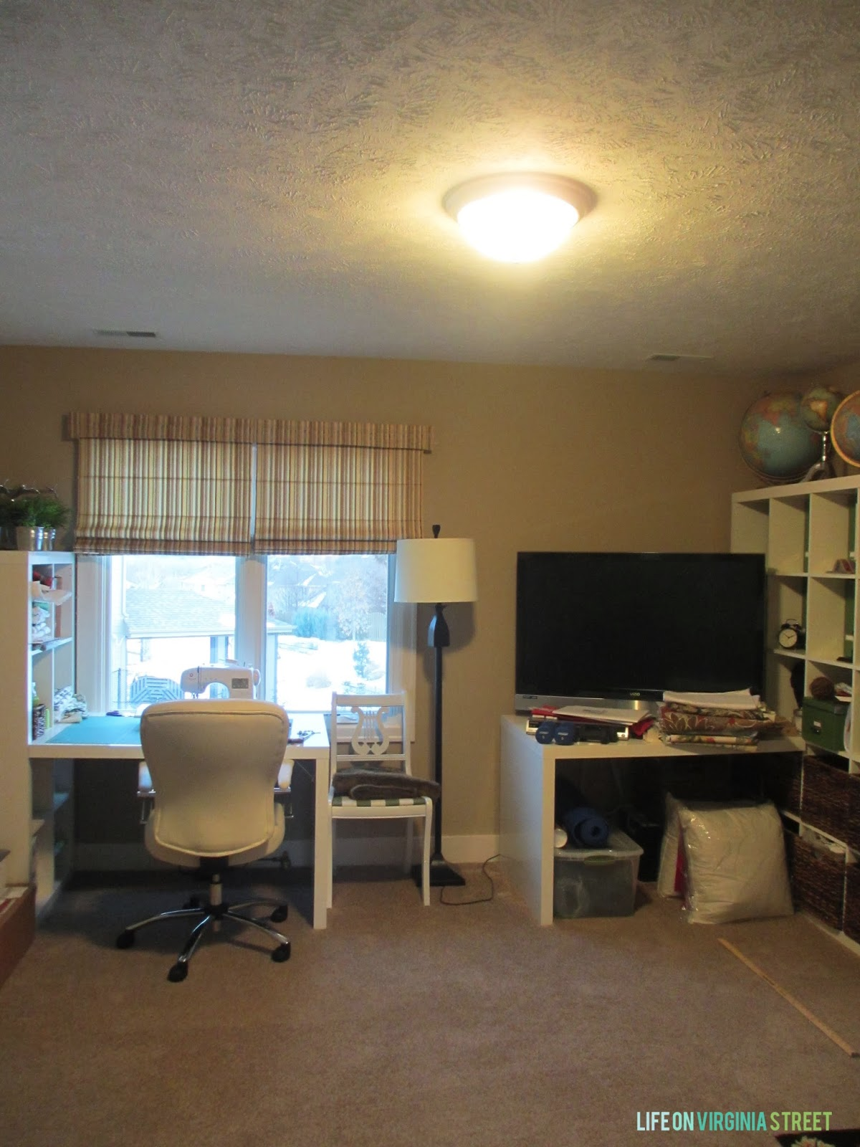
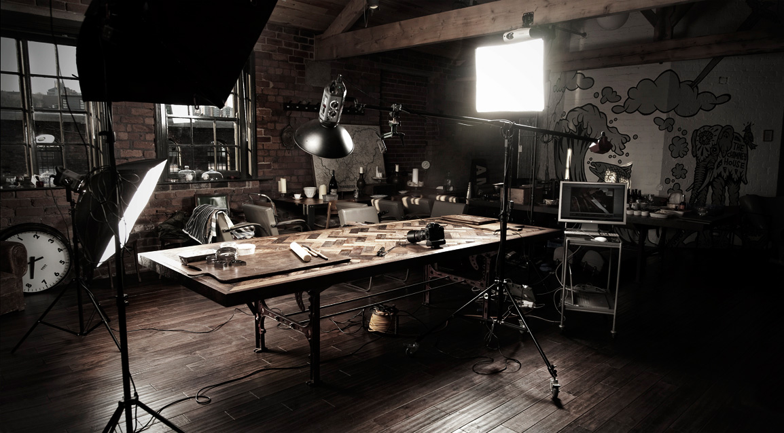
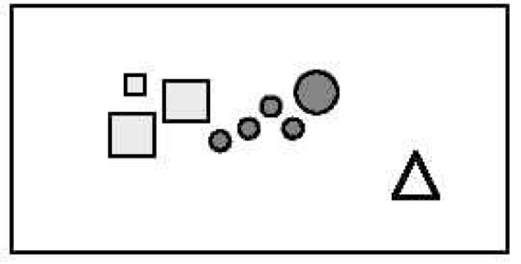
Unity and Harmony Lights helps with unity and harmony of the composition
i. Our brains group objects (size, shape, color, value) close together into a larger unit. It also groups negative or empty space with positive.
ii. Unity is when we tend to group similar elements and find a relationship that exists between them. When these elements come together they should make a whole that’s balanced and harmonious or make the space feel right.
1. Too much unity can be boring and the eye will lose interest if there’s nothing to solve when looking at the composition. Very little unity will make the image complicated for the viewer’s eye and they’ll lose interest.
2. Light can unify a disorganize/busy composition by adding shadows and emphasizing light on certain elements. Light creates a focal point.

Slide 13
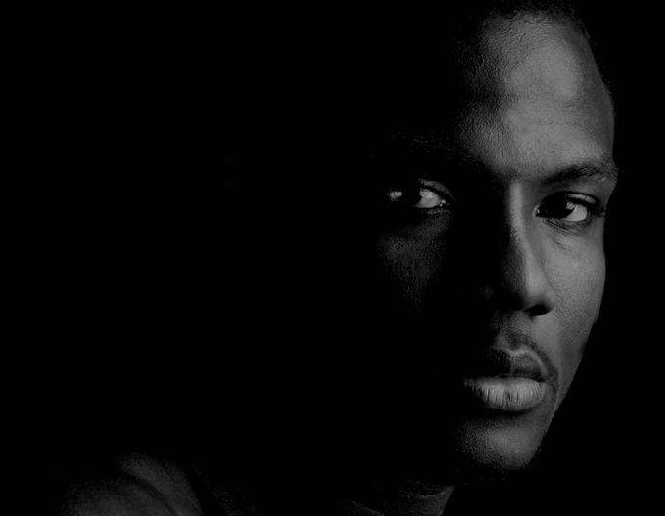
Mood Lighting is important in establishing mood and is very powerful in affecting us emotionally and or physically.
-The tonal range of values from light to dark affects the mood of the story.
High Key Light:
Well lit, soft fill light, no heavy/hard shadow supports light hearted or comedic moods. Contrast is low, dark areas are soft and few.
Low key light:
Range of shades of middle tonality to convey a feeling of calmness and bleak oppression.

Slide 14

High Key Lighting

Slide 15
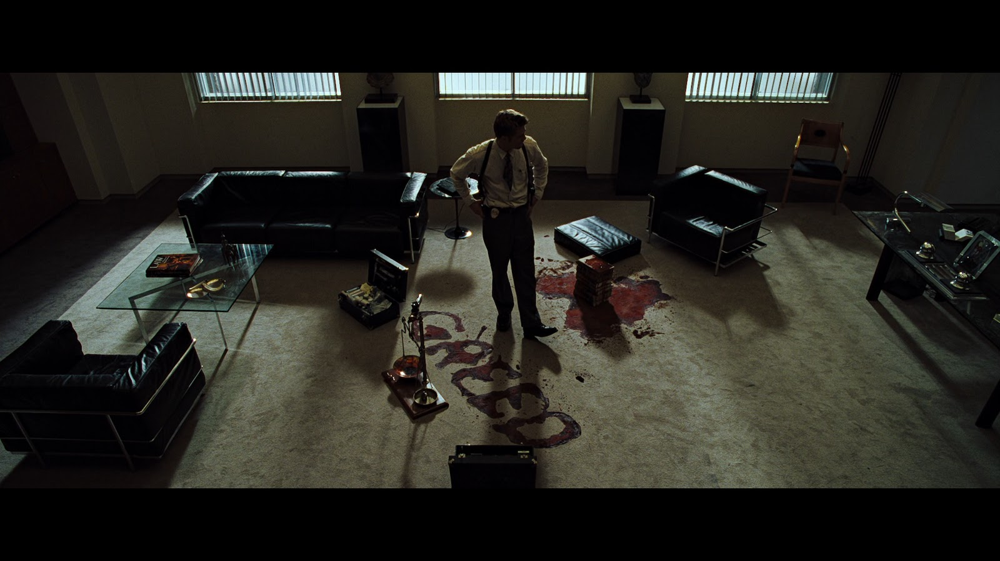
Low Key Lighting

Slide 16
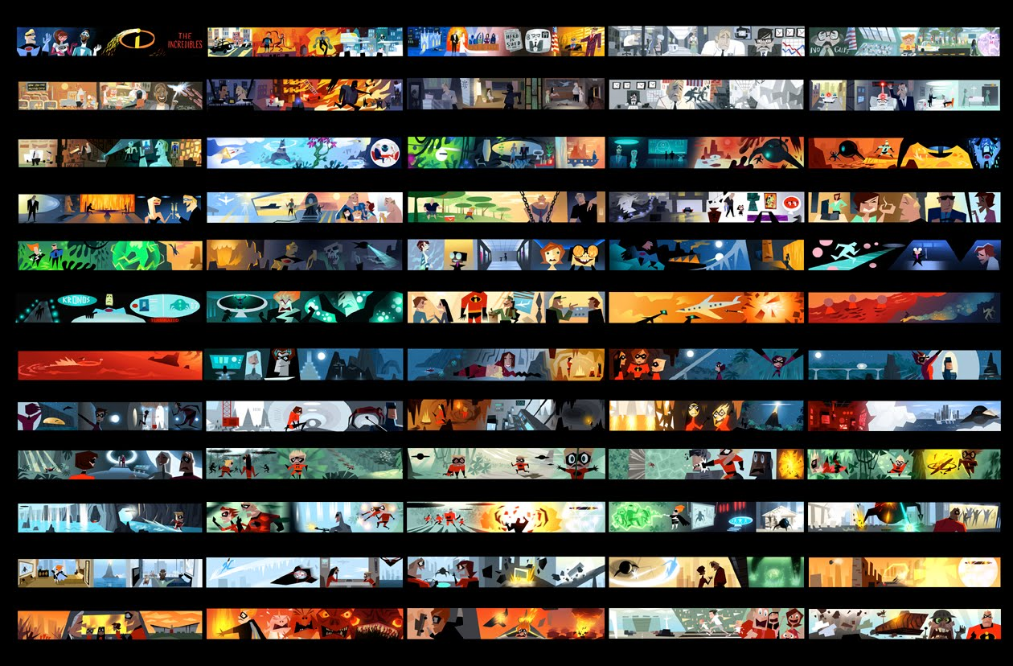
Color can influence how someone feels (especially when it’s universal to all cultures). It allows the audience to become emotionally involved with the story and characters.

Slide 17
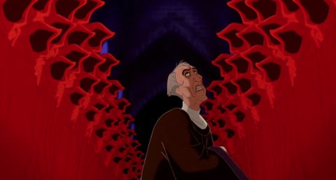
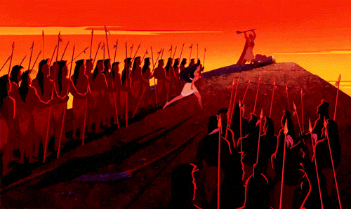
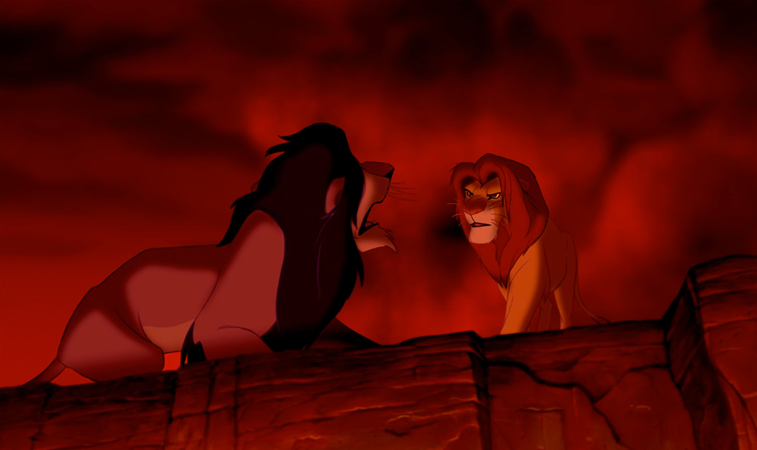
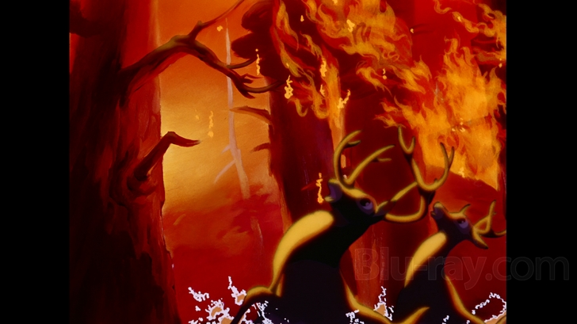
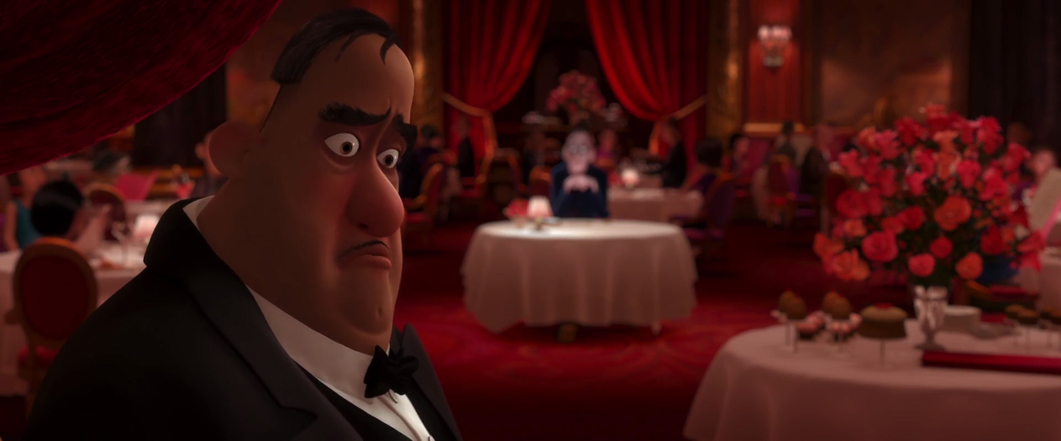
RED
-Physical, courage, strength, warmth, energy, basic survival, 'fight or flight', stimulation, masculinity, excitement, aggression, visual impact, strain.
-Grabs attention first and affects us physically by raising our pulse rate.

Slide 18
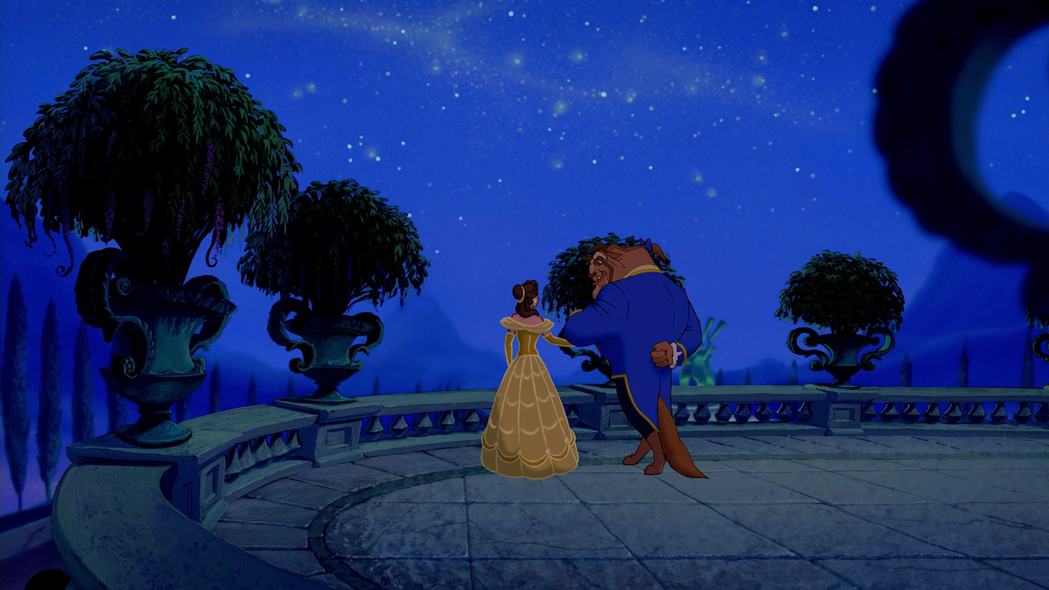
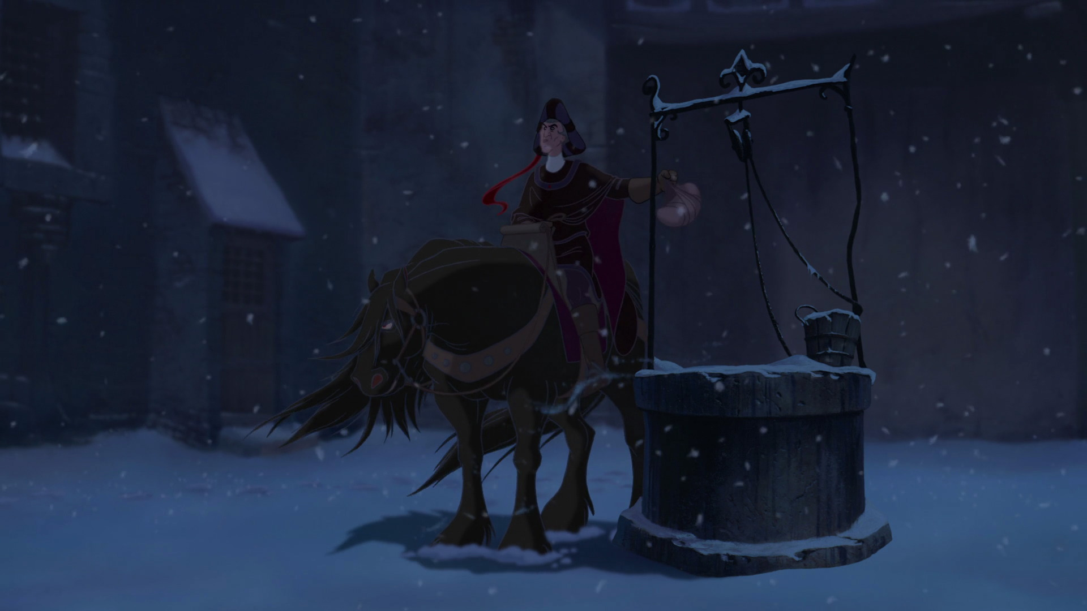
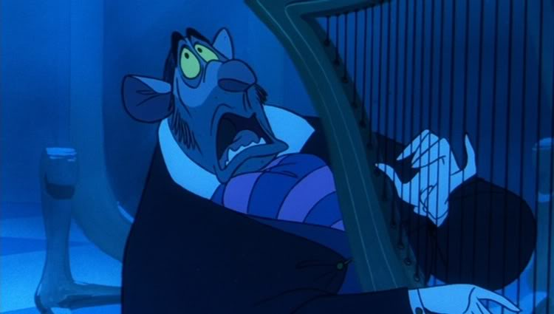
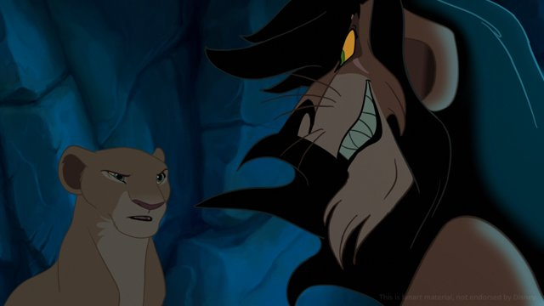

BLUE
-Coldness, unfriendly, lack of emotion, serenity, logic, reflection and calmness.
‐Blue is soothing and affects us more emotionally. Calm blues will calm the mind and can help with concentration.

Slide 19
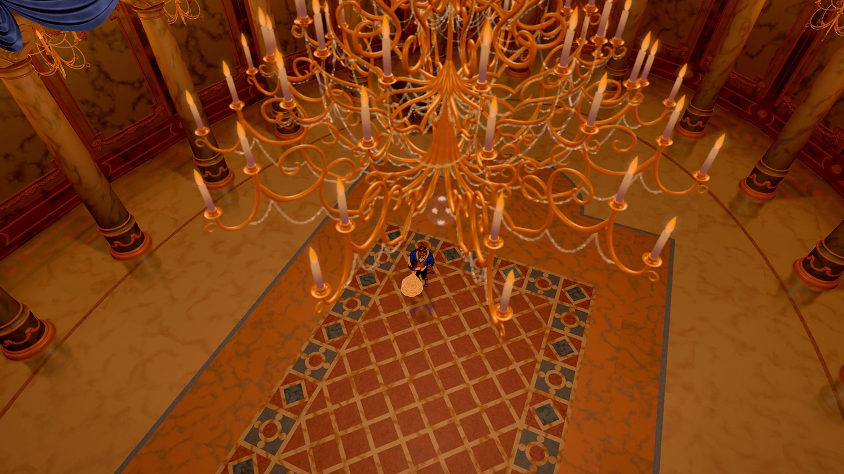
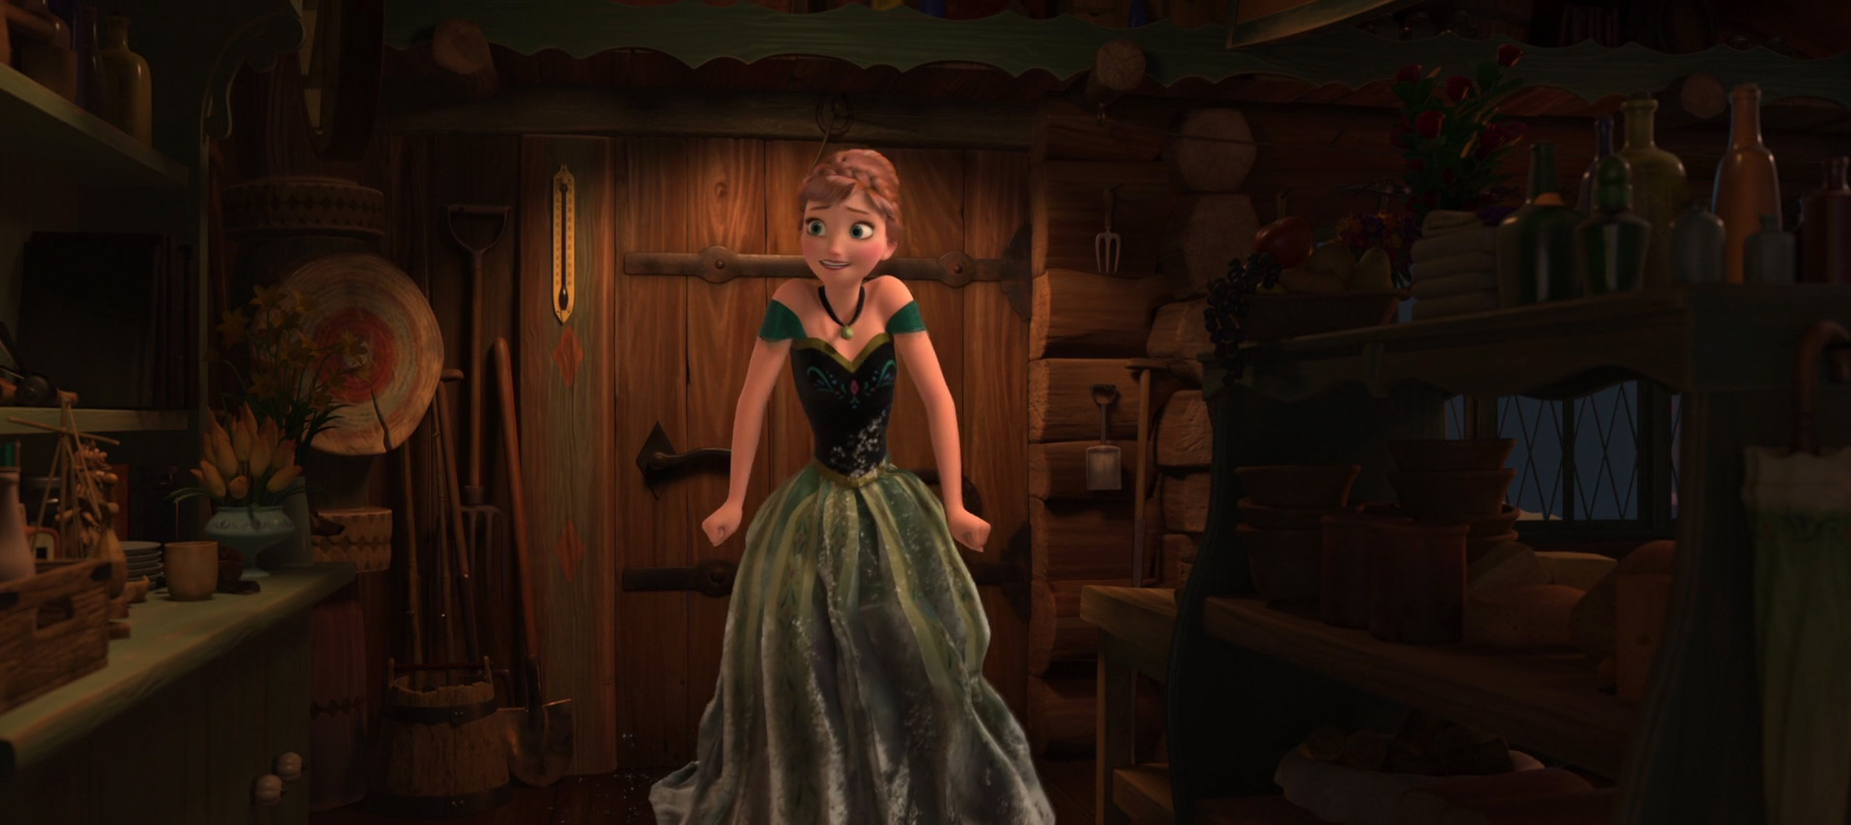
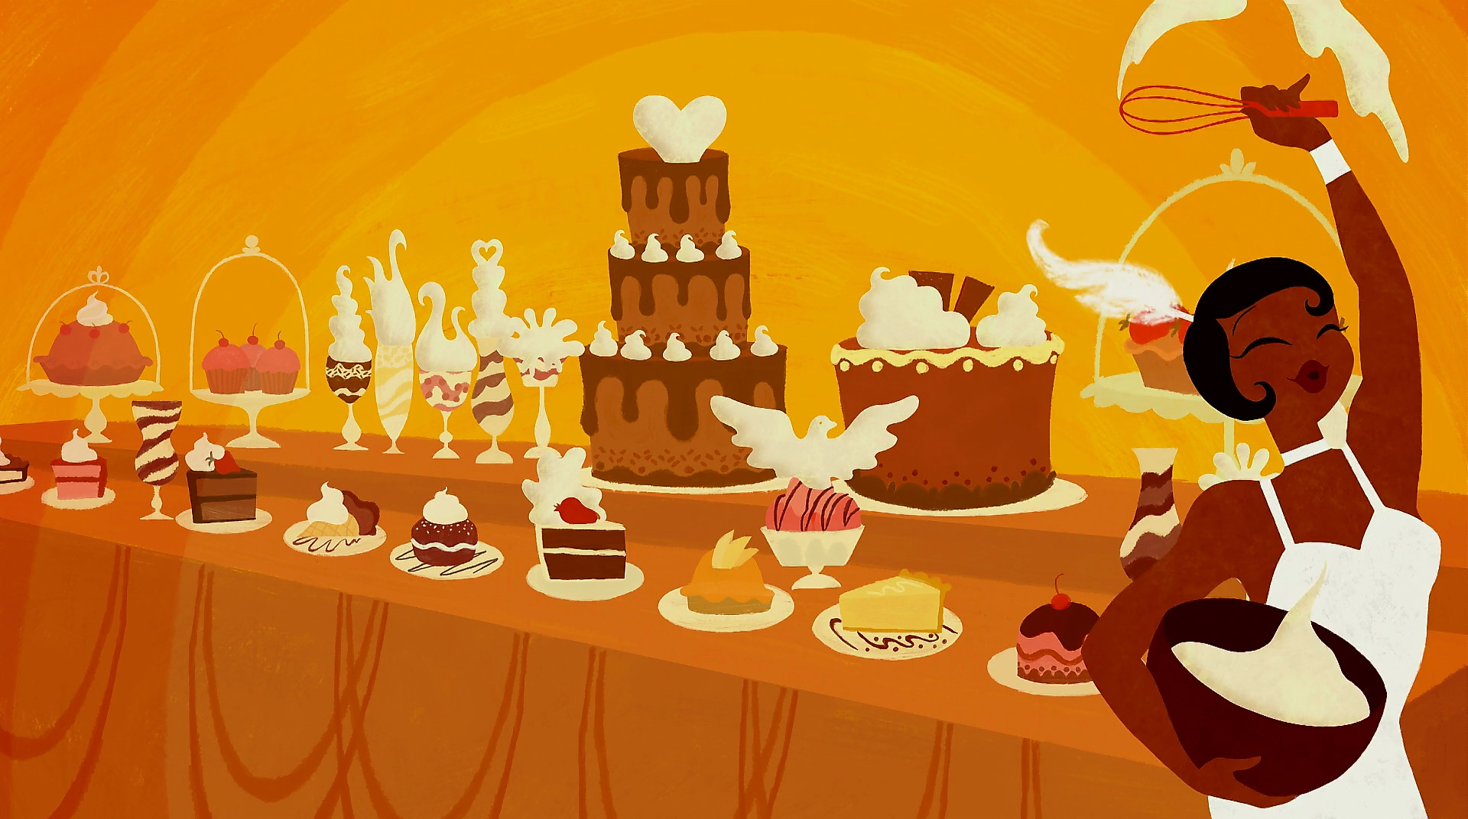
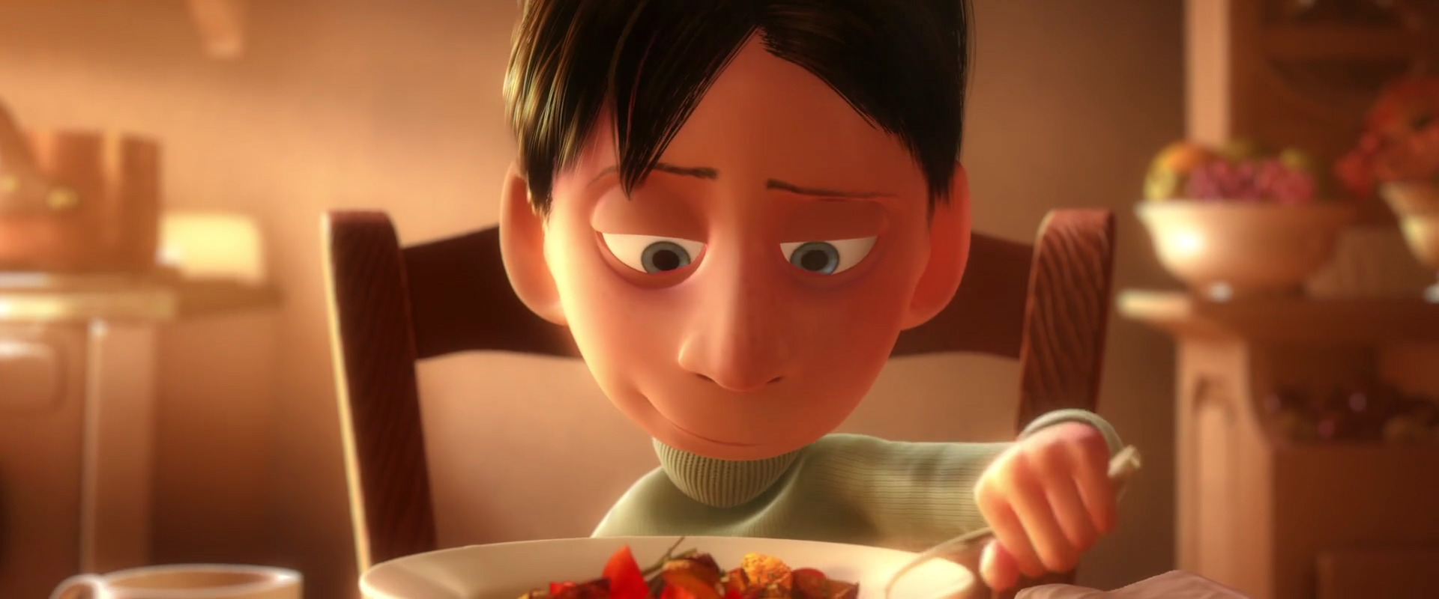
Orange
-Physical comfort, food, warmth, security, sensuality, passion, abundance, fun, deprivation, frustration, immaturity.
-The combination of red and yellow is a combination of physical and emotion. It triggers physical comfort that you would feel from food, warmth, or shelter. It’s also considered a fun color.

Slide 20
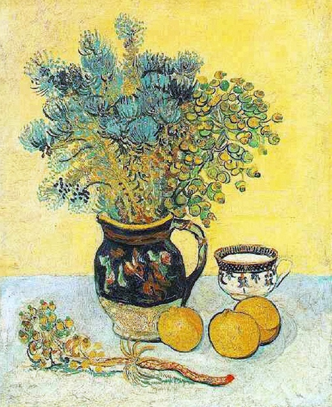
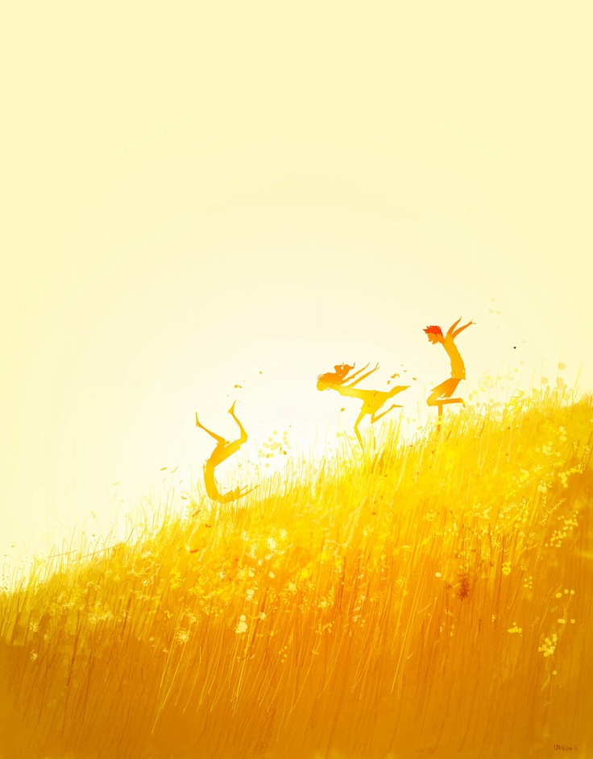
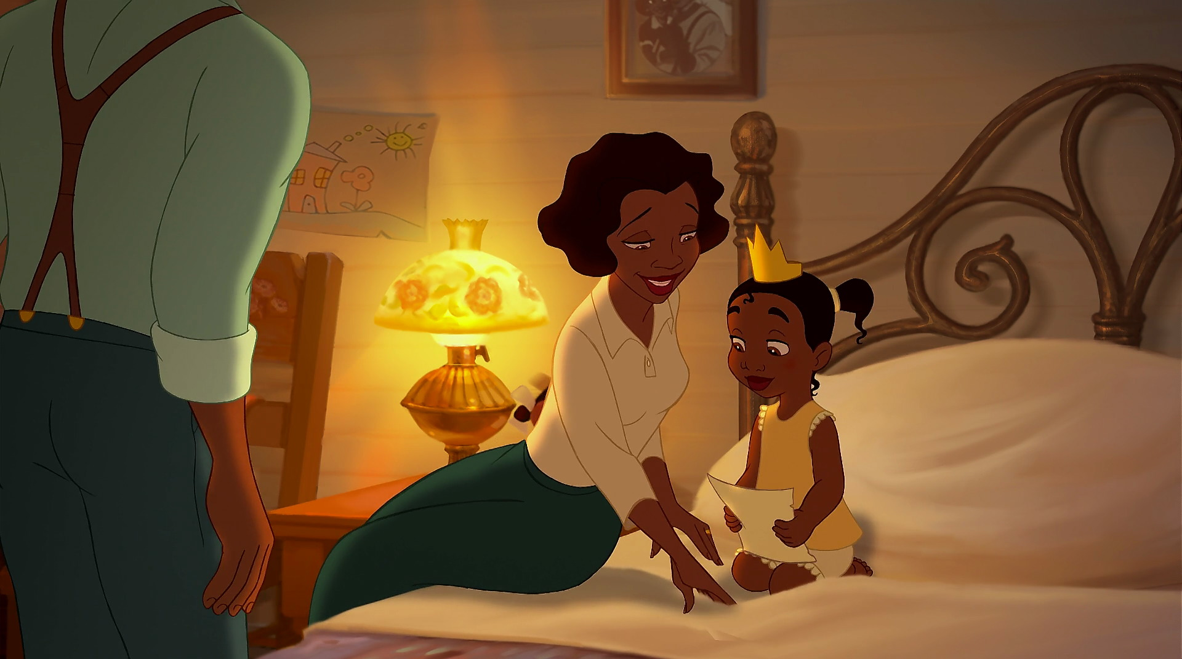


Yellow
-­Optimism, confidence, self-esteem, emotional strength, friendliness, creativity, irrationality, fear, emotional fragility, depression, anxiety, suicide. ‐Like blue, it affects us emotionally and has long wavelengths of color that’s stimulating. It lifts our spirit and self-esteem. If there’s too much of it paired with the wrong types of colors, then it creates fear and anxiety.

Slide 21





Green
-Harmony, balance, refreshment, universal, rest, restoration, peace, stagnation, enervation, sickly, unsettling.
-Green is a restful color to the eye and is a color of balance. When there’s green, it indicates the presence of water .

Slide 22





Purple
-Spiritual awareness, vision, luxury, authenticity, truth, quality, suppression, inferiority, death.
-Purple is related more towards higher levels of thought and even higher spiritual awareness. It encourages deep contemplation and meditation. It also has associations with royalty.

Slide 23





Pink
-Physical tranquility, nurture, warmth, femininity, love, sexuality, physical weakness.

Slide 24





Grey
-Lack of confidence, depression, hibernation, lack of energy.

Slide 25




White
White
-Hygiene, sterility, clarity, purity, cleanness, simplicity, sophistication, coldness, and unfriendliness.

Slide 26





White
Black
-Sophistication, glamour, security, efficiency, substance, oppression, coldness, heaviness.

Slide 27
Other Resources:
Visions of Light The Art of Cinematography (1992)
Link

