Slide 1
Modeler Help Session

Slide 2
Help Session Overview
Checking out, building, and using the sample solution
Part 1: Surface of Revolution
Part 2: Hierarchical Modeling
Part 3: Blinn-Phong Shader
Part 4: Custom Shader(s)

Slide 3
Checking Out Your Code
Use Gitlab, just like for Impressionist
Detailed instructions are in the project description

Slide 4
Building in Visual Studio
Go to your project folder
Double-click the .vcxproj file
Configuration menu next to green arrow
Debug – lets you set breakpoints
Release – for turn-in
Pick Debug, then click the green arrow next to it to build and run your project (Hotkey: F5)
Let us know if the skeleton doesn’t build!

Slide 5
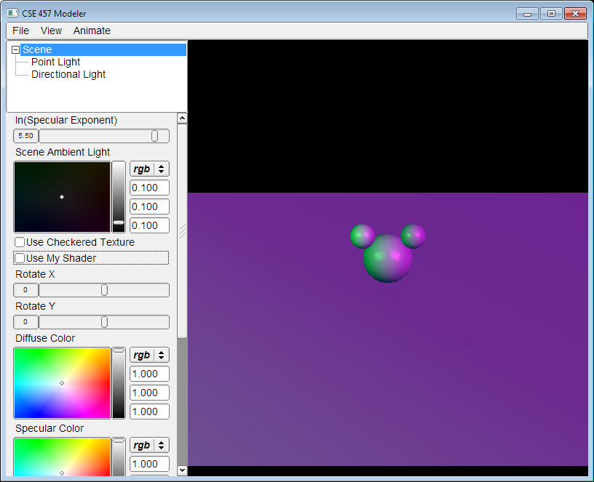
Introducing Modeler
Control
Groups
View of your model
Move the camera by dragging
the mouse while holding down:
Left button: rotate the
view like a huge trackball.
Right button (or left button + CTRL): zoom in/out
Middle button (or left button + SHIFT): pan
List of
Controls

Slide 6
Dividing Up The Work
Partner A: Modeling
Part 1: Surface of revolution
Part 2: Hierarchical Modeling
Partner B: Shading
Part 3: Blinn-Phong Shader
Part 4: Custom Shader(s)
NOTE: this division of labor is just a suggestion!

Slide 7
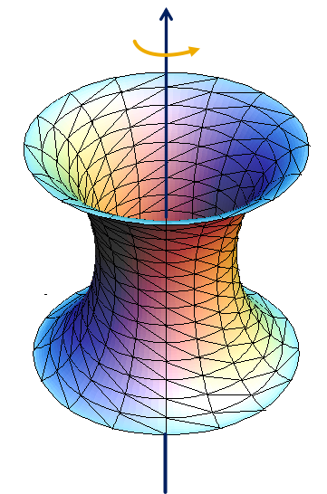
Part 1: Surface of Revolution
You will write OpenGL code to draw a surface by rotating a curve.
Each vertex must have an appropriate:
Texture coordinate pair
Vertex normal
Position
Replace code for drawRevolution() in modelerdraw.cpp
The divisions variable determines number of slices
Current skeleton implementation is a naïve and incorrect one, but illustrates how curve files can be changed into geometry
Load new curve with File->”Load Revolution Curve File”

Slide 8
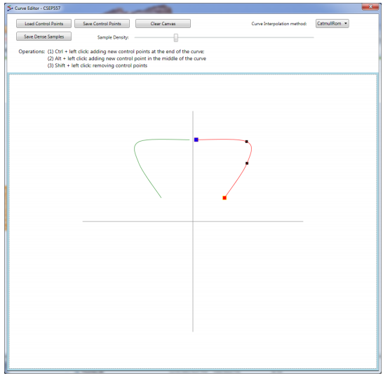
How to start
Drawing a curve
Using the curve editor tool
Start by left click with ctrl key on
Save dense point samples into .apts file
Load point samples in modeler

Slide 9
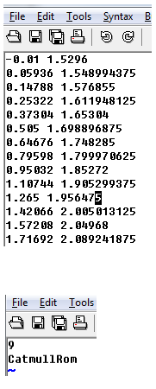
Curve file format
A curve file is basically a .txt file with a list of x,y coordinates for control points
.apts
Densely sampled points on a curve
.cfg: curve configuration file
Row 1: sample density
Row 2: curve interpolation method

Slide 10
Slicing it into Triangle Strips
Divide the surface into “bands” by longitude
Compute vertex positions and normals
Using sin(), cos() in C++ code
See lecture notes for normal computation
Connect the dots with OpenGL triangles

Slide 11
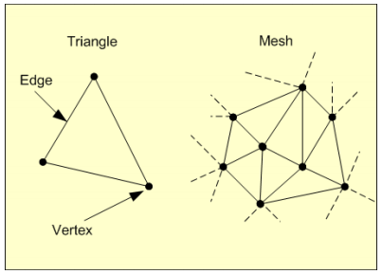
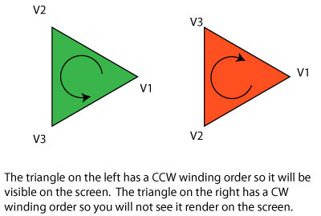
Connecting dots in a modern way
Use glDrawElements with GL_TRIANGLES (required!)
The order of vertices matters
Right-hand rule

Slide 12
Connecting dots
It’s okay to use glBegin(), glEnd() for testing shapes, but don’t use them in the final submitted code
Don’t use GL_QUAD_STRIP or GL_TRIANGLE_STRIP in the final submission, either.
In the submitted code, you need to build a triangle mesh and send it to OpenGL
Using glDrawElements with GL_TRIANGLES

Slide 13
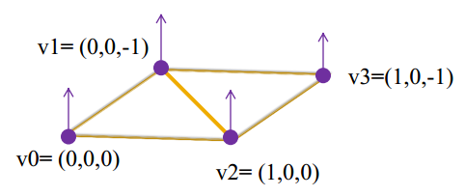
An Example
This is an overly simplified example of
drawing a plane using glDrawElements.
The plane consists of two connecting
triangles and the normal vectors of all
vertices are pointing up.
// preparing the data for the vertices’ positions
GLfloat vertices[12] = { 0,0,0, 0,0,-1, 1,0,0, 1,0,-1 };
// normal directions
GLfloat normals[12] = {0,1,0, 0,1,0, 0,1,0, 0,1,0};
// texture coordinates
GLfloat texture_uv[8] = {0,0, 0,1, 1,0, 1,1};
// vertex indices in order to form triangles
// (order of the vertices follows the right hand rule)
const int indices_length = 6;
GLuint indices[indices_length] = { 1,0,2, 1,2,3 };
glEnableClientState(GL_VERTEX_ARRAY);
glEnableClientState(GL_NORMAL_ARRAY);
glEnableClientState(GL_TEXTURE_COORD_ARRAY);
glVertexPointer(3, GL_FLOAT, 0, vertices);
glNormalPointer(GL_FLOAT,0,normals);
glTexCoordPointer(2,GL_FLOAT,0,texture_uv);
glDrawElements(GL_TRIANGLES, indices_length
,GL_UNSIGNED_INT, indices);
glDisableClientState(GL_TEXTURE_COORD_ARRAY);
glDisableClientState(GL_NORMAL_ARRAY);
glDisableClientState(GL_VERTEX_ARRAY);

Slide 14
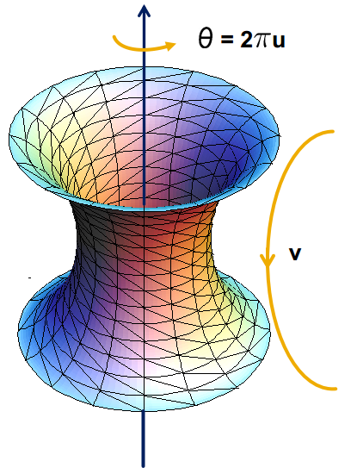
Texture Mapping
See lecture slides for texture mapping
Basic idea: use longitude and arc length (curve distance) as texture coordinates
Each vertex must have an appropriate:
Vertex normal
Position
Texture Coordinate Pair
u,v Є [0,1]

Slide 15
Part 2: Hierarchical Modeling
You must make a character with:
2 levels of branching
Something drawn at each level
Meaningful controls
Otherwise, you will be overwhelmed when you animate it!
You will need to:
Extend the Model class
Override the draw() method
Add properties that Modeler users can control
Give an instance of your class to ModelerUserInterface in the main() function

Slide 16
Building a scene of your own
In sample.cpp, the Scene class extends Model
draw() method draws the green floor, sphere, cylinder, etc.
Add and replace with drawing commands of your own
You can use these draw commands as OpenGL references
Modelerdraw.cpp
drawBox
drawCylinder
drawRevolution

Slide 17
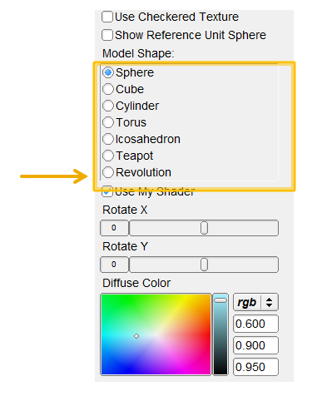
Add a radio button for your scene
Add a new radio button for your scene at the end of the list

Slide 18
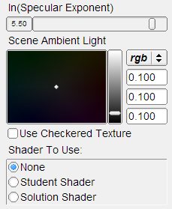
Add Properties to Control It
Kinds of properties (in properties.h):
BooleanProperty = checkbox
RangeProperty = slider
RGBProperty = color
ChoiceProperty = radio buttons
Need to add it to:
Class definition
Constructor
Property list
See sample.cpp for example

Slide 19
OpenGL Is A State Machine
glEnable()/glDisable() changes state
Once you change something, it stays that way until you change it to something new
OpenGL’s state includes:
Current color
Transformation matrices
Drawing modes
Light sources

Slide 20
OpenGL’s Transformation Matrix
Just two of them: projection and modelview. We’ll modify modelview.
Matrix applied to all vertices and normals
These functions multiply transformations: glRotated(), glTranslated(), glScaled()
Applies transformations in REVERSE order from the order in which they are called.
Transformations are cumulative. Since they’re all “squashed” into one matrix, you can’t “undo” a transformation.

Slide 21
Transformations: Going “Back”
How do we get back to an earlier transformation matrix?
We can “remember” it
OpenGL maintains a stack of matrices.
To store the current matrix, call glPushMatrix().
To restore the last matrix you stored, call glPopMatrix().

Slide 22
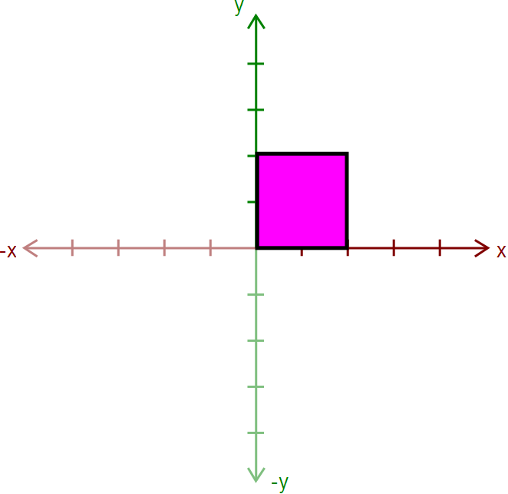
Hierarchical Modeling in OpenGL
Draw the body
Use glPushMatrix() to remember the current matrix.
Imagine that a matrix corresponds to a set of coordinate axes:
By changing your matrix, you can move, rotate, and scale the axes OpenGL uses.

Slide 23
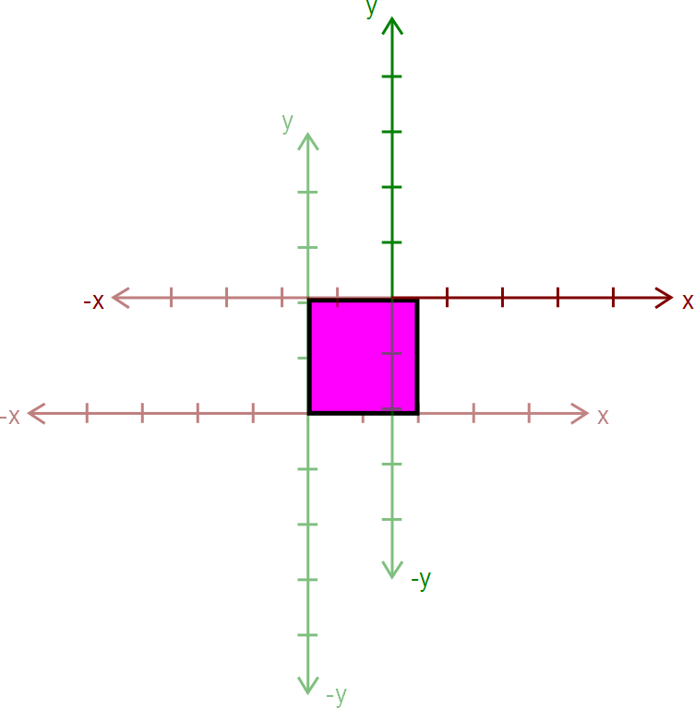
Hierarchical Modeling in OpenGL
Apply a transform:
glRotated()
glTranslated()
glScaled()
Here, we apply glTranslated(1.5,2,0)
All points translated 1.5 units left and 2 units up
It’s as if we moved our coordinate axes!
Current axes
Old axes

Slide 24
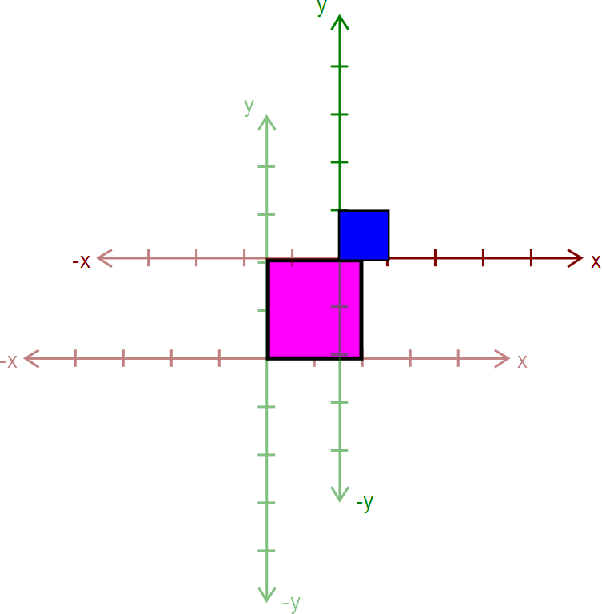
Hierarchical Modeling in OpenGL
Draw an ear.
This ear thinks it was drawn at the origin.
Transformations let us transform objects without changing their geometry!
We didn’t have to edit that ear’s drawing commands to transform it
Current axes
Old axes

Slide 25
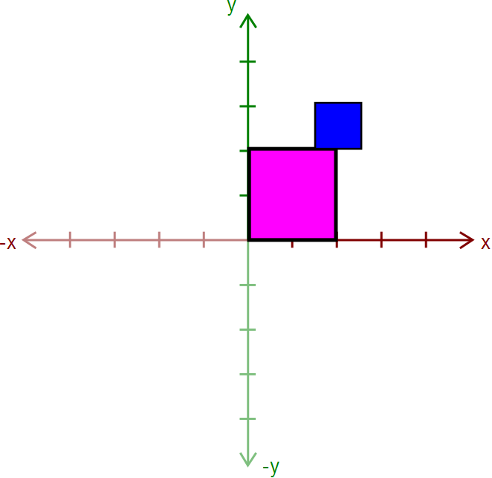
Hierarchical Modeling in OpenGL
Call glPopMatrix() to return to the body’s coordinate axes.
To draw the other ear, call glPushMatrix() again…

Slide 26
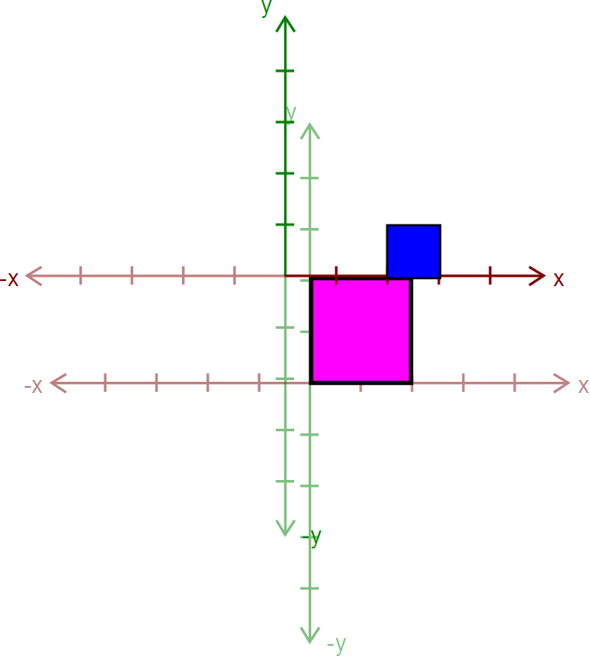
Hierarchical Modeling in OpenGL
Apply another transform…
Where will the ear be drawn now?
Current axes
Old axes

Slide 27
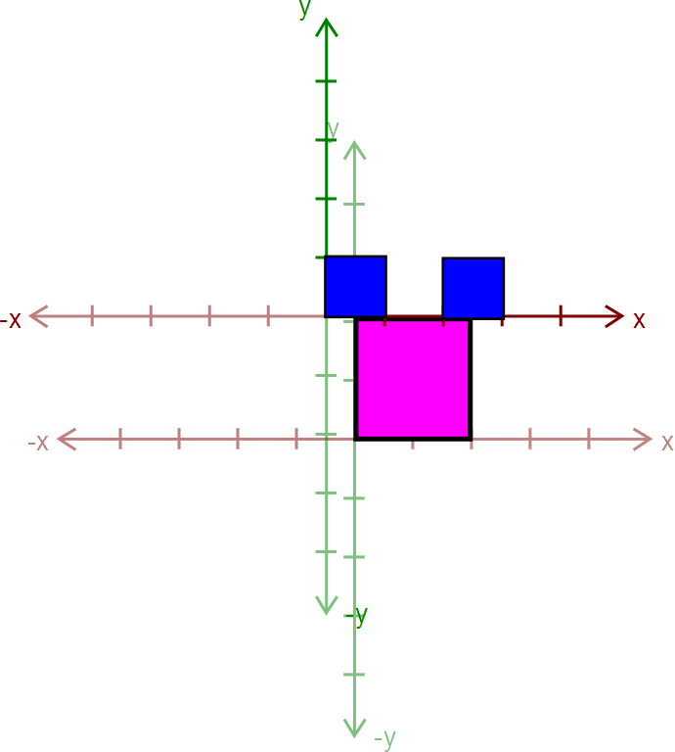
Hierarchical Modeling in OpenGL
Draw the other ear
Current axes
Old axes

Slide 28
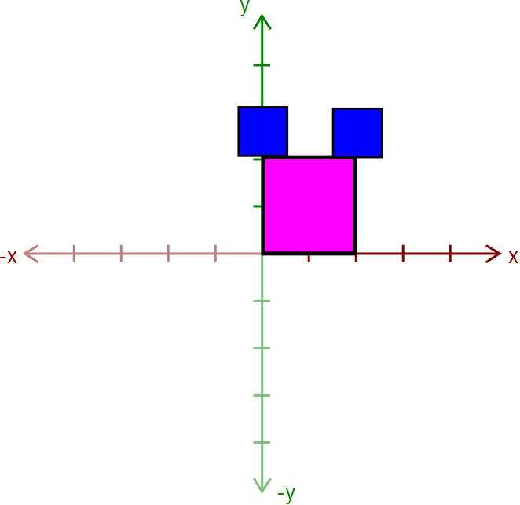
Hierarchical Modeling in OpenGL
Then, call glPopMatrix() to return to the body’s “axes”
Technically, you don’t need to if that second ear is the last thing you draw.
But what if you wanted to add something else to the body?

Slide 29
Rule: A Pop For Every Push
Make sure there’s a glPopMatrix() for every glPushMatrix()!
You can divide your draw() function into a series of nested methods, each with a push at the beginning and a pop at the end.

Slide 30
Levels of Branching
Your scene must have two levels of branching like in this diagram.
Circles are objects
Arrows are transformations
Call glPushMatrix() after drawing green, so you can draw orange after drawing red
Do the same for orange
You must draw something at each level.

Slide 31
Multiple-Joint Slider
Needs to control multiple aspects of your model.
Example: Rotate multiple joints at once
Don’t get too complicated!
Wait for Animator in four weeks!

Slide 32
Part 3. Blinn-Phong Shader
We provide a directional light shader in OpenGL Shading Language (GLSL)
You must extend it to support point lights.
Files to edit:
shader.frag – your fragment shader
shader.vert – your vertex shader

Slide 33
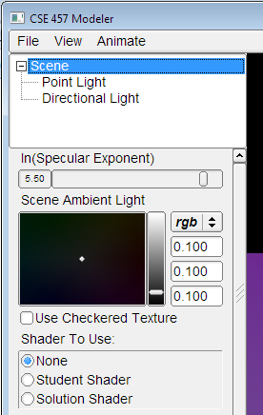
Compare with the Sample Solution
modeler_solution.exe in your project folder
Loads your shader.frag and shader.vert.
Also contains our sample shaders.
Use radio buttons to compare with sample solution
Choose shader here

Slide 34
Useful GLSL Variables
gl_LightSource[i].position.xyz – the position of light source i.
gl_FrontLightProduct[i] – object that stores the product of a light’s properties with the current surface’s material properties:
Example: gl_FrontLightProduct[i].diffuse == gl_FrontMaterial.diffuse * gl_LightSource[i].diffuse

Slide 35
Part 4. Your Custom Shader
Anything you want!
Can earn extra credit!
Ask TA’s for estimated extra credit value of an option.
See the OpenGL orange book in the lab for details + code.
Can still use sample solution to test (depending on complexity)
Warnings
Don’t modify any files except your model file and the required modifications
Or, your model might not work in Animator (project 4)

Slide 36
Preparing Your Work Environment
Make sure that your repository works by:
Cloning or pulling the latest updates
Building it
Tweaking something
Committing
Do this on each work environment you plan to use, even if you aren’t going to start work yet:
Lab machines
Your home computer
The sooner we know of a problem, the sooner we can fix it.
Remember that we’ll grade using the lab machines!

Slide 37
Avoiding Git Conflicts
In general, never put anything besides source code into source control:
Debug and Release folders
Modeler.suo
Modeler.ncb
*.user files
DO put source files (*.cpp, *.h, *.vcproj, image files, etc.) in the repository
Make sure you both add AND commit the files.

Slide 38
Quick Summary
Things To Do
Warnings
Partner A: Modeling
Part 1: Surface of revolution
Part 2: Hierarchical Modeling
Partner B: Shading
Part 3: Blinn-Phong Shader
Part 4: Custom Shader(s)
You don’t have to divide work up this way!
Don’t modify any files except your model file and the required modifications
Or, your model might not work in Animator
Make sure you can pull, commit, and build!

Slide 39
Before You Leave
Try adjusting the sample model
Let us know if you have problems
COMMIT BEFORE LOGOFF!
Your files in C:\User\... will go away when you log out, due to Deep Freeze!

