Slide 1
Modeler Help Session
Due: Thursday, April 28th by the stroke of midnight!
TA: Jeff Booth

Slide 2
Help Session Overview
Checking out, building, and using the sample solution
Part 1: Rendering a Sphere
Part 2: Hierarchical Modeling
Part 3: gluLookAt()
Part 4: Blinn-Phong Shader
Part 5: Custom Shader

Slide 3
Checking Out Your Code
Go to the Modeler course page for detailed check-out directions.
Repository path:
svn+ssh://Your CSE NetID@attu.cs.washington.edu/projects/instr/11sp/cse457/modeler/Your Group ID/source

Slide 4
Building in Visual Studio
Go to your project folder
Double-click the .vcxproj file
Configuration menu next to green arrow
Debug – lets you set breakpoints
Release – for turn-in
Pick Debug, then click the green arrow next to it to build and run your project
Let us know if it doesn’t build!

Slide 5
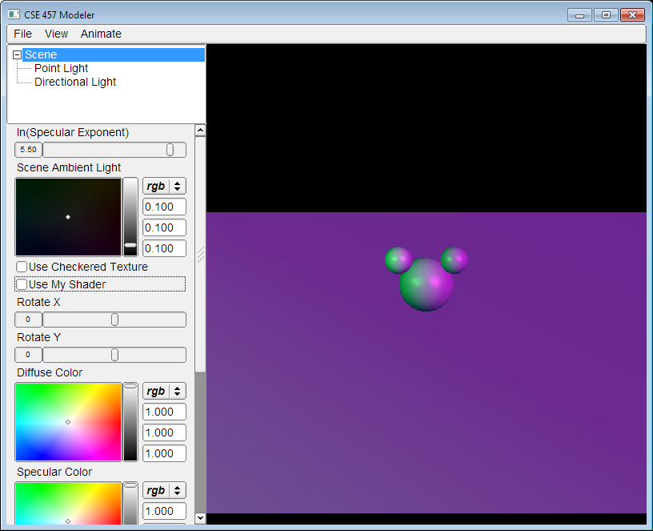
Introducing Modeler
Control
Groups
View of your model
Move the camera by dragging
the mouse while holding down:
Left button: rotate the
view like a huge trackball.
Right button (or left button + CTRL): zoom in/out
Middle button (or left button + SHIFT): pan
List of
Controls

Slide 6
Dividing Up The Work
Partner A: Modeling
Part 1: Hierarchical Modeling
Part 2: Custom Primitive
Either Partner:
Part 3: gluLookAt()
Partner B: Shading
Part 4: Blinn-Phong Shader
Part 5: Custom Shader
NOTE: this division of labor is just a suggestion!

Slide 7
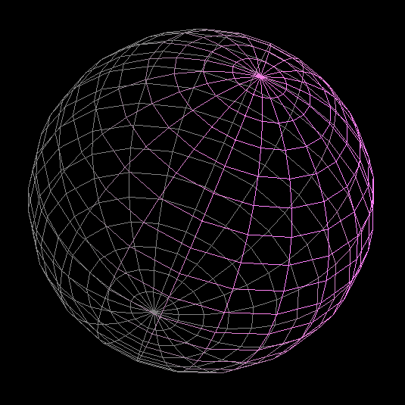
Part 1: Rendering a Sphere
You will write OpenGL code to draw a sphere.
Each vertex must have an appropriate:
Texture coordinate pair
Vertex normal
Position
Replace code for drawSphere() in modelerdraw.cpp
The divisions variable determines number of slices

Slide 8
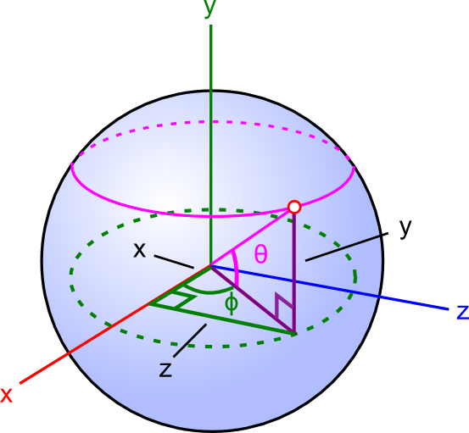
Parameterizing a Sphere
Determine (x,y,z) coordinates of each point using sphere radius, latitude θ and longitude ɸ
For trig:
Give degrees to all GL functions
Give radians to C++ math functions (sin(), cos(), etc.)

Slide 9
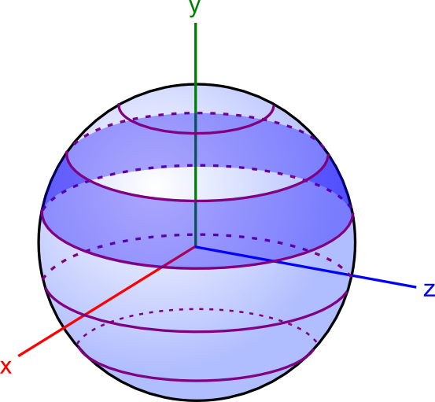
Slicing It Into Polygon Strips
Divide sphere into “rings” (purple lines) by latitude
# of rings = divisions variable
Fill in the area between each ring (dark blue region) with a strip of polygons

Slide 10
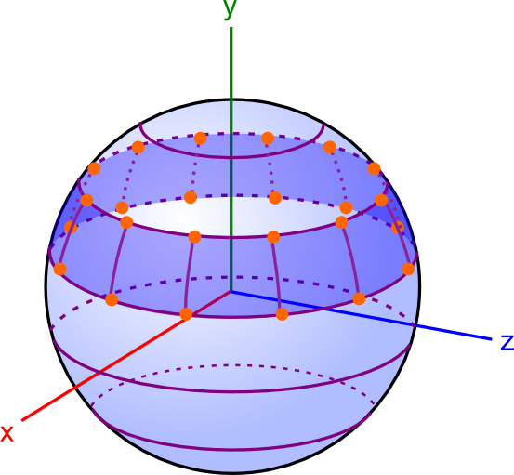
Drawing Each Polygon Strip
Divide slices into quadrilaterals by longitude
# of slices = divisions variable!
Connect the dots with OpenGL quadrilaterals or triangles.

Slide 11
Drawing with OpenGL
glBegin(DRAW_TYPE);
…
glNormal3f(0, 1, 0);
glTexCoord2f(0,0);
glVertex3f(1, 2, 3);
…
glEnd();
Tell OpenGL what primitive you’re drawing with glBegin()
GL_TRIANGLES
GL_TRIANGLE_STRIP
GL_TRIANGLE_FAN
GL_QUADS
GL_QUAD_STRIP

Slide 12
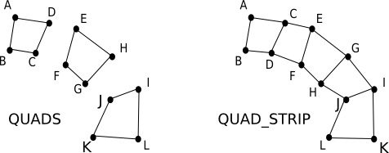
Using Strip Primitives
Use strip primitives like GL_QUAD_STRIP for connected polygons
If you send 12 points to graphics card:
GL_QUADS draws 3 quads
GL_QUAD_STRIP draws 5 quads by reusing points for more than one quad.
Order matters – see diagram!
Diagram comparing quads drawn by GL_QUADS and GL_QUAD_STRIP, given the same points (from http://math.hws.edu/graphicsnotes/c3/s2.html)

Slide 13
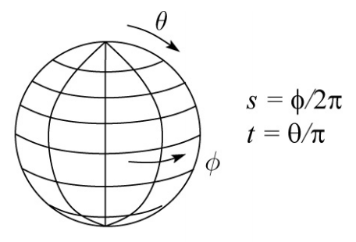
Spherical Texture Mapping
See lecture slides for spherical texture mapping
Basic idea: use latitude and longitude as texture coordinates

Slide 14
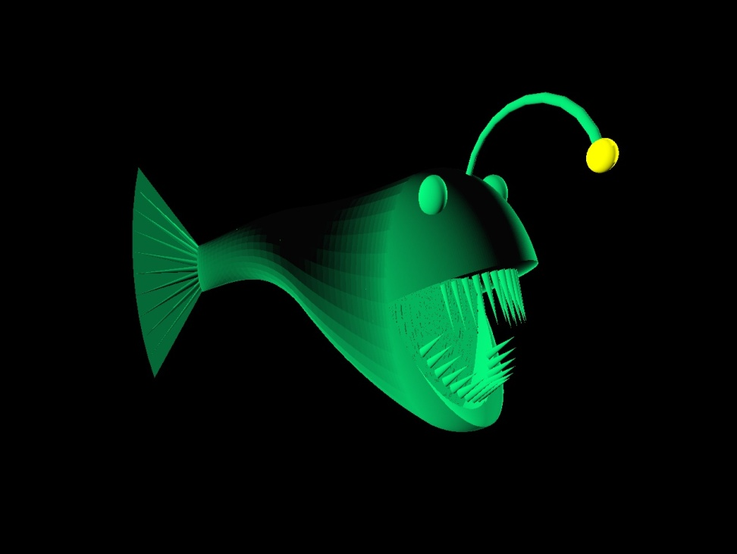
Extra Credit: Cool Surfaces
Surfaces of Rotation
Smooth Surfaces
Swept Surfaces
Rail Surfaces
Non-Linear Transformations
Heightfields
Most are easy once you implement the sphere!
Smooth fishy surface (Michael Kidd and Igor Tolkov, Spring 2010)

Slide 15
Part 2: Hierarchical Modeling
You must make a character with:
2 levels of branching
Something drawn at each level
Meaningful controls
Otherwise, you will be overwhelmed when you animate it!
You will need to:
Extend the Model class
Override the draw() method
Add properties that Modeler users can control
Give an instance of your class to ModelerUserInterface in the main() function

Slide 16
Building a Scene
In sample.cpp, the Scene class extends Model
draw() method draws the green floor, sphere, and cylinder
Add and replace drawing commands of your own
Where are the drawing commands?
Modelerdraw.cpp
drawBox
drawCylinder
drawSphere

Slide 17
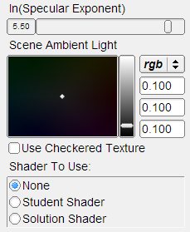
Add Properties to Control It
Kinds of properties (in properties.h):
BooleanProperty = checkbox
RangeProperty = slider
RGBProperty = color
ChoiceProperty = radio buttons
Need to add it to:
Class definition
Constructor
Property list
See sample.cpp for example

Slide 18
OpenGL Is A State Machine
glEnable()/glDisable() changes state
Once you change something, it stays that way until you change it to something new
OpenGL’s state includes:
Current color
Transformation matrices
Drawing modes
Light sources

Slide 19
OpenGL’s Transformation Matrix
Just two of them: projection and modelview. We’ll modify modelview.
Matrix applied to all vertices and normals
These functions multiply transformations: glRotated(), glTranslated(), glScaled()
Applies transformations in REVERSE order from the order in which they are called.
Transformations are cumulative. Since they’re all “squashed” into one matrix, you can’t “undo” a transformation.

Slide 20
Transformations: Going “Back”
How do we get back to an earlier transformation matrix?
We can “remember” it
OpenGL maintains a stack of matrices.
To store the current matrix, call glPushMatrix().
To restore the last matrix you stored, call glPopMatrix().

Slide 21
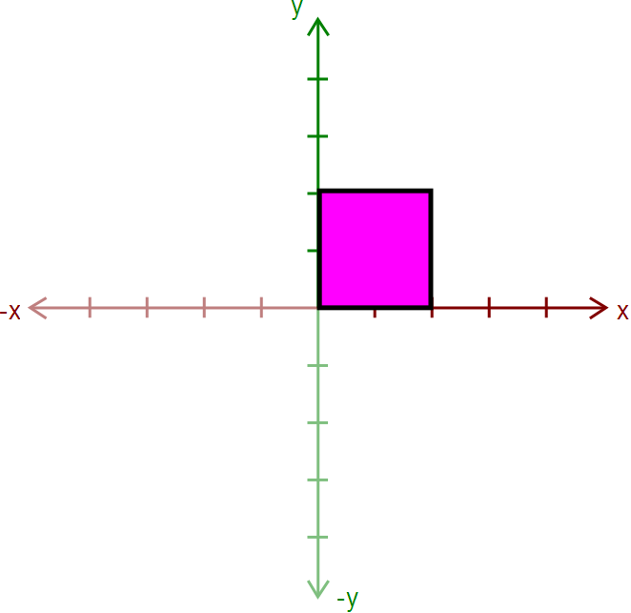
Hierarchical Modeling in OpenGL
Draw the body
Use glPushMatrix() to remember the current matrix.
Imagine that a matrix corresponds to a set of coordinate axes:
By changing your matrix, you can move, rotate, and scale the axes OpenGL uses.

Slide 22
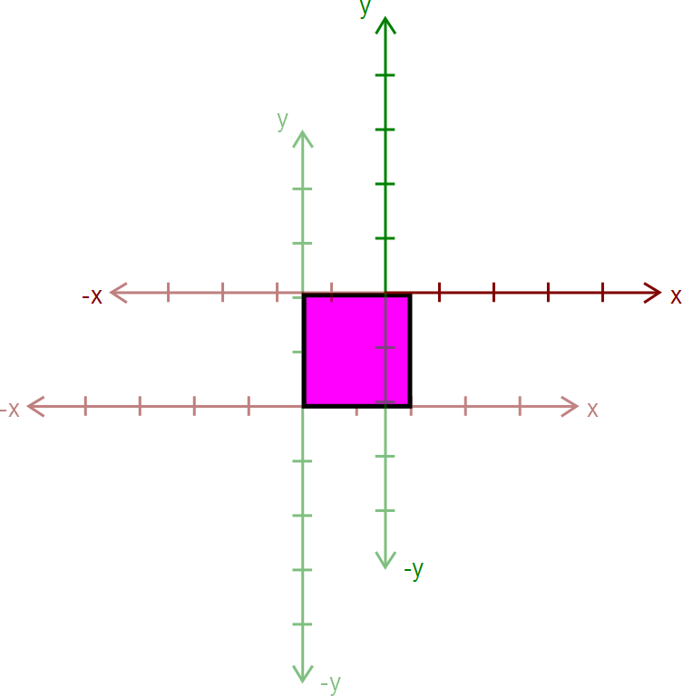
Hierarchical Modeling in OpenGL
Apply a transform:
glRotated()
glTranslated()
glScaled()
Here, we apply glTranslated(1.5,2,0)
All points translated 1.5 units left and 2 units up
It’s as if we moved our coordinate axes!

Slide 23
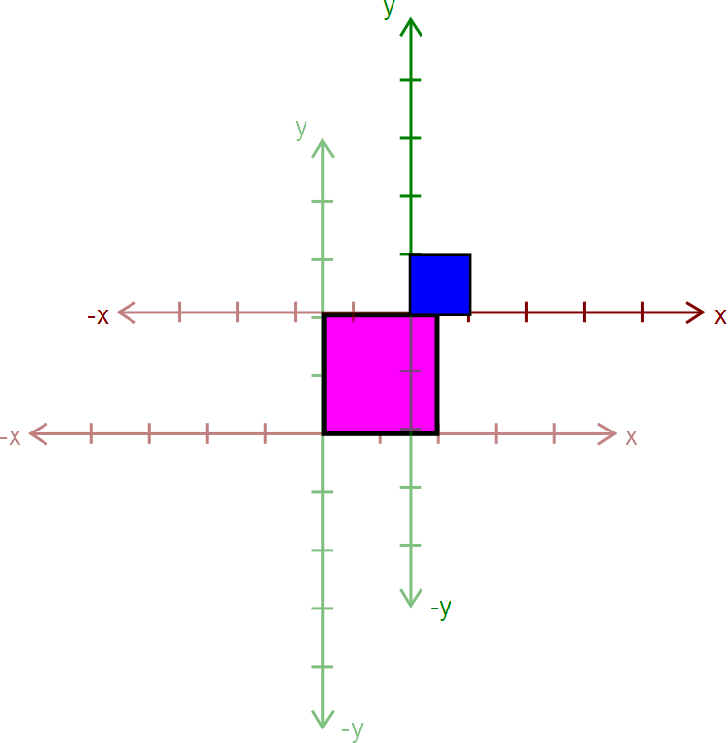
Hierarchical Modeling in OpenGL
Draw an ear.
This ear thinks it was drawn at the origin.
Transformations let us transform objects without changing their geometry!
We didn’t have to edit that ear’s drawing commands to transform it

Slide 24
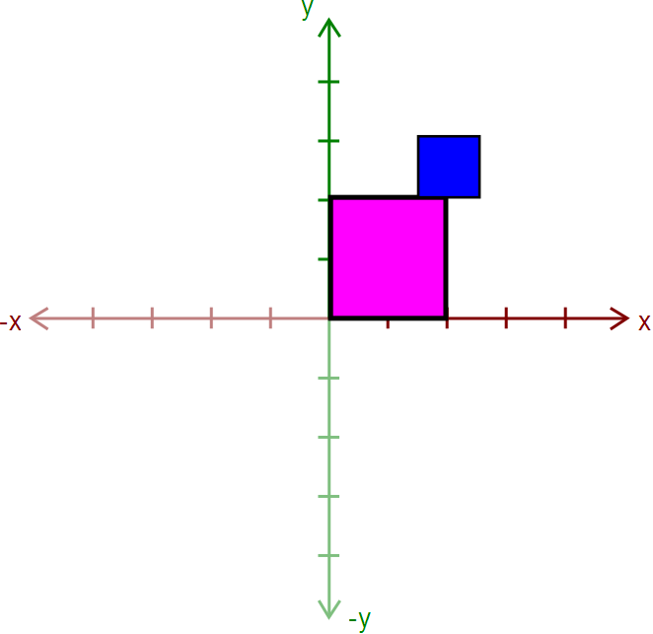
Hierarchical Modeling in OpenGL
Call glPopMatrix() to return to the body’s coordinate axes.
To draw the other ear, call glPushMatrix() again…

Slide 25
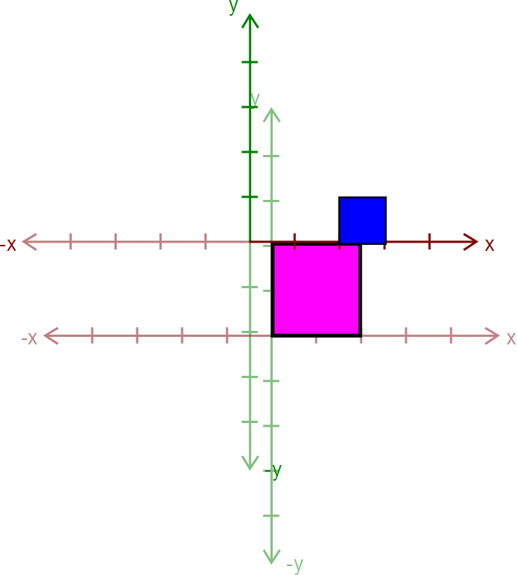
Hierarchical Modeling in OpenGL
Apply another transform…
Where will the ear be drawn now?

Slide 26
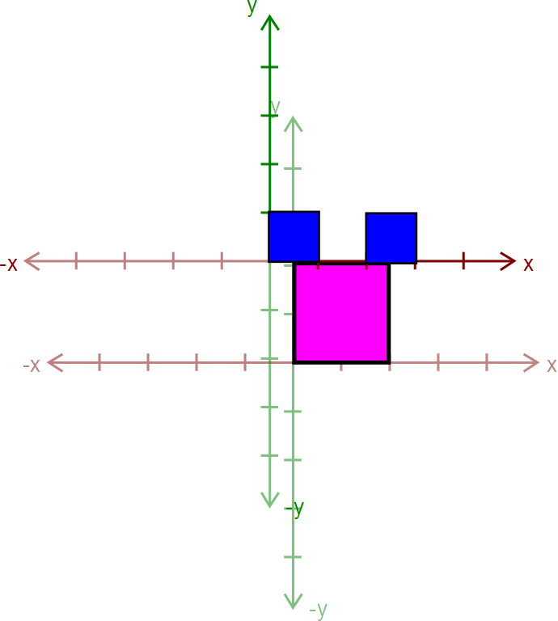
Hierarchical Modeling in OpenGL
Draw the other ear

Slide 27
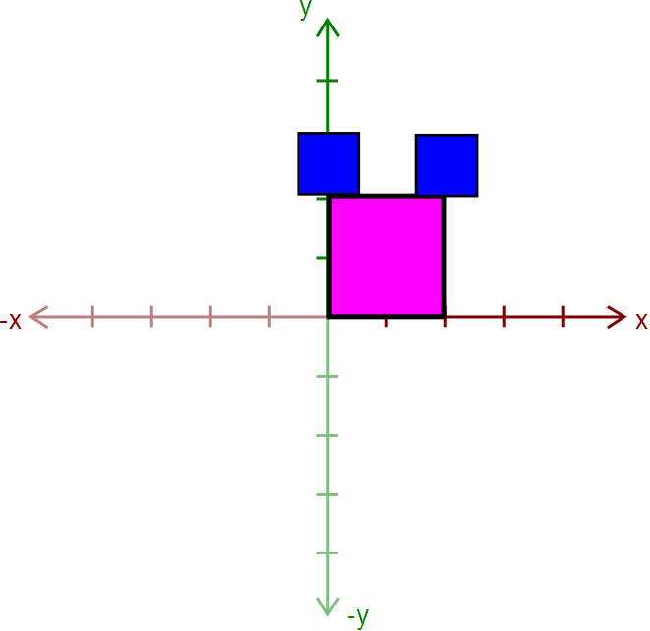
Hierarchical Modeling in OpenGL
Then, call glPopMatrix() to return to the body’s “axes”
Technically, you don’t need to if that second ear is the last thing you draw.
But what if you wanted to add something else to the body?

Slide 28
Rule: A Pop For Every Push
Make sure there’s a glPopMatrix() for every glPushMatrix()!
You can divide your draw() function into a series of nested methods, each with a push at the beginning and a pop at the end.

Slide 29
Levels of Branching
Your scene must have two levels of branching like in this diagram.
Circles are objects
Arrows are transformations
Call glPushMatrix() for green, so you can draw orange after drawing red
Do the same for orange
You must draw something at each level.

Slide 30
Multiple-Joint Slider
Needs to control multiple aspects of your model.
Example: Rotate multiple joints at once
Don’t get too complicated!
Wait for Animator in four weeks!

Slide 31
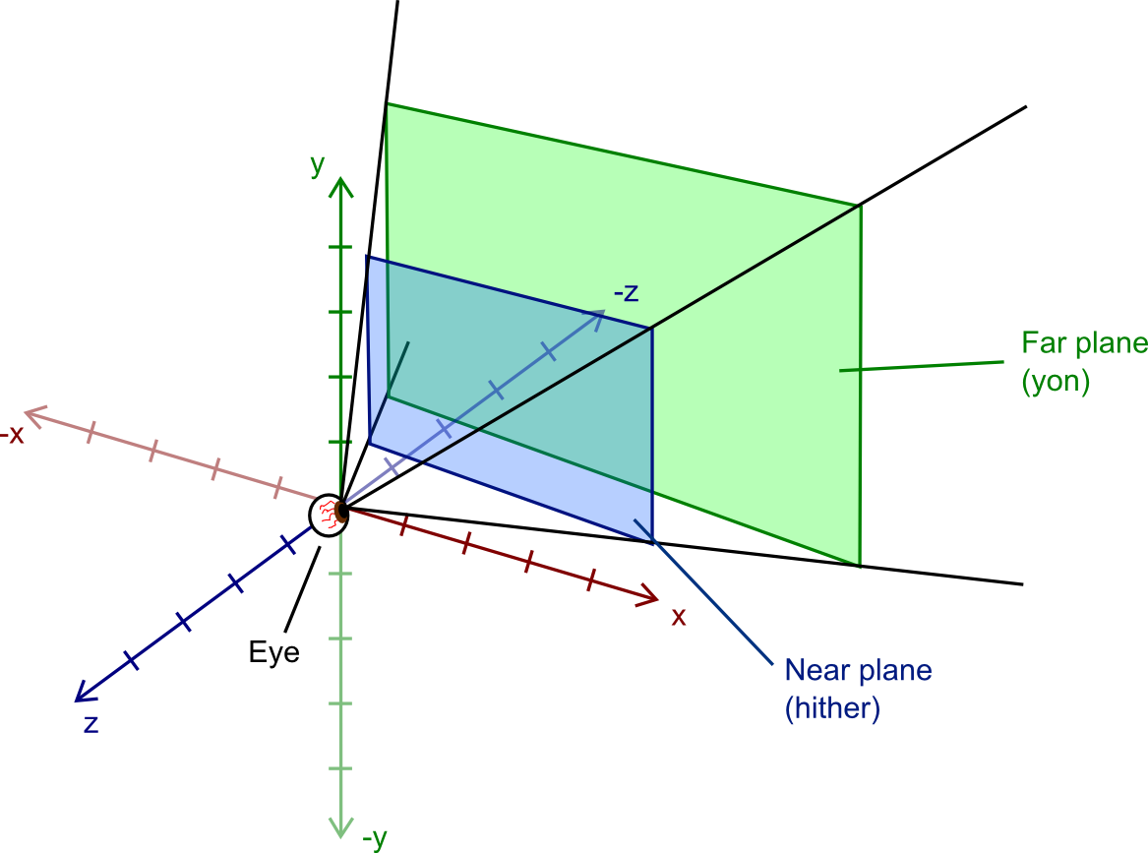
Part 3. gluLookAt
OpenGL’s Camera/Eye
Position: The origin
Direction: Looking down the –z axis
Up Vector: Y-axis corresponds to “up”
Since we can’t move the camera, we move the world instead – it has the same effect.
A function called gluLookAt() does this.
You will replace the call to gluLookAt() in camera.cpp with code that does the same thing.

Slide 32
Starting In World Space…
+y
You are given the camera’s:
Position
Up-vector
Look-at point
Everything is in world space.
Here’s a side view (looking down –x axis)
Up Vector
(ux,uy,uz)
Object
Position
(x,y,z)
Look-At Point
(lx,ly,lz)
+z
-z
-y

Slide 33
Get Direction
+y
Use the position and look-at point to get direction
Ending point – starting point = vector from start to end
Normalize it
Up Vector
(ux,uy,uz)
Object
Position
(x,y,z)
Direction
(dx,dy,dz)
+z
-z
-y

Slide 34
Line Up Camera With Origin
+y
Apply a translation to all vertices, so that the camera’s center lines up with the origin.
Up Vector
(ux,uy,uz)
+z
-z
Position
(x,y,z)
Object
Direction
(dx,dy,dz)
-y

Slide 35
Rotate World to Line Up Vectors
+y
Up vector → +y
Direction → -z
How?
glRotatef() – do the rotations manually
glMultMatrixf() – create a custom rotation matrix (preferred)
Up Vector
(ux,uy,uz)
+z
Object
-z
Position
(x,y,z)
Direction
(dx,dy,dz)
-y

Slide 36
gluLookAt Notes
See lecture slides for gluLookAt()
Make sure you understand how works
Lots of “magic code” on the Internet
You might be asked about it during grading
Mat.h has a useful matrix class, but you shouldn’t need it.

Slide 37
Part 4. Blinn-Phong Shader
We provide a directional light shader in OpenGL Shading Language (GLSL)
You must extend it to support point lights.
Files to edit:
shader.frag – your fragment shader
shader.vert – your vertex shader

Slide 38
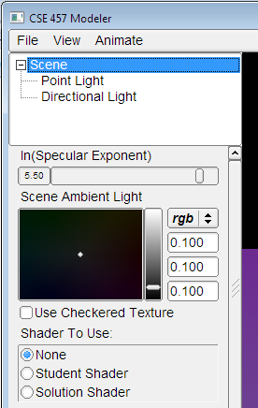
Compare with the Sample Solution
modeler_solution.exe in your project folder
Loads your shader.frag and shader.vert.
Also contains our sample shaders.
Use radio buttons to compare with sample solution
Choose shader here

Slide 39
Useful GLSL Variables
gl_LightSource[i].position.xyz – the position of light source i.
gl_FrontLightProduct[i] – object that stores the product of a light’s properties with the current surface’s material properties:
Example: gl_FrontLightProduct[i].diffuse == gl_FrontMaterial.diffuse * gl_LightSource[i].diffuse

Slide 40
Part 5. Your Custom Shader
Anything you want!
Can earn extra credit!
Ask TA’s for estimated extra credit value of an option.
See the OpenGL orange book in the lab for details + code.
Can still use sample solution to test (depending on complexity)

Slide 41
Preparing Your Work Environment
Make sure that your repository works by:
Checking it out
Building it
Tweaking something
Committing
Do this on each work environment you plan to use, even if you aren’t going to start work yet:
Lab machines
Your home computer
The sooner we know of a problem, the sooner we can fix it.

Slide 42
Avoiding SVN Conflicts
In general, never put anything besides source code into source control:
Debug and Release folders
Modeler.suo
Modeler.ncb
*.user files
DO put source files (*.cpp, *.h, *.vcproj, image files, etc.) in the repository
Make sure you both add AND commit the files.
TortoiseSVN: when you commit, make sure all the files you added have a checkmark.

Slide 43
Quick Summary
Things To Do
Warnings
Partner A: Modeling
Part 1: Rendering a Sphere
Part 2: Hierarchical Modeling
Either Partner:
Part 3: gluLookAt()
Partner B: Shading
Part 4: Blinn-Phong Shader
Part 5: Custom Shader
You don’t have to divide work up this way!
Don’t modify any files except your model file and the required modifications
Or, your model might not work in Animator
Make sure you can check out, commit, and build!

Slide 44
Before You Leave
Try adjusting the sample model
Let us know if you have problems
COMMIT BEFORE LOGOFF!
Your files in C:\User\... will go away when you log out, due to Deep Freeze!

