Slide 1
Lecture 2
Pixels and Filters
Slides adapted from: Ranjay Krishna

Slide 2
Administrative
A0 out this week
Meant to help you with python and numpy basics
Learn how to do homeworks and submit them on gradescope.

Slide 3
Administrative
Recording
  There should be a recording of today’s class.
Office hours set
Correction on the grading percentages

Slide 4
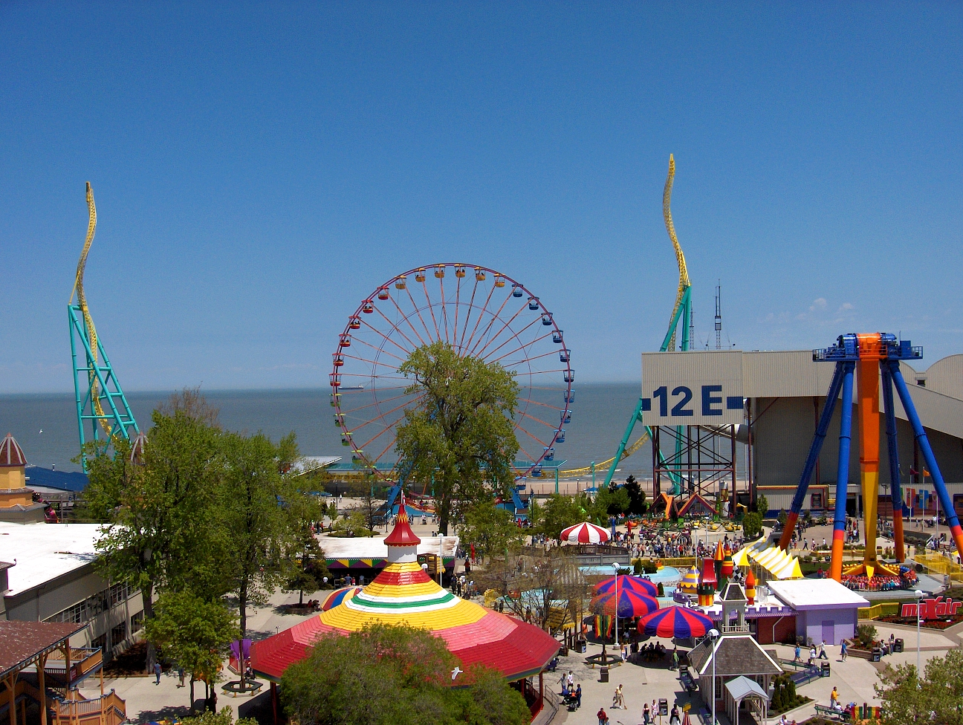
amusement park
sky
Objects
Activities
Scenes
Locations
Text / writing
Faces
Gestures
Motions
Emotions…
Recap: computer Vision extracts semantic information
The Wicked Twister
Cedar Point
ride
Ferris wheel
ride
12 E
Lake Erie
water
ride
tree
tree
people waiting in line
people sitting on ride
umbrellas
tree
maxair
carousel
deck
bench
tree
pedestrians

Slide 5
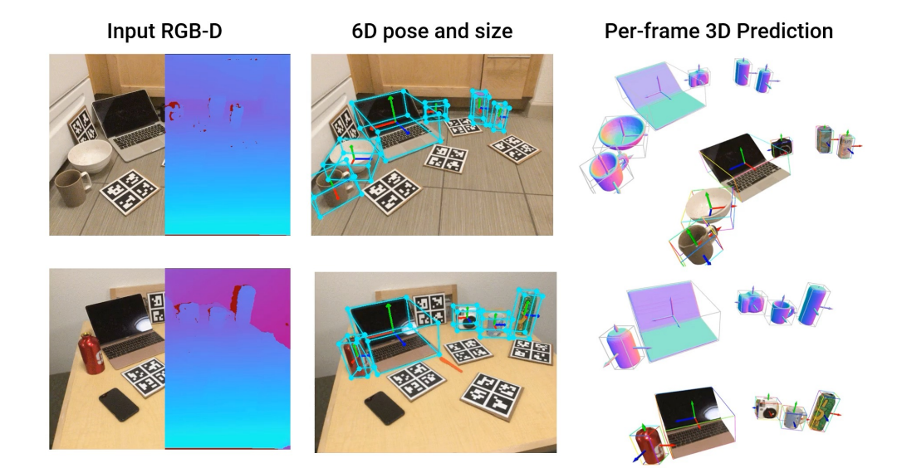
Recap: Computer vision extracts geometric 3D information from 2D images
TRI & GATech’s ShaPO (ECCV’22): https://zubair-irshad.github.io/projects/ShAPO.html

Slide 6
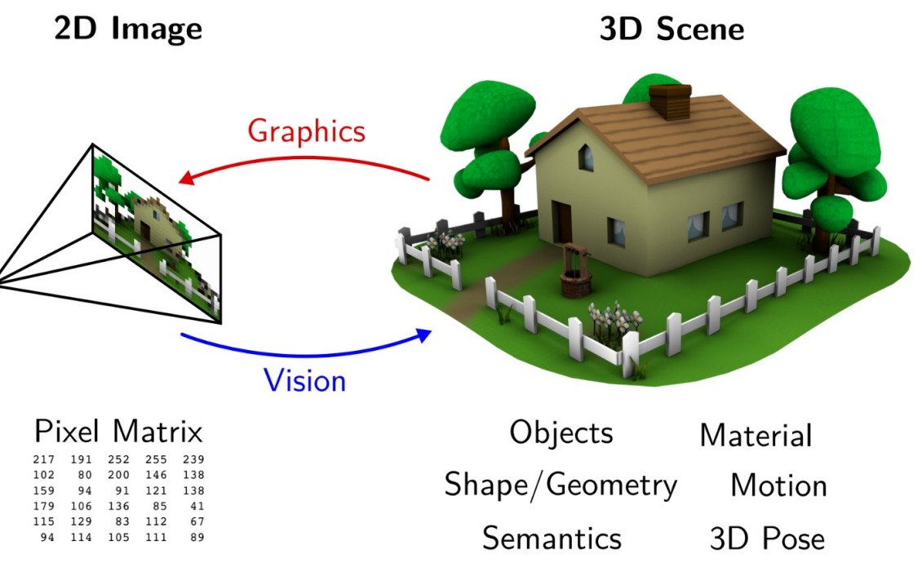
So far: why is computer vision hard?
It is an ill posed problem
Notes:
underdetermined

Slide 7
CSE 455 Roadmap
Pixels
Video
Camera
Segment
ML
Convolutions
Edges
Descriptors
Motion
Tracking
Camera
3D Geometry
Segmentation
Clustering
Detection
Linear Models
(Conv) Neural networks
From Convolutions to Convolutions

Slide 8
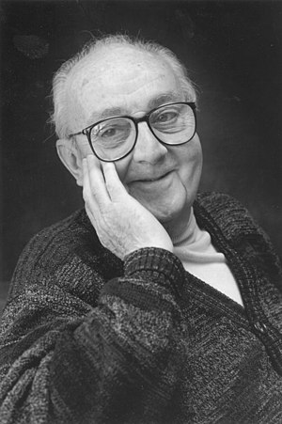
“Every model is wrong, but some are useful”
George E.P. Box

Slide 9
Today’s agenda
Color spaces
Image sampling and quantization
Image histograms
Images as functions
Filters
Properties of systems
Some background reading:
Forsyth and Ponce, Computer Vision, Chapter 7

Slide 10
Today’s agenda
Color spaces
Image sampling and quantization
Image histograms
Images as functions
Filters
Properties of systems
Some background reading:
Forsyth and Ponce, Computer Vision, Chapter 7

Slide 11
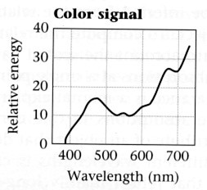
How to compute the weights of the primaries to match any spectral signal
p₁ p₂ p₃
Matching functions: the amount of each primary needed to match a monochromatic light source at each wavelength

Slide 12
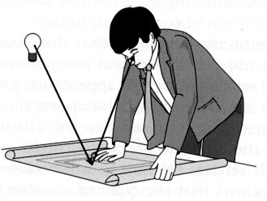
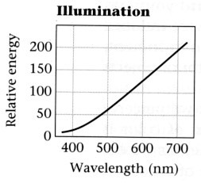
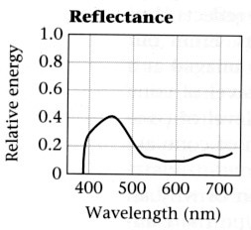
Explaining Color - A Simplified “Model”
.*
=
Foundations of Vision, by Brian Wandell, Sinauer Assoc., 1995

Slide 13
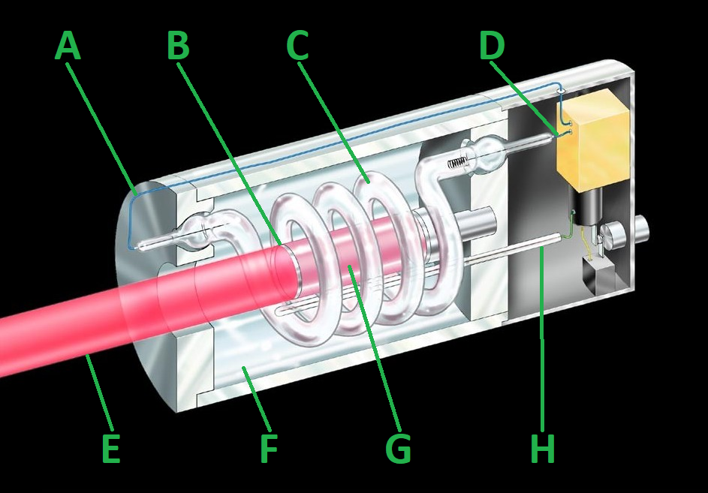
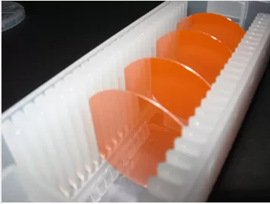
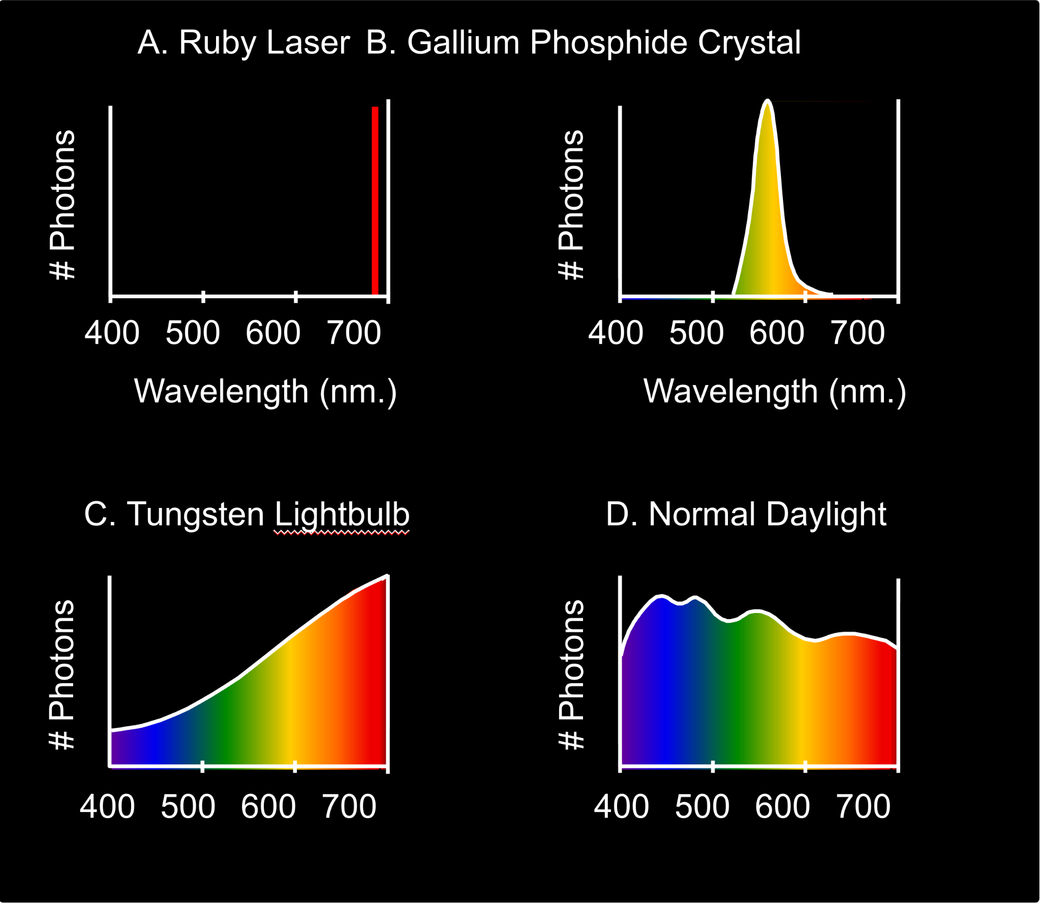

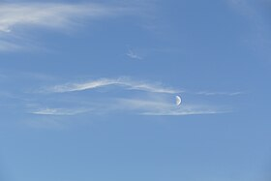
The Physics of Light Sources
Some examples of the spectra of light sources
A. Ruby Laser B. Gallium Phosphide Crystal

Slide 15
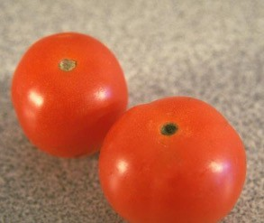
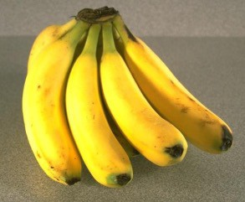
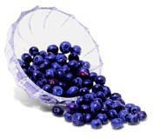
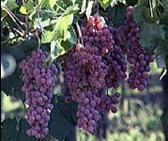
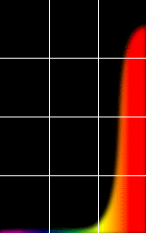
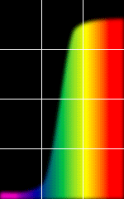
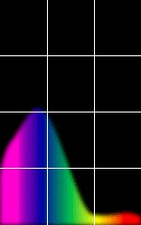
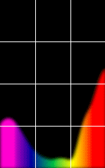
The Physics of Reflectance
Some examples of the reflectance spectra of surfaces
Red
Yellow
Blue
Purple
% Photons Reflected
400 700
400 700 400
Wavelength (nm)
700 400 700
Notes:
cones(relectatance(light source)))

Slide 16
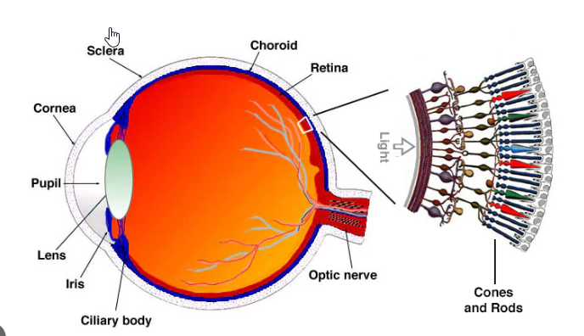
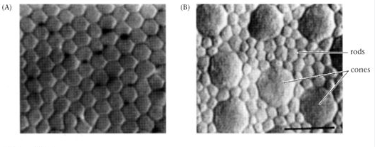
Human visual system

Slide 17
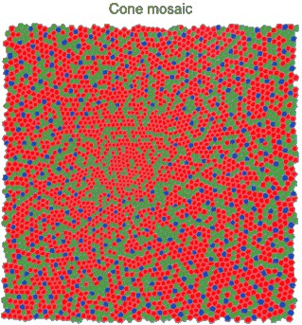
Physiology of Human Vision
Three kinds of cones:
440 530 560 nm.
100
S
M L
RELATIVE ABSORBANCE (%)
50
400
450 500 550 600 650
WAVELENGTH (nm.)

Slide 18
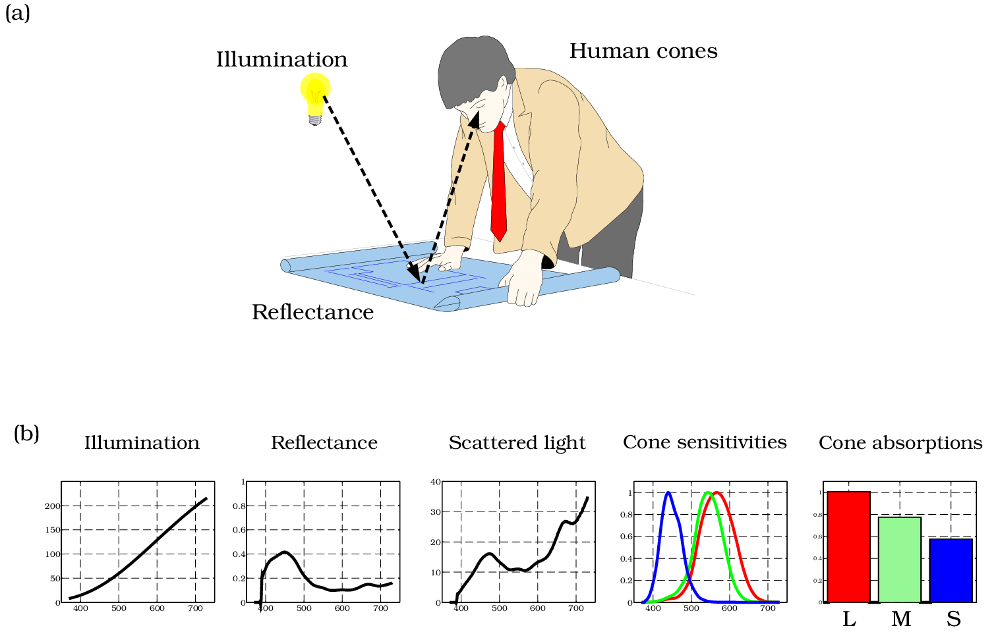
A Slightly Complex “Model”

Slide 19
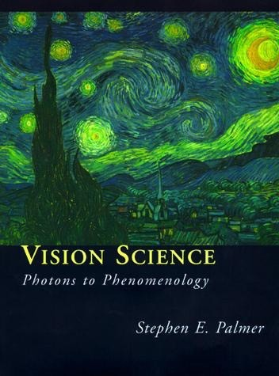
Color is a psychological phenomenon
Do we really see the same color?
The result of interaction between physical light in the environment and our visual system.
A psychological property of our visual experiences when we look at objects and lights, not a physical property of those objects or lights.
Slide credit: Lana Lazebnik

Slide 20






Linear (RGB) color spaces
Defined by a choice of three primaries
The coordinates of a color are given by the weights of the primaries used to match it
mixing two lights produces colors that lie along a straight line in color space
mixing three lights produces colors that lie within the triangle they define in color space
Notes:
coordinate with primitive colors

Slide 21
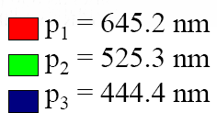
RGB space
Primaries are monochromatic lights (for monitors, they correspond to the three types of phosphors)
RGB primaries

Slide 22


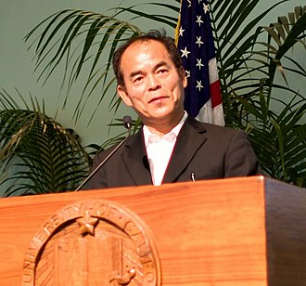
Blue Light LED (90’s)
Shuji Nakamura,
Nobel Prize in Physics 2014

Slide 23
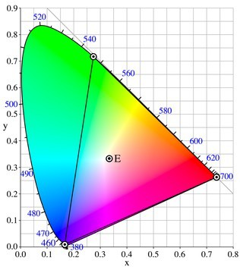
Other spaces: CIE XYZ
Primaries (X, Y and Z) are imaginary
X: Represents a mix of red and green.
Y: Represents luminance (brightness).
Z: Represents a mix of blue and green.
2D visualization: draw (x,y), where
x = X/(X+Y+Z), y = Y/(X+Y+Z)
http://en.wikipedia.org/wiki/CIE_1931_color_space
Notes:
Y is the luminance, Z is quasi-equal to blue (of CIE RGB), and X is a mix of the three CIE RGB curves chosen to be nonnegative, not very interpretable to human

Slide 24
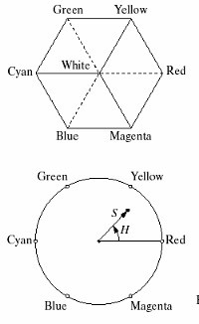
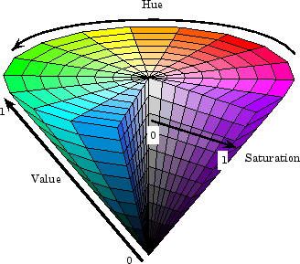
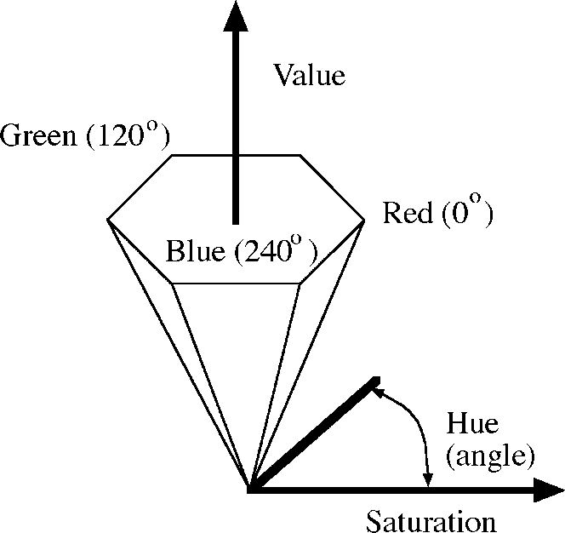
Other color spaces: HSV
Perceptually meaningful dimensions: Hue, Saturation (Brightness), Value (Intensity)
Useful in data augmentation for training large models
Notes:
intensity (black to white

Slide 25

Other color spaces: HSV
Perceptually meaningful dimensions: Hue, Saturation, Value (Intensity)

Slide 26
Today’s agenda
Color spaces
Image sampling and quantization
Image histograms
Images as functions
Filters
Properties of systems
Some background reading:
Forsyth and Ponce, Computer Vision, Chapter 7

Slide 27


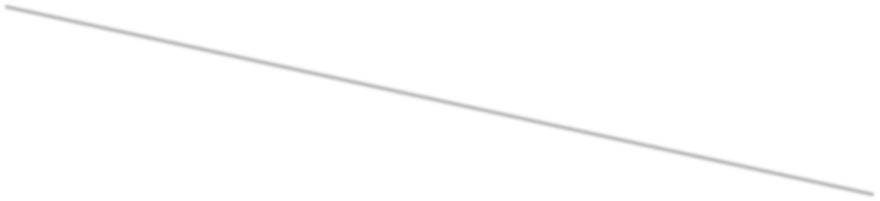







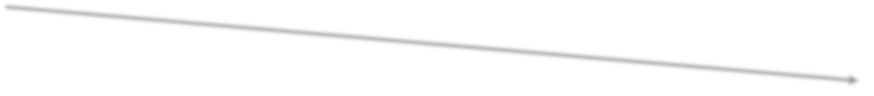


Image Formation
Light Source
Lens
Physical Object
Sensor Plane

Slide 28
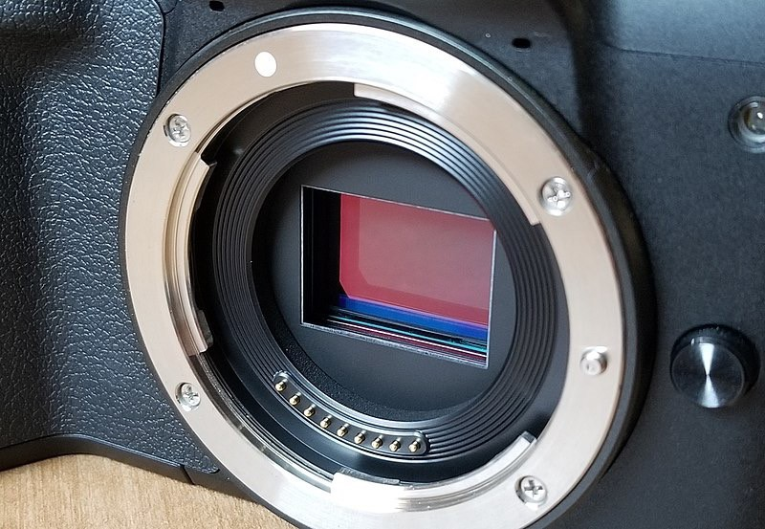
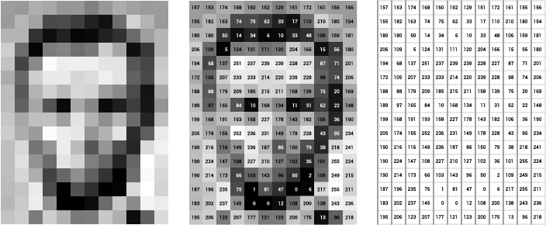
Camera sensors produce discrete outputs
https://ai.stanford.edu/~syyeung/cvweb/Pictures1/imagematrix.png
https://commons.wikimedia.org/wiki/File:Mirrorless_Camera_Sensor.jpg

Slide 29
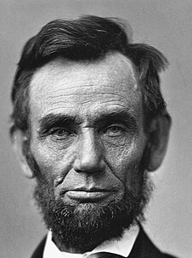
Camera sensors produce discrete outputs
https://ai.stanford.edu/~syyeung/cvweb/Pictures1/imagematrix.png
https://commons.wikimedia.org/wiki/File:Mirrorless_Camera_Sensor.jpg

Slide 30
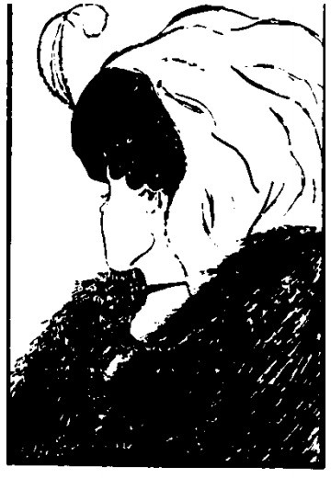
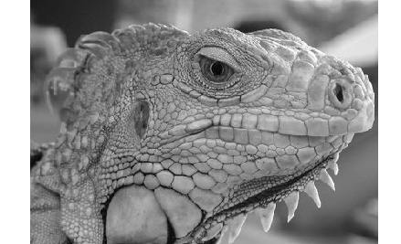
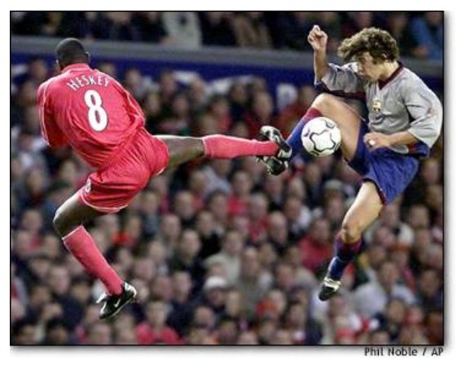
Types of Images
Binary
Grayscale
Color

Slide 31
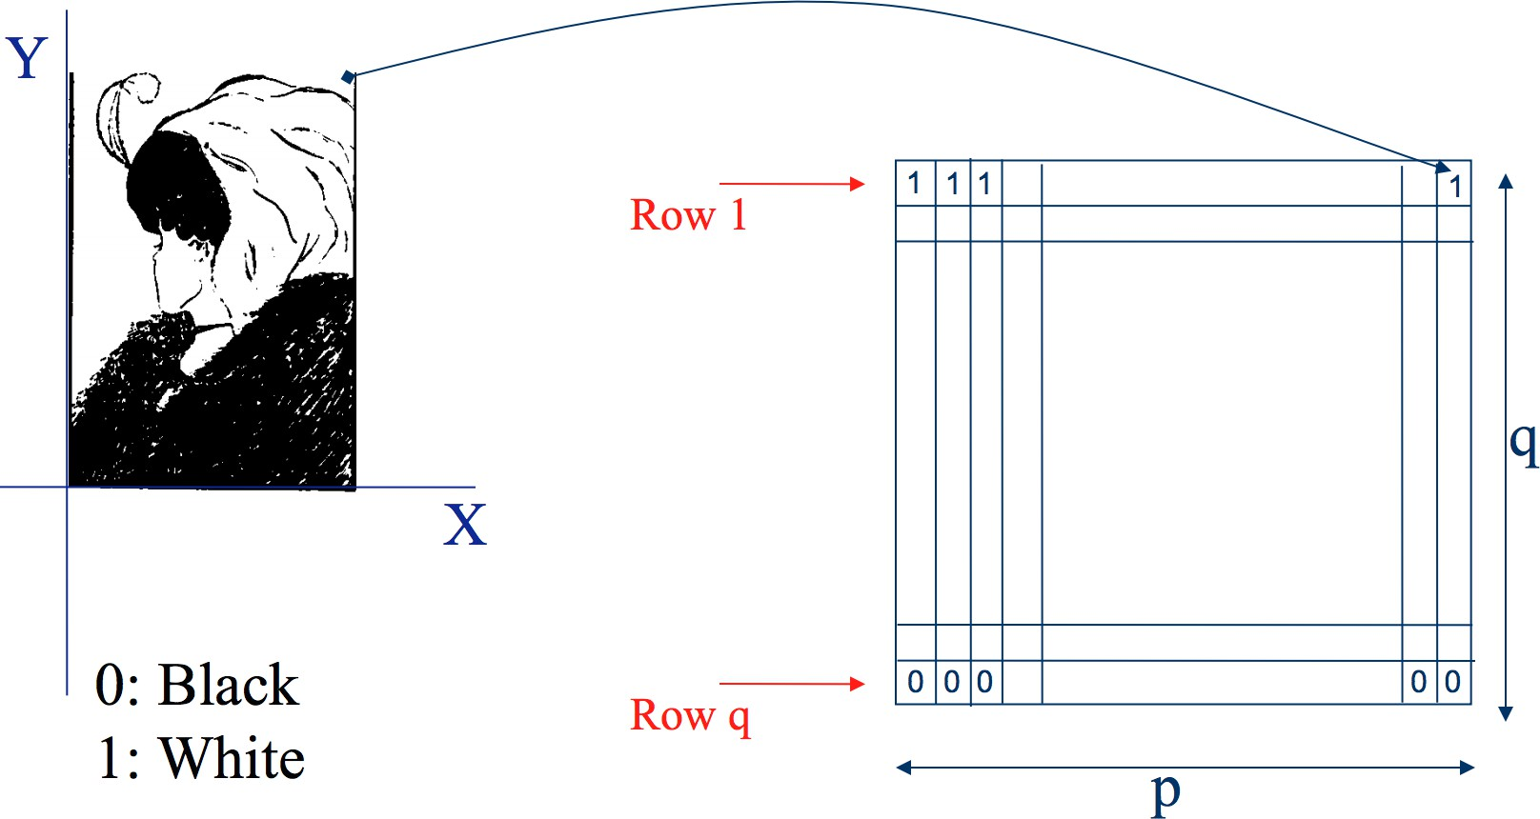
Binary image representation

Slide 32
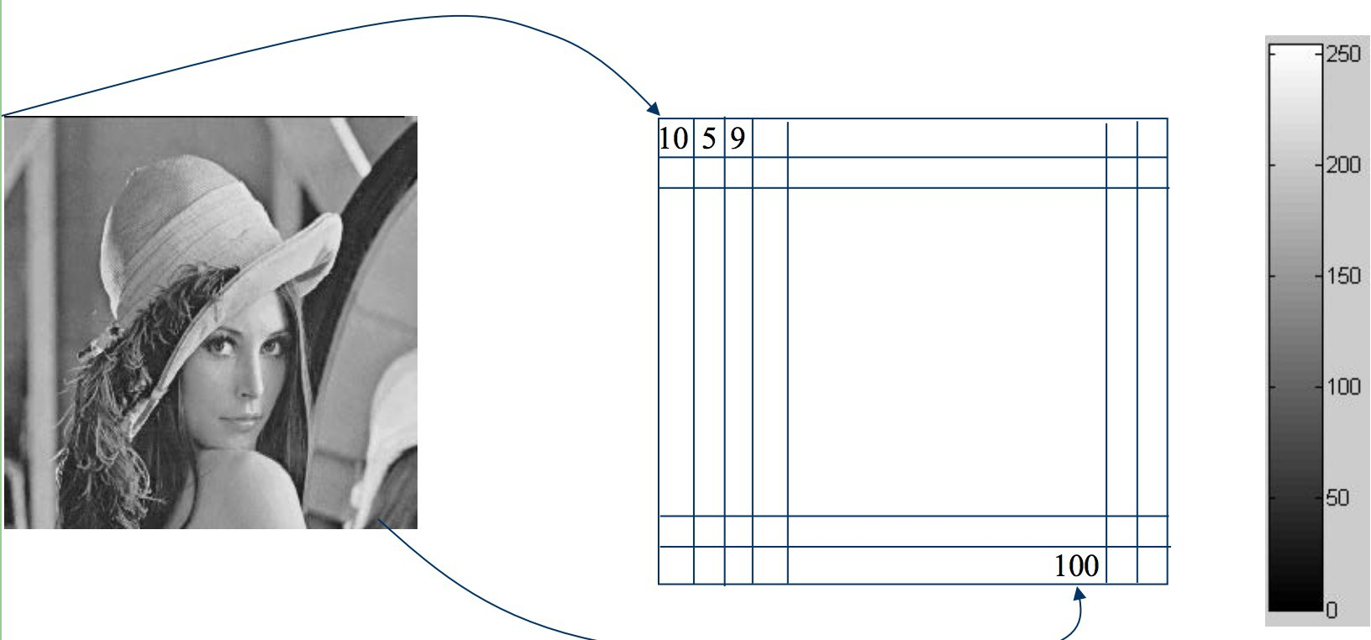
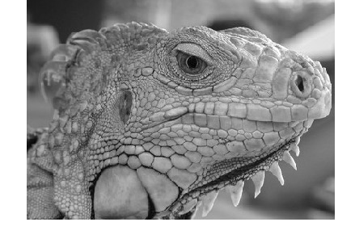
Grayscale image representation

Slide 33
Notes:
Value

Slide 34
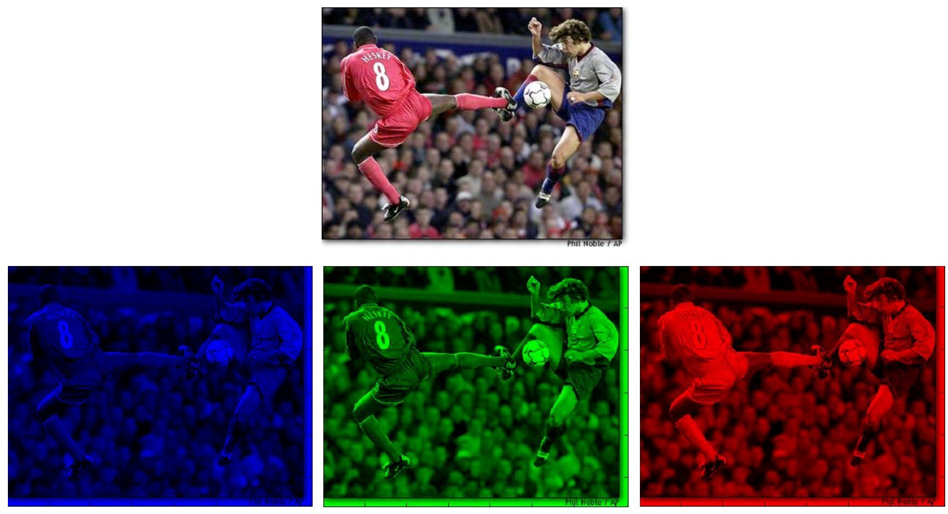
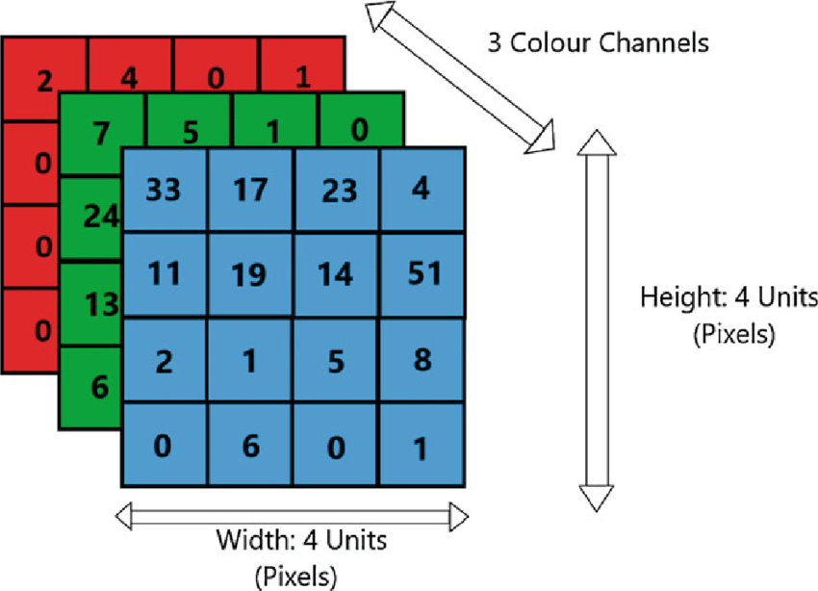
Color image representation
B channel
G channel
R channel

Slide 35
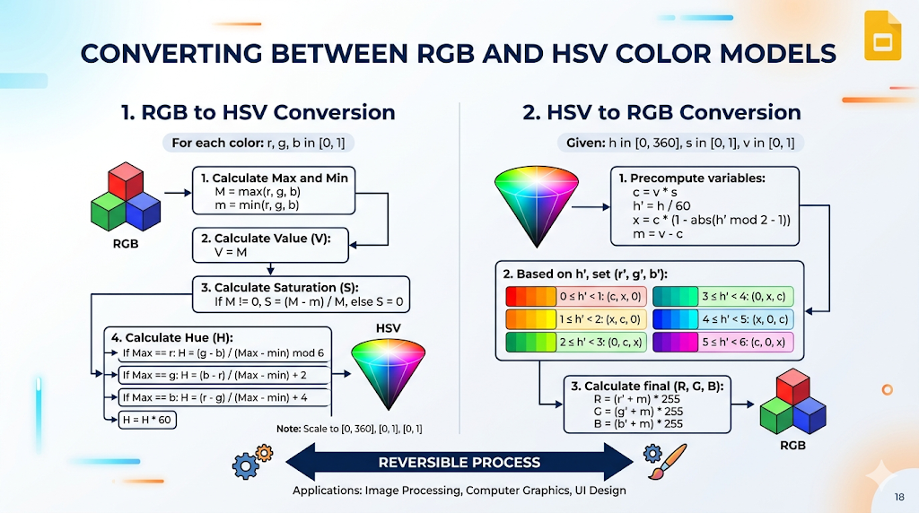

Slide 36

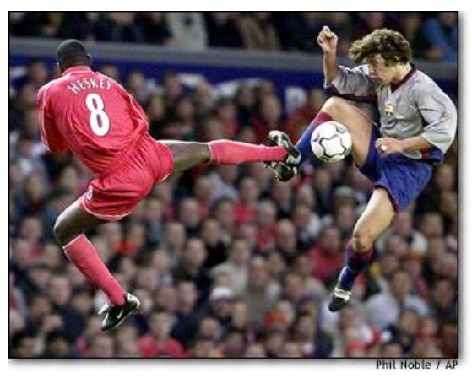
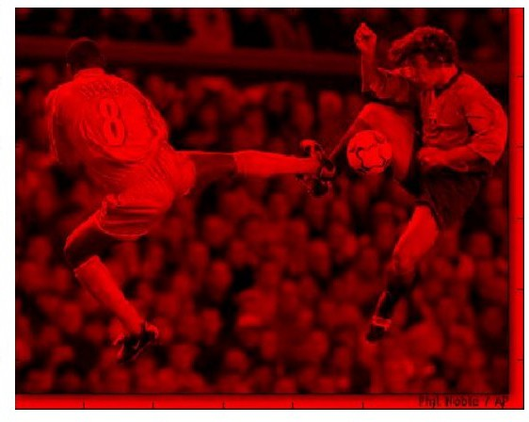
Color image - one channel
R channel

Slide 37
Types of Images
Binary
Grayscale
Color
[0, 1]
[0, 1, …, 255]
[0, 1, …, 255]^3

Slide 38

Digital Images are sampled
What happens when we zoom into the images we capture?

Slide 39
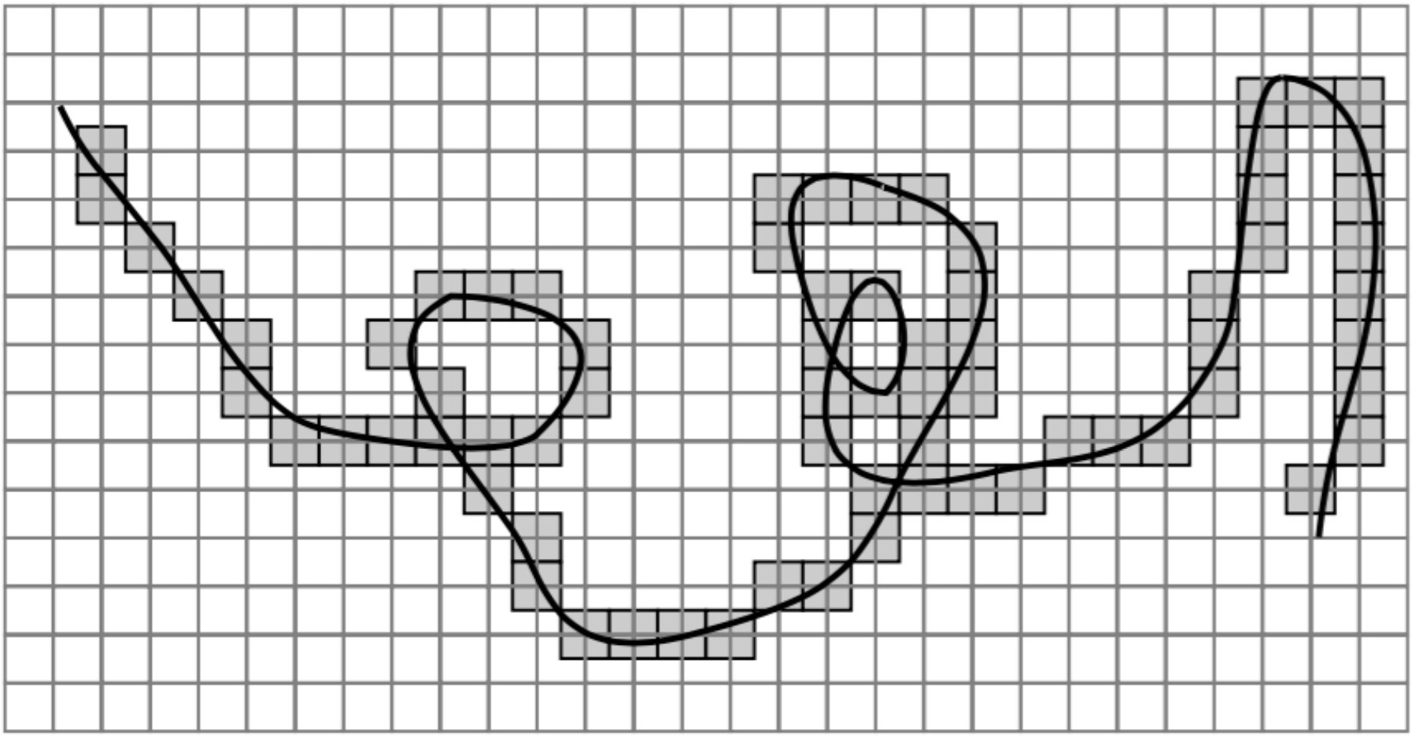
Errors due to Sampling
Q: How to compensate the error?

Slide 40

Resolution
is a sampling parameter, defined in dots per inch (DPI) or equivalent measures of spatial pixel density
Notes:
A 4K monitor has a fixed number of pixels (~8M), however its DPI varies between 185 (23 inches) and 110 (40 inches)

Slide 41


Resolution

Slide 42



Images are Sampled and Quantized
An image contains discrete number of pixels
–Pixel value:
“grayscale”
(or “intensity”): [0,255]
75
231
148

Slide 43



Images are Sampled and Quantized
An image contains discrete number of pixels
–Pixel value:
“grayscale”
(or “intensity”): [0,255]
“color”
–RGB: [R, G, B]
[90, 0, 53]
[249, 215, 203]
Q: Why [0, 255] but not [0, 1]?
[213, 60, 67]

Slide 44
With this loss of information (from sampling and quantization),
How many possible 256x256x3 images do we have?
256^{256x256x3} = 2^1572864
How many images can a person perceive in the whole life?
1 (img/sec) x 86,400 (sec/day) x 365 (day/year) x 80 (years) ≈ 2,500,000,000
Q: What’s the implication?

Slide 45
With this loss of information (from sampling and quantization),
Can we still use images for useful tasks?

Slide 46
Today’s agenda
Color spaces
Image sampling and quantization
Image histograms
Images as functions
Filters
Properties of systems
Some background reading:
Forsyth and Ponce, Computer Vision, Chapter 7

Slide 47
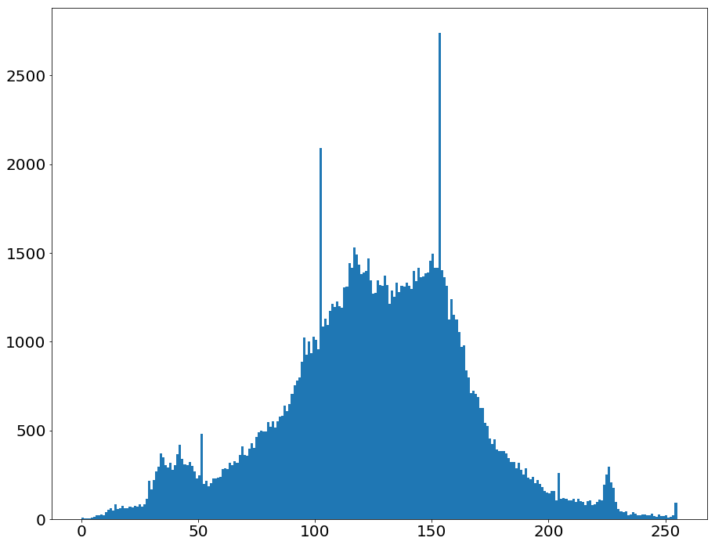
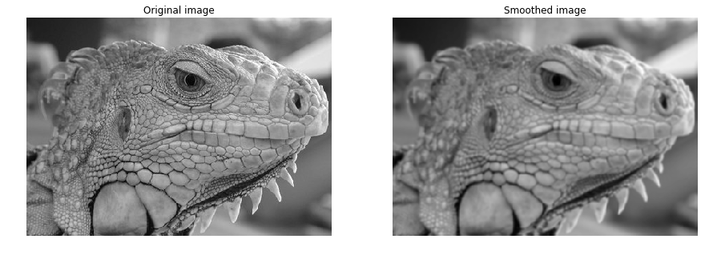
Starting with grayscale images:
Histogram captures the distribution of gray levels in the image.
How frequently each gray level occurs in the image
Notes:
Simple and nice “representation” of image!

Slide 48
Grayscale histograms in code
Histogram of an image provides the frequency of the brightness (intensity) value in the image.
Here is a simple implementation of calculating histograms:
def histogram(im):
h = np.zeros(256)
for row in im.shape[0]:
for col in im.shape[1]:
val = im[row, col]
h[val] += 1

Slide 49
Grayscale histograms in code
def histogram(im):
h = np.zeros(256)
for row in im.shape[0]:
for col in im.shape[1]:
val = im[row, col]
h[val] += 1

Slide 50

Visualizing Histograms for patches
Q: How to use histogram for retrieval?
Slide credit: Dr. Mubarak Shah

Slide 51


Histogram – use case
In emphysema, the inner walls of the lungs' air sacs called alveoli are damaged, causing them to eventually rupture.
You can take a picture of the lung with special dye to mark the alveoli
Slide credit: Dr. Mubarak Shah

Slide 52

Histogram – use case
Video Shot Boundary Detection and Condensed Representation : A Review

Slide 53
Histograms are a convenient representation to extract information
Commonly used before deep learning or low-power devices
A very cheap “representation”
Still useful even in deep learning era (really?!?!)
Q: Is image/histogram an one-to-one mapping transformation?
Can we develop better transformations than histograms?

Slide 54
Today’s agenda
Color spaces
Image sampling and quantization
Image histograms
Images as functions
Filters
Properties of systems
Some background reading:
Forsyth and Ponce, Computer Vision, Chapter 7

Slide 55
Images are a function!!!
This is a new formalism that will allow us to borrow ideas from signal processing to extract meaningful information.
At every pixel location, we get an intensity value for that pixel.
The world captured by the image continues beyond the confines of the image

Slide 56


Images as discrete functions
Also popular in high-dimensional statistics and machine learning
  function v.s. vector
Digital images are usually discrete:
  Sample the 2D space on a regular grid
Represented as a matrix of integer values
m
pixel intensity
n

Slide 57
Images as discrete function f
The input to the image function is a pixel location, [n m]
The output to the image function is the pixel intensity
pixel intensity
m
f(0, 5) f[0, 5] = 120
n

Slide 58


Images as discrete function f
Also popular in high-dimensional statistics and machine learning
  function v.s. vector

Slide 59
Images as discrete function f
The input to the image function is a pixel location, [n m]
The output to the image function is the pixel intensity
Q1. What is f[0, 0]?
pixel intensity
m
n
Notes:
62

Slide 60
Images as discrete function f
The input to the image function is a pixel location, [n m]
The output to the image function is the pixel intensity
Q2. What is f[0, 4]?
pixel intensity
m
n
Notes:
120

Slide 61
Images as discrete function f
The input to the image function is a pixel location, [n m]
The output to the image function is the pixel intensity
Q2. What is f[0, -8]?
m
n
Notes:
120

Slide 62









Images as coordinates
We can represent this function as f.
f[n, m] represents the pixel intensity at that value.
n and m can be any integer
Even negative!!
Notation for
discrete
functions

Slide 63

We don’t have the intensity values for negative indices
n and m can be any integer
Even negative!!

Slide 64

Images as functions
An Image as a function f from R² to R^{C}:
  if grayscale, C=1,
  if color, C=3
  f [n, m] gives the intensity at position [n, m] ​
  Has values over a rectangle, with a finite range:
    f: [0,H] x [0,W] [0,255]

Slide 65
Images as functions
An Image as a function f from R² to R^{C}:
  if grayscale, C=1,
  if color, C=3
  f [n, m] gives the intensity at position [n, m] ​
  Has values over a rectangle, with a finite range:
    f: [0,H] x [0,W] [0,255]
Domain support
range

Slide 66
Images as functions
An Image as a function f from R² to R^{C}:
  if grayscale, C=1,
  if color, C=3
  f [n, m] gives the intensity at position [n, m] ​
  Has values over a rectangle, with a finite range:
    f: [0,H] x [0,W] [0,255]
Domain support
range
Doesn’t have values outside of the image rectangle
f: [-inf,inf] x [-inf,inf] [0,255]
we assume that f[n, m] = 0 outside of the image rectangle

Slide 67
Images as functions
An Image as a function f from R² to R^{C}:
  f [n, m] gives the intensity at position [n, m] ​
  Defined over a rectangle, with a finite range:
    f: [a,b] x [c,d ] [0,255]
Domain support
range
Notes:
Each r, g, b are functions that like the one above

Slide 68

A highly impactful question today
“NeRF: Representing Scenes as Neural Radiance Fields for View Synthesis”, ECCV 2020
Image as a function + neural network
One of the most important paper in the recent CV development
>10,000 citations in 5 years

Slide 69
Histograms are also a type of function

Slide 70
Ideas for other image proxy functions
https://tinyurl.com/cse455-q2

Slide 71
Today’s agenda
Color spaces
Image sampling and quantization
Image histograms
Images as functions
Filters
Properties of systems
Some background reading:
Forsyth and Ponce, Computer Vision, Chapter 7

Slide 72
Systems and Filters
Filtering:
  Forming a new image whose pixel values are transformed from original pixel values
Goals of filters:
Goal is to extract useful information from images, or transform images into another domain where we can modify/enhance image properties
  Features (edges, corners, blobs…)
  super-resolution; in-painting; de-noising

Slide 73






Applications of filters
De-noising
Super-resolution
In-painting
Bertamio et al

Slide 74

Intuition behind systems
We will view systems as a sequence of filters applied to an image
  function v.s. functions of functions
Notes:
So images are a function from the real world to pixel values. Filters are a function that take the pixel values and do something else to them.
I hope it is become evident where we are going. We are going to be creating functions after functions after functions to convert light into something meaningful.

Slide 75
Repeat: Images produce a 2D matrix with pixel intensities at every location
Notation for
discrete
functions
0’s

Slide 76

Systems use Filters
we define a system as a unit that converts an input function f[n,m] into an output (or response) function g[n,m]
  where (n,m) index into the function
  In the case for images, (n,m) represents the spatial position in the image.

Slide 77


2D discrete system
(system is a sequence of filters)
S is the system operator, defined as a mapping or assignment of possible inputs f[n,m] to some possible outputs g[n,m].
Other notations:

Slide 78
Filter example #1: Moving Average
Q. What do you think will happen to the photo if we use a moving average filter?
Assume that the moving average replaces each pixel with an average value of itself and all its neighboring pixels.

Slide 79
Filter example #1: Moving Average

Slide 80


Visualizing what happens with a moving average filter
0 | 0 | 0 | 0 | 0 | 0 | 0 | 0 | 0 | 0
0 | 0 | 0 | 0 | 0 | 0 | 0 | 0 | 0 | 0
0 | 0 | 0 | 90 | 90 | 90 | 90 | 90 | 0 | 0
0 | 0 | 0 | 90 | 90 | 90 | 90 | 90 | 0 | 0
0 | 0 | 0 | 90 | 90 | 90 | 90 | 90 | 0 | 0
0 | 0 | 0 | 90 | 0 | 90 | 90 | 90 | 0 | 0
0 | 0 | 0 | 90 | 90 | 90 | 90 | 90 | 0 | 0
0 | 0 | 0 | 0 | 0 | 0 | 0 | 0 | 0 | 0
0 | 0 | 90 | 0 | 0 | 0 | 0 | 0 | 0 | 0
0 | 0 | 0 | 0 | 0 | 0 | 0 | 0 | 0 | 0
 | 0
The red box is the h matrix
0 | 0 | 0 | 0 | 0 | 0 | 0 | 0 | 0 | 0
0 | 0 | 0 | 0 | 0 | 0 | 0 | 0 | 0 | 0
0 | 0 | 0 | 90 | 90 | 90 | 90 | 90 | 0 | 0
0 | 0 | 0 | 90 | 90 | 90 | 90 | 90 | 0 | 0
0 | 0 | 0 | 90 | 90 | 90 | 90 | 90 | 0 | 0
0 | 0 | 0 | 90 | 0 | 90 | 90 | 90 | 0 | 0
0 | 0 | 0 | 90 | 90 | 90 | 90 | 90 | 0 | 0
0 | 0 | 0 | 0 | 0 | 0 | 0 | 0 | 0 | 0
0 | 0 | 90 | 0 | 0 | 0 | 0 | 0 | 0 | 0
0 | 0 | 0 | 0 | 0 | 0 | 0 | 0 | 0 | 0
Courtesy of S. Seitz

Slide 81
Visualizing what happens with a moving average filter
0 | 0 | 0 | 0 | 0 | 0 | 0 | 0 | 0 | 0
0 | 0 | 0 | 0 | 0 | 0 | 0 | 0 | 0 | 0
0 | 0 | 0 | 90 | 90 | 90 | 90 | 90 | 0 | 0
0 | 0 | 0 | 90 | 90 | 90 | 90 | 90 | 0 | 0
0 | 0 | 0 | 90 | 90 | 90 | 90 | 90 | 0 | 0
0 | 0 | 0 | 90 | 0 | 90 | 90 | 90 | 0 | 0
0 | 0 | 0 | 90 | 90 | 90 | 90 | 90 | 0 | 0
0 | 0 | 0 | 0 | 0 | 0 | 0 | 0 | 0 | 0
0 | 0 | 90 | 0 | 0 | 0 | 0 | 0 | 0 | 0
0 | 0 | 0 | 0 | 0 | 0 | 0 | 0 | 0 | 0
 | 0 | 10
0 | 0 | 0 | 0 | 0 | 0 | 0 | 0 | 0 | 0
0 | 0 | 0 | 0 | 0 | 0 | 0 | 0 | 0 | 0
0 | 0 | 0 | 90 | 90 | 90 | 90 | 90 | 0 | 0
0 | 0 | 0 | 90 | 90 | 90 | 90 | 90 | 0 | 0
0 | 0 | 0 | 90 | 90 | 90 | 90 | 90 | 0 | 0
0 | 0 | 0 | 90 | 0 | 90 | 90 | 90 | 0 | 0
0 | 0 | 0 | 90 | 90 | 90 | 90 | 90 | 0 | 0
0 | 0 | 0 | 0 | 0 | 0 | 0 | 0 | 0 | 0
0 | 0 | 90 | 0 | 0 | 0 | 0 | 0 | 0 | 0
0 | 0 | 0 | 0 | 0 | 0 | 0 | 0 | 0 | 0

Slide 82
Visualizing what happens with a moving average filter
0 | 0 | 0 | 0 | 0 | 0 | 0 | 0 | 0 | 0
0 | 0 | 0 | 0 | 0 | 0 | 0 | 0 | 0 | 0
0 | 0 | 0 | 90 | 90 | 90 | 90 | 90 | 0 | 0
0 | 0 | 0 | 90 | 90 | 90 | 90 | 90 | 0 | 0
0 | 0 | 0 | 90 | 90 | 90 | 90 | 90 | 0 | 0
0 | 0 | 0 | 90 | 0 | 90 | 90 | 90 | 0 | 0
0 | 0 | 0 | 90 | 90 | 90 | 90 | 90 | 0 | 0
0 | 0 | 0 | 0 | 0 | 0 | 0 | 0 | 0 | 0
0 | 0 | 90 | 0 | 0 | 0 | 0 | 0 | 0 | 0
0 | 0 | 0 | 0 | 0 | 0 | 0 | 0 | 0 | 0
 | 0 | 10 | 20
0 | 0 | 0 | 0 | 0 | 0 | 0 | 0 | 0 | 0
0 | 0 | 0 | 0 | 0 | 0 | 0 | 0 | 0 | 0
0 | 0 | 0 | 90 | 90 | 90 | 90 | 90 | 0 | 0
0 | 0 | 0 | 90 | 90 | 90 | 90 | 90 | 0 | 0
0 | 0 | 0 | 90 | 90 | 90 | 90 | 90 | 0 | 0
0 | 0 | 0 | 90 | 0 | 90 | 90 | 90 | 0 | 0
0 | 0 | 0 | 90 | 90 | 90 | 90 | 90 | 0 | 0
0 | 0 | 0 | 0 | 0 | 0 | 0 | 0 | 0 | 0
0 | 0 | 90 | 0 | 0 | 0 | 0 | 0 | 0 | 0
0 | 0 | 0 | 0 | 0 | 0 | 0 | 0 | 0 | 0

Slide 83
Visualizing what happens with a moving average filter
0 | 0 | 0 | 0 | 0 | 0 | 0 | 0 | 0 | 0
0 | 0 | 0 | 0 | 0 | 0 | 0 | 0 | 0 | 0
0 | 0 | 0 | 90 | 90 | 90 | 90 | 90 | 0 | 0
0 | 0 | 0 | 90 | 90 | 90 | 90 | 90 | 0 | 0
0 | 0 | 0 | 90 | 90 | 90 | 90 | 90 | 0 | 0
0 | 0 | 0 | 90 | 0 | 90 | 90 | 90 | 0 | 0
0 | 0 | 0 | 90 | 90 | 90 | 90 | 90 | 0 | 0
0 | 0 | 0 | 0 | 0 | 0 | 0 | 0 | 0 | 0
0 | 0 | 90 | 0 | 0 | 0 | 0 | 0 | 0 | 0
0 | 0 | 0 | 0 | 0 | 0 | 0 | 0 | 0 | 0
 | 0 | 10 | 20 | 30
0 | 0 | 0 | 0 | 0 | 0 | 0 | 0 | 0 | 0
0 | 0 | 0 | 0 | 0 | 0 | 0 | 0 | 0 | 0
0 | 0 | 0 | 90 | 90 | 90 | 90 | 90 | 0 | 0
0 | 0 | 0 | 90 | 90 | 90 | 90 | 90 | 0 | 0
0 | 0 | 0 | 90 | 90 | 90 | 90 | 90 | 0 | 0
0 | 0 | 0 | 90 | 0 | 90 | 90 | 90 | 0 | 0
0 | 0 | 0 | 90 | 90 | 90 | 90 | 90 | 0 | 0
0 | 0 | 0 | 0 | 0 | 0 | 0 | 0 | 0 | 0
0 | 0 | 90 | 0 | 0 | 0 | 0 | 0 | 0 | 0
0 | 0 | 0 | 0 | 0 | 0 | 0 | 0 | 0 | 0

Slide 84
Visualizing what happens with a moving average filter
0 | 0 | 0 | 0 | 0 | 0 | 0 | 0 | 0 | 0
0 | 0 | 0 | 0 | 0 | 0 | 0 | 0 | 0 | 0
0 | 0 | 0 | 90 | 90 | 90 | 90 | 90 | 0 | 0
0 | 0 | 0 | 90 | 90 | 90 | 90 | 90 | 0 | 0
0 | 0 | 0 | 90 | 90 | 90 | 90 | 90 | 0 | 0
0 | 0 | 0 | 90 | 0 | 90 | 90 | 90 | 0 | 0
0 | 0 | 0 | 90 | 90 | 90 | 90 | 90 | 0 | 0
0 | 0 | 0 | 0 | 0 | 0 | 0 | 0 | 0 | 0
0 | 0 | 90 | 0 | 0 | 0 | 0 | 0 | 0 | 0
0 | 0 | 0 | 0 | 0 | 0 | 0 | 0 | 0 | 0
 | 0 | 10 | 20 | 30 | 30

Slide 85
Visualizing what happens with a moving average filter
0 | 0 | 0 | 0 | 0 | 0 | 0 | 0 | 0 | 0
0 | 0 | 0 | 0 | 0 | 0 | 0 | 0 | 0 | 0
0 | 0 | 0 | 90 | 90 | 90 | 90 | 90 | 0 | 0
0 | 0 | 0 | 90 | 90 | 90 | 90 | 90 | 0 | 0
0 | 0 | 0 | 90 | 90 | 90 | 90 | 90 | 0 | 0
0 | 0 | 0 | 90 | 0 | 90 | 90 | 90 | 0 | 0
0 | 0 | 0 | 90 | 90 | 90 | 90 | 90 | 0 | 0
0 | 0 | 0 | 0 | 0 | 0 | 0 | 0 | 0 | 0
0 | 0 | 90 | 0 | 0 | 0 | 0 | 0 | 0 | 0
0 | 0 | 0 | 0 | 0 | 0 | 0 | 0 | 0 | 0
 | 0 | 10 | 20 | 30 | 30 | 30 | 20 | 10
 | 0 | 20 | 40 | 60 | 60 | 60 | 40 | 20
 | 0 | 30 | 60 | 90 | 90 | 90 | 60 | 30
 | 0 | 30 | 50 | 80 | 80 | 90 | 60 | 30
 | 0 | 30 | 50 | 80 | 80 | 90 | 60 | 30
 | 0 | 20 | 30 | 50 | 50 | 60 | 40 | 20
 | 10 | 20 | 30 | 30 | 30 | 30 | 20 | 10
 | 10 | 10 | 10 | 0 | 0 | 0 | 0 | 0
Notes:
What is the effect on the output?
What happens to the sharp edges?

Slide 86


Visual interpretation of moving average
A moving average over a 3 × 3 neighborhood window
h is a 3x3 matrix with values 1/9 everywhere.
1
1
1
0 | 0 | 0 | 0 | 0 | 0 | 0 | 0 | 0 | 0
0 | 0 | 0 | 0 | 0 | 0 | 0 | 0 | 0 | 0
0 | 0 | 0 | 90 | 90 | 90 | 90 | 90 | 0 | 0
0 | 0 | 0 | 90 | 90 | 90 | 90 | 90 | 0 | 0
0 | 0 | 0 | 90 | 90 | 90 | 90 | 90 | 0 | 0
0 | 0 | 0 | 90 | 0 | 90 | 90 | 90 | 0 | 0
0 | 0 | 0 | 90 | 90 | 90 | 90 | 90 | 0 | 0
0 | 0 | 0 | 0 | 0 | 0 | 0 | 0 | 0 | 0
0 | 0 | 90 | 0 | 0 | 0 | 0 | 0 | 0 | 0
0 | 0 | 0 | 0 | 0 | 0 | 0 | 0 | 0 | 0
1
1
1
1
1
1
Notes:
Board:
Input image
Output image
each pixel results from a neighborhood operation

Slide 87
Visual interpretation of moving average
A moving average over a 3 × 3 neighborhood window
h is a 3x3 matrix with values 1/9 everywhere.
Q. Why are the values 1/9?
1
1
1
1
1
1
1
1
1
Notes:
Board:
Input image
Output image
each pixel results from a neighborhood operation

Slide 88
Filter example #1: Moving Average
In summary:
This filter “Replaces” each pixel with an average of its neighborhood.
Achieve smoothing effect (remove sharp features)
1
1
1
1
1
1
1
1
1

Slide 89
Mathematical interpretation of moving average
How do we represent applying this filter mathematically?
1
1
1
1
1
1
1
1
1
Notes:
Board:
Input image
Output image
each pixel results from a neighborhood operation

Slide 90
Mathematical interpretation of moving average
How do we represent applying this filter mathematically?
1
1
1
1
1
1
1
1
1
Notes:
Board:
Input image
Output image
each pixel results from a neighborhood operation

Slide 91

Mathematical formulation of moving average
0 | 0 | 0 | 0 | 0 | 0 | 0 | 0 | 0 | 0
0 | 0 | 0 | 0 | 0 | 0 | 0 | 0 | 0 | 0
0 | 0 | 0 | 90 | 90 | 90 | 90 | 90 | 0 | 0
0 | 0 | 0 | 90 | 90 | 90 | 90 | 90 | 0 | 0
0 | 0 | 0 | 90 | 90 | 90 | 90 | 90 | 0 | 0
0 | 0 | 0 | 90 | 0 | 90 | 90 | 90 | 0 | 0
0 | 0 | 0 | 90 | 90 | 90 | 90 | 90 | 0 | 0
0 | 0 | 0 | 0 | 0 | 0 | 0 | 0 | 0 | 0
0 | 0 | 90 | 0 | 0 | 0 | 0 | 0 | 0 | 0
0 | 0 | 0 | 0 | 0 | 0 | 0 | 0 | 0 | 0
 |  |  | 20
0 | 0 | 0 | 0 | 0 | 0 | 0 | 0 | 0 | 0
0 | 0 | 0 | 0 | 0 | 0 | 0 | 0 | 0 | 0
0 | 0 | 0 | 90 | 90 | 90 | 90 | 90 | 0 | 0
0 | 0 | 0 | 90 | 90 | 90 | 90 | 90 | 0 | 0
0 | 0 | 0 | 90 | 90 | 90 | 90 | 90 | 0 | 0
0 | 0 | 0 | 90 | 0 | 90 | 90 | 90 | 0 | 0
0 | 0 | 0 | 90 | 90 | 90 | 90 | 90 | 0 | 0
0 | 0 | 0 | 0 | 0 | 0 | 0 | 0 | 0 | 0
0 | 0 | 90 | 0 | 0 | 0 | 0 | 0 | 0 | 0
0 | 0 | 0 | 0 | 0 | 0 | 0 | 0 | 0 | 0

Slide 92
Mathematical formulation of moving average
…
0 | 0 | 0 | 0 | 0 | 0 | 0 | 0 | 0 | 0
0 | 0 | 0 | 0 | 0 | 0 | 0 | 0 | 0 | 0
0 | 0 | 0 | 90 | 90 | 90 | 90 | 90 | 0 | 0
0 | 0 | 0 | 90 | 90 | 90 | 90 | 90 | 0 | 0
0 | 0 | 0 | 90 | 90 | 90 | 90 | 90 | 0 | 0
0 | 0 | 0 | 90 | 0 | 90 | 90 | 90 | 0 | 0
0 | 0 | 0 | 90 | 90 | 90 | 90 | 90 | 0 | 0
0 | 0 | 0 | 0 | 0 | 0 | 0 | 0 | 0 | 0
0 | 0 | 90 | 0 | 0 | 0 | 0 | 0 | 0 | 0
0 | 0 | 0 | 0 | 0 | 0 | 0 | 0 | 0 | 0
 |  |  | 20
0 | 0 | 0 | 0 | 0 | 0 | 0 | 0 | 0 | 0
0 | 0 | 0 | 0 | 0 | 0 | 0 | 0 | 0 | 0
0 | 0 | 0 | 90 | 90 | 90 | 90 | 90 | 0 | 0
0 | 0 | 0 | 90 | 90 | 90 | 90 | 90 | 0 | 0
0 | 0 | 0 | 90 | 90 | 90 | 90 | 90 | 0 | 0
0 | 0 | 0 | 90 | 0 | 90 | 90 | 90 | 0 | 0
0 | 0 | 0 | 90 | 90 | 90 | 90 | 90 | 0 | 0
0 | 0 | 0 | 0 | 0 | 0 | 0 | 0 | 0 | 0
0 | 0 | 90 | 0 | 0 | 0 | 0 | 0 | 0 | 0
0 | 0 | 0 | 0 | 0 | 0 | 0 | 0 | 0 | 0

Slide 93
Mathematical formulation of moving average
…
0 | 0 | 0 | 0 | 0 | 0 | 0 | 0 | 0 | 0
0 | 0 | 0 | 0 | 0 | 0 | 0 | 0 | 0 | 0
0 | 0 | 0 | 90 | 90 | 90 | 90 | 90 | 0 | 0
0 | 0 | 0 | 90 | 90 | 90 | 90 | 90 | 0 | 0
0 | 0 | 0 | 90 | 90 | 90 | 90 | 90 | 0 | 0
0 | 0 | 0 | 90 | 0 | 90 | 90 | 90 | 0 | 0
0 | 0 | 0 | 90 | 90 | 90 | 90 | 90 | 0 | 0
0 | 0 | 0 | 0 | 0 | 0 | 0 | 0 | 0 | 0
0 | 0 | 90 | 0 | 0 | 0 | 0 | 0 | 0 | 0
0 | 0 | 0 | 0 | 0 | 0 | 0 | 0 | 0 | 0
 |  |  | 20
0 | 0 | 0 | 0 | 0 | 0 | 0 | 0 | 0 | 0
0 | 0 | 0 | 0 | 0 | 0 | 0 | 0 | 0 | 0
0 | 0 | 0 | 90 | 90 | 90 | 90 | 90 | 0 | 0
0 | 0 | 0 | 90 | 90 | 90 | 90 | 90 | 0 | 0
0 | 0 | 0 | 90 | 90 | 90 | 90 | 90 | 0 | 0
0 | 0 | 0 | 90 | 0 | 90 | 90 | 90 | 0 | 0
0 | 0 | 0 | 90 | 90 | 90 | 90 | 90 | 0 | 0
0 | 0 | 0 | 0 | 0 | 0 | 0 | 0 | 0 | 0
0 | 0 | 90 | 0 | 0 | 0 | 0 | 0 | 0 | 0
0 | 0 | 0 | 0 | 0 | 0 | 0 | 0 | 0 | 0

Slide 94
Mathematical formulation of moving average
0 | 0 | 0 | 0 | 0 | 0 | 0 | 0 | 0 | 0
0 | 0 | 0 | 0 | 0 | 0 | 0 | 0 | 0 | 0
0 | 0 | 0 | 90 | 90 | 90 | 90 | 90 | 0 | 0
0 | 0 | 0 | 90 | 90 | 90 | 90 | 90 | 0 | 0
0 | 0 | 0 | 90 | 90 | 90 | 90 | 90 | 0 | 0
0 | 0 | 0 | 90 | 0 | 90 | 90 | 90 | 0 | 0
0 | 0 | 0 | 90 | 90 | 90 | 90 | 90 | 0 | 0
0 | 0 | 0 | 0 | 0 | 0 | 0 | 0 | 0 | 0
0 | 0 | 90 | 0 | 0 | 0 | 0 | 0 | 0 | 0
0 | 0 | 0 | 0 | 0 | 0 | 0 | 0 | 0 | 0
 |  |  | 20
0 | 0 | 0 | 0 | 0 | 0 | 0 | 0 | 0 | 0
0 | 0 | 0 | 0 | 0 | 0 | 0 | 0 | 0 | 0
0 | 0 | 0 | 90 | 90 | 90 | 90 | 90 | 0 | 0
0 | 0 | 0 | 90 | 90 | 90 | 90 | 90 | 0 | 0
0 | 0 | 0 | 90 | 90 | 90 | 90 | 90 | 0 | 0
0 | 0 | 0 | 90 | 0 | 90 | 90 | 90 | 0 | 0
0 | 0 | 0 | 90 | 90 | 90 | 90 | 90 | 0 | 0
0 | 0 | 0 | 0 | 0 | 0 | 0 | 0 | 0 | 0
0 | 0 | 90 | 0 | 0 | 0 | 0 | 0 | 0 | 0
0 | 0 | 0 | 0 | 0 | 0 | 0 | 0 | 0 | 0

Slide 95

Lastly, divide by 1/9
0 | 0 | 0 | 0 | 0 | 0 | 0 | 0 | 0 | 0
0 | 0 | 0 | 0 | 0 | 0 | 0 | 0 | 0 | 0
0 | 0 | 0 | 90 | 90 | 90 | 90 | 90 | 0 | 0
0 | 0 | 0 | 90 | 90 | 90 | 90 | 90 | 0 | 0
0 | 0 | 0 | 90 | 90 | 90 | 90 | 90 | 0 | 0
0 | 0 | 0 | 90 | 0 | 90 | 90 | 90 | 0 | 0
0 | 0 | 0 | 90 | 90 | 90 | 90 | 90 | 0 | 0
0 | 0 | 0 | 0 | 0 | 0 | 0 | 0 | 0 | 0
0 | 0 | 90 | 0 | 0 | 0 | 0 | 0 | 0 | 0
0 | 0 | 0 | 0 | 0 | 0 | 0 | 0 | 0 | 0
 |  |  | 20
0 | 0 | 0 | 0 | 0 | 0 | 0 | 0 | 0 | 0
0 | 0 | 0 | 0 | 0 | 0 | 0 | 0 | 0 | 0
0 | 0 | 0 | 90 | 90 | 90 | 90 | 90 | 0 | 0
0 | 0 | 0 | 90 | 90 | 90 | 90 | 90 | 0 | 0
0 | 0 | 0 | 90 | 90 | 90 | 90 | 90 | 0 | 0
0 | 0 | 0 | 90 | 0 | 90 | 90 | 90 | 0 | 0
0 | 0 | 0 | 90 | 90 | 90 | 90 | 90 | 0 | 0
0 | 0 | 0 | 0 | 0 | 0 | 0 | 0 | 0 | 0
0 | 0 | 90 | 0 | 0 | 0 | 0 | 0 | 0 | 0
0 | 0 | 0 | 0 | 0 | 0 | 0 | 0 | 0 | 0

Slide 96

Now, instead of [0, 0], let’s do [n, m]
0 | 0 | 0 | 0 | 0 | 0 | 0 | 0 | 0 | 0
0 | 0 | 0 | 0 | 0 | 0 | 0 | 0 | 0 | 0
0 | 0 | 0 | 90 | 90 | 90 | 90 | 90 | 0 | 0
0 | 0 | 0 | 90 | 90 | 90 | 90 | 90 | 0 | 0
0 | 0 | 0 | 90 | 90 | 90 | 90 | 90 | 0 | 0
0 | 0 | 0 | 90 | 0 | 90 | 90 | 90 | 0 | 0
0 | 0 | 0 | 90 | 90 | 90 | 90 | 90 | 0 | 0
0 | 0 | 0 | 0 | 0 | 0 | 0 | 0 | 0 | 0
0 | 0 | 90 | 0 | 0 | 0 | 0 | 0 | 0 | 0
0 | 0 | 0 | 0 | 0 | 0 | 0 | 0 | 0 | 0
 |  |  | 20
0 | 0 | 0 | 0 | 0 | 0 | 0 | 0 | 0 | 0
0 | 0 | 0 | 0 | 0 | 0 | 0 | 0 | 0 | 0
0 | 0 | 0 | 90 | 90 | 90 | 90 | 90 | 0 | 0
0 | 0 | 0 | 90 | 90 | 90 | 90 | 90 | 0 | 0
0 | 0 | 0 | 90 | 90 | 90 | 90 | 90 | 0 | 0
0 | 0 | 0 | 90 | 0 | 90 | 90 | 90 | 0 | 0
0 | 0 | 0 | 90 | 90 | 90 | 90 | 90 | 0 | 0
0 | 0 | 0 | 0 | 0 | 0 | 0 | 0 | 0 | 0
0 | 0 | 90 | 0 | 0 | 0 | 0 | 0 | 0 | 0
0 | 0 | 0 | 0 | 0 | 0 | 0 | 0 | 0 | 0

Slide 97
Now, instead of [0, 0], let’s do [n, m]
…
0 | 0 | 0 | 0 | 0 | 0 | 0 | 0 | 0 | 0
0 | 0 | 0 | 0 | 0 | 0 | 0 | 0 | 0 | 0
0 | 0 | 0 | 90 | 90 | 90 | 90 | 90 | 0 | 0
0 | 0 | 0 | 90 | 90 | 90 | 90 | 90 | 0 | 0
0 | 0 | 0 | 90 | 90 | 90 | 90 | 90 | 0 | 0
0 | 0 | 0 | 90 | 0 | 90 | 90 | 90 | 0 | 0
0 | 0 | 0 | 90 | 90 | 90 | 90 | 90 | 0 | 0
0 | 0 | 0 | 0 | 0 | 0 | 0 | 0 | 0 | 0
0 | 0 | 90 | 0 | 0 | 0 | 0 | 0 | 0 | 0
0 | 0 | 0 | 0 | 0 | 0 | 0 | 0 | 0 | 0
 |  |  | 20
0 | 0 | 0 | 0 | 0 | 0 | 0 | 0 | 0 | 0
0 | 0 | 0 | 0 | 0 | 0 | 0 | 0 | 0 | 0
0 | 0 | 0 | 90 | 90 | 90 | 90 | 90 | 0 | 0
0 | 0 | 0 | 90 | 90 | 90 | 90 | 90 | 0 | 0
0 | 0 | 0 | 90 | 90 | 90 | 90 | 90 | 0 | 0
0 | 0 | 0 | 90 | 0 | 90 | 90 | 90 | 0 | 0
0 | 0 | 0 | 90 | 90 | 90 | 90 | 90 | 0 | 0
0 | 0 | 0 | 0 | 0 | 0 | 0 | 0 | 0 | 0
0 | 0 | 90 | 0 | 0 | 0 | 0 | 0 | 0 | 0
0 | 0 | 0 | 0 | 0 | 0 | 0 | 0 | 0 | 0

Slide 98
Now, instead of [0, 0], let’s do [n, m]
…
0 | 0 | 0 | 0 | 0 | 0 | 0 | 0 | 0 | 0
0 | 0 | 0 | 0 | 0 | 0 | 0 | 0 | 0 | 0
0 | 0 | 0 | 90 | 90 | 90 | 90 | 90 | 0 | 0
0 | 0 | 0 | 90 | 90 | 90 | 90 | 90 | 0 | 0
0 | 0 | 0 | 90 | 90 | 90 | 90 | 90 | 0 | 0
0 | 0 | 0 | 90 | 0 | 90 | 90 | 90 | 0 | 0
0 | 0 | 0 | 90 | 90 | 90 | 90 | 90 | 0 | 0
0 | 0 | 0 | 0 | 0 | 0 | 0 | 0 | 0 | 0
0 | 0 | 90 | 0 | 0 | 0 | 0 | 0 | 0 | 0
0 | 0 | 0 | 0 | 0 | 0 | 0 | 0 | 0 | 0
 |  |  | 20
0 | 0 | 0 | 0 | 0 | 0 | 0 | 0 | 0 | 0
0 | 0 | 0 | 0 | 0 | 0 | 0 | 0 | 0 | 0
0 | 0 | 0 | 90 | 90 | 90 | 90 | 90 | 0 | 0
0 | 0 | 0 | 90 | 90 | 90 | 90 | 90 | 0 | 0
0 | 0 | 0 | 90 | 90 | 90 | 90 | 90 | 0 | 0
0 | 0 | 0 | 90 | 0 | 90 | 90 | 90 | 0 | 0
0 | 0 | 0 | 90 | 90 | 90 | 90 | 90 | 0 | 0
0 | 0 | 0 | 0 | 0 | 0 | 0 | 0 | 0 | 0
0 | 0 | 90 | 0 | 0 | 0 | 0 | 0 | 0 | 0
0 | 0 | 0 | 0 | 0 | 0 | 0 | 0 | 0 | 0

Slide 99
Now, instead of [0, 0], let’s do [n, m]
…
0 | 0 | 0 | 0 | 0 | 0 | 0 | 0 | 0 | 0
0 | 0 | 0 | 0 | 0 | 0 | 0 | 0 | 0 | 0
0 | 0 | 0 | 90 | 90 | 90 | 90 | 90 | 0 | 0
0 | 0 | 0 | 90 | 90 | 90 | 90 | 90 | 0 | 0
0 | 0 | 0 | 90 | 90 | 90 | 90 | 90 | 0 | 0
0 | 0 | 0 | 90 | 0 | 90 | 90 | 90 | 0 | 0
0 | 0 | 0 | 90 | 90 | 90 | 90 | 90 | 0 | 0
0 | 0 | 0 | 0 | 0 | 0 | 0 | 0 | 0 | 0
0 | 0 | 90 | 0 | 0 | 0 | 0 | 0 | 0 | 0
0 | 0 | 0 | 0 | 0 | 0 | 0 | 0 | 0 | 0
 |  |  | 20
0 | 0 | 0 | 0 | 0 | 0 | 0 | 0 | 0 | 0
0 | 0 | 0 | 0 | 0 | 0 | 0 | 0 | 0 | 0
0 | 0 | 0 | 90 | 90 | 90 | 90 | 90 | 0 | 0
0 | 0 | 0 | 90 | 90 | 90 | 90 | 90 | 0 | 0
0 | 0 | 0 | 90 | 90 | 90 | 90 | 90 | 0 | 0
0 | 0 | 0 | 90 | 0 | 90 | 90 | 90 | 0 | 0
0 | 0 | 0 | 90 | 90 | 90 | 90 | 90 | 0 | 0
0 | 0 | 0 | 0 | 0 | 0 | 0 | 0 | 0 | 0
0 | 0 | 90 | 0 | 0 | 0 | 0 | 0 | 0 | 0
0 | 0 | 0 | 0 | 0 | 0 | 0 | 0 | 0 | 0

Slide 100
Now, instead of [0, 0], let’s do [n, m]
…
0 | 0 | 0 | 0 | 0 | 0 | 0 | 0 | 0 | 0
0 | 0 | 0 | 0 | 0 | 0 | 0 | 0 | 0 | 0
0 | 0 | 0 | 90 | 90 | 90 | 90 | 90 | 0 | 0
0 | 0 | 0 | 90 | 90 | 90 | 90 | 90 | 0 | 0
0 | 0 | 0 | 90 | 90 | 90 | 90 | 90 | 0 | 0
0 | 0 | 0 | 90 | 0 | 90 | 90 | 90 | 0 | 0
0 | 0 | 0 | 90 | 90 | 90 | 90 | 90 | 0 | 0
0 | 0 | 0 | 0 | 0 | 0 | 0 | 0 | 0 | 0
0 | 0 | 90 | 0 | 0 | 0 | 0 | 0 | 0 | 0
0 | 0 | 0 | 0 | 0 | 0 | 0 | 0 | 0 | 0
 |  |  | 20
0 | 0 | 0 | 0 | 0 | 0 | 0 | 0 | 0 | 0
0 | 0 | 0 | 0 | 0 | 0 | 0 | 0 | 0 | 0
0 | 0 | 0 | 90 | 90 | 90 | 90 | 90 | 0 | 0
0 | 0 | 0 | 90 | 90 | 90 | 90 | 90 | 0 | 0
0 | 0 | 0 | 90 | 90 | 90 | 90 | 90 | 0 | 0
0 | 0 | 0 | 90 | 0 | 90 | 90 | 90 | 0 | 0
0 | 0 | 0 | 90 | 90 | 90 | 90 | 90 | 0 | 0
0 | 0 | 0 | 0 | 0 | 0 | 0 | 0 | 0 | 0
0 | 0 | 90 | 0 | 0 | 0 | 0 | 0 | 0 | 0
0 | 0 | 0 | 0 | 0 | 0 | 0 | 0 | 0 | 0

Slide 101
Now, instead of [0, 0], let’s do [n, m]
…
0 | 0 | 0 | 0 | 0 | 0 | 0 | 0 | 0 | 0
0 | 0 | 0 | 0 | 0 | 0 | 0 | 0 | 0 | 0
0 | 0 | 0 | 90 | 90 | 90 | 90 | 90 | 0 | 0
0 | 0 | 0 | 90 | 90 | 90 | 90 | 90 | 0 | 0
0 | 0 | 0 | 90 | 90 | 90 | 90 | 90 | 0 | 0
0 | 0 | 0 | 90 | 0 | 90 | 90 | 90 | 0 | 0
0 | 0 | 0 | 90 | 90 | 90 | 90 | 90 | 0 | 0
0 | 0 | 0 | 0 | 0 | 0 | 0 | 0 | 0 | 0
0 | 0 | 90 | 0 | 0 | 0 | 0 | 0 | 0 | 0
0 | 0 | 0 | 0 | 0 | 0 | 0 | 0 | 0 | 0
 |  |  | 20
0 | 0 | 0 | 0 | 0 | 0 | 0 | 0 | 0 | 0
0 | 0 | 0 | 0 | 0 | 0 | 0 | 0 | 0 | 0
0 | 0 | 0 | 90 | 90 | 90 | 90 | 90 | 0 | 0
0 | 0 | 0 | 90 | 90 | 90 | 90 | 90 | 0 | 0
0 | 0 | 0 | 90 | 90 | 90 | 90 | 90 | 0 | 0
0 | 0 | 0 | 90 | 0 | 90 | 90 | 90 | 0 | 0
0 | 0 | 0 | 90 | 90 | 90 | 90 | 90 | 0 | 0
0 | 0 | 0 | 0 | 0 | 0 | 0 | 0 | 0 | 0
0 | 0 | 90 | 0 | 0 | 0 | 0 | 0 | 0 | 0
0 | 0 | 0 | 0 | 0 | 0 | 0 | 0 | 0 | 0

Slide 102
Now, instead of [0, 0], let’s do [n, m]
0 | 0 | 0 | 0 | 0 | 0 | 0 | 0 | 0 | 0
0 | 0 | 0 | 0 | 0 | 0 | 0 | 0 | 0 | 0
0 | 0 | 0 | 90 | 90 | 90 | 90 | 90 | 0 | 0
0 | 0 | 0 | 90 | 90 | 90 | 90 | 90 | 0 | 0
0 | 0 | 0 | 90 | 90 | 90 | 90 | 90 | 0 | 0
0 | 0 | 0 | 90 | 0 | 90 | 90 | 90 | 0 | 0
0 | 0 | 0 | 90 | 90 | 90 | 90 | 90 | 0 | 0
0 | 0 | 0 | 0 | 0 | 0 | 0 | 0 | 0 | 0
0 | 0 | 90 | 0 | 0 | 0 | 0 | 0 | 0 | 0
0 | 0 | 0 | 0 | 0 | 0 | 0 | 0 | 0 | 0
 |  |  | 20
0 | 0 | 0 | 0 | 0 | 0 | 0 | 0 | 0 | 0
0 | 0 | 0 | 0 | 0 | 0 | 0 | 0 | 0 | 0
0 | 0 | 0 | 90 | 90 | 90 | 90 | 90 | 0 | 0
0 | 0 | 0 | 90 | 90 | 90 | 90 | 90 | 0 | 0
0 | 0 | 0 | 90 | 90 | 90 | 90 | 90 | 0 | 0
0 | 0 | 0 | 90 | 0 | 90 | 90 | 90 | 0 | 0
0 | 0 | 0 | 90 | 90 | 90 | 90 | 90 | 0 | 0
0 | 0 | 0 | 0 | 0 | 0 | 0 | 0 | 0 | 0
0 | 0 | 90 | 0 | 0 | 0 | 0 | 0 | 0 | 0
0 | 0 | 0 | 0 | 0 | 0 | 0 | 0 | 0 | 0

Slide 103
Now, instead of [0, 0], let’s do [n, m]
0 | 0 | 0 | 0 | 0 | 0 | 0 | 0 | 0 | 0
0 | 0 | 0 | 0 | 0 | 0 | 0 | 0 | 0 | 0
0 | 0 | 0 | 90 | 90 | 90 | 90 | 90 | 0 | 0
0 | 0 | 0 | 90 | 90 | 90 | 90 | 90 | 0 | 0
0 | 0 | 0 | 90 | 90 | 90 | 90 | 90 | 0 | 0
0 | 0 | 0 | 90 | 0 | 90 | 90 | 90 | 0 | 0
0 | 0 | 0 | 90 | 90 | 90 | 90 | 90 | 0 | 0
0 | 0 | 0 | 0 | 0 | 0 | 0 | 0 | 0 | 0
0 | 0 | 90 | 0 | 0 | 0 | 0 | 0 | 0 | 0
0 | 0 | 0 | 0 | 0 | 0 | 0 | 0 | 0 | 0
 |  |  | 20
0 | 0 | 0 | 0 | 0 | 0 | 0 | 0 | 0 | 0
0 | 0 | 0 | 0 | 0 | 0 | 0 | 0 | 0 | 0
0 | 0 | 0 | 90 | 90 | 90 | 90 | 90 | 0 | 0
0 | 0 | 0 | 90 | 90 | 90 | 90 | 90 | 0 | 0
0 | 0 | 0 | 90 | 90 | 90 | 90 | 90 | 0 | 0
0 | 0 | 0 | 90 | 0 | 90 | 90 | 90 | 0 | 0
0 | 0 | 0 | 90 | 90 | 90 | 90 | 90 | 0 | 0
0 | 0 | 0 | 0 | 0 | 0 | 0 | 0 | 0 | 0
0 | 0 | 90 | 0 | 0 | 0 | 0 | 0 | 0 | 0
0 | 0 | 0 | 0 | 0 | 0 | 0 | 0 | 0 | 0

Slide 104
Now, instead of [0, 0], let’s do [n, m]
0 | 0 | 0 | 0 | 0 | 0 | 0 | 0 | 0 | 0
0 | 0 | 0 | 0 | 0 | 0 | 0 | 0 | 0 | 0
0 | 0 | 0 | 90 | 90 | 90 | 90 | 90 | 0 | 0
0 | 0 | 0 | 90 | 90 | 90 | 90 | 90 | 0 | 0
0 | 0 | 0 | 90 | 90 | 90 | 90 | 90 | 0 | 0
0 | 0 | 0 | 90 | 0 | 90 | 90 | 90 | 0 | 0
0 | 0 | 0 | 90 | 90 | 90 | 90 | 90 | 0 | 0
0 | 0 | 0 | 0 | 0 | 0 | 0 | 0 | 0 | 0
0 | 0 | 90 | 0 | 0 | 0 | 0 | 0 | 0 | 0
0 | 0 | 0 | 0 | 0 | 0 | 0 | 0 | 0 | 0
 |  |  | 20
0 | 0 | 0 | 0 | 0 | 0 | 0 | 0 | 0 | 0
0 | 0 | 0 | 0 | 0 | 0 | 0 | 0 | 0 | 0
0 | 0 | 0 | 90 | 90 | 90 | 90 | 90 | 0 | 0
0 | 0 | 0 | 90 | 90 | 90 | 90 | 90 | 0 | 0
0 | 0 | 0 | 90 | 90 | 90 | 90 | 90 | 0 | 0
0 | 0 | 0 | 90 | 0 | 90 | 90 | 90 | 0 | 0
0 | 0 | 0 | 90 | 90 | 90 | 90 | 90 | 0 | 0
0 | 0 | 0 | 0 | 0 | 0 | 0 | 0 | 0 | 0
0 | 0 | 90 | 0 | 0 | 0 | 0 | 0 | 0 | 0
0 | 0 | 0 | 0 | 0 | 0 | 0 | 0 | 0 | 0

Slide 105

Lastly, divide by 1/9
0 | 0 | 0 | 0 | 0 | 0 | 0 | 0 | 0 | 0
0 | 0 | 0 | 0 | 0 | 0 | 0 | 0 | 0 | 0
0 | 0 | 0 | 90 | 90 | 90 | 90 | 90 | 0 | 0
0 | 0 | 0 | 90 | 90 | 90 | 90 | 90 | 0 | 0
0 | 0 | 0 | 90 | 90 | 90 | 90 | 90 | 0 | 0
0 | 0 | 0 | 90 | 0 | 90 | 90 | 90 | 0 | 0
0 | 0 | 0 | 90 | 90 | 90 | 90 | 90 | 0 | 0
0 | 0 | 0 | 0 | 0 | 0 | 0 | 0 | 0 | 0
0 | 0 | 90 | 0 | 0 | 0 | 0 | 0 | 0 | 0
0 | 0 | 0 | 0 | 0 | 0 | 0 | 0 | 0 | 0
 |  |  | 20
0 | 0 | 0 | 0 | 0 | 0 | 0 | 0 | 0 | 0
0 | 0 | 0 | 0 | 0 | 0 | 0 | 0 | 0 | 0
0 | 0 | 0 | 90 | 90 | 90 | 90 | 90 | 0 | 0
0 | 0 | 0 | 90 | 90 | 90 | 90 | 90 | 0 | 0
0 | 0 | 0 | 90 | 90 | 90 | 90 | 90 | 0 | 0
0 | 0 | 0 | 90 | 0 | 90 | 90 | 90 | 0 | 0
0 | 0 | 0 | 90 | 90 | 90 | 90 | 90 | 0 | 0
0 | 0 | 0 | 0 | 0 | 0 | 0 | 0 | 0 | 0
0 | 0 | 90 | 0 | 0 | 0 | 0 | 0 | 0 | 0
0 | 0 | 0 | 0 | 0 | 0 | 0 | 0 | 0 | 0

Slide 106

Mathematical formulation of moving average
We can re-write the equation using summations
Q. What values will k take?
1
1
1
1
1
1
1
1
1
Notes:
Board:
Input image
Output image
each pixel results from a neighborhood operation

Slide 107

Mathematical formulation of moving average
How do we represent applying this filter mathematically?
k goes from n-1 to n+1
1
1
1
1
1
1
1
1
1
Notes:
Board:
Input image
Output image
each pixel results from a neighborhood operation

Slide 108

Mathematical formulation of moving average
How do we represent applying this filter mathematically?
Q. What values will l take?
1
1
1
1
1
1
1
1
1
Notes:
Board:
Input image
Output image
each pixel results from a neighborhood operation

Slide 109

Mathematical formulation of moving average
How do we represent applying this filter mathematically?
l goes from m-1 to m+1
1
1
1
1
1
1
1
1
1
Notes:
Board:
Input image
Output image
each pixel results from a neighborhood operation

Slide 110

Math formula for the moving average filter
A moving average over a 3 × 3 neighborhood window
We can write this operation mathematically:
1
1
1
1
1
1
1
1
1
Notes:
Board:
Input image
Output image
each pixel results from a neighborhood operation

Slide 111

Rewriting this formula
We are almost done. Let’s rewrite this formula a little bit
Let
1
1
1
1
1
1
1
1
1
Notes:
Board:
Input image
Output image
each pixel results from a neighborhood operation

Slide 112

Rewriting this formula
We are almost done. Let’s rewrite this formula a little bit
Let
therefore,
Now we can replace k in the equation above
1
1
1
1
1
1
1
1
1
Notes:
Board:
Input image
Output image
each pixel results from a neighborhood operation

Slide 113

Rewriting this formula
We are almost done. Let’s rewrite this formula a little bit
Let
therefore,
1
1
1
1
1
1
1
1
1
Notes:
Board:
Input image
Output image
each pixel results from a neighborhood operation

Slide 114
Rewriting this formula
So now we have this:
1
1
1
1
1
1
1
1
1
Notes:
Board:
Input image
Output image
each pixel results from a neighborhood operation

Slide 115

Rewriting this formula
So now we have this:
We can simplify the equations in red:
1
1
1
1
1
1
1
1
1
Notes:
Board:
Input image
Output image
each pixel results from a neighborhood operation

Slide 116
Rewriting this formula
So now we have this:
Remember that summations are just for-loops!!
1
1
1
1
1
1
1
1
1
Notes:
Board:
Input image
Output image
each pixel results from a neighborhood operation

Slide 117

Rewriting this formula
So now we have this:
Remember that summations are just for-loops!!
1
1
1
1
1
1
1
1
1
Notes:
Board:
Input image
Output image
each pixel results from a neighborhood operation

Slide 118

Rewriting this formula
One last change: since there are no more k and only k’, let’s just write k’ as k
1
1
1
1
1
1
1
1
1
Notes:
Board:
Input image
Output image
each pixel results from a neighborhood operation

Slide 119

Mathematical interpretation of moving average
Let’s repeat for l, just like we did for k
1
1
1
1
1
1
1
1
1
Notes:
Board:
Input image
Output image
each pixel results from a neighborhood operation

Slide 120
Mathematical interpretation of moving average
Let’s repeat for l, just like we did for k
1
1
1
1
1
1
1
1
1
Q: how to use a larger 5x5 filter?
Notes:
Board:
Input image
Output image
each pixel results from a neighborhood operation

Slide 121
Filter example #1: Moving Average

Slide 122
Filter example #2: Image Segmentation
Q. How would you use pixel values to design a filter to segment an image so that you only keep around the edges?

Slide 123

Filter example #2: Image Segmentation
255,
Use a simple pixel threshold:
Exercise: Is this linear or non-linear operation?

Slide 124
Summary so far
Beyond examples we have seen today, there are A HUGE number of possible filters we can design.
Discrete systems, with filters, convert input discrete signals and convert them into something more meaningful.
What are ways we can category the space of possible systems?

Slide 125

From a signal processing view
Filter → Filter → Filter → Filter
→ Output
System

Slide 126
In ML langauge
Neural networks and specifically convolutional neural networks are a sequence of filters (except they are a non-linear system) that contains multiple individual linear sub-systems.
filter as layer & system as model

Slide 127
Today’s agenda
Color spaces
Image sampling and quantization
Image histograms
Images as functions
Filters
Properties of systems

Slide 128
Properties of systems
Amplitude properties:
  Additivity

Slide 129

Example question:
Q. Is the moving average filter additive?
How would you prove it?
1
1
1
1
1
1
1
1
1

Slide 130

Example question:
1
1
1
1
1
1
Let
1
1
1

Slide 131

Example question:
1
1
1
1
1
1
Let
1
1
1

Slide 132
Example question:
1
1
1
1
1
1
Let
1
1
1

Slide 133
Example question:
1
1
1
1
1
1
Let
1
1
1

Slide 134
Example question:
1
1
1
1
1
1
Let
1
1
1

Slide 135
Example question:
1
1
1
1
1
1
Let
1
1
1

Slide 136
Properties of systems
Amplitude properties:
  Additivity

Slide 137

Properties of systems
Amplitude properties:
  Additivity
  Homogeneity

Slide 138
Another question:
Q. Is the moving average filter homogeneous?
Practice proving it at home using:
1
1
1
1
1
1
1
1
1
Notes:
Yes

Slide 139
What we covered today
Color spaces
Image sampling and quantization
Image histograms
Images as functions
Filters
Properties of systems

Slide 140
Classic v.s. Deep Learning ?!
Should I take CSE455? Or should I go ahead to take the deep learning class?

Slide 141


History
Recent neural networks is invented before 2000’s
But here is the popular agenda in 2000’s

Slide 142
Deep Learning
is a powerful tool
immediately useful (for your problem, and maybe for job hunting)
it’s not the problem (at least not CV problem)

Slide 143
Why basics?
Learning the problem (CSE455)
and knowing the tool (any other deep learning classes)

Slide 144
Recall the groundbreaking NeRF paper
“NeRF: Representing Scenes as Neural Radiance Fields for View Synthesis”, ECCV 2020
Image as a function + neural network
One of the most important paper in the recent CV development
>10,000 citations in 5 years

Slide 145
Why basics?
Learning the problem (CSE455)
  and knowing the tool (any other deep learning classes)
Our goal in CSE455:
  learning foundation, ideas, and basics
  build your taste and intuition to computer vision
Classic approaches are still useful nowadays
  especially in scale (cheap!!)

Slide 146
Next time:
Linear systems and convolutions

