Slide 1
Lecture 1:
Brief history of computer vision
CSE 455 - Computer Vision
Slide Credit: Ranjay Krishna

Slide 2
Science stands on the shoulder of giants
Notes:
everything i research, I am able to do because of the giants who figured out hard problems before me.
Knowing about this history could help us build better systems. So, I usually like to begin every course I teach with a lecture dedicated to understanding where we started, and where we are.

Slide 3
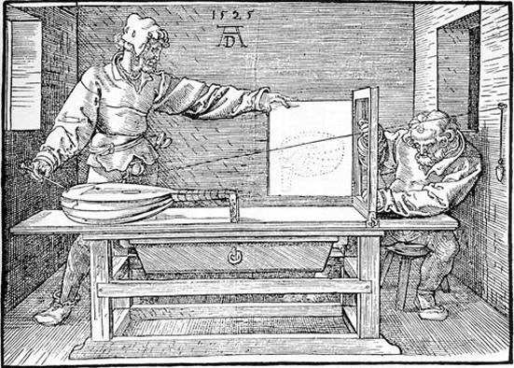
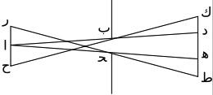
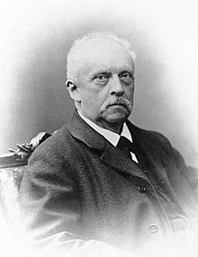
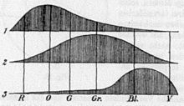
Computer vision draws origins from math & physics
Pinhole projection, optics
Projective geometry
Models of color vision (trichromacy)
Early theories of visual perception: Helmholtz, others
Notes:
physics, understanding how light passes through lens, similar to the lens in our eyes
projective geometry to understand geometric properties of hand-drawn scenes. Learning how to draw realistic looking spaces
Building models of color and design to make things people like seeing

Slide 4



Slide 5
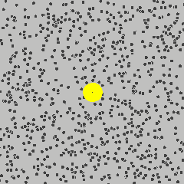


Computer vision draws origins from math & physics
Brownian motion & Schrödinger equation
Notes:
physics, understanding how light passes through lens, similar to the lens in our eyes
projective geometry to understand geometric properties of hand-drawn scenes. Learning how to draw realistic looking spaces
Building models of color and design to make things people like seeing

Slide 6
Three big technologies changed how computer vision was studied and how we understand them today.
Q. Can anyone here guess what those three events were?

Slide 7
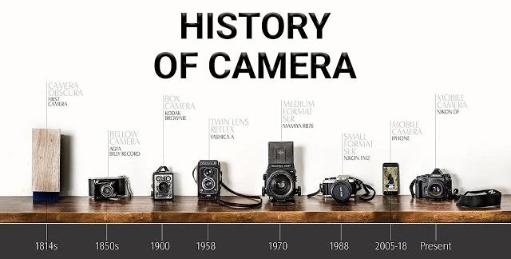
First technology

Slide 8
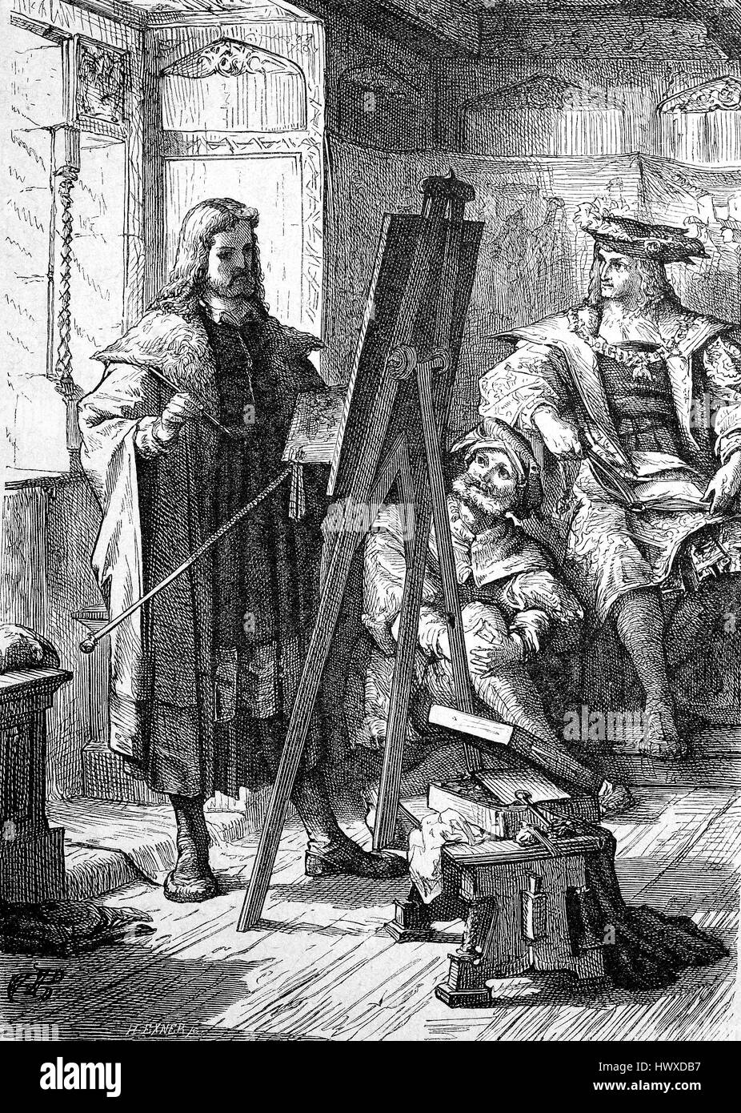
Pictures before 1838
Portraiture - artists would spend hours/days drawing their subjects who stood still in front of them

Slide 9
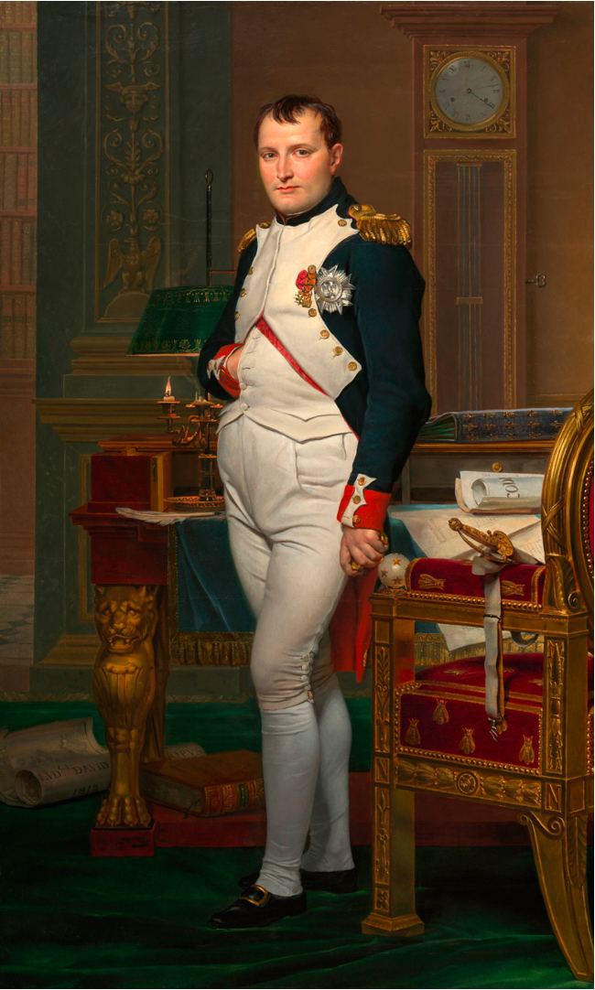
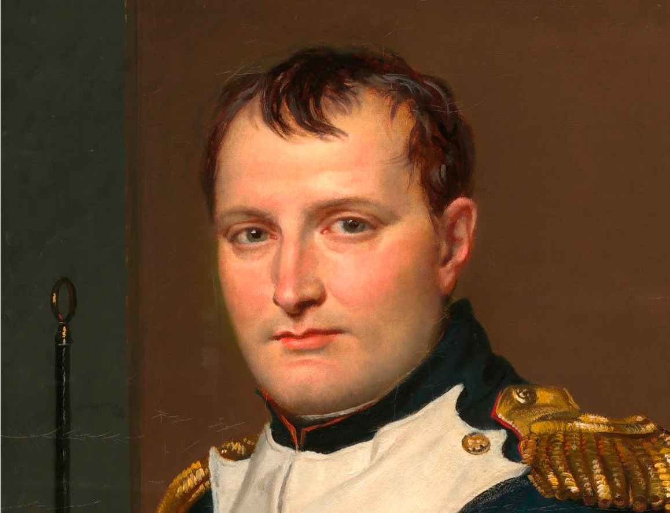
1812: Jacques-Louis-David The Emperor Napoleon at his Study at the Tuileries
Notes:
Paintings in 1838 looked like this

Slide 10
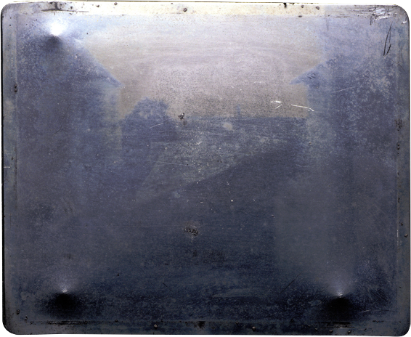
1826~1827, View from the Window at Le Gras, Niépce

Slide 11
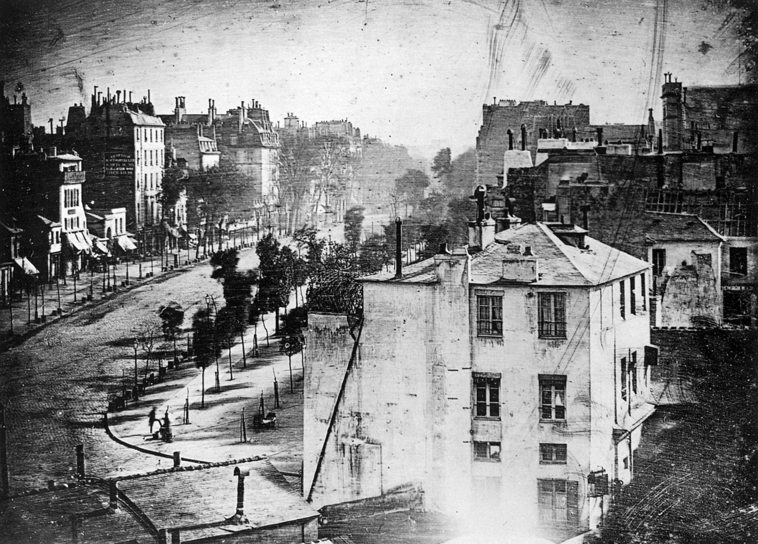
1838: Boulevard du Temple, Daguerre

Slide 12
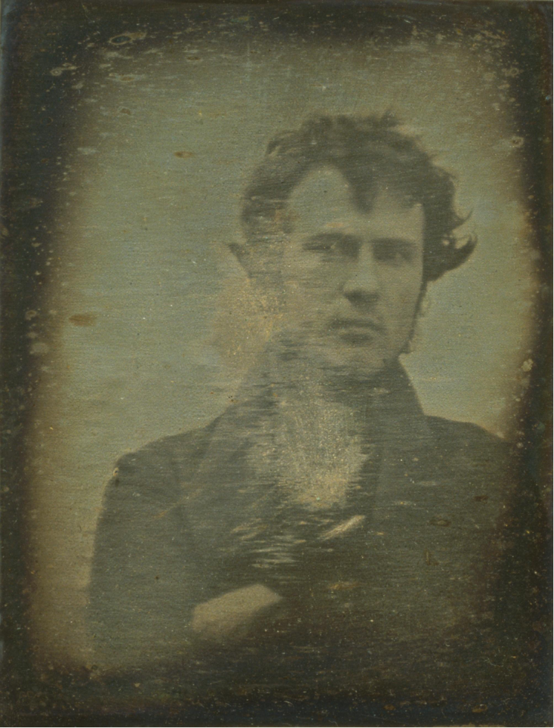
1838: First selfie, Robert Cornelius

Slide 13
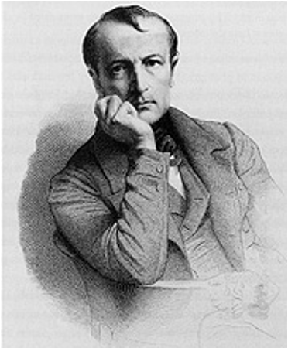
Technology often begets fear
“From today, painting is dead”
— painter Paul Delaroche at a demonstration of the Daguerreotype, 1839

Slide 14
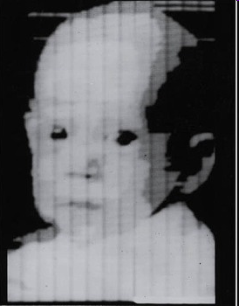
Second technology
1957: Digital scanner invented at NIST
Notes:
first digital scan of a photo

Slide 15

With smaller cameras and larger storage,
We began curating large scale databases of images online
MNIST, 28x28, 1994

Slide 16
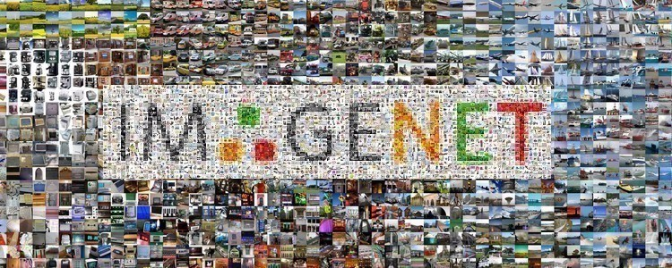
With smaller cameras and larger storage,
We began curating large scale databases of images online

Slide 17
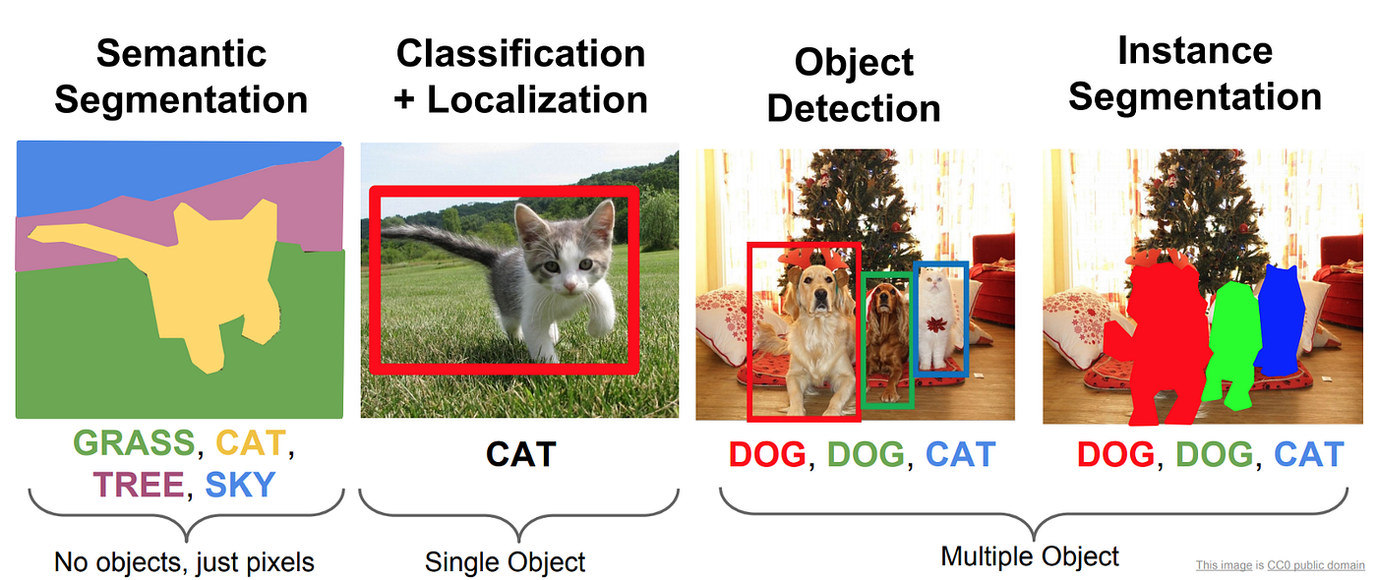
With those images, we now train models to understand what is in an image

Slide 18
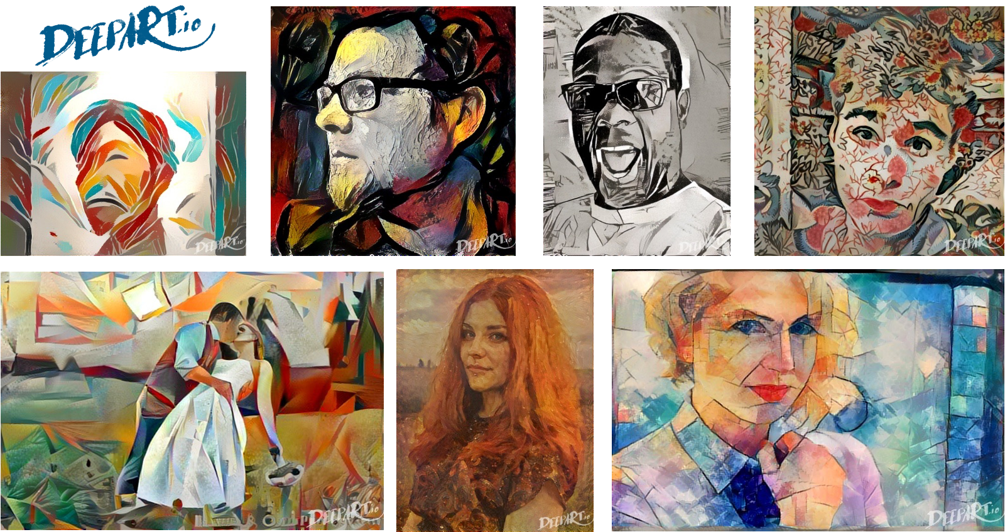
We can also train models to generate new images
Neural Style Transfer [Gatys et al. 2015]

Slide 20
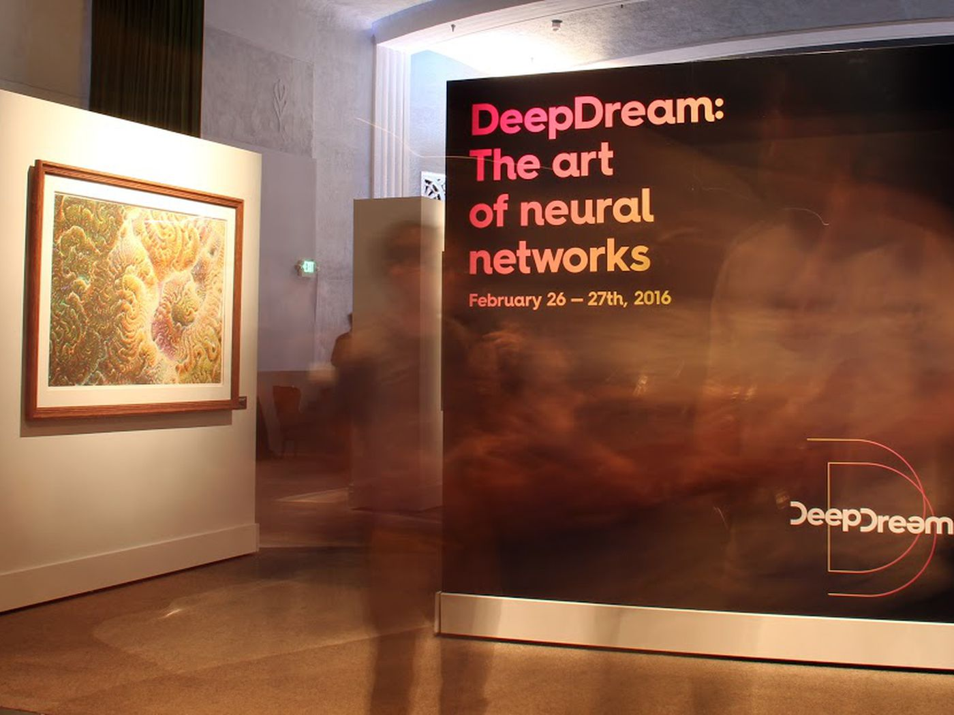
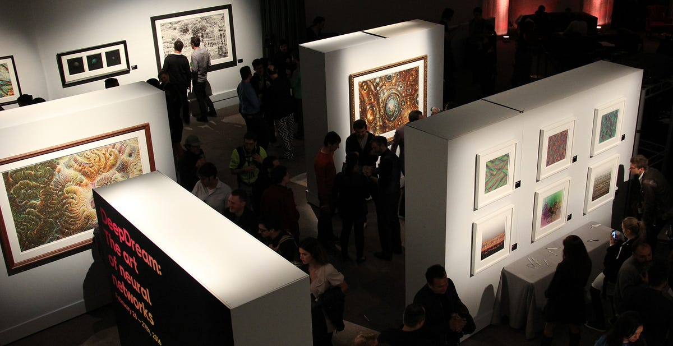
AI Art

Slide 21
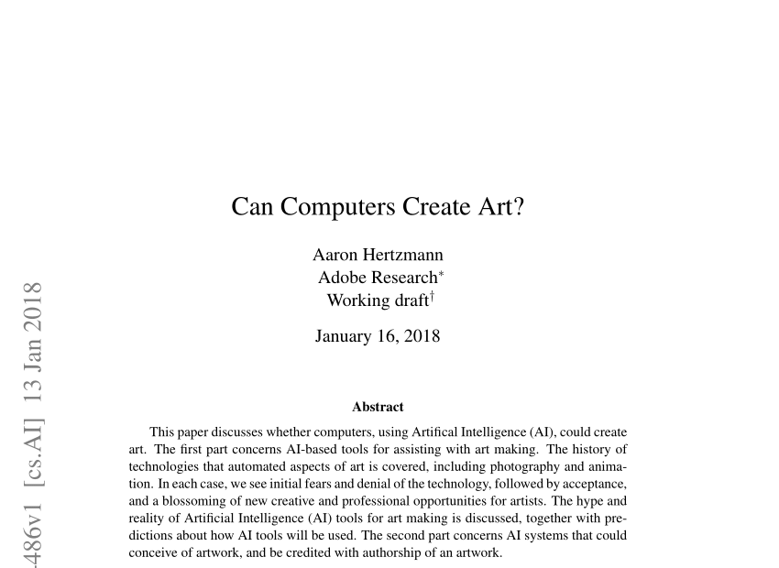
New technology begets fear

Slide 22
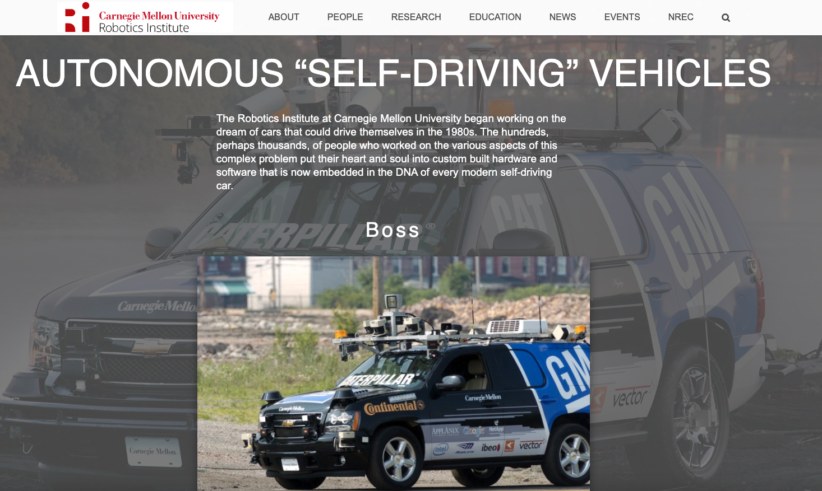
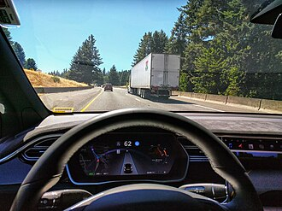
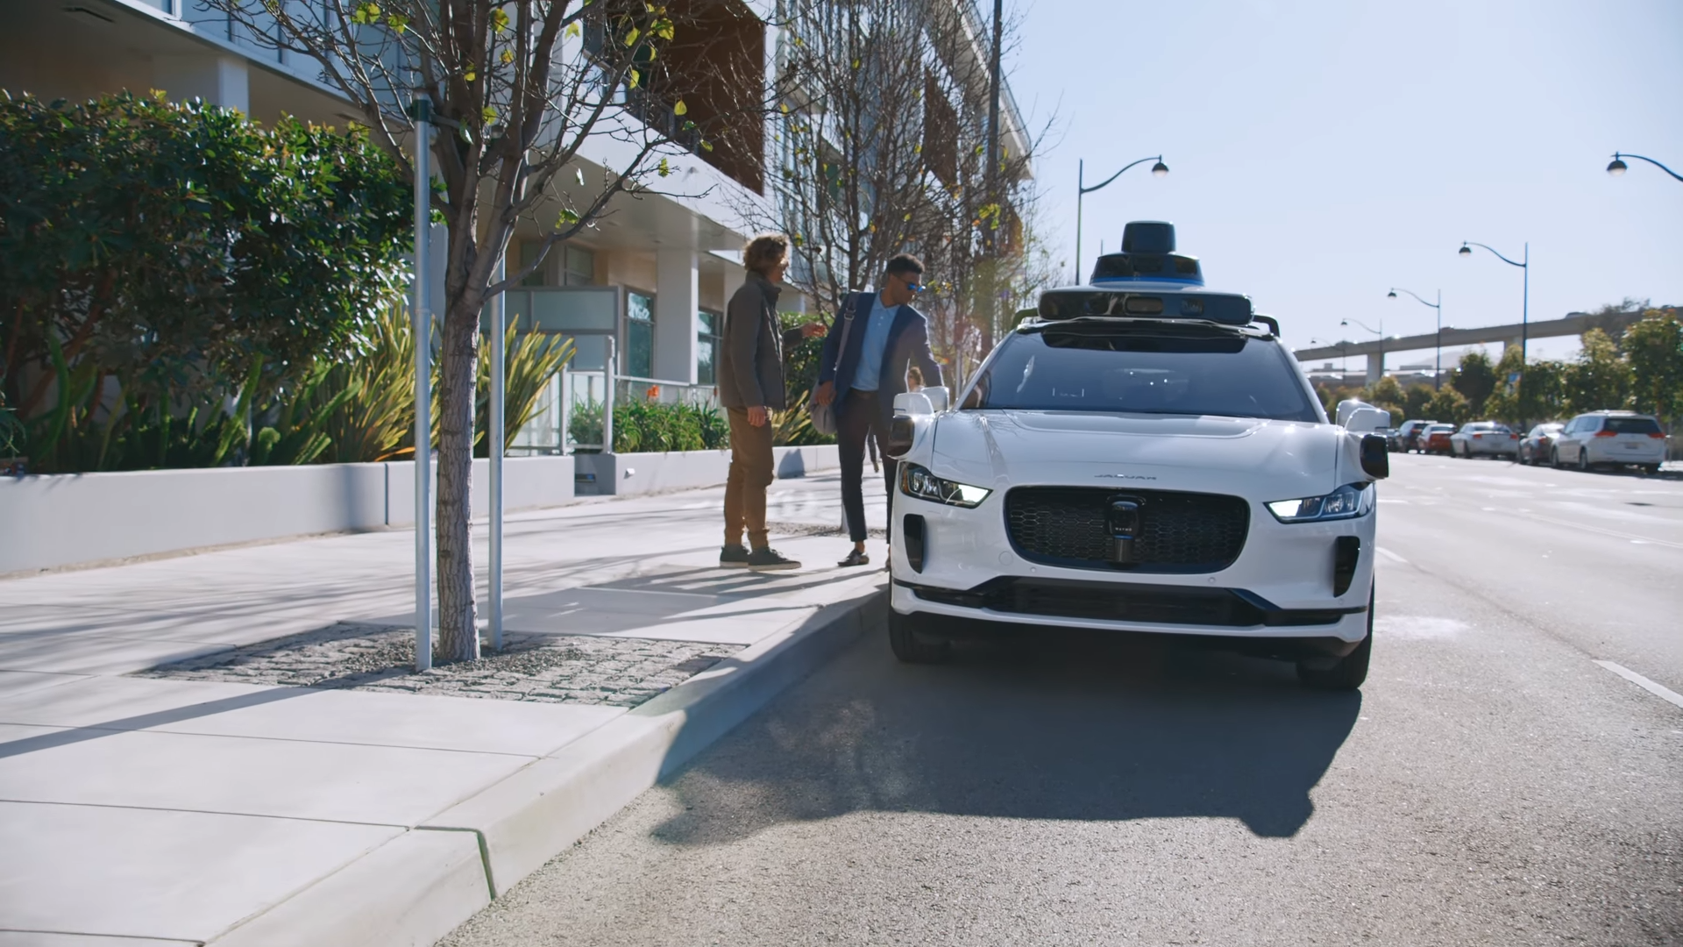
At the end of the day, vision is for doing

Slide 23
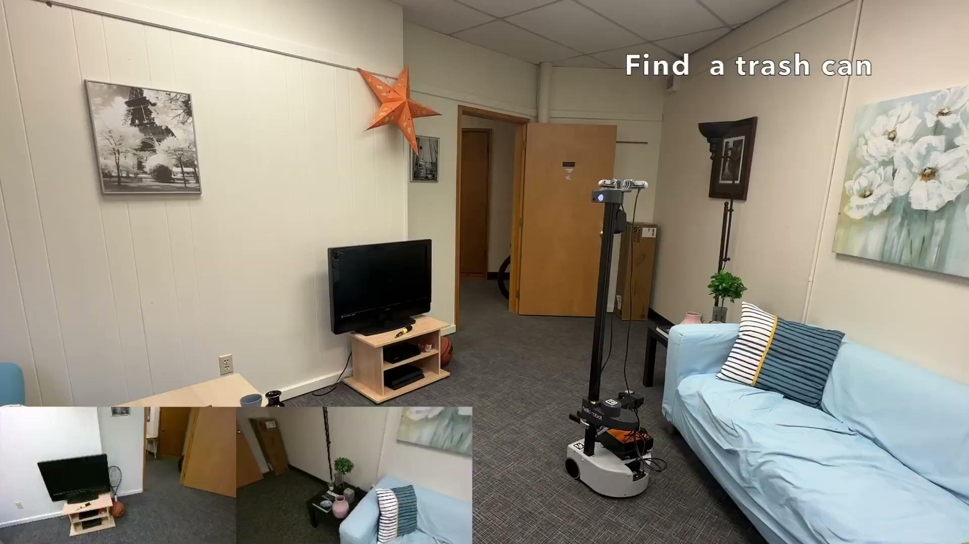
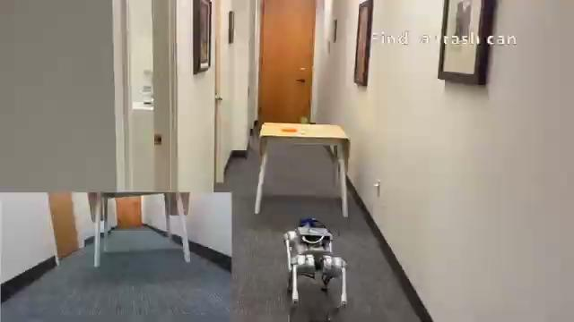
At the end of the day, vision is for doing
UW x AI2 research controls multiple robot embodiments [Link to paper]

Slide 24
Robots and agents powered by vision
have often been depicted by popular media

Slide 25
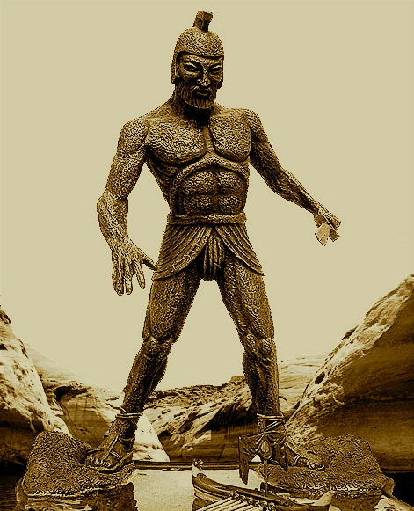

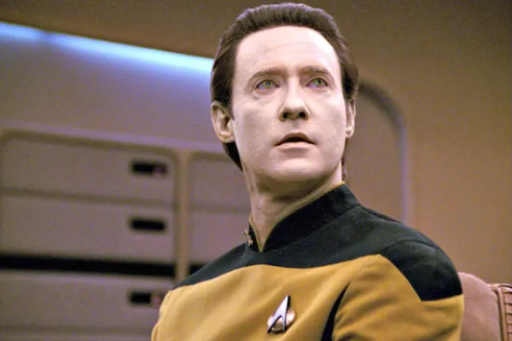
Depictions of AI: Myths and Stories
Legend of Talos Adrienne Mayor, Gods and Robots
R. U. R. (1920)
Data in Star Trek (1987)
Notes:
And why popular culture is important – it drives expectations about what AI systems are and how to interact with them.

Slide 26
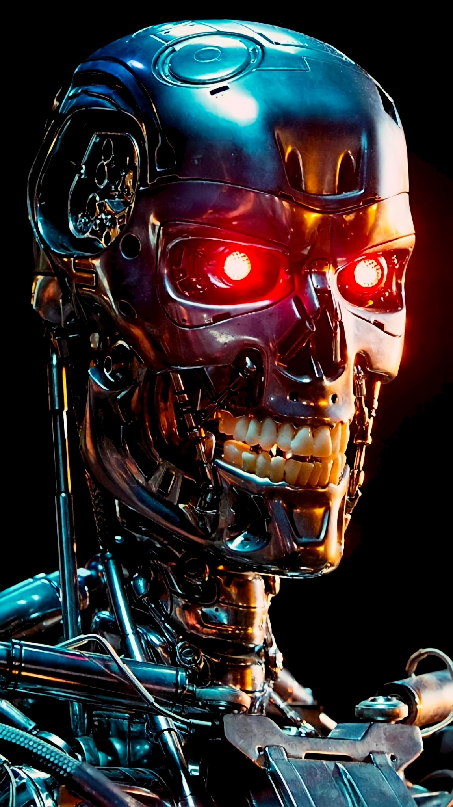

I’m sorry, Dave.
I’m afraid I can’t do that.
1968 1984
Notes:
Somewhere along the way, popular culture began to villionize AI. Perhaps most recognition to today’s generation is HAL, the AI that wanted to kill all the human astronauts and The entire terminator series.
HAL on the left
Terminator on the right

Slide 27

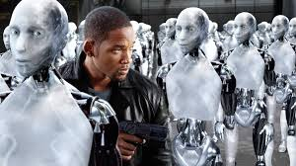




Slide 28
Aside from physics, math, art, popular media,
Computer Vision also draws on fundamental findings in neuroscience

Slide 29
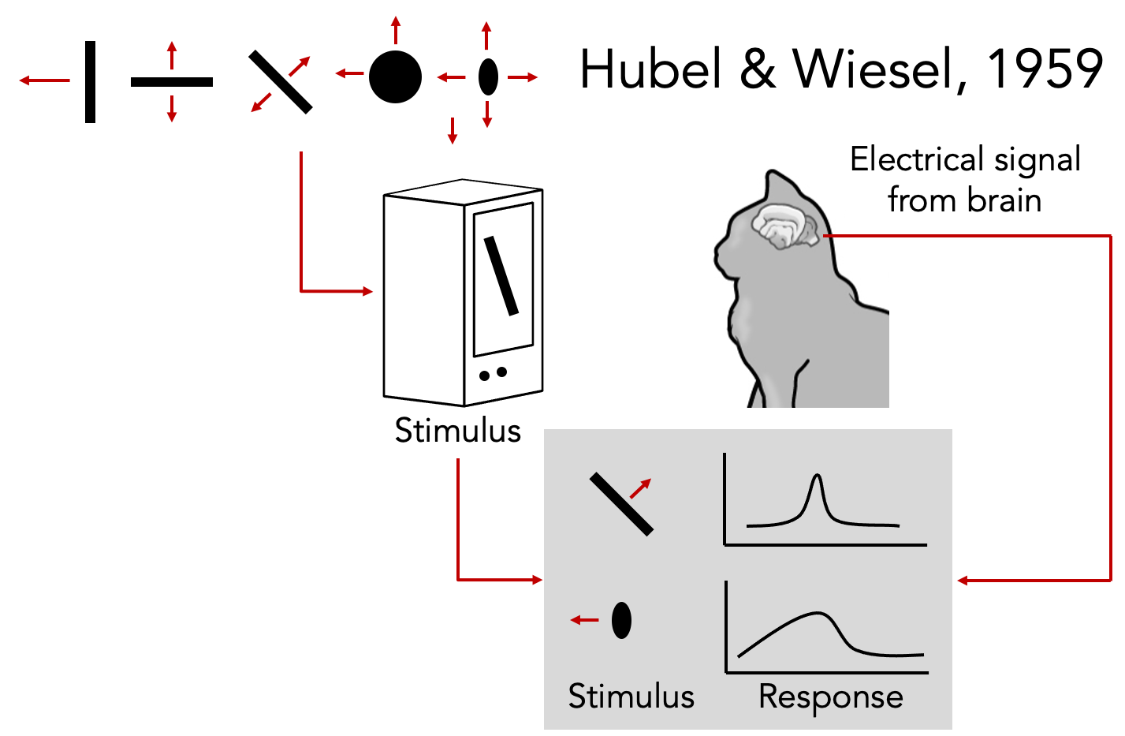
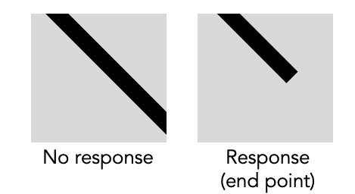
How does animal vision work?
Won Nobel Prize in 1981
Visual processing is hierarchical, involving recognizing simpler structures, edges, etc.
Notes:
Instead of capturing the visual world, scientists began trying to understand how human vision works.
Many neuroscientists were at the forefront of this research. Two that specifically changed the course of history for computer vision were Hubel and Wiesel.
They wanted to probe and figure out how the brain reacts to different visual stimuli.
But of course, probing the primary visual cortex in a human brain would be too dangerous. But at that time, with the dearth of animal safety laws, Hubel and Wiesel began experimenting with cats.
They opened up a cat’s brain and stuck some electrical probes in there. They showed the cat many different visual stimuli. What would you show a cat? Showed birds, fish, mouse, But nothing worked.
Anecdote about lunch time - how removing the piece of paper with the stimuli caused the neurons to spike
Beginning of visual processing is not recognizing whole objects, instead just tiny simple structures, like edges, and smaller parts
Won Nobel Prize in Medicine in 1981

Slide 30

Human vision is superbly efficient
Potter, Biederman, etc. 1970s
Notes:
Task:
Can u detect a person?
100 ms per frame,
Never seen the picture, do not know the person
Can do effortlessly

Slide 31

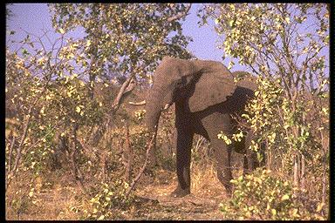

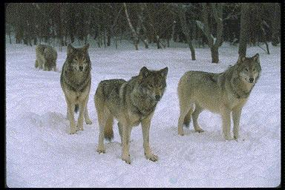




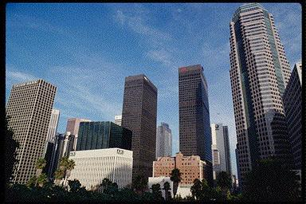

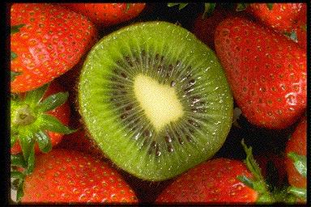
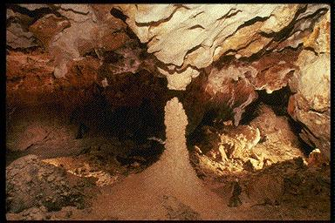
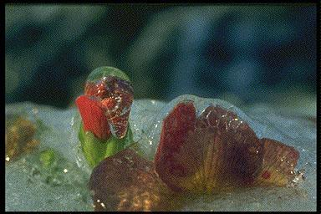
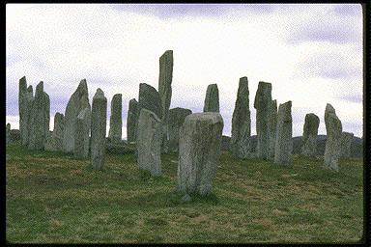
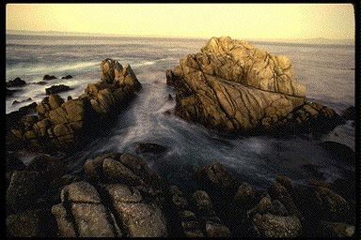
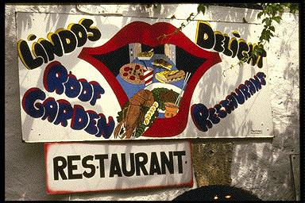
Thorpe, et al. Nature, 1996
Notes:
27ms flash
Very complex pictures – multiple animals, city, textures, etc
Unlike circles in simple background
Task:
Animal vs non animal
Humans do 97%
The most remarkable is next slide

Slide 32
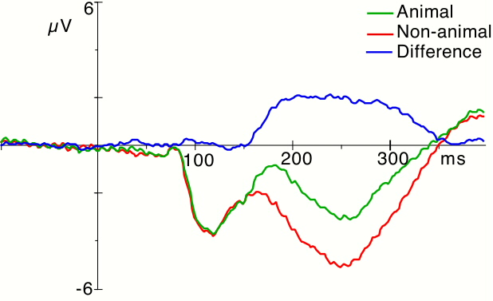
150 ms !!
Thorpe, et al. Nature, 1996
Notes:
Measure brain EEG (electric potential)
Y, voltage /activity
X, 0 is onset from picture
Average all the trials where there is an animal
Red is non animal
Blue is difference
150ms

Slide 33
Aside from physics, math, art, popular media, neuroscience
Computer Vision is also influenced by cognitive science explorations

Slide 34
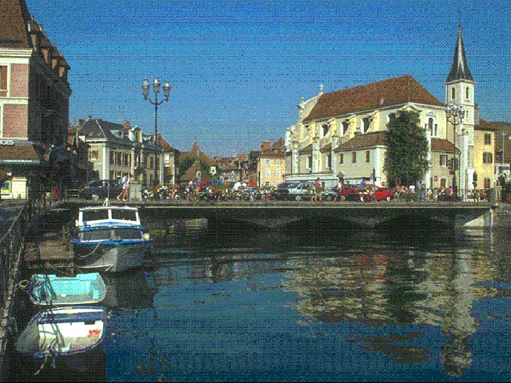
Change Blindness
Rensink, O’regan, Simon, etc.
Notes:
Brain is amazing, but is not remarkable not all the time
Two alternating pictures, repeated, different by one thing
Raise when you see it
This one is easy, try another one

Slide 35

Change Blindness
Rensink, O’regan, Simon, etc.
Notes:
The signal is in your eyes,
Brain decides to ignore it. Does not process it

Slide 36
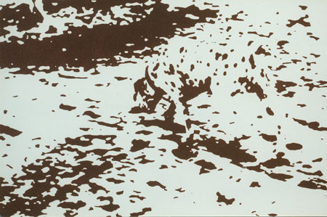
camouflage

Slide 37
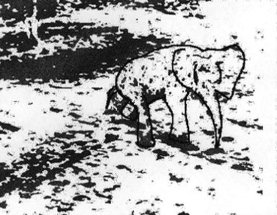
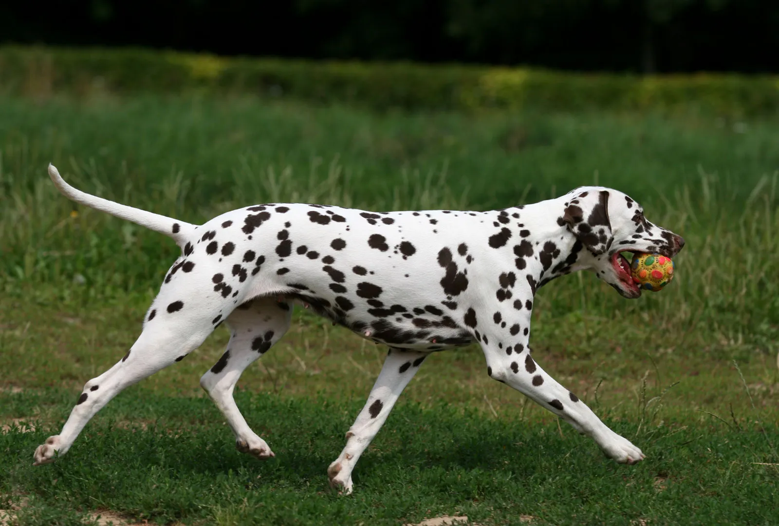
camouflage
Notes:
Dalmatian

Slide 38
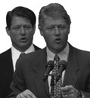
Who are these two people?
Notes:
not clinton and al gore but two clintons

Slide 39
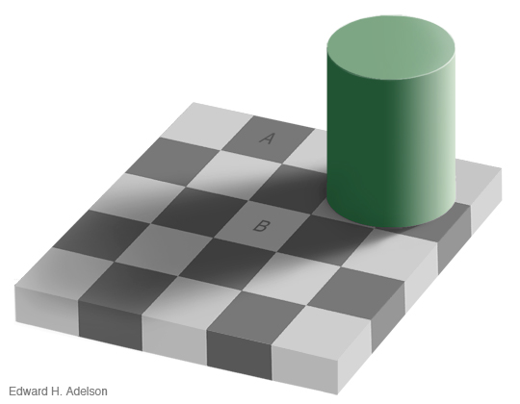

Slide 40
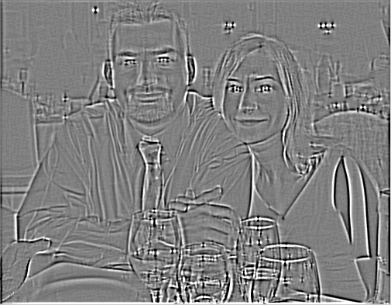
Motion without movement

Slide 41

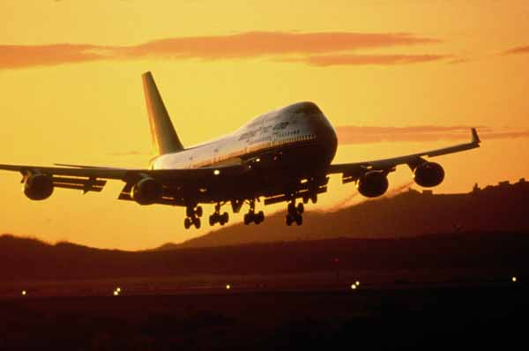
Common theme in computer vision: which parts of human vision are necessary for intelligent systems?

Slide 42


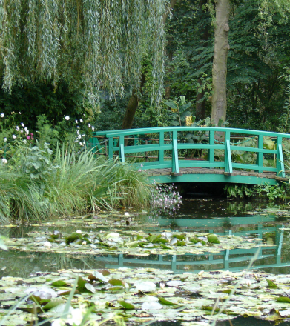


So, what is computer vision?
Sensing device
Interpreting device
Interpretations
Image (or video)
garden, spring,
bridge, water,
trees, flower,
green, etc.

Slide 43
Today's agenda
History of understanding perception
Introduction to computer vision
Course overview

Slide 44
Today's agenda
History of understanding perception
Introduction to computer vision
Course overview

Slide 45

The goal of computer vision: convert light into meaning

Slide 46


MIT thought that computer vision would be solved as an undergraduate summer project
Let’s connect camera with the computer and do something with it in the summer
L. G. Roberts, Machine Perception of Three Dimensional Solids, Ph.D. thesis, MIT Department of Electrical Engineering, 1963.
Prof. Marvin Minsky (MIT)
Prof. Gerald Jay Sussman (MIT)

Slide 47

MIT thought that computer vision would be solved as an undergraduate summer project
"The primary goal of the project is to construct a system of programs which will divide a [...] picture into regions such as likely objects, likely background areas and chaos."
"The final goal is OBJECT IDENTIFICATION which will actually name objects by matching them with a vocabulary of known objects."
L. G. Roberts, Machine Perception of Three Dimensional Solids, Ph.D. thesis, MIT Department of Electrical Engineering, 1963.

Slide 48
What kind of information can we extract from an image?
Semantic information
Geometric 3D information

Slide 49

amusement park
sky
Objects
Activities
Scenes
Locations
Text / writing
Faces
Gestures
Motions
Emotions…
Vision as a source of semantic information
The Wicked Twister
Cedar Point
ride
Ferris wheel
ride
12 E
Lake Erie
water
ride
tree
tree
people waiting in line
people sitting on ride
umbrellas
tree
maxair
carousel
deck
bench
tree
pedestrians

Slide 50

Extracting Semantic
Segment Anything
2023

Slide 51





Extracting geometric information
Real-time stereo
Structure from motion
Reconstruction from Internet photo collections
NASA Mars Rover
Pollefeys et al.
Goesele et al.

Slide 52

Geometric 3D information from 2D images
TRI & GATech’s ShaPO (ECCV’22): https://zubair-irshad.github.io/projects/ShAPO.html

Slide 53

But why is computer vision so hard?
It is an ill posed problem

Slide 54


Computers need to convert pixel intensities into meaning
What we see
What a computer sees

Slide 55




























Why study computer vision?
Vision is useful: Images and video are everywhere!
Personal photo albums
Movies, news, sports
Medical and scientific images

Slide 56
80% of all web traffic is images and videos Majority of the internet is dark matter without computer vision
Notes:
Dark matter makes up most of the mass of galaxies and galaxy clusters, and is responsible for the way galaxies are organized on grand scales.

Slide 57




Special effects: shape and motion capture

Slide 58




Special effects: shape and motion capture

Slide 59


3D urban modeling
Google Streetview - custom campus tours

Slide 60

3D urban modeling: Microsoft Photosynth
http://photosynth.net

Slide 61

Face detection
Many digital cameras now detect faces
Canon, Sony, Fuji, and your phones…
Source: S. Seitz
Notes:
Why would this be useful? Main reason is focus. Also enables “smart” cropping.

Slide 62



Different detections
Selfie with palm (Samsung)
Sony Cyber-shot® T70 Digital Still Camera
Source: S. Seitz
Notes:
Take a picture in the perfect moment

Slide 63

Image Search

Slide 64



Biometrics
Fingerprint scanners on many new laptops, other devices
iPhone Face ID

Slide 65




Biometrics
How the Afghan Girl was Identified by Her Iris Patterns

Slide 66


Optical character recognition (OCR)
Technology to convert scanned docs to text
If you have a scanner, it probably came with OCR software
Digit recognition, AT&T labs
License plate readers
http://en.wikipedia.org/wiki/Automatic_number_plate_recognition

Slide 67

Google maps: Annotate all houses and streets
Goodfellow et al. 2014

Slide 68



Vision-powered toys and robots in the 2000s

Slide 69



Vision-powered toys and robots in the 2020s
Scout home security robot - monitors your house
Unitree Go1’s companion robot - like a dog

Slide 70


Augmented Reality

Slide 71


Notes:
Style.ai

Slide 72



Apple Vision Pro, Snapstacles and Meta Quest

Slide 73


Virtual Reality

Slide 74

Self-Driving cars
Source: A. Shashua, S. Seitz

Slide 75


Slide 76

Self-Driving cars
Mobileye: Vision systems in high-end BMW, GM, Volvo models
Claimed that they would release self-driving cars by 2015.
Finally, 2026 with Lyft at Dallas
Source: A. Shashua, S. Seitz

Slide 77

Vision in supermarkets
LaneHawk by EvolutionRobotics
(acquired by iRobot for $74M in 2012)
“A smart camera is flush-mounted in the checkout lane, continuously watching for items. When an item is detected and recognized, the cashier verifies the quantity of items that were found under the basket, and continues to close the transaction. The item can remain under the basket, and with LaneHawk, you are assured to get paid for it… “
Source: S. Seitz

Slide 78
Amazon Go

Slide 79

Vision for robotics, space exploration
NASA'S Mars Exploration Rover Spirit captured this westward view from atop a low plateau where Spirit spent the closing months of 2007.
Vision systems (JPL) used for several tasks
Panorama stitching
3D terrain modeling
Obstacle detection, position tracking
For more, read “Computer Vision on Mars” by Matthies et al.
Source: S. Seitz

Slide 80
Question for you
Most unexpected uses of computer vision:
https://bit.ly/4s8Bv3U

Slide 81
How should you make sense of computer vision as a field?
Let’s situate computer vision in the broader context of AI
I want to change your conception of computer vision is

Slide 82
Artificial Intelligence

Slide 83
Artificial Intelligence
Machine learning

Slide 84
Artificial Intelligence
Machine learning
Deep Learning

Slide 85
Artificial Intelligence
Machine learning
Computer vision
Deep Learning
Natural language processing

Slide 86
Artificial Intelligence
Robotics
Machine learning
Computer vision
Deep Learning
Natural language processing
Speech recognition

Slide 87
CSE 455 course
Artificial Intelligence
Robotics
Machine learning
Computer vision
Deep Learning
Natural language processing
Speech recognition

Slide 88
CSE 455 course
Artificial Intelligence
Robotics
Machine learning
Computer vision
Deep Learning
455 will prepare you with broad fundamental tools for vision
Natural language processing
Speech recognition

Slide 89

Computer Vision and Pattern Recognition Conference (CVPR)
https://cvpr.thecvf.com/

Slide 90

Computer Vision and Pattern Recognition Conference (CVPR)
https://cvpr.thecvf.com/

Slide 91

Why should you go to CVPR? It is ranked #4 amongst all scientific publications across all disciplines
Source: Google scholar

Slide 92
Biology
Psychology
Neuroscience
Physics
optics
Cognitive
sciences
Computer
Vision
Image
processing
Algorithms,
theory,…
Computer Science
Speech, NLP
Systems,
architecture, …
Robotics
Information
retrieval
Engineering
Machine
learning
Mathematics
Art

Slide 93

CVPR has seen a large number of deep learning people enter

Slide 94



https://arxiv.org/pdf/2304.06035.pdf
https://vision.soic.indiana.edu/papers/affective2021cvpr.pdf

Slide 95

Workshops in 2023 in response
https://sites.google.com/view/academic-cv/
https://gkioxari.github.io/Tutorials/iccv2023/

Slide 96


2018

Slide 97
Decade by decade
1960s: Image processing and pattern recognition, blocks world
1970s: Key recovery problems defined: structure from motion, stereo, shape from shading, color constancy. Attempts at knowledge-based recognition
1980s: Fundamental and essential matrix, multi-scale analysis, corner and edge detection, optical flow, geometric recognition as alignment
1990s: Multi-view geometry, statistical and appearance-based models for recognition, first approaches for (class-specific) object detection
2000s: Local features, generic object recognition and detection
2010s: Deep learning, big data
Adapted from J. Malik

Slide 98

CVPR is a lot more than just deep learning and recognition - what CSE455 will cover

Slide 99
What would be covered in CSE493G1 deep learning course

Slide 100
Question for you
Future breakthrough uses of computer vision
https://bit.ly/4sHDtJj

Slide 101
Today's agenda
History of computer vision
Introduction to computer vision
Course overview

Slide 102
Course staff (Office hours coming soon)

Slide 103
Class times
Lectures
Tue/Thurs 11:30am
Recitations
Friday TBD
come to the recitation!

Slide 104
Contacting instructor and TAs
All announcements, Q&A in EdStem
https://edstem.org/us/courses/97217/discussion
All course related posts should be public.
All private correspondences to course staff should post private (instructors only) post on EdStem.
Use this for personal problems, and debugging help to avoid showing other people your solutions.
If you have questions that others can benefit from, do a public post.

Slide 105
How to think about CSE455?
Breadth
Computer vision is a huge field
It can impact every aspect of life and society
It is driving the current generative AI revolution
Pixels are everywhere in our lives and cyber space
CSE455 is meant as an broad overview course,
we will not cover all topics of CV
Lectures are mixture of detailed techniques and high level ideas
I want to teach you to speak our “language”
Depth
…

Slide 106
How to think about CSE455?
Breadth
…
Depth
Computer vision is a highly technical field, i.e. know your math!
Master bread-and-butter techniques: face recognition, corners, lines, features, optical flows, clustering and segmentation
Programming assignments: be a good coder AND a good writer
Math problem questions: know your concepts!
Final Exam: your chance to shine!

Slide 107
Syllabus
Official website
https://courses.cs.washington.edu/courses/cse455/26sp/

Slide 108
Grading policy
70%: 5 Assignments.
25%: Final Exam.
5%: Course Participation in Recitations & Class Microquizzes
up to 10%: Extra Credit - in assignments and in final exam.

Slide 109
Why you shouldn’t come here?
Better use your time – your own judgement
I don’t gain much from actively thinking during lectures and synthesizing information on the fly
I’m ok with 5% drop in my grade due to not taking microquizzes

Slide 110
Why you should come here
Zoom & recording may not work
Engaged thinking to answer many questions I pose during lectures
Ask me questions
Micro-quizzes in class are part of your grade

Slide 111
Grading policy - assignments
Most assignments will have an extra credit
Late policy
5 free late days – use them in your ways
Maximum of 2 late days per assignment
Afterwards, 25% off per day late
Collaboration policy
Read the student code book, understand what is ‘collaboration’ and what is ‘academic infraction’
We have links to this on the course webpage
AI tools: write your own answer!

Slide 112
Submitting homeworks
Homeworks will consist of python files with code and jupyter notebooks.
Jupyter notebooks:
Will guide you through the assignments.
Might contain written questions
Once you are done, convert the ipython notebook into a pdf and submit on Gradescope ( https://www.gradescope.com/courses/1010664 ).
Access code: 1010664
Python files:
All code must be submitted to Gradescope as well.
Check our course website for details on submissions.
A0 will be live soon, you can start working on it immediately. We will try and get all the assignments out to you as soon as they are ready.

Slide 113
Final exam
Will contain written questions from the concept covered in class or any questions in the homeworks.
Can require you to solve technical math problems.
Will contain a lot of multiple choice and true-false questions. We will release a practice final towards the end of the quarter.

Slide 114
CSE 455 Roadmap
Pixels
Video
Camera
Segment
ML
Convolutions
Edges
Descriptors
Motion
Tracking
Camera 3D Geometry
Segmentation
Clustering
Detection
Linear Models
(Conv) Neural networks
From Convolutions to Convolutions

Slide 115

Welcome to CSE455
Let's have a fun quarter!

Slide 116
Thanks & Questions?

