Slide 1
Computer Vision
CSE 455
Filters
Linda Shapiro
Professor of Computer Science & Engineering
Professor of Electrical & Computer Engineering

Slide 2
Let’s do something interesting already!!

Slide 3
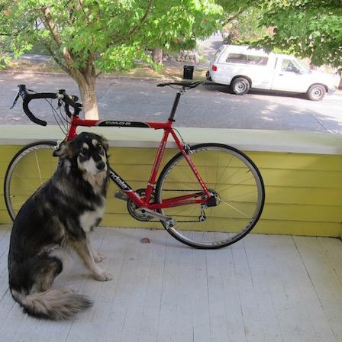
Want to make image smaller

Slide 4

448x448 -> 64x64

Slide 5
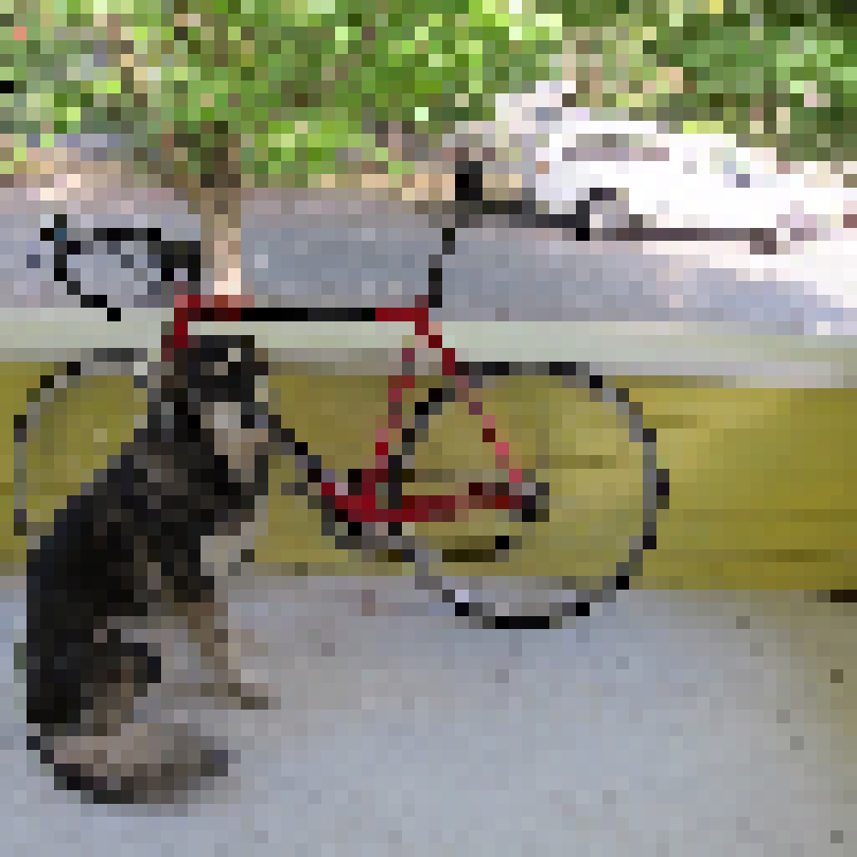
448x448 -> 64x64

Slide 6
448x448 -> 64x64

Slide 7

448x448 -> 64x64

Slide 8
448x448 -> 64x64

Slide 9
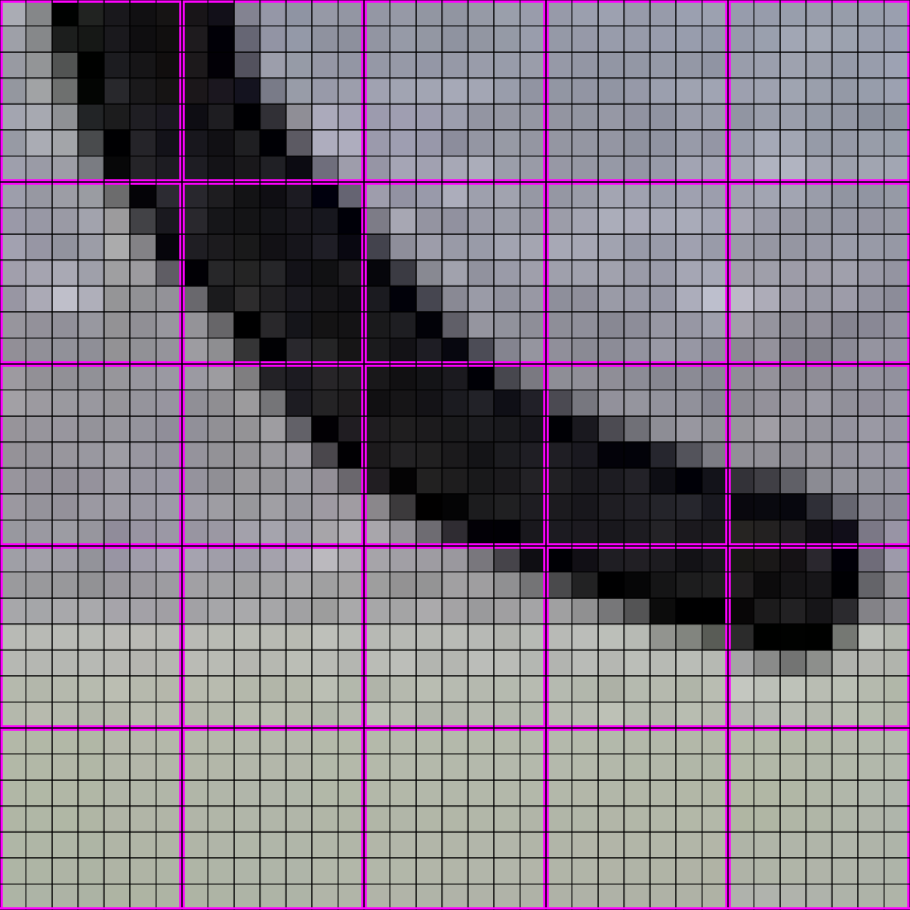
448x448 -> 64x64

Slide 10

448x448 -> 64x64

Slide 11
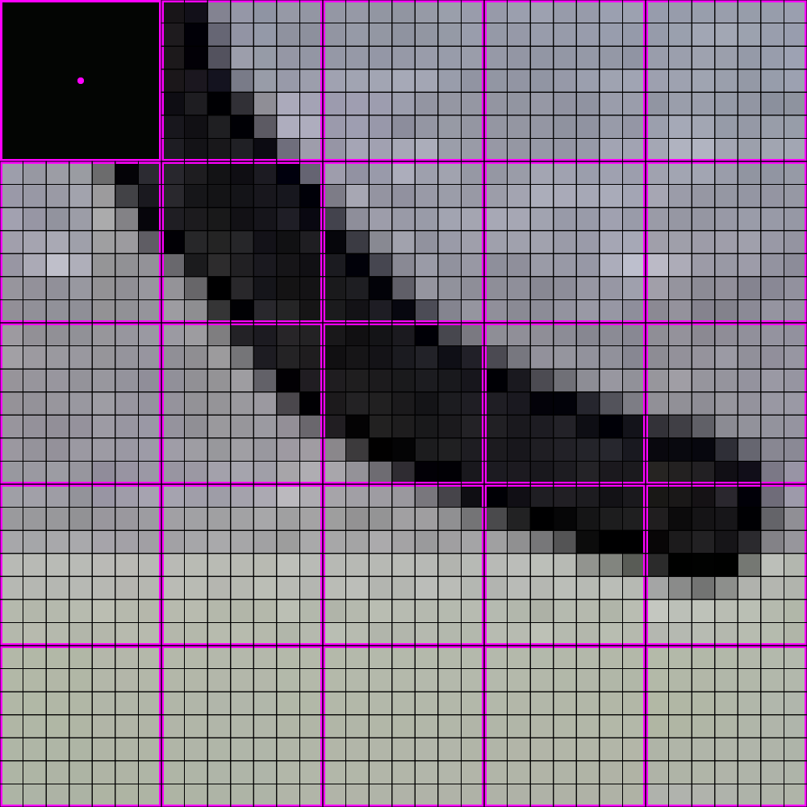
448x448 -> 64x64

Slide 12

448x448 -> 64x64

Slide 13
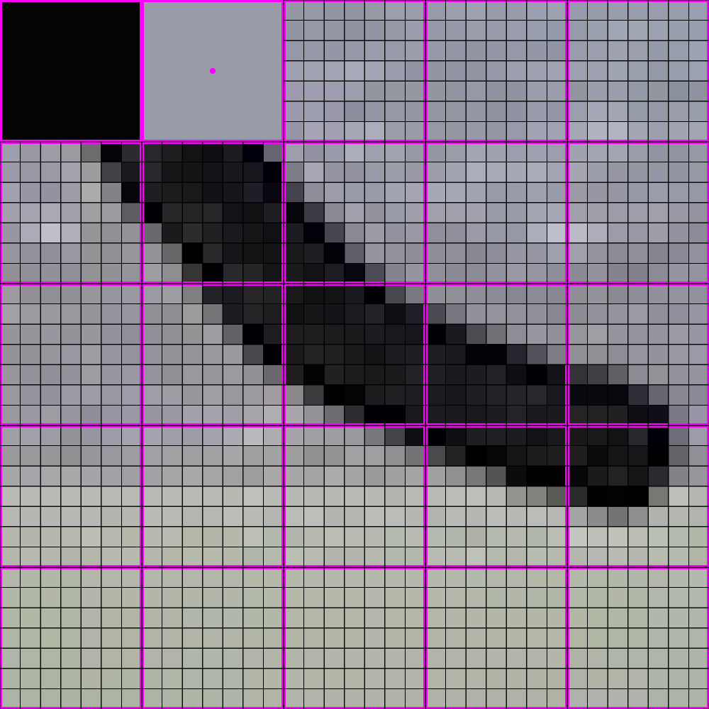
448x448 -> 64x64

Slide 14

448x448 -> 64x64

Slide 15
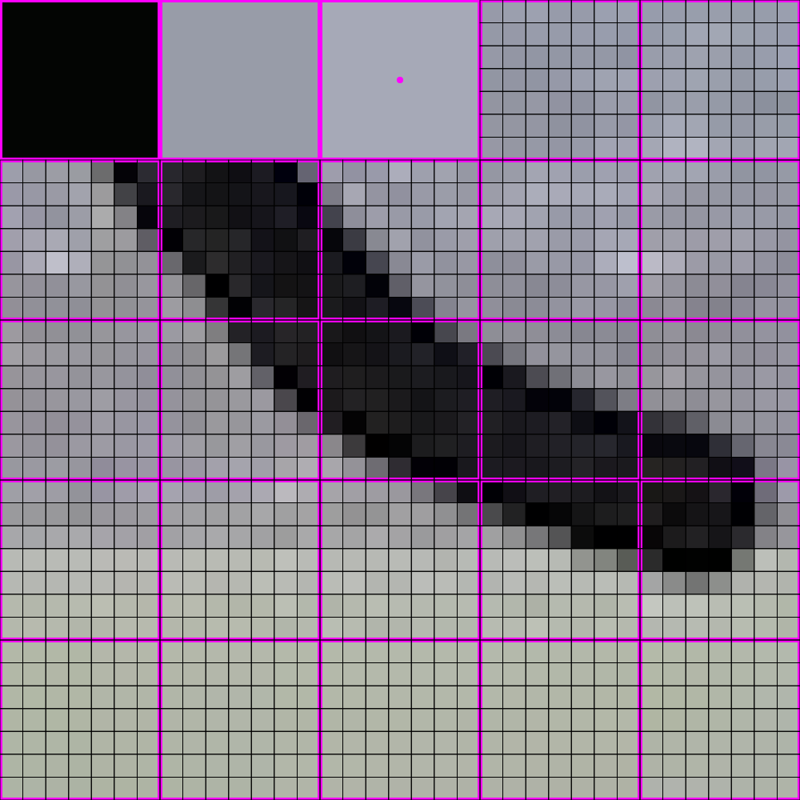
448x448 -> 64x64

Slide 16

448x448 -> 64x64

Slide 17
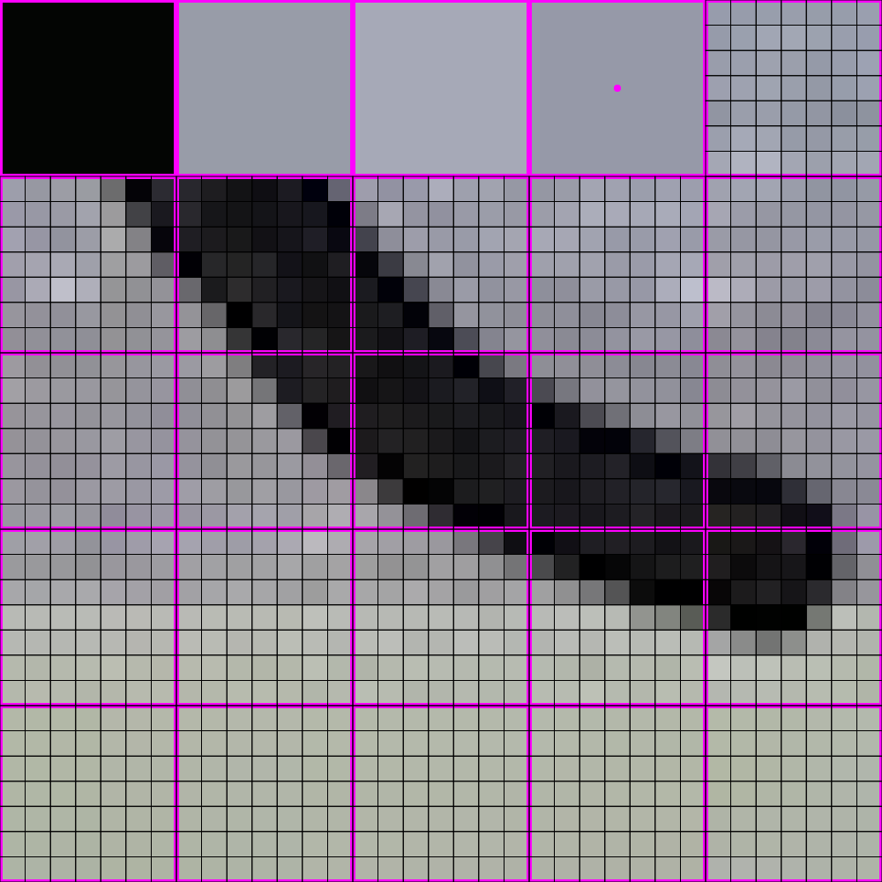
448x448 -> 64x64

Slide 18

448x448 -> 64x64

Slide 19
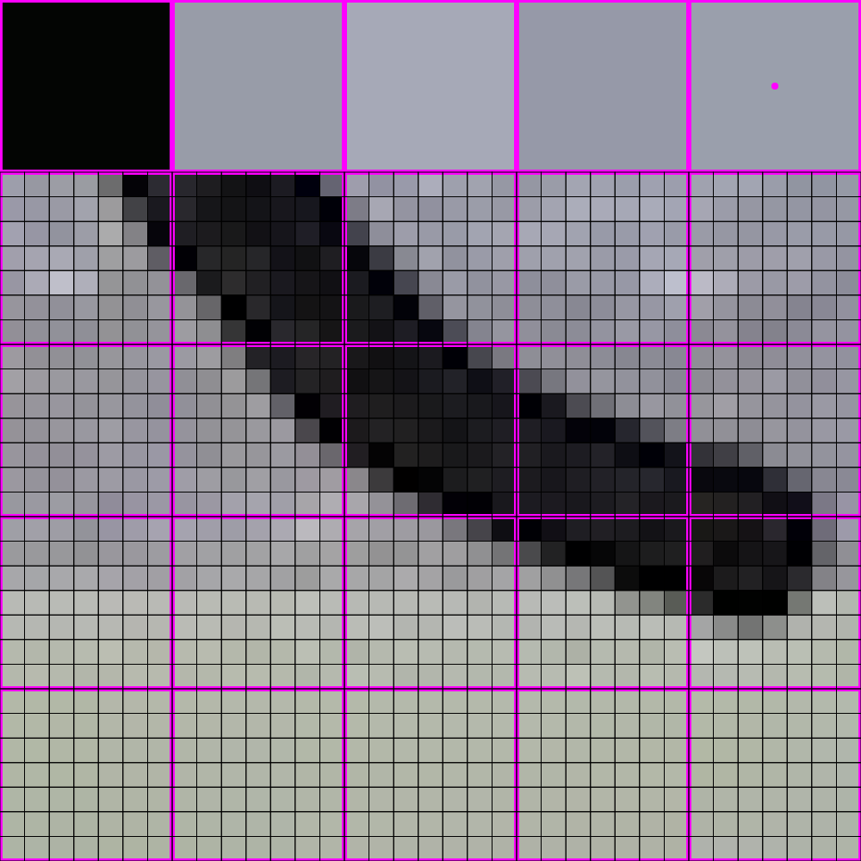
448x448 -> 64x64

Slide 20

448x448 -> 64x64

Slide 21
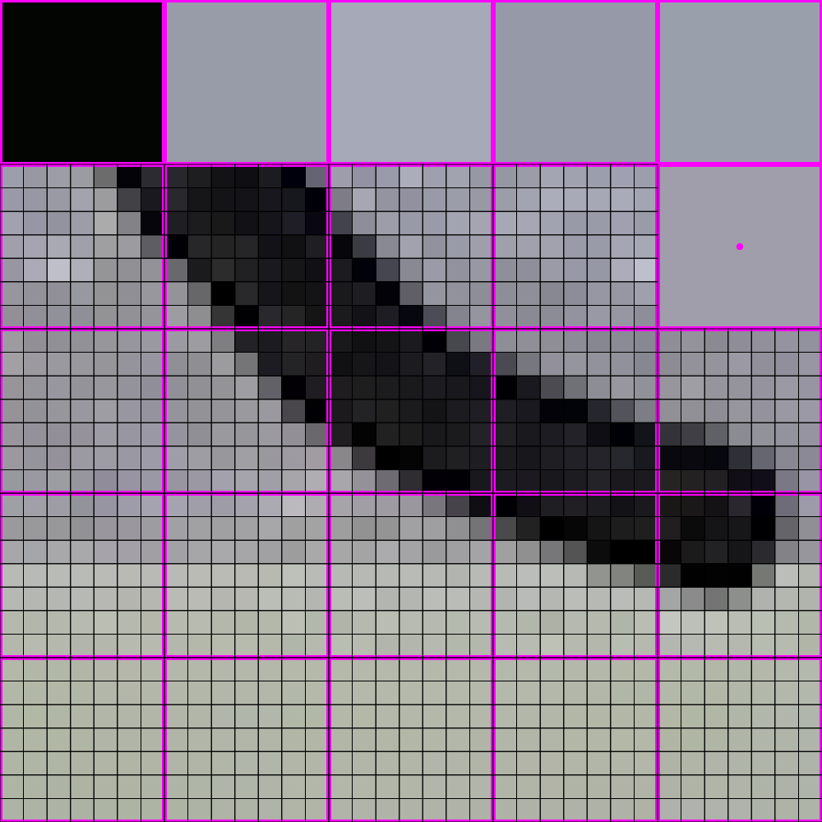
448x448 -> 64x64

Slide 22
448x448 -> 64x64

Slide 23

448x448 -> 64x64

Slide 24
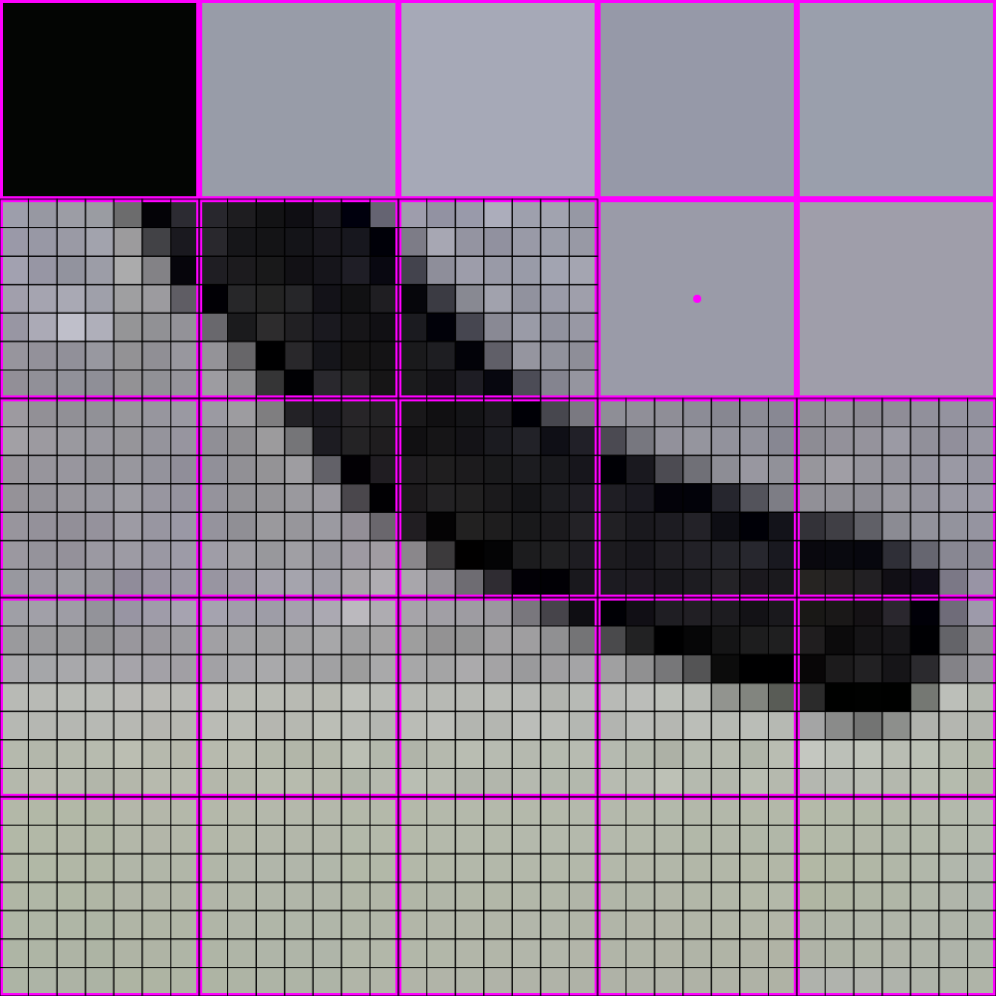
448x448 -> 64x64

Slide 25

448x448 -> 64x64

Slide 26
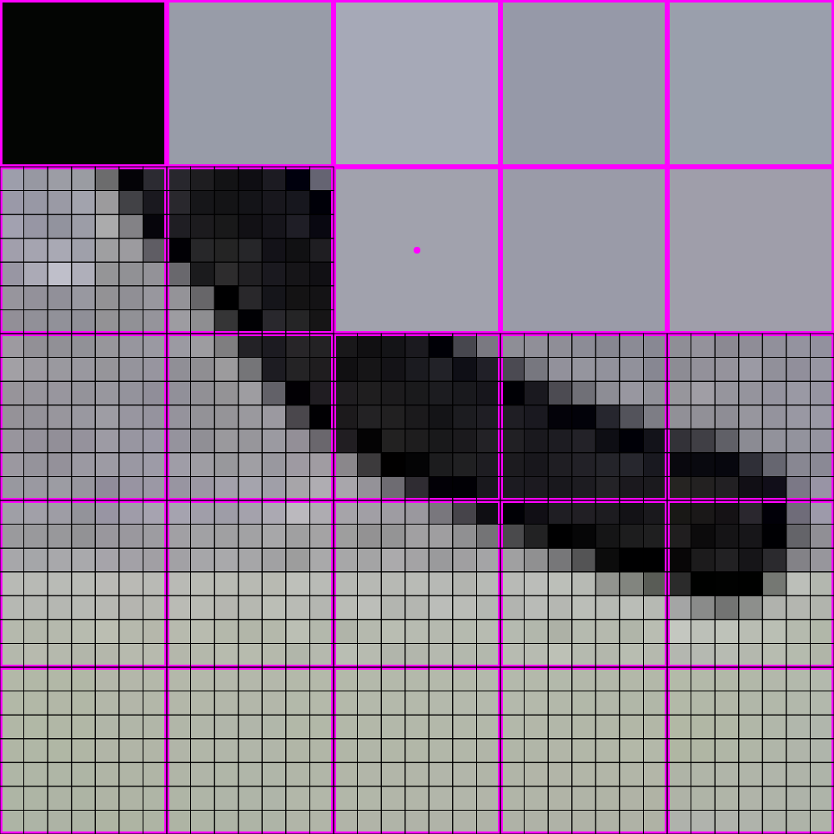
448x448 -> 64x64

Slide 27
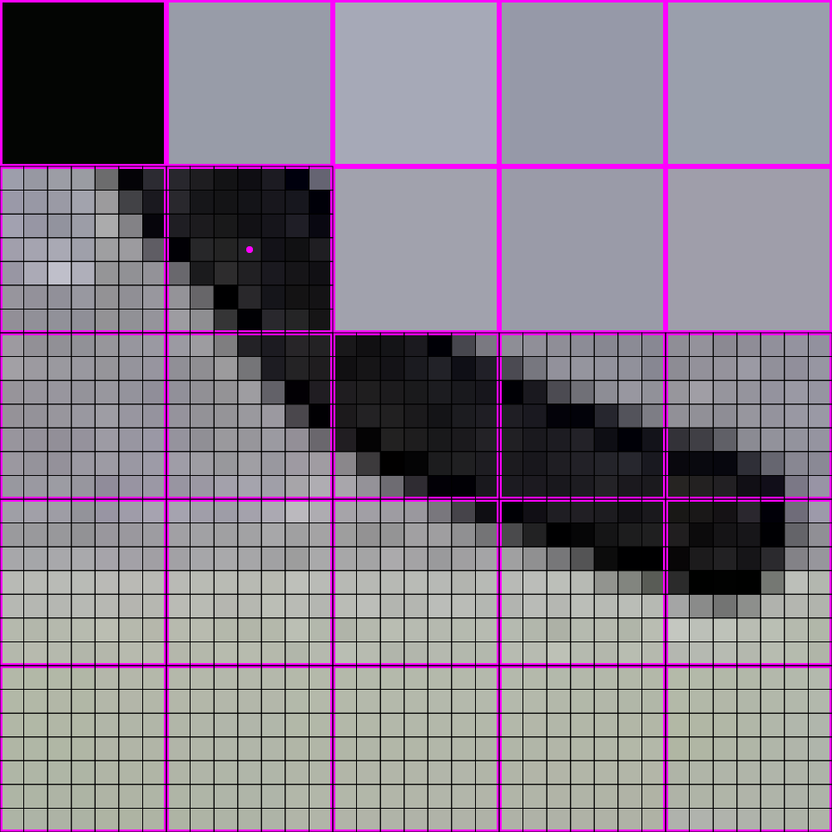
448x448 -> 64x64

Slide 28
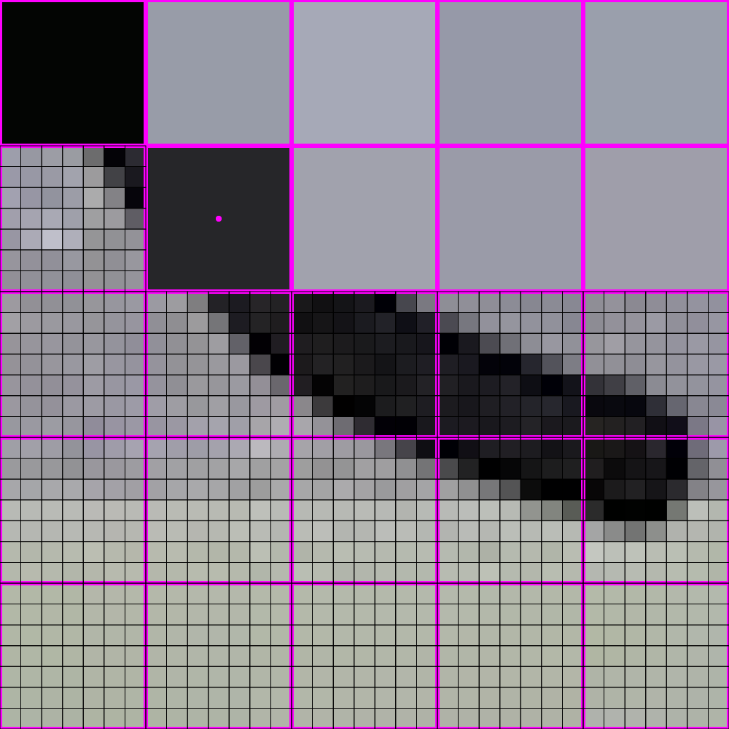
448x448 -> 64x64

Slide 29
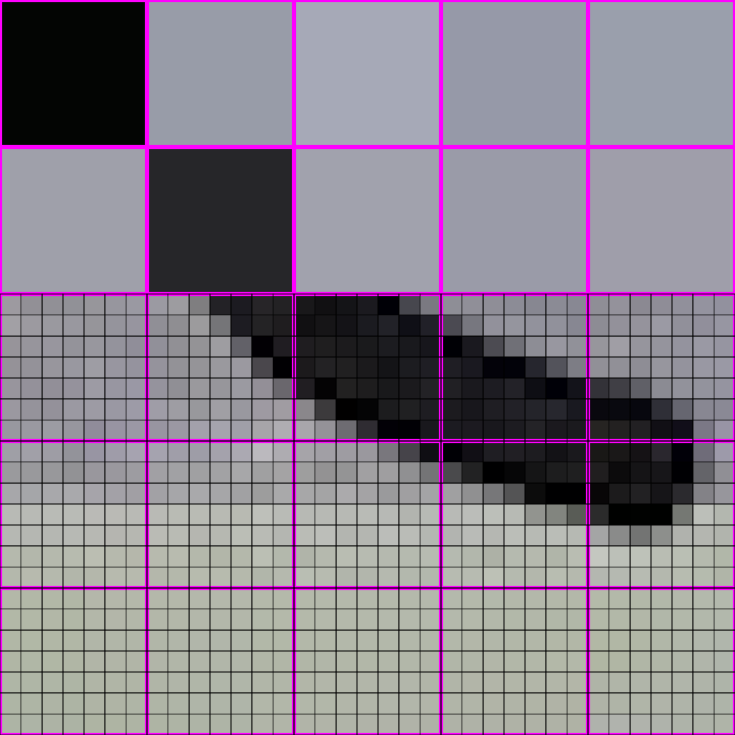
448x448 -> 64x64

Slide 30
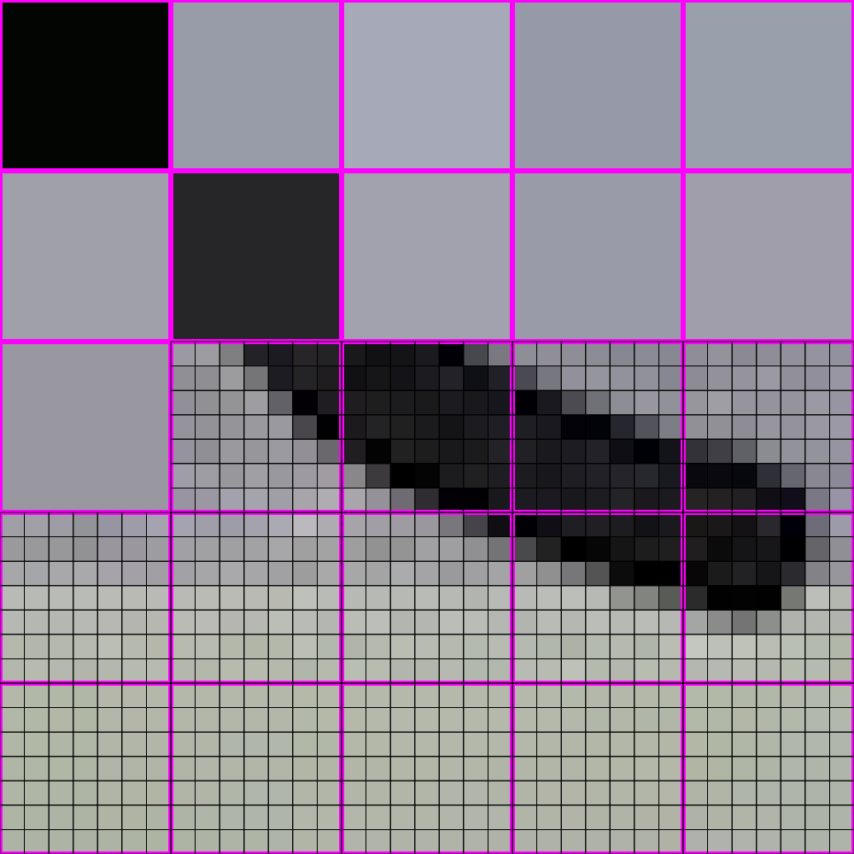
448x448 -> 64x64

Slide 31
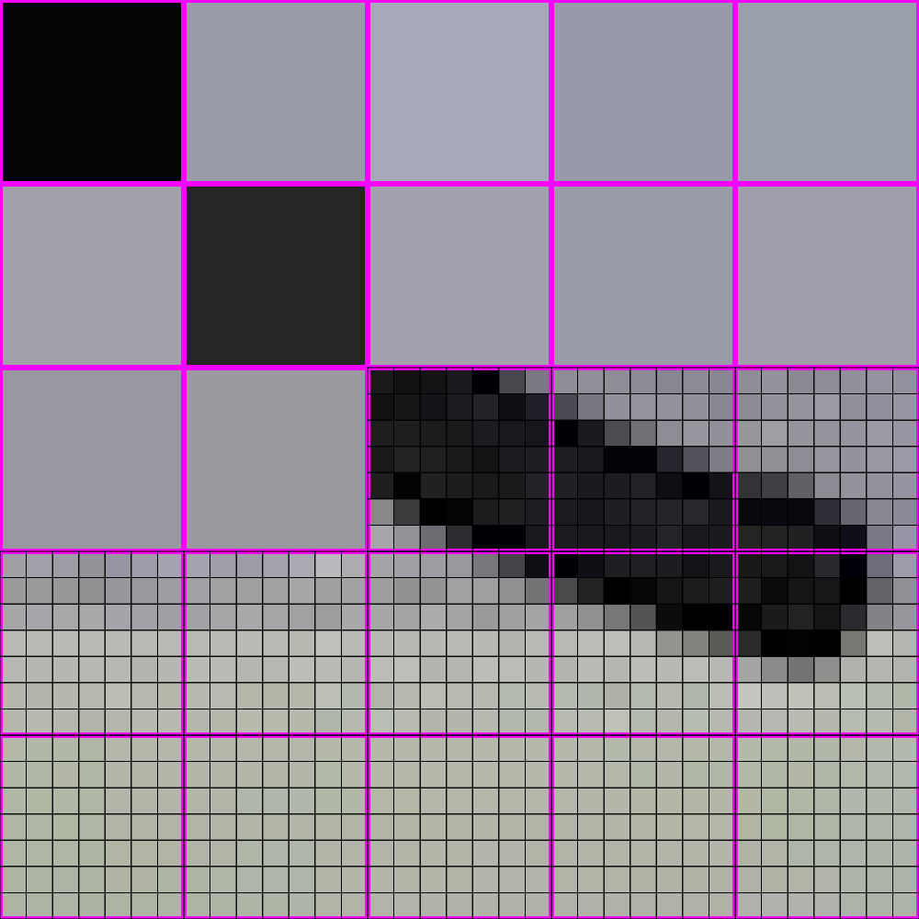
448x448 -> 64x64

Slide 32
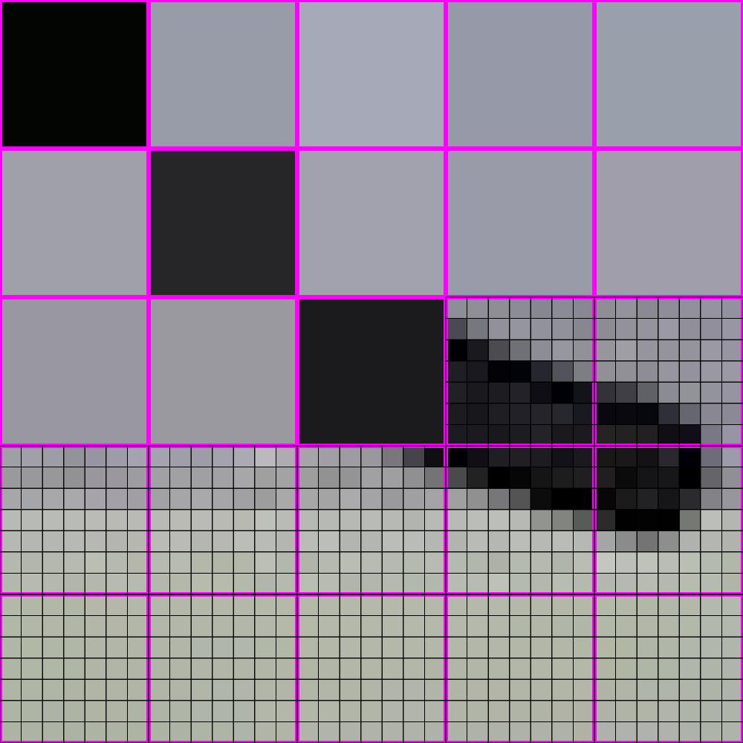
448x448 -> 64x64

Slide 33
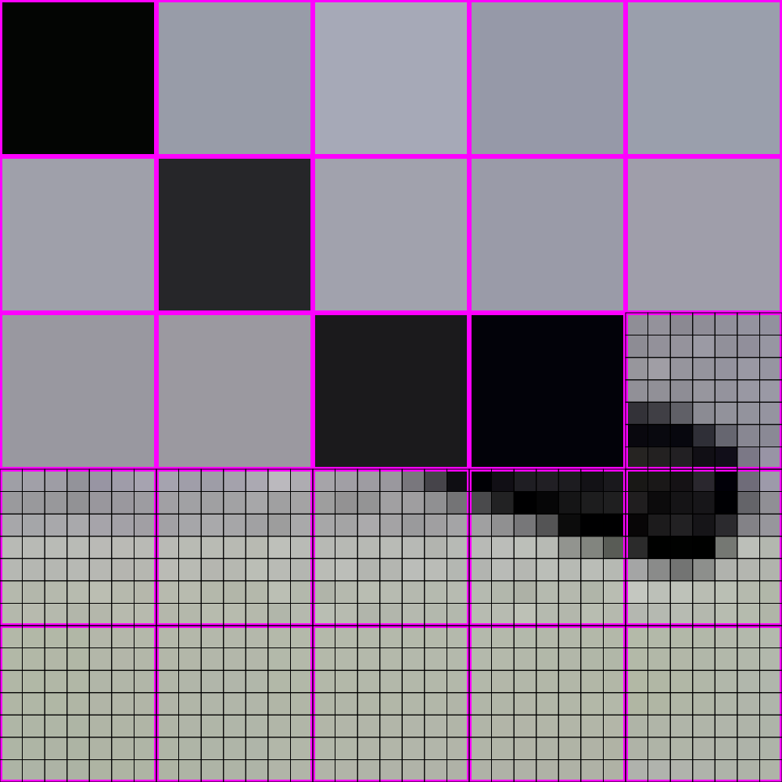
448x448 -> 64x64

Slide 34
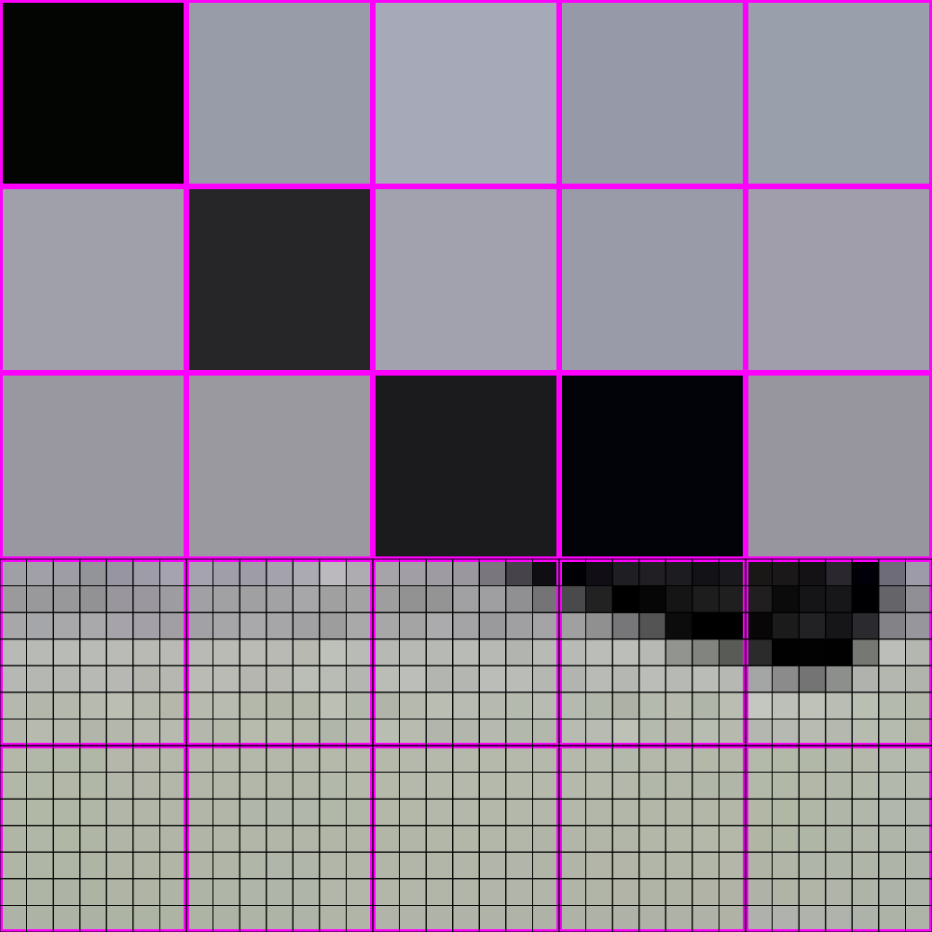
448x448 -> 64x64

Slide 35
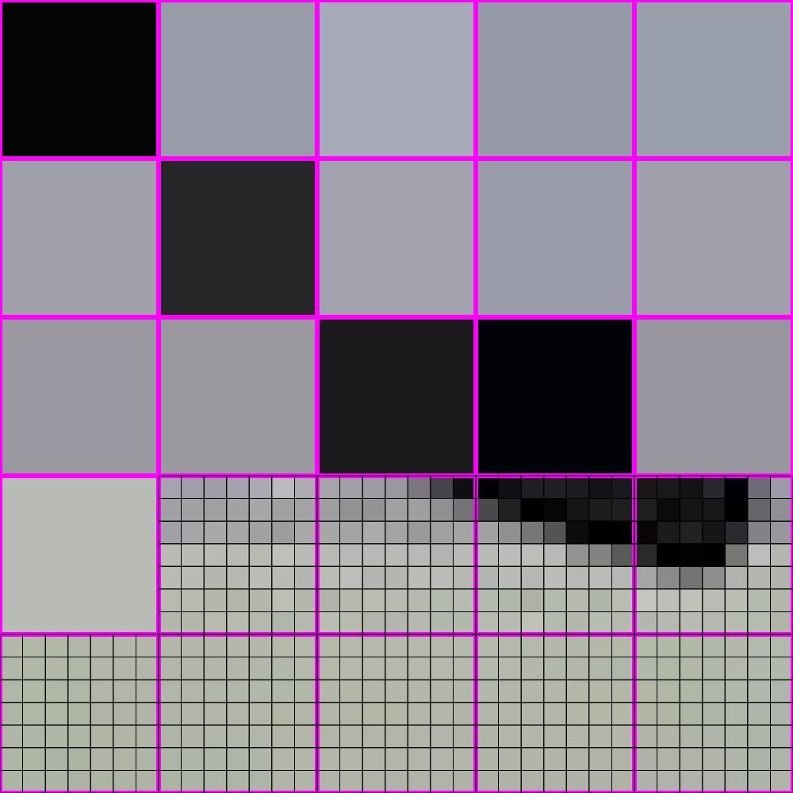
448x448 -> 64x64

Slide 36
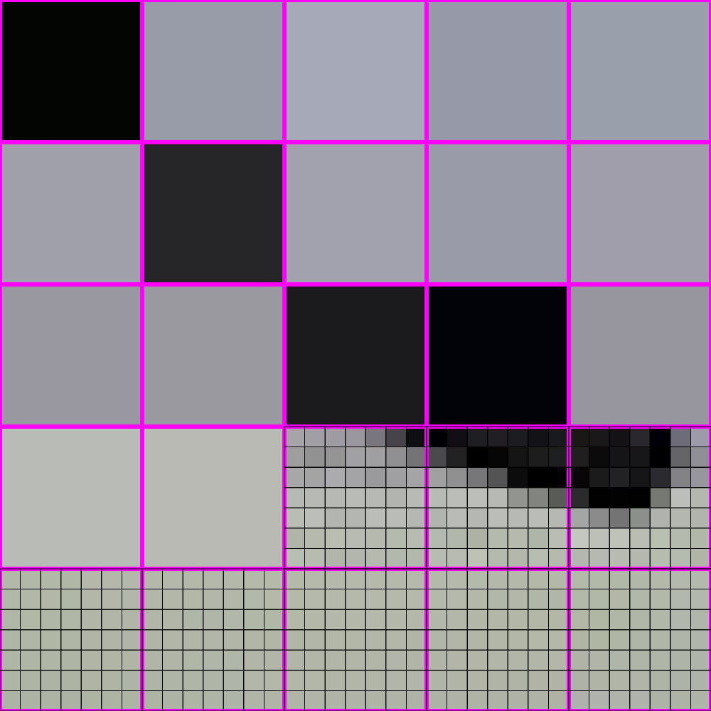
448x448 -> 64x64

Slide 37
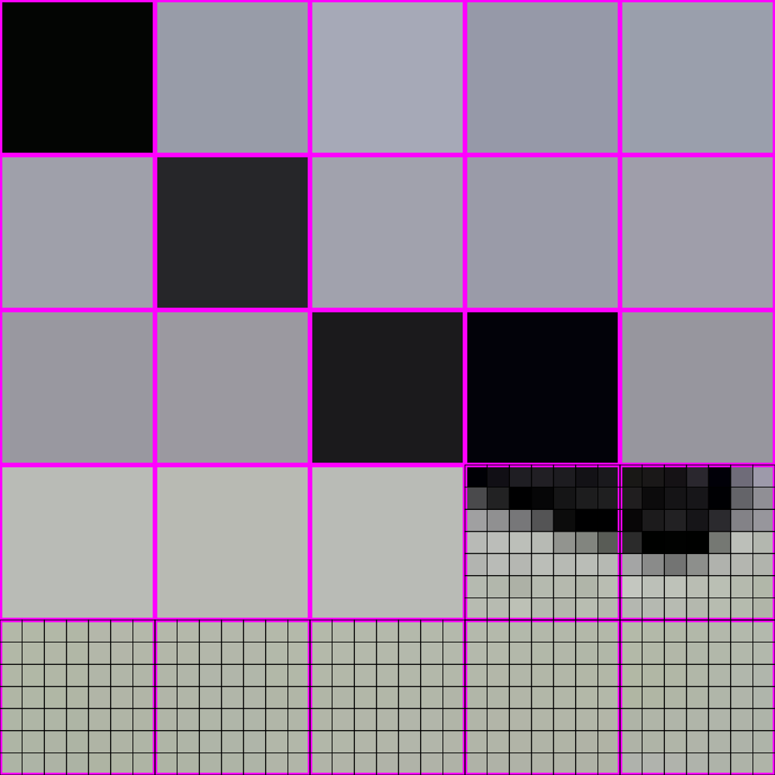
448x448 -> 64x64

Slide 38
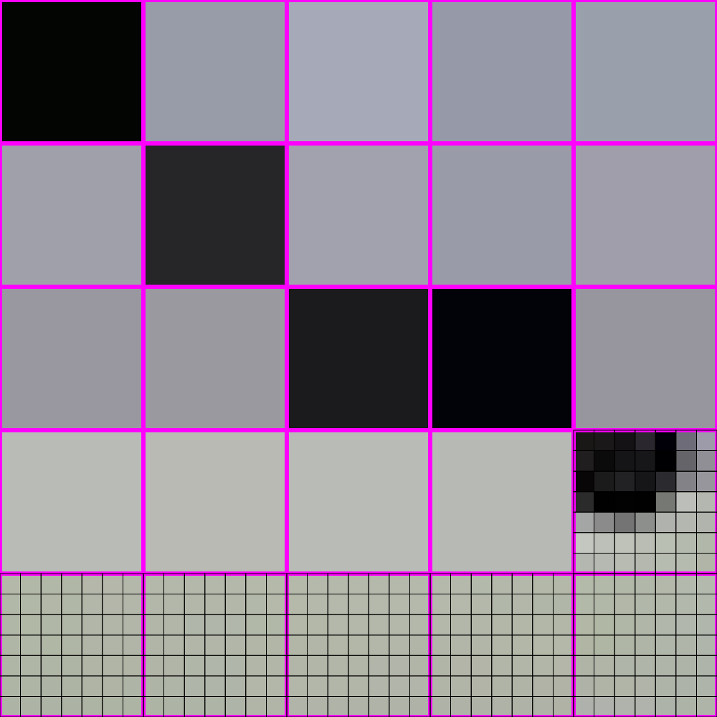
448x448 -> 64x64

Slide 39
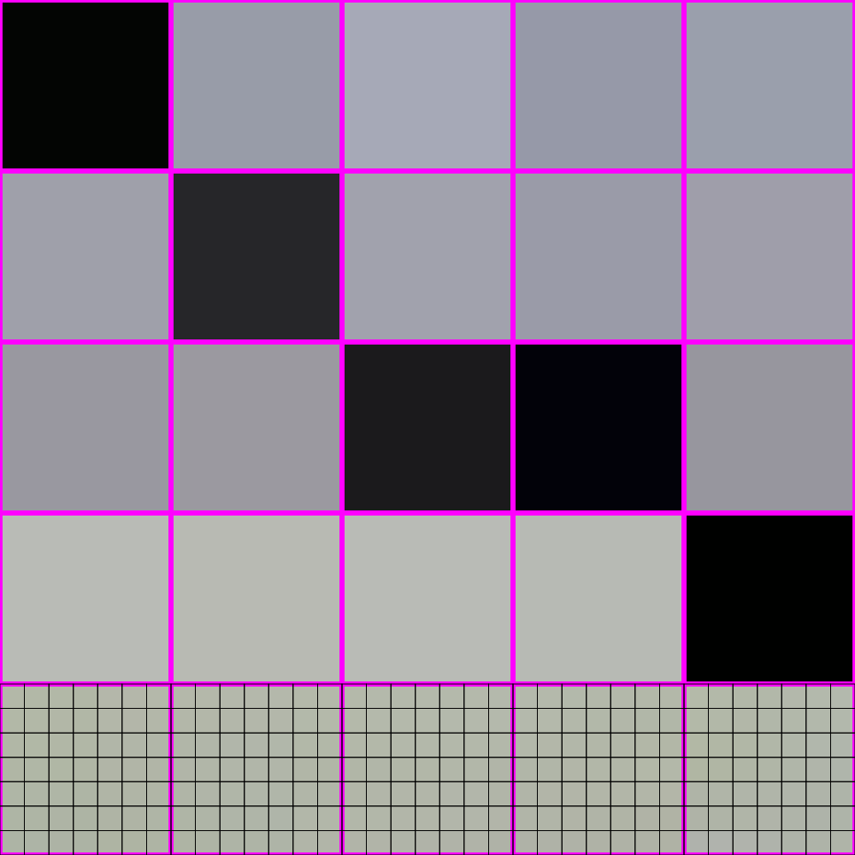
448x448 -> 64x64

Slide 40
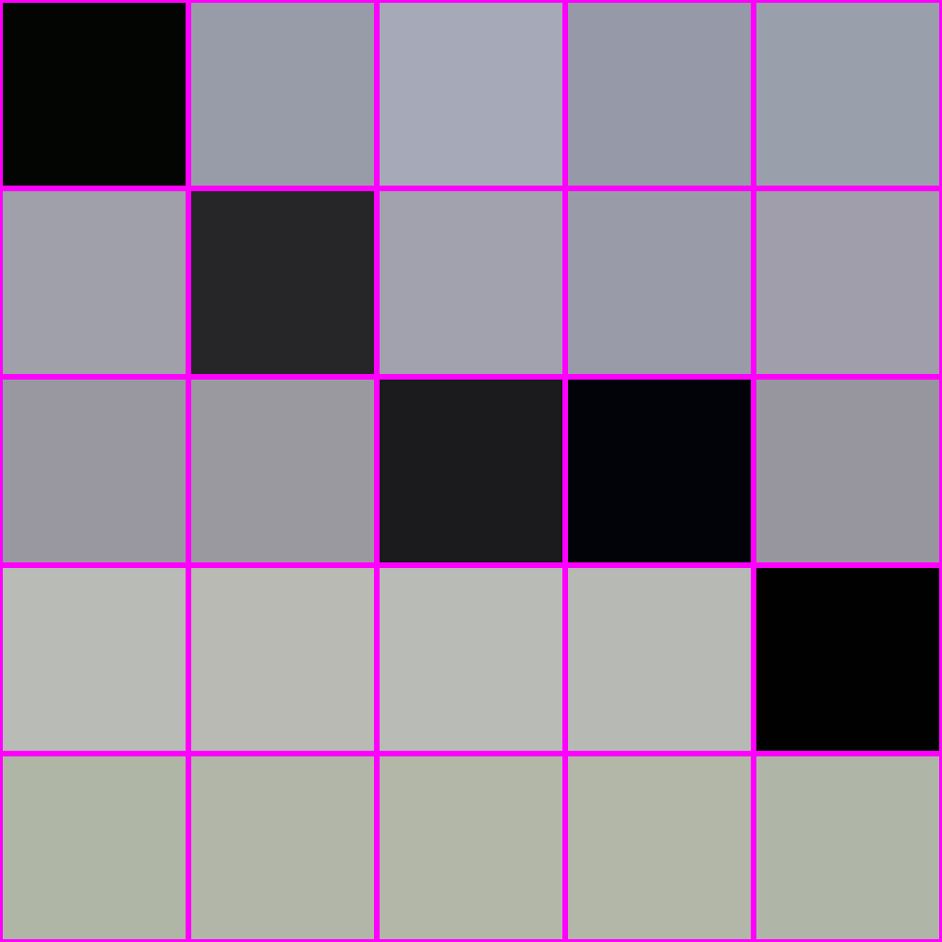
448x448 -> 64x64

Slide 41
448x448 -> 64x64

Slide 42
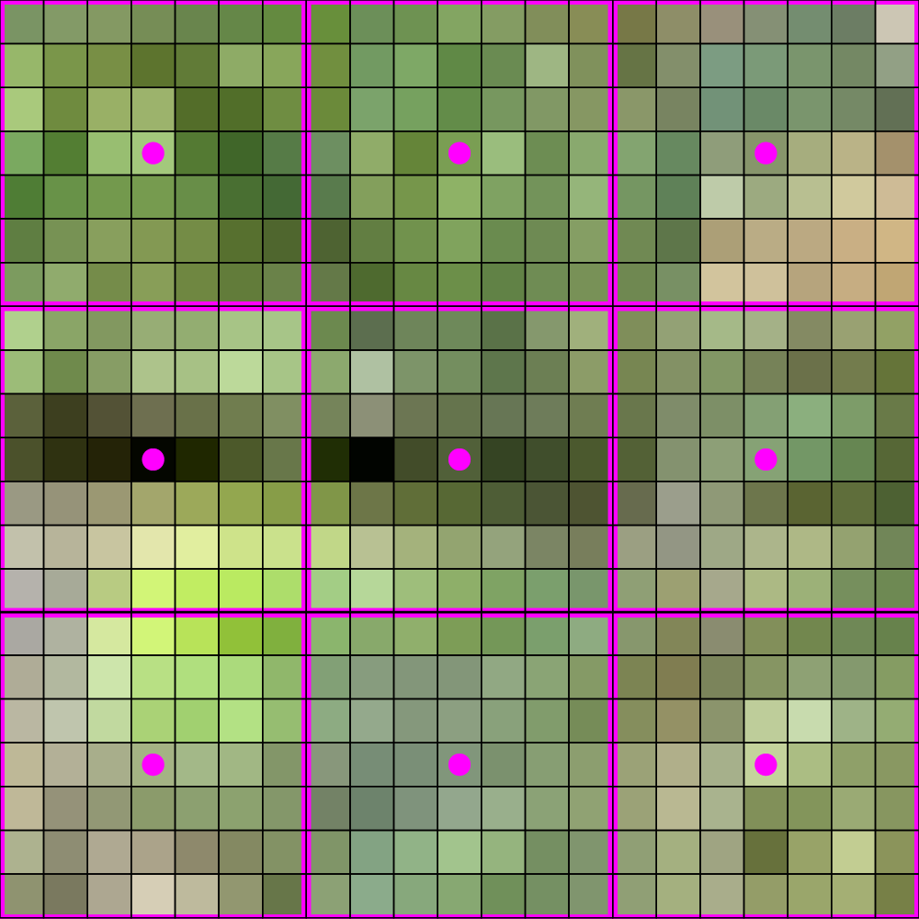
448x448 -> 64x64

Slide 43
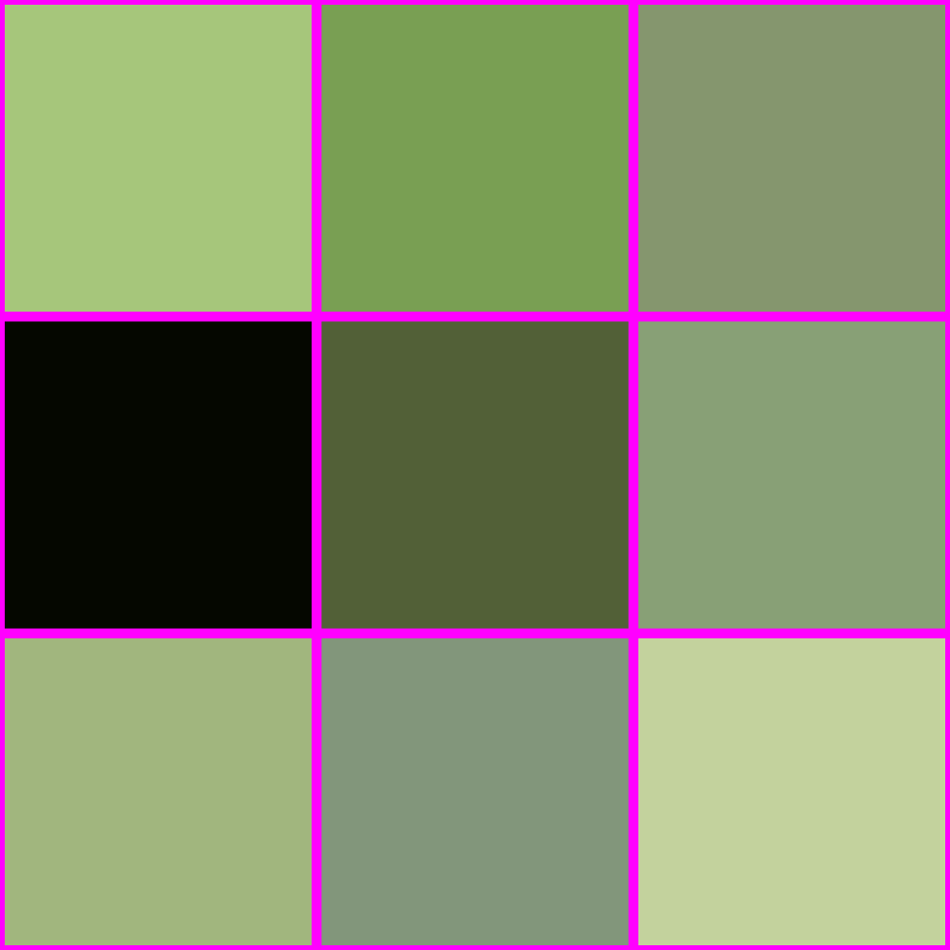
448x448 -> 64x64

Slide 44
IS THIS ALL THERE IS??

Slide 45

THERE IS A BETTER WAY!

Slide 46

LOOK AT HOW MUCH BETTER

Slide 47
How do?

Slide 48
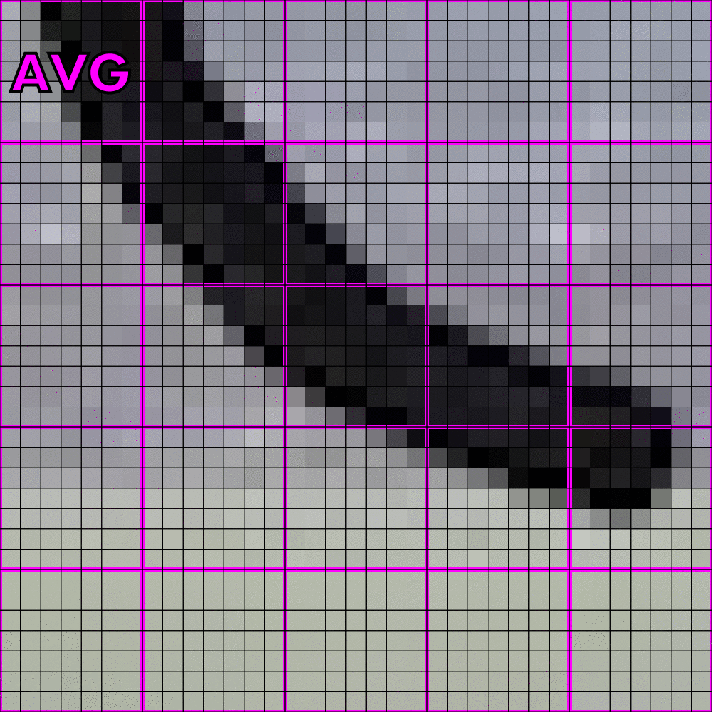
How do? Averaging!

Slide 49

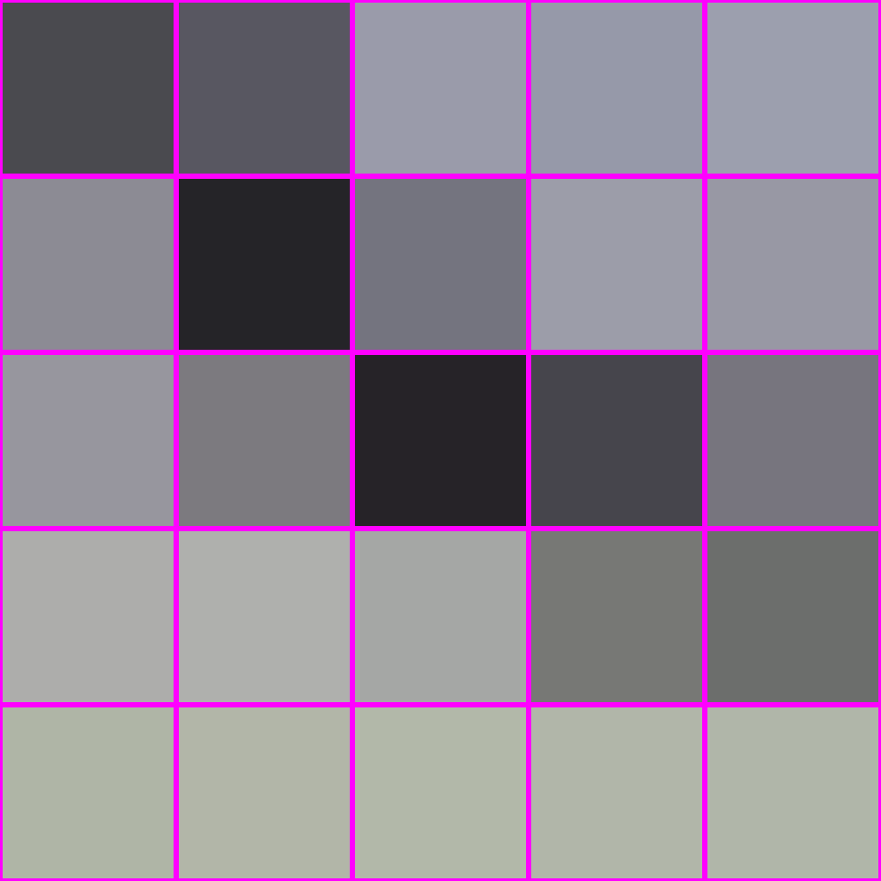
How do? Averaging!
“interpolation”
averaging
X

Slide 50

What is averaging?

Slide 51

What is averaging? A weighted sum

Slide 52
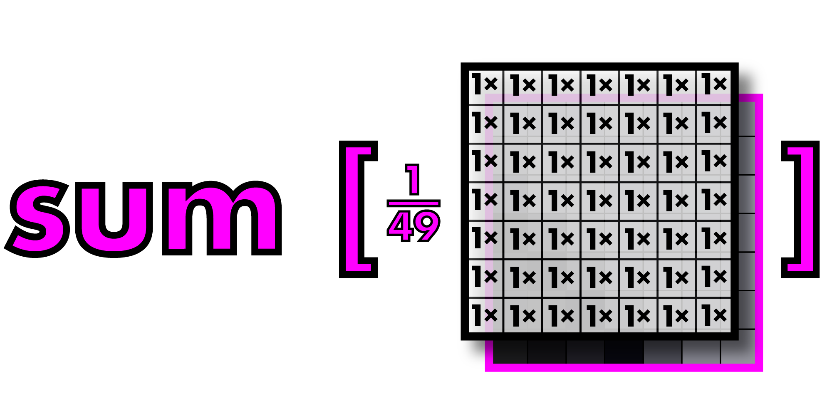
What is averaging? A weighted sum

Slide 53
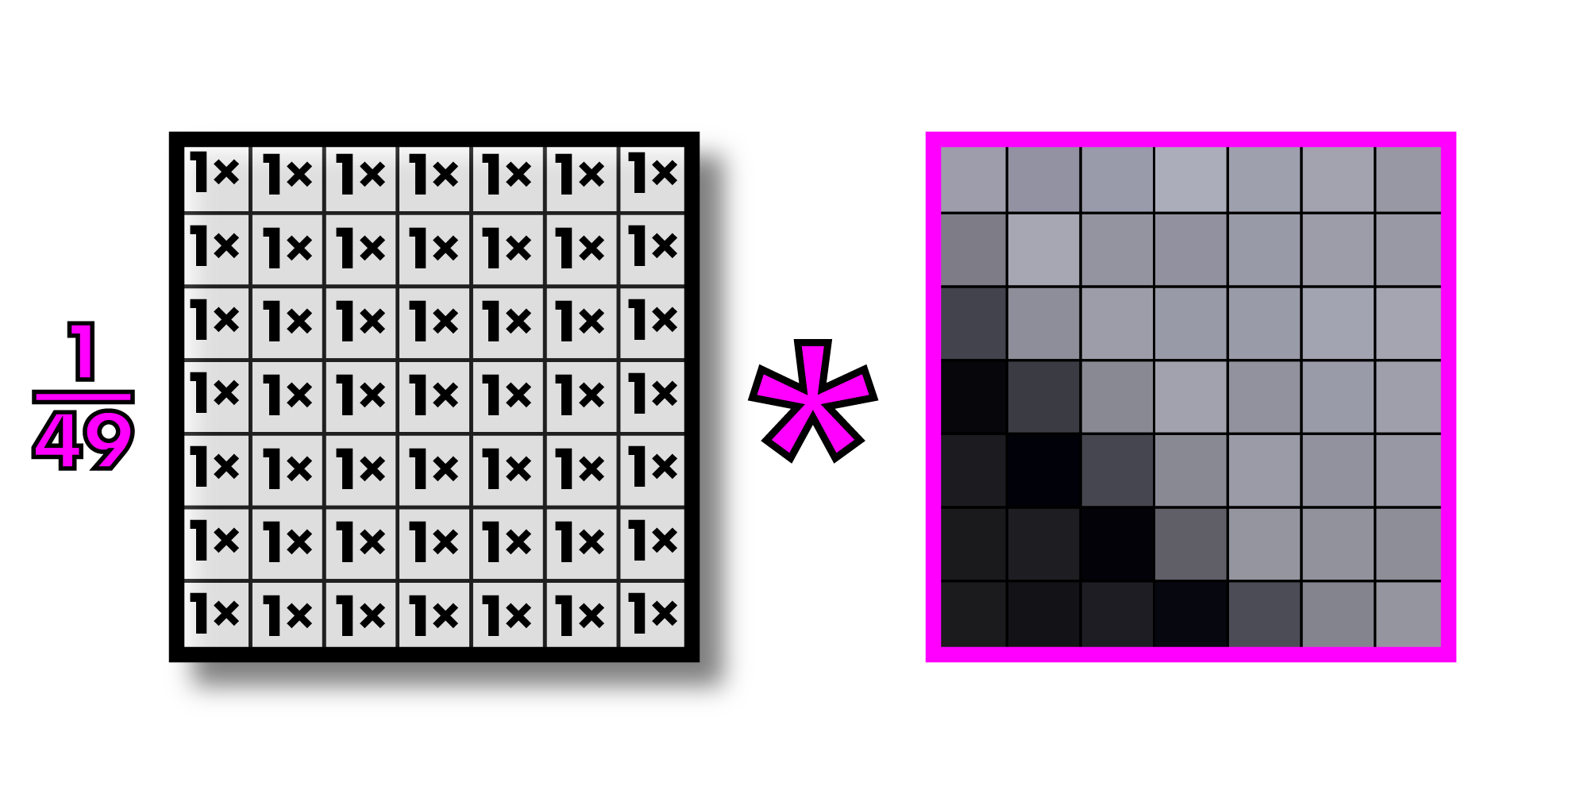
Call this operation “convolution”
Filter or kernel
Note: multiplying an image section by a filter is actually called “correlation” and convolution
Involves inverting the filter first, but since our filters are generally symmetric, we call
Everything convolution. This is what all computer vision people do.

Slide 54
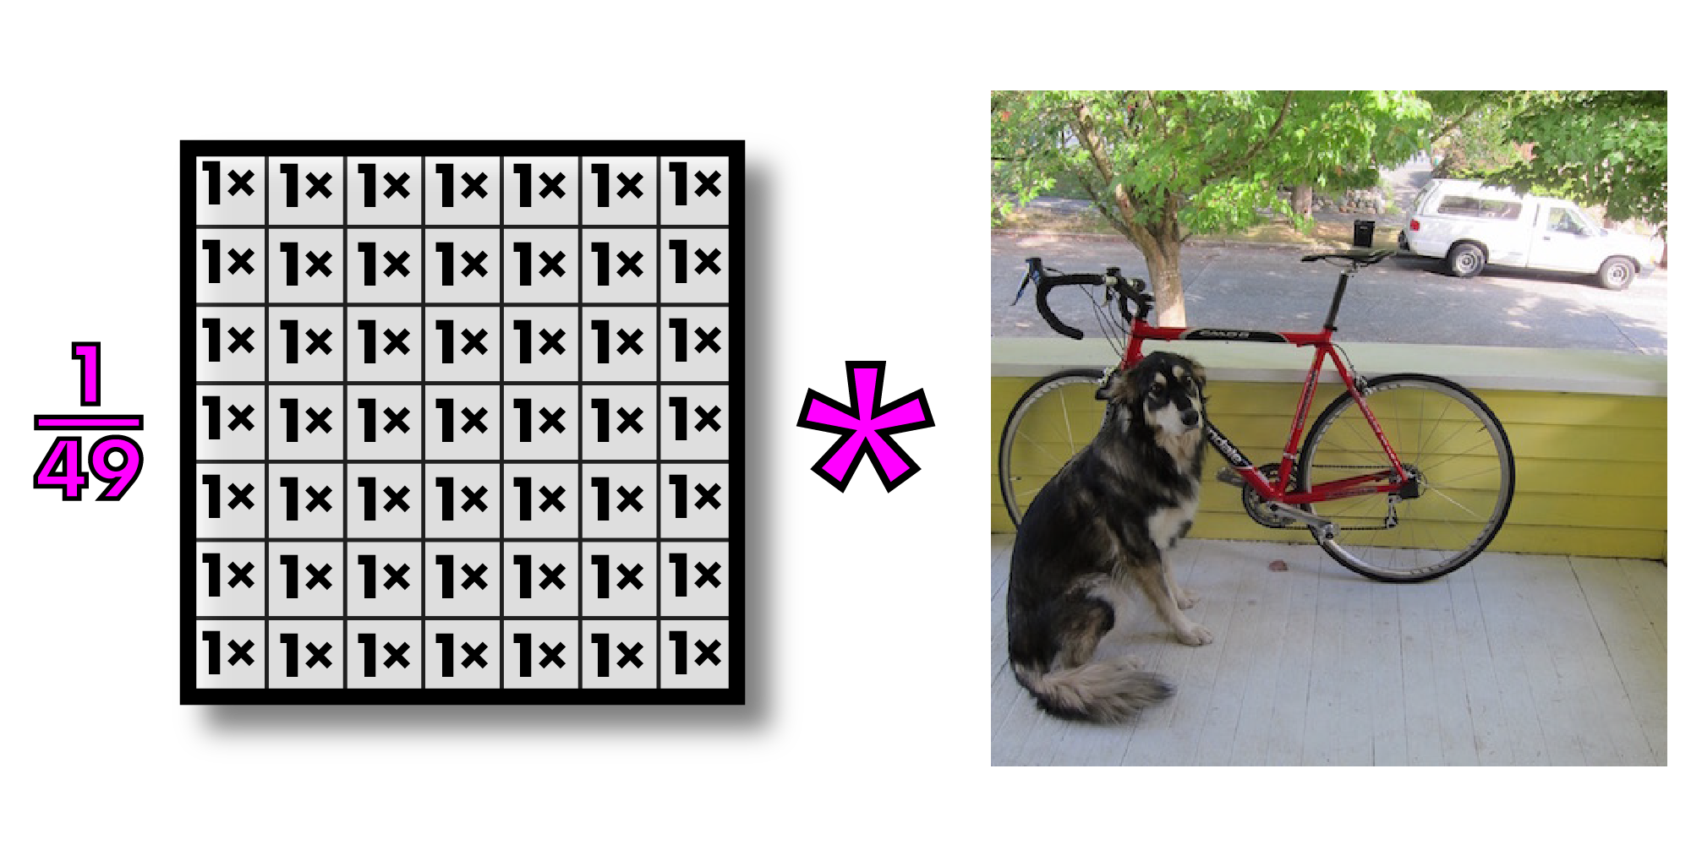
Convolutions on larger images

Slide 55
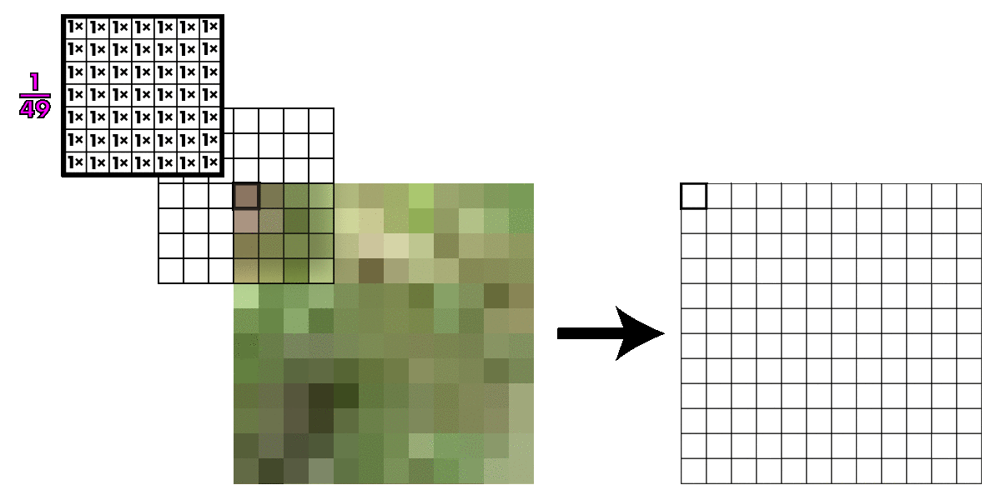
Kernel slides across image

Slide 56
Kernel slides across image
What happens at the edges of the images?
Zero padding: easiest but can give bad results
Duplicate the outermost row or column
Use wraparound

Slide 57

Convolutions on larger images

Slide 58
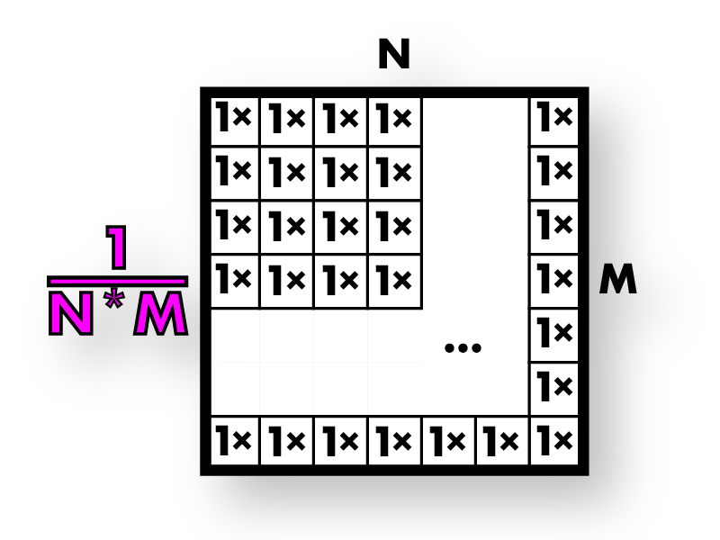
This is called box filter
Box filters

Slide 59
Box filters smooth image
Box filters

Slide 60
Box filters smooth image
Box filters

Slide 61
Now we resize our smoothed image

Slide 62
So much better!

Slide 63
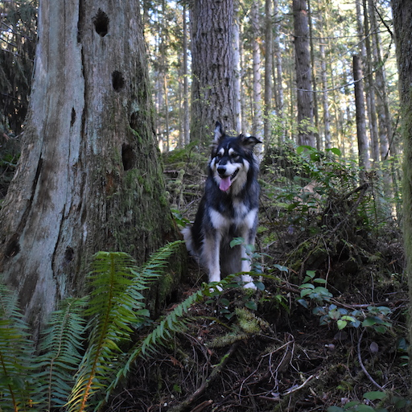

Box filters have artifacts

Slide 64
Box filters have artifacts

Slide 65
Box filters: vertical + horizontal streaking

Slide 66
Box filters: vertical + horizontal streaking

Slide 67
Box filters: vertical + horizontal streaking

Slide 68
Box filters: vertical + horizontal streaking

Slide 69
We want a smoothly weighted kernel

Slide 70
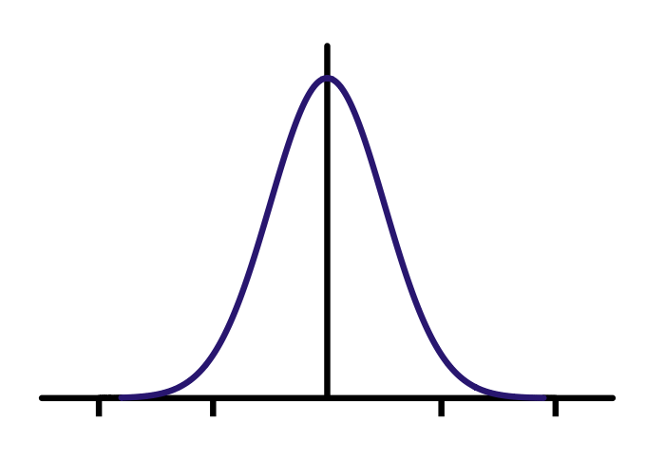

Gaussians

Slide 71

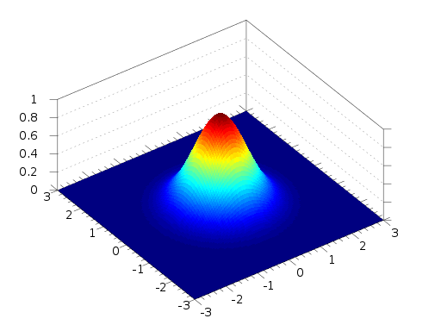
2d Gaussian

Slide 72

Better smoothing with Gaussians
=
*

Slide 73
Better smoothing with Gaussians

Slide 74
Better smoothing with Gaussians
Box Filtered Gaussian Filtered

Slide 75
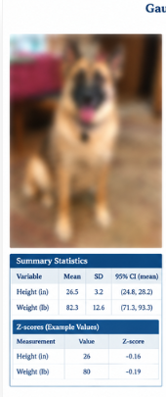
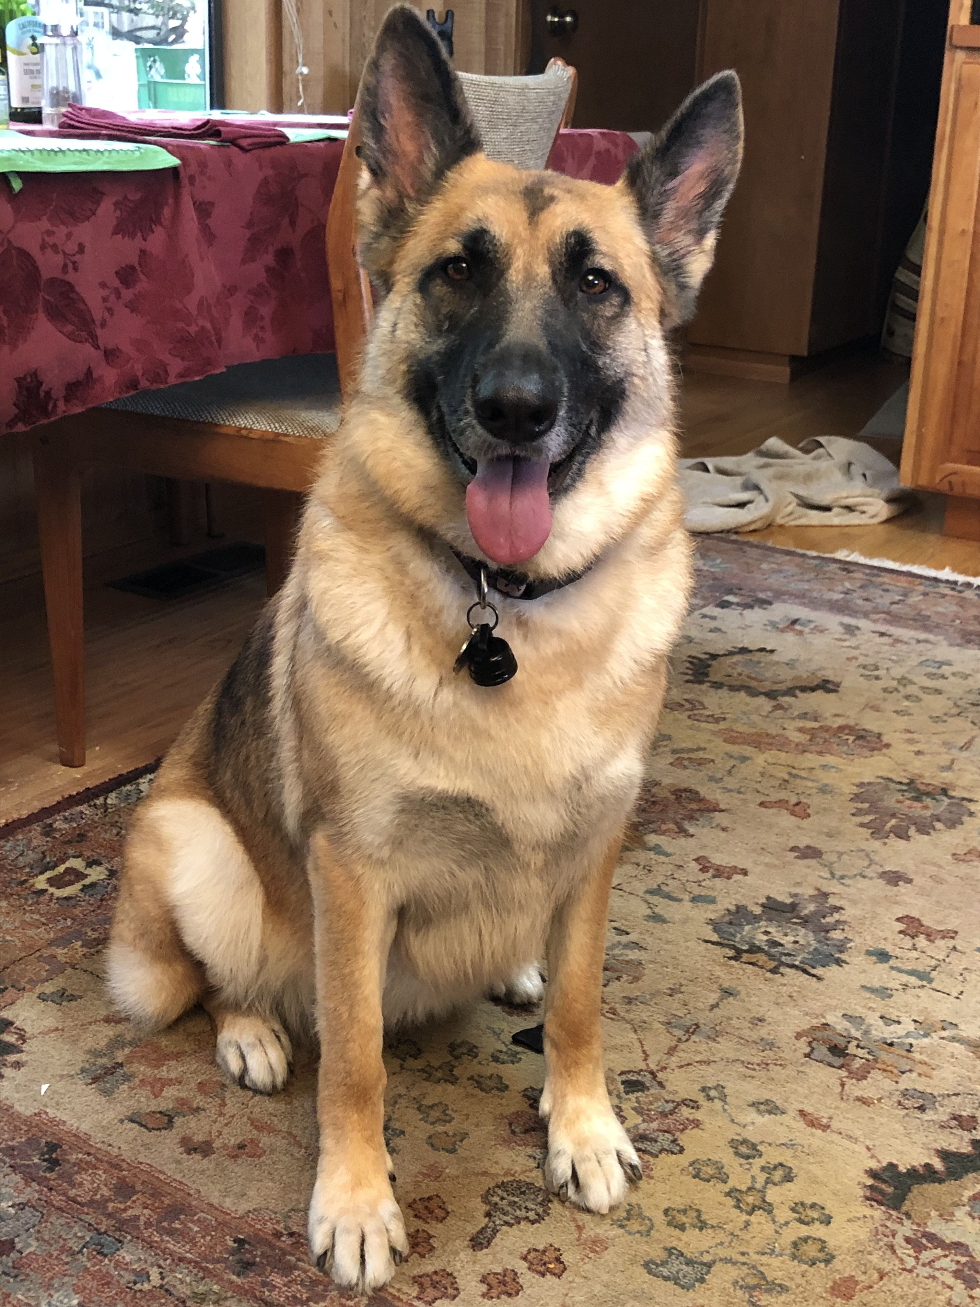

Slide 76
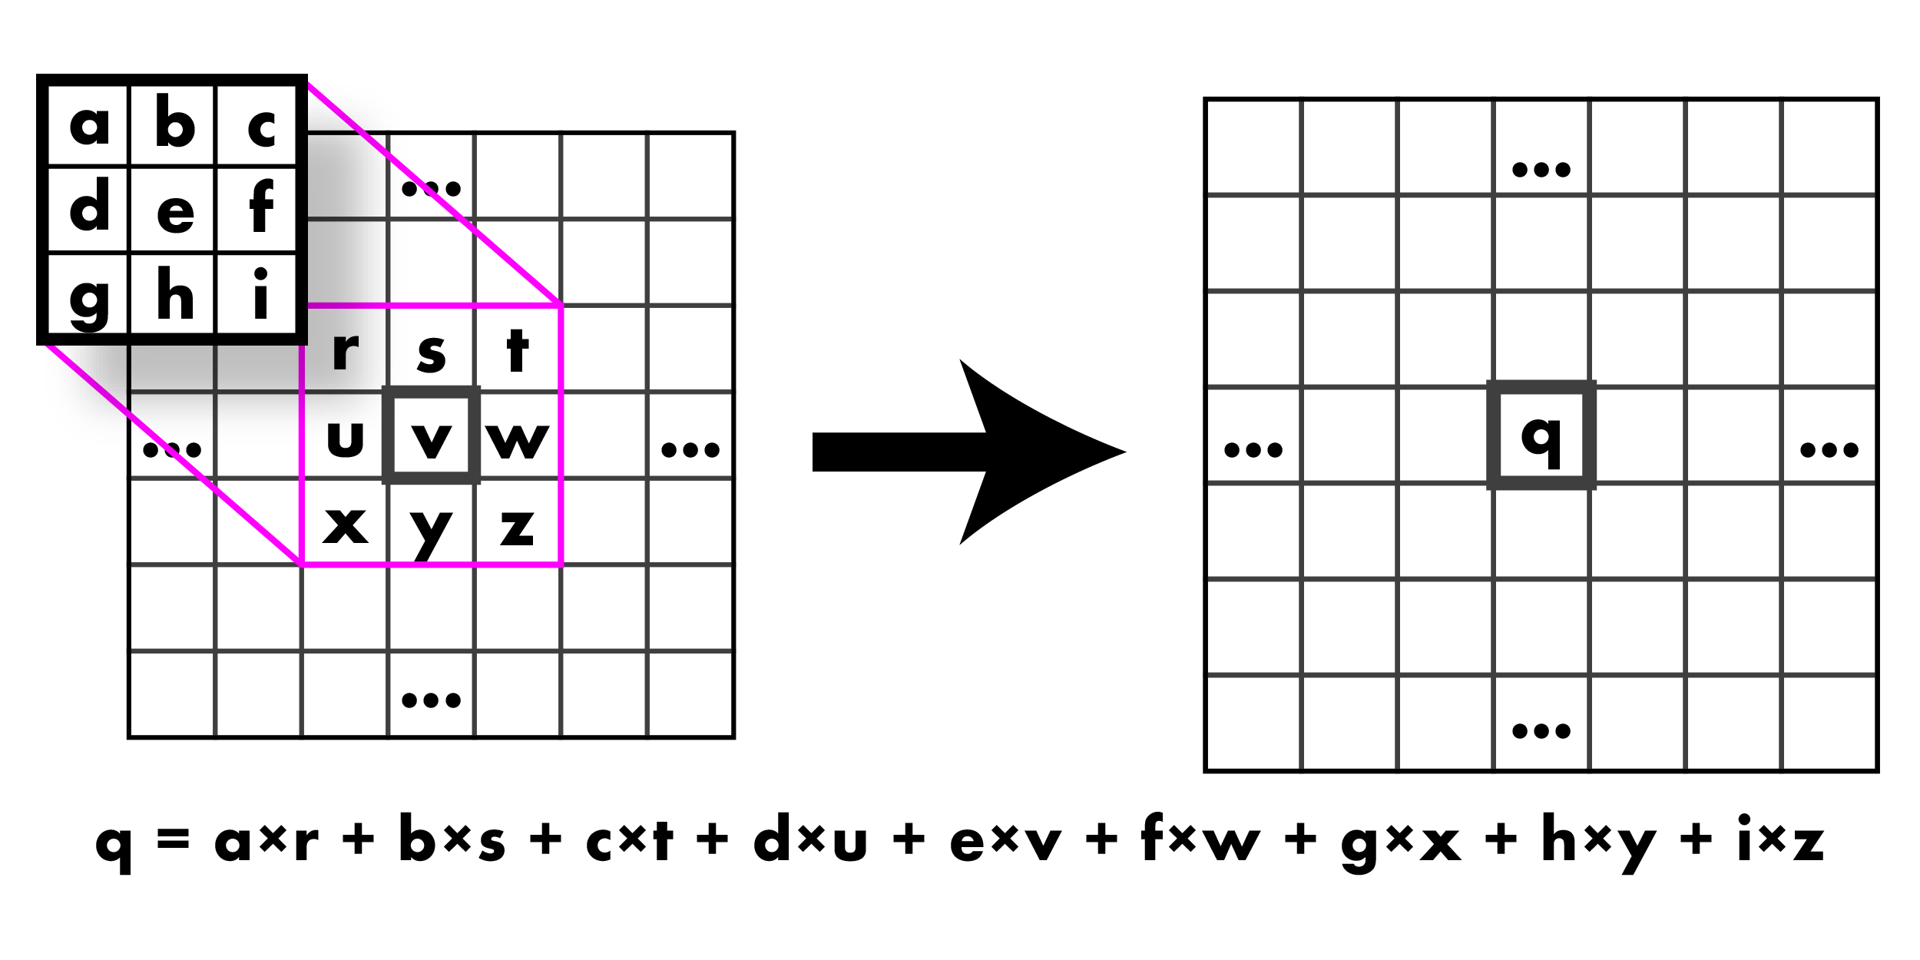
Wow, so what was that convolution thing??

Slide 77
Wow, so what was that convolution thing??

Slide 78
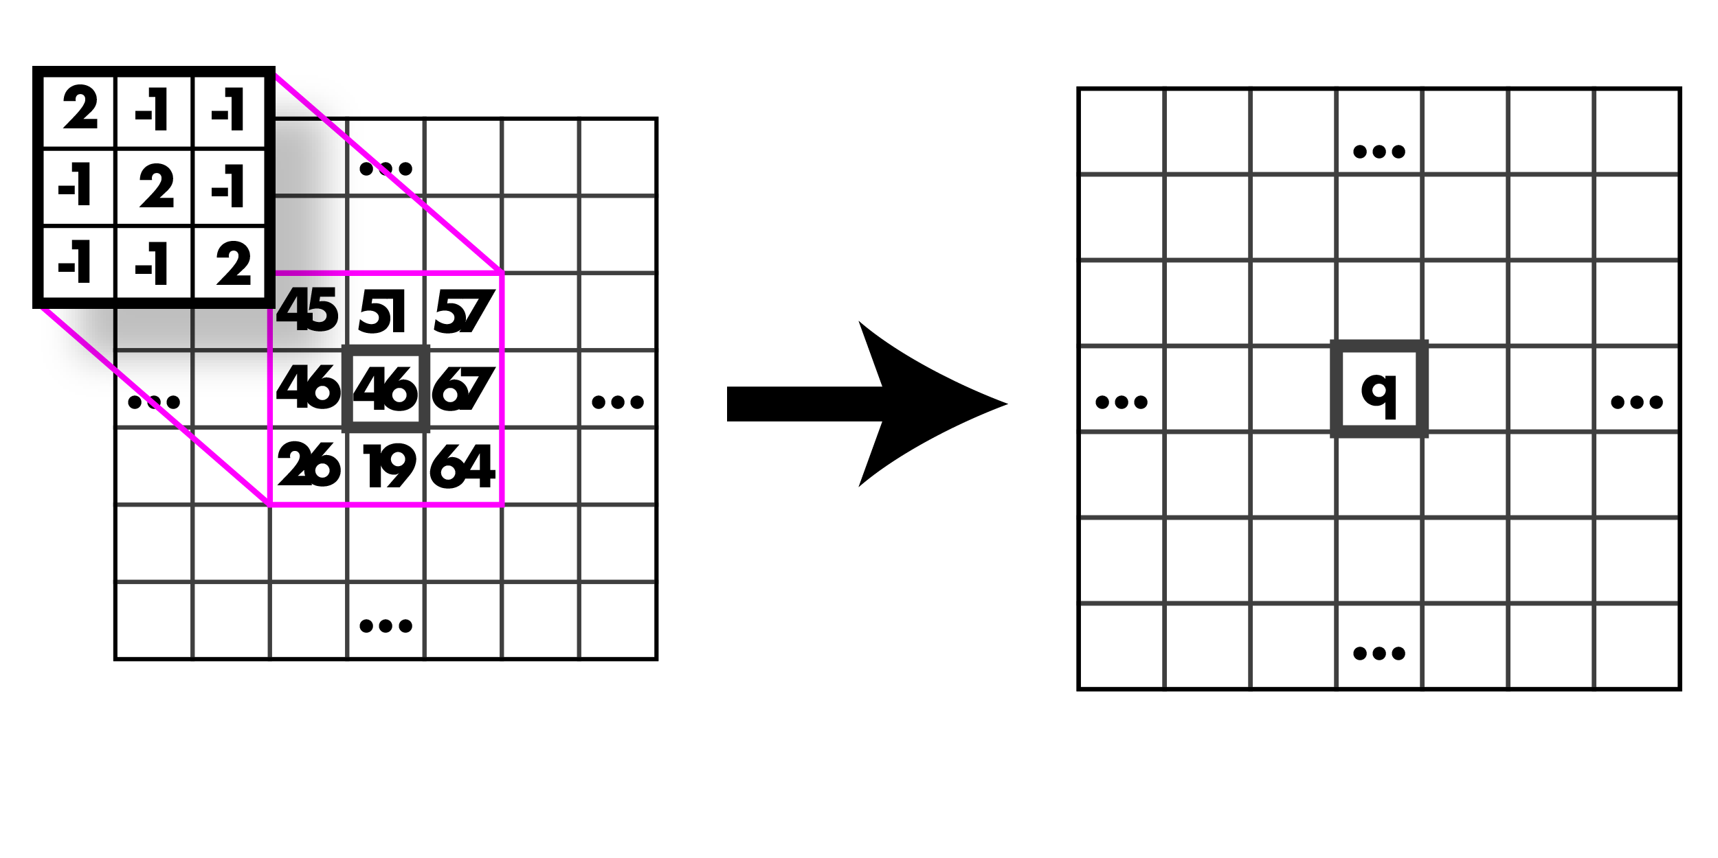
Calculate it, go!

Slide 79
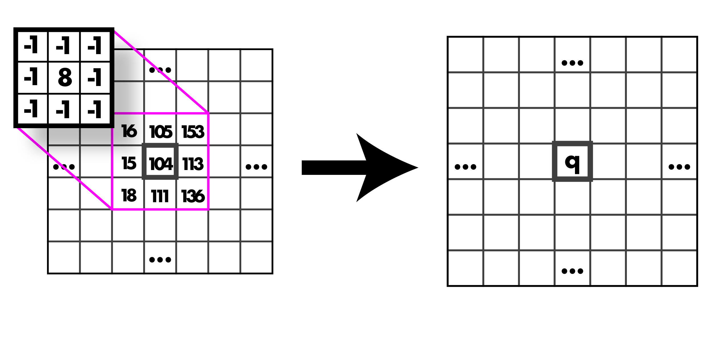
Calculate it, go!

Slide 80
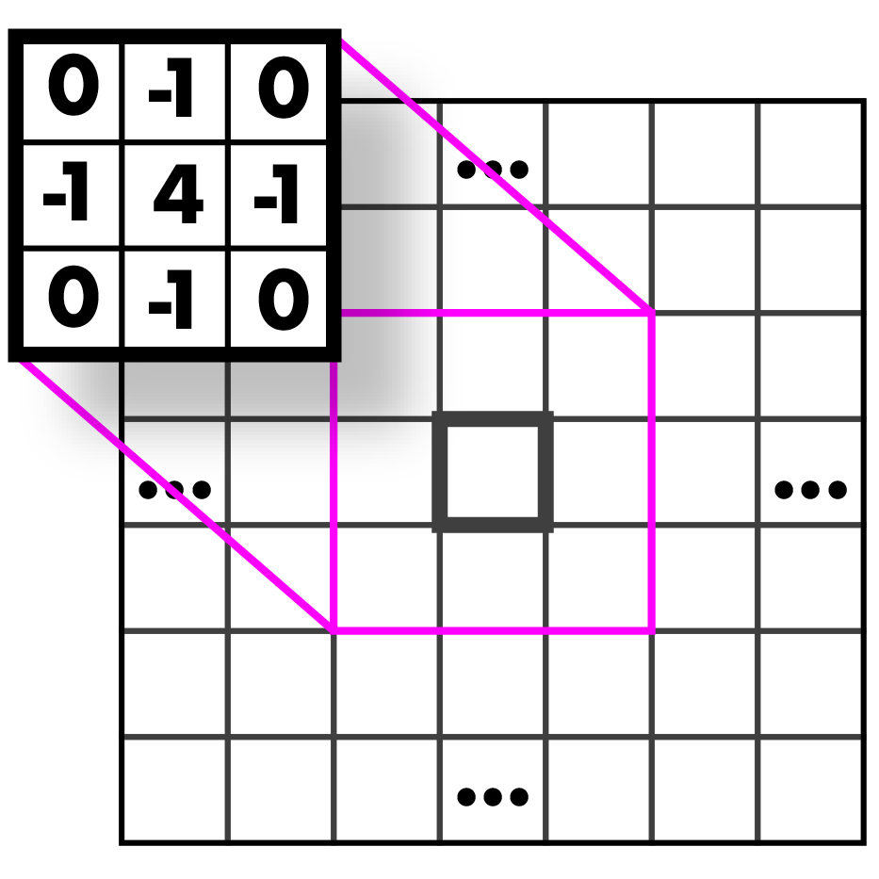
Guess that kernel!

Slide 81
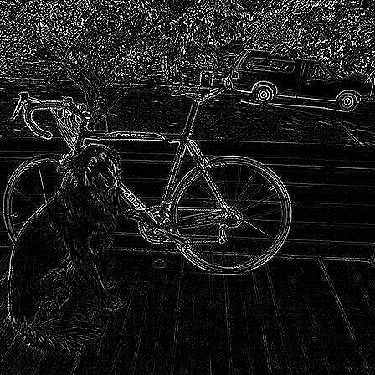
Highpass Kernel: finds edges
(applied to the graytone image!)

Slide 82
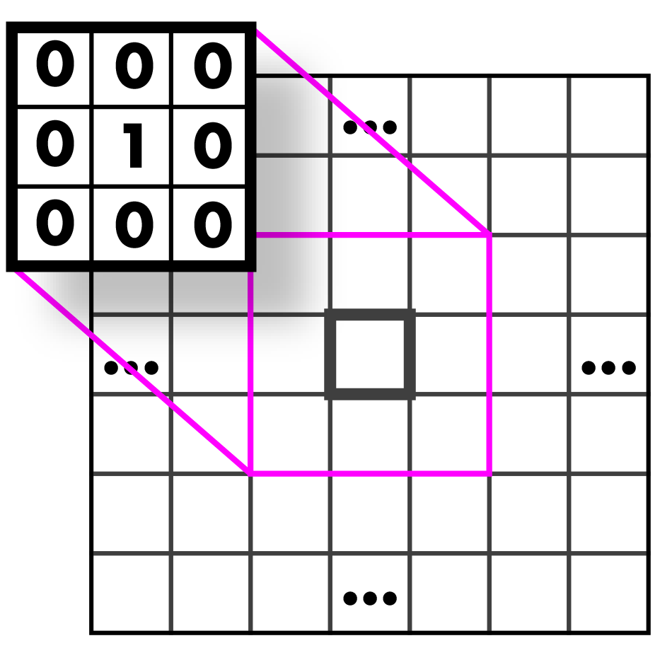
Guess that kernel!

Slide 83
Identity Kernel: Does nothing!

Slide 84

Guess that kernel!

Slide 85
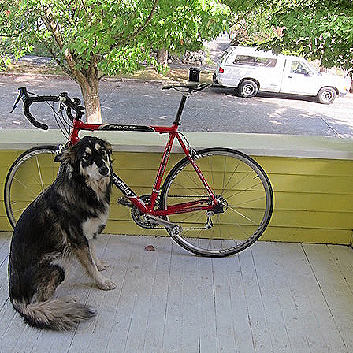
Sharpen Kernel: sharpens!
(applied to all three bands)
Note: sharpen = highpass + identity!

Slide 86

Guess that kernel!

Slide 87
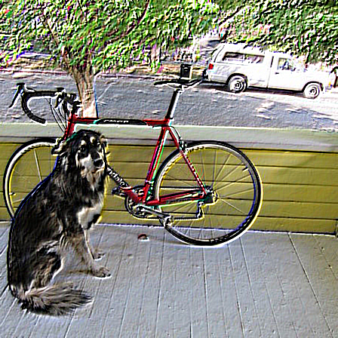
Emboss Kernel: stylin’ (applied to all three bands)

Slide 88
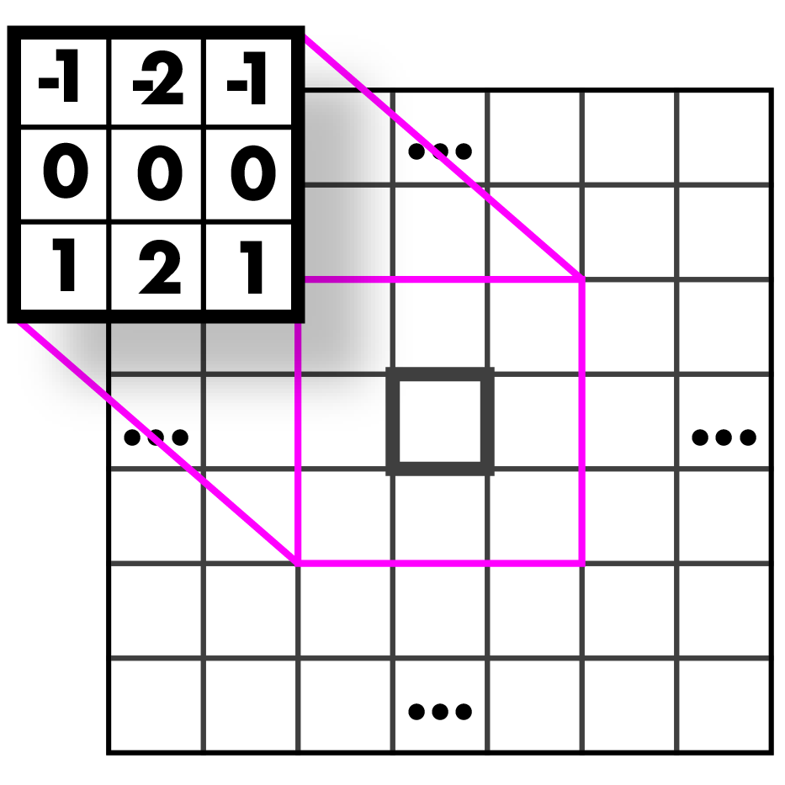

Guess those kernels!

Slide 89
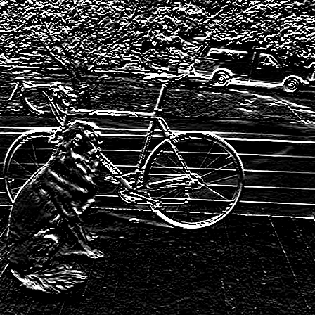
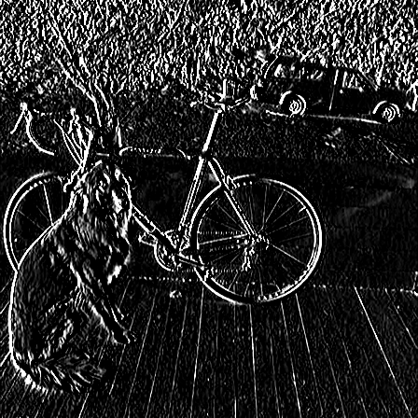
Sobel Kernels: edges (applied to a graytone image and thresholded)

Slide 90

Sobel Kernels: edges and gradient!

Slide 91
Sobel Kernels: edges and gradient!
This visualization is showing the magnitude and direction of the gradient. We will talk further about this when we discuss edges.

Slide 92
And so much more!!

Slide 93
Assignment 2
Image resizing and filtering

Slide 94
First things first!
Remember that you might need some of your code from the previous hw (e.g. set_pixel) for this hw as well. Have your code from hw1 in your src folder.

Slide 95
Assignment 2
Nearest Neighbor Interpolation and Resizing
def nn_interpolate(image im, float x, float y, int c) -> float
def nn_resize(image im, int w, int h) -> image
Bilinear Interpolation and Resizing
def bilinear_interpolate(image im, float x, float y, int c) -> float
def bilinear_resize(image im, int w, int h) -> image

Slide 96
Assignment 2
Box Filter
def l1_normalize(image im) -> None
def make_box_filter(int w) -> image
Convolution
def convolve_image(image im, image filter, int preserve) -> image
def make_highpass_filter() -> image
def make_sharpen_filter() -> image
def make_emboss_filter() -> image

Slide 97
Assignment 2
Gaussian
def make_gaussian_filter(float sigma) -> image
Hybrid Images
def add_image(image a, image b) -> image
def sub_image(image a, image b) -> image

Slide 98
Assignment 2
Sobel Operator (next lecture)
def make_gx_filter() -> image
def make_gy_filter() -> image
def feature_normalize(image im) -> None
def *sobel_image(image im) -> image
def colorize_sobel(image im) ->image

