Slide 1
Computer Vision
CSE 455
Linda Shapiro
Professor of Computer Science & Engineering
Professor of Electrical & Computer Engineering

Slide 2





Course Information
Time:
  TTH 11:30 – 12:50
Location:
  CSE2 G01
Contact:
  shapiro@cs.uw.edu
TAs:
  Nishat Khan
  nkhan51@uw.edu
  Yichuan (Ethan) Deng
  ycdeng@uw.edu
  Raymond Yu
  ryu5@uw.edu
  Yinuo Yang
  yinuoy@uw.edu
  Hank Fang
  fang0106@uw.edu
Website:
  https://courses.cs.washington.edu/courses/cse455/26au/

Slide 3
Topics
Introduction
Color and Texture
Image Coordinates, Transforms, and Resizing
Filters and Convolutions
Edges and Lines
Interest Operators, Image Matching, Image Stitching
Face Detection/Recognition
Machine Learning Overview including Neural Nets
Object Detection and Recognition with ML
Convolutional Neural Networks
Self-Supervised Learning
Motion/Optical Flow
Stereo and 3D Depth Perception

Slide 4
Grading (tentative)
Five regular assignments (75%)
One Course Project (25%)
NO EXAMS (Yay!)
There will be some pop quizzes for extra points.

Slide 5
Assignments
Build a vision library from the ground up
Recently converted to Python; one in PyTorch
Play with advanced tools, neural networks
Beginning: lots of skeleton code, explanations
End: less guidance, more experimentation

Slide 6
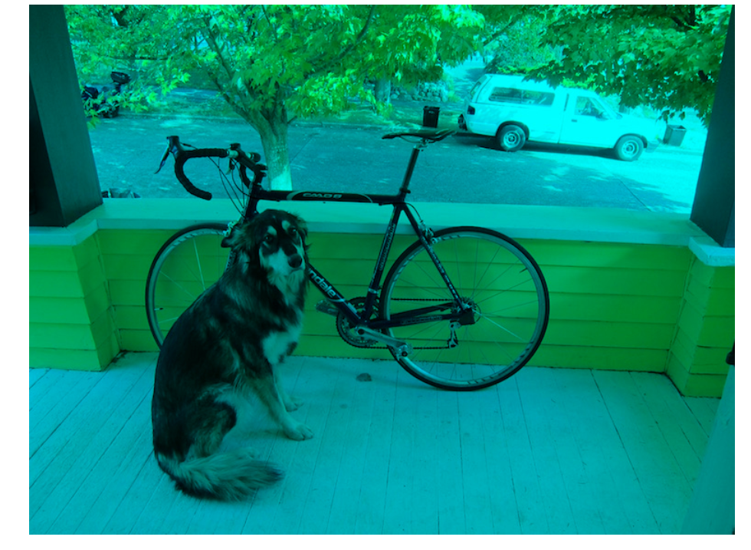
Assignment 1: Fun with Color

Slide 7
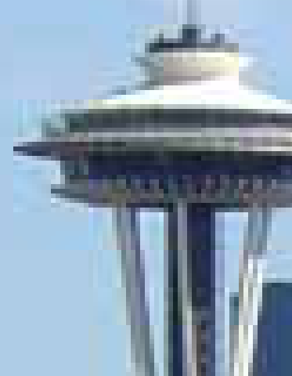

Assignment 2: Image Resizing and Filtering

Slide 8
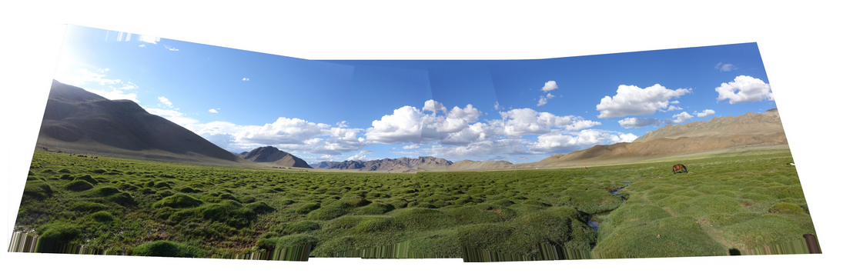
Assignment 3: Panorama Stitching

Slide 9
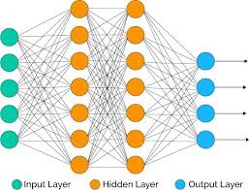
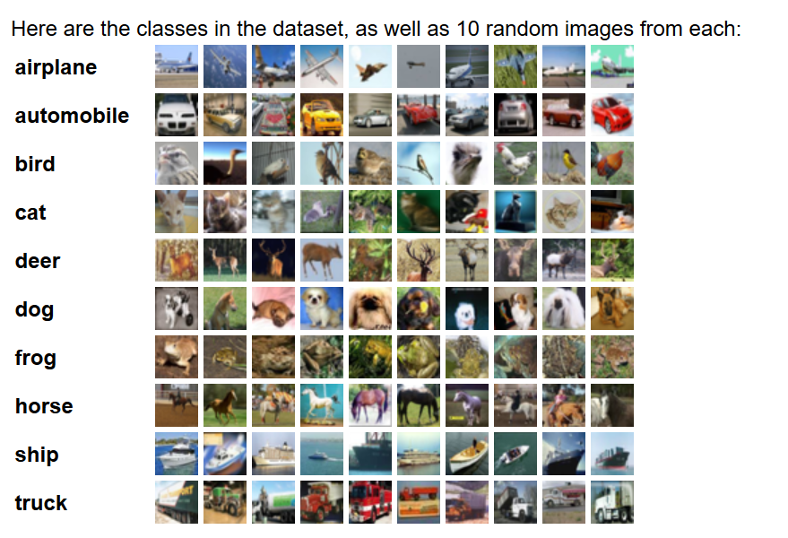
Assignment 4: Neural Networks

Slide 10
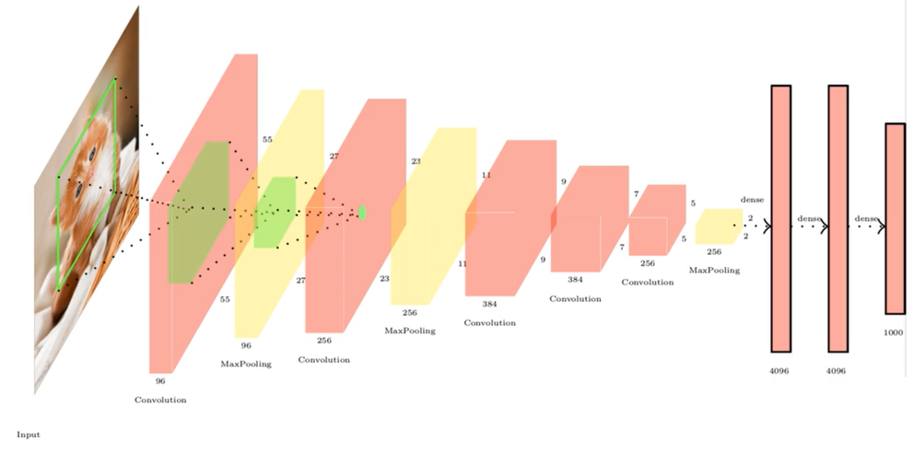
Assignment 5: PyTorch

Slide 11
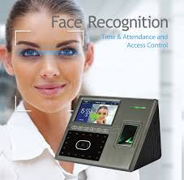
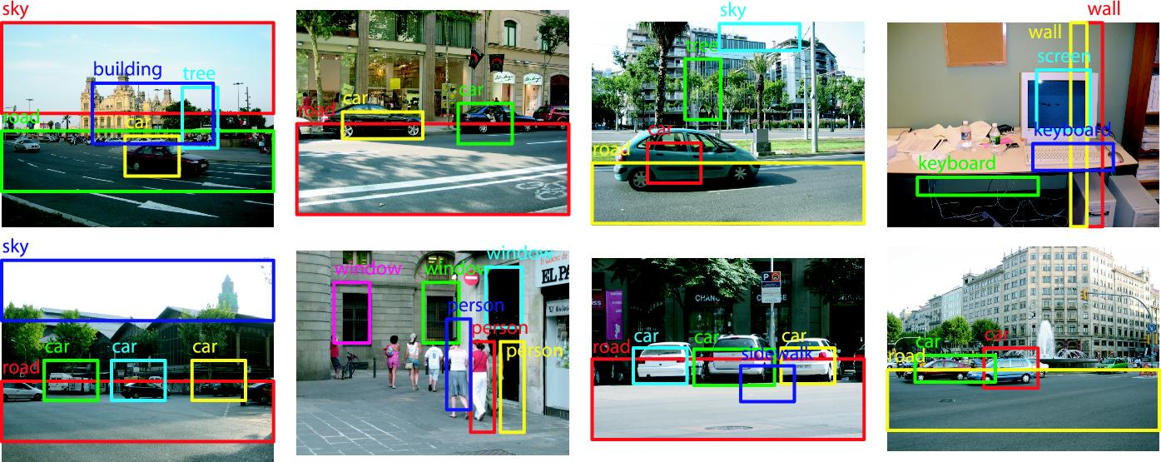
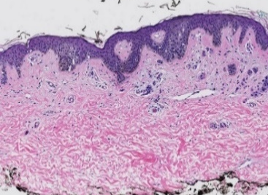
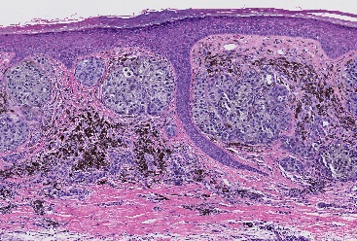

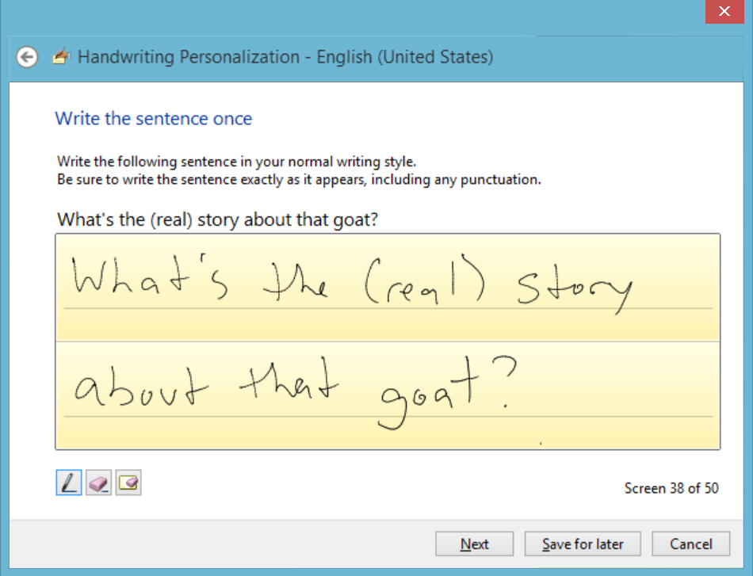







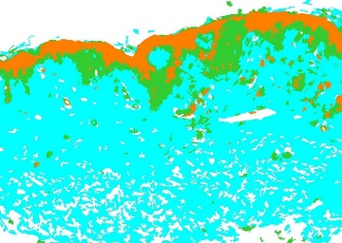
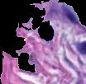
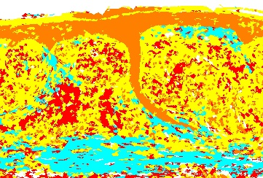


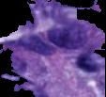

Final Course Project: Machine Learning for Some Kind of Application
b
d
a
c

Slide 12
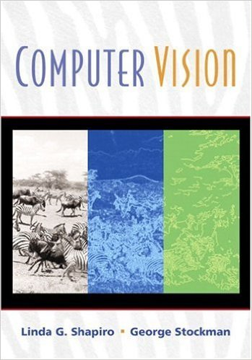
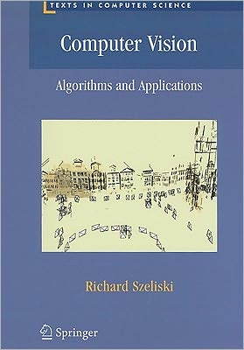
Books
Older, but designed
for undergrads and
has the basics. Chapters
available from our web
page.
Newest and available
as a pdf online (2020
version).

Slide 13
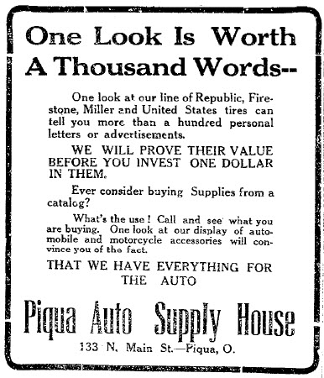
Notes:
Why?

Slide 14
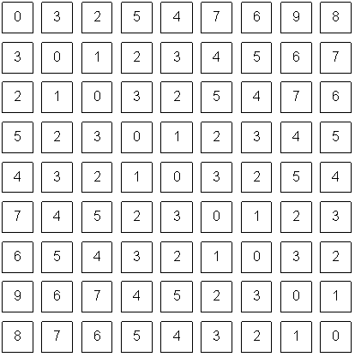
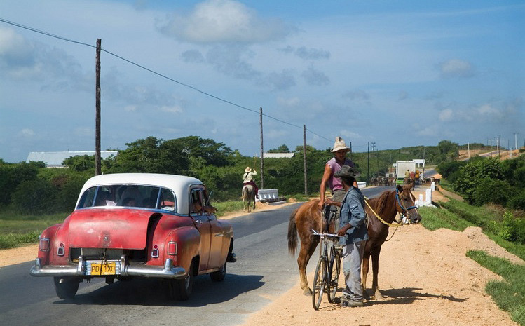
Notes:
pixels

Slide 15
The car is in front of the pole
Sky
Person
White
Horse
Car
Road
Shadow
1m
Wheel
Notes:
What do we care about in this image? color, measurement, foreground/background, potential objects, detecting particular objects

Slide 16
The car is in front of the pole
Sky
Person
Road
White
Horse
Car
Shadow
1m
Wheel

Slide 17
Computer Vision
Low Level Vision
  Measurements
  Enhancements
  Region segmentation
  Features
Mid Level Vision
  Reconstruction
  Depth
  Motion Estimation
High Level Vision
  Category detection
  Activity recognition
  Deep understandings

Slide 18
Computer Vision
Low Level Vision
  Measurements
  Enhancements
  Region segmentation
  Features
Mid Level Vision
  Reconstruction
  Depth
  Motion Estimation
High Level Vision
  Category detection
  Activity recognition
  Deep understandings
White
Shadow
1m

Slide 19
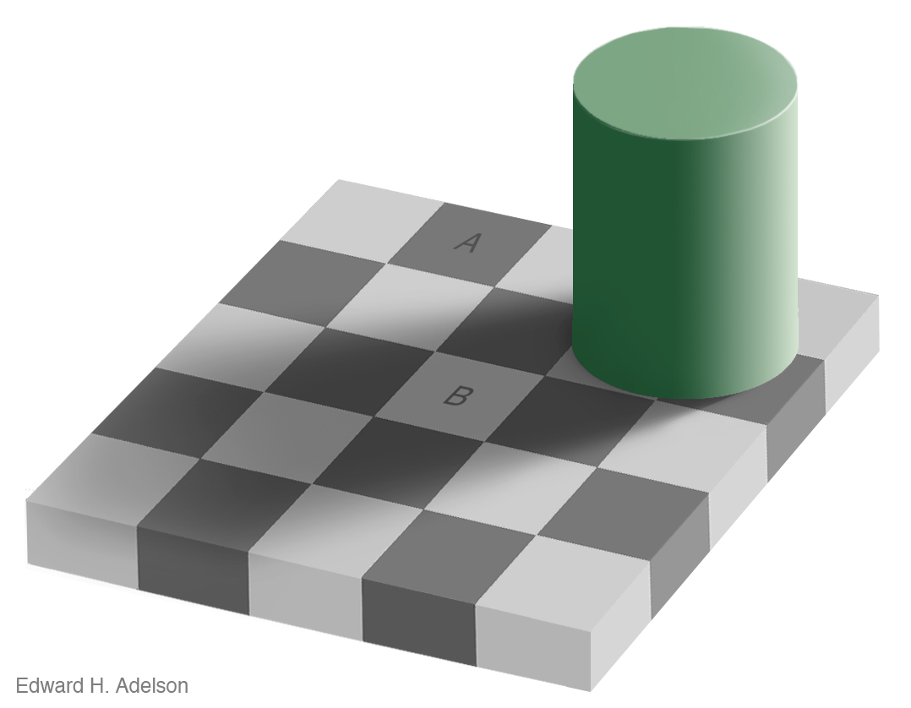
Measurement
Brightness
Notes:
See VIDEO

Slide 20
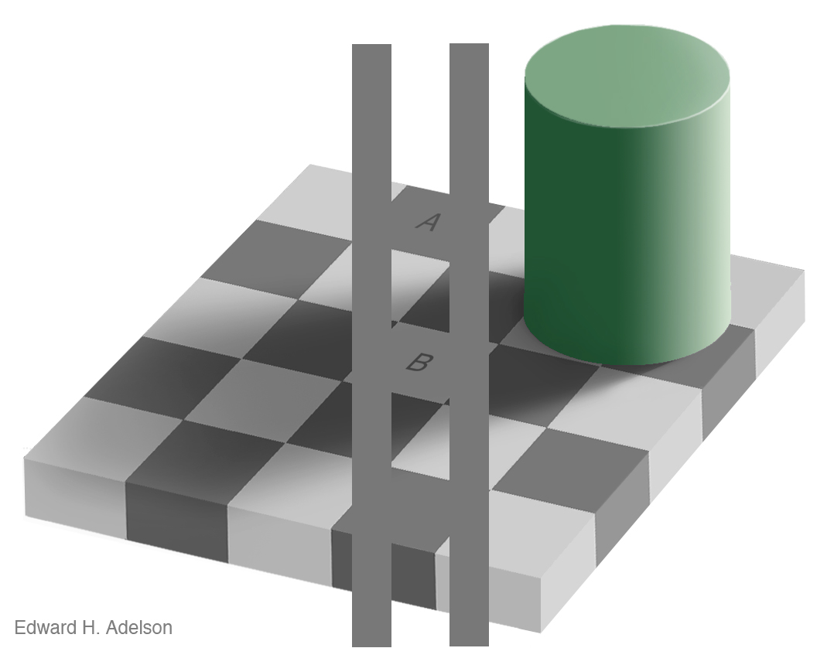
Measurement
Brightness
http://www.newworldencyclopedia.org/entry/Same_color_illusion
Slide Credit: Alyosha Efros

Slide 21
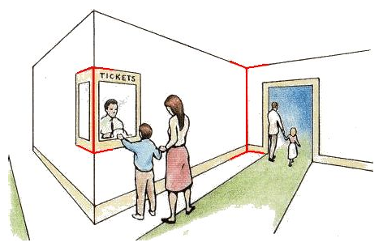
Measurement
Length
Müller-Lyer Illusion
http://www.michaelbach.de/ot/sze_muelue/index.html
Slide Credit: Alyosha Efros
Notes:
red vertical lines look like same length in image but not in reality

Slide 22
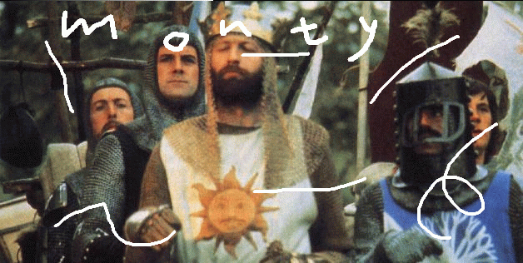
Image Enhancement
Image Inpainting, M. Bertalmío et al.
http://www.iua.upf.es/~mbertalmio//restoration.html
Notes:
About restoration

Slide 23
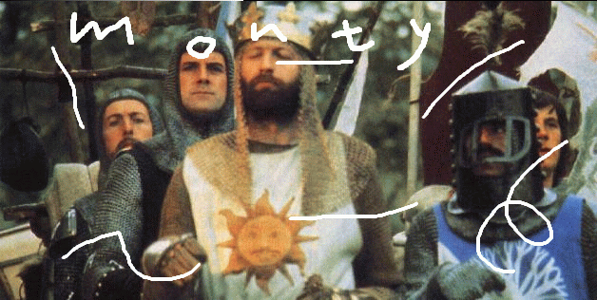
Image Enhancement
Image Inpainting, M. Bertalmío et al.
http://www.iua.upf.es/~mbertalmio//restoration.html

Slide 24
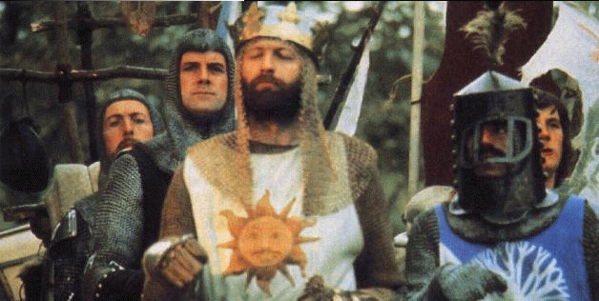
Image Enhancement
Image Inpainting, M. Bertalmío et al.
http://www.iua.upf.es/~mbertalmio//restoration.html

Slide 25
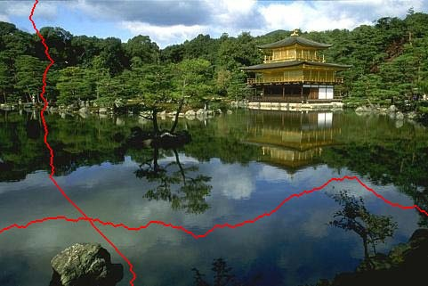
Seam Carving
less
important
[Shai & Avidan, SIGGRAPH 2007]

Slide 26
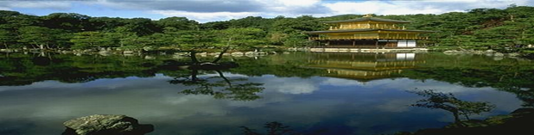
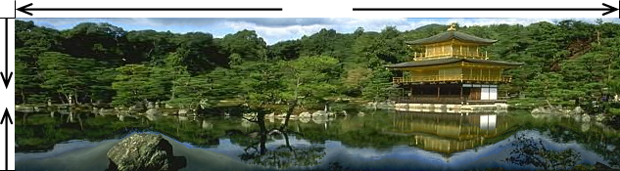
Traditional resizing uses and stretches the whole image.
Content-aware resizing uses important areas.
Extends in horizontal direction and reduces in vertical.
[Shai & Avidan, SIGGRAPH 2007]

Slide 27
Computer Vision
Low Level Vision
  Measurements
  Enhancements
  Region segmentation
  Features
Mid Level Vision
  Reconstruction
  Depth
  Motion Estimation
High Level Vision
  Category detection
  Activity recognition
  Deep understandings
The car is in front of the pole

Slide 28
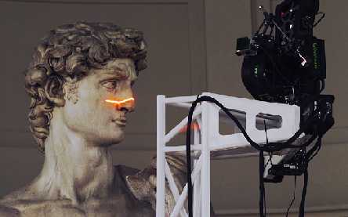
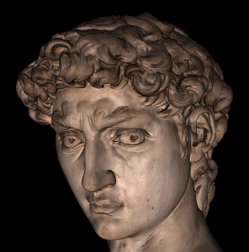
Applications: 3D Scanning
Scanning Michelangelo’s “The David”
  The Digital Michelangelo Project (Marc Levoy)
    - http://graphics.stanford.edu/projects/mich/
  UW Prof. Brian Curless, collaborator
  Linda’s former student Kari Pulli, collaborator
  2 BILLION polygons, accuracy to .29mm

Slide 29
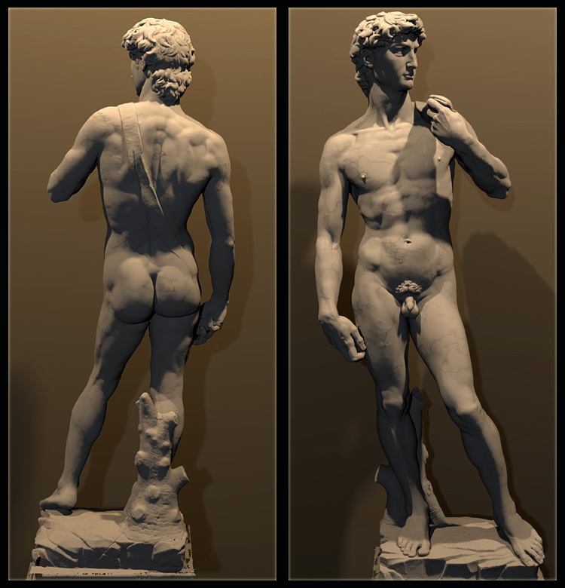
  The Digital Michelangelo Project, Levoy et al.

Slide 30
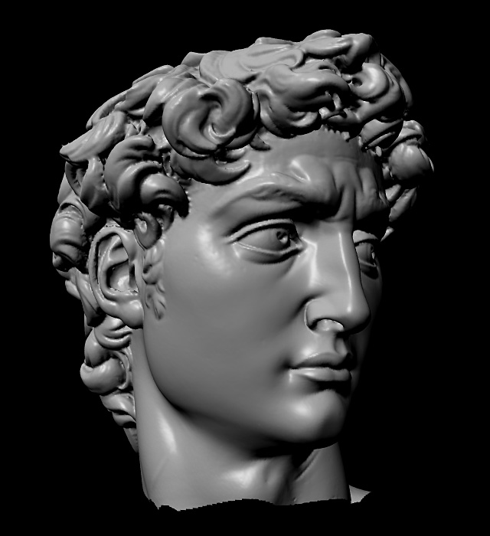

Slide 31
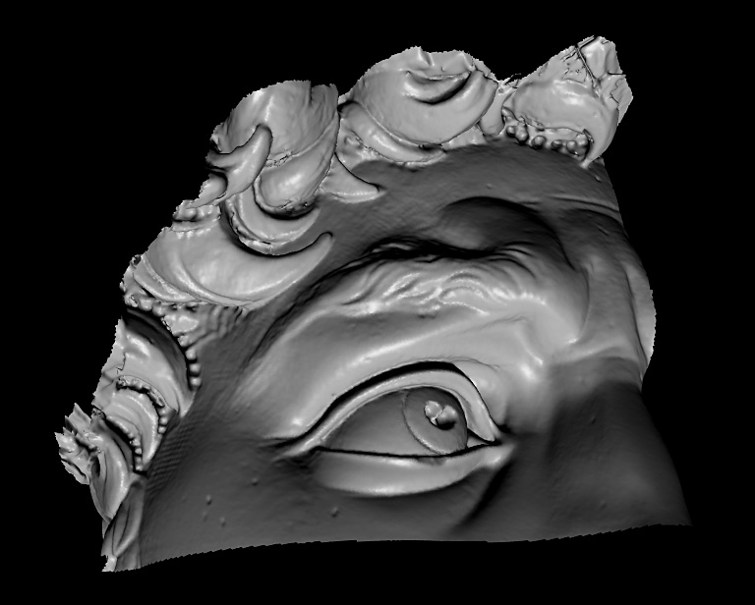

Slide 32
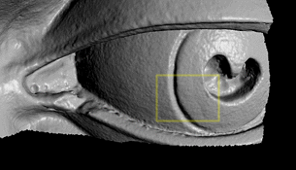

Slide 33
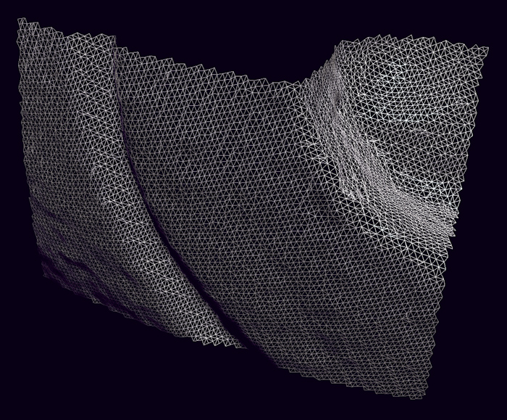

Slide 34
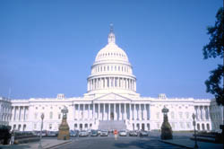
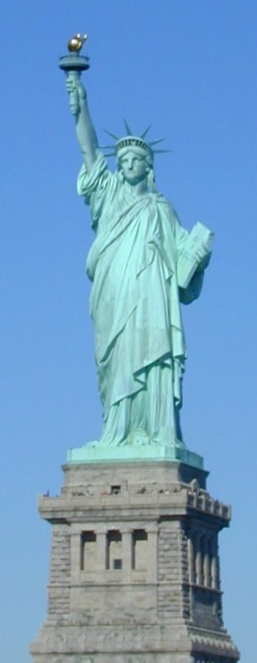
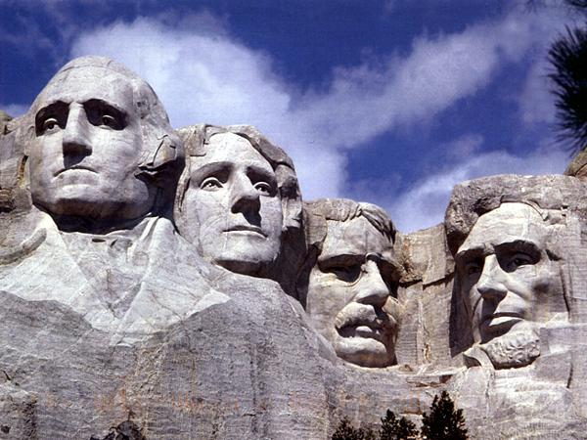
Notes:
Could these be done in the same way as David? NO.

Slide 35
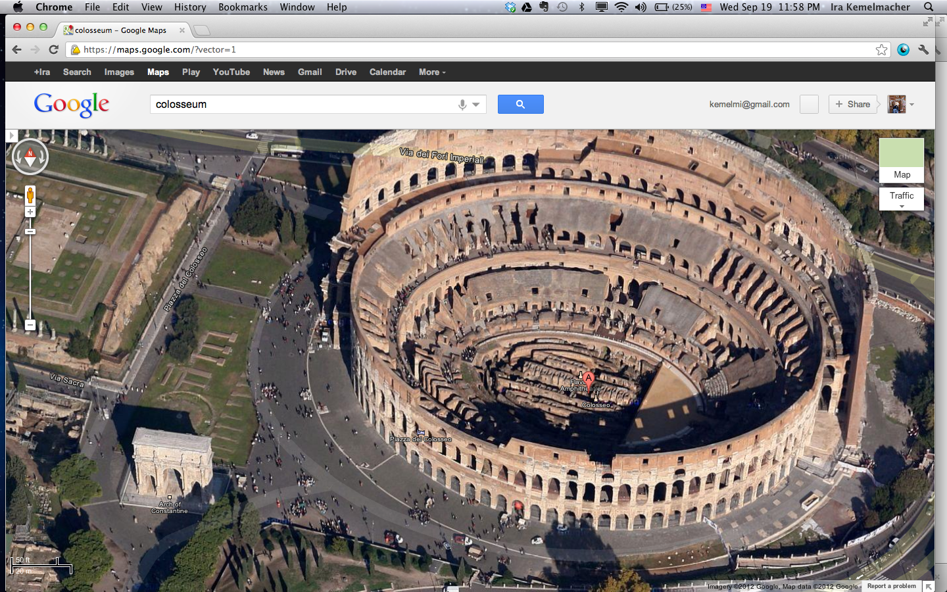
Google’s 3D Maps
Structure estimation from tourist photos

Slide 36
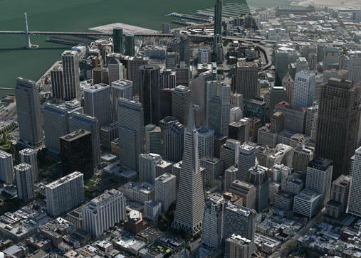
Apple’s 3D maps
https://www.youtube.com/watch?v=InIVv-LsgZE
Notes:
See link to video.

Slide 37
Computer Vision
Low Level Vision
  Measurements
  Enhancements
  Region segmentation
  Features
Mid Level Vision
  Reconstruction
  Depth
  Motion Estimation
High Level Vision
  Category detection
  Activity recognition
  Deep understandings
  Pose estimation
Sky
Person
Road
Car
Horse

Slide 38
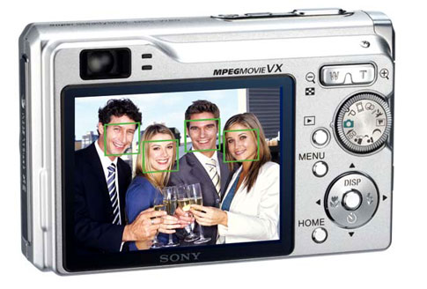
Face detection
Many new digital cameras now detect faces
  Canon, Sony, Fuji, …
Source: S. Seitz
Notes:
Why would this be useful? Main reason is focus. Also enables “smart” cropping.

Slide 39
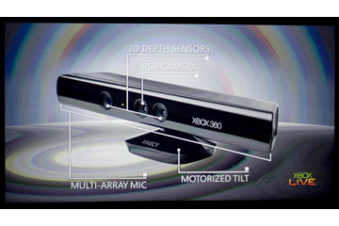
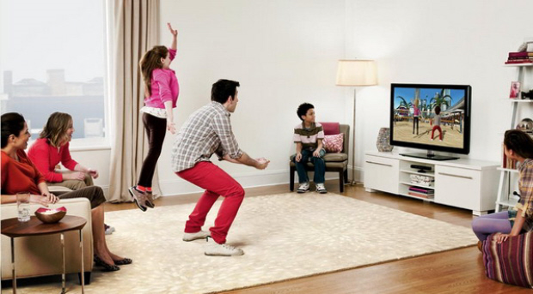
Vision-based interaction: Xbox Kinect

Slide 40
How hard is computer vision?

Slide 41
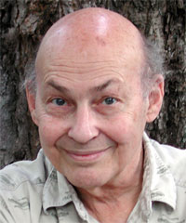
“In 1966, Minsky hired a first-year undergraduate student and assigned him a problem to solve over the summer: connect a television camera to a computer and get the machine to describe what it sees.”
Crevier 1993, pg. 88
Marvin Minsky, MIT
Turing award,1969

Slide 42
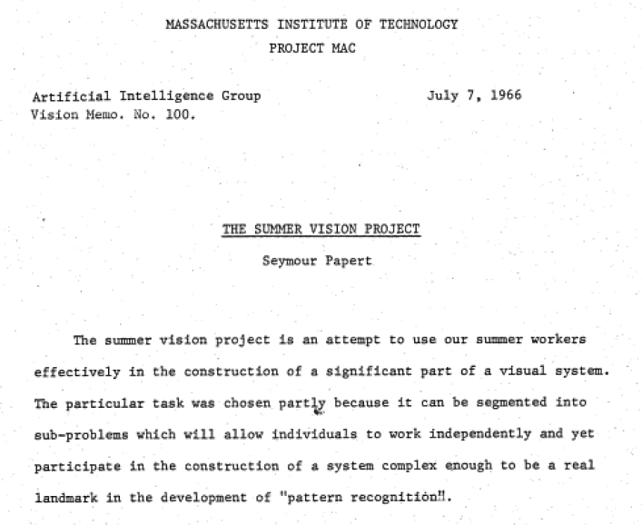

Slide 43
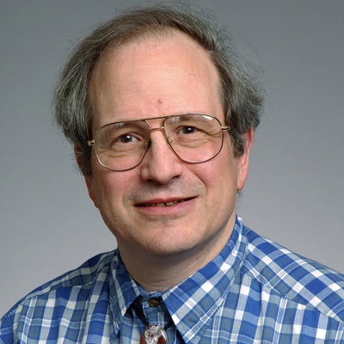
Marvin Minsky, MIT
Turing award,1969
Gerald Sussman, MIT
(the undergraduate)
“You’ll notice that Sussman never worked in vision again!” – Berthold Horn

Slide 44
Why vision is so hard?

Slide 45
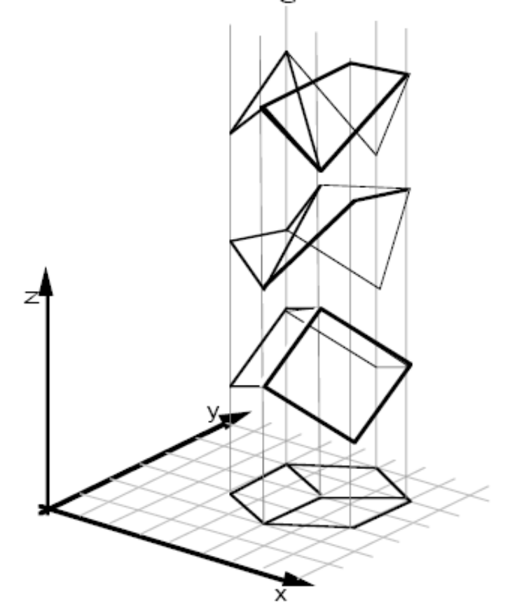
Why is vision so hard?
Ill-posed problem
[Sinha and Adelson 1993]
Notes:
Recovering 3D geometry from a single 2D image is mathematically impossible. A single 2D projection can be produced by any of infinite number of 3D geometrical configurations.

Slide 46
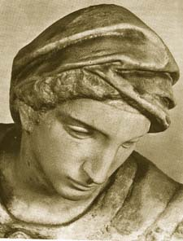
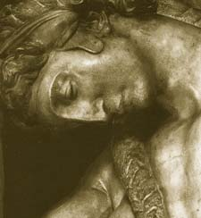

Challenges 1: view point variation
Michelangelo 1475-1564
slide by Fei Fei, Fergus & Torralba

Slide 47


Challenges 2: illumination
slide credit: S. Ullman

Slide 48

Challenges 3:
occlusion
Magritte, 1957
slide by Fei Fei, Fergus & Torralba

Slide 49

Challenges 4: scale
slide by Fei Fei, Fergus & Torralba

Slide 50

Challenges 5: deformation
slide by Fei Fei, Fergus & Torralba
Xu, Beihong 1943

Slide 51

Challenges 6: background clutter
Klimt, 1913
slide by Fei Fei, Fergus & Torralba

Slide 52






Challenges 7: object intra-class variation
slide by Fei-Fei, Fergus & Torralba

Slide 53




Challenges 8: local ambiguity
slide by Fei-Fei, Fergus & Torralba
Notes:
What is that patch in the different images? hand, shoes person talking on cellphone, car, person

Slide 54


Challenges 9: the world behind the image
Slide Credit: Alyosha Efros
Notes:
Ask Ali.

Slide 55
What Works Today?

Slide 56

Reading license plates, zip codes, checks
Svetlana Lazebnik

Slide 57




Biometrics
Fingerprint scanners on many new laptops,
other devices
Face recognition systems now beginning to appear more widely
http://www.sensiblevision.com/
Source: S. Seitz

Slide 58


Mobile visual search: Google Goggles

Slide 59
Face detection
Many digital cameras now detect faces
  Canon, Sony, Fuji, …
Source: S. Seitz
Notes:
Why would this be useful? Main reason is focus. Also enables “smart” cropping.

Slide 60


Smile detection
Sony Cyber-shot® T70 Digital Still Camera
Source: S. Seitz

Slide 61

Face recognition: Apple iPhoto, Facebook, Google, etc

Slide 62

Object recognition (in supermarkets)
LaneHawk by EvolutionRobotics
“A smart camera is flush-mounted in the checkout lane, continuously watching for items. When an item is detected and recognized, the cashier verifies the quantity of items that were found under the basket, and continues to close the transaction. The item can remain under the basket, and with LaneHawk,you are assured to get paid for it… “

Slide 63


Safety

Slide 64


Security

Slide 65

Automotive safety
Mobileye: Vision systems in high-end BMW, GM, Volvo models
  Pedestrian collision warning
  Forward collision warning
  Lane departure warning
  Headway monitoring and warning
Source: A. Shashua, S. Seitz

Slide 66

Google cars
Oct 9, 2010. "Google Cars Drive Themselves, in Traffic". The New York Times. John Markoff
June 24, 2011. "Nevada state law paves the way for driverless cars". Financial Post. Christine Dobby
Aug 9, 2011, "Human error blamed after Google's driverless car sparks five-vehicle crash". The Star (Toronto)

Slide 67
Vision-based interaction: Xbox Kinect

Slide 68

Augmented reality, consumer products
Mark Billinghurst and Tom Furness developed with me.
http://nconnex.com/wp/

Slide 69




Special effects: shape and motion capture
Source: S. Seitz
Notes:
vision are used in many special effects. 3D modeling is used to insert synthetic objects in the scene and relight them, so they look realistic. In motion capture, instead of animating the motion from scratch, you can have people performing the motion, then the motion is transferred to the animated character.

Slide 70

Vision for robotics, space exploration
NASA'S Mars Exploration Rover Spirit captured this westward view from atop
a low plateau where Spirit spent the closing months of 2007.
Vision systems (JPL) used for several tasks
  Panorama stitching
  3D terrain modeling
  Obstacle detection, position tracking
Source: S. Seitz

Slide 71


Medical imaging
3D imaging
MRI, CT
Image guided surgery
Grimson et al., MIT

Slide 72

Classification of 22q11.2DS
Treat 2D azimuth-elevation angle
histogram as feature vector
Notes:
We also used the 2D histogram to analyze the 22q11.2DS data.
This figure shows the projection of the histogram bins back onto the face. We can see that there is a difference in the pattern between individuals with 22q11.2DS and controls.
All the experiments were performed using 10 fold cross validation
SVM classifier

Slide 73


Computer vision research in healthcare
assisted living, patient monitoring
[Lan et al, PAMI 2012]
autism screening
http://www.gatech.edu/newsroom/release.html?nid=60509

Slide 74
Computer vision in the real-world
Most examples are less than 7 years old
Very active research area. Many new applications to come.
A website of computer vision industries maintained by Prof. David Lowe (UBC)
Note: website is old but interesting
Note: David Lowe retired and moved to Google 2015 to 2018
http://www.cs.ubc.ca/~lowe/vision.html

Slide 75
Assignments
Assignment 1: Fun with Color
Assignment 2: Image Resizing and Filtering
Assignment 3: Panorama Stitching
Assignment 4: Neural Networks
Assignment 5: Pytorch and Deep Neural Nets
Course Project: Teams working on Machine Learning Projects

Slide 76
Assignment 1
It’s about color, which we will next time.
It’s meant to be very easy, but you want to start it early.

Slide 77

Assignment 1 Parts
1. data class for an image
    class Image:
    w: int
    h: int
    c: int
    data: np.ndarray
So an image is a 3D array with channels, height, and width (like for colors).
data is floating point numbers between 0 and 1

Slide 78
Assignment 1: Parts
Read them
TODO #1: get_pixel and set_pixel
TODO #2: copy_image
TODO #3: rgb_to_grayscale
TODO #4: shift_image (shifts values)
TODO #5: clamp_image (get values between 0 and 1)
TODO #6: rgb_to_hsv
TODO #7: hsv_to_rgb

Slide 79
Have Fun
But note:
Collaboration is encouraged! Feel free to discuss homework and class material with
other students. However, make sure you understand the concepts. Each student will
complete and submit their own work. Do not directly or indirectly copy other students' work.
It is entirely illegal to copy code you find on the web from former students (or whatever it
may be) or to have one of the versions of GPT (or any LLM) generate your code.
If you are working together or helping another student, work on teaching them concepts and
answering general questions, not directly telling them what code to write. You're all smart;
you should understand the line between productive collaboration and giving someone answers.

