Slide 1
Generative Diffusion Models
Mehmet Saygin Seyfioglu
02/27/24

Slide 2
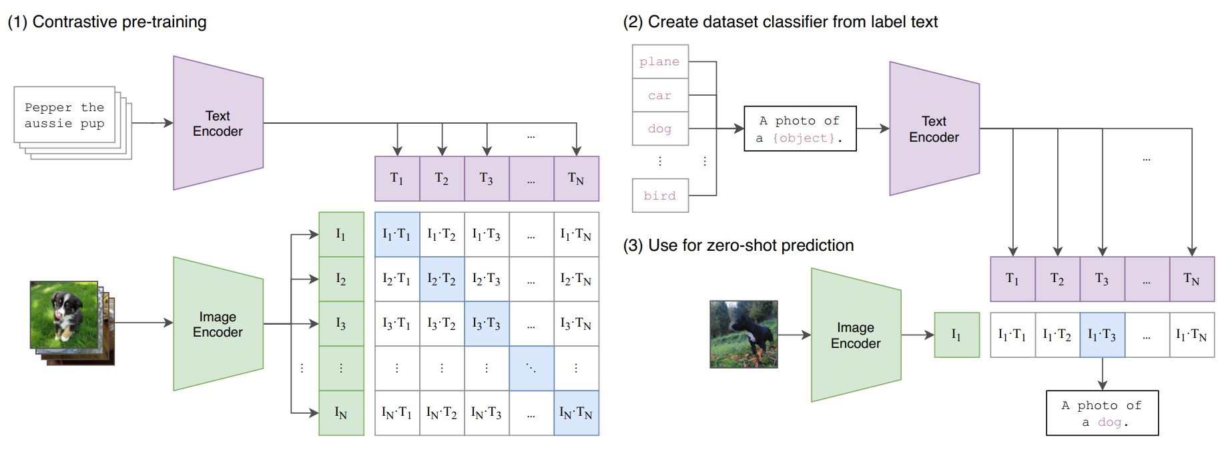
Recap CLIP
We talked about image-text (multi modal) learning with CLIP.
  This is very useful in other domains!

Slide 3
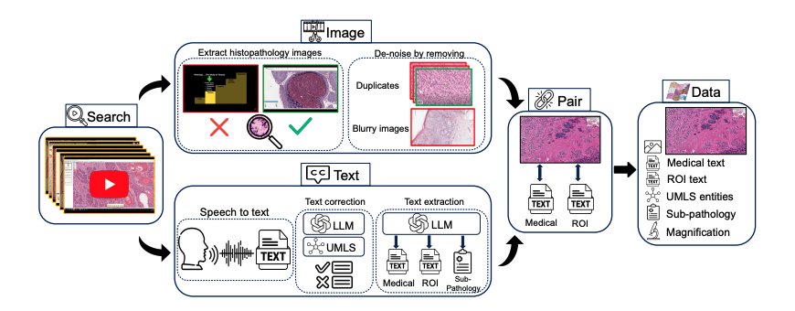
Quilt-1M
Ikezogwo et al. "Quilt-1m: One million image-text pairs for histopathology." Advances in Neural Information Processing Systems 36 (2024).

Slide 4
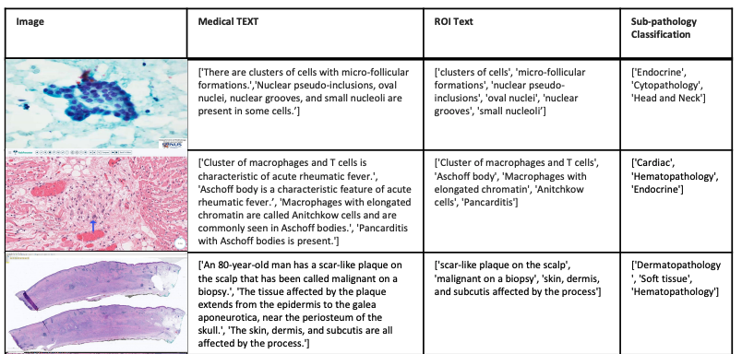
Quilt-1M: Dataset

Slide 5
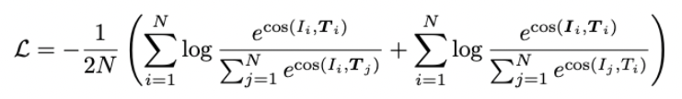
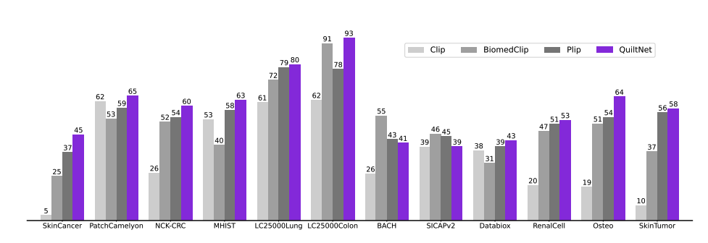
QuiltNet

Slide 6
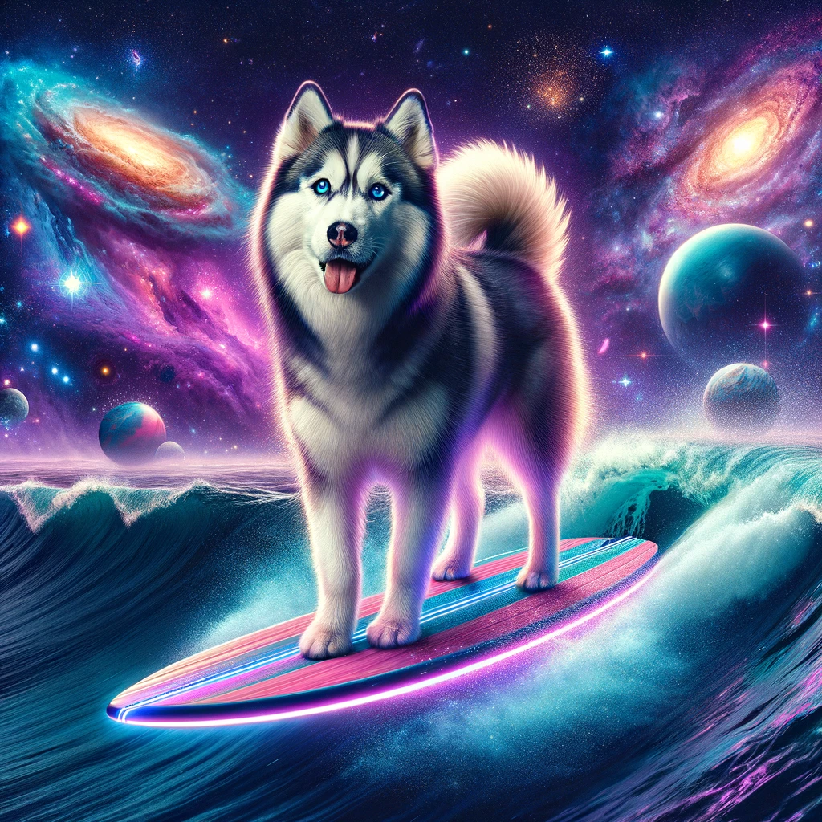
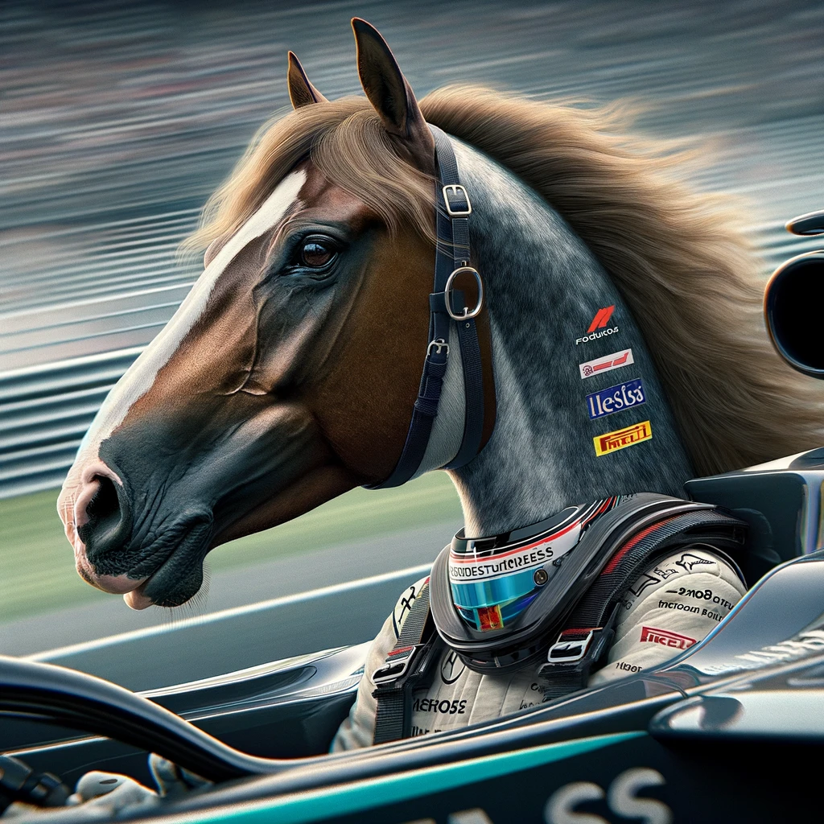
Diffusion Models
An image of a husky surfing in the space
A horse formula 1 driver
Notes:
In recent years, a new paradigm was born in the AI field called diffusion generative models, which dethroned Generative Adversarial Networks.

Slide 7
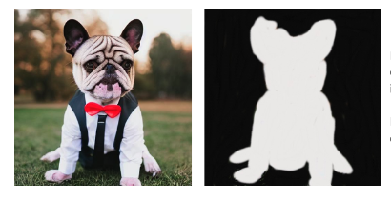
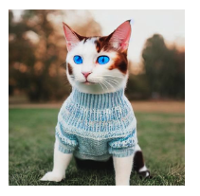

Inpainting
Taken from https://aws.amazon.com/tr/blogs/machine-learning/inpaint-images-with-stable-diffusion-using-amazon-sagemaker-jumpstart/

Slide 8
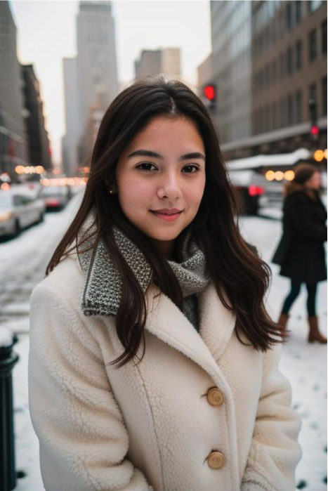
Outpainting
Taken from https://blog.segmind.com/exploring-the-magic-of-outpainting-with-stable-diffusion-uncropping-the-creative-possibilities/

Slide 9
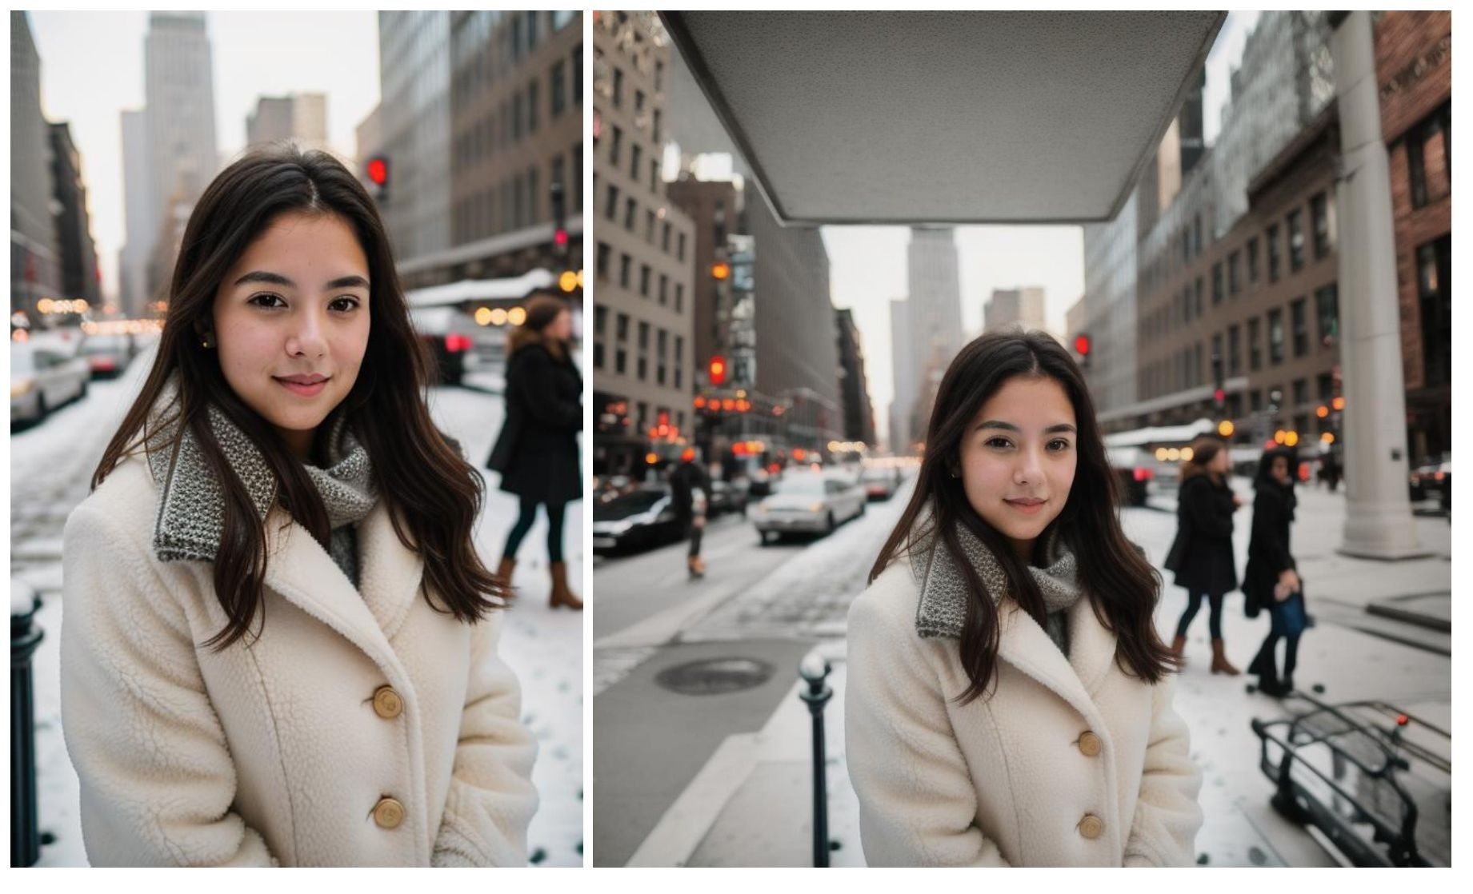
Outpainting
Taken from https://blog.segmind.com/exploring-the-magic-of-outpainting-with-stable-diffusion-uncropping-the-creative-possibilities/

Slide 10
Diffusion Models
Is actually a self-supervised framework.
This time, instead of aligning image and text embeddings, like in the case of CLIP. We do something more advanced.
We learn the distribution of images, then use text (or whatever other modality) to generate them from noise.
How?

Slide 11
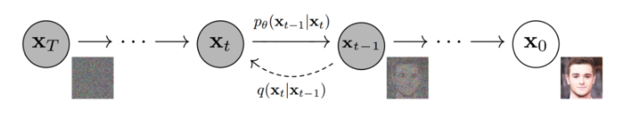


Diffusion Models
What we aim is to, create a self-supervised paradigm, where we gradually add noise to an image until it becomes an isotropic gaussian noise.
Then use a neural network to predict the added noise and gradually decrease it.
Pdf of an image at timestep t given image x_{t-1}
Pdf of x_{t-1} given x_t parameterized by the model (theta)
Taken from https://learnopencv.com/denoising-diffusion-probabilistic-models/
Notes:
isotropic gaussian means zero mean and unit variance (for all pixels)
We are sampling the mean of every pixel, or the distribution of our images.
https://learnopencv.com/denoising-diffusion-probabilistic-models/

Slide 12
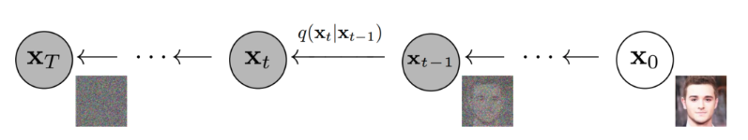
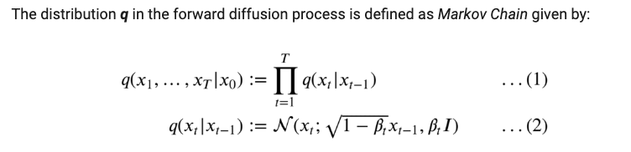
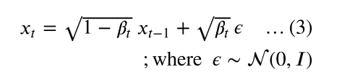
The Forward Process
The probability density function
Adding noise
x_t is generated from x_{t-1} adding noise.
In this way, starting from x0, the original image is iteratively corrupted from t=1…T
Notes:
The distribution q is calculated by a markov chain. This distribution simply tells us how the image pixel means and variances are distributed after applying this noising process in a chain.
We begin by taking an image from our dataset: x0. Mathematically it’s stated as sampling a data point from the original (but unknown) data distribution: x0 ~ q(x0).
The PDF of the forward process is the product of individual distribution starting from timestep 1 → T.
The forward diffusion process is fixed and known. so no learning here
At each timestep t, the parameters that define the distribution of image xt are set as:
Mean : sqrt(1-B_t)x_{t-1} here Beta_t is a scheduler factor and Coviariance is B_t * I where I is isotropic gaussian distribution (gaussian of zeros means and Identity covariance, means pixels has no relationship with one another) Also this is a distribution because we consider a group of pixels, not just one pixel. So mean and variance of each pixel

Slide 13
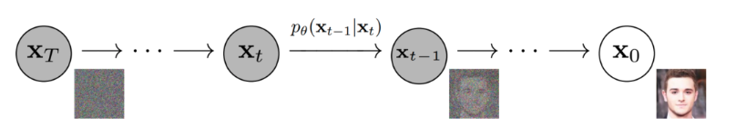

Reverse Diffusion Process
Reverse Markov Chain -> We want this because if we follow the forward trajectory in reverse, we may return to the original data distribution
At step x_{t-1}, the network predicts the mean of the noise that is added at x_t
In doing so, we would also learn how to generate new samples that closely match the underlying data distribution, starting from a pure gaussian noise
Ho, Jonathan, Ajay Jain, and Pieter Abbeel. "Denoising diffusion probabilistic models." Advances in neural information processing systems 33 (2020):
Notes:
The learning happens here
The Markov chain for the reverse diffusion starts from where the forward process ends, i.e., at timestep T, where the data distribution has been converted into (nearly an) isotropic gaussian distribution.
The PDF of the reverse diffusion process is an “integral” over all the possible pathways we can take to arrive at a data sample (in the same distribution as the original) starting from pure noise xT.
Turns out “maximizing the log-likelihood of the sample generated (at the end of the reverse process) (x) belonging to the original data distribution.” is the same process as predicting the noise added at each step (Check original DDPM paper and the references therein to understand the math fully. It’s out of the scope of this class, as it requires an understand on reparameterization trick, evidence lower bound, variational autoencoding etc. )

Slide 14
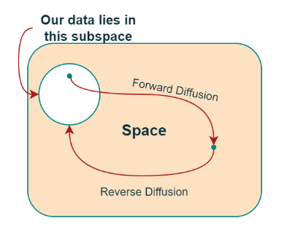
A high-level conceptual overview of the entire image space
Notes:
Move a sample point out of its distribution manifold into isotropic gaussian space, then reverse it.
Why do we have to do it gradually? Would it be tractable to go from N(0,1) to images directly? (Nope, original ddpm paper states that it is not tractable)
What is the point of this though? We do this because if we manage to learn this reverse process, we start from noise, run the reverse process and acquire a sample from q(x_0), generating a novel data point from the original data distribution!

Slide 15
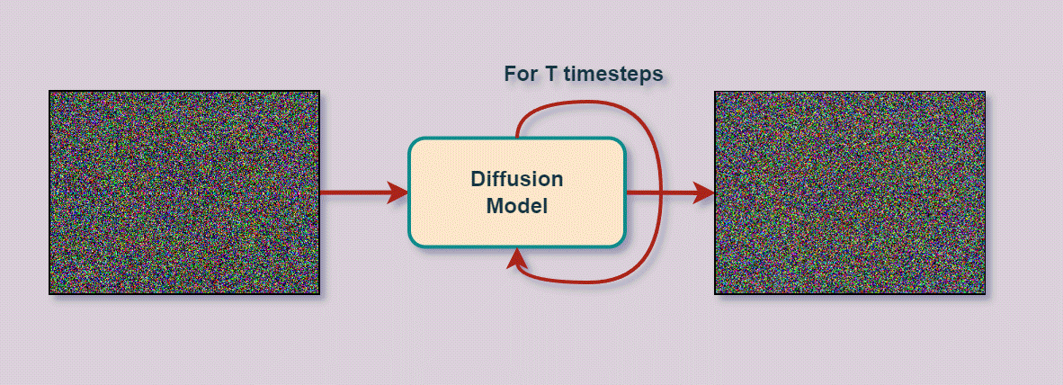
After Learning The Model

Slide 16
Conditional Diffusion
Better yet, instead of just learning the underlying data distribution to sample new stuff of that certain category, we can guide the diffusion process. This is great because we can now then mix concepts together, which the model has not even seen before!
Remember LAION 5b? That’s really handy to train this model (image caption pairs)
Also the CLIP model? That’s a tool we could leverage

Slide 17
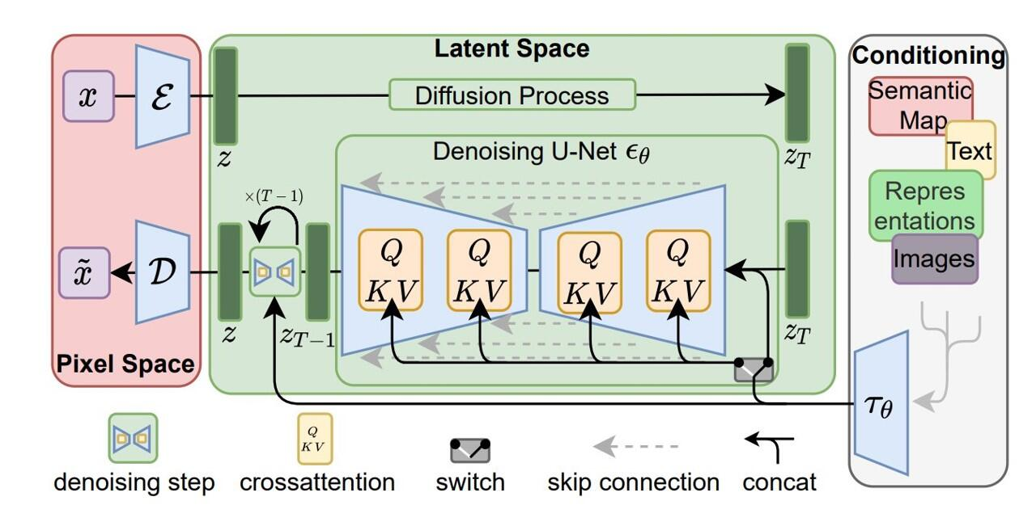
The Only Open-Source Diffusion Model: Stable Diffusion
Rombach, Robin, et al. "High-resolution image synthesis with latent diffusion models." Proceedings of the IEEE/CVF conference on computer vision and pattern recognition. 2022.

Slide 18
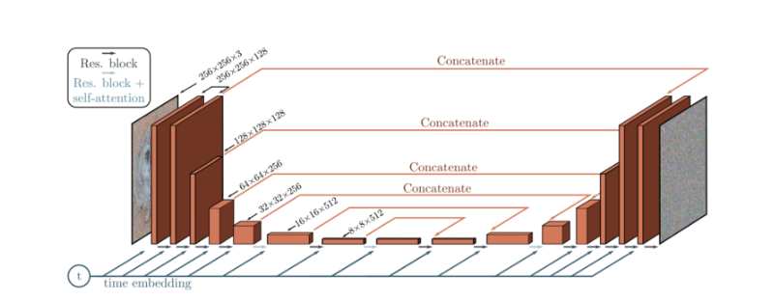
Architecture

Slide 19
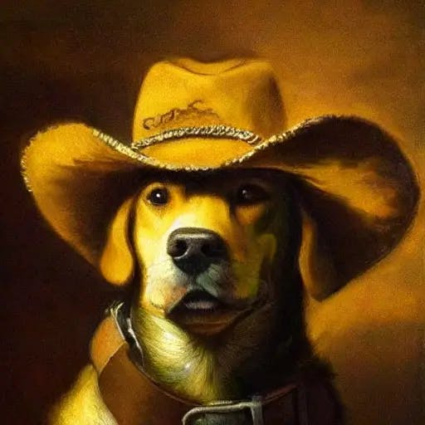
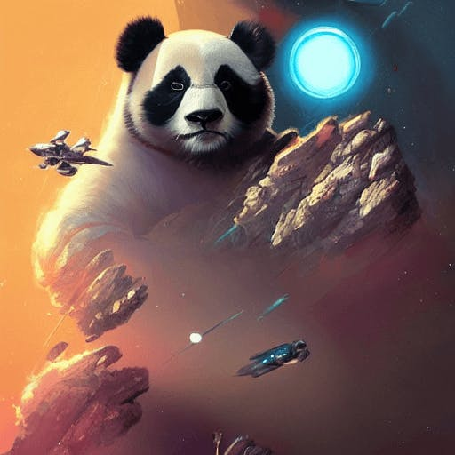
Stable Diffusion Examples
A Dog In A Hat Looking
Like A Vintage Portrait
A Giant Panda In
Between A Celestial War

Slide 20
Some State of the Art Diffusion Applications
In the last year, some cool methods have been proposed using Stable Diffusion.

Slide 21
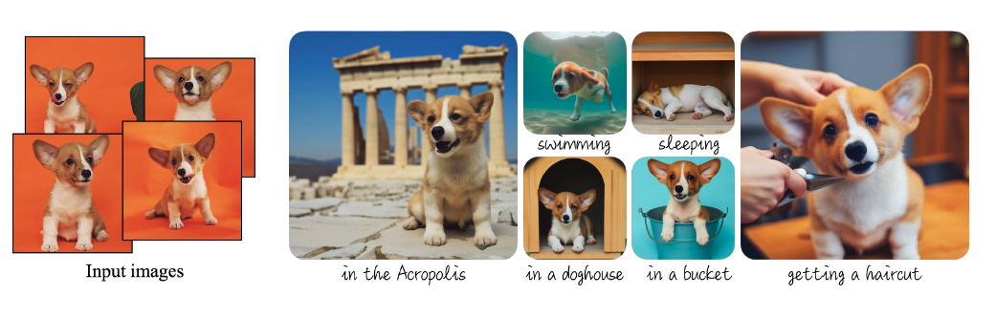
DreamBooth
Ruiz, Nataniel, et al. "Dreambooth: Fine tuning text-to-image diffusion models for subject-driven generation." Proceedings of the IEEE/CVF Conference on Computer Vision and Pattern Recognition. 2023.

Slide 22
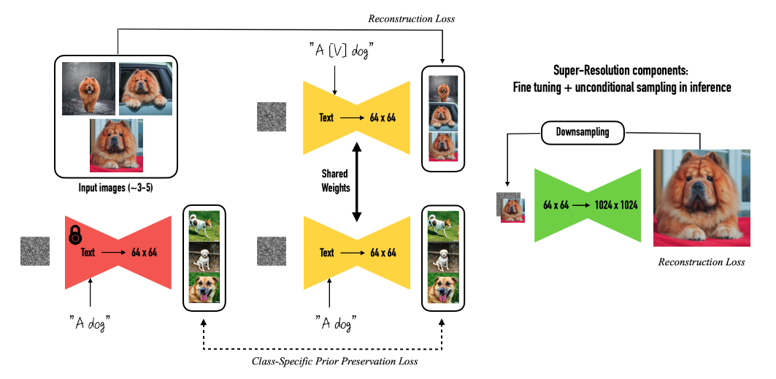
DreamBooth

Slide 23
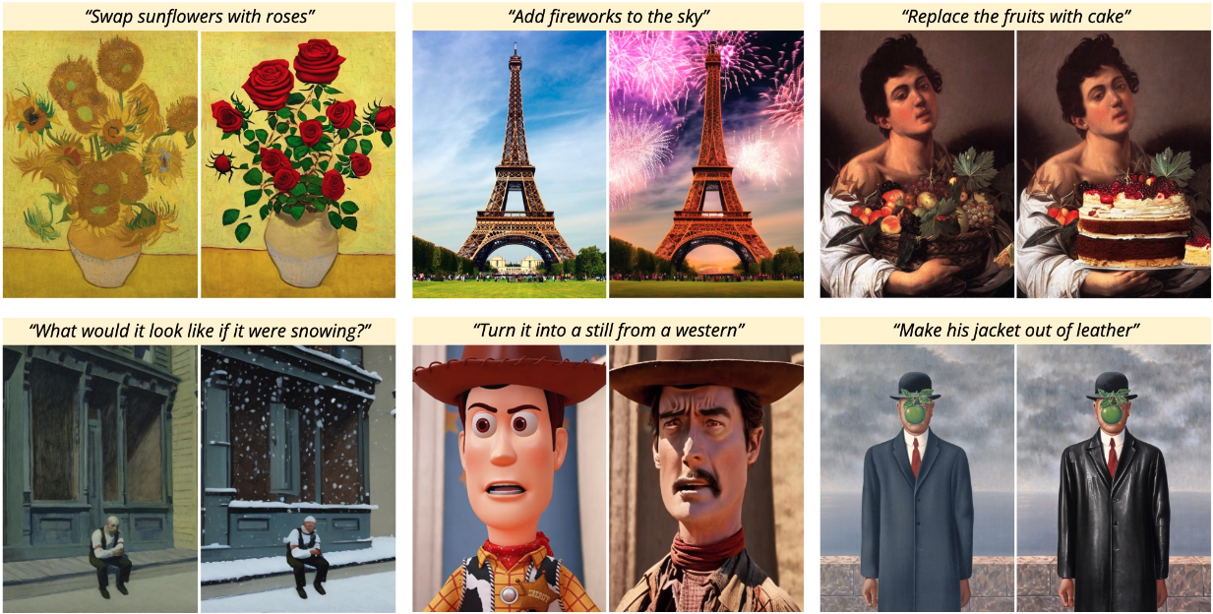
InstructPix2Pix

Slide 24
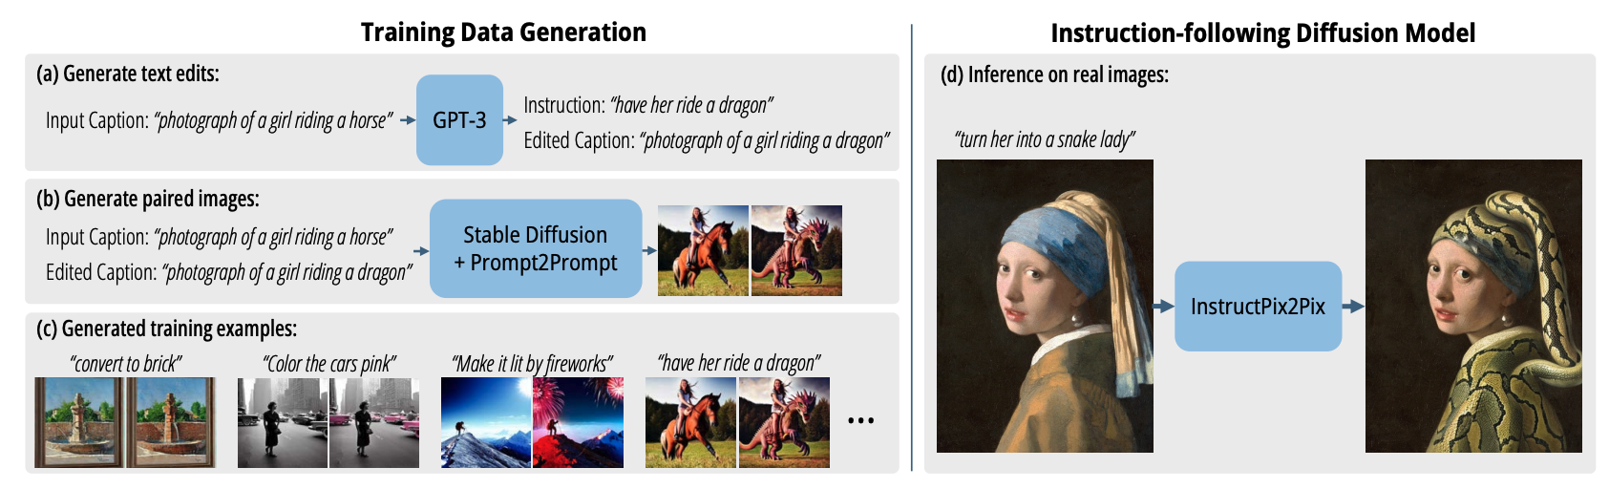
InstructPix2Pix
Brooks, Tim, Aleksander Holynski, and Alexei A. Efros. "Instructpix2pix: Learning to follow image editing instructions." Proceedings of the IEEE/CVF Conference on Computer Vision and Pattern Recognition. 2023.

Slide 25
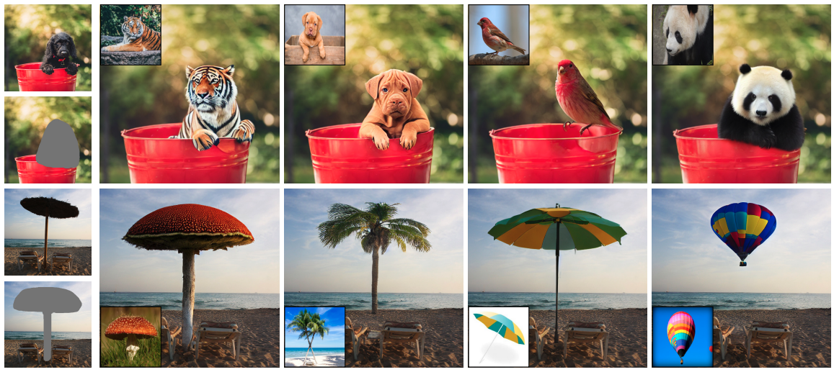
Paint by Example
Yang, Binxin, et al. "Paint by example: Exemplar-based image editing with diffusion models." Proceedings of the IEEE/CVF Conference on Computer Vision and Pattern Recognition. 2023.

Slide 26
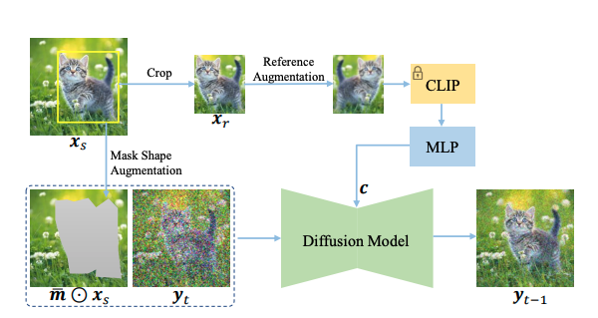
Paint by Example

Slide 27
My Diffusion Research
I try to achieve Virtual Try-All
Allowing shoppers to virtually ‘try’ any product from any category within their personal environments (in the wild examples).

Slide 28
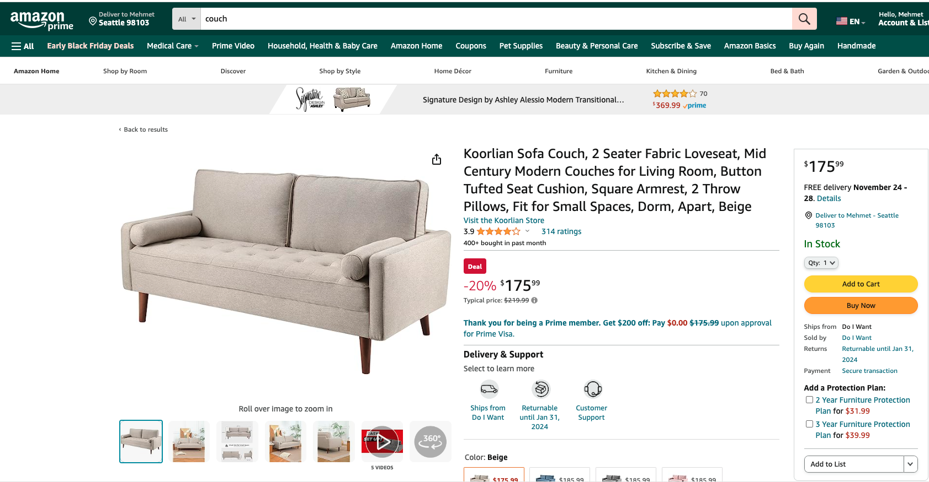
Virtual Try-All cont’d

Slide 29
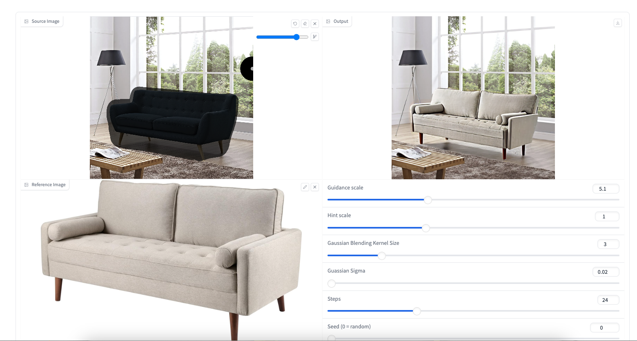
Virtual Try-All cont’d

Slide 30
How?
For Virtual Try-All model to be effective, it must fulfill three primary conditions:
Operate in any 'in-the-wild' user image, and reference image,
Integrate the reference product harmoniously with the surrounding context while maintaining the product's identity
Perform fast inference to facilitate real-time usage across billions of products and millions of users.

Slide 31
DreamPaint
Previously we implemented DreamPaint [1] (Dreambooth-Inpaint), which is a framework to intelligently inpaint any e-commerce product on any user-provided context image without requiring any expensive 3D AR/VR inputs.
[1] Seyfioglu, Mehmet Saygin, et al. "DreamPaint: Few-Shot Inpainting of E-Commerce Items for Virtual Try-On without 3D Modeling." arXiv preprint arXiv:2305.01257 (2023).

Slide 32
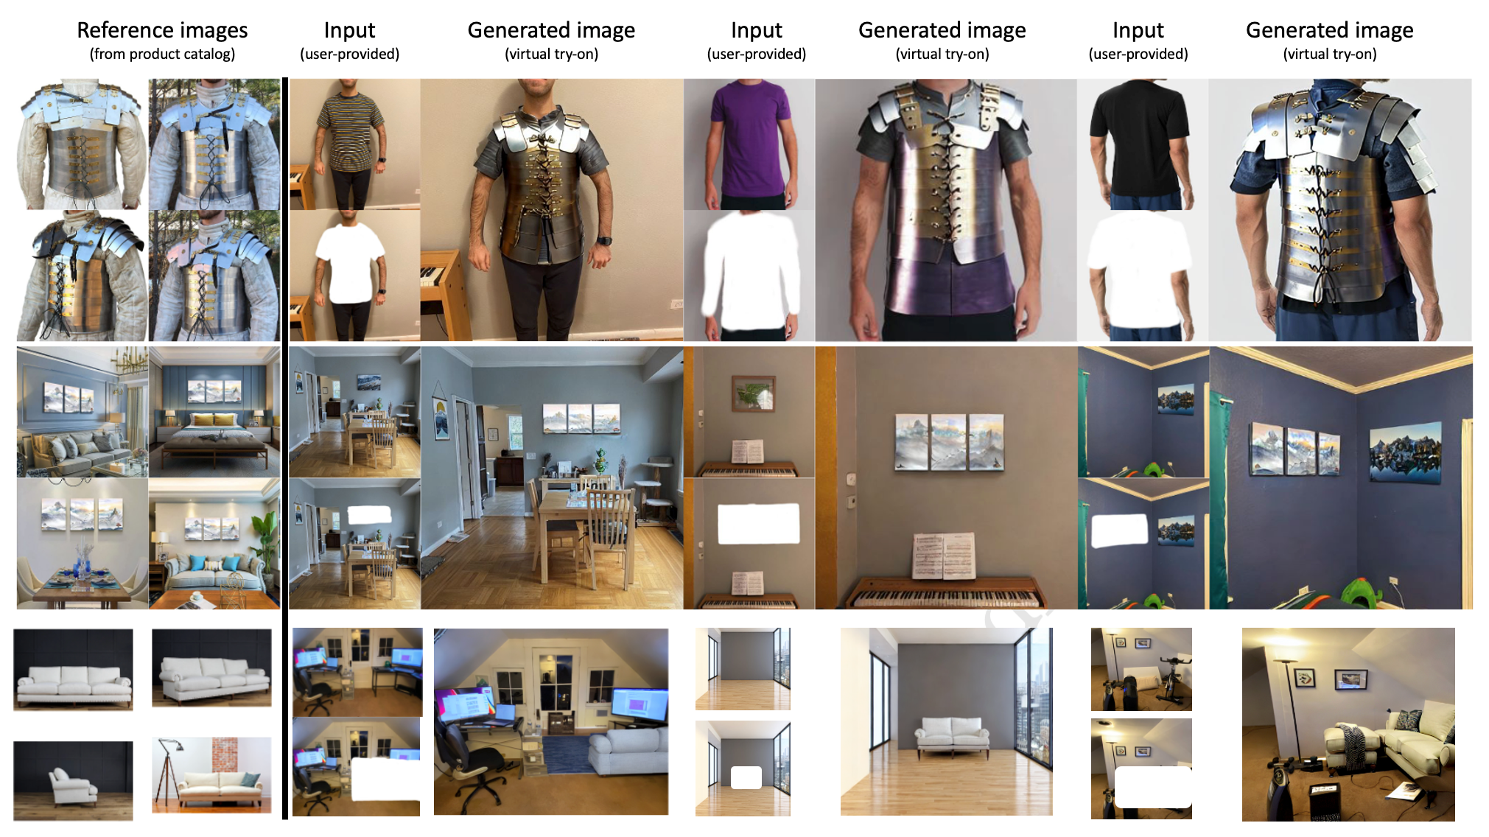
DreamPaint Examples

Slide 33
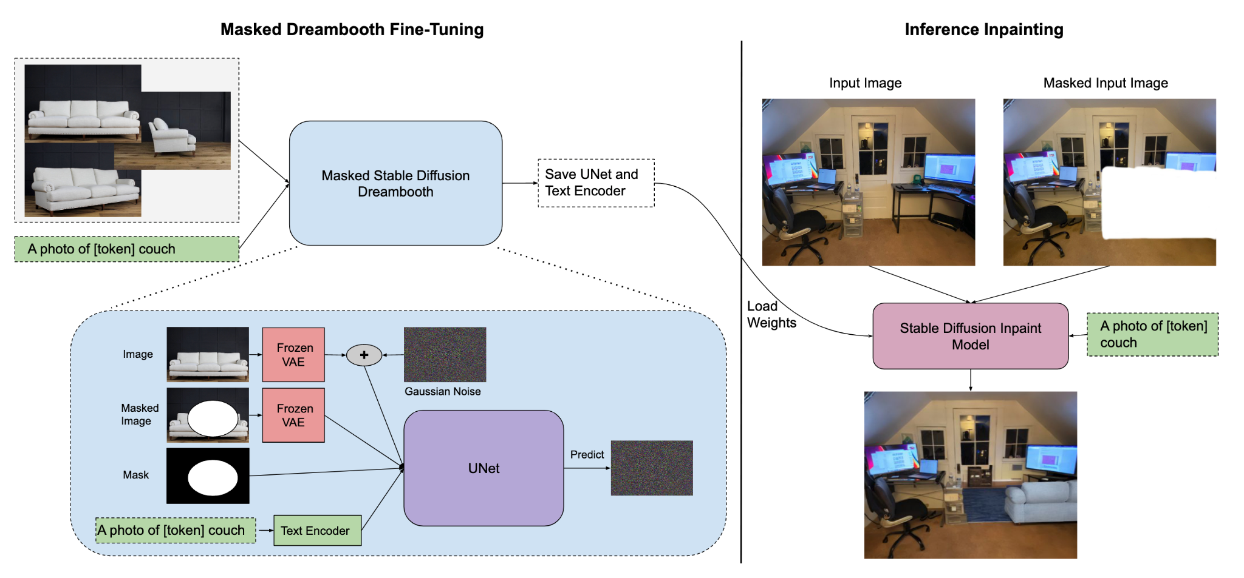
DreamPaint Model

Slide 34


DreamPaint
DreamPaint is pretty good at operating with in-the-wild images.
DreamPaint can preserve most of the product details, and can semantically blend the product image with its context.
DreamPaint requires 40 minutes of fine-tuning with few-shot examples for each product.
  We can do LORA + save only cross attention weights to save space (which reduces model size from 10GB to 30MB) But we still have to train individual models for each asin.

Slide 35
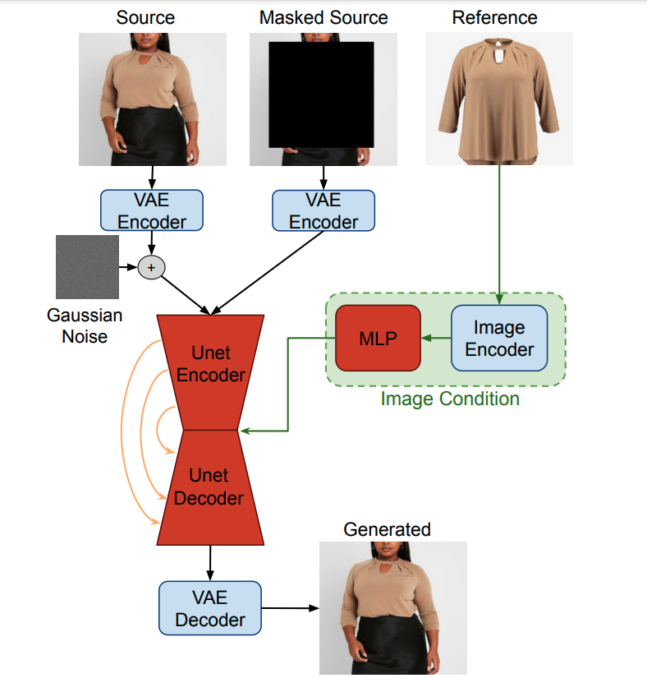
Paint by Example (PBE)
For catalog items, we don’t have to constraint ourselves with self-referencing.
  Thus no need for the information bottleneck and aggressive augmentations.
How far can we go with this approach?

Slide 36

PBE
PBE is pretty good at operating with in-the-wild images.
PBE in its proposed form cannot preserve most product details.
After trained, PBE can operate in zero-shot setting, only takes about 5 seconds to generate an image on a low-end GPU with 12GB of RAM.

Slide 37
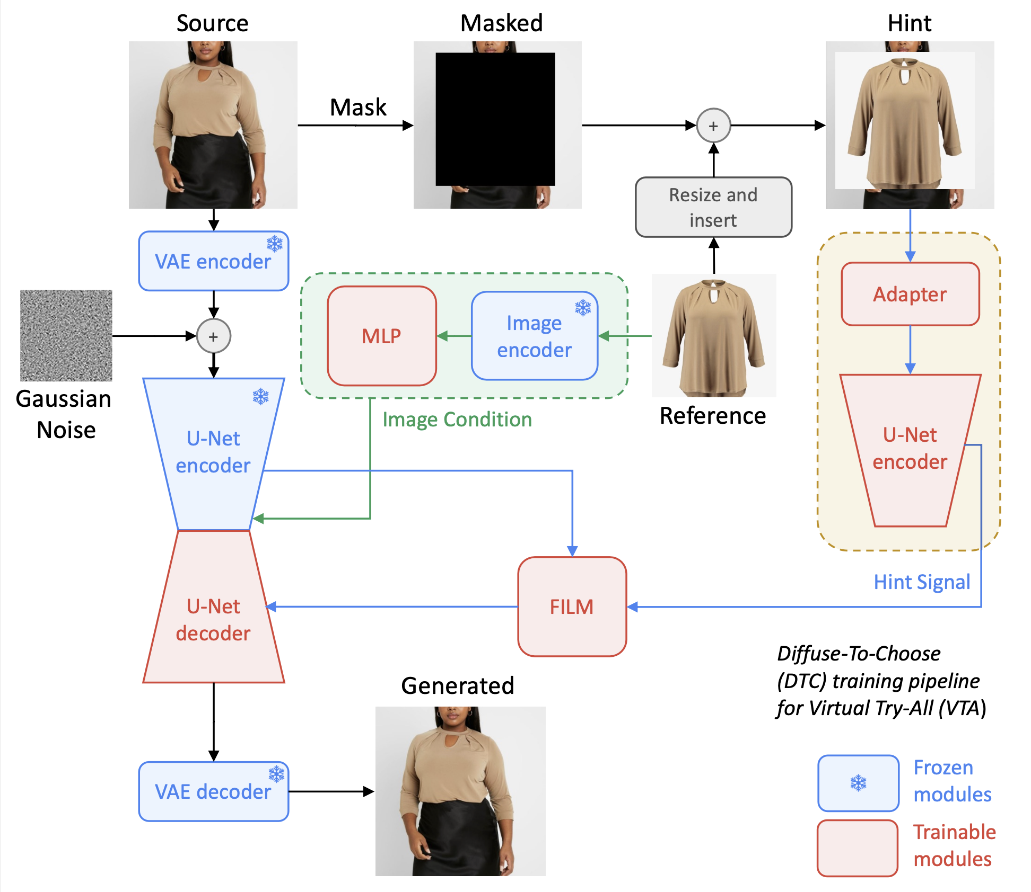
Diffuse to Choose

Slide 38
Diffuse to Choose
https://7cb9c8c71416f5be57.gradio.live/

Slide 39
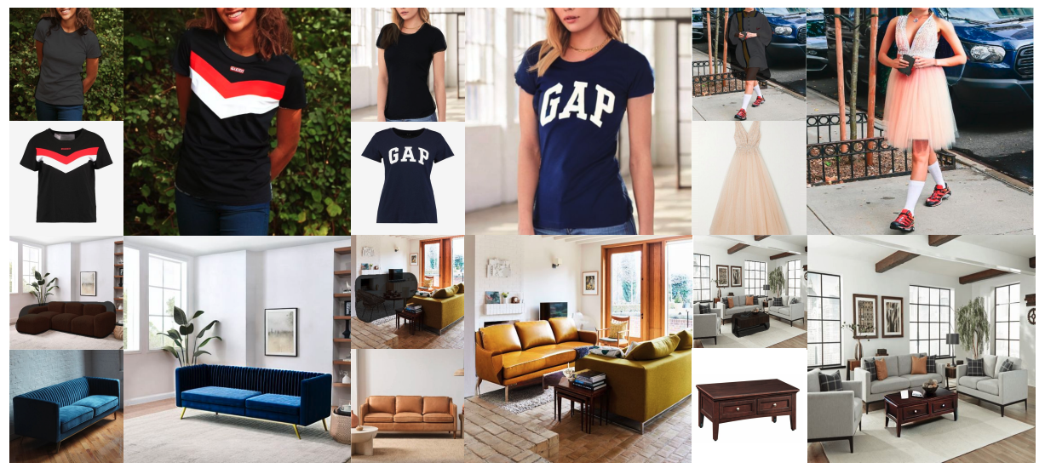
Visual Results

Slide 40
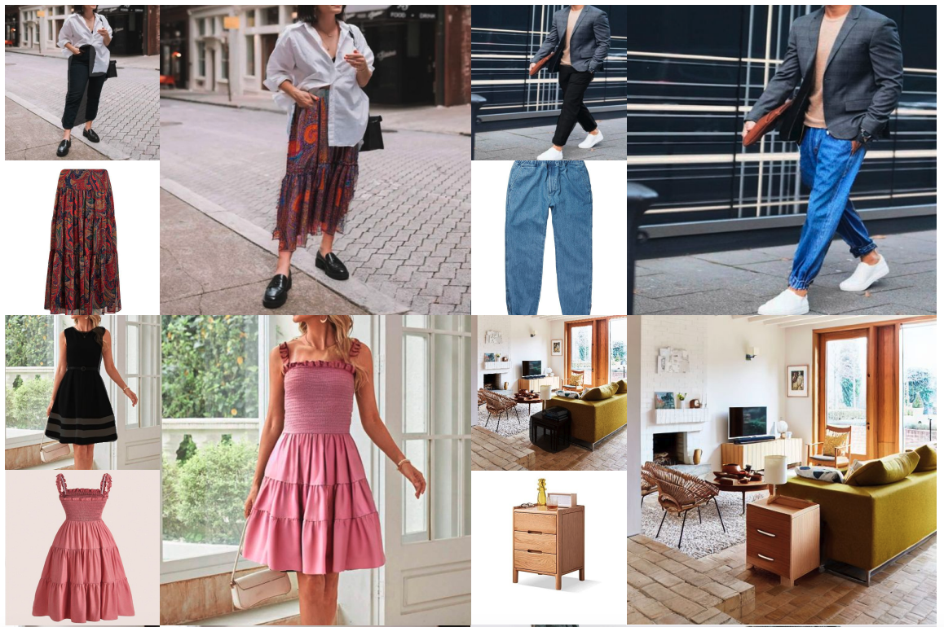
Visual Results

Slide 41
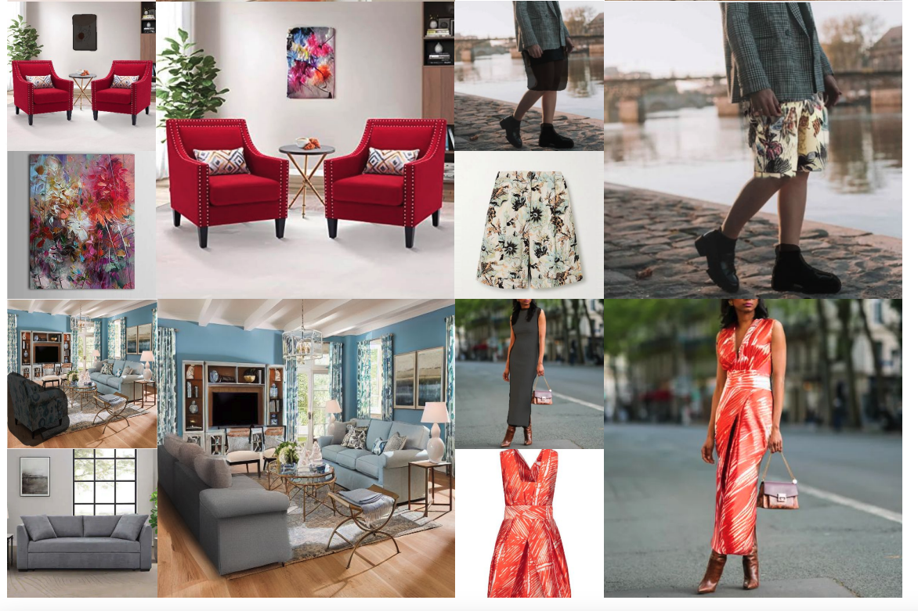
Visual Results

Slide 42
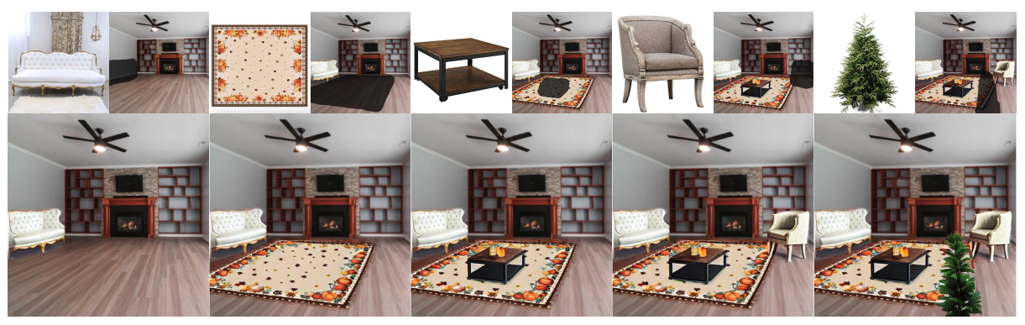
Iterative Decoration

Slide 43
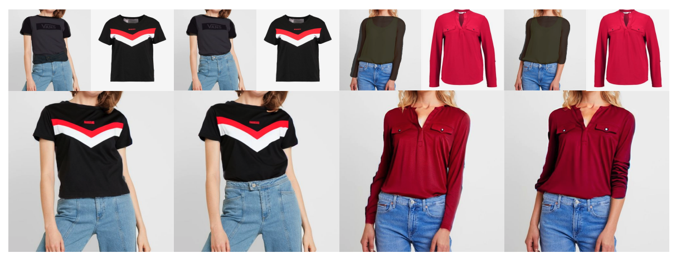
Cool Masking Effect

Slide 44
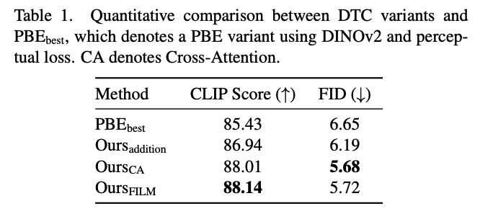
The Best DTC variant
Directly stitch the hint image and use FILM on decoding (we computed FID and CLIP scores on our dataset) performs the best. (Cross Attention is really close to FILM)

Slide 45
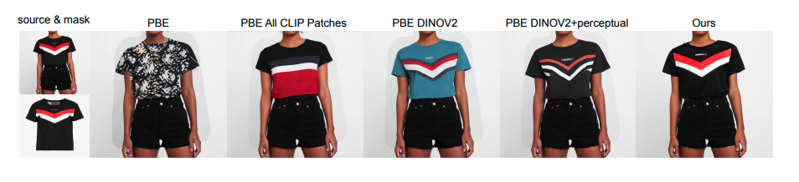
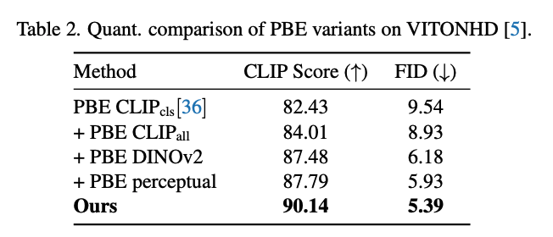
Compare Against PBE variants

Slide 46
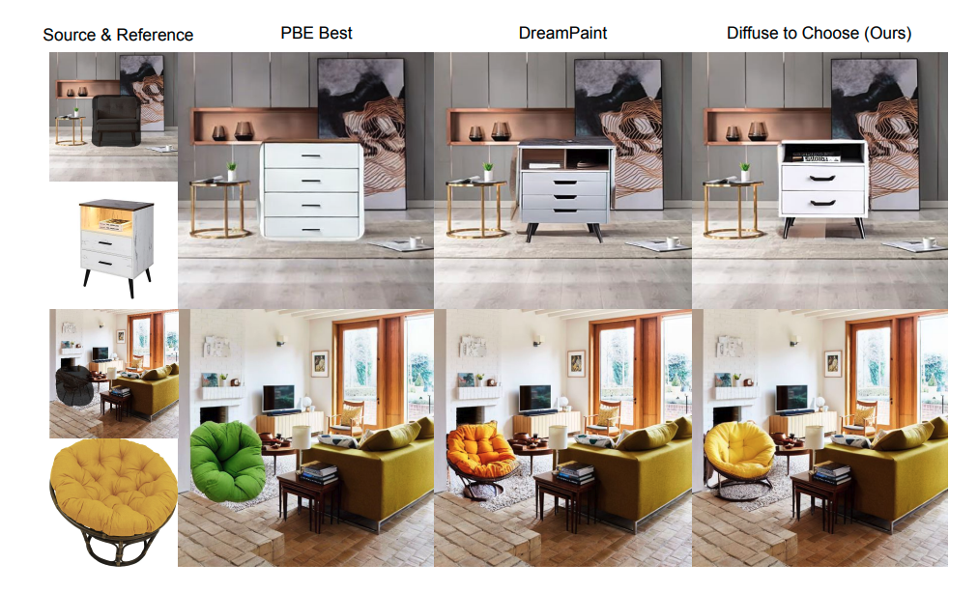
We further compared against DreamPaint

Slide 47
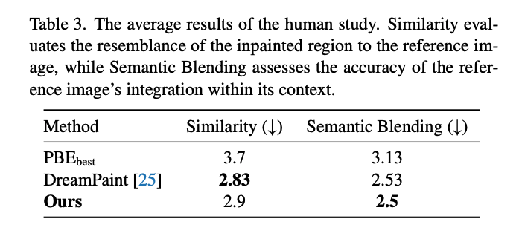
Human Study

