Slide 1
Computer Vision
CSE 455
Matching and Blending
Linda Shapiro
Professor of Computer Science & Engineering
Professor of Electrical & Computer Engineering

Slide 2
Review
Descriptors
Matching
Computing Transformation

Slide 3
Simple Normalized Descriptor
interest point neighborhood around normalized neighborhood
interest point around interest point
56 200
201 200
85 101 105
145 1
0 1
116 100 96
201
The simple descriptor just subtracts the center value from each of the neighbors, including itself to normalize for lighting and exposure.
We can store this as a 1D vector to be efficient:
156 145 1 155 0 1 116 100 96

Slide 4
Properties of our Descriptor
Translation Invariant
Not scale invariant
Not rotation invariant
Somewhat invariant to lighting changes
Let’s look at the SIFT descriptor, because it is heavily used, even without using the SIFT key point detector.
It already solves the scale problem by computing at multiple scales and keeping track.

Slide 5
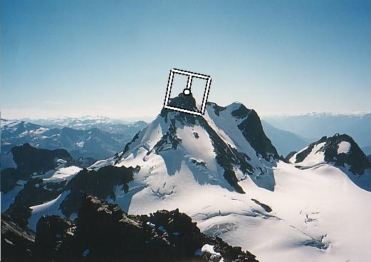
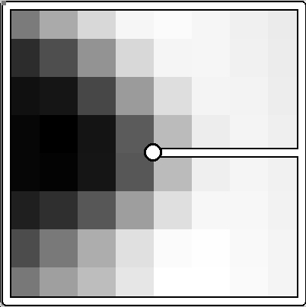
Rotation invariance
CSE 576: Computer Vision
Rotate patch according to its dominant gradient orientation
This puts the patches into a canonical orientation.
Image from Matthew Brown
Notes:
5

Slide 6
Orientation Normalization
Compute orientation histogram
Select dominant orientation
Normalize: rotate to fixed orientation
[Lowe, SIFT, 1999]
0
2
π
T. Tuytelaars, B. Leibe

Slide 7
Once we have found the key points and a dominant orientation for each,
we need to describe the (rotated and scaled) neighborhood about each.
128-dimensional vector

Slide 8
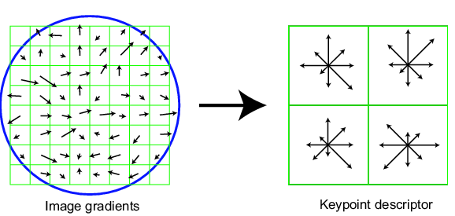
SIFT descriptor
Full version
  Divide the 16x16 window into a 4x4 grid of cells (2x2 case shown below)
  Compute an orientation histogram for each cell
  16 cells * 8 orientations = 128 dimensional descriptor
Adapted from slide by David Lowe

Slide 9
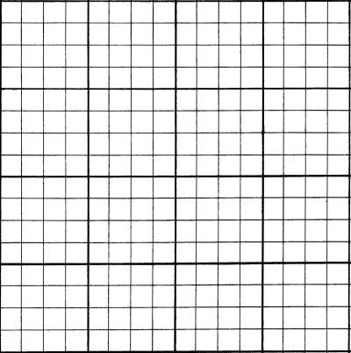

SIFT descriptor
Full version
  Divide the 16x16 window into a 4x4 grid of cells
  Compute an orientation histogram for each cell
  16 cells * 8 orientations = 128 dimensional descriptor
8 8 . . . 8

Slide 10
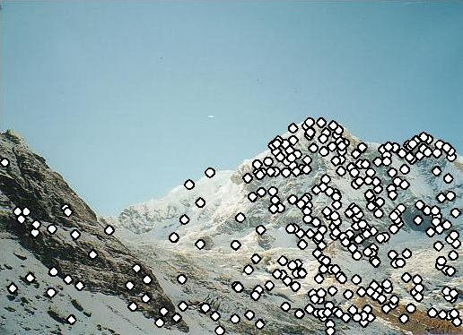
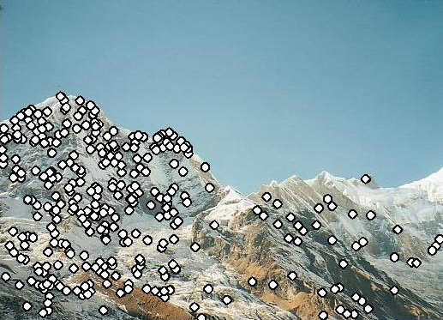
Matching with Features
Detect feature points in both images

Slide 11
Matching with Features
Detect feature points in both images
Find corresponding pairs

Slide 12
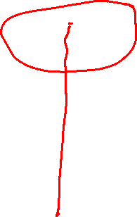
Find the best matches
For each descriptor a in A, find its best match b in B
And store it in a vector of matches
Note: this is abstract; see code for details.
A B M
i j
i
j

Slide 13
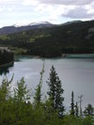
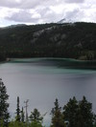
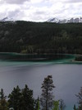
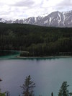
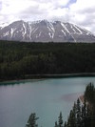
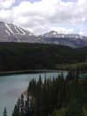
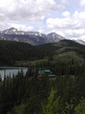
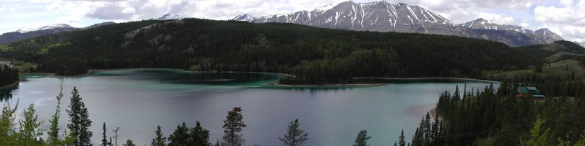
Larger Goal: Combine two or more overlapping images to make one larger image
Add example
Slide credit: Vaibhav Vaish

Slide 14


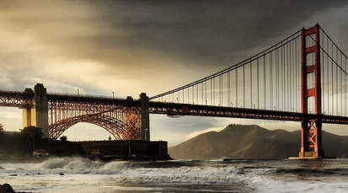
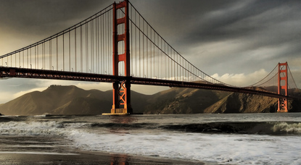




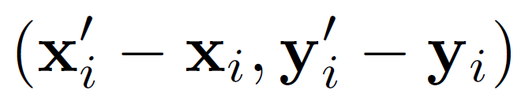
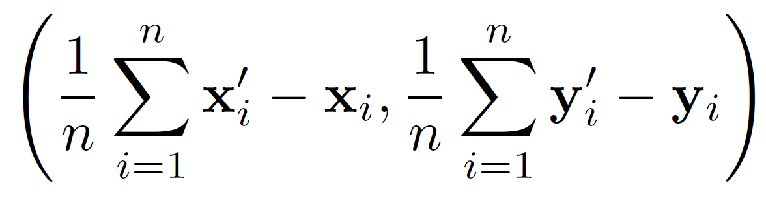

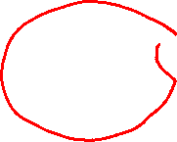
Simple case: translations
Displacement of match i =
Mean displacement =

Slide 15
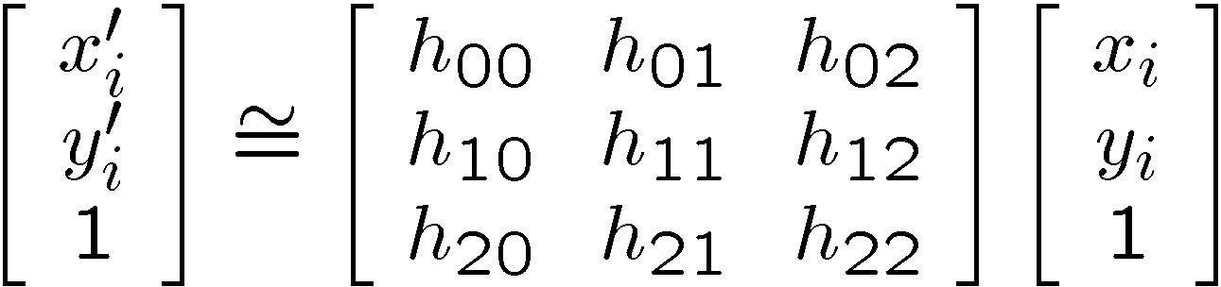
Solving for homographies
Why is this now a variable and not just 1?
A homography is a projective object, in that it has no scale.
It is represented by the above matrix, up to scale.
One way of fixing the scale is to set one of the coordinates to 1,
though that choice is arbitrary.
But that’s what most people do and your assignment code does.

Slide 16
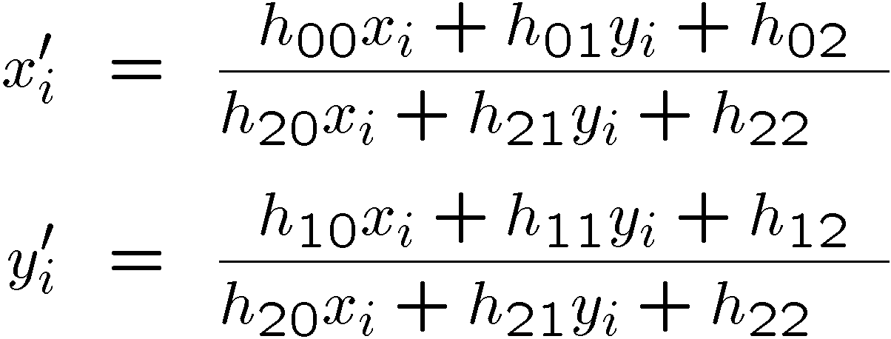
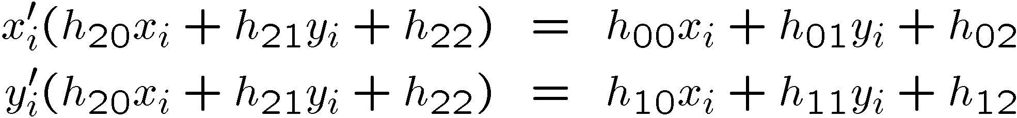

Solving for homographies
Why the division?

Slide 17
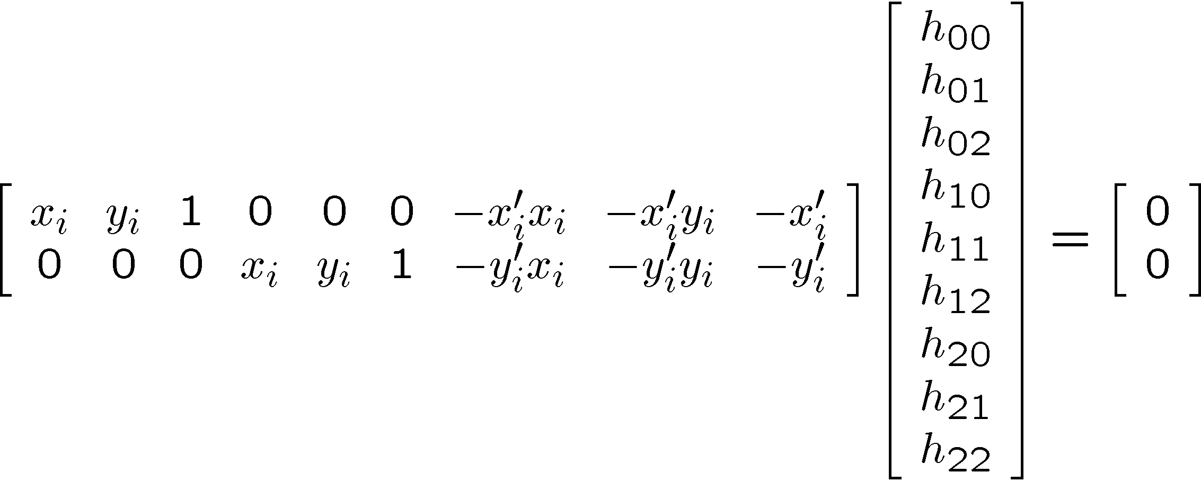
Solving for homographies
This is just for one pair of points.

Slide 18
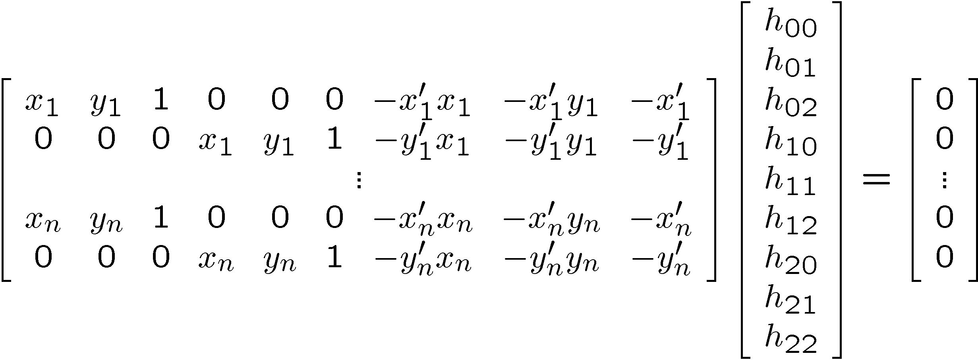






Direct Linear Transforms (n points)
2n × 9
9
2n
Defines a least squares problem:
  Since is only defined up to scale, solve for unit vector
  Solution: = eigenvector of with smallest eigenvalue
  Works with 4 or more points

Slide 19
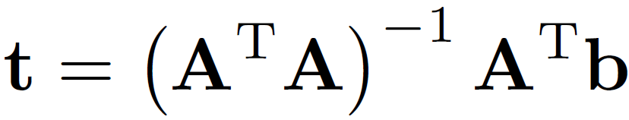
Direct Linear Transforms
Why could we not solve for the homography in exactly the same way we did for the affine transform, ie.

Slide 20
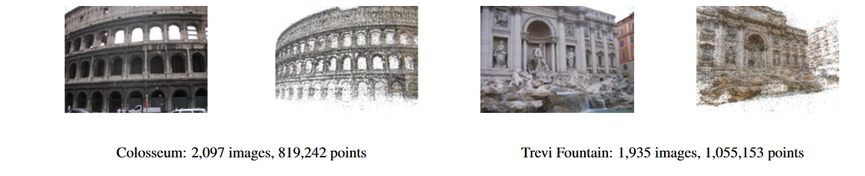
Answer from Sameer Agarwal
(Dr. Rome in a Day)
For an affine transform, we have equations of the form Ax_{i} + b = y_{i}, solvable by linear regression.
For the homography, the equation is of the form
Hx̃_{i} ̴ ỹ_{i} (homogeneous coordinates)
and the ̴ means it holds only up to scale. The affine solution does not hold.

Slide 21
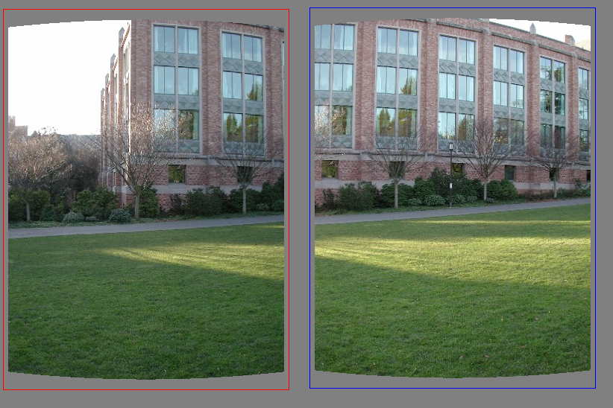
Matching features
What do we do about the “bad” matches?

Slide 22
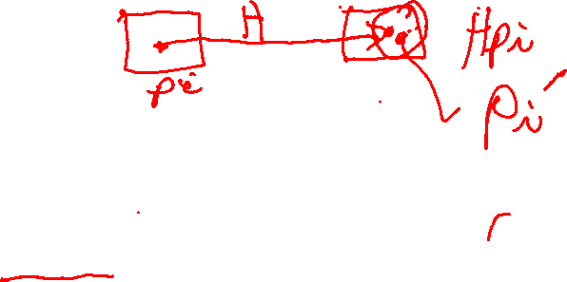

RANSAC for estimating homography
RANSAC loop:
Select four feature pairs (at random)
Compute homography H (exact)
Compute inliers where ||p_{i}´, H p_{i}|| < ε
Keep largest set of inliers
Re-compute least-squares H estimate using all of the inliers

Slide 23
Panorama algorithm:
Find corners in both images
Calculate descriptors
Match descriptors
RANSAC to find homography
Stitch together images with homography

Slide 24
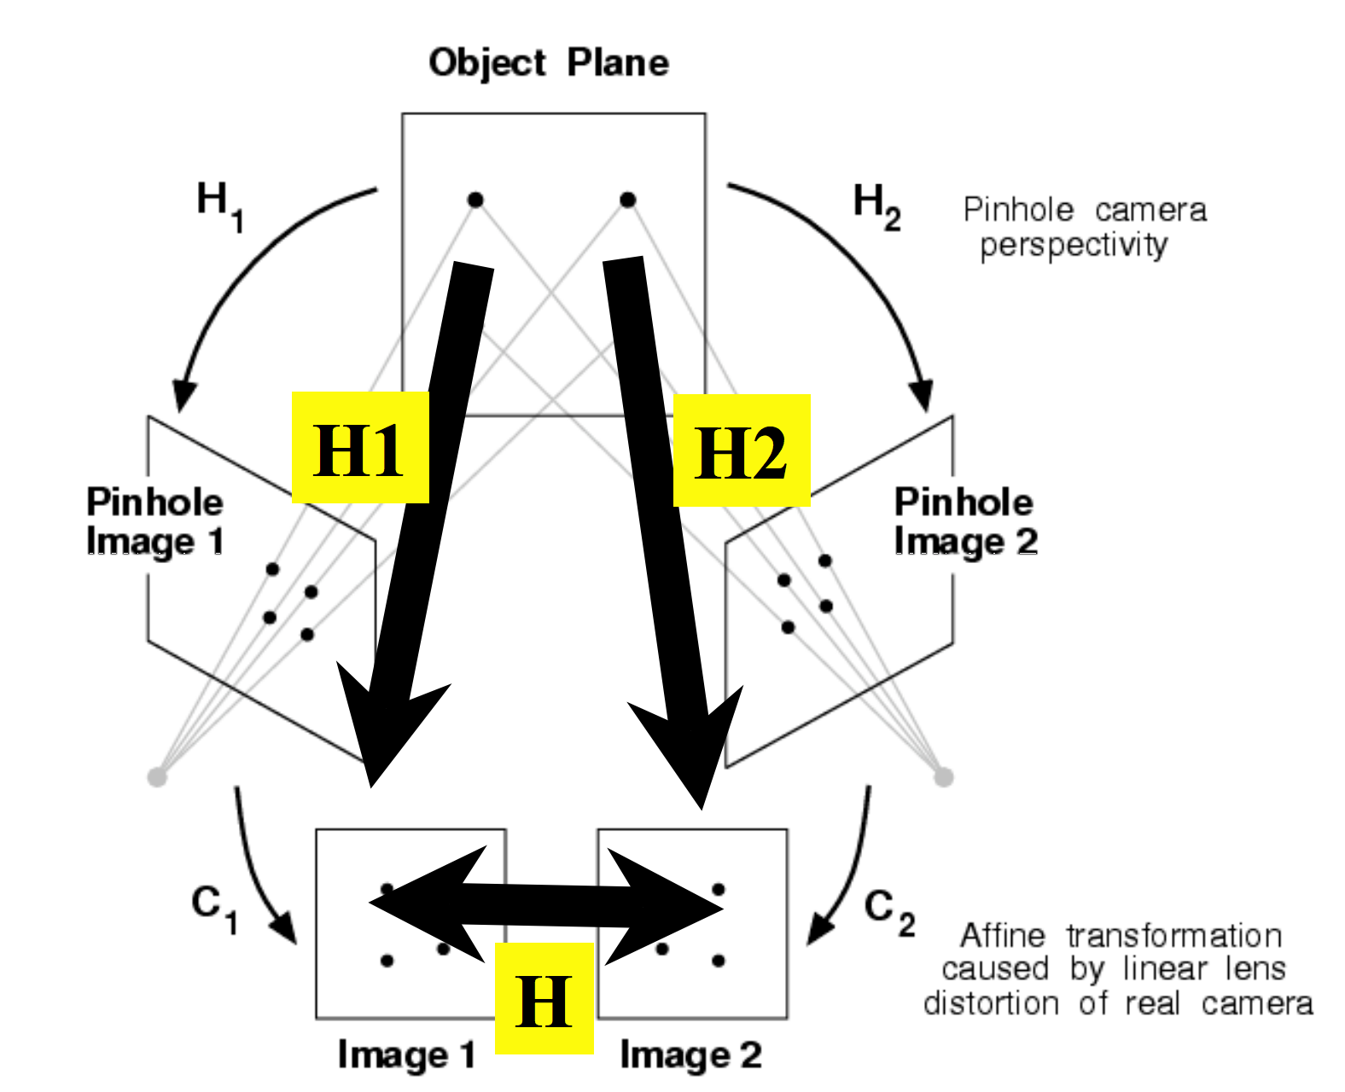
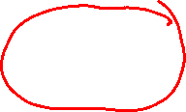
Stitching panoramas:
We know homography is right choice under certain assumption:
  Assume we are taking multiple images of planar object
3D
homography H

Slide 25
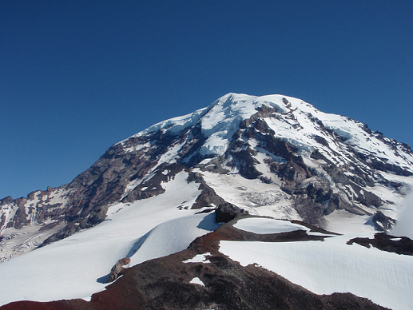
In practice:

Slide 26
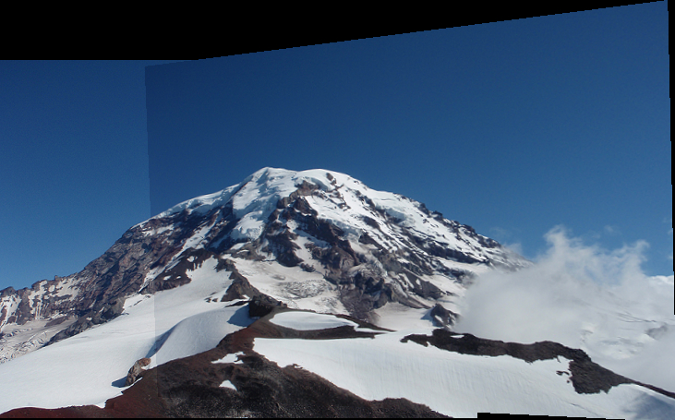
In practice:

Slide 27
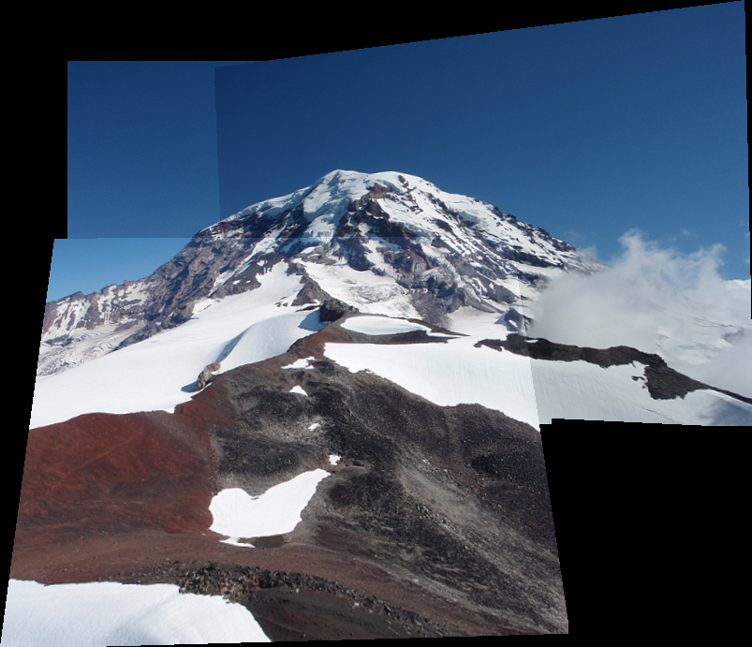
In practice:

Slide 28
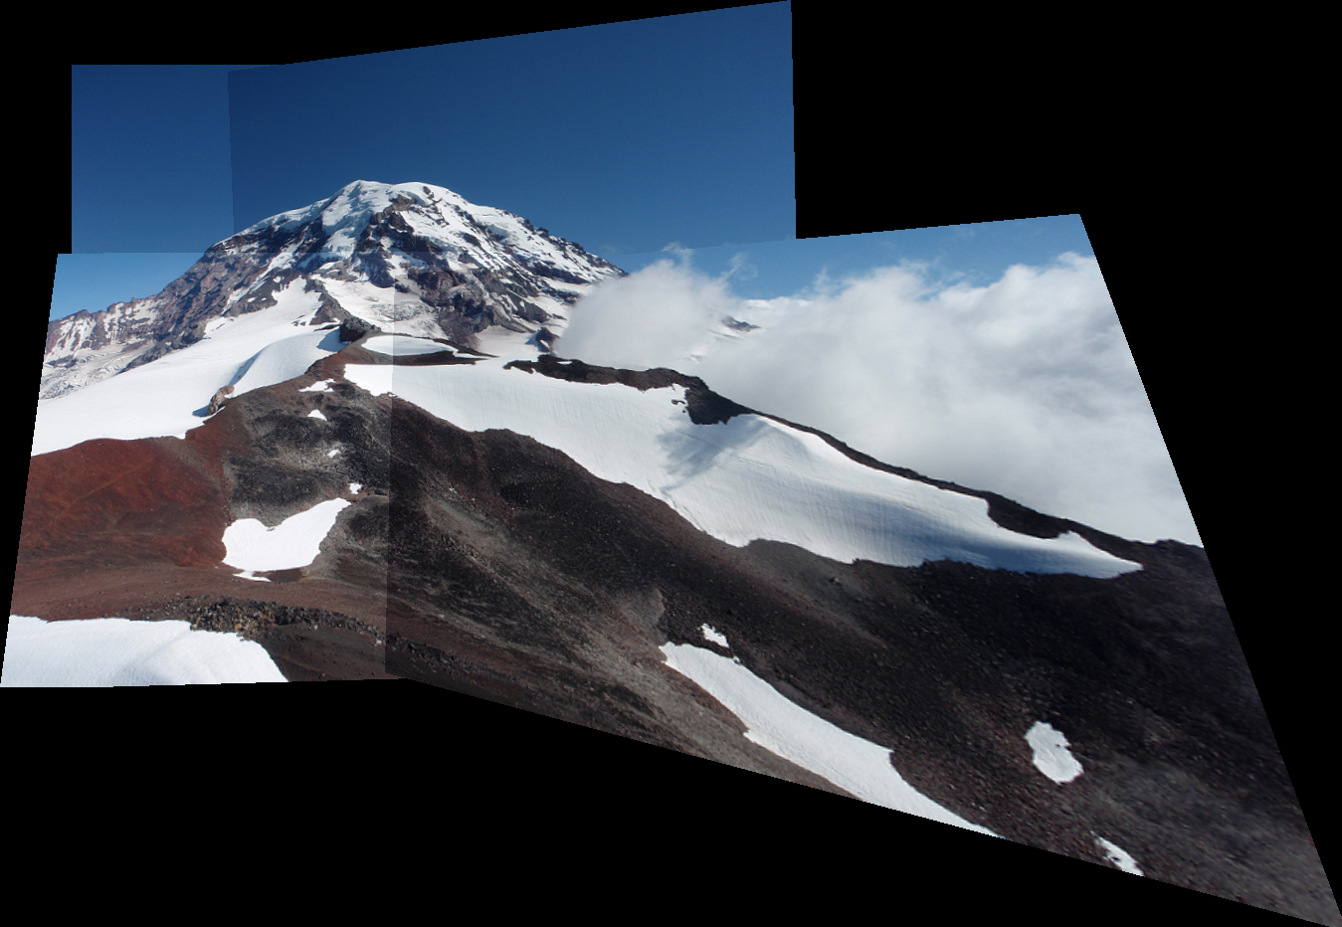
In practice:

Slide 29
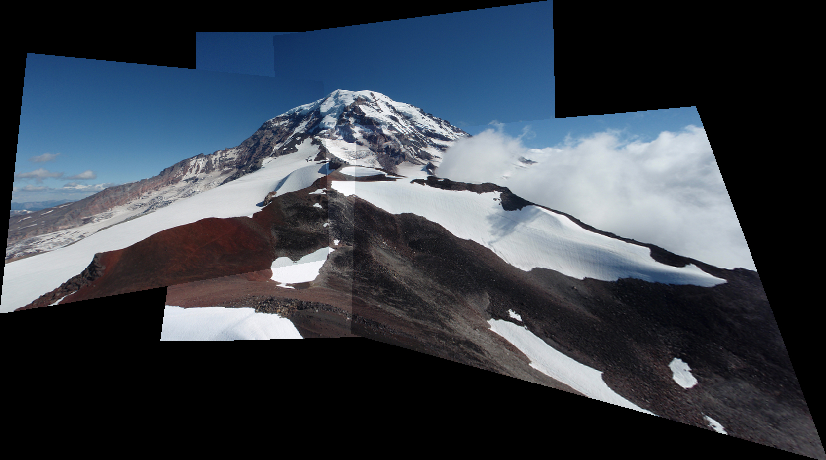
In practice:

Slide 30
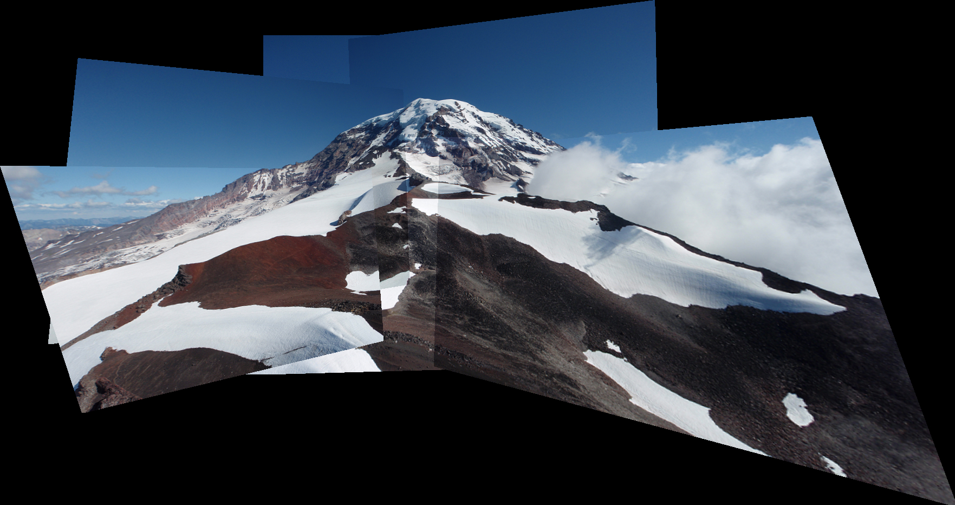
In practice:

Slide 31
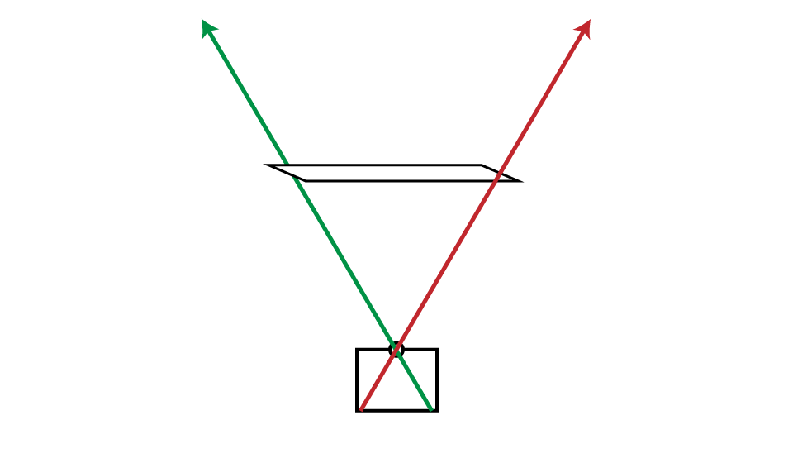
What’s happening?

Slide 32
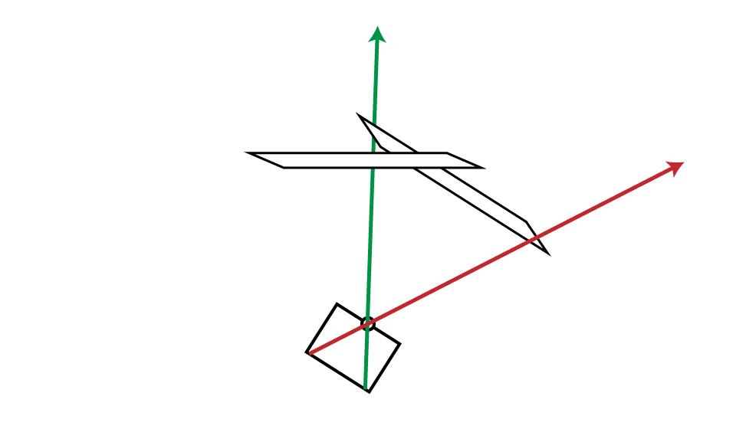
What’s happening?

Slide 33
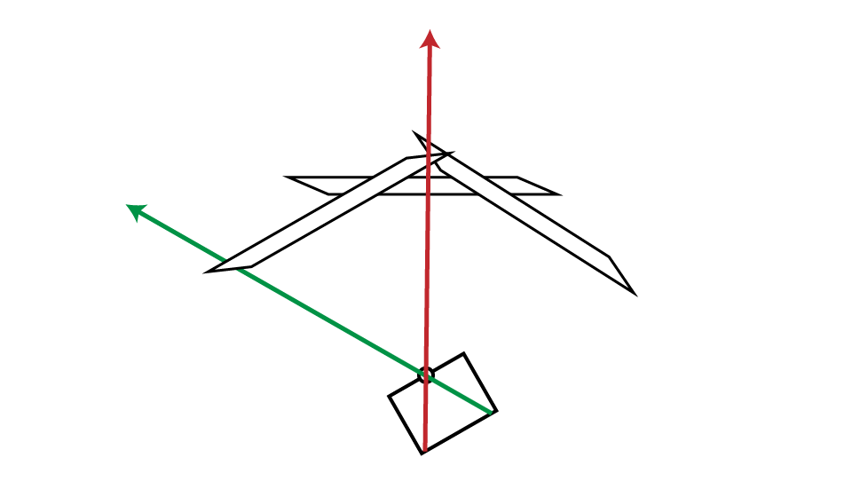
What’s happening?

Slide 34
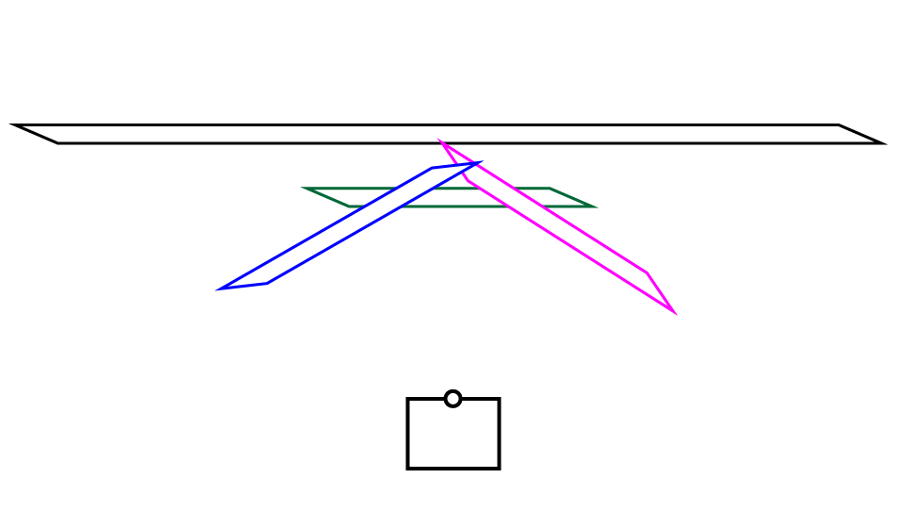
What’s happening?

Slide 35
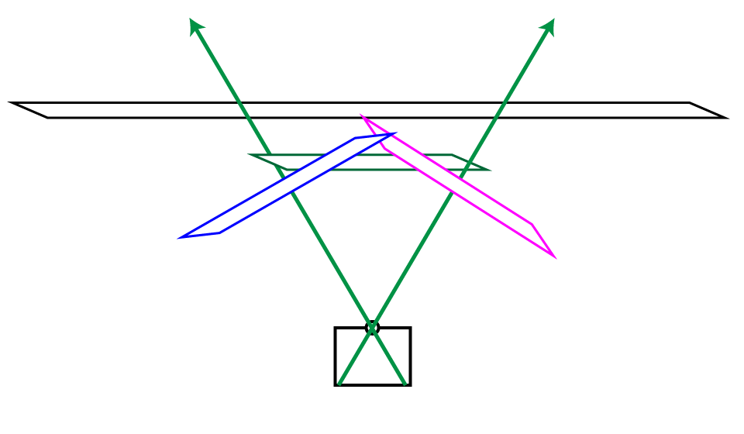
What’s happening?

Slide 36
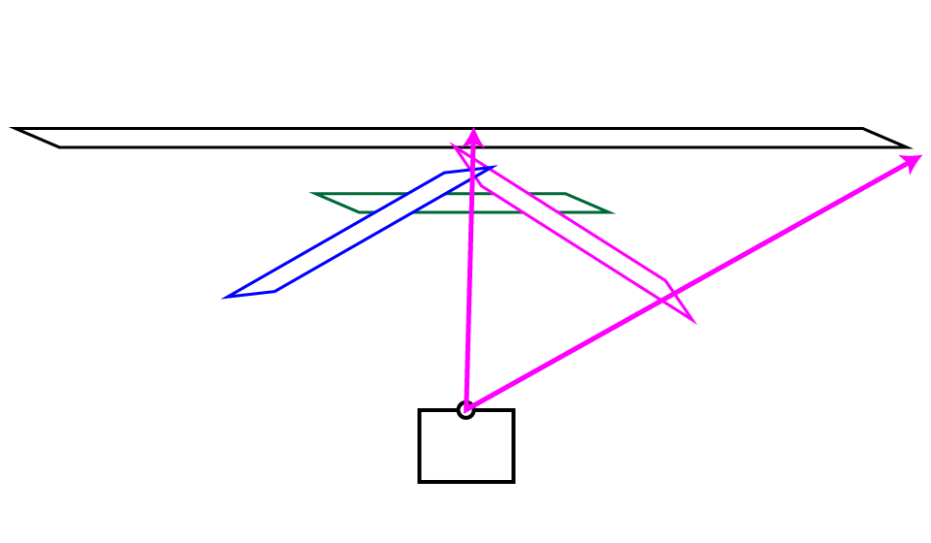
What’s happening?

Slide 37
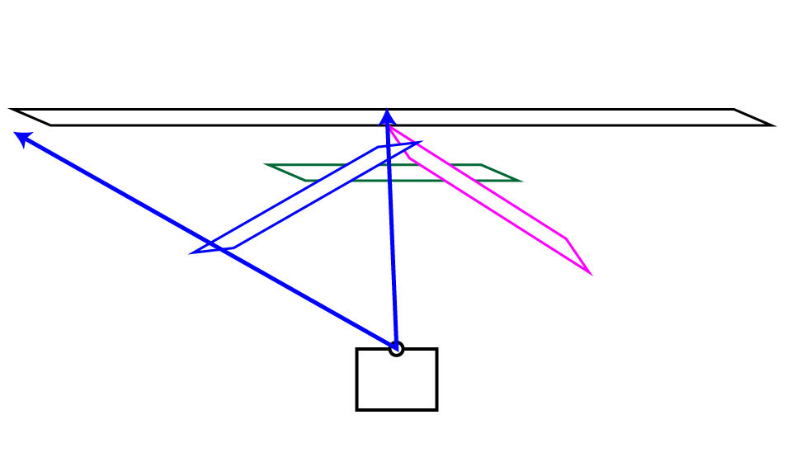
What’s happening?

Slide 38
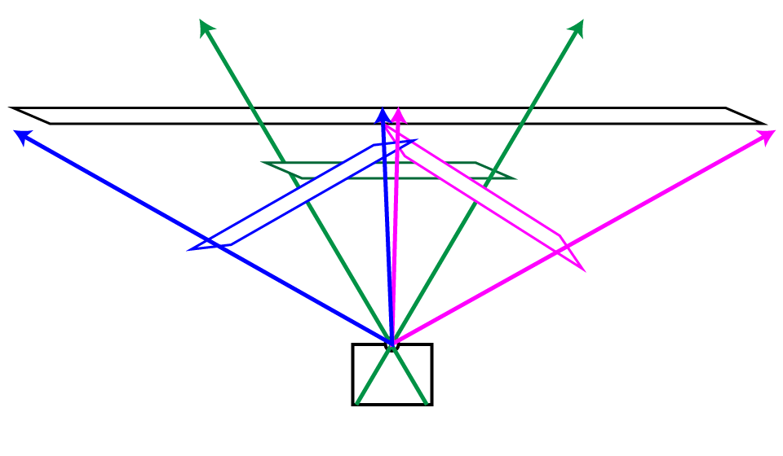
What’s happening?

Slide 39
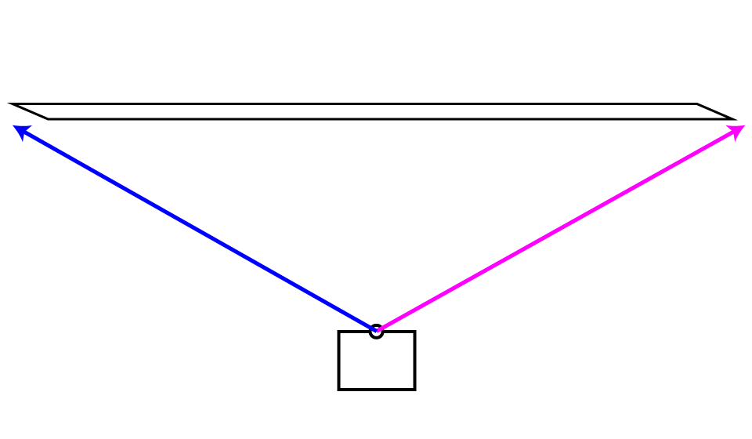
What’s happening?

Slide 40
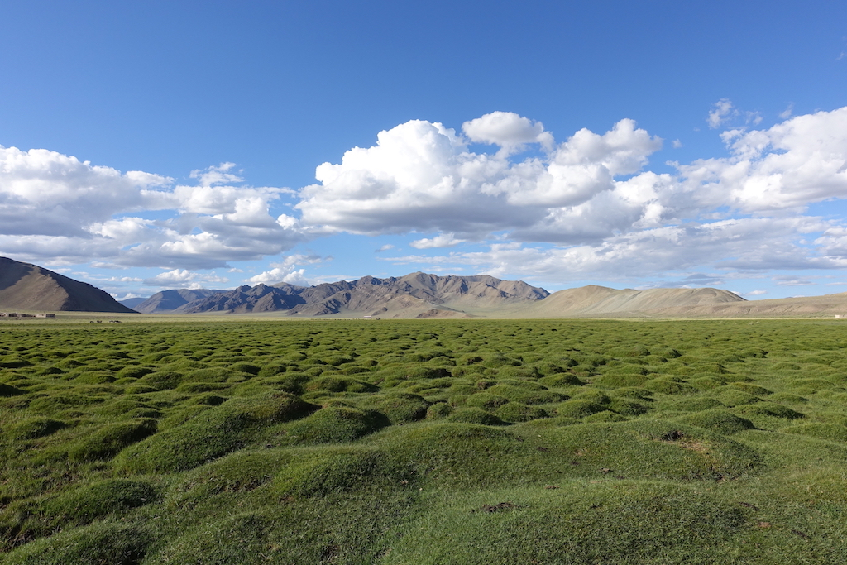
Very bad for big panoramas!

Slide 41
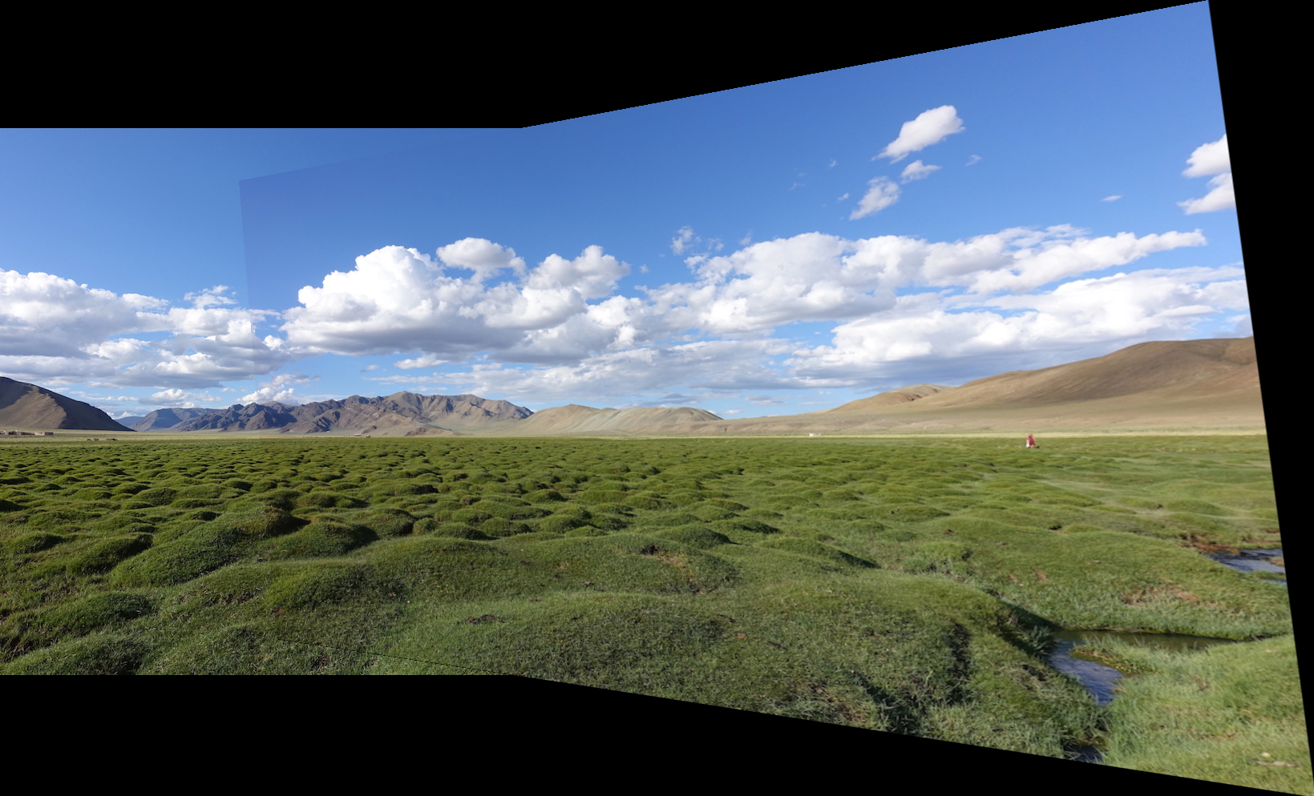
Very bad for big panoramas!

Slide 42
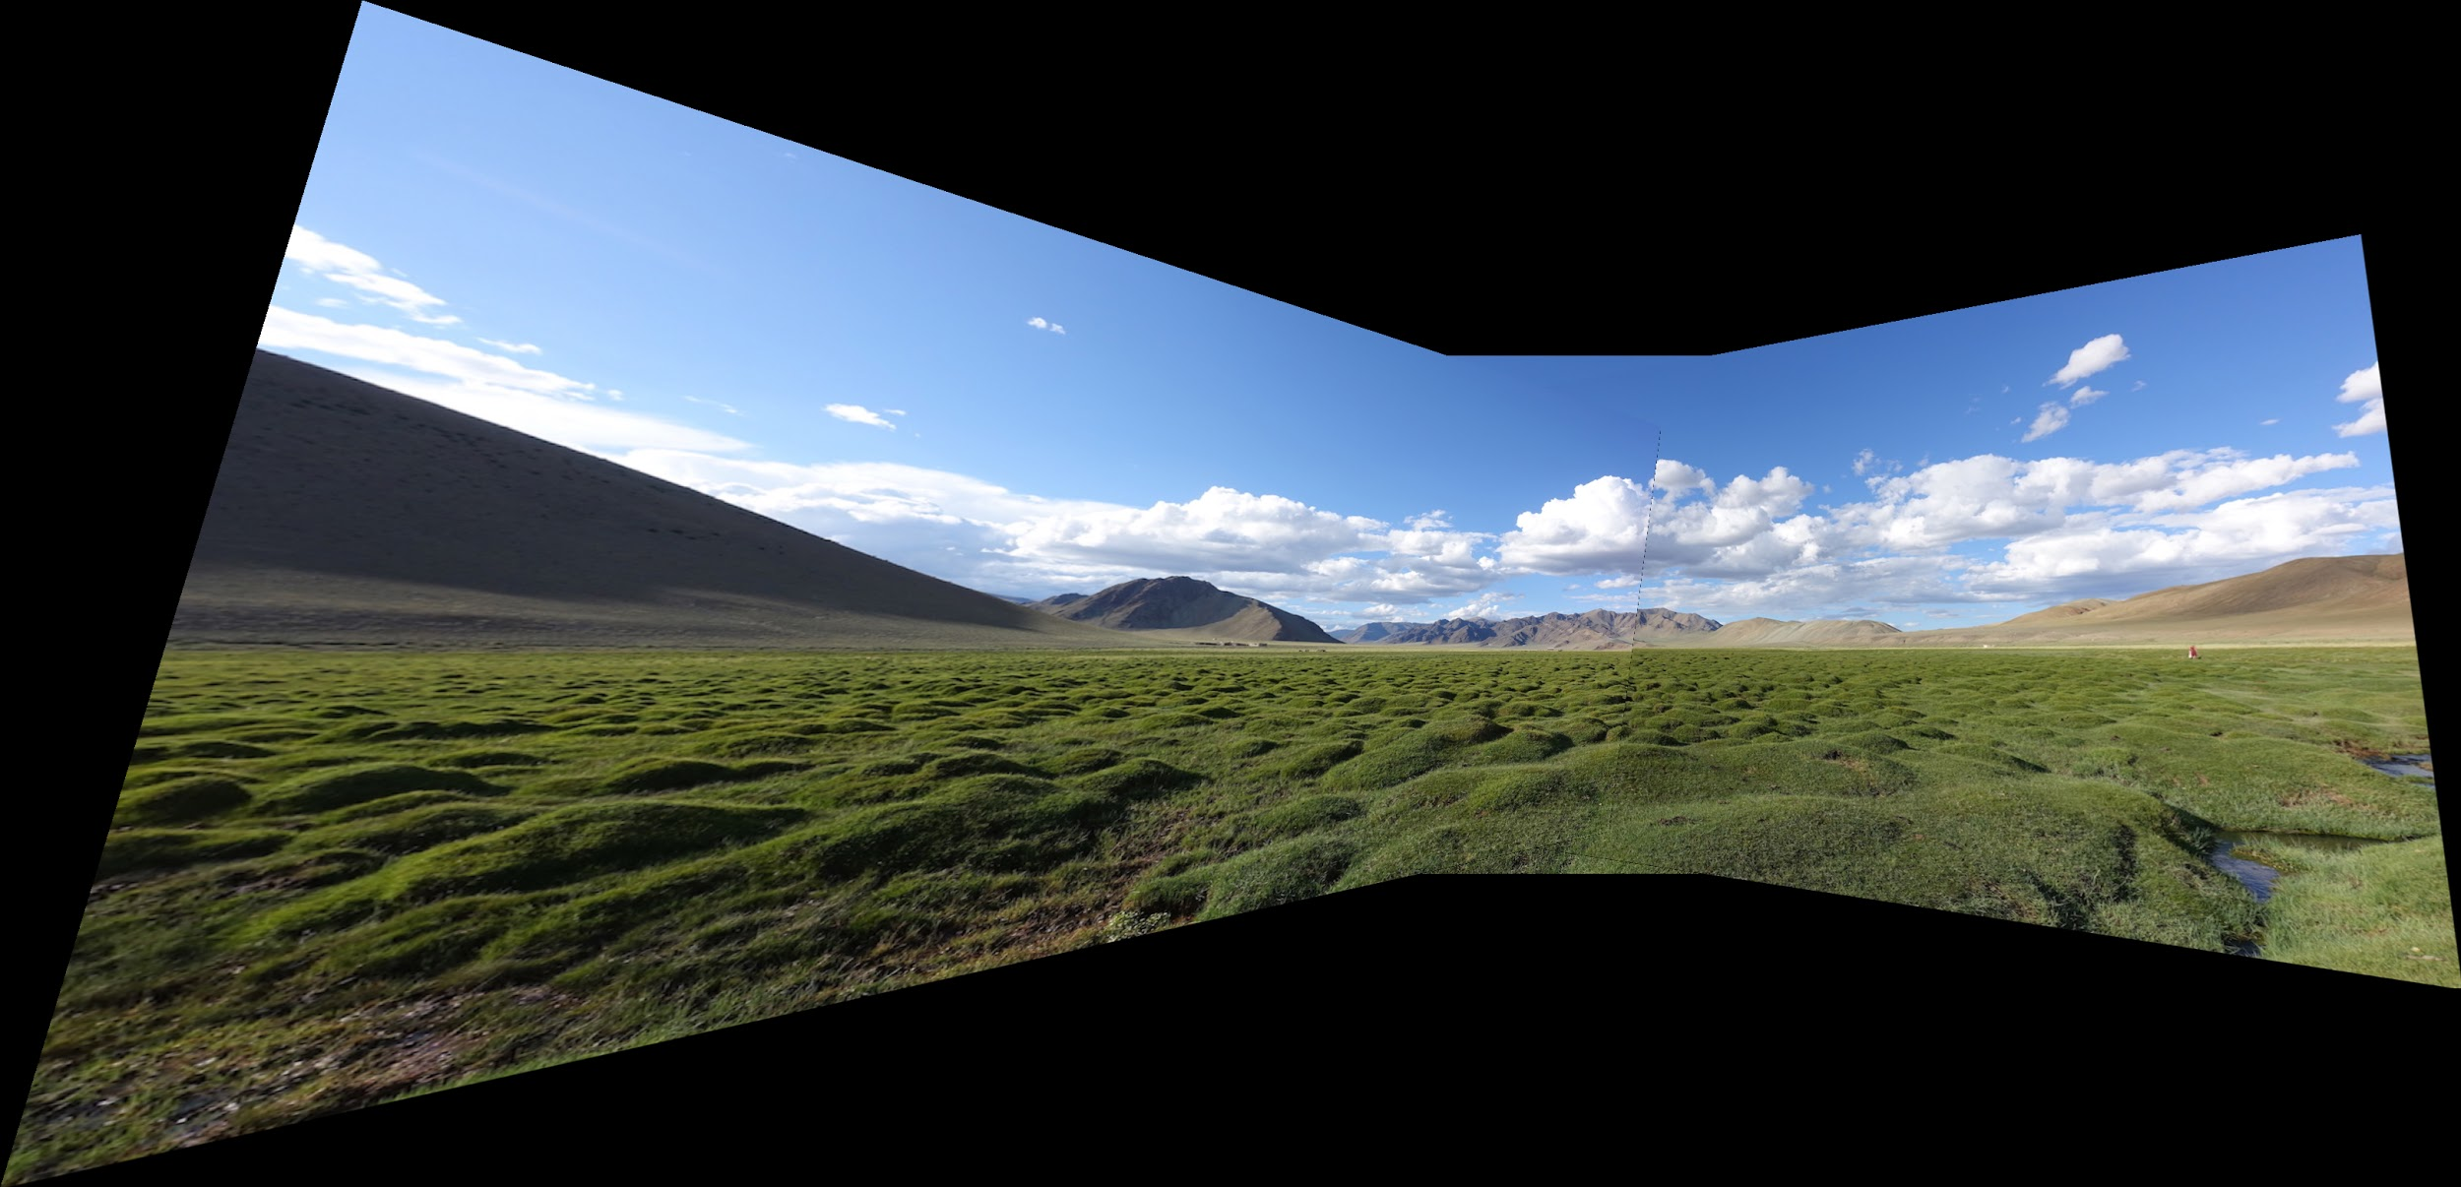
Very bad for big panoramas!

Slide 43
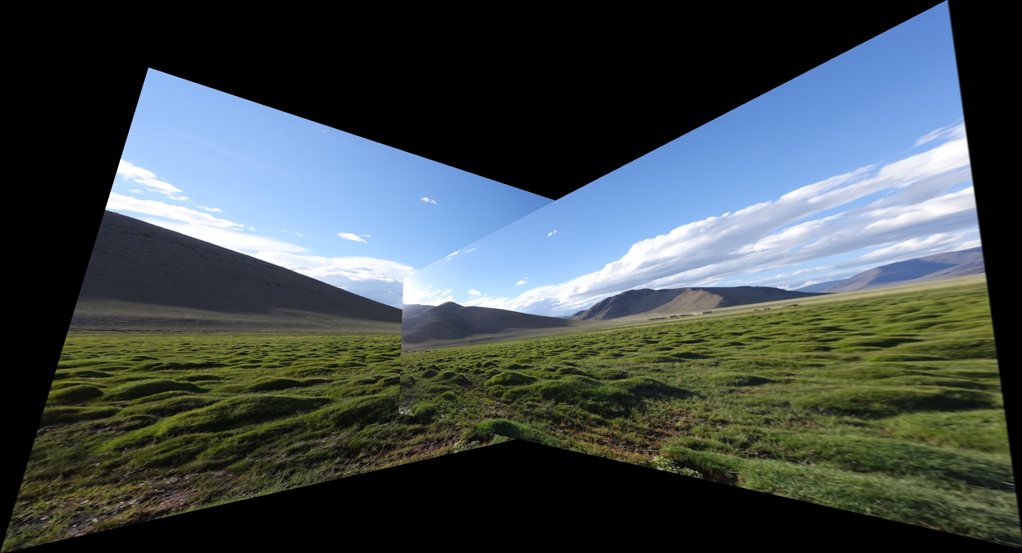
Fails :-(

Slide 44
How do we fix it? Cylinders!

Slide 45

How do we fix it? Cylinders!

Slide 46

How do we fix it? Cylinders!

Slide 47

How do we fix it? Cylinders!

Slide 48

How do we fix it? Cylinders!

Slide 49

How do we fix it? Cylinders!

Slide 50


How do we fix it? Cylinders!
(xc,yc) = center of projection and f = focal length of camera

Slide 51

Dependent on focal length!

Slide 52


f = 300 f = 500

Slide 53

f = 1000

Slide 54

f = 1400

Slide 55

f = 10,000

Slide 56
f = 10,000

Slide 57








Does it work?

Slide 58

Does it work?

Slide 59

Does it work?

Slide 60

Does it work?

Slide 61

Does it work?

Slide 62

Does it work? Yay!

Slide 63
Where are we?
We are going to build a panorama from two (or more) images.
We need to learn about
  Finding interest points
  Describing small patches about such points
  Finding matches between pairs of such points on two images, using the descriptors
  Selecting the best set of matches and saving them
  Constructing homographies (transformations) from one image to the other and picking the best one
  Stitching the images together to make the panorama

Slide 64


RANSAC for Homography
Initial Matched Points

Slide 65


RANSAC for Homography
Final Matched Points

Slide 66

RANSAC for Homography

Slide 67



Image Blending
What’s wrong?

Slide 68




Feathering
+
1
1
0
ramp
0
=

Slide 69


Effect of window (ramp-width) size
1
left
1
right
0
0

Slide 70


Effect of window size
1
1
0
0

Slide 71

Good window size
1
What can we do
instead?
0
“Optimal” window: smooth but not ghosted
Doesn’t always work...

Slide 72




Pyramid blending
apple
orange
Create a Laplacian pyramid, blend each level
Burt, P. J. and Adelson, E. H., A Multiresolution Spline with Application to Image Mosaics, ACM Transactions on Graphics, 42(4), October 1983, 217-236. http://persci.mit.edu/pub_pdfs/spline83.pdf

Slide 73

Alpha Blending
I₃
p
I₁
Optional: see Blinn (CGA, 1994) for details:
http://ieeexplore.ieee.org/iel1/38/7531/00310740.pdf?isNumber=7531&prod=JNL&arnumber=310740&arSt=83&ared=87&arAuthor=Blinn%2C+J.F.
I₂
Encoding blend weights: I(x,y) = (αR, αG, αB, α )
color at p =
Implement this in two steps:
1. accumulate: add up the (α premultiplied) RGB values at each pixel
2. normalize: divide each pixel’s accumulated RGB by its α value
Notes:
A: render as black

Slide 74


Gain Compensation: Getting rid of artifacts
Simple gain adjustment
  Compute average RGB intensity of each image in overlapping region
  Normalize intensities by ratio of averages

Slide 75


Blending Comparison

Slide 76




























Recognizing Panoramas
Some of following material from Brown and Lowe 2003 talk
Brown and Lowe 2003, 2007

Slide 77

Recognizing Panoramas
Input: N images
Extract SIFT points, descriptors from all images
Find K-nearest neighbors for each point (K=4)
For each image
  Select M candidate matching images by counting matched keypoints (m=6)
  Solve homography H_{ij} for each matched image

Slide 78


Slide 79
Recognizing Panoramas
Input: N images
Extract SIFT points, descriptors from all images
Find K-nearest neighbors for each point (K=4)
For each image
  Select M candidate matching images by counting matched keypoints (m=6)
  Solve homography H_{ij} for each matched image
  Decide if match is valid (n_{i} > 8 + 0.3 n_{f} )
# inliers
# keypoints in overlapping area

Slide 80
Recognizing Panoramas (cont.)
(now we have matched pairs of images)
Make a graph of matched pairs
Find connected components of the graph

Slide 81

Finding the panoramas

Slide 82

Finding the panoramas

Slide 83
Recognizing Panoramas (cont.)
(now we have matched pairs of images)
Find connected components
For each connected component
  Solve for rotation and f
  Project to a surface (plane, cylinder, or sphere)
  Render with multiband blending

Slide 84
Finding the panoramas

Slide 85

Homework 3
CREATING PANORAMAS!

Slide 86
Useful structures (defined in image.h)
Data structure for an point
typedef struct{
float x, y;
} point;
Data structure for a descriptor
typedef struct{
point p; <-pixel location
int n; <-size of data
float *data;
} descriptor;
Data structure for a match
typedef struct{
point p, q; <-matching
points
int ai, bi; <-matching indices of descriptor arrays
float distance; <-dist.
between matching descriptors
} match;

Slide 87
Overall algorithm
image panorama_image(image a, image b, float sigma, float thresh, int nms, float inlier_thresh, int iters, int cutoff)
{
// Calculate corners and descriptors descriptor *ad = harris_corner_detector(a, sigma, thresh, nms, &an);
descriptor *bd = harris_corner_detector(b, sigma, thresh, nms, &bn);
// Find matches
match *m = match_descriptors(ad, an, bd, bn, &mn);
// Run RANSAC to find the homography
matrix H = RANSAC(m, mn, inlier_thresh, iters, cutoff);
// Stitch the images together with the homography
image combine = combine_images(a, b, H);
return combine;
}

Slide 88
1. Harris corner detection
TODO #1.1: Compute structure matrix S
TODO #1.2: Compute cornerness response map R from structure matrix S
TODO #1.3: Find local maxes in map R using non-maximum suppression
TODO #1.4: Compute descriptors for final corners

Slide 89
TODO #1.1: structure matrix
Compute Ix and Iy using Sobel filters from HW2
Create an empty image of 3 channels
  Assign channel 1 to Ix²
  Assign channel 2 to Iy²
  Assign channel 3 to Ix * Iy
Compute weighted sum of neighbors
  smooth the image with a gaussian of given sigma
Notes:
Calculate image derivatives Ix and Iy.
Calculate measures Ix^2, Iy^2, and Ix * Iy.
Smooth Ix^2, Iy^2, Ix*Iy with gaussian kernel

Slide 90
TODO #1.1.1: make a fast smoother
Decompose a 2D gaussian to 2 1D convolutions.
Separable kernel
Factors into product of two 1D Gaussians
Discrete example:

Slide 91
TODO #1.2: response map
For each pixel of the given structure matrix S:
  Get Ix², Iy² and IxIy from the 3 channels
  Compute Det(S) = Ix² * Iy² – IxIy * IxIy
  Compute Tr(S) = Ix² + Iy²
  Compute R = Det(S) – 0.06 * Tr(S) * Tr(S)
Notes:
Calculate Harris "cornerness" as estimate of 2nd eigenvalue: Determinant(S) - α trace(S)^2, α = .06
Run non-max suppression on response map

Slide 92
TODO #1.3: NMS
For each pixel ‘p’ of the given response map R
  get value(p)
  loop over all neighboring pixels ‘q’ in a 2w+1 window
    +/- w around the current pixel location
    if value(q) > value (p), value(p) = -999999 (very low)
  set ‘p’ to value(p)
Notes:
We only want local maximum responses to our corner detector so that the matching is easier.
For every pixel in the Image, check every neighbor within w pixels (Chebyshev distance).

Slide 93
TODO #1.4: corner descriptors
Given: Response map after NMS
Initialize count; loop over each pixel
  if pixel value > threshold, increment count
Initialize descriptor array of size ‘count’
Loop over each pixel again
  if pixel value > threshold, create descriptor for that pixel
    use describe_index() defined in harris_image.c
  add this new descriptor to the array

Slide 94
2. Matching descriptors
TODO #2.1: Implement L1 distance
TODO #2.2.1: Find best matches from descriptor array “a” to descriptor array “b”
TODO #2.2.2: Eliminate duplicate matches to ensure one-to-one match between “a” and “b”
TODO #2.3: Project points given a homography and compute inliers from an array of matches
TODO #2.4: Implement RANSAC algorithm
TODO #2.5: Combine images

Slide 95

TODO #2.1: Distance Metrics
For comparing patches we'll use L1 distance.

Slide 96
TODO #2.2.1: best matches
For each descriptor ‘a_{r}’ in array ‘a’:
  initialize min_distance and best_index
  for each descriptor ‘b_{s}’ in array ‘b’:
  compute L1 distance between a_{r} and b_{s}
    sum of absolute differences
  if distance < min_distance:
    update min_distance and best_index

Slide 97
TODO #2.2.2: remove duplicates
Sort the matches based on distance (shortest is first)
Initialize an array of 0s called ‘seen’
Loop over all matches:
  if b-index of current match is ≠1 in ‘seen’
    set the corresponding value in ‘seen’ to 1
    retain the match
  else, discard the match
Notes:
Each descriptor in a will only appear in one match. But several of them may match with the same descriptor in b. This can be problematic. Namely, if a bunch of matches go to the same point there is an easy homography to estimate that just shrinks the whole image down to one point to project from a to b. But we know that's wrong. So let's just get rid of these duplicate matches and make our matches be one-to-one.
To do this, sort the matches based on distance so shortest distance is first. A given comparator match_compare is already implemented for you to use, just look up how to properly apply qsort if you don't know already. Next, loop through the matches in order and keep track of which elements in b we've seen. If we see one for a second (or third, etc.) time, throw it out! To throw it out, just shift the other elements forward in the list and then remember how many one-to-one matches we have at the end. This can be done with a single pass through the data.

Slide 98
TODO #2.3.1: point projection
Given point p, set matrix c_{3x1} = [x-coord, y-coord,1]
Compute M_{3x1} = H_{3x3}* c_{3x1} with given Homography
Compute x,y coordinates of a point ’q’:
  x-coord: M[0] / M[2]
  y-coord: M[1] / M[2]
Return point ‘q’

Slide 99
TODO #2.3.2, 2.3.3: L2 distance and model inliers
Loop over each match from array of matches (starting from end):
  project point ‘p’ of match using given ‘H’
  compute L2 distance between point ‘q’ of match and the projected point
  if distance < given threshold:
    it is an inlier; bring match to the front of array (swap)
    update inlier count

Slide 100
TODO #2.3.4:Fitting the homography
Use the matrix operations discussed in class to solve equations like M*a = b.
Most of this is already implemented
  you just have to fill in the matrices M and b with our match information.

Slide 101
TODO #2.4-2.5: implement RANSAC
For each iteration:
  compute homography with 4 random matches
    call compute_homography() with argument 4
  if homography is empty matrix, continue
  else compute inliers with this homography
  if #inliers > max_inliers:
    compute new homography with all inliers
    update best_homography with this new homography
    update max_inliers with #inliers computed with this new homography unless new homography is empty
    if updated max_inliers > given cutoff: return best_homography
Return best_homography

Slide 102
TODO #2.6: combine images
Project corners of image ‘b’ and create a big empty image ‘c’ to place image ‘a’ and projected ‘b’. This part is given in the code.
For each pixel in image ‘a’, get pixel value and assign it to ‘c’ after proper offset
For each pixel in image ’c’ within projected bounds:
  project to image ‘b’ using given homography
  get pixel value at projected location using bilinear interpolation
  assign the value to ’c’ after proper offset

Slide 103


Slide 104
3. Cylindrical Projection
Implement cylindrical projection for an image
  See lecture slides for the formulas
  See Tryhw3, which will call the panorama code to do the stitching.
  See code for the code stub you will fill in to cylinderize an image.

Slide 105

Have Fun

