Slide 1
Multi-Class Classification
Notes:
So now you’ve just learned about binary classification, but in hw4 you will be working on a multi-class problem.

Slide 2
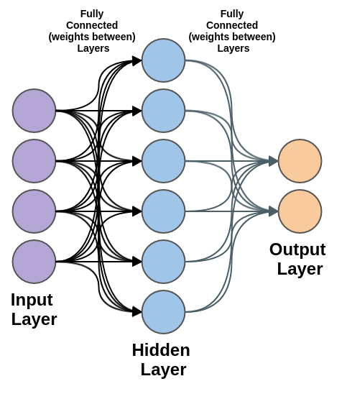
Solution
Traditional Method: 1-vs-other method
Too slow. If we have n-classes, we need to train n models
Performance is not great, because the sample size is different for positive and negative classes
Multiple Neurons
Use n output neuron to correspond n classes.
Easy, fast, and robust
Problem: how to model the probability? The values in the neural network can be negative or greater than 1.
Notes:
So usually, you can easily solve the multi-class problem (let’s say for SVM) using 1 vs other method, but the problem is that it’s too slow and performance is usually not great because error would accumulate and also the data can easily become very imbalanced.
With neural network, we can solve this multi-class problem using n output neurons corresponding to n classes. Compared to 1 vs other, this is easy, fast and more robust. But how do we model the probability? The values output from neurons are not limited to between 0 and 1. A simple solution is we normalize the output value using the sum of output, but it’s still hard to account for negative values.

Slide 3
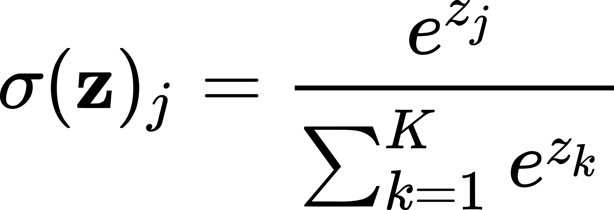
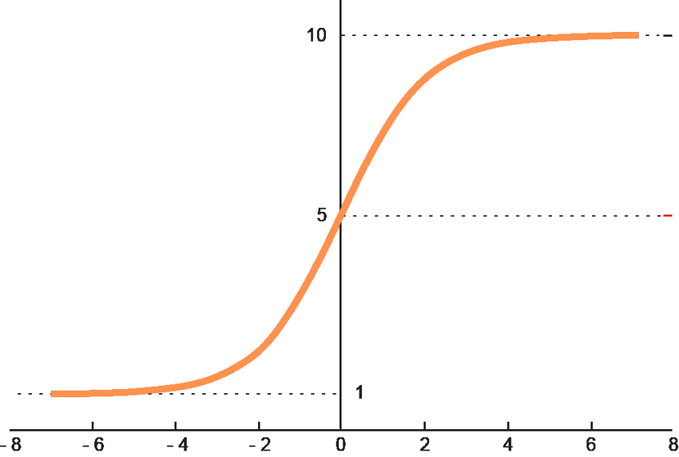
Softmax: normalized exponential
Input: vector of reals Output: probability distribution
softmax([1,2,7,3,2]): Calculate e^{x}: [2.72, 7.39, 1096.63, 20.09, 7.39] Calculate sum(e^{x}): 2.72+7.39+1096.63+20.09+7.39 = 1134.22 Normalize: e^{x}/sum(e^{x}) = [0.002, 0.007, 0.967, 0.017, 0.007]
Result is a vector of reals.
Notes:
To solve this problem, we use softmax function, which is essentially an exponential normalization function that converts neuron output to probability distribution.

Slide 4
A Simple Example
Here, we will go over a simple 2-layer neural network (no bias).

Slide 5
Mini-batch for Machine Learning
Let’s say we have S images of size 28x28
We use a matrix to represent data.
When s is very large RAM overload
In HW4, we will use a batch size of 128
s
s
D = 784
D = 784

Slide 6

Neural Network Easy Example
3
Input
First pixel
3 | 2 | 4
. | . | .
. | . | .
2
Bsz = 3
Second pixel
4
Third pixel
First Batch

Slide 7
Neural Network Easy Example
A
C
First pixel
3
2
Second pixel
4
D
Third pixel
B
Input
Output Layer
with Softmax

Slide 8
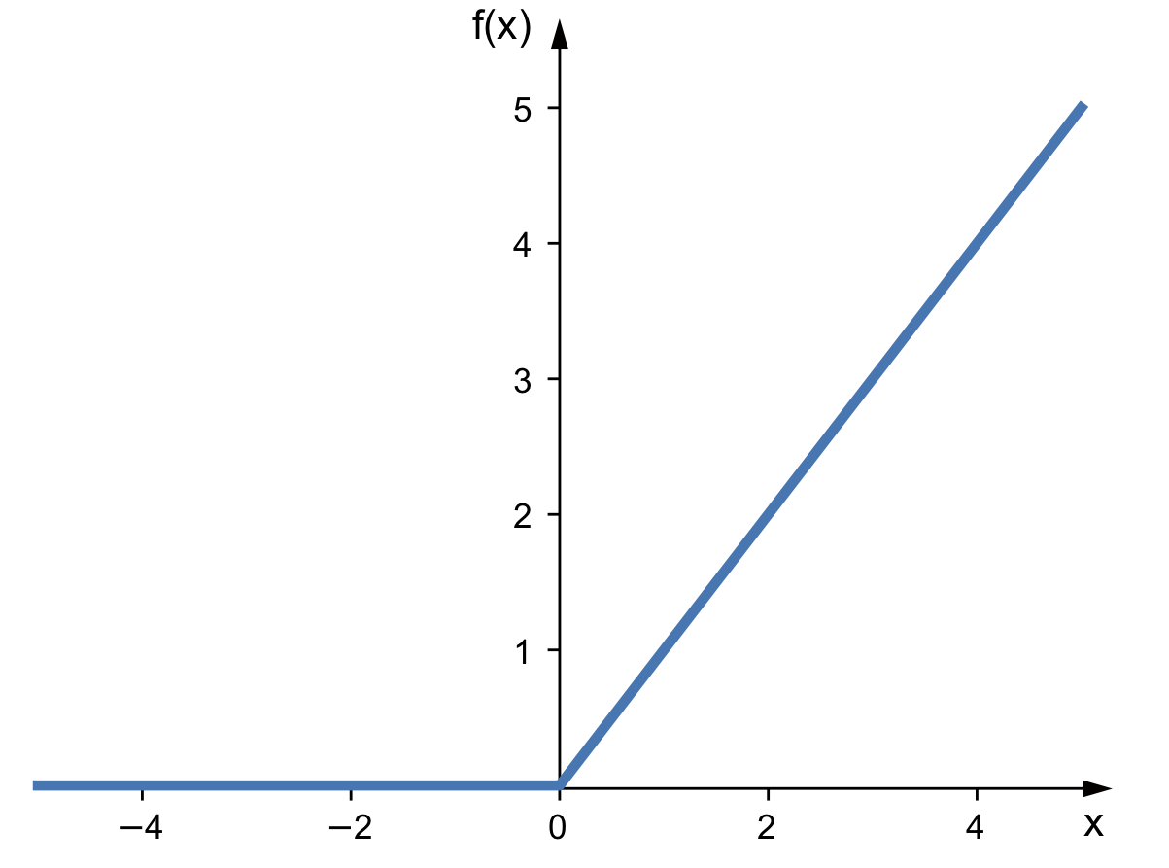

Neural Network Easy Example
A
1
First pixel
3
1-st Layer (ReLU)
0.1
-2.3
1 | 0.5
0.1 | 1
-2.3 | -0.5
2
Second pixel
0.5
A
B
4
1
Third pixel
-0.5
B
Input
3 | 2 | 4
. | . | .
. | . | .

Slide 9



Neural Network Easy Example
A
0.7
1
C
First pixel
3
0.1
0.1
-2.3
2
Second pixel
-2.1
0.5
4
1
D
Third pixel
-0.2
-0.5
B
Input
Output Layer
with Softmax
3 | 2 | 4
. | . | .
. | . | .
1-st Layer (ReLU)
1 | 0.5
0.1 | 1
-2.3 | -0.5
0.7 | -2.1
0.1 | -0.2

Slide 10

1st Layer with ReLU
A
1
First pixel
3
0.1
-2.3
2
Second pixel
4
Third pixel
RELU

Slide 11

Neural Network Easy Example
A
1
First pixel
3
0.1
-2.3
2
Second pixel
0.5
4
1
Third pixel
-0.5
B
Input
3 | 2 | 4
. | . | .
. | . | .
1-st Layer (ReLU)
0 | 1.5
. | .
. | .
1 | 0.5
0.1 | 1
-2.3 | -0.5

Slide 12
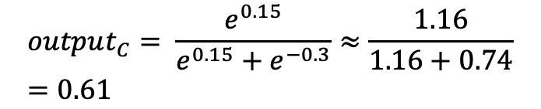
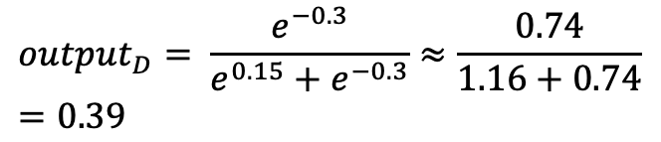
Neural Network Easy Example
A
0.7
1
C
3
0.1
0
-2.3
0.1
0.15
2
-0.3
-2.1
0.5
4
1
1.5
D
-0.2
-0.5
B
Input
Output Layer
with Softmax
1-st Layer (ReLU)

Slide 13

Neural Network Easy Example
A
0.7
1
C
3
0.1
0
-2.3
0.1
0.15
2
-0.3
0.61 | 0.39
. | .
. | .
-2.1
0.5
4
1
1.5
D
-0.2
-0.5
B
Input
Output Layer
with Softmax
1-st Layer (ReLU)

Slide 14




Neural Network Easy Example
A
0.7
1
C
First pixel
3
0
0.1
0.1
-2.3
2
Second pixel
-2.1
0.5
4
1
1.5
D
Third pixel
-0.2
-0.5
B
Input
1-st Layer (ReLU)
Output Layer
with Softmax
3 | 2 | 4
. | . | .
. | . | .
0 | 1.5
. | .
. | .
0.61 | 0.39
. | .
. | .
1 | 0.5
0.1 | 1
-2.3 | -0.5
0.7 | -2.1
0.1 | -0.2

Slide 15



Neural Network Easy Example
Ground Truth
A
0.7
1
1
C
First pixel
3
0
0.1
0.1
-2.3
2
Second pixel
-2.1
0.5
0
4
1
1.5
D
Third pixel
-0.2
-0.5
B
Input
1-st Layer (ReLU)
Output Layer
with Softmax
3 | 2 | 4
. | . | .
. | . | .
0 | 1.5
. | .
. | .
0.61 | 0.39
. | .
. | .
1 | 0.5
0.1 | 1
-2.3 | -0.5
0.7 | -2.1
0.1 | -0.2

Slide 16



Neural Network Easy Example
Ground Truth
C
1
0
D
0.61 | 0.39
. | .
. | .

Slide 17
What to do with this error?

Slide 18
What to do with this error?
Backpropagate it to update the weights!
How?

Slide 19
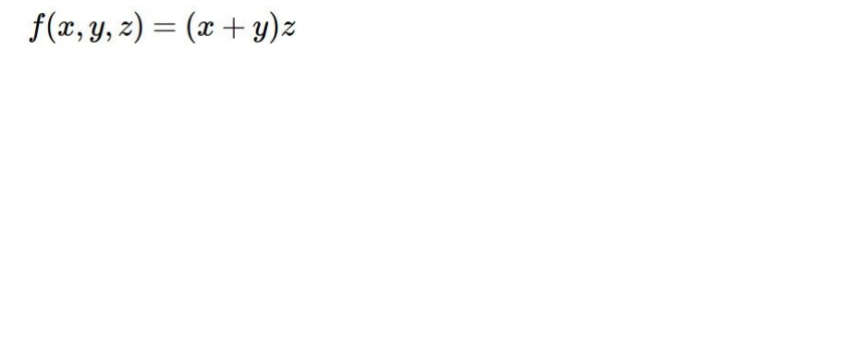
A Computational Graph Perspective
Figure taken from Ranjay Krishna’s course CSE493

Slide 20
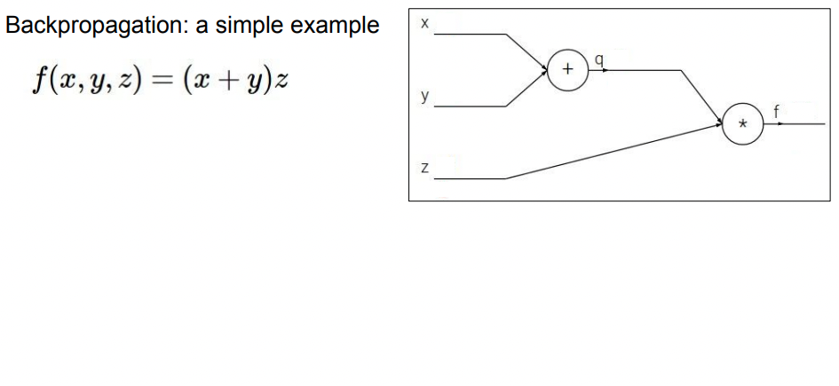
A Computational Graph Perspective
Figure taken from Ranjay Krishna’s course CSE493

Slide 21
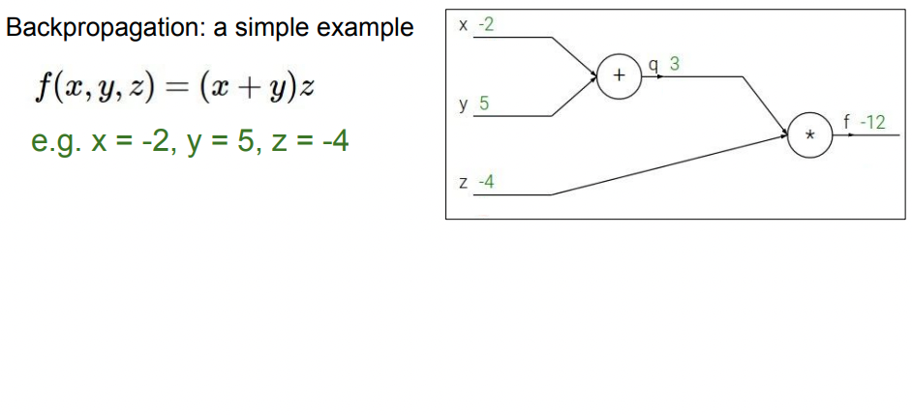
A Computational Graph Perspective
Figure taken from Ranjay Krishna’s course CSE493

Slide 22
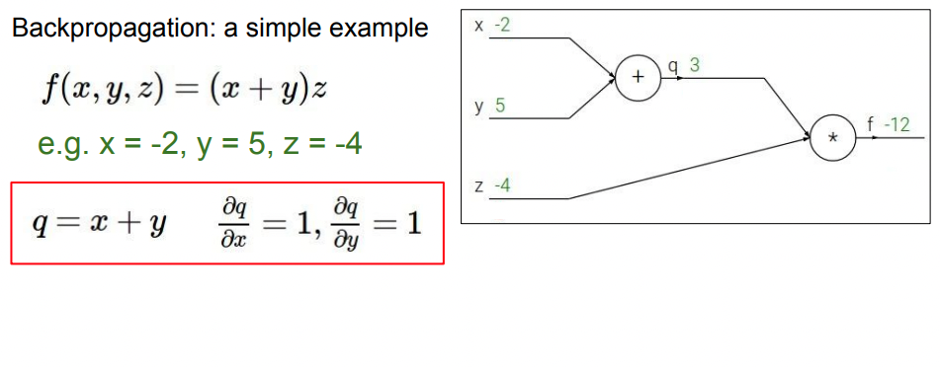
A Computational Graph Perspective
Figure taken from Ranjay Krishna’s course CSE493

Slide 23
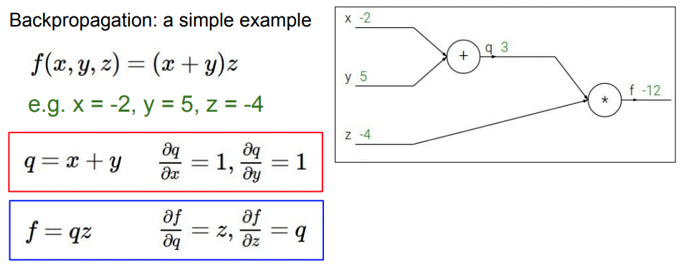
A Computational Graph Perspective
Figure taken from Ranjay Krishna’s course CSE493

Slide 24
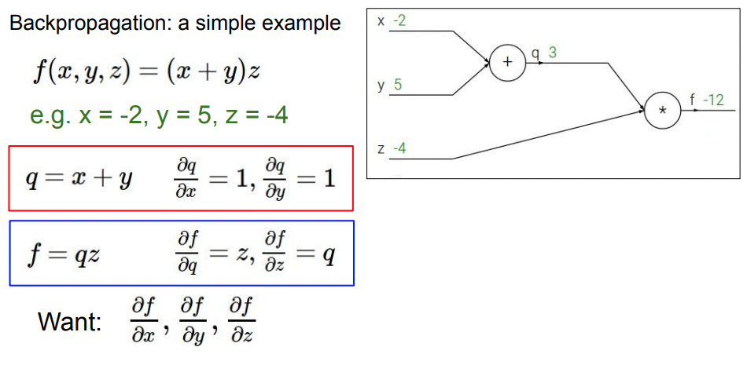
A Computational Graph Perspective
Figure taken from Ranjay Krishna’s course CSE493

Slide 25
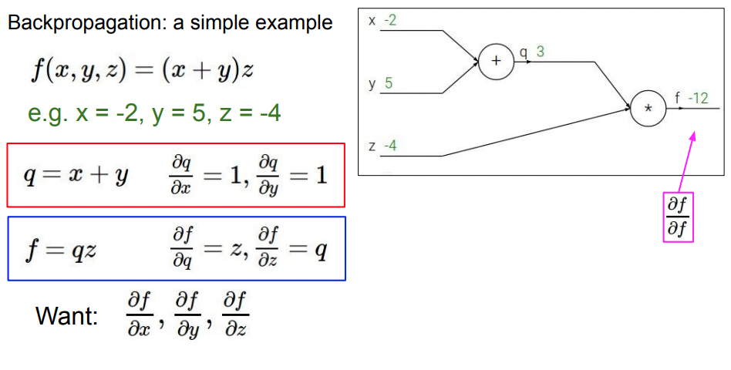
A Computational Graph Perspective
Figure taken from Ranjay Krishna’s course CSE493

Slide 26
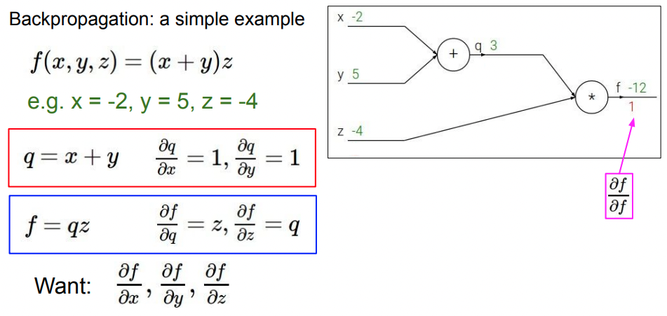
A Computational Graph Perspective
Figure taken from Ranjay Krishna’s course CSE493

Slide 27
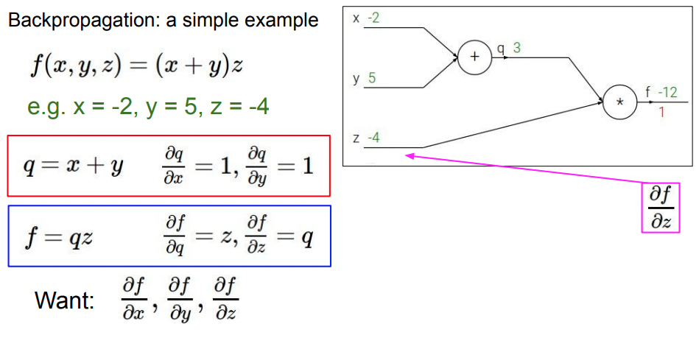
A Computational Graph Perspective
Figure taken from Ranjay Krishna’s course CSE493

Slide 28
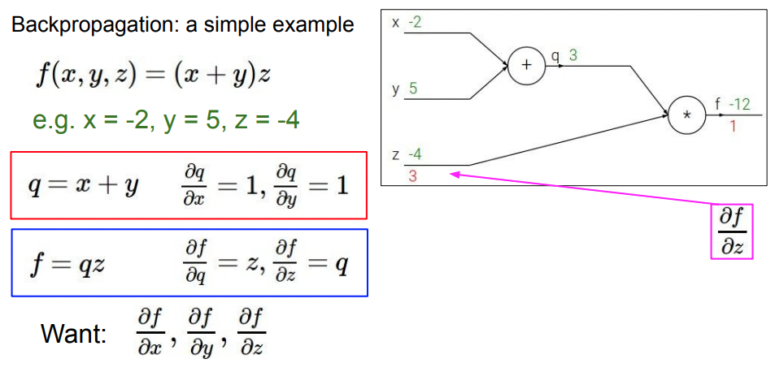
A Computational Graph Perspective
Figure taken from Ranjay Krishna’s course CSE493

Slide 29
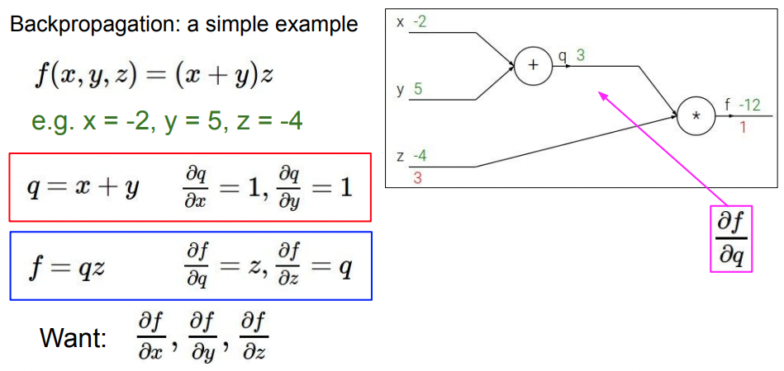
A Computational Graph Perspective
Figure taken from Ranjay Krishna’s course CSE493

Slide 30
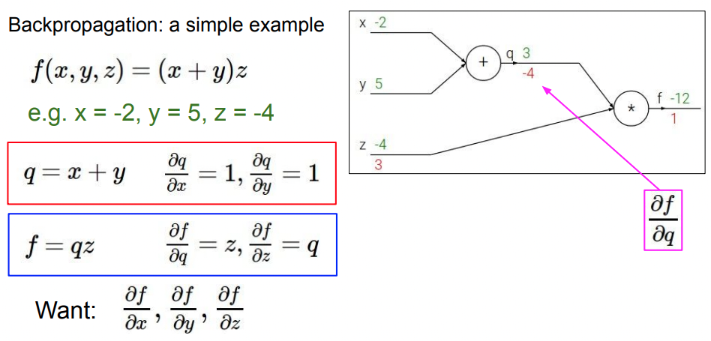
A Computational Graph Perspective
Figure taken from Ranjay Krishna’s course CSE493

Slide 31
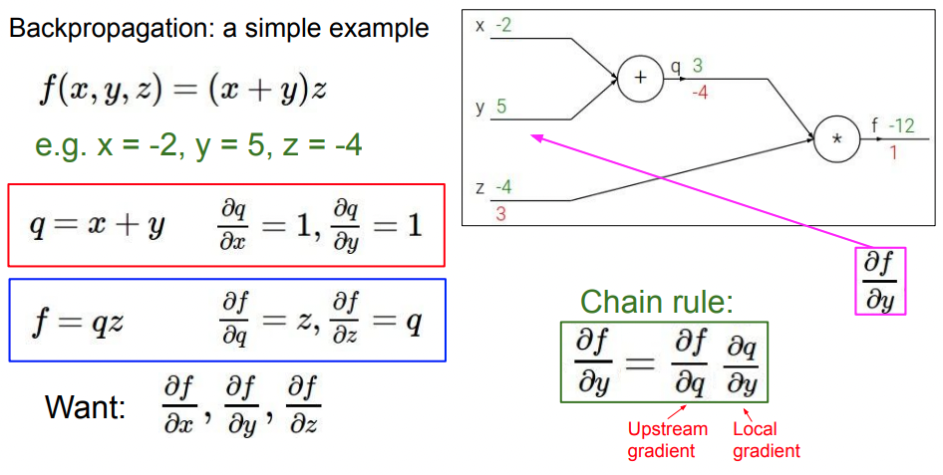
A Computational Graph Perspective
Figure taken from Ranjay Krishna’s course CSE493

Slide 32
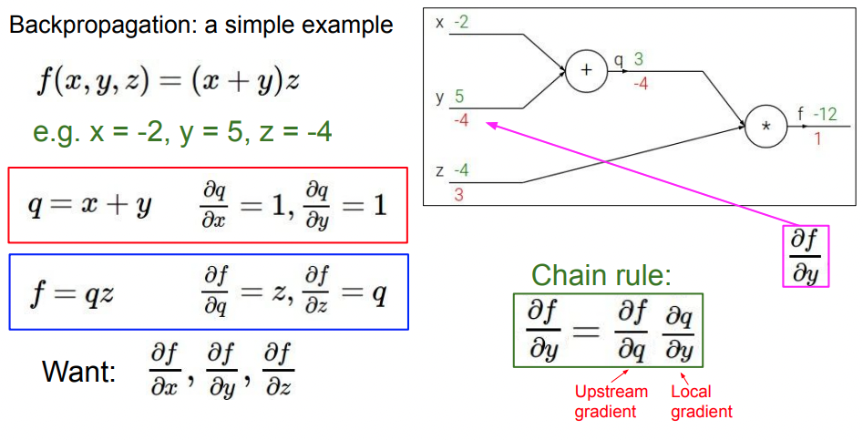
A Computational Graph Perspective
Figure taken from Ranjay Krishna’s course CSE493

Slide 33
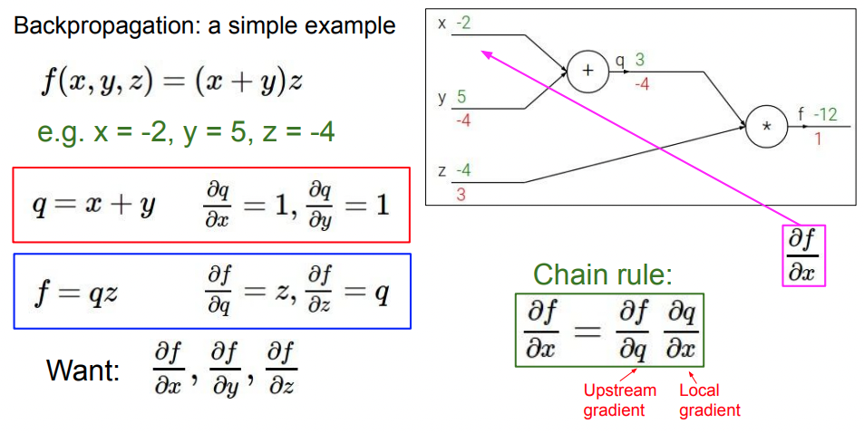
A Computational Graph Perspective
Figure taken from Ranjay Krishna’s course CSE493

Slide 34
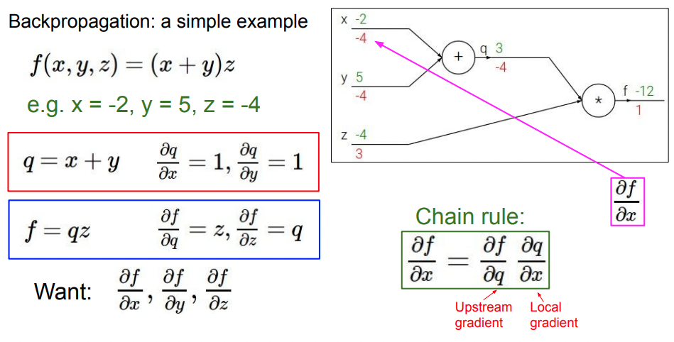
A Computational Graph Perspective
Figure taken from Ranjay Krishna’s course CSE493

Slide 35
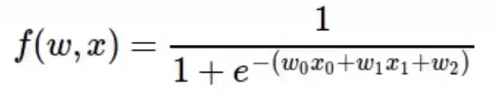
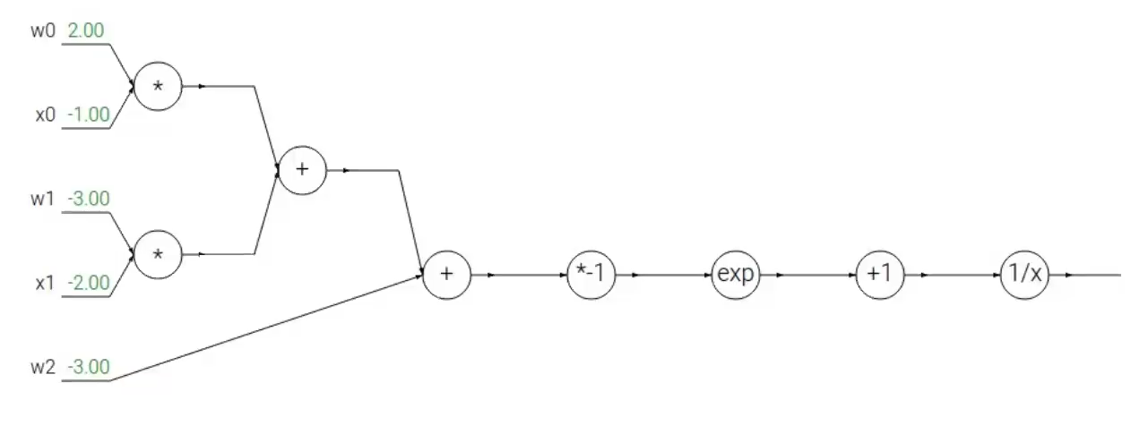
One more example
Figure taken from Ranjay Krishna’s course CSE493

Slide 36
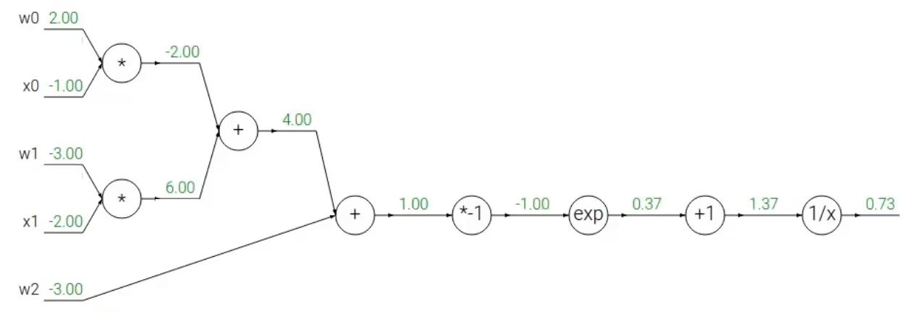
One more example
Figure taken from Ranjay Krishna’s course CSE493

Slide 37
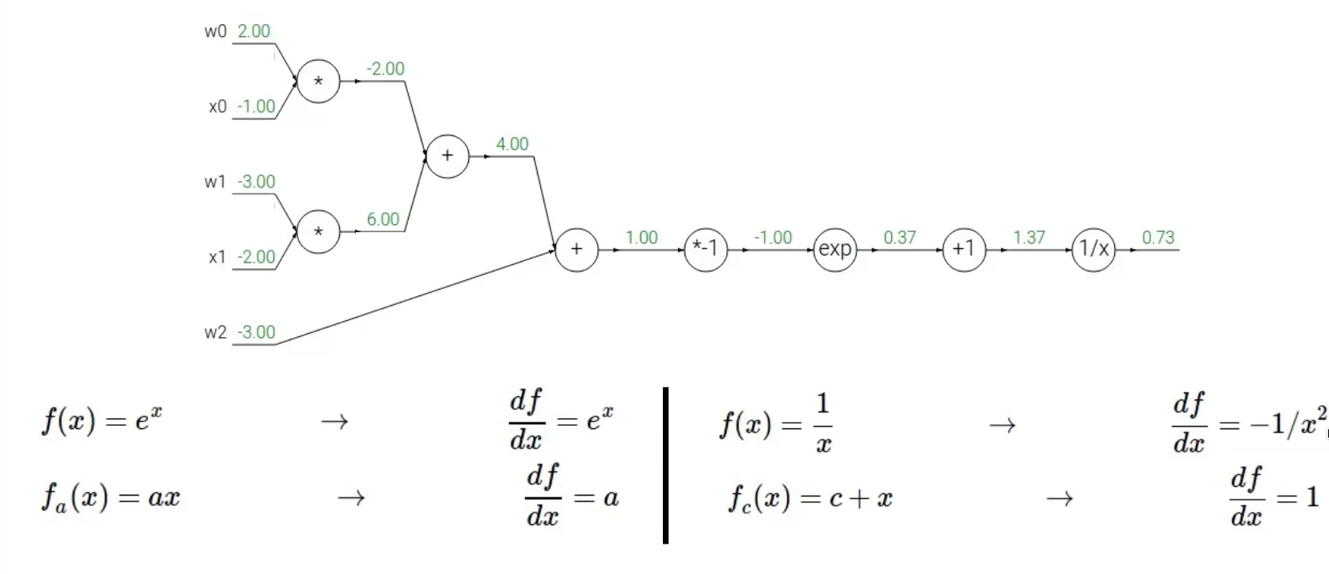
One more example
Figure taken from Ranjay Krishna’s course CSE493

Slide 38
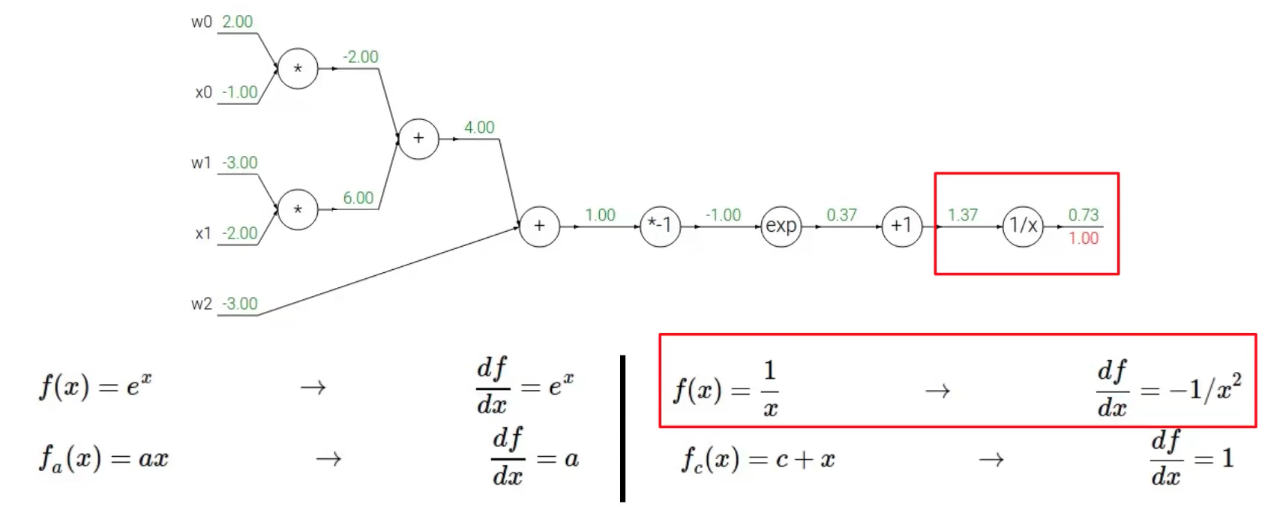
One more example
Figure taken from Ranjay Krishna’s course CSE493
Notes:
Gradient of itself is always 1

Slide 39
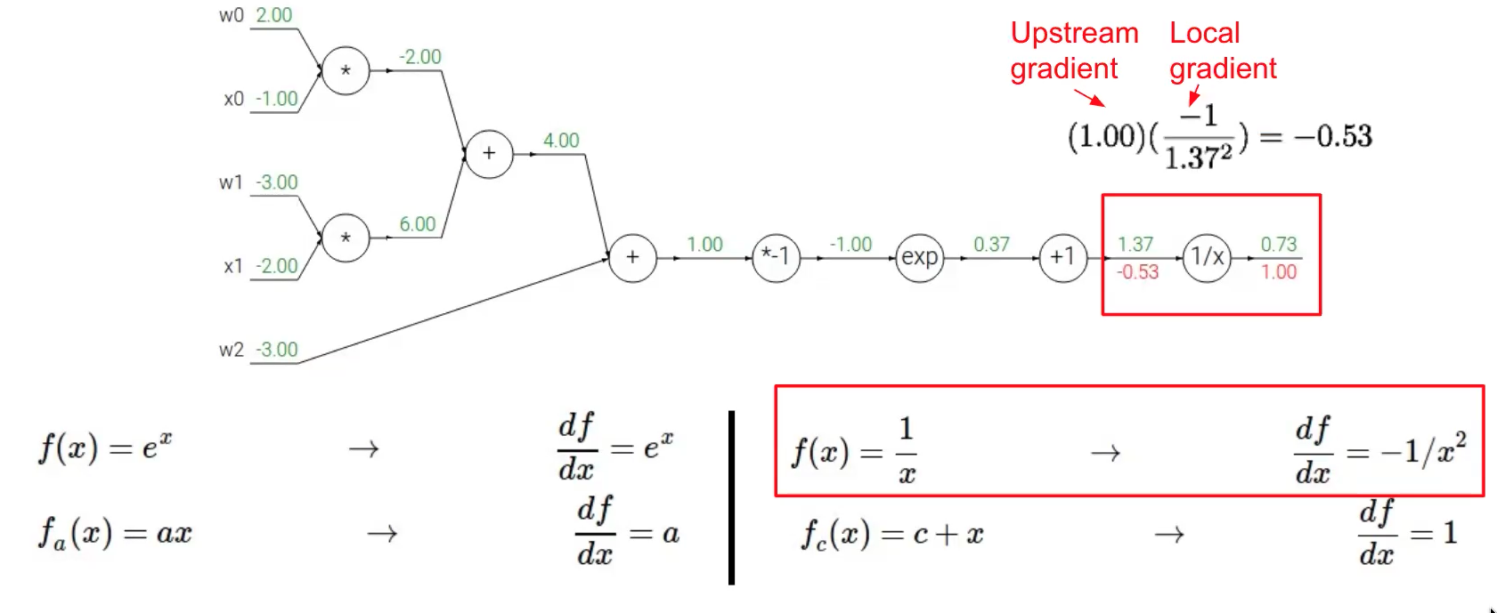
One more example
Figure taken from Ranjay Krishna’s course CSE493

Slide 40
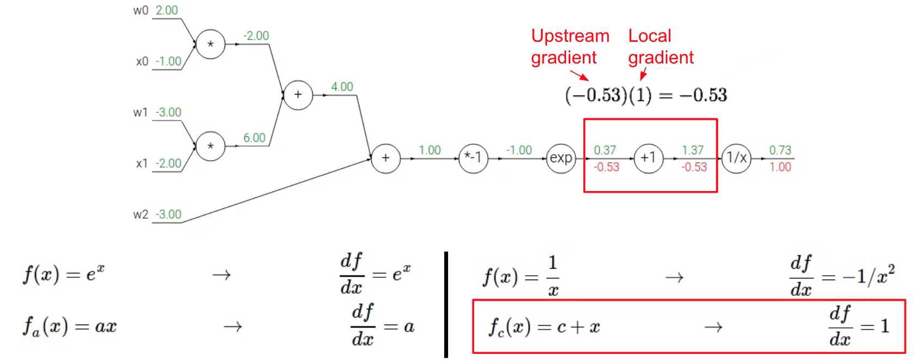
One more example
Figure taken from Ranjay Krishna’s course CSE493

Slide 41
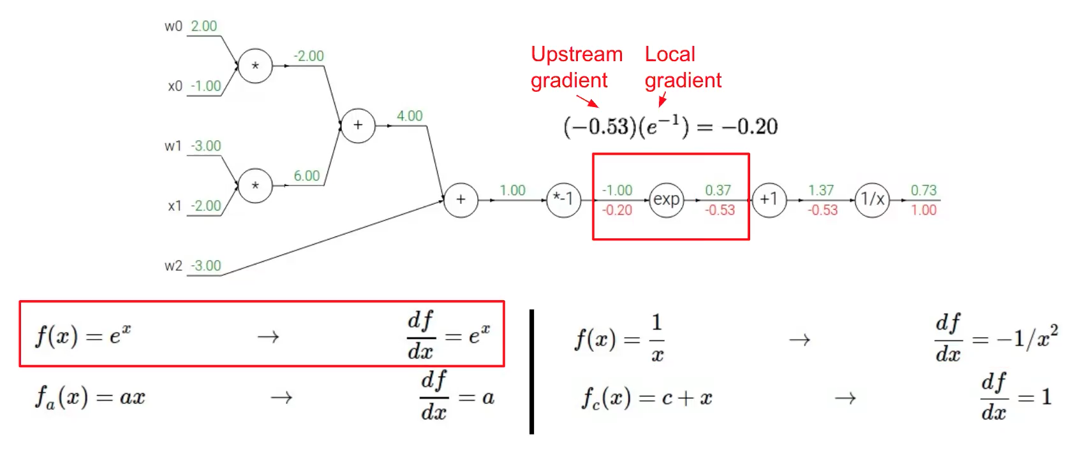
One more example
Figure taken from Ranjay Krishna’s course CSE493

Slide 42
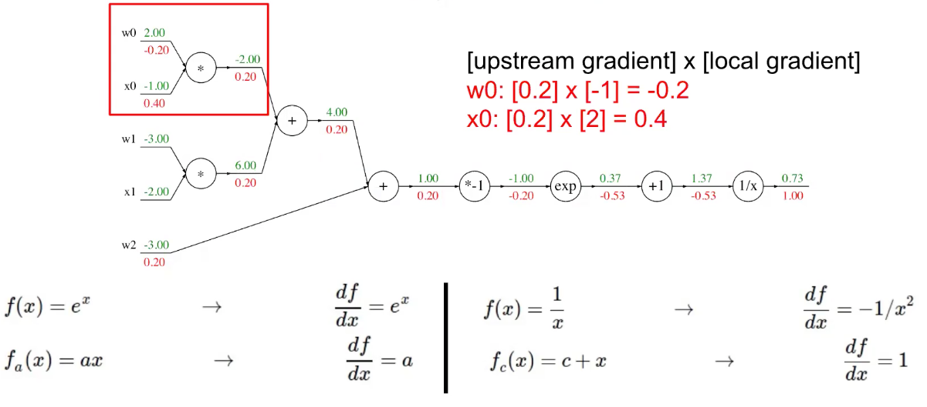
One more example
Figure taken from Ranjay Krishna’s course CSE493

Slide 43
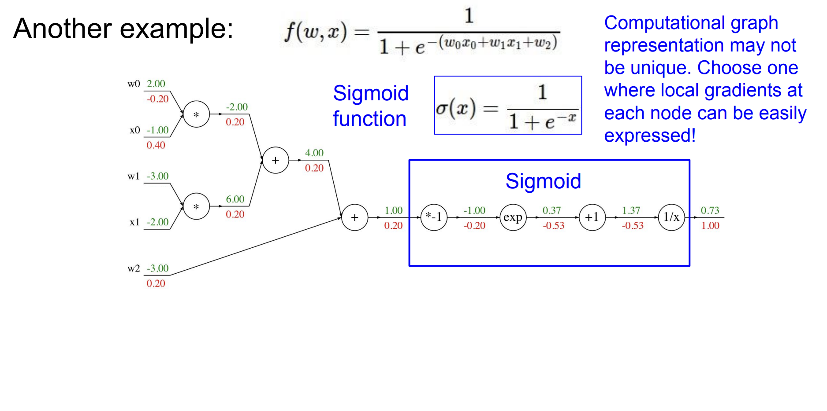
One more example
Figure taken from Ranjay Krishna’s course CSE493

Slide 44
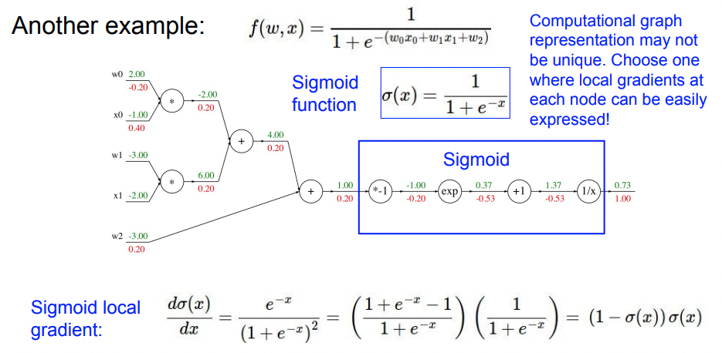
One more example
Figure taken from Ranjay Krishna’s course CSE493

Slide 45
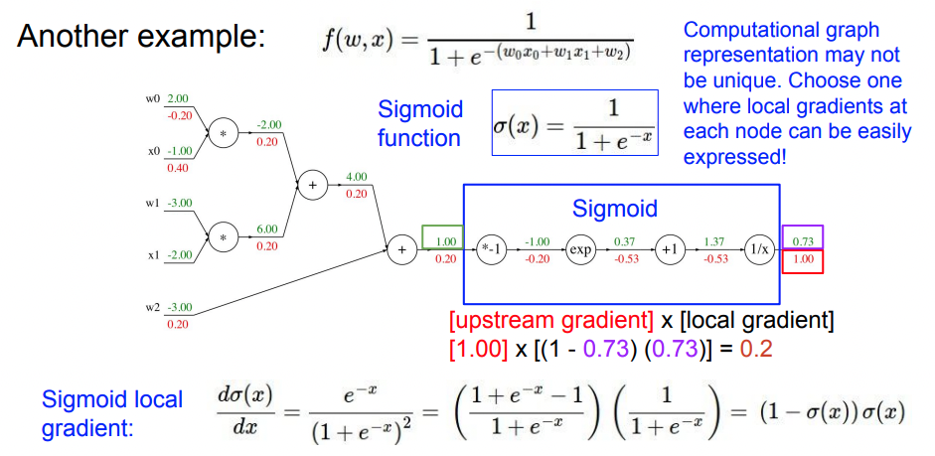
One more example
Figure taken from Ranjay Krishna’s course CSE493

Slide 46
So far: backprop with scalars, let’s go back to our initial example of vectors

Slide 47
Back to our Neural Network Example
Ground Truth
C
1
0
D
0.61 | 0.39
. | .
. | .

Slide 48

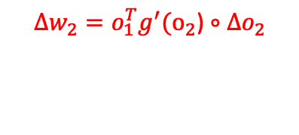
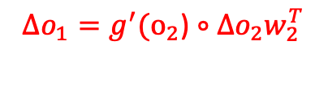
Backpropagation [Cont.]
0.39 | -0.39
. | .
. | .
0.15
0
1
0.7
.61
3
0.1
1.092
0.1
-2.3
0.39
0 | 0
0.585 | -0.585
2
-0.3
-2.1
1.092 | 0.117
. | .
. | .
0.5
.39
4
1
1.5
-0.2
-0.5
-0.39
Input
Output Layer
with Softmax
0.117
3 | 2 | 4
. | . | .
. | . | .
1-st Layer (ReLU)
0 | 1.5
. | .
. | .
0.61 | 0.39
. | .
. | .
1 | 0.5
0.1 | 1
-2.3 | -0.5
0.7 | -2.1
0.1 | -0.2
Notes:
Now we found Delta W2, which is the gradient to change W2 weights. This tells us how much we should nudge W2 weights to make the loss go down, which means in this example to make the distribution fitting to [1,0] output vector from our [0.61, 0.39]
Now let’s do for W1

Slide 49

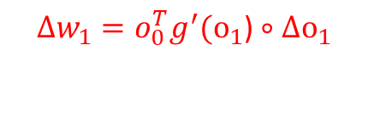
Backpropagation [Cont.]
0 | 0.117
. | .
. | .
0.39 | -0.39
. | .
. | .
0.15
0
1
0.7
.61
3
0 | 0.351
0 | 0.234
0 | 0.468
0.1
1.092
0.1
-2.3
0.39
0 | 0
0.585 | -0.585
2
-0.3
-2.1
1.092 | 0.117
. | .
. | .
0.5
.39
4
1
1.5
-0.2
-0.5
-0.39
Input
Output Layer
with Softmax
0.117
3 | 2 | 4
. | . | .
. | . | .
1-st Layer (ReLU)
0 | 1.5
. | .
. | .
0.61 | 0.39
. | .
. | .
1 | 0.5
0.1 | 1
-2.3 | -0.5
0.7 | -2.1
0.1 | -0.2

Slide 50





Now we backpropagate with a learning rate of 0.1
1
0.7
3
0.1
-2.3
0.1585
2
-2.1
.5351
4
1.0234
-0.2585
-0.4532
Input Layer
Output Layer
with Softmax
1-st Layer (ReLU)
3 | 2 | 4
. | . | .
. | . | .
1 | 0.5351
0.1 | 1.0234
-2.3 | -0.4532
0.7 | -2.1
0.1585 | -0.2585

Slide 51
Think: What will happen if we go forward again?
0.292
Previous
Output
0
0.15
1
0.7
.68
1
.61
3
0.1
-2.3
0.1585
The final output is closer to the actual label
2
-2.1
-0.475
-0.3
.5351
.32
0
4
.39
1.0234
1.84
-0.2585
-0.4532
Label
Input Layer
Output Layer
with Softmax
1-st Layer (ReLU)
3 | 2 | 4
. | . | .
. | . | .
1 | 0.5351
0.1 | 1.0234
-2.3 | -0.4532
0.7 | -2.1
0.1585 | -0.2585

Slide 52
Tricks for Training Neural Networks

Slide 53
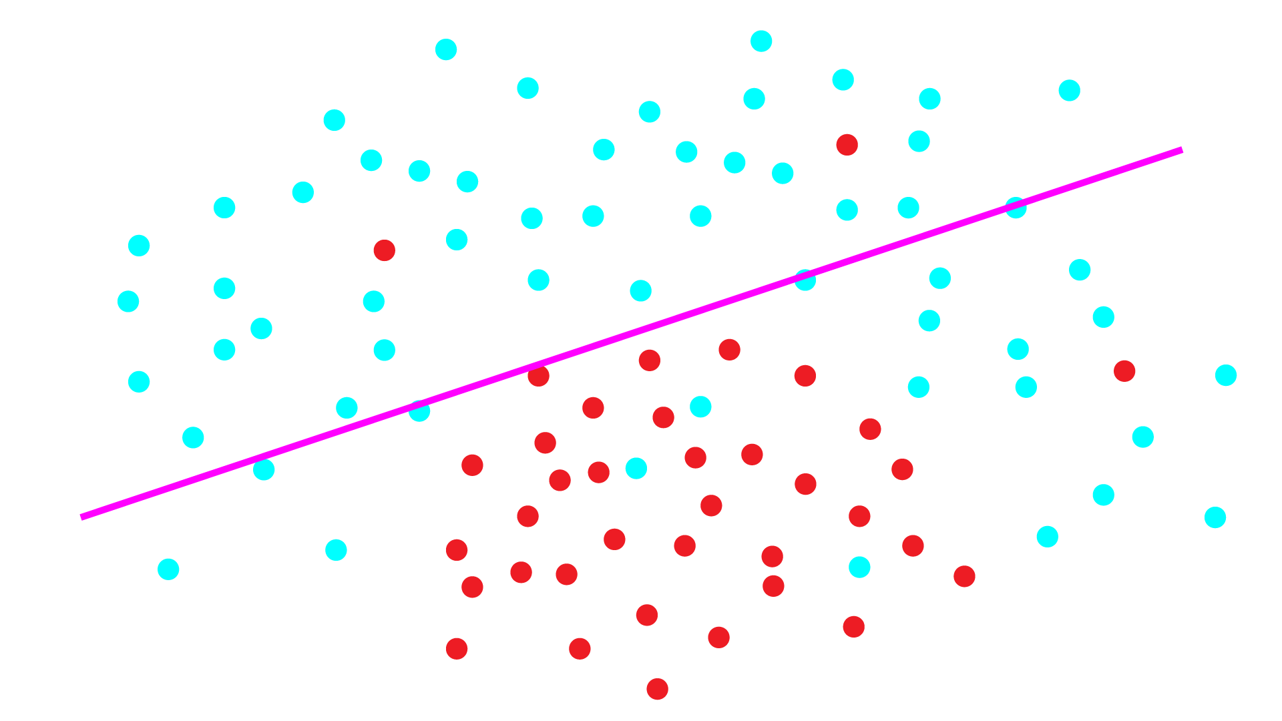
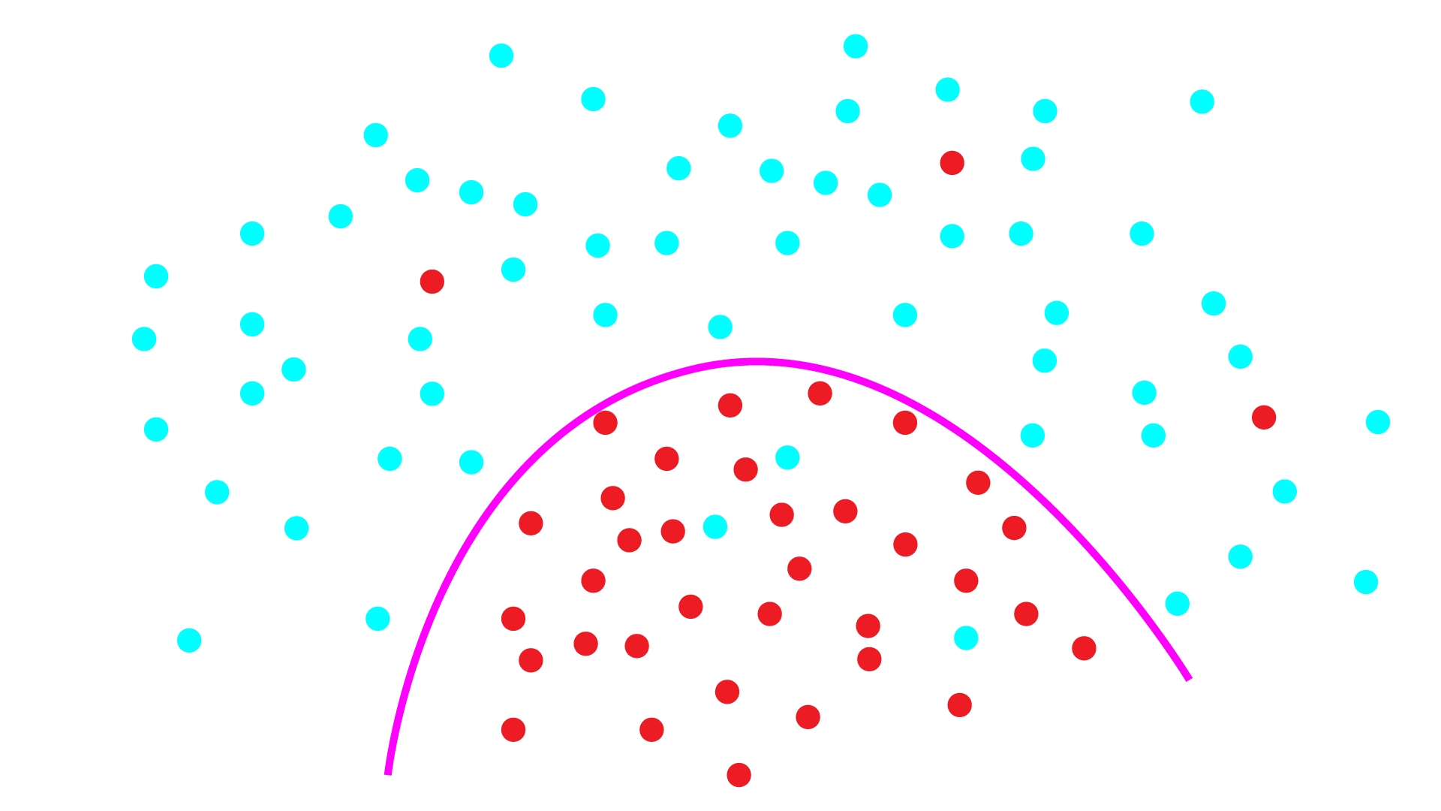
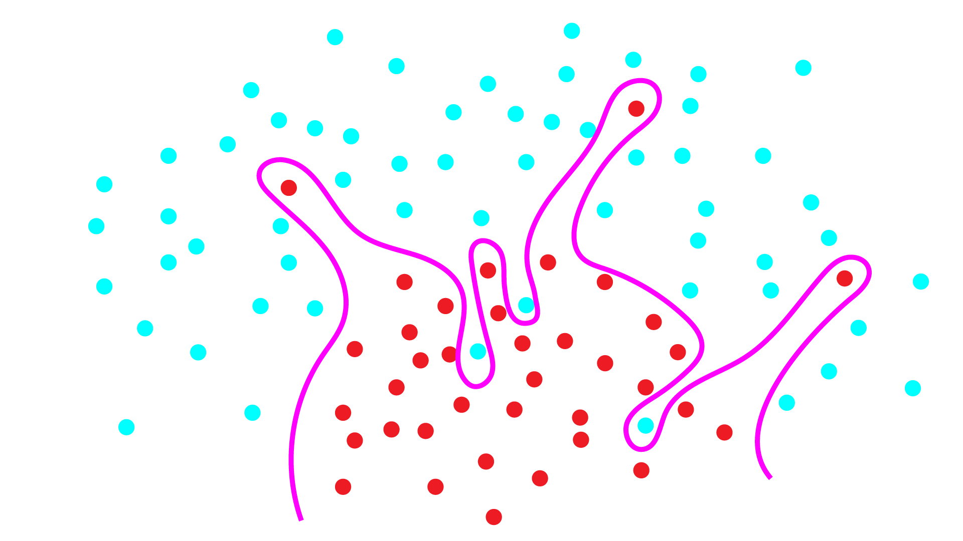
Problem: Under and Overfitting
Underfitting: model not powerful enough, too much bias
Overfitting: model too powerful, fits to noise, doesn’t generalize well

Slide 54

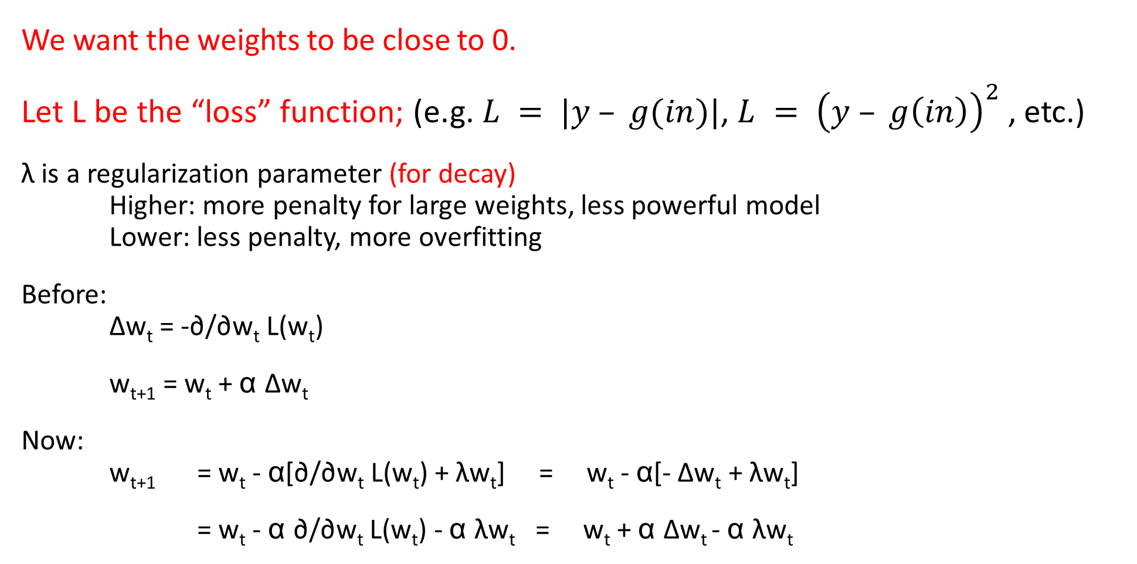
Weight decay: neural network regularization
Subtract a little bit of weight every iteration

Slide 55
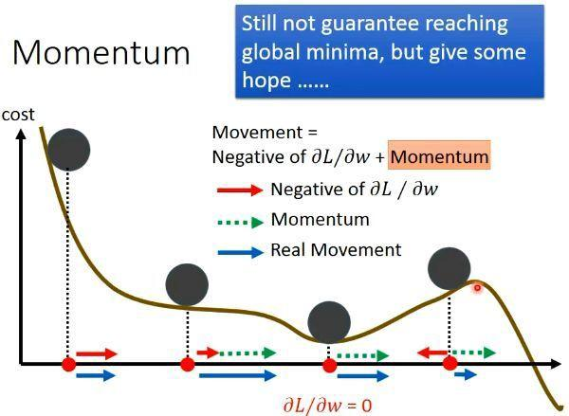
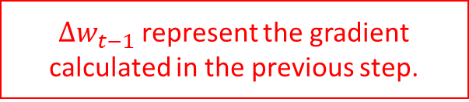
Momentum: speeding up SGD
If we keep moving in same direction we should move further every round
Before: Δw_{t} = -∂/∂w_{t} L(w_{t})
Now: Δw_{t} = -∂/∂w_{t} L(w_{t}) + mΔw_{t-1}
w_{t+1} = w_{t} + α Δw_{t}
Side effect: smooths out updates if gradient is in different directions

Slide 56
NN updates with weight decay and momentum
Δw’_{t} = -∂/∂w_{t} L(w_{t}) - λw_{t} + mΔw’_{t-1}
w_{t+1} = w_{t} + α Δw’_{t}
Momentum
Gradient of loss
Weight decay
Learning rate

Slide 57
Dropout
Randomly eliminate some nodes during training
Notes:
What does this achieve?
Does this increase the variance, or bias?

Slide 58
Activations
Notes:
An Activation Function decides whether a neuron should be activated or not.
The purpose of an activation function is to add non-linearity to the neural network.

Slide 59
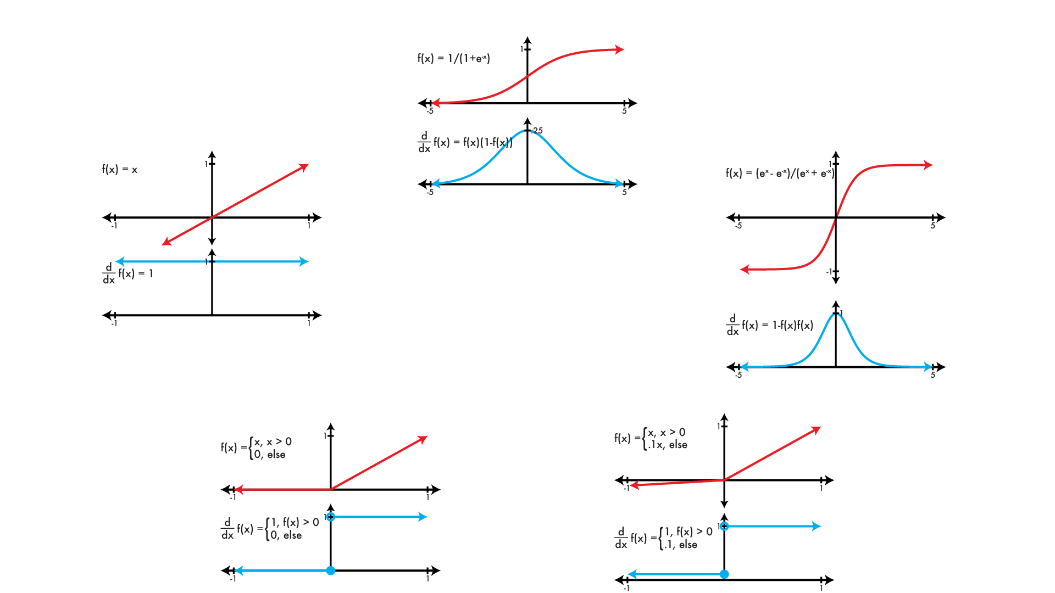
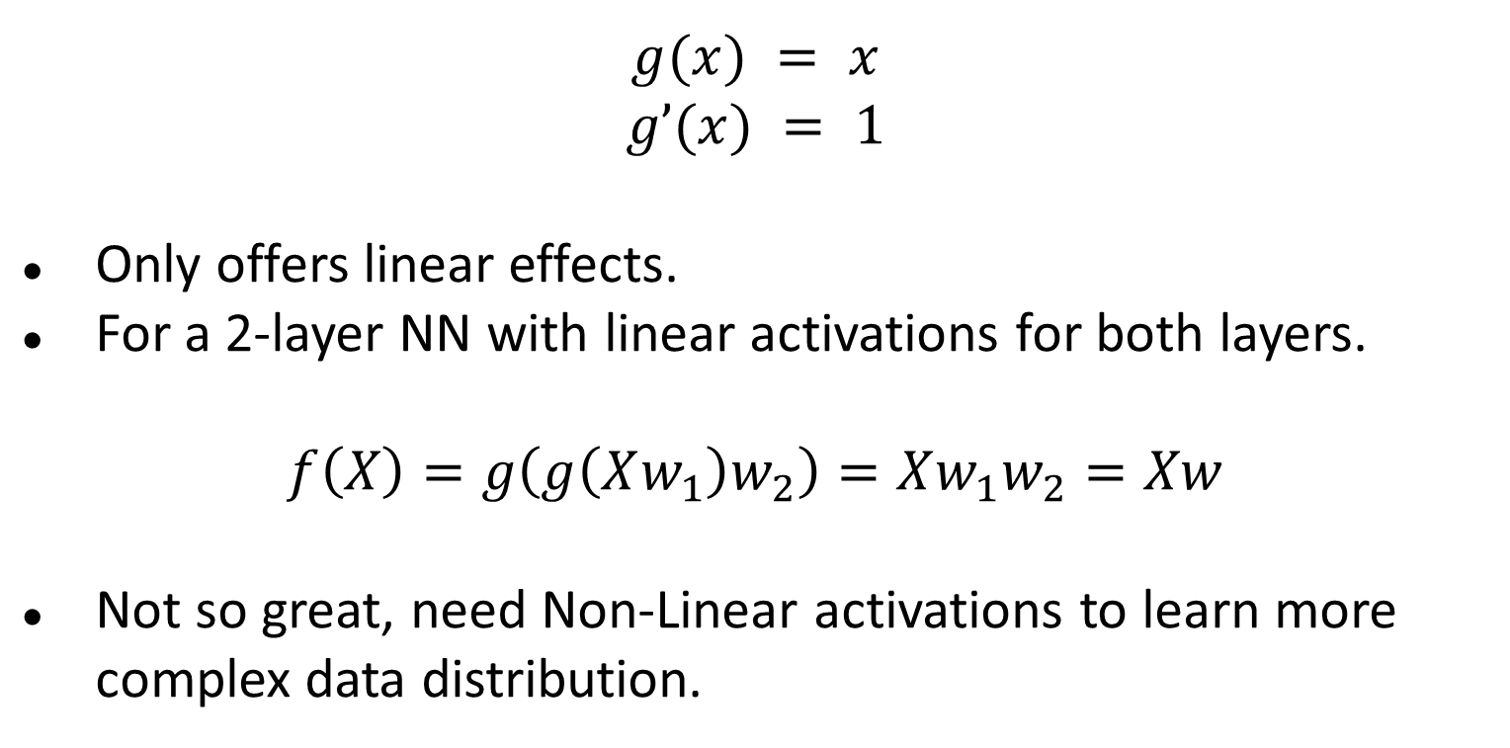
Linear Activation
Notes:
Linear Activation Function
The linear activation function, also known as "no activation," or "identity function" (multiplied x1.0), is where the activation is proportional to the input.
The function doesn't do anything to the weighted sum of the input, it simply spits out the value it was given.

Slide 60
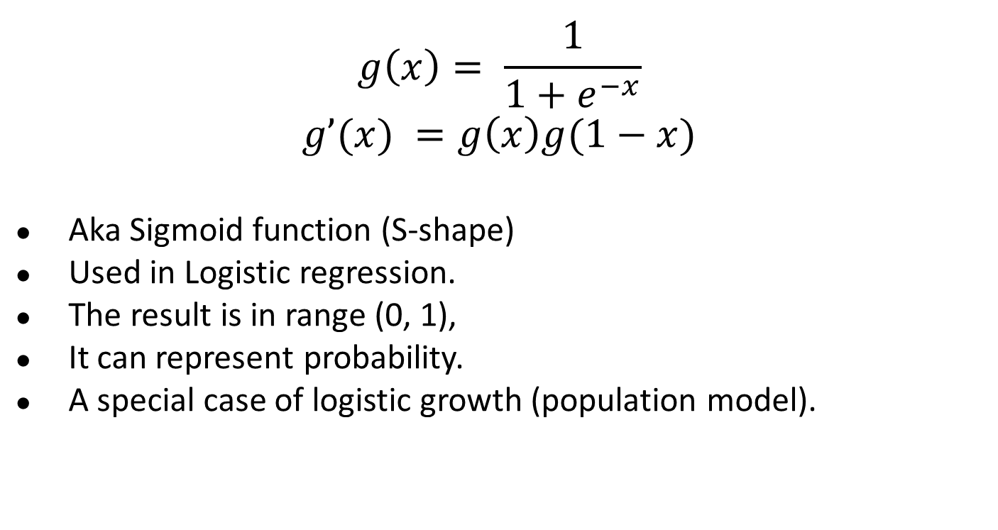
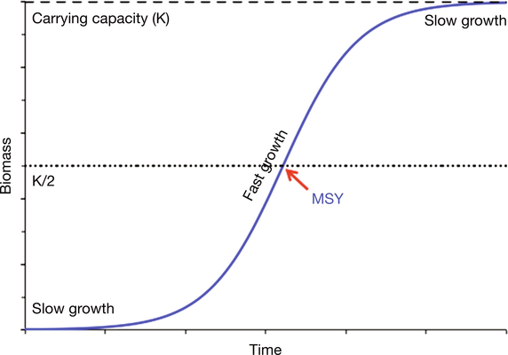
Logistic Activation
Notes:
Sigmoid / Logistic Activation Function
This function takes any real value as input and outputs values in the range of 0 to 1.
The larger the input (more positive), the closer the output value will be to 1.0, whereas the smaller the input (more negative), the closer the output will be to 0.0, as shown below.

Slide 61
Do you see the problem with Sigmoidal activations?
Notes:
Squishing gradients between 0 and 1 diminishes the gradients in large neural networks (you multiply a bunch of values between 0 and 1)

Slide 62
Do you see the problem with Sigmoidal activations?
Vanishing gradients!
Notes:
Squishing gradients between 0 and 1 diminishes the gradients in large neural networks (you multiply a bunch of values between 0 and 1)

Slide 63
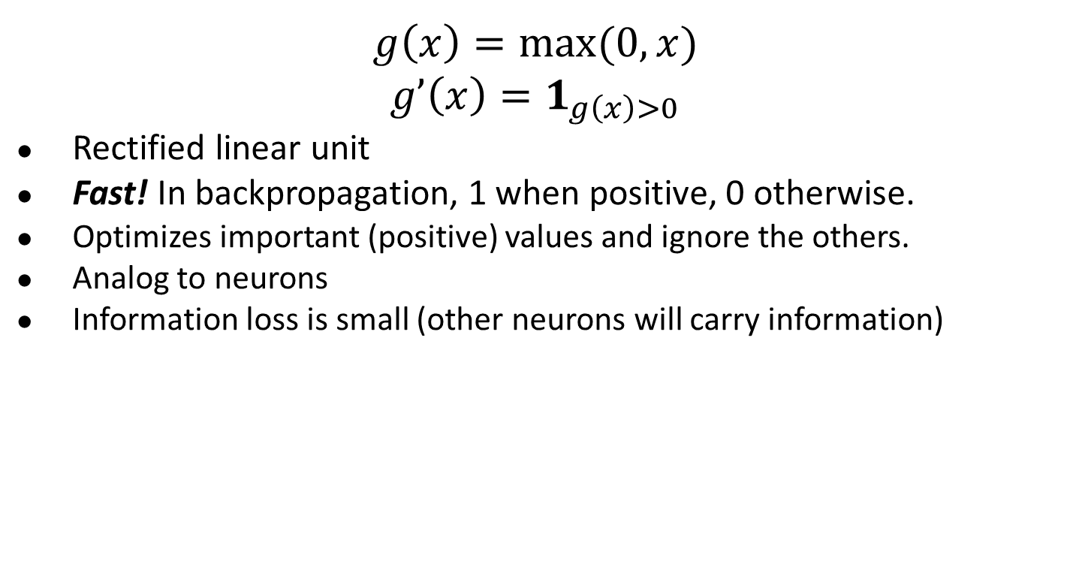
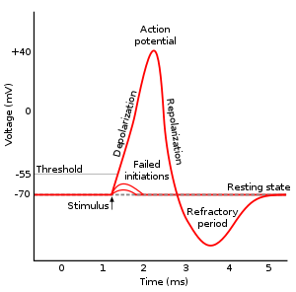
ReLU Activation
Notes:
ReLU Function
ReLU stands for Rectified Linear Unit.
Although it gives an impression of a linear function, ReLU has a derivative function and allows for backpropagation while simultaneously making it computationally efficient.
The main catch here is that the ReLU function does not activate all the neurons at the same time. The neurons will only be deactivated if the output of the linear transformation is less than 0.
The advantages of using ReLU as an activation function are as follows:
Since only a certain number of neurons are activated, the ReLU function is far more computationally efficient when compared to the sigmoid and tanh functions.

Slide 64
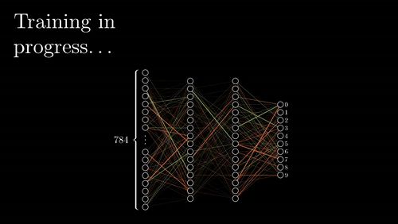
Visualization with ReLU
https://www.youtube.com/channel/UCYO_jab_esuFRV4b17AJtAw
Notes:
ReLU accelerates the convergence of gradient descent towards the global minimum of the loss function due to its linear, non-saturating property.

Slide 65

Why ReLU provides non-linearity?

Slide 66
Why ReLU provides non-linearity?
The function is not linear if it does not satisfy the superposition principles: 1) additivity, 2) homogeneity
F (x1 + x2) = F(x1) + F(x2)
F(ax) = aF(x)
Notes:
It does not hold the additivity principle. F(-5 + 3) != F(-5) + F(3)

Slide 67
Why ReLU provides non-linearity?
Taken from https://www.blog.dailydoseofds.com/p/a-visual-and-intuitive-guide-to-what#:~:text=The%20core%20point%20to%20understand,of%20a%20non%2Dlinear%20curve.

Slide 68

The Dying ReLU Problem
Notes:
The limitations faced by this function are:
The Dying ReLU problem, which I explained below.

Slide 69
LeakyReLU Activation
No information loss (compared to ReLU)
Solves “dying ReLU” problem (i.e. all neurons output 0)
Similar to ReLU, pays less attention to less important neurons
Not always better than ReLU
Notes:
Leaky ReLU is an improved version of ReLU function to solve the Dying ReLU problem as it has a small positive slope in the negative area.
The advantages of Leaky ReLU are same as that of ReLU, in addition to the fact that it does enable backpropagation, even for negative input values.
By making this minor modification for negative input values, the gradient of the left side of the graph comes out to be a non-zero value. Therefore, we would no longer encounter dead neurons in that region.

Slide 70
Do you see any other issues with ReLU?

Slide 71
Do you see any other issues with ReLU?
Exploding gradients: Exact opposite phenomena we had with Sigmoid (vanishing gradients)

Slide 72
Do you see any other issues with ReLU?
Exploding gradients: Exact opposite phenomena we had with Sigmoid (vanishing gradients)
Do gradient clipping, or layer-wise normalization

Slide 73
Homework 4
Neural Network

Slide 74

MNIST: Handwriting recognition
50,000 images of handwriting Input: 28 x 28 x 1 (grayscale) 784 pixel values Numbers 0-9 10 classes
Train a linear softmax model > 95% accuracy

Slide 75
Functions You need to Code
Functions You need to Code (classifier.c)
void activate_matrix(matrix m, ACTIVATION a)
void gradient_matrix(matrix m, ACTIVATION a, matrix d)
matrix forward_layer(layer *l, matrix in)
matrix backward_layer(layer *l, matrix delta)
void update_layer(layer *l, double rate, double momentum, double decay)
Run Experiments and Write a Report (hw4.pdf)
Play around with tryhw4.py file, and answer the questions.
Save your question to a PDF file and submit to Canvas for grading.

Slide 76
Important Data Structure (image.h)
typedef enum{LINEAR, LOGISTIC, RELU, LRELU, SOFTMAX} ACTIVATION;
typedef struct {
matrix in; // Saved input to a layer
matrix w; // Current weights for a layer
matrix dw; // Current weight updates
matrix v; // Past weight updates (for use with momentum)
matrix out; // Saved output from the layer
ACTIVATION activation; // Activation the layer uses
} layer;
typedef struct {
layer *layers;
int n;
} model;

Slide 77
Useful Matrix manipulation functions (matrix.c)
matrix matrix_mult_matrix(matrix a, matrix b);
matrix transpose_matrix(matrix m);
matrix axpy_matrix(double a, matrix x, matrix y); // a * x + y

Slide 78
Forward Pass in Homework
forward_model
forward_layer
Input: layer l, data in
Input: model m, data X
X = in * l->w
forward_layer
activation_matrix
(X, l->activation)
Output
Output

Slide 79



Backward Pass in Homework
backward_model
backward_layer
Input: layer l, matrix delta
Input: model m, matrix d
gradient_matrix
backward_layer
Output

Slide 80





Weight Update in Homework
update_model
update_layer
update_layer
Output

Slide 81
TODO void activate_matrix(matrix m, ACTIVATION a)
for(i = 0; i < m.rows; ++i){
double sum = 0;
for(j = 0; j < m.cols; ++j){
double x = m.data[i][j];
if(a == LOGISTIC){
// TODO m.data[i][j] should equals 1 / (1 + exp(-x));
} else if (a == RELU){
// TODO m.data[i][j] should equals x if x > 0; otherwise, it should equal 0
} else if (a == LRELU){
// TODO m.data[i][j] should equals x if x > 0; otherwise, it should equal 0.1 * x.
} else if (a == SOFTMAX){
// TODO m.data[i][j] should equals exp(x) here, and we will normalize it later.
}
sum += m.data[i][j];
}
if (a == SOFTMAX) {
// TODO: have to normalize by sum if we are using SOFTMAX
// for all the possible j, we should normalize it as m.data[i][j] /= sum;
}
}
Apply activation “a” to the matrix “m”

Slide 82

TODO void gradient_matrix(matrix m, ACTIVATION a, matrix d)
int i, j;
for(i = 0; i < m.rows; ++i){
for(j = 0; j < m.cols; ++j){
double x = m.data[i][j];
// TODO: multiply the correct element of d by the gradient
// if a is SOFTMAX or a is LINEAR, we should do nothing (multiply by 1)
// if a is LOGISTIC, d.data[i][j] should times x * (1.0 - x);
// if a is RELU and x <= 0, d.data[i][j] should be zero
// if a is LRELU and x <= 0, d.data[i][j] should multiple 0.1
}
}
Notes:
As we are calculating the partial derivatives for the weights of our model we have to remember to factor in the gradient from our activation function at every layer.

Slide 83
TODO matrix forward_layer(layer *l, matrix in)
Given the input data “in” and layer “l”, calculate the output data.
l->in = in; // Save the input for backpropagation
// TODO: multiply input by weights and apply activation function.
// Calculate out = in * l->w (note: matrix multiplication here)
// Then, apply activate_matrix function to out with l->activation
free_matrix(l->out);// free the old output
l->out = out; // Save the current output for gradient calculation
return out;

Slide 84

TODO matrix backward_layer(layer *l, matrix delta)
// delta is Δout
// TODO: modify it in place to be “g'(out) * delta” out with // gradient_matrix function.
// You can use gradient_matrix function with “l->out” and “l->activation” to “delta”
// TODO: then calculate dL/dw and save it in l->dw
free_matrix(l->dw);
// Calculate xt as the transpose matrix of “l->in”
// Calculate dw as xt times delta (matrix multiplication)
// free matrix xt to avoid memory leak
l->dw = dw;
// TODO: finally, calculate dL/dx and return it. (Similar to 1.4.2. Care memory leak)
// Calculate dx = delta * (l->w)^T, where * is matrix multiplication and ^T is matrix transpose
return dx;
Notes:
First we need to calculate delta using the gradient of our activation function.
Next we want to calculate the derivative with respect to our weights,
Next we want to calculate the derivative wit

Slide 85
TODO void update_layer(layer *l, double rate, double momentum, double decay)
Given a layer “l”, learning rate, momentum, and decay rate,
Update the weight (i.e. l->w)
// Calculate Δw_t = dL/dw_t - λw_t + mΔw_{t-1}
// save it to l->v
// Note that You can use axpy_matrix to perform the matrix summation/subtraction
// Update l->w
// l->w = rate * l->v + l->w
Note the multiplication and summation in this slides all mean matrix multiplication or matrix summation.
Notes:
After we've performed a round of forward and backward propagation we want to update our weights. Remember from last class we talked about the formula for weight update with momentum and decay.

Slide 86
Functions You Need to Know before Experiments
For simplicity, we already filled the following functions for you. You should read and understand these functions (classifier.c) before running experiments.
layer make_layer(int input, int output, ACTIVATION activation)
matrix forward_model(model m, matrix X)
void backward_model(model m, matrix dL)
void update_model(model m, double rate, double momentum, double decay)
double accuracy_model(model m, data d)
double cross_entropy_loss(matrix y, matrix p)
void train_model(model m, data d, int batch, int iters, double rate, double momentum, double decay)

Slide 87
Get the Data
1. Download, Unzip, and Prepare the MNIST Dataset
wget https://pjreddie.com/media/files/mnist_train.tar.gz
wget https://pjreddie.com/media/files/mnist_test.tar.gz
tar xzf mnist_train.tar.gz
tar xzf mnist_test.tar.gz
find train -name \*.png > mnist.train
find test -name \*.png > mnist.test
2. Download, Unzip, and Prepare the CIFAR-10 Dataset
wget http://pjreddie.com/media/files/cifar.tgz
tar xzf cifar.tgz
find cifar/train -name \*.png > cifar.train
find cifar/test -name \*.png > cifar.test

Slide 88
Experiments (Write Your Answers to hw4.pdf)
Coding and Data prepare
MNIST Experiments
Linear Softmax Model (1-layer)
Run the basic model
Tune the learning rate
Tune the decay
Neural Network (2-layer NNs and 3-layer NNs)
Find the best activation
Tune the learning rate
Tune the decay
Tune the decay for 3-layer Neural Network
Experiments for CIFAR-10
Neural Network (3-layer NNs)
Tune the learning rate and decay

Slide 89

How to write this in code
Figure taken from Ranjay Krishna’s course CSE493

Slide 90


Back to our Neural Network Example
Ground Truth
0.39
C
1
Assume g’(.) = 1
0
D
-0.39
0.61 | 0.39
. | .
. | .

Slide 91





Neural Network Easy Example
Ground Truth
0.39
C
1
0.39 | -0.39
. | .
. | .
0 | 0
0.585 | -0.585
1.092 | 0.117
. | .
. | .
0
D
-0.39
0.61 | 0.39
. | .
. | .
Assume g’(.) = 1

