Slide 1
Computer Vision CSE 455 SVMs and Neural Nets Linda Shapiro Professor of Computer Science & Engineering Professor of Electrical & Computer Engineering

Slide 2
Kernel Machines
A relatively new learning methodology (1992) derived from statistical learning theory.
Became famous when it gave accuracy comparable to neural nets in a handwriting recognition class.
Was introduced to computer vision researchers by Tomaso Poggio at MIT who started using it for face detection and got better results than neural nets.
Has become very popular and widely used with packages available.

Slide 3
Support Vector Machines (SVM)
Support vector machines are learning algorithms
that try to find a hyperplane that separates
the different classes of data the most.
They are a specific kind of kernel machines based on
two key ideas:
maximum margin hyperplanes
a kernel ‘trick’

Slide 4
The SVM Equation
y_{SVM}(x_{q}) = argmax Σ α_{i,c} K(x_{i},x_{q})
x_{q} is a query or unknown object
c indexes the classes
there are m support vectors x_{i} with weights α_{i,c}, i=1 to m for class c
K is the kernel function that compares x_{i} to x_{q}
c i=1,m
*** This is for multiple class SVMs with support vectors
for every class; we’ll see a simpler equation for 2 class.

Slide 5
Maximal Margin (2 class problem)
In 2D space,
a hyperplane is
a line.
In 3D space,
it is a plane.
margin
hyperplane
Find the hyperplane with maximal margin for all
the points. This originates an optimization problem
which has a unique solution.

Slide 6
Support Vectors
The weights α_{i} associated with data points are zero, except for those points closest to the separator.
The points with nonzero weights are called the support vectors (because they hold up the separating plane).
Because there are many fewer support vectors than total data points, the number of parameters defining the optimal separator is small.

Slide 7
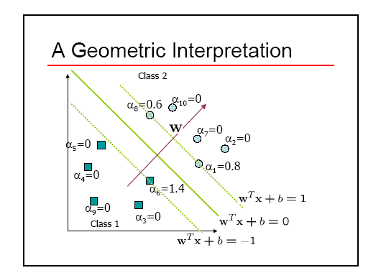
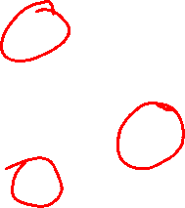

Slide 8
Kernels
A kernel is just a similarity function. It takes 2 inputs and decides how similar they are.
Kernels offer an alternative to standard feature vectors. Instead of using a bunch of features, you define a single kernel to decide the similarity between two objects.

Slide 9
Kernels and SVMs
Under some conditions, every kernel function can be expressed as a dot product in a (possibly infinite dimensional) feature space (Mercer’s theorem)
SVM machine learning can be expressed in terms of dot products.
So SVM machines can use kernels instead of feature vectors.

Slide 10
The Kernel Trick
The SVM algorithm implicitly maps the original
data to a feature space of possibly infinite dimension
in which data (which is not separable in the
original space) becomes separable in the feature space.
Original space R^{k}
Feature space R^{n}
1
0
1
1
0
0
1
0
0
1
0
Kernel
trick
0
1
0
0
0
1
1

Slide 11
Kernel Functions
The kernel function is designed by the developer of the SVM.
It is applied to pairs of input data to evaluate dot products in some corresponding feature space.
Kernels can be all sorts of functions including polynomials and exponentials.
Simplest is just the plain dot product: xi•xj
The polynomial kernel K(xi,xj) = (xi•xj + 1)^{p}, where p is a tunable parameter.

Slide 12
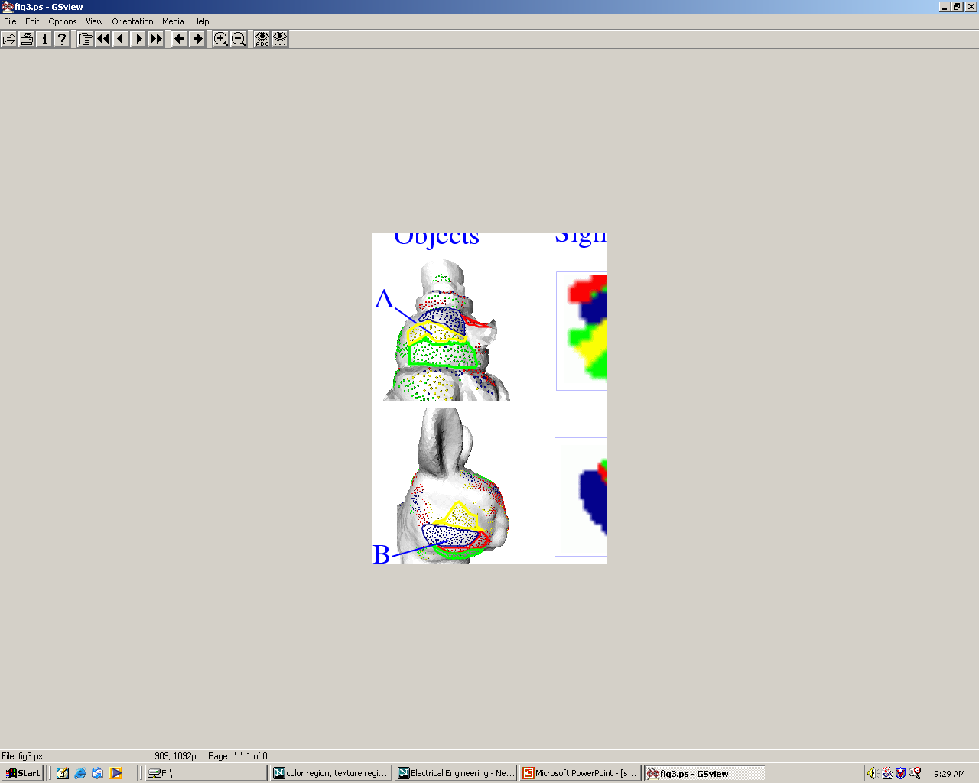
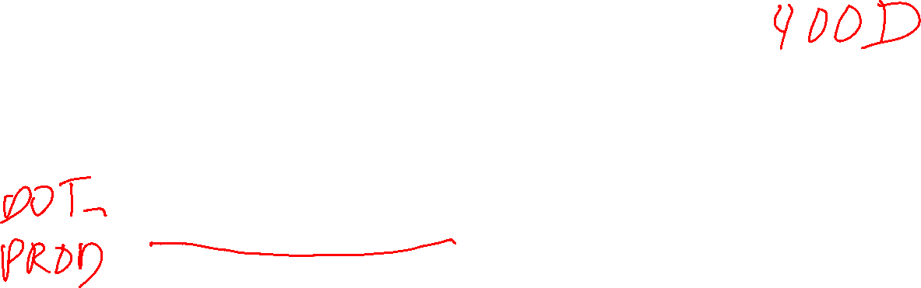
Kernel Function used in our 3D Computer Vision Work
k(A,B) = exp(-θ²_{AB}/σ²)
A and B are shape descriptors (big vectors).
θ is the angle between these vectors.
σ² is the “width” of the kernel.

Slide 13
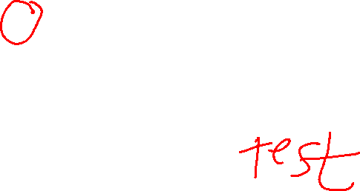
What does SVM learning solve?
The SVM is looking for the best separating plane in its alternate space.
It solves a quadratic programming optimization problem
argmax Σα_{j} - 1/2 Σα_{j} α_{k} y_{j} y_{k} (x_{j}•x_{k})
subject to α_{j} > 0 and Σα_{j}y_{j} = 0.
The equation for the separator for these optimal α_{j} is
h(x) = sign(Σα_{j} y_{j} (x•x_{j}) – b)
α j j,k
j

Slide 14
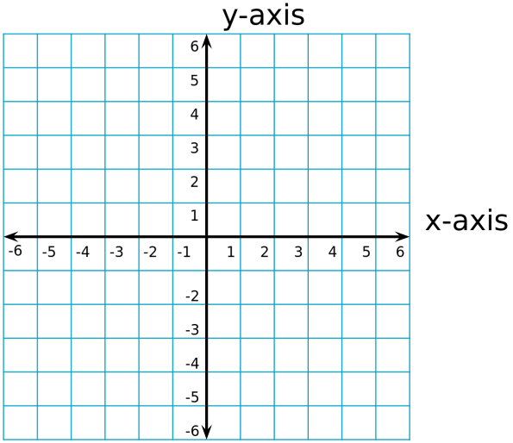

Simple Example of Classification
K(A,B) = A • B
known positive class points {(3,1),(3,-1),(6,1),(6,-1)}
known negative class points {(1,0),(0,1),(0,-1),(-1,0)}
support vectors: s = {(1,0),(3,1),(3,-1)} with weights α = -3.5, .75, .75
classifier equation: f(x) = sign(Σ_{i} [α_{i}*K(s_{i},x)]-b)
b=2
f(1,1) = sign(Σ_{i} α_{i} s_{i} • (1,1) - 2)
= sign(.75*(3,1) • (1,1) + .75*(3,-1)•(1,1)+(-3.5)*(1,0)•(1,1) -2)
= sign(1 – 2) = sign(-1) = - negative class
CORRECT

Slide 15
Time taken to build model: 0.15 seconds
Correctly Classified Instances 319 83.5079 %
Incorrectly Classified Instances 63 16.4921 %
Kappa statistic 0.6685
Mean absolute error 0.1649
Root mean squared error 0.4061
Relative absolute error 33.0372 %
Root relative squared error 81.1136 %
Total Number of Instances 382
TP Rate FP Rate Precision Recall F-Measure ROC Area Class
0.722 0.056 0.925 0.722 0.811 0.833 cal
0.944 0.278 0.78 0.944 0.854 0.833 dor
W Avg. 0.835 0.17 0.851 0.835 0.833 0.833
=== Confusion Matrix ===
a b <-- classified as
135 52 | a = cal
11 184 | b = dor

Slide 16
Neural Net Learning
Motivated by studies of the brain.
A network of “artificial neurons” that learns a function.
Doesn’t have clear decision rules like decision trees, but highly successful in many different applications. (e.g. face detection)
We use them frequently in our research.
I’ll be using algorithms from
http://www.cs.mtu.edu/~nilufer/classes/cs4811/2016-spring/lecture-slides/cs4811-neural-net-algorithms.pdf

Slide 17
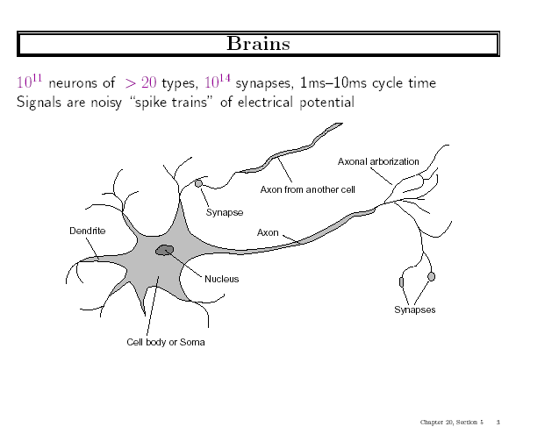

Slide 18
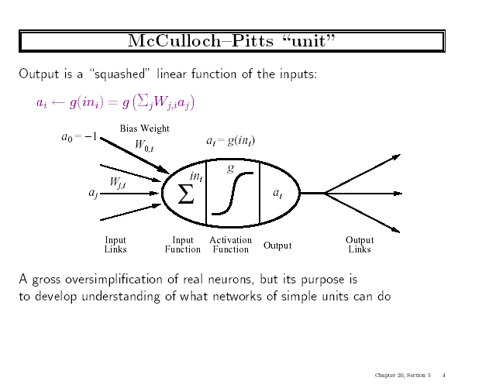
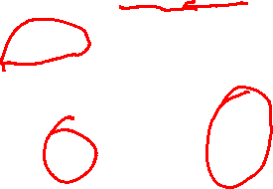

Slide 19
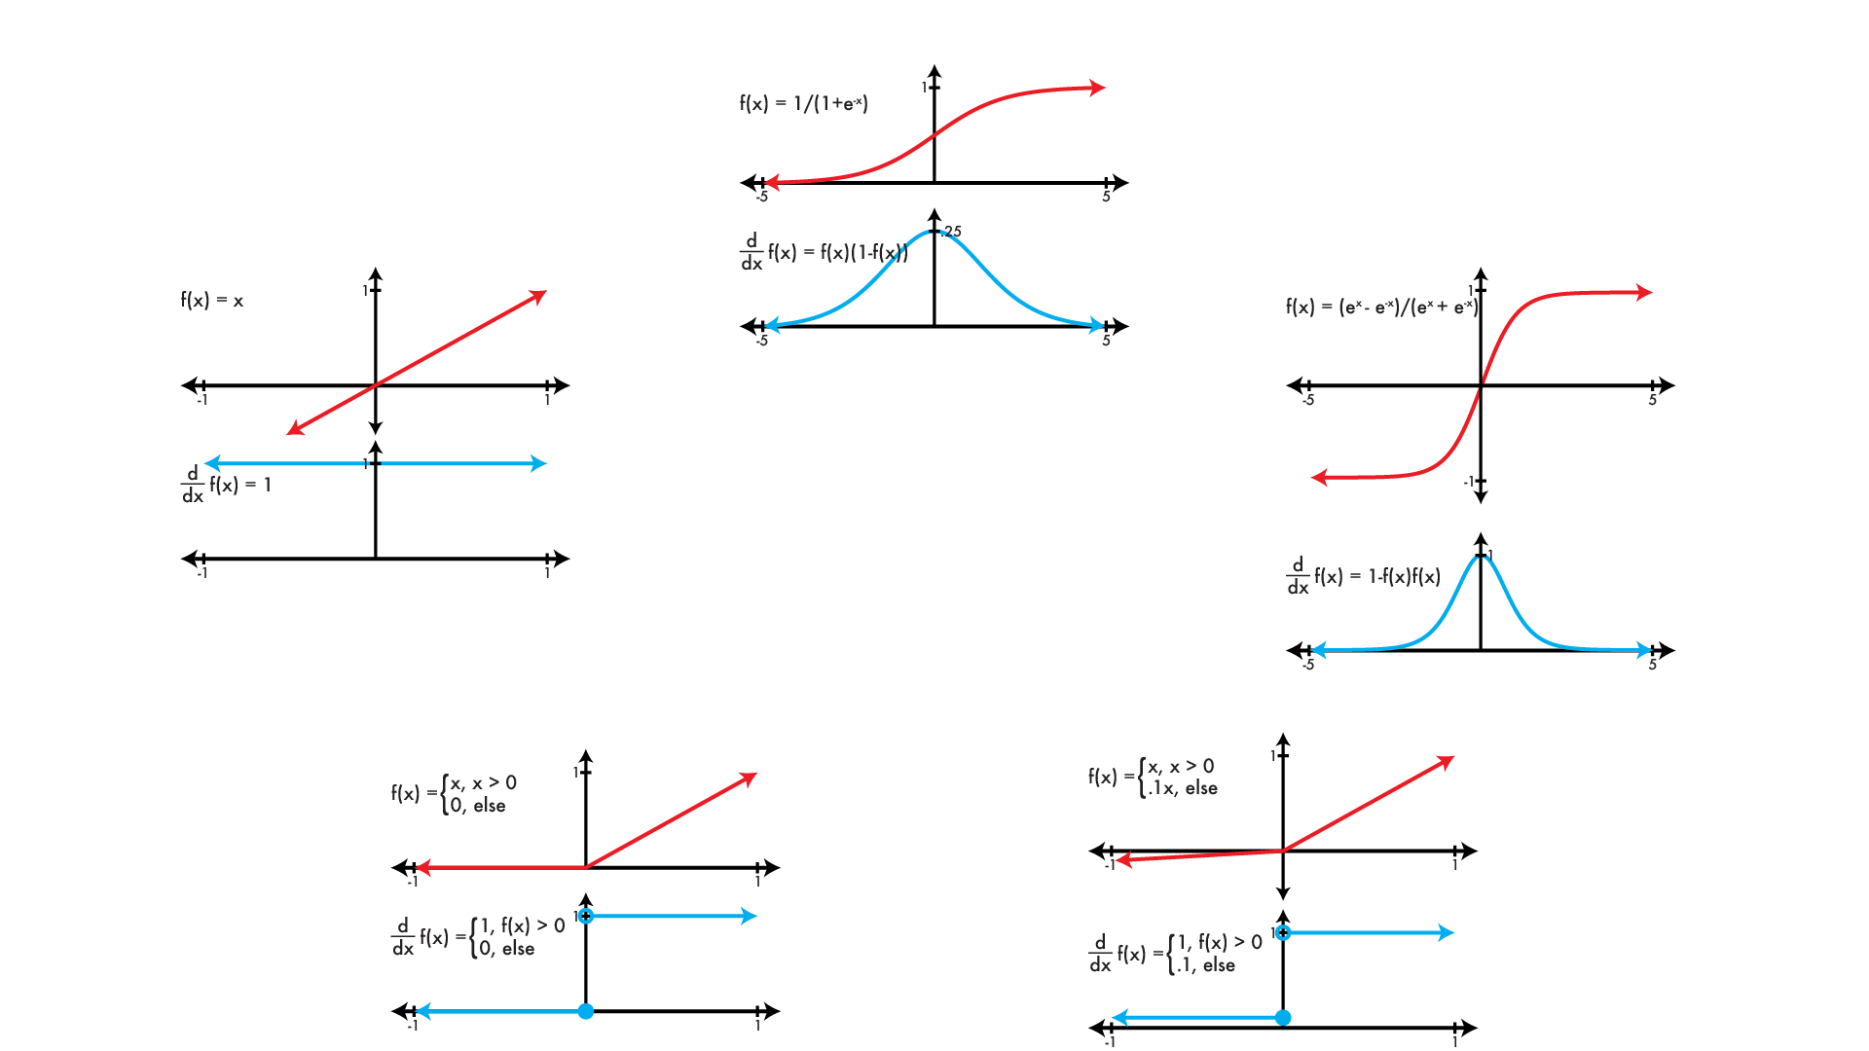

Common activation functions φ
logistic
linear
tanh
REctified Linear Unit (RELU)
Leaky RELU

Slide 20
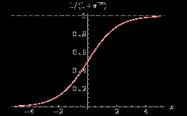
Simple Feed-Forward Perceptrons
in = (∑ W_{j} x_{j}) + θ
out = g[in]
x1
W1
g(in)
out
g is the activation function
It can be a step function:
g(x) = 1 if x >=0 and 0 (or -1) else.
It can be a sigmoid function:
g(x) = 1/(1+exp(-x)).
x2
W2
θ
The sigmoid function is differentiable
and can be used in a gradient descent
algorithm to update the weights.
and other things…

Slide 21
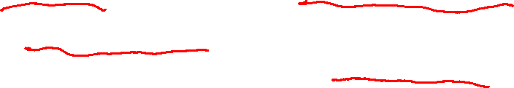
Gradient Descent takes steps proportional to the negative of the gradient of a function to find its local minimum
Let X be the inputs, y the class, W the weights
in = ∑ W_{j} x_{j}
Err = y – g(in)
E = ½ Err² is the squared error to minimize
∂E/∂W_{j} = Err * ∂Err/∂W_{j} = Err * ∂/∂W_{j}(g(in))(-1)
= -Err * g’(in) * x_{j}
The update is W_{j} <- W_{j} + α * Err * g’(in) * x_{j}
α is called the learning rate.

Slide 22

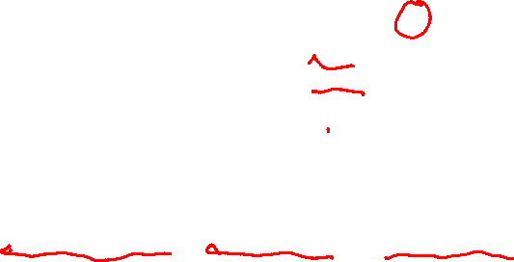
Simple Feed-Forward Perceptrons
x1
W1
repeat
for each e in examples do
in = (∑ W_{j} x_{j}) + θ
Err = y[e] – g[in]
W_{j} = W_{j} + α Err g’(in) x_{j}[e]
until done
g(in)
out
x2
W2
θ
Examples: A=[(.5,1.5),+1], B=[(-.5,.5),-1], C=[(.5,.5),+1]
Initialization: W₁ = 1, W₂ = 2, θ = -2
Note1: when g is a step function, the g’(in) is removed.
Note2: later in back propagation, Err * g’(in) will be called
We’ll let g(x) = 1 if x >=0 else -1

Slide 23

Graphically
Examples: A=[(.5,1.5),+1], B=[(-.5,.5),-1], C=[(.5,.5),+1]
Initialization: W₁ = 1, W₂ = 2, θ = -2
W₂
Boundary is W₁x₁ + W₂x₂ + θ = 0
wrong
boundary
A
B
C
W₁

Slide 24
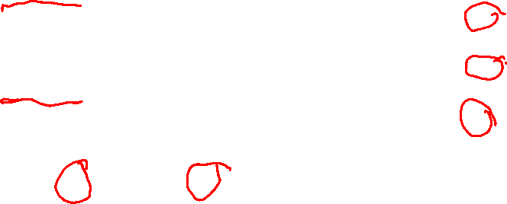
Learning
repeat
for each e in examples do
in = (∑ W_{j} x_{j}) + θ
Err = y[e] – g[in]
W_{j} = W_{j} + α Err g’(in) x_{j}[e]
until done
Examples:
A=[(.5,1.5),+1],
B=[(-.5,.5),-1],
C=[(.5,.5),+1]
Initialization: W₁ = 1, W₂ = 2, θ = -2
A=[(.5,1.5),+1]
in = .5(1) + (1.5)(2) -2 = 1.5
g(in) = 1; Err = 0; NO CHANGE
B=[(-.5,.5),-1]
In = (-.5)(1) + (.5)(2) -2 = -1.5
g(in) = -1; Err = 0; NO CHANGE
Let α=.5
W1 <- W1 + .5(2) (.5) leaving out g’
<- 1 + 1(.5) = 1.5
W2 <- W2 + .5(2) (.5)
<- 2 + 1(.5) = 2.5
<- θ + .5(+1 – (-1))
<- -2 + .5(2) = -1
C=[(.5,.5),+1]
in = (.5)(1) + (.5)(2) – 2 = -.5
g(in) = -1; Err = 1-(-1)=2

Slide 25
Graphically
Examples: A=[(.5,1.5),+1], B=[(-.5,.5),-1], C=[(.5,.5),+1]
Initialization: W₁ = 1, W₂ = 2, θ = -2
W₂
_{a}
Boundary is W₁x₁ + W₂x₂ + θ = 0
wrong
boundary
A
B
C
W₁
approximately correct boundary

Slide 26
Back Propagation
Simple single layer networks with feed forward learning were not powerful enough.
Could only produce simple linear classifiers.
More powerful networks have multiple hidden layers.
The learning algorithm is called back propagation, because it computes the error at the end and propagates it back through the weights of the network to the beginning.

Slide 27

Let’s break it
into steps.

Slide 28
Initialize
layer 1 2 3=L
x1
w11
w21
n1
w1f
nf
x2
w31
w2f
n2
x3

Slide 29
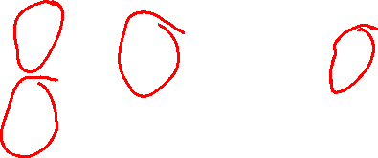
Forward Computation
g(in_{n1}) = a_{n1}
layer 1 2 3=L
x1
w11
w21
n1
w1f
nf
g(in_{nf}) = a_{nf}
x2
w31
w2f
n2
x3
g(in_{n2}) = a_{n2}

Slide 30

Backward Propagation 1
Node nf is the only node in our output layer.
Compute the error at that node and multiply by the derivative of the weighted
input sum to get the change delta.
layer 1 2 3=L
x1
w11
w21
n1
w1f
nf
$Δ$_{nf} = g’(in_{nf}) * (y_{nf} – a_{nf})
x2
w31
w2f
n2
x3

Slide 31
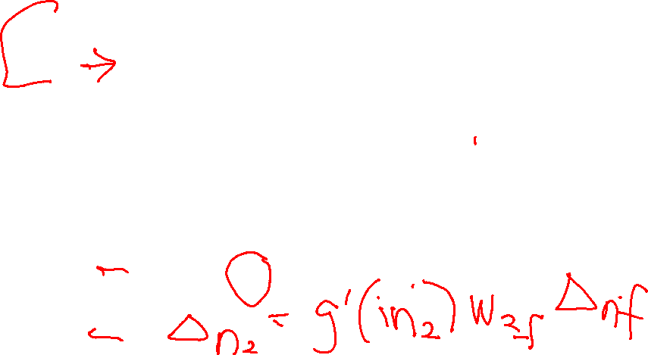

Backward Propagation 2
ht
At each of the other layers, the deltas use
the derivative of its input sum
the sum of its output weights
the delta computed for the output error
layer 1 2 3=L
If there were two output nodes, there would be a summation.
x1
w11
$Δn1=g^{′}\left(inn1\right)w1f Δ$_{nf}
w21
n1
w1f
nf
x2
$$Δnf$$
w31
w2f
n2
x3

Slide 32

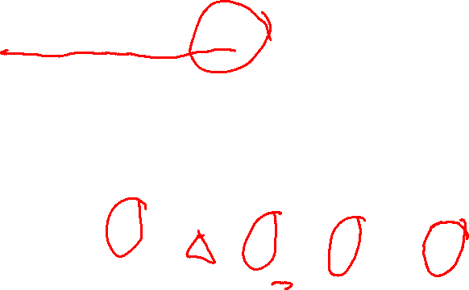
Backward Propagation 3
Now that all the deltas are defined, the weight updates just use them.
layer 1 2 3=L
x1
w11
w21
n1
w1f
a_{i}
w_{ij}
nf
$$Δj$$
x2
i
j
w31
w2f
n2
x3

Slide 33
Back Propagation Summary
Compute delta values for the output units using observed errors.
Starting at the output-1 layer
repeat
propagate delta values back to previous layer
till done with all layers
update weights for all layers
This is done for all examples and multiple epochs, till convergence or enough iterations.

Slide 34
Time taken to build model: 16.2 seconds
Correctly Classified Instances 307 80.3665 % (did not boost)
Incorrectly Classified Instances 75 19.6335 %
Kappa statistic 0.6056
Mean absolute error 0.1982
Root mean squared error 0.41
Relative absolute error 39.7113 %
Root relative squared error 81.9006 %
Total Number of Instances 382
TP Rate FP Rate Precision Recall F-Measure ROC Area Class
0.706 0.103 0.868 0.706 0.779 0.872 cal
0.897 0.294 0.761 0.897 0.824 0.872 dor
W Avg. 0.804 0.2 0.814 0.804 0.802 0.872
=== Confusion Matrix ===
a b <-- classified as
132 55 | a = cal
20 175 | b = dor

