Slide 1
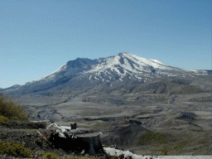
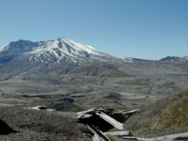
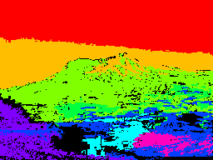
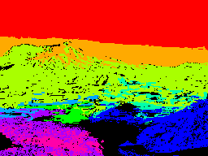
Assignment 3
Content-Based Image Retrieval

Slide 2
Steps
Represent each image in the database we give you by a feature vector. (Preprocess)
Design an image distance measure that can compare pairs of image.
Retrieve, for each test image, the database images in ascending order of distance to the query. The query itself should have distance 0 and be first. Use the interface provided for retrieval.

Slide 3
Initial Processing
First apply color clustering to the image to get a labeled image of multiple different cluster labels: 1, 2, 3, ...K.
Then apply connected components (provided) to the labeled image to produce a second labeled image that labels each connected component of cluster labels: 1, 2, ... N. A single color cluster may break into more than one component.
Possibly perform some noise cleaning to remove small regions. Don’t vary parameters between images. You can get noise cleaning ideas or code from anywhere.

Slide 4
Features
For each major region (use a size threshold), compute at least the following features:
size (number of pixels) given
mean color, in RGB, or whatever space you like given
at least the following co-occurrence texture features using spatial relationship d=(1,1): energy, entropy, contrast.
centroid (row, column)
bounding box (or if you prefer, could be an ellipse)
Store the features in the feature vector defined in the code.

Slide 5
Extra Credit Features
Other region features you want to add
RAG (region adjacency graph) including for each pair of adjacent regions:
above adjacency
below adjacency
left adjacency
right adjacency
other
A fancier distance function to handle RAGs.

Slide 6
Distance Measure
Dist(I₁,I₂) determines the distance from image I₁ to image I₂.
Compute Dist from a correspondence you find from the regions of I₁ to those of I₂.
Start with a greedy method: for each region of I₁, find the most similar region of I₂
Do not ask me HOW to do this. That’s for you.

Slide 7
More on Distance Measure
You should try at least two difference distance measures. They can differ in:
attributes used, weights on attributes
the actual distance, ie. Euclidean vs. others
If you do the graph structure, you need some kind of graph distance. See S&S Section 11.6 or make up your own.

Slide 8
Report
Turn in a brief report in Word or PDF that describes:
the attributes you implemented
the distance measures you tried
the results of your tests including both the 8 screenshots and your comments.

Slide 9
