Slide 1
Recognition
Part II: Face Detection via AdaBoost
Linda Shapiro
CSE 455

Slide 2
What’s Coming
The basic AdaBoost algorithm (next)
The Viola Jones face detector features
The modified AdaBoost algorithm that is used in Viola-Jones face detection
HW 4

Slide 3
Learning from weighted data
sample class weight
1.5 2.6 I 1/2
2.3 8.9 II 1/2
Consider a weighted dataset
  D(i) – weight of i th training example (x^{i},y^{i})
  Interpretations:
    i th training example counts as if it occurred D(i) times
    If I were to “resample” data, I would get more samples of “heavier” data points
Now, always do weighted calculations:
  e.g., MLE for Naïve Bayes, redefine Count(Y=y) to be weighted count:
  where δ(P) = 1 when P is true else 0, and
  setting D(j)=1 (or any constant like 1/n) for all j, will recreates unweighted case

Slide 4
AdaBoost Overview
Input is a set of training examples (X_{i}, y_{i}) i = 1 to m.
We are going to train a sequence of weak classifiers, such as decision trees, neural nets or SVMs. Weak because not as strong as the final classifier.
The training examples will have weights, initially all equal.
At each step, we use the current weights, train a new classifier, and use its performance on the training data to produce new weights for the next step.
But we keep ALL the weak classifiers.
When it’s time for testing on a new feature vector, we will combine the results from all of the weak classifiers.

Slide 5
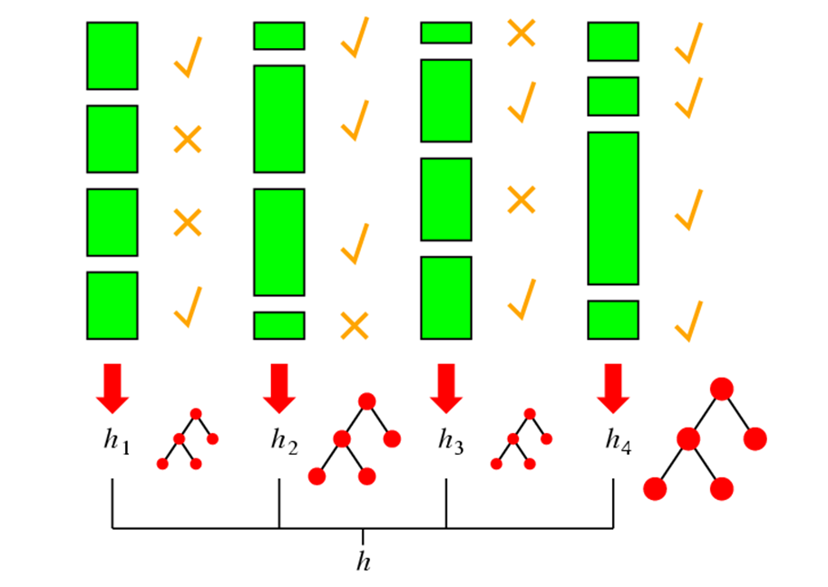
Idea of Boosting
(from AI text)

Slide 6
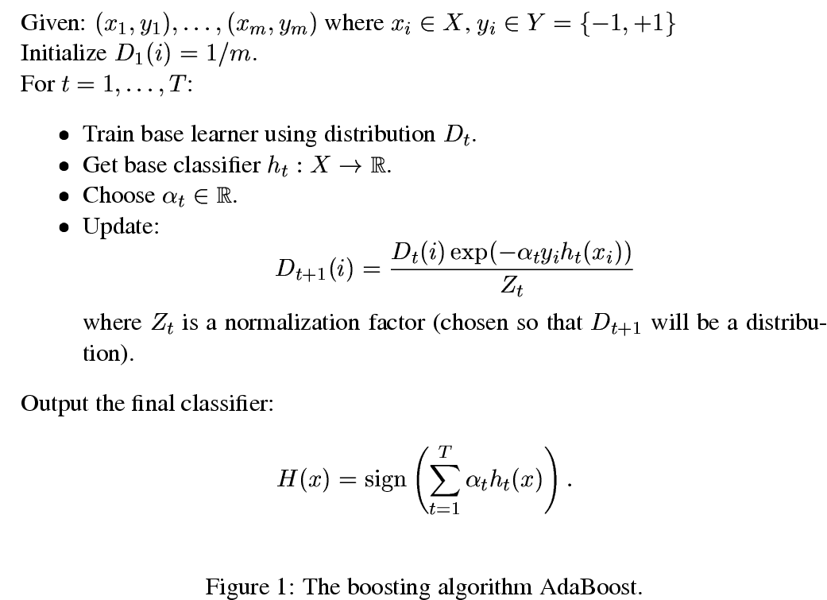
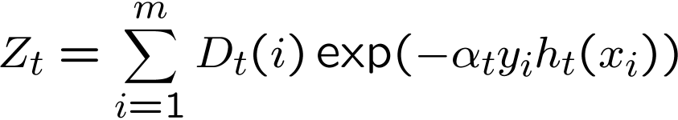
m samples 2 classes
labeled training
data
start with equal weights
How to choose Many possibilities. Will see one shortly!
update
weights
weight at time
t+1 for sample i
sum over m samples
Final Result: linear sum
of “base” or “weak”
classifier outputs.

Slide 7
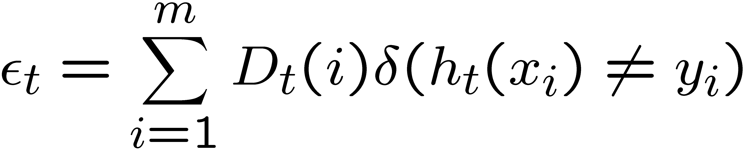
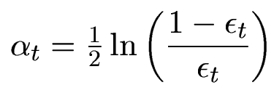
δ(P) = 1 when P is true else 0
error
α_{t} is a weight for weak learner h_{t}.

Slide 8
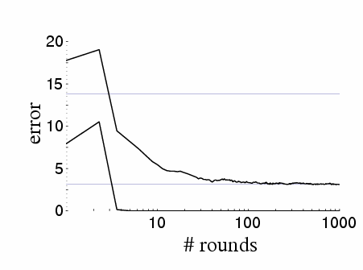
Boosting results – Digit recognition
[Schapire, 1989]
Test error
Training error
Boosting:
  Seems to be robust to overfitting
  Test error can decrease even after training error is zero!!!

Slide 9
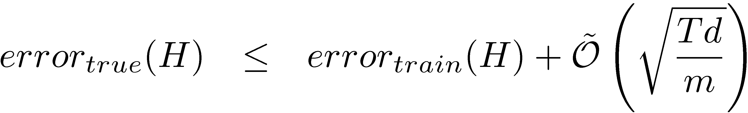
Boosting generalization error bound
[Freund & Schapire, 1996]
Constants:
T: number of boosting rounds
  Higher T → Looser bound, what does this imply?
d: VC dimension of weak learner, measures complexity of classifier
  Higher d → bigger hypothesis space → looser bound
m: number of training examples
  more data → tighter bound
The VC dimension (for Vapnik–Chervonenkis dimension) is a measure of the
capacity (complexity) of a statistical classification algorithm.

Slide 10
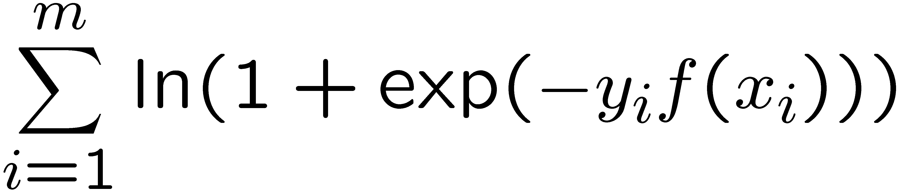
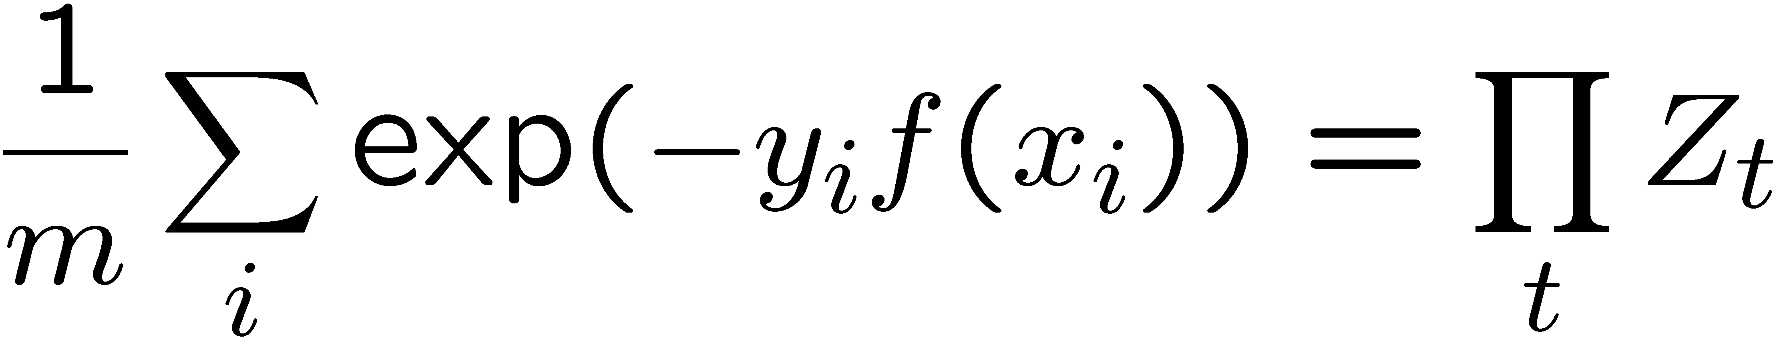
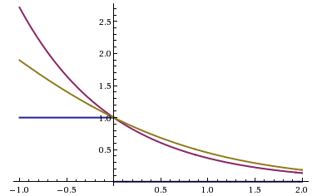
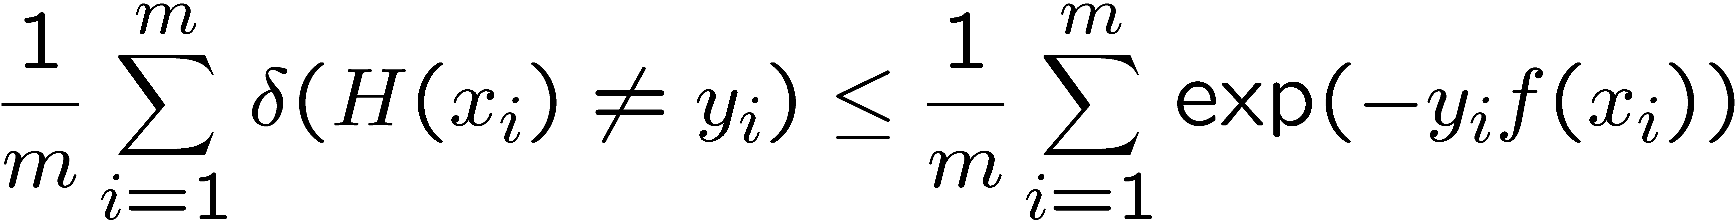
Boosting and Logistic Regression
Logistic regression equivalent to minimizing log loss:
Boosting minimizes similar loss function:

Slide 11
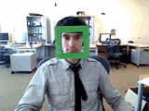
Face detection
State-of-the-art face detection demo
(Courtesy Boris Babenko)

Slide 12


Face detection and recognition
Detection
Recognition
“Sally”

Slide 13
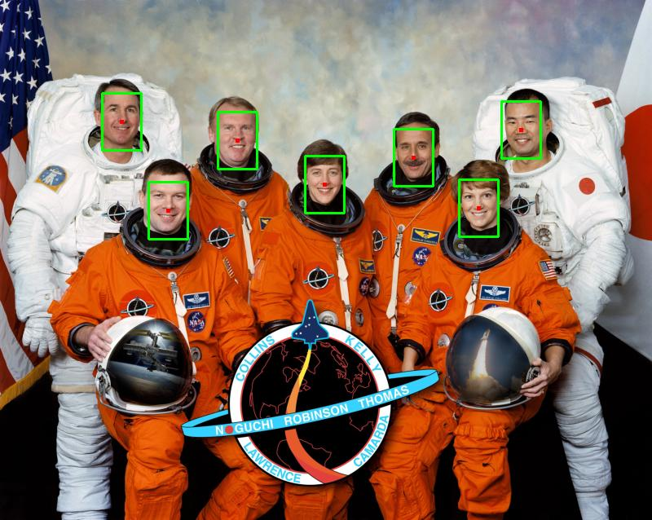
Face detection
Where are the faces?

Slide 14
Face Detection
What kind of features?
What kind of classifiers?
Uses a pyramid to get faces
of many different sizes.
Neural Net
Classifier

Slide 15
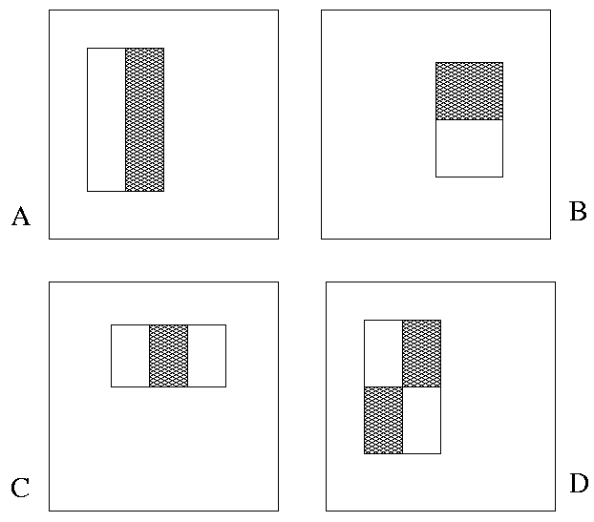
Image Features
“Rectangle filters”
+1
-1
People call them Haar-like features,
since similar to 2D Haar wavelets.
Value =
∑ (pixels in white area) –
∑ (pixels in black area)

Slide 16


Feature extraction
“Rectangular” filters
  Feature output is difference between adjacent regions
  Efficiently computable with integral image: any sum can be computed in constant time
  Avoid scaling images scale features directly for same cost
Viola & Jones, CVPR 2001
K. Grauman, B. Leibe
Notes:
16

Slide 17
Recall: Sums of rectangular regions
How do we compute the sum of the pixels in the red box?
243 | 239 | 240 | 225 | 206 | 185 | 188 | 218 | 211 | 206 | 216 | 225
242 | 239 | 218 | 110 | 67 | 31 | 34 | 152 | 213 | 206 | 208 | 221
243 | 242 | 123 | 58 | 94 | 82 | 132 | 77 | 108 | 208 | 208 | 215
235 | 217 | 115 | 212 | 243 | 236 | 247 | 139 | 91 | 209 | 208 | 211
233 | 208 | 131 | 222 | 219 | 226 | 196 | 114 | 74 | 208 | 213 | 214
232 | 217 | 131 | 116 | 77 | 150 | 69 | 56 | 52 | 201 | 228 | 223
232 | 232 | 182 | 186 | 184 | 179 | 159 | 123 | 93 | 232 | 235 | 235
232 | 236 | 201 | 154 | 216 | 133 | 129 | 81 | 175 | 252 | 241 | 240
235 | 238 | 230 | 128 | 172 | 138 | 65 | 63 | 234 | 249 | 241 | 245
237 | 236 | 247 | 143 | 59 | 78 | 10 | 94 | 255 | 248 | 247 | 251
234 | 237 | 245 | 193 | 55 | 33 | 115 | 144 | 213 | 255 | 253 | 251
248 | 245 | 161 | 128 | 149 | 109 | 138 | 65 | 47 | 156 | 239 | 255
190 | 107 | 39 | 102 | 94 | 73 | 114 | 58 | 17 | 7 | 51 | 137
23 | 32 | 33 | 148 | 168 | 203 | 179 | 43 | 27 | 17 | 12 | 8
17 | 26 | 12 | 160 | 255 | 255 | 109 | 22 | 26 | 19 | 35 | 24
After some pre-computation, this can be done in constant time for any box.
This “trick” is commonly used for computing Haar wavelets (a fundemental building block of many object recognition approaches.)

Slide 18
Sums of rectangular regions
The trick is to compute an “integral image.” Every pixel is the sum of its neighbors to the upper left.
Sequentially compute using:

Slide 19
Sums of rectangular regions
 |  | A |  |  |  |  |  |  | B
 |  | C |  |  |  |  |  |  | D
Solution is found using:
A + D – B - C
What if the position of the box lies between pixels?
Use bilinear interpolation.

Slide 20
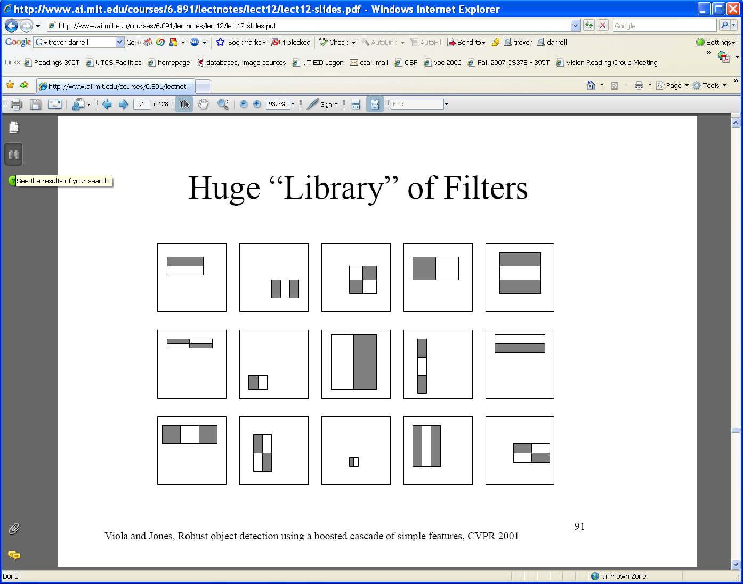
Large library of filters
  Considering all possible filter parameters: position, scale, and type:
160,000+ possible features associated with each 24 x 24 window
Use AdaBoost both to select the informative features and to form the classifier
Viola & Jones, CVPR 2001
Notes:
20

Slide 21
Feature selection
For a 24x24 detection region, the number of possible rectangle features is ~160,000!
At test time, it is impractical to evaluate the entire feature set
Can we create a good classifier using just a small subset of all possible features?
How to select such a subset?

Slide 22
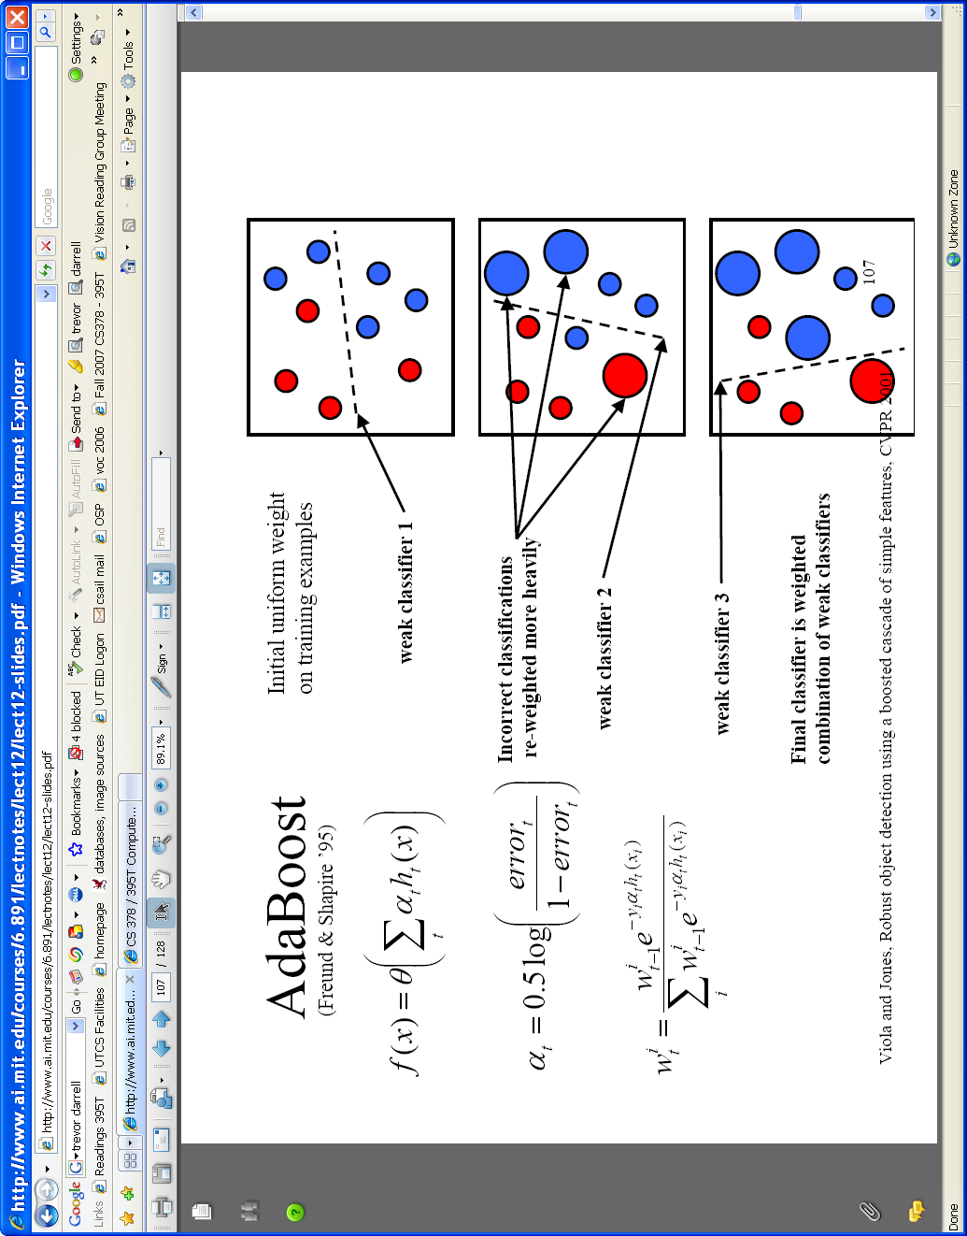

AdaBoost for feature+classifier selection
Want to select the single rectangle feature and threshold that best separates positive (faces) and negative (non-faces) training examples, in terms of weighted error.
θ_{t} is a threshold for classifier h_{t}
Resulting weak classifier:
0
For next round, reweight the examples according to errors, choose another filter/threshold combo.
…
Outputs of a possible rectangle feature on faces and non-faces.
Viola & Jones, CVPR 2001
Notes:
22

Slide 23
Weak Classifiers
Each weak classifier works on exactly one rectangle feature.
Each weak classifier has 3 associated variables
  its threshold θ
  its polarity p
  its weight α
The polarity can be 0 or 1
The weak classifier computes its one feature f
  When the polarity is 1, we want f > θ for face
  When the polarity is 0, we want f < θ for face
The weight will be used in the final classification by AdaBoost.
The code
does not
actually
compute h.
h(x) = 1 if p*f(x) < pθ, else 0
used for the combination step

Slide 24
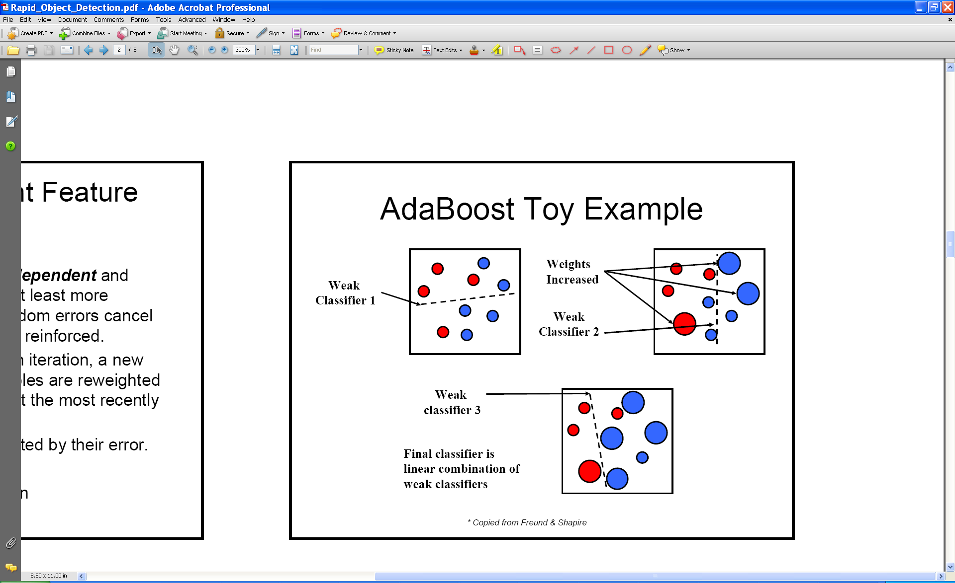
AdaBoost: Intuition
Consider a 2-d feature space with positive and negative examples.
Each weak classifier splits the training examples with at least 50% accuracy.
Examples misclassified by a previous weak learner are given more emphasis at future rounds.
K. Grauman, B. Leibe
Figure adapted from Freund and Schapire
Notes:
24

Slide 25
AdaBoost: Intuition
K. Grauman, B. Leibe
Notes:
25

Slide 26
AdaBoost: Intuition
Final classifier is combination of the weak classifiers
K. Grauman, B. Leibe
Notes:
26

Slide 27
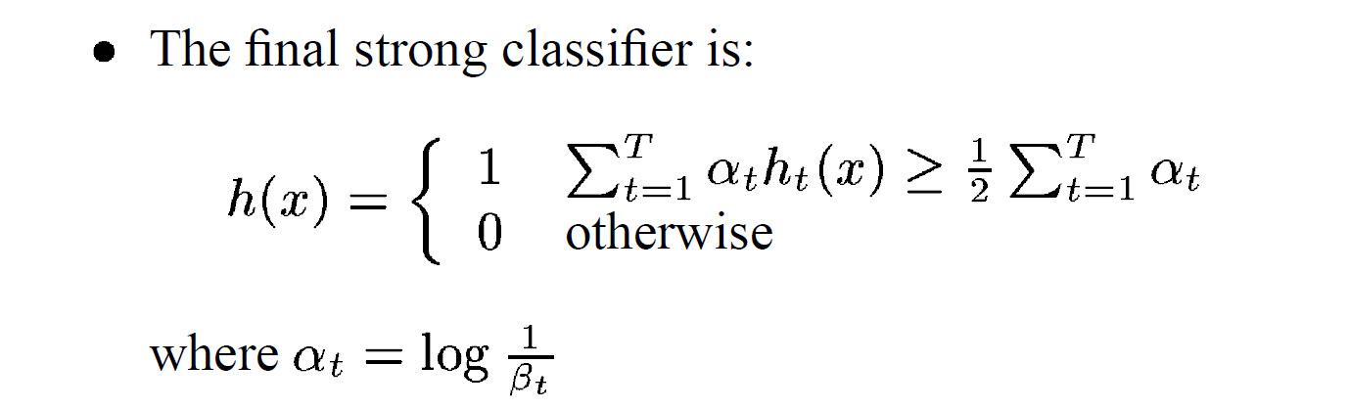
β_{t} = ε_{t} / (1- ε_{t}): the training error of the classifier h_{t}
Final classifier is combination of the weak ones, weighted according to error they had.

Slide 28
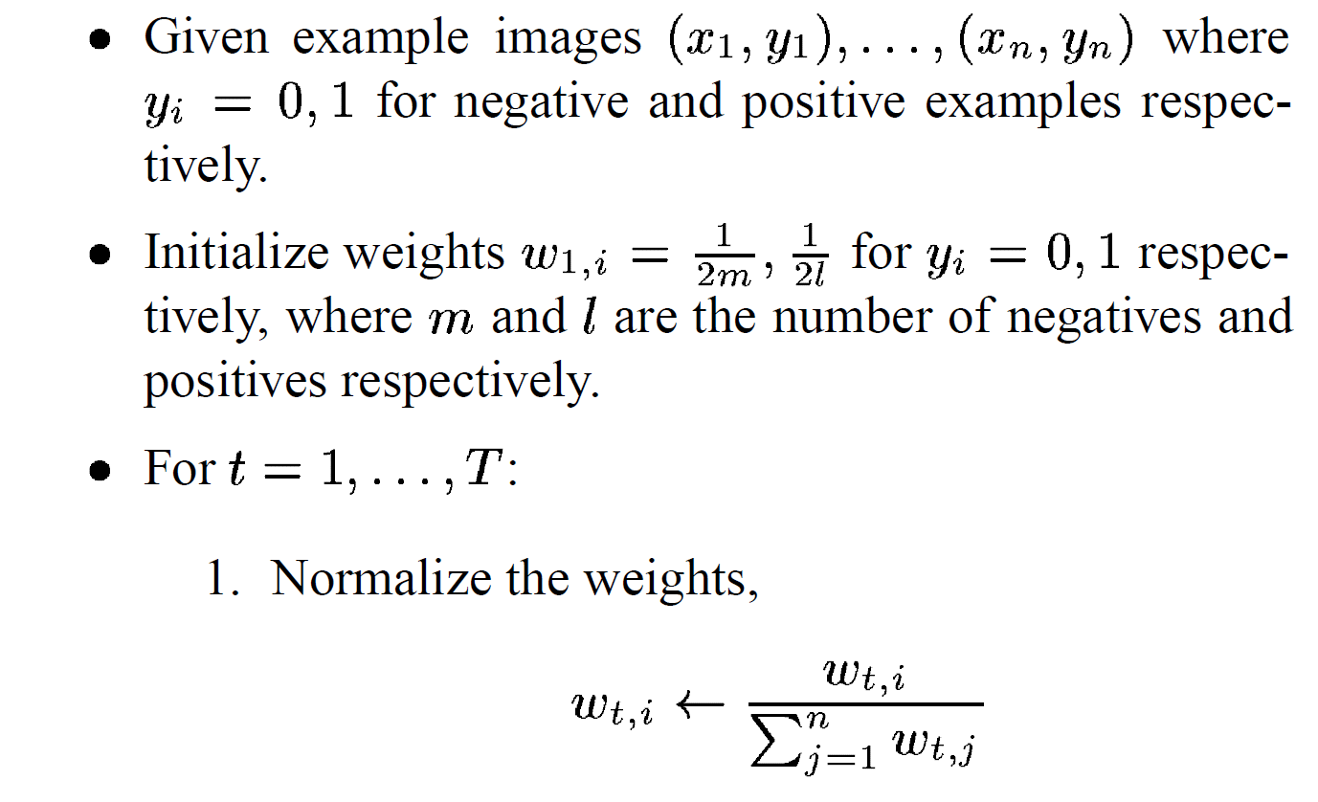
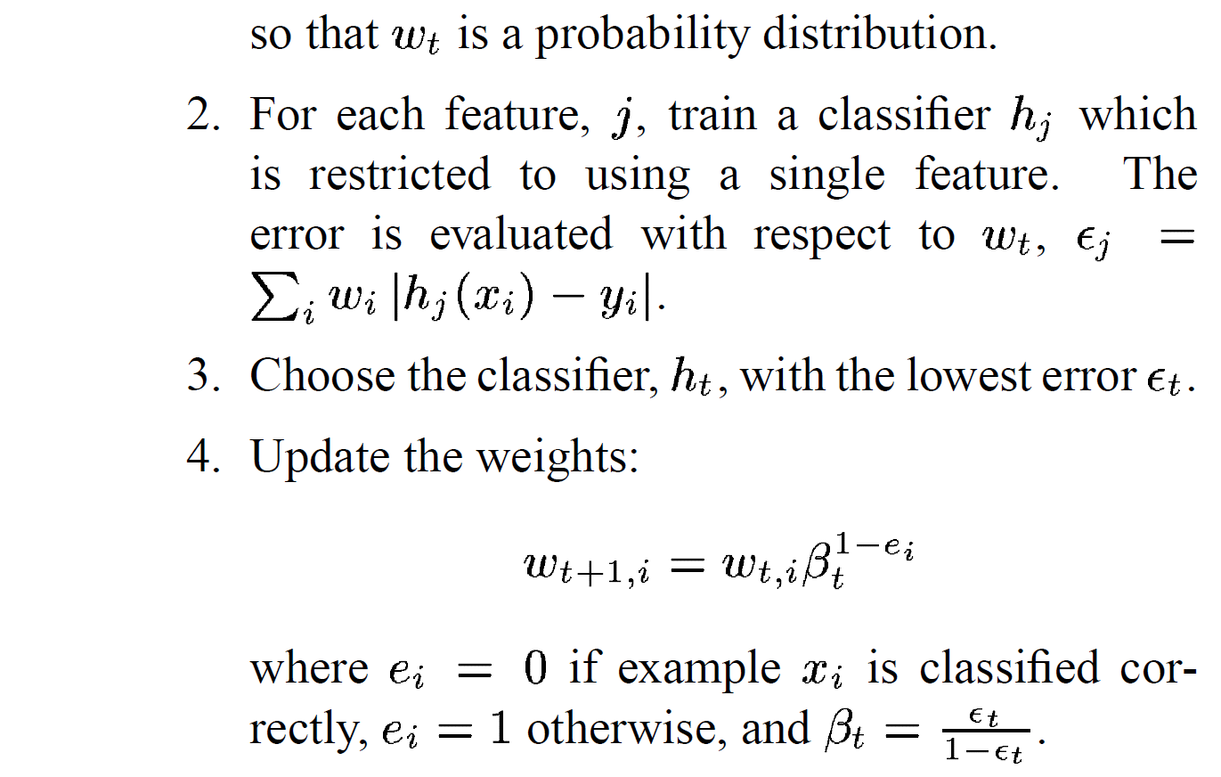
AdaBoost Algorithm modified by Viola Jones
NOTE: Our code
uses equal weights
for all samples
{x₁,…x_{n}}
For T rounds:
meaning we will
construct T weak
classifiers
Normalize weights
Find the best threshold and polarity for each feature, and return error.
sum over training samples
Re-weight the examples:
Incorrectly classified -> more weight
Correctly classified -> less weight
Notes:
28

Slide 29
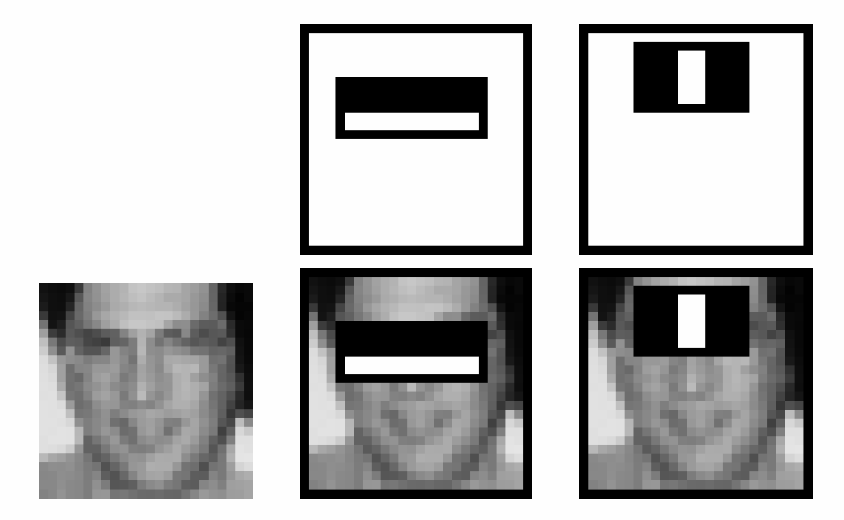
Recall
Classification
  Nearest Neighbor
  Naïve Bayes
  Decision Trees and Forests
  Logistic Regression
  Boosting
  ....
Face Detection
  Simple Features
  Integral Images
  Boosting
 |  | A |  |  |  |  |  |  | B
 |  | C |  |  |  |  |  |  | D

Slide 30

Picking the (threshold for the) best classifier
Efficient single pass approach:
At each sample compute:
= min ( S + (T – S), S + (T – S) )
Find the minimum value of , and use the value of the corresponding sample as the threshold.
S = sum of samples with feature value below the current sample
T = total sum of all samples
S and T are for faces; S and T are for background.

Slide 31
Picking the threshold for the best classifier
The features are actually sorted
in the code according to numeric
value!
Efficient single pass approach:
At each sample compute:
= min ( S + (T – S), S + (T – S) )
Find the minimum value of , and use the value of the corresponding sample as the threshold.
S = sum of weights of samples with feature value below the current sample
T = total sum of all samples
S and T are for faces; S and T are for background.

Slide 32
Picking the threshold for the best classifier
The features for the training samples are actually sorted in the code according to numeric value!
Algorithm:
find AFS, the sum of the weights of all the face samples
find ABG, the sum of the weights of all the background samples
set to zero FS, the sum of the weights of face samples so far
set to zero BG, the sum of the weights of background samples so far
go through each sample s in a loop IN THE SORTED ORDER
At each sample, add weight to FS or BG and compute:
= min (BG + (AFS – FS), FS + (ABG – BG))
Find the minimum value of e, and use the feature value of the corresponding sample as the threshold.

Slide 33
What’s going on?
error = min (BG + (AFS – FS), FS + (ABG –BG))
left right
Let’s pretend the weights on the samples are all 1’s.
The samples are arranged in a sorted order by feature value
and we know which ones are faces (f) and background (b).
Left is the number of background patches so far plus the number
of faces yet to be encountered.
Right is the number of faces so far plus the number of background
patches yet to be encountered.
1+5-0
0+5-1
b b b f b f f b f f
(6,4) (7,3) (8,2) (7,3) (8,2) (7,3) (4,4) (7,3) (6,4) (5,5)
4 3 2 3 2 3 4 3 4 5

Slide 34
Measuring classification performance
Confusion matrix
Accuracy
  (TP+TN)/
  (TP+TN+FP+FN)
True Positive Rate=Recall
  TP/(TP+FN)
False Positive Rate
  FP/(FP+TN)
Precision
  TP/(TP+FP)
F1 Score
  2*Recall*Precision/
  (Recall+Precision)
 |  | Predicted class
 |  | Class1 | Class2 | Class3
Actual class | Class1 | 40 | 1 | 6
 | Class2 | 3 | 25 | 7
 | Class3 | 4 | 9 | 10
 |  | Predicted
 |  | Positive | Negative
Actual | Positive | True Positive | False Negative
 | Negative | False Positive | True Negative
Notes:
Compare to the output of classifier to the actual label
In the case of binary classification, postive and negative
Confusion matrix, each entry show the frequency of will show actual value, predicted value.
True positive, the number of positive examples that has been correctly classified as positive. False positive, negative, positive

Slide 35
Boosting for face detection
First two features selected by boosting:
This feature combination can yield 100% detection rate and 50% false positive rate

Slide 36
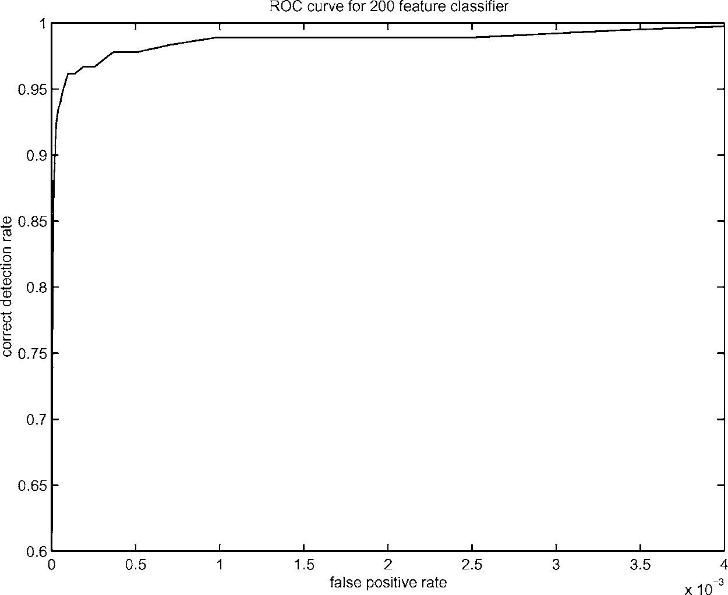
Boosting for face detection
A 200-feature classifier can yield 95% detection rate and a false positive rate of 1 in 14084
Is this good enough?
Receiver operating characteristic (ROC) curve

Slide 37
Attentional cascade (from Viola-Jones)
This part will be extra credit for HW4
We start with simple classifiers which reject many of the negative sub-windows while detecting almost all positive sub-windows
Positive response from the first classifier triggers the evaluation of a second (more complex) classifier, and so on
A negative outcome at any point leads to the immediate rejection of the sub-window
T
T
T
IMAGE
SUB-WINDOW
T
FACE
Classifier 1
Classifier 2
Classifier 3
F
F
F
NON-FACE
NON-FACE
NON-FACE

Slide 38
Attentional cascade
Chain of classifiers that are progressively more complex and have lower false positive rates:
Receiver operating characteristic
% False Pos
0
50
vs
false
neg
determined by
0 100
% Detection
T
T
T
IMAGE
SUB-WINDOW
T
FACE
Classifier 1
Classifier 2
Classifier 3
F
F
F
NON-FACE
NON-FACE
NON-FACE
Notes:
In general simple classifiers, while they are more efficient, they are also weaker.
We could define a computational risk hierarchy (in analogy with structural risk minimization)…
A nested set of classifier classes
The training process is reminiscent of boosting…
- previous classifiers reweight the examples used to train subsequent classifiers
The goal of the training process is different
- instead of minimizing errors minimize false positives

Slide 39
Attentional cascade
The detection rate and the false positive rate of the cascade are found by multiplying the respective rates of the individual stages
A detection rate of 0.9 and a false positive rate on the order of 10⁻⁶ can be achieved by a
10-stage cascade if each stage has a detection rate of 0.99 (0.99¹⁰ ≈ 0.9) and a false positive rate of about 0.30 (0.3¹⁰ ≈ 6×10⁻⁶)
T
T
T
IMAGE
SUB-WINDOW
T
FACE
Classifier 1
Classifier 2
Classifier 3
F
F
F
NON-FACE
NON-FACE
NON-FACE

Slide 40
Training the cascade
Set target detection and false positive rates for each stage
Keep adding features to the current stage until its target rates have been met
  Need to lower AdaBoost threshold to maximize detection
  (as opposed to minimizing total classification error)
  Test on a validation set
If the overall false positive rate is not low enough, then add another stage
Use false positives from current stage as the negative training examples for the next stage

Slide 41
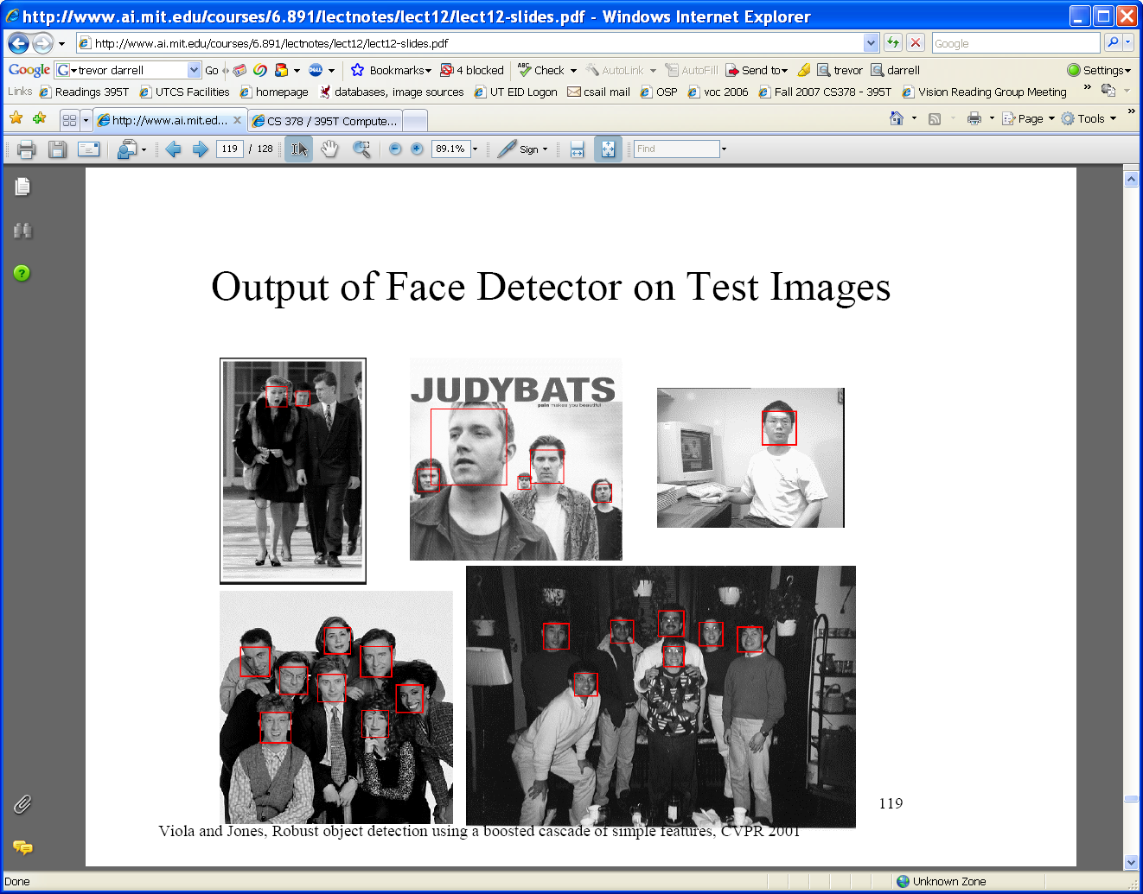
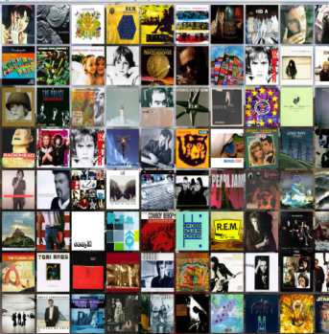





Viola-Jones Face Detector: Summary
Train cascade of classifiers with AdaBoost
Apply to each subwindow
Faces
New image
Selected features, thresholds, and weights
Non-faces
Train with 5K positives, 350M negatives
Real-time detector using 38 layer cascade
6061 features in final layer
[Implementation available in OpenCV: http://www.intel.com/technology/computing/opencv/]
Notes:
41

Slide 42

The implemented system
Training Data
  5000 faces
    All frontal, rescaled to
    24x24 pixels
  300 million non-faces
    9500 non-face images
  Faces are normalized
    Scale, translation
Many variations
  Across individuals
  Illumination
  Pose
Notes:
This situation with negative examples is actually quite common… where negative examples are free.

Slide 43
System performance
Training time: “weeks” on 466 MHz Sun workstation
38 layers, total of 6061 features
Average of 10 features evaluated per window on test set
“On a 700 Mhz Pentium III processor, the face detector can process a 384 by 288 pixel image in about .067 seconds”
  15 Hz
  15 times faster than previous detector of comparable accuracy (Rowley et al., 1998)

Slide 44
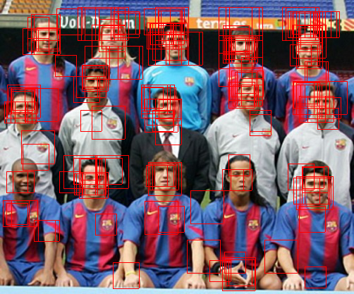
Non-maximal suppression (NMS)
Many detections above threshold.

Slide 45
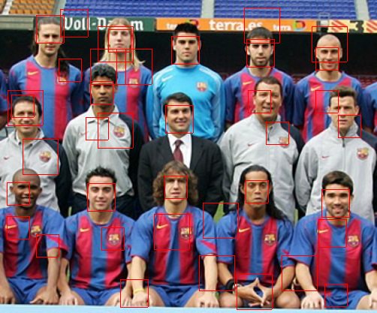
Non-maximal suppression (NMS)

Slide 46
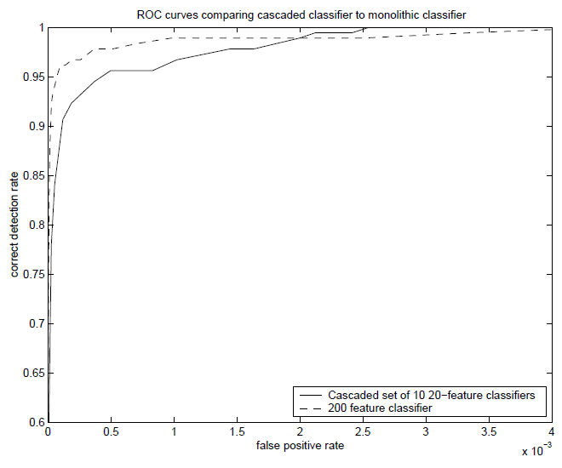
Is this good?
Similar accuracy, but 10x faster

Slide 47
Viola-Jones Face Detector: Results
Notes:
47

Slide 48
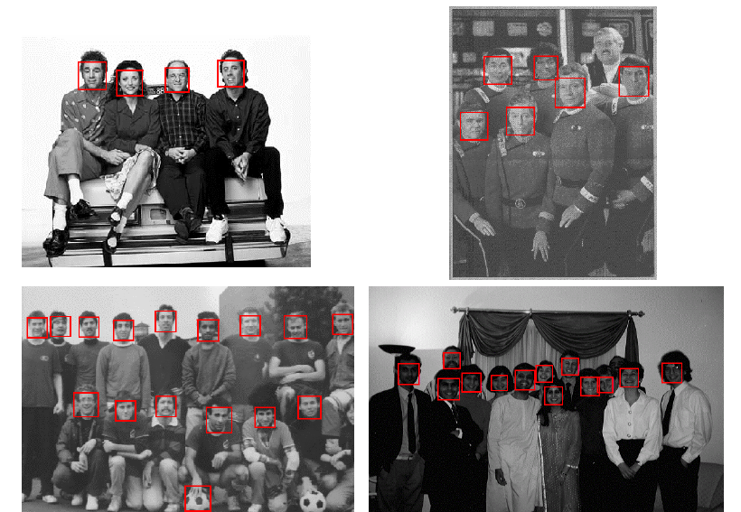
Viola-Jones Face Detector: Results
Notes:
48

Slide 49
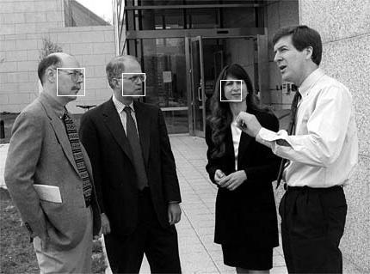
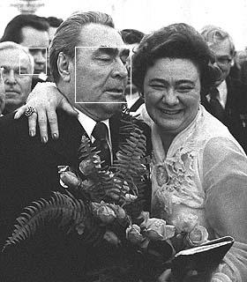
Viola-Jones Face Detector: Results

Slide 50
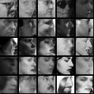
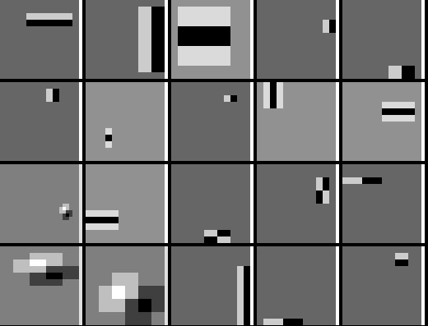
Detecting profile faces?
Detecting profile faces requires training separate detector with profile examples.

Slide 51
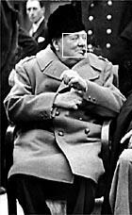

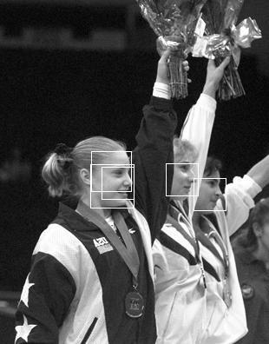
Viola-Jones Face Detector: Results
Paul Viola, ICCV tutorial

Slide 52
Summary: Viola/Jones detector
Rectangle features
Integral images for fast computation
Boosting for feature selection
Attentional cascade for fast rejection of negative windows

