Slide 1
Stereo
CSE 455
Linda Shapiro

Slide 2
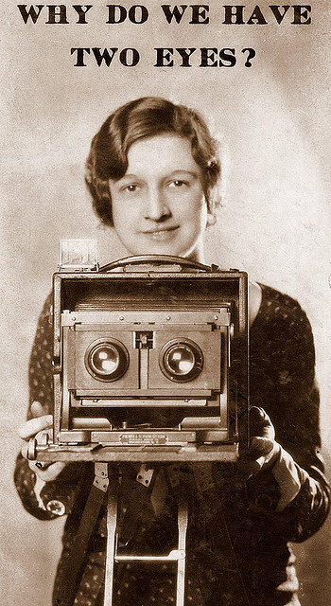

Slide 3
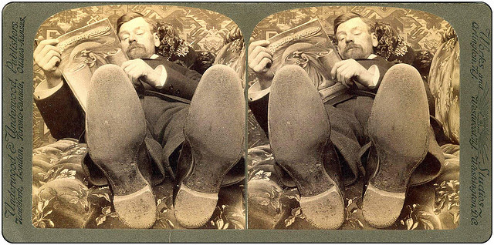
Why do we perceive depth?

Slide 4
What do humans use as depth cues?
Motion
Convergence
When watching an object close to us, our eyes point slightly inward. This difference in the direction of the eyes is called convergence. This depth cue is effective only on short distances (less than 10 meters).
Binocular Parallax
As our eyes see the world from slightly different locations, the images sensed by the eyes are slightly different. This difference in the sensed images is called binocular parallax. Human visual system is very sensitive to these differences, and binocular parallax is the most important depth cue for medium viewing distances. The sense of depth can be achieved using binocular parallax even if all other depth cues are removed.
Monocular Movement Parallax
If we close one of our eyes, we can perceive depth by moving our head. This happens because human visual system can extract depth information in two similar images sensed after each other, in the same way it can combine two images from different eyes.
Focus
Accommodation
Accommodation is the tension of the muscle that changes the focal length of the lens of eye. Thus it brings into focus objects at different distances. This depth cue is quite weak, and it is effective only at short viewing distances (less than 2 meters) and with other cues.
Marko Teittinen http://www.hitl.washington.edu/scivw/EVE/III.A.1.c.DepthCues.html

Slide 5
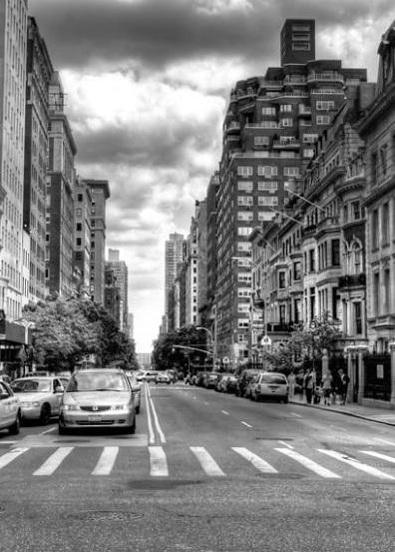
What do humans use as depth cues?
Image cues
Retinal Image Size
When the real size of the object is known, our brain compares the sensed size of the object to this real size, and thus acquires information about the distance of the object.
Linear Perspective
When looking down a straight level road we see the parallel sides of the road meet in the horizon. This effect is often visible in photos and it is an important depth cue. It is called linear perspective.
Texture Gradient
The closer we are to an object the more detail we can see of its surface texture. So objects with smooth textures are usually interpreted being farther away. This is especially true if the surface texture spans all the distance from near to far.
Overlapping
When objects block each other out of our sight, we know that the object that blocks the other one is closer to us. The object whose outline pattern looks more continuous is felt to lie closer.
Aerial Haze
The mountains in the horizon look always slightly bluish or hazy. The reason for this are small water and dust particles in the air between the eye and the mountains. The farther the mountains, the hazier they look.
Shades and Shadows
When we know the location of a light source and see objects casting shadows on other objects, we learn that the object shadowing the other is closer to the light source. As most illumination comes downward we tend to resolve ambiguities using this information. The three dimensional looking computer user interfaces are a nice example on this. Also, bright objects seem to be closer to the observer than dark ones.
Jonathan Chiu
Marko Teittinen http://www.hitl.washington.edu/scivw/EVE/III.A.1.c.DepthCues.html

Slide 7
Amount of horizontal movement is …
…inversely proportional to the distance from the camera

Slide 8
Depth from Stereo
Goal: recover depth by finding image coordinate x’ that corresponds to x
X
X
x
z
x
x’
x'
f
f
C
Baseline
B
C’

Slide 9
Depth from disparity
X
z
x
x’
f
f
O
Baseline
B
O’
Disparity is inversely proportional to depth.

Slide 10
Depth from Stereo
Goal: recover depth by finding image coordinate x’ that corresponds to x
Sub-Problems
  Calibration: How do we recover the relation of the cameras (if not already known)?
  Correspondence: How do we search for the matching point x’?
X
x
x'

Slide 11


Correspondence Problem
x
?
We have two images taken from cameras with different intrinsic and extrinsic parameters
How do we match a point in the first image to a point in the second? How can we constrain our search?

Slide 12

Key idea: Epipolar constraint
X
X
X
x
x’
x’
x’
Potential matches for x have to lie on the corresponding line l’.
Potential matches for x’ have to lie on the corresponding line l.

Slide 13

Epipolar geometry: notation
X
x
x’
Baseline – line connecting the two camera centers
Epipoles
= intersections of baseline with image planes
= projections of the other camera center
Epipolar Plane – plane containing baseline (1D family)

Slide 14
Epipolar geometry: notation
X
x
x’
Baseline – line connecting the two camera centers
Epipoles
= intersections of baseline with image planes
= projections of the other camera center
Epipolar Plane – plane containing baseline (1D family)
Epipolar Lines - intersections of epipolar plane with image
planes (always come in corresponding pairs)

Slide 15



Example: Converging cameras

Slide 16



Example: Motion parallel to image plane

Slide 17
Example: Forward motion
What would the epipolar lines look like if the camera moves directly forward?

Slide 18
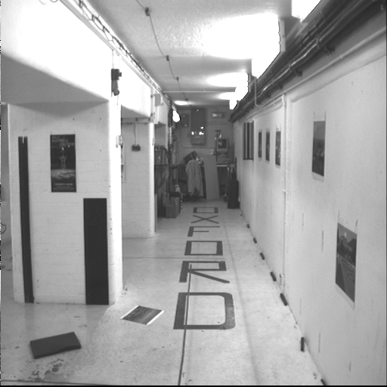
Example: Motion perpendicular to image plane

Slide 19
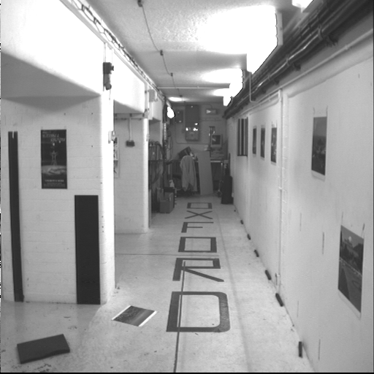
Example: Motion perpendicular to image plane
Points move along lines radiating from the epipole: “focus of expansion”
Epipole is the principal point

Slide 20
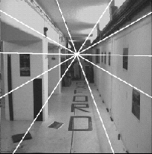
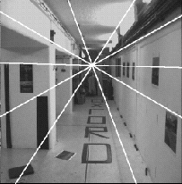
Example: Forward motion
e’
e
Epipole has same coordinates in both images.
Points move along lines radiating from “Focus of expansion”

Slide 21
Epipolar constraint
X
x
x’
If we observe a point x in one image, where can the corresponding point x’ be in the other image?

Slide 22
Epipolar constraint
X
X
X
x
x’
x’
x’
Potential matches for x have to lie on the corresponding
epipolar line l’.
Potential matches for x’ have to lie on the corresponding
epipolar line l.

Slide 23
Epipolar constraint example

Slide 24
Epipolar constraint: Calibrated case
X
x
x’
Assume that the intrinsic and extrinsic parameters of the cameras are known
We can multiply the projection matrix of each camera (and the image points) by the inverse of the calibration matrix to get normalized image coordinates
We can also set the global coordinate system to the coordinate system of the first camera. Then the projection matrices of the two cameras can be written as [I | 0] and [R | t]

Slide 25
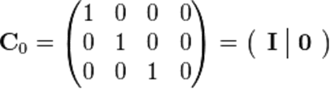

Simplified Matrices for the 2 Cameras
= (R | T)

Slide 26
Epipolar constraint: Calibrated case
X
= (x,1)^{T}
x
x’ = Rx+t
t
R
The vectors Rx, t, and x’ are coplanar
Notes:
X’ is X in the second camera’s coordinate system
We can identify the non-homogeneous 3D vectors X and X’ with the homogeneous coordinate vectors x and x’ of the projections of the two points into the two respective images

Slide 27
Epipolar constraint: Calibrated case
X
x
x’
Essential Matrix E
(Longuet-Higgins, 1981)
The vectors Rx, t, and x’ are coplanar

Slide 28
Epipolar constraint: Calibrated case
X
x
x’
E x is the epipolar line associated with x (l' = E x)
E^{T}x' is the epipolar line associated with x' (l = E^{T}x')
E e = 0 and E^{T}e' = 0
E is singular (rank two)
E has five degrees of freedom

Slide 29
Epipolar constraint: Uncalibrated case
X
x
x’
The calibration matrices K and K’ of the two cameras are unknown
We can write the epipolar constraint in terms of unknown normalized coordinates:

Slide 30
Epipolar constraint: Uncalibrated case
X
x
x’
Fundamental Matrix
(Faugeras and Luong, 1992)

Slide 31

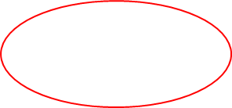
Epipolar constraint: Uncalibrated case
X
x
x’
F x is the epipolar line associated with x (l' = F x)
F^{T}x' is the epipolar line associated with x' (l' = F^{T}x')
F e = 0 and F^{T}e' = 0

Slide 32
The eight-point algorithm
A
Smallest eigenvalue of A^{T}A
Minimize:
under the constraint
||F||²=1

Slide 33

Comparison of estimation algorithms
 | 8-point | Normalized 8-point | Nonlinear least squares
Av. Dist. 1 | 2.33 pixels | 0.92 pixel | 0.86 pixel
Av. Dist. 2 | 2.18 pixels | 0.85 pixel | 0.80 pixel

Slide 34

Moving on to stereo…
Fuse a calibrated binocular stereo pair to produce a depth image
image 1
image 2
Dense depth map
Many of these slides adapted from Steve Seitz and Lana Lazebnik

Slide 35
Depth from disparity
X
z
x
x’
f
f
O
Baseline
B
O’
Disparity is inversely proportional to depth.

Slide 36

Basic stereo matching algorithm
If necessary, rectify the two stereo images to transform epipolar lines into scanlines
For each pixel x in the first image
  Find corresponding epipolar scanline in the right image
  Search the scanline and pick the best match x’
  Compute disparity x-x’ and set depth(x) = fB/(x-x’)

Slide 37
Basic stereo matching algorithm
For each pixel in the first image
  Find corresponding epipolar line in the right image
  Search along epipolar line and pick the best match
  Triangulate the matches to get depth information
Simplest case: epipolar lines are scanlines
  When does this happen?

Slide 38
Simplest Case: Parallel images
Epipolar constraint:
R = I t = (T, 0, 0)
x
x’
t
The y-coordinates of corresponding points are the same

Slide 39
Stereo image rectification

Slide 40
Stereo image rectification
Reproject image planes onto a common plane parallel to the line between camera centers
Pixel motion is horizontal after this transformation
Two homographies (3x3 transform), one for each input image reprojection
C. Loop and Z. Zhang. Computing Rectifying Homographies for Stereo Vision. IEEE Conf. Computer Vision and Pattern Recognition, 1999.

Slide 41
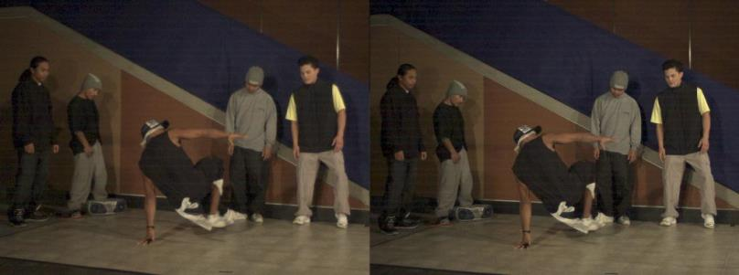
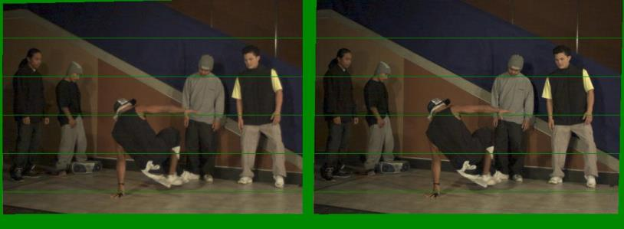
Example
Unrectified
Rectified

Slide 42


Correspondence search: for HW3
Left
Right
scanline
Matching cost
disparity
Slide a window along the right scanline and compare contents of that window with the reference window in the left image
Matching cost: SSD, SAD, or normalized correlation

Slide 43
Correspondence search
Left
Right
scanline
SSD

Slide 44
Correspondence search
Left
Right
scanline
Norm. corr

Slide 45


Effect of window size
W = 3
W = 20
Smaller window
  + More detail
  More noise
Larger window
  + Smoother disparity maps
  Less detail
  Fails near boundaries
Notes:
smaller window: more detail, more noise
bigger window: less noise, more detail

Slide 46


Failures of correspondence search
Textureless surfaces
Occlusions, repetition
Non-Lambertian surfaces, specularities

Slide 47



Results with window search
Data
Window-based matching
Ground truth

Slide 48
How can we improve window-based matching?
So far, matches are independent for each point
What constraints or priors can we add?

Slide 49
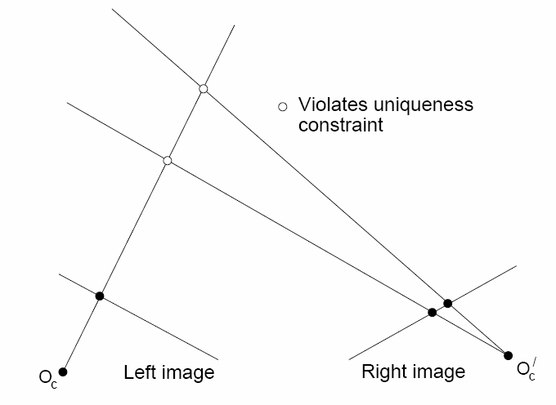
Stereo constraints/priors
Uniqueness
  For any point in one image, there should be at most one matching point in the other image

Slide 50
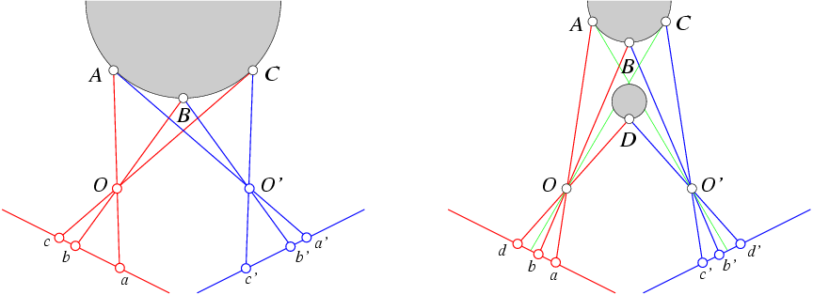
Stereo constraints/priors
Uniqueness
  For any point in one image, there should be at most one matching point in the other image
Ordering
  Corresponding points should be in the same order in both views

Slide 51
Stereo constraints/priors
Uniqueness
  For any point in one image, there should be at most one matching point in the other image
Ordering
  Corresponding points should be in the same order in both views
Ordering constraint doesn’t hold

Slide 52
Priors and constraints
Uniqueness
  For any point in one image, there should be at most one matching point in the other image
Ordering
  Corresponding points should be in the same order in both views
Smoothness
  We expect disparity values to change slowly (for the most part)

Slide 53
Stereo as energy minimization
What defines a good stereo correspondence?
  Match quality
    Want each pixel to find a good match in the other image
  Smoothness
    If two pixels are adjacent, they should (usually) move about the same amount

Slide 54





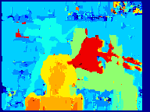



Matching windows: for HW3
Similarity Measure | Formula
Sum of Absolute Differences (SAD)
Sum of Squared Differences (SSD)
Zero-mean SAD
Locally scaled SAD
Normalized Cross Correlation (NCC)
SAD
SSD
NCC
Ground truth
http://siddhantahuja.wordpress.com/category/stereo-vision/
Notes:
smaller window: more detail, more noise
bigger window: less noise, more detail

Slide 55
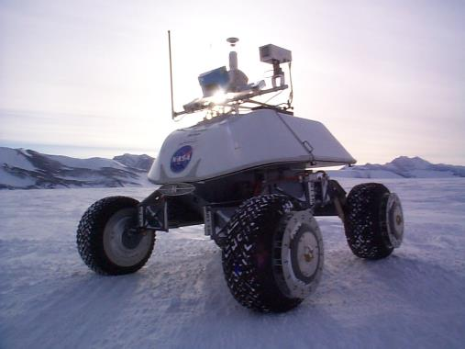
Real-time stereo
Nomad robot searches for meteorites in Antartica
  http://www.frc.ri.cmu.edu/projects/meteorobot/index.html
Used for robot navigation (and other tasks)
  Several software-based real-time stereo techniques have been developed (most based on simple discrete search)

Slide 56
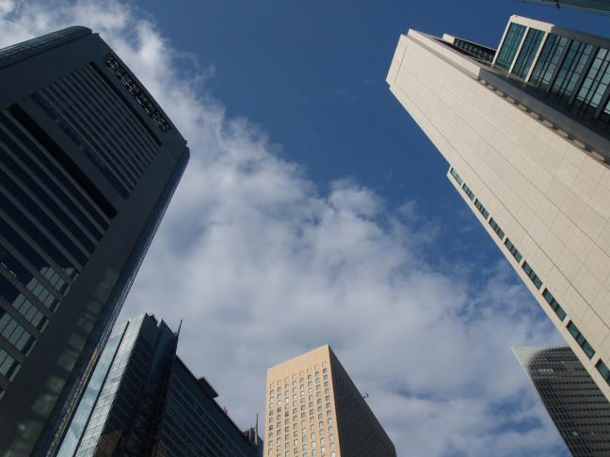
Why does stereo fail?
Fronto-Parallel Surfaces: Depth is constant within the region of local support

Slide 57
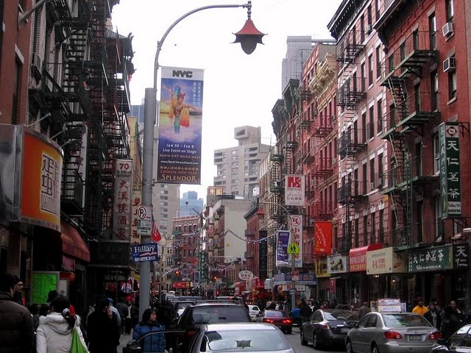
Why does stereo fail?
Monotonic Ordering - Points along an epipolar scanline appear in the same order in both stereo images
Occlusion – All points are visible in each image

Slide 58
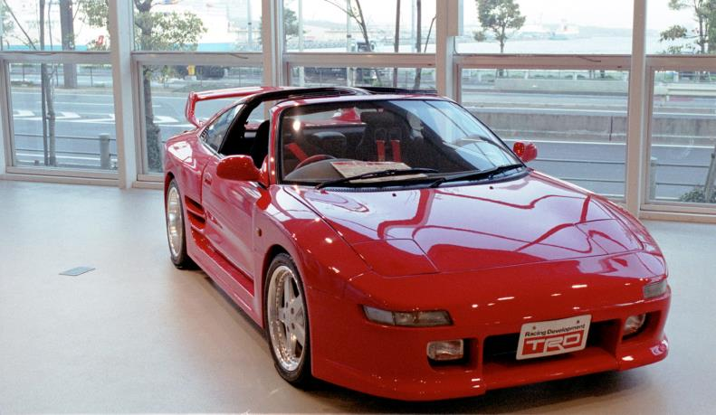
Why does stereo fail?
Image Brightness Constancy: Assuming Lambertian surfaces, the brightness of corresponding
points in stereo images are the same.

Slide 59

Why does stereo fail?
Match Uniqueness: For every point in one stereo image, there is at most one corresponding point in the other image.

Slide 60
Stereo reconstruction pipeline
Steps
  Calibrate cameras
  Rectify images
  Compute disparity
  Estimate depth
  Camera calibration errors
  Poor image resolution
  Occlusions
  Violations of brightness constancy (specular reflections)
  Large motions
  Low-contrast image regions
What will cause errors?

Slide 61
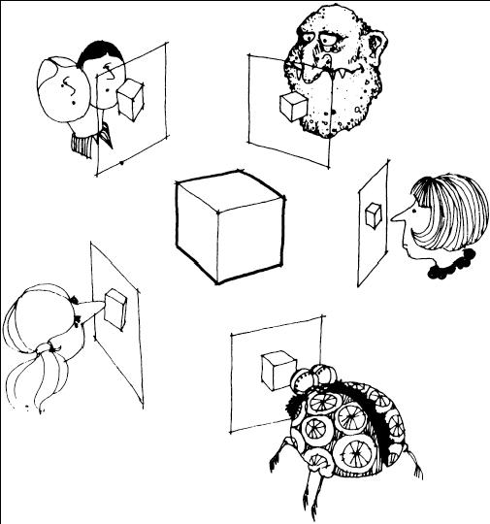
Multi-view stereo ?

Slide 62



Using more than two images
Multi-View Stereo for Community Photo Collections
M. Goesele, N. Snavely, B. Curless, H. Hoppe, S. Seitz
Proceedings of ICCV 2007,

