Slide 1
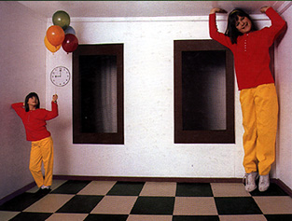
Ames Room
Projective Geometry and Single View Modeling
CSE 455, Winter 2010
January 29, 2010

Slide 2
Announcements
Project 1a grades out
https://catalysttools.washington.edu/gradebook/iansimon/17677
Statistics
  Mean 82.24
  Median 86
  Std. Dev. 17.88

Slide 3
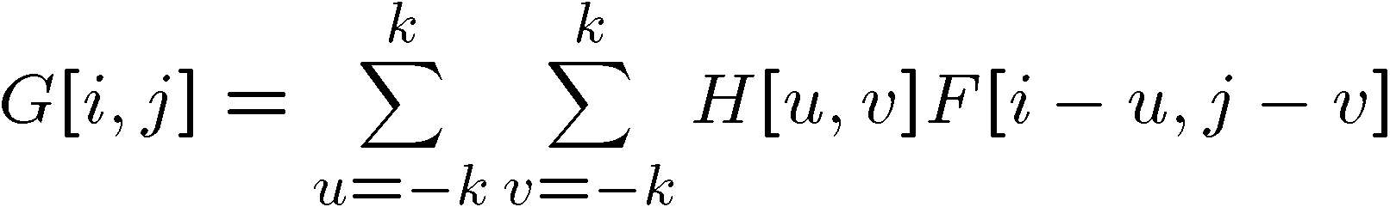
Project 1a Common Errors
Assuming odd size filters
Assuming square filters
Cross correlation vs. Convolution
Not normalizing the Gaussian filter
Resizing only works for shrinking not enlarging
Convolution operation is a cross-correlation where the filter is flipped both horizontally and vertically before being applied to the image:

Slide 4
Review from last time

Slide 5
Image rectification
p’
p
To unwarp (rectify) an image
  solve for homography H given p and p’
  solve equations of the form: wp’ = Hp
    linear in unknowns: w and coefficients of H
    H is defined up to an arbitrary scale factor
    how many points are necessary to solve for H?
Notes:
Explain how many points, why
4 points, x,y each, 8 degrees of freedom

Slide 6


Solving for homographies
A
h
0
2n × 9
9
2n
Defines a least squares problem:
  Since h is only defined up to scale, solve for unit vector ĥ
  Solution: ĥ = eigenvector of A^{T}A with smallest eigenvalue
  Works with 4 or more points

Slide 7
The projective plane
Why do we need homogeneous coordinates?
  represent points at infinity, homographies, perspective projection, multi-view relationships
What is the geometric intuition?
  a point in the image is a ray in projective space
-y
(sx,sy,s)
(x,y,1)
(0,0,0)
-z
x
image plane
  Each point (x,y) on the plane is represented by a ray (sx,sy,s)
    all points on the ray are equivalent: (x, y, 1) ≅ (sx, sy, s)

Slide 8
Projective lines
What does a line in the image correspond to in projective space?
  A line is a plane of rays through origin
    all rays (x,y,z) satisfying: ax + by + cz = 0
l
p
  A line is also represented as a homogeneous 3-vector l

Slide 9
Vanishing points
image plane
vanishing point v
camera
center
C
line on ground plane
Vanishing point
  projection of a point at infinity

Slide 10
Vanishing points
image plane
vanishing point v
camera
center
C
line on ground plane
line on ground plane
Properties
  Any two parallel lines have the same vanishing point v
  The ray from C through v is parallel to the lines
  An image may have more than one vanishing point
    in fact every pixel is a potential vanishing point
Notes:
How to determine which lines in the scene vanish at a given pixel?

Slide 11
Today
Projective Geometry continued

Slide 12
Perspective cues

Slide 13
Perspective cues

Slide 14
Perspective cues

Slide 15
Comparing heights
Vanishing
Point

Slide 16
Measuring height
5.4
5
Camera height
4
3.3
3
2.8
2
1
What is the height of the camera?

Slide 17
Computing vanishing points (from lines)
v
q₂
q₁
p₂
p₁
Intersect p₁q₁ with p₂q₂
Least squares version
  Better to use more than two lines and compute the “closest” point of intersection
  See notes by Bob Collins for one good way of doing this:
    http://www-2.cs.cmu.edu/~ph/869/www/notes/vanishing.txt

Slide 18
Measuring height without a ruler
C
Z
ground plane
Compute Z from image measurements
  Need more than vanishing points to do this

Slide 19
The cross ratio
A Projective Invariant
  Something that does not change under projective transformations (including perspective projection)
The cross-ratio of 4 collinear points
P₄
P₃
P₂
P₁
Can permute the point ordering
  4! = 24 different orders (but only 6 distinct values)
This is the fundamental invariant of projective geometry

Slide 20
Measuring height
∞
scene cross ratio
T (top of object)
t
r
R (reference point)
C
H
b
R
image cross ratio
v_{Z}
B (bottom of object)
ground plane
scene points represented as
image points as

Slide 21


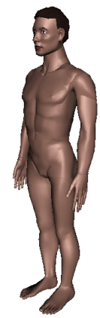
Measuring height
v_{z}
r
vanishing line (horizon)
t₀
t
v_{x}
v
v_{y}
H
R
H
b₀
b
image cross ratio

Slide 22
Measuring height
v_{z}
r
t₀
vanishing line (horizon)
t₀
v_{x}
v
v_{y}
m₀
t₁
b₀
b₁
b
What if the point on the ground plane b₀ is not known?
  Here the guy is standing on the box, height of box is known
  Use one side of the box to help find b₀ as shown above

Slide 23
Computing (X,Y,Z) coordinates
Notes:
Answer: exact same idea as before, but substitute X for Z (e.g., need a reference object with known X coordinates)

Slide 24
Monocular Depth Cues
Stationary Cues:
  Perspective
  Relative size
  Familiar size
  Aerial perspective
  Occlusion
  Peripheral vision
  Texture gradient

Slide 25
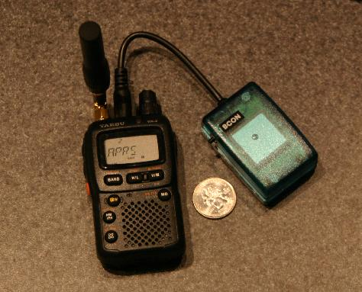
Familiar Size

Slide 26

Arial Perspective

Slide 27
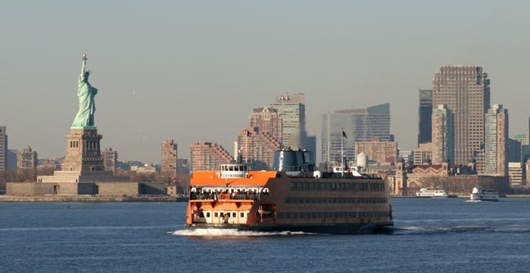
Occlusion

Slide 28
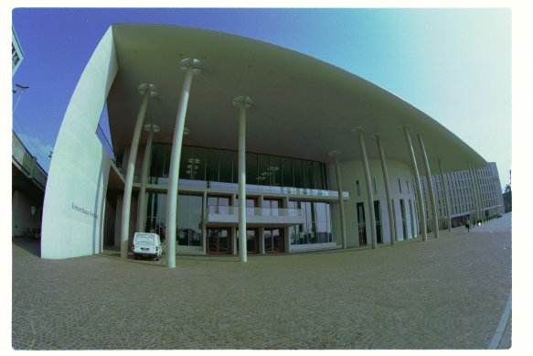
Peripheral Vision

Slide 29
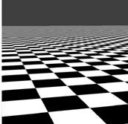
Texture Gradient

Slide 30
Camera calibration
Goal: estimate the camera parameters
  Version 1: solve for projection matrix
  Version 2: solve for camera parameters separately
    intrinsics (focal length, principle point, pixel size)
    extrinsics (rotation angles, translation)
    radial distortion

Slide 31
Vanishing points and projection matrix
= v_{x} (X vanishing point)
similarly,
π
=
v
,
π
=
v
2
Y
3
Z
Not So Fast! We only know v’s and o up to a scale factor
  Need a bit more work to get these scale factors…

Slide 32
Finding the scale factors…
Let’s assume that the camera is reasonable
  Square pixels
  Image plane parallel to sensor plane
  Principle point in the center of the image

Slide 33
Solving for f
Orthogonal
vectors
Orthogonal
vectors

Slide 34
Solving for a, b, and c
Norm
= 1/a
Norm
= 1/a
Solve for a, b, c
  Divide the first two rows by f, now that it is known
  Now just find the norms of the first three columns
  Once we know a, b, and c, that also determines R
How about d?
  Need a reference point in the scene

Slide 35
Solving for d
Suppose we have one reference height H
  E.g., we known that (0, 0, H) gets mapped to (u, v)
Finally, we can solve for t

Slide 36

Calibration using a reference object
Place a known object in the scene
  identify correspondence between image and scene
  compute mapping from scene to image
Issues
  must know geometry very accurately
  must know 3D->2D correspondence

Slide 37
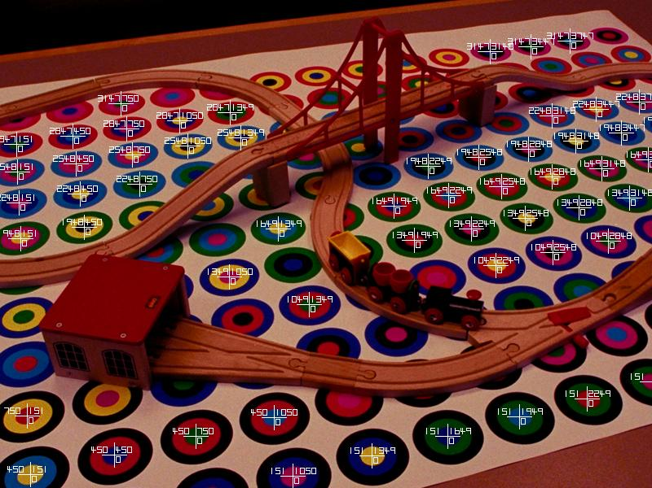
Chromaglyphs
Courtesy of Bruce Culbertson, HP Labs
http://www.hpl.hp.com/personal/Bruce_Culbertson/ibr98/chromagl.htm
Notes:
Pattern that allows automatic pose detection

Slide 38
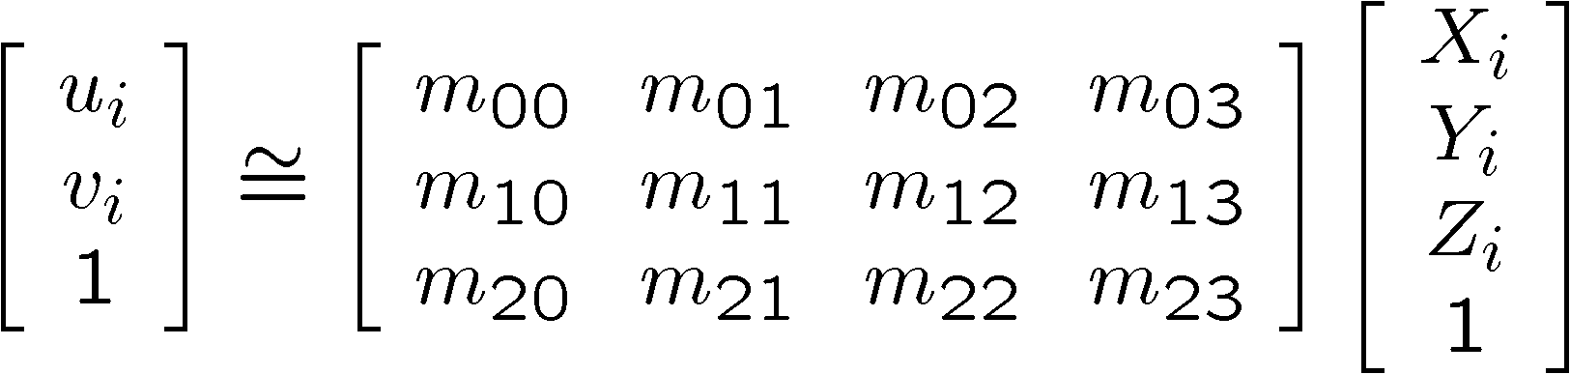
Estimating the projection matrix
Place a known object in the scene
  identify correspondence between image and scene
  compute mapping from scene to image

Slide 39
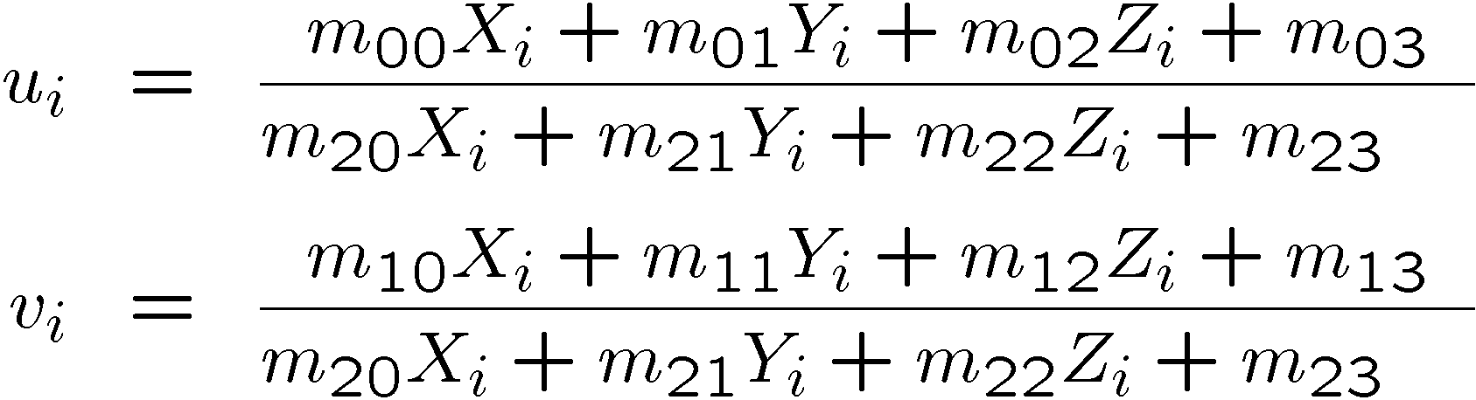
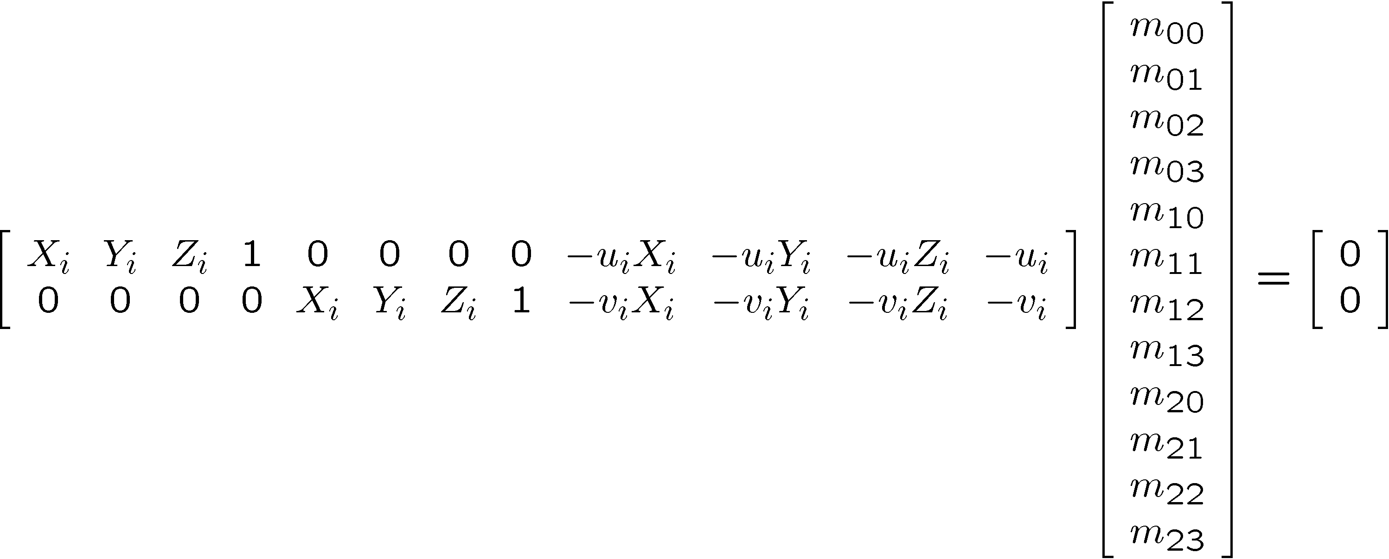
Direct linear calibration

Slide 40
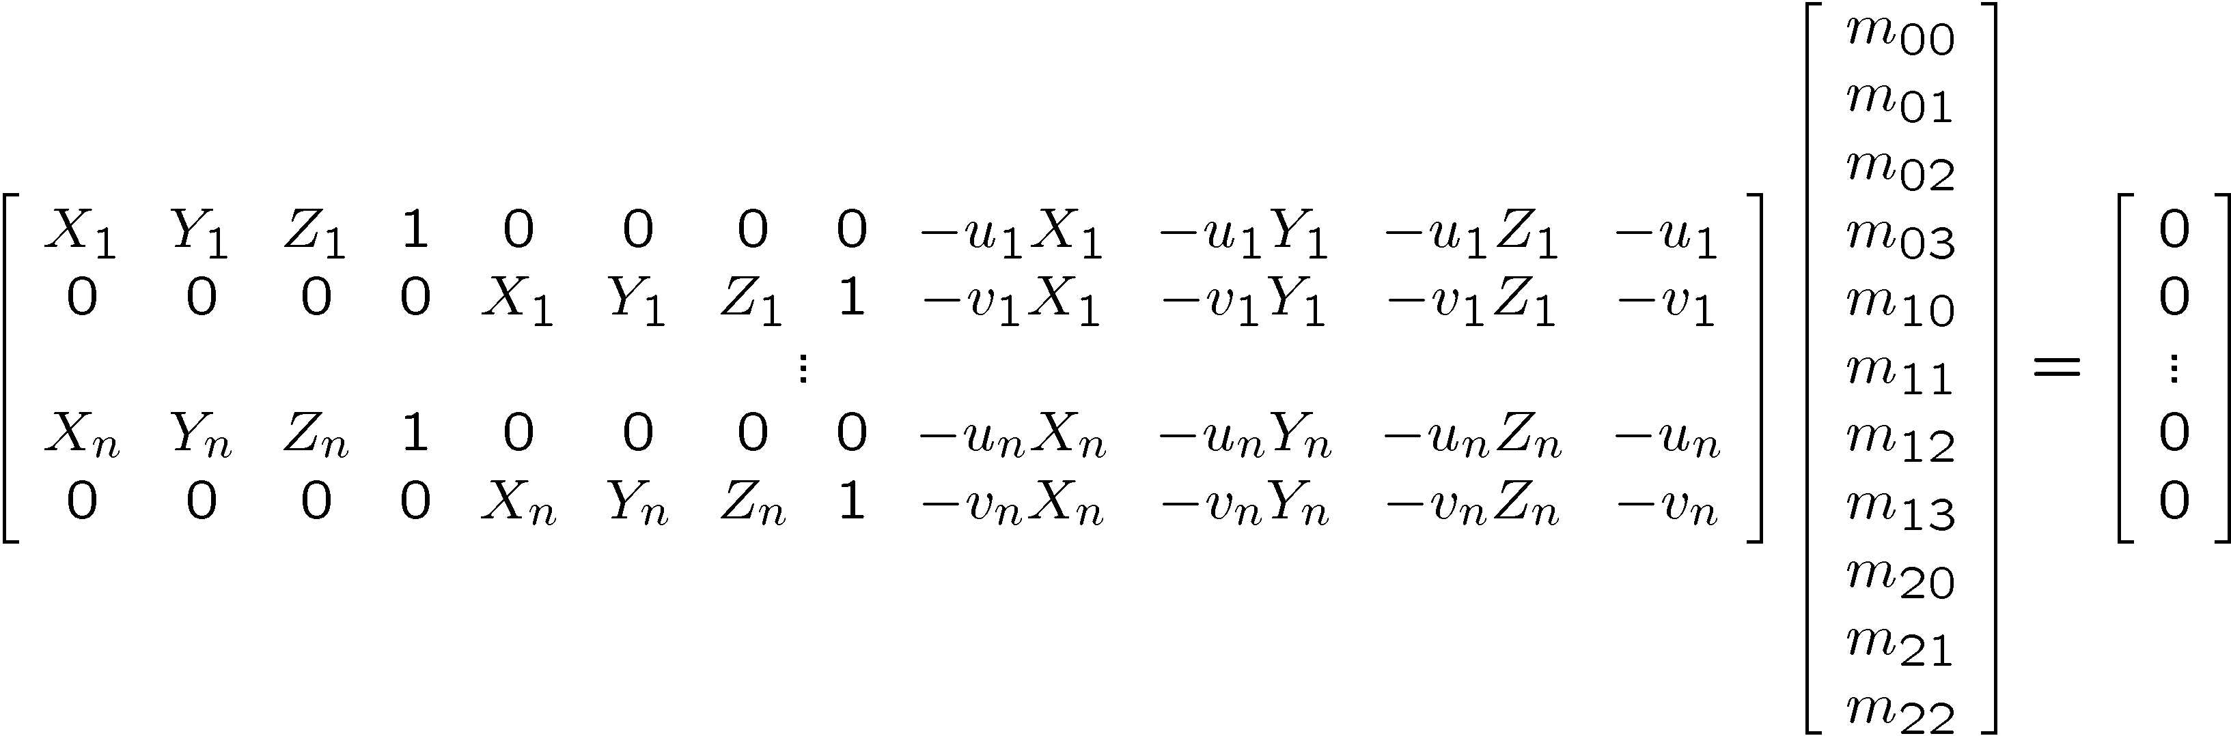
Direct linear calibration
Can solve for m_{ij} by linear least squares
  use eigenvector trick that we used for homographies

Slide 41
Direct linear calibration
Advantage:
  Very simple to formulate and solve
Disadvantages:
  Doesn’t tell you the camera parameters
  Doesn’t model radial distortion
  Hard to impose constraints (e.g., known focal length)
  Doesn’t minimize the right error function
For these reasons, nonlinear methods are preferred
  Define error function E between projected 3D points and image positions
    E is nonlinear function of intrinsics, extrinsics, radial distortion
  Minimize E using nonlinear optimization techniques
    e.g., variants of Newton’s method (e.g., Levenberg Marquart)

Slide 42
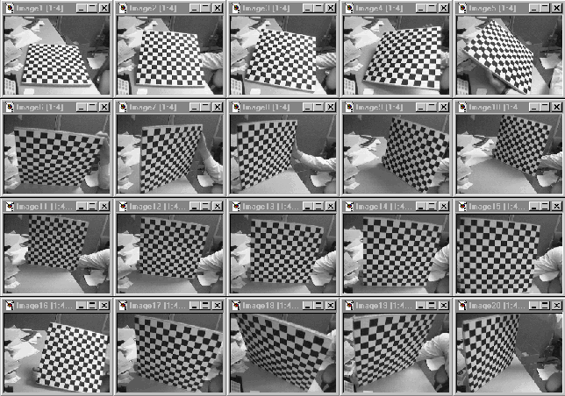
Alternative: multi-plane calibration
Images courtesy Jean-Yves Bouguet, Intel Corp.
Advantage
  Only requires a plane
  Don’t have to know positions/orientations
  Good code available online!
    Intel’s OpenCV library: http://www.intel.com/research/mrl/research/opencv/
    Matlab version by Jean-Yves Bouget: http://www.vision.caltech.edu/bouguetj/calib_doc/index.html
    Zhengyou Zhang’s web site: http://research.microsoft.com/~zhang/Calib/

Slide 43
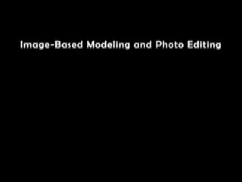
Some Related Techniques
Image-Based Modeling and Photo Editing
  Mok et al., SIGGRAPH 2001
  http://graphics.csail.mit.edu/ibedit/

Slide 44
Some Related Techniques
Single View Modeling of Free-Form Scenes
  Zhang et al., CVPR 2001
  http://grail.cs.washington.edu/projects/svm/

