Slide 1

SIFT
CSE 455, Winter 2010
February 3, 2010

Slide 2
Announcements
Project 1b grades out
https://catalysttools.washington.edu/gradebook/iansimon/17677
Statistics
  Mean 88.95
  Median 100
  Std. Dev. 20.97

Slide 3
Review From Last Time

Slide 4


Image Matching
NASA Mars Rover images
with SIFT feature matches
Figure by Noah Snavely

Slide 5
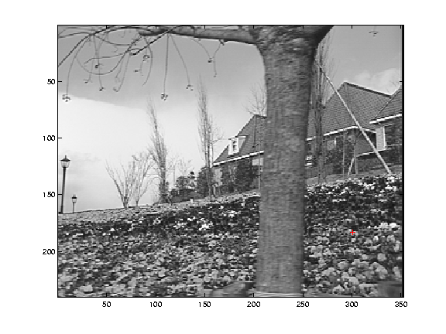
What makes a good feature?
Snoop demo

Slide 6
Want uniqueness
Look for image regions that are unusual
  Lead to unambiguous matches in other images
How to define “unusual”?

Slide 7
Feature detection
Local measure of feature uniqueness
  How does the window change when you shift it?
  Shifting the window in any direction causes a big change
“flat” region:
no change in all directions
“edge”:
no change along the edge direction
“corner”:
significant change in all directions
Slide adapted form Darya Frolova, Denis Simakov, Weizmann Institute.

Slide 8
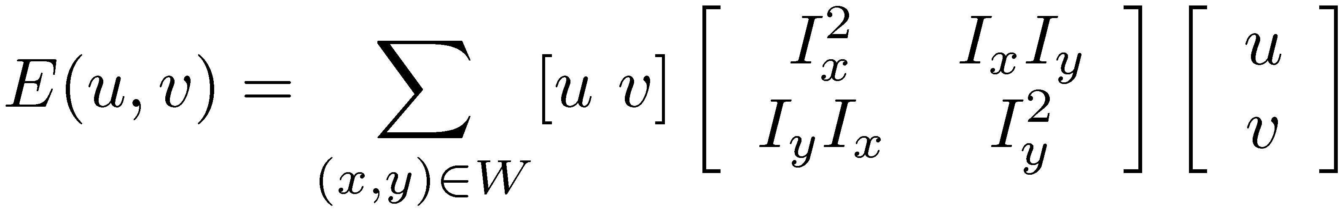


Feature detection: the math
This can be rewritten:
For the example above
  You can move the center of the green window to anywhere on the blue unit circle
  Which directions will result in the largest and smallest E values?
  We can find these directions by looking at the eigenvectors of H

Slide 9
Today
Invariant Features
Readings
  M. Brown et al. Multi-Image Matching using Multi-Scale Oriented Patches, CVPR 2005

Slide 10
Invariance
Suppose you rotate the image by some angle
  Will you still pick up the same features?
What if you change the brightness?
Scale?
Notes:
Rotation: yes (with some caveats—image resampling errors…)
Change brightness: probably, but will have to adjust thresholds
Scale: no, generally.

Slide 11
Scale invariant detection
Suppose you’re looking for corners
Key idea: find scale that gives local maximum of f
  f is a local maximum in both position and scale
Notes:
Show other scales and how the feature looks less corner like

Slide 12


Feature descriptors
We know how to detect good points
Next question: How to match them?
?

Slide 13
Feature descriptors
We know how to detect good points
Next question: How to match them?
Lots of possibilities (this is a popular research area)
  Simple option: match square windows around the point
  State of the art approach: SIFT
    David Lowe, UBC http://www.cs.ubc.ca/~lowe/keypoints/
?

Slide 14
Invariance
Suppose we are comparing two images I₁ and I₂
  I₂ may be a transformed version of I₁
  What kinds of transformations are we likely to encounter in practice?
We’d like to find the same features regardless of the transformation
  This is called transformational invariance
  Most feature methods are designed to be invariant to
    Translation, 2D rotation, scale
  They can usually also handle
    Limited 3D rotations (SIFT works up to about 60 degrees)
    Limited affine transformations (some are fully affine invariant)

Slide 15
How to achieve invariance
Need both of the following:
Make sure your detector is invariant
  Harris is invariant to translation and rotation
  Scale is trickier
    common approach is to detect features at many scales using a Gaussian pyramid (e.g., MOPS)
    More sophisticated methods find “the best scale” to represent each feature (e.g., SIFT)
2. Design an invariant feature descriptor
  A descriptor captures the information in a region around the detected feature point
  The simplest descriptor: a square window of pixels
    What’s this invariant to?
  Let’s look at some better approaches…

Slide 16

Rotation invariance for feature descriptors
Find dominant orientation of the image patch
  This is given by x₊, the eigenvector of H corresponding to λ₊
    λ₊ is the larger eigenvalue
  Rotate the patch according to this angle
Figure by Matthew Brown

Slide 17

Multiscale Oriented PatcheS descriptor
Take 40x40 square window around detected feature
  Scale to 1/5 size (using prefiltering)
  Rotate to horizontal
  Sample 8x8 square window centered at feature
  Intensity normalize the window by subtracting the mean, dividing by the standard deviation in the window
40 pixels
8 pixels
Adapted from slide by Matthew Brown

Slide 18
Detections at multiple scales

Slide 19
Scale Invariant Feature Transform
Basic idea:
  Take 16x16 square window around detected feature
  Compute edge orientation (angle of the gradient - 90°) for each pixel
  Throw out weak edges (threshold gradient magnitude)
  Create histogram of surviving edge orientations
0
2π
angle histogram
Adapted from slide by David Lowe

Slide 20
SIFT descriptor
Full version
  Divide the 16x16 window into a 4x4 grid of cells (2x2 case shown below)
  Compute an orientation histogram for each cell
  16 cells * 8 orientations = 128 dimensional descriptor
Adapted from slide by David Lowe

Slide 21


Properties of SIFT
Extraordinarily robust matching technique
  Can handle changes in viewpoint
    Up to about 60 degree out of plane rotation
  Can handle significant changes in illumination
    Sometimes even day vs. night (below)
  Fast and efficient—can run in real time
  Lots of code available
    http://people.csail.mit.edu/albert/ladypack/wiki/index.php/Known_implementations_of_SIFT

Slide 22
Feature matching
Given a feature in I₁, how to find the best match in I₂?
  Define distance function that compares two descriptors
  Test all the features in I₂, find the one with min distance

Slide 23
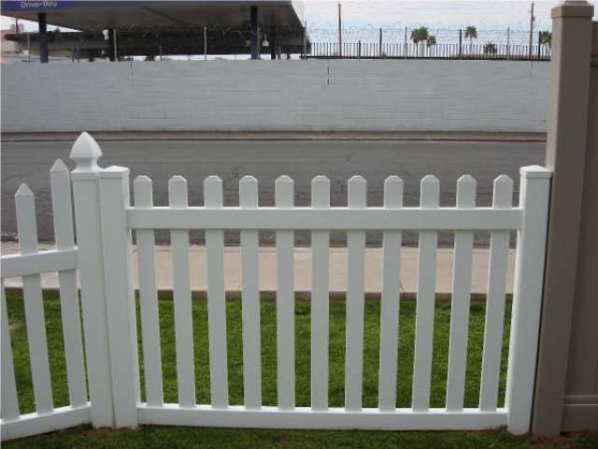
Feature distance
How to define the difference between two features f₁, f₂?
  Simple approach is SSD(f₁, f₂)
    sum of square differences between entries of the two descriptors
    can give good scores to very ambiguous (bad) matches
f₁
f₂
I₁
I₂

Slide 24
Feature distance
How to define the difference between two features f₁, f₂?
  Better approach: ratio distance = SSD(f₁, f₂) / SSD(f₁, f₂’)
    f₂ is best SSD match to f₁ in I₂
    f₂’ is 2nd best SSD match to f₁ in I₂
    gives small values for ambiguous matches
f₁
f₂'
f₂
I₁
I₂

Slide 25
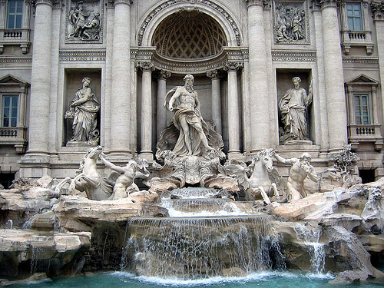
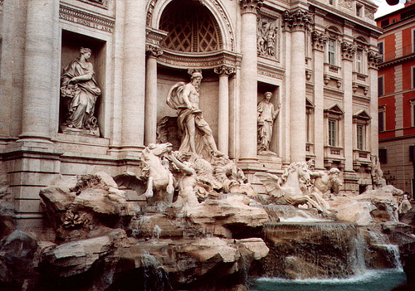
Evaluating the results
How can we measure the performance of a feature matcher?
50
75
200
feature distance

Slide 26
True/false positives
The distance threshold affects performance
  True positives = # of detected matches that are correct
    Suppose we want to maximize these—how to choose threshold?
  False positives = # of detected matches that are incorrect
    Suppose we want to minimize these—how to choose threshold?
50
true match
75
200
false match
feature distance

Slide 27
Evaluating the results
How can we measure the performance of a feature matcher?
1
0.7
# true positives
# matching features (positives)
true
positive
rate
0
1
false positive rate
0.1
# false positives
# unmatched features (negatives)

Slide 28
Evaluating the results
How can we measure the performance of a feature matcher?
ROC curve (“Receiver Operator Characteristic”)
1
0.7
# true positives
# matching features (positives)
true
positive
rate
0
1
false positive rate
0.1
# false positives
# unmatched features (negatives)
ROC Curves
  Generated by counting # current/incorrect matches, for different threholds
  Want to maximize area under the curve
  Useful for comparing different feature matching methods
  For more info: http://en.wikipedia.org/wiki/Receiver_operating_characteristic

Slide 29
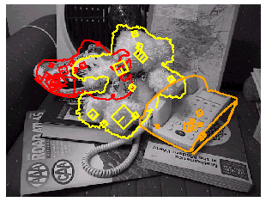
Object recognition (David Lowe)

Slide 30
Aibo
Sony Aibo
SIFT usage:
Recognize
charging
station
Communicate
with visual
cards
Teach object
recognition

Slide 31
Demos
Gigapixel Panoramas
PhotoTourism

Slide 32
Midterm
Topics:
  Filtering
  Edge + Corner Detection
  Resampling
  Interpolation
  Image Gradients, Energies
  Recognition, Eigenfaces
  Camera, Projective Geometry
  Single View Modeling
  Features
  SIFT

Slide 33
Midterm
Conceptual Questions
  E.G. Designing a filter, interpreting a filter
  Types of transformations
Mathematical Questions
  Measuring distances
  Lens properties
Algorithm Design
Stepping through an Algorithm

