Slide 1
Mosaics part 3
CSE 455, Winter 2010
February 12, 2010

Slide 2
Announcements
The Midterm:
  Due this NOW
  Late exams not be accepted
Project 3:
  Out today
  We’ll discuss it towards the end of class

Slide 3
Review From Last Time

Slide 4
How to do it?
Similar to Structure from Motion, but easier
Basic Procedure
  Take a sequence of images from the same position
    Rotate the camera about its optical center
  Compute transformation between second image and first
  Transform the second image to overlap with the first
  Blend the two together to create a mosaic
  If there are more images, repeat

Slide 5
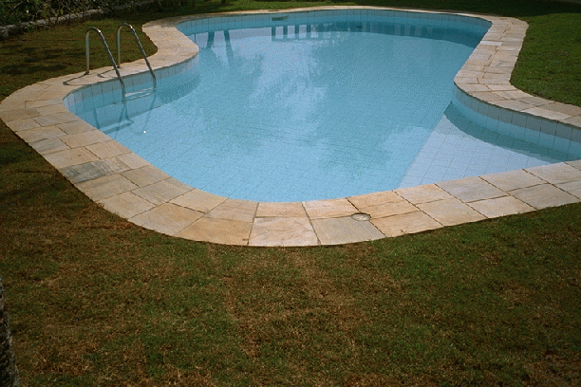
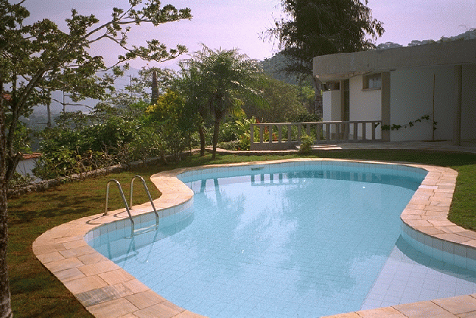
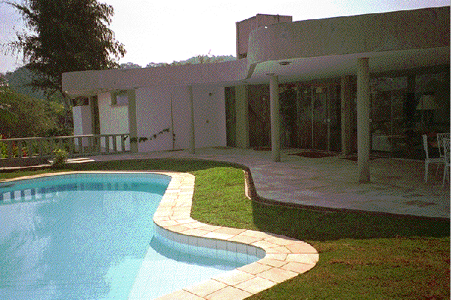
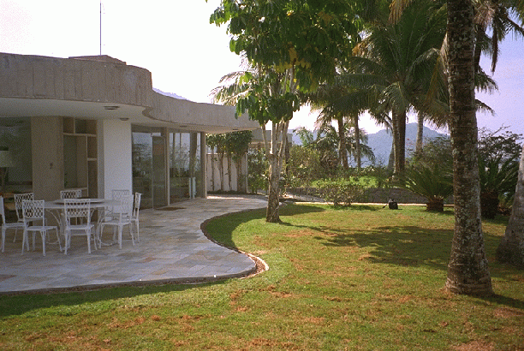
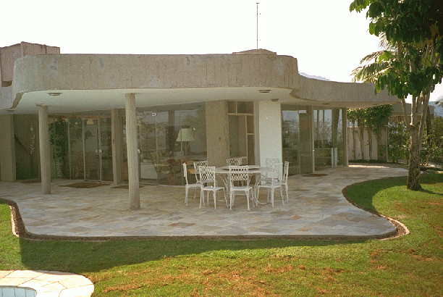
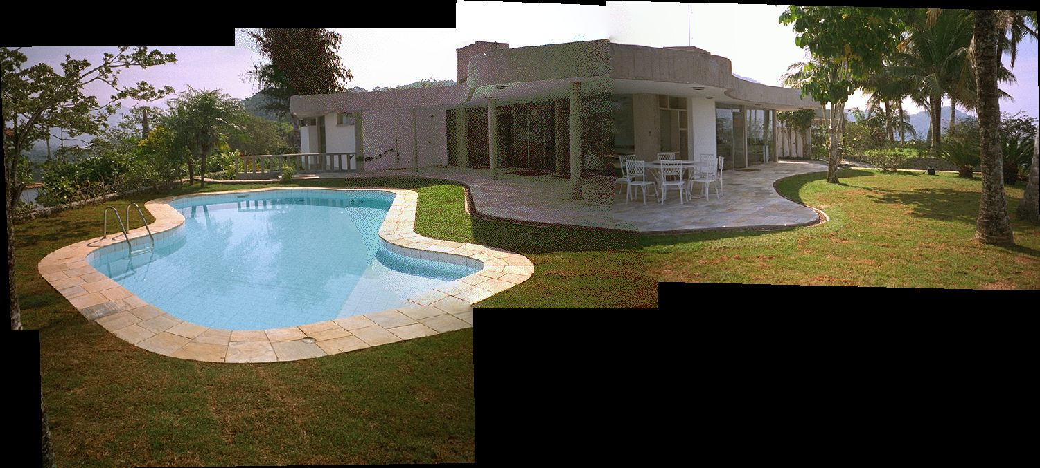
Panoramic Stitching
Input
Goal

Slide 6
Image reprojection
mosaic plane
The mosaic has a natural interpretation in 3D
  The images are reprojected onto a common plane
  The mosaic is formed on this plane

Slide 7
Algorihtm for finding correspondences
Guess some matches
Compute a transformation using those matches
Check if the transformation is good (count “inliers”)
Keep the correspondences and transformation the is the best

Slide 8

RAndom SAmple Consensus
Select one match, count inliers
(in this case, only one)

Slide 9
RAndom SAmple Consensus
Select one match, count inliers
(4 inliers)

Slide 10
Least squares fit
Find “average” translation vector
for largest set of inliers

Slide 11
RANSAC
Same basic approach works for any transformation
  Translation, rotation, homographies, etc.
  Very useful tool
General version
  Randomly choose a set of K correspondences
    Typically K is the minimum size that lets you fit a model
  Fit a model (e.g., homography) to those correspondences
  Count the number of inliers that “approximately” fit the model
    Need a threshold on the error
  Repeat as many times as you can
  Choose the model that has the largest set of inliers
  Refine the model by doing a least squares fit using ALL of the inliers

Slide 12
Today
Stitching Order and Transformation Order
Blending
Warping
Project 3

Slide 13
Assembling the panorama
Stitch pairs together, blend, then crop

Slide 14
Problem: Drift
Error accumulation
  small errors accumulate over time

Slide 15
Simple Solution
Build out from the center
Pick the center after an initial round of pairwise matching

Slide 16
Problem: Drift
(x₁,y₁)
(x_{n},y_{n})
copy of first image
Solution
  add another copy of first image at the end
  this gives a constraint: y_{n} = y₁
  there are a bunch of ways to solve this problem
    add displacement of (y₁ – y_{n})/(n -1) to each image after the first
    compute a global warp: y’ = y + ax
    run a big optimization problem, incorporating this constraint
      best solution, but more complicated
      known as “bundle adjustment”

Slide 17


Image warping
h(x,y)
y
y’
x
x’
f(x,y)
g(x’,y’)
Given a coordinate transform (x’,y’) = h(x,y) and a source image f(x,y), how do we compute a transformed image g(x’,y’) = f(h(x,y))?

Slide 18
Forward warping
h(x,y)
y
y’
x
x’
f(x,y)
g(x’,y’)
Send each pixel f(x,y) to its corresponding location
(x’,y’) = h(x,y) in the second image
Q: what if pixel lands “between” two pixels?

Slide 19
Forward warping
h(x,y)
y
y’
x
x’
f(x,y)
g(x’,y’)
Send each pixel f(x,y) to its corresponding location
(x’,y’) = h(x,y) in the second image
Q: what if pixel lands “between” two pixels?
A: distribute color among neighboring pixels (x’,y’)
  Known as “splatting”

Slide 20
Inverse warping
h⁻¹(x,y)
y
y’
x
x
x’
f(x,y)
g(x’,y’)
Get each pixel g(x’,y’) from its corresponding location
(x,y) = h⁻¹(x’,y’) in the first image
Q: what if pixel comes from “between” two pixels?

Slide 21
Inverse warping
h⁻¹(x,y)
y
y’
x
x
x’
f(x,y)
g(x’,y’)
Get each pixel g(x’,y’) from its corresponding location
(x,y) = h⁻¹(x’,y’) in the first image
Q: what if pixel comes from “between” two pixels?
A: resample color value
  We discussed resampling techniques before
    nearest neighbor, bilinear, Gaussian, bicubic

Slide 22
Forward vs. inverse warping
Q: which is better?
A: usually inverse—eliminates holes
  however, it requires an invertible warp function—not always possible...

Slide 23
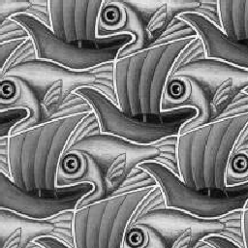
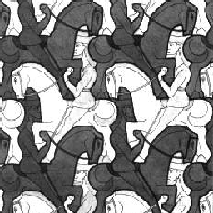
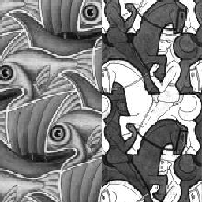
Image Blending

Slide 24
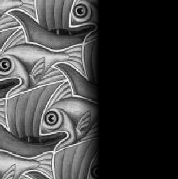
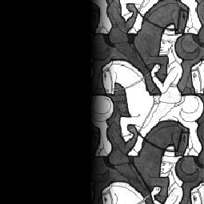

Feathering
+
1
1
0
0
=

Slide 25
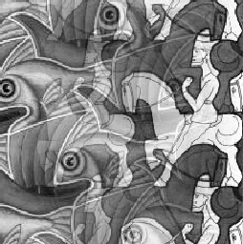
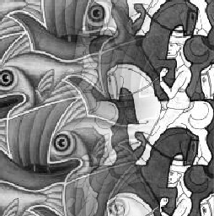
Effect of window size
1
left
1
right
0
0

Slide 26


Effect of window size
1
1
0
0

Slide 27

Good window size
1
0
“Optimal” window: smooth but not ghosted
  Doesn’t always work...

Slide 28
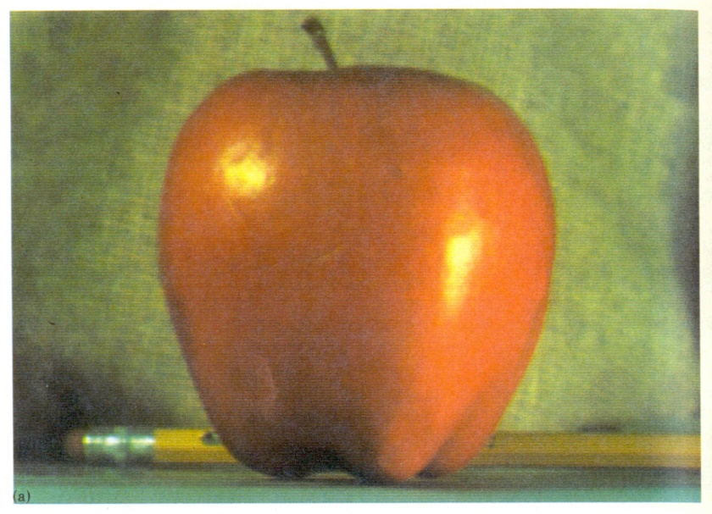
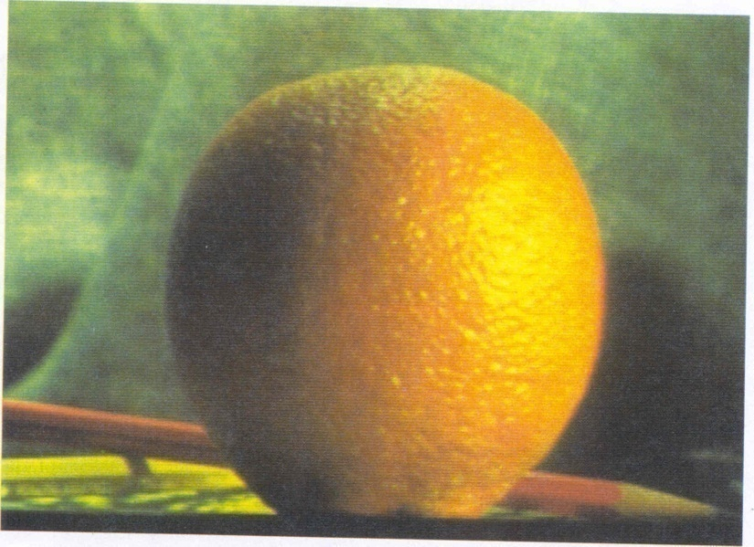
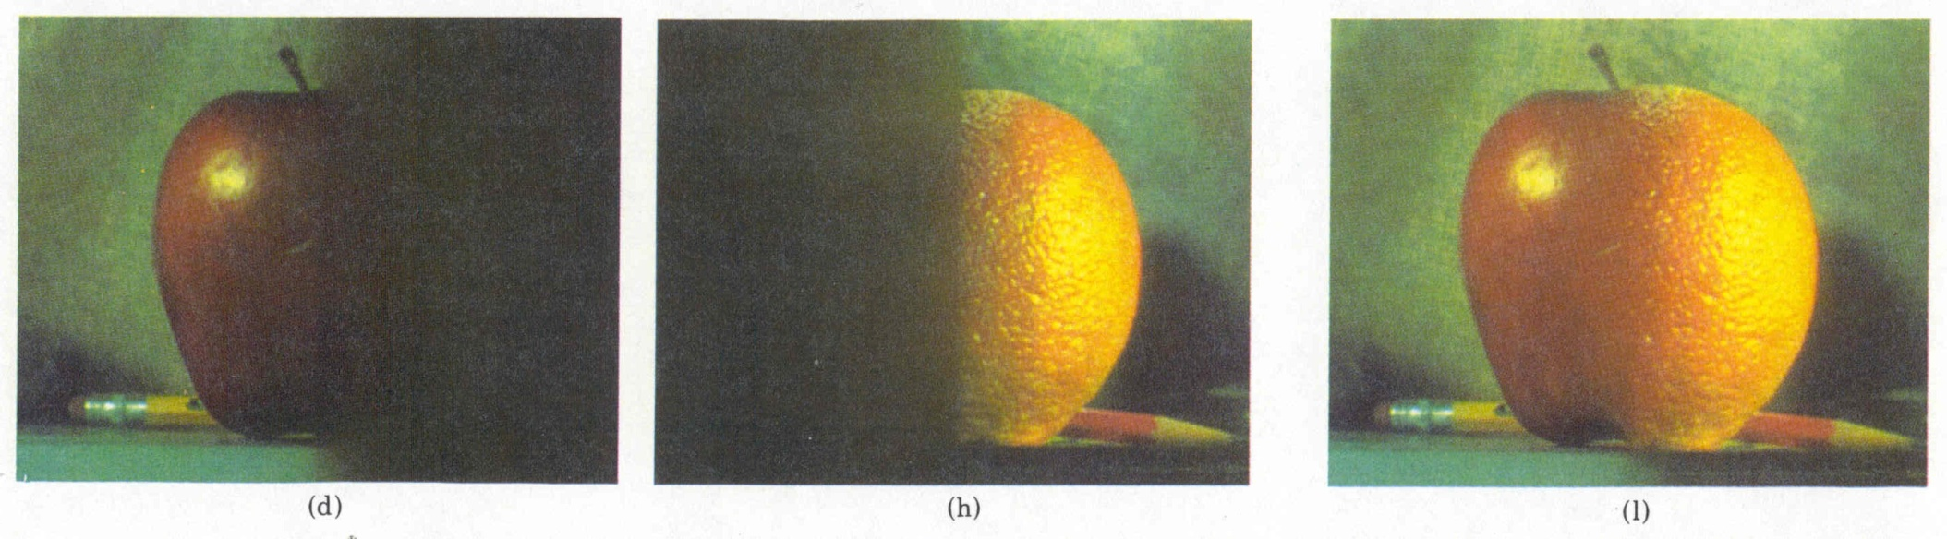
Pyramid blending
Create a Laplacian pyramid, blend each level
  Burt, P. J. and Adelson, E. H., A multiresolution spline with applications to image mosaics, ACM Transactions on Graphics, 42(4), October 1983, 217-236.

Slide 29
Gaussian Blending

Slide 30
Alpha Blending
I₃
p
I₁
Optional: see Blinn (CGA, 1994) for details:
http://ieeexplore.ieee.org/iel1/38/7531/00310740.pdf?isNumber=7531&prod=JNL&arnumber=310740&arSt=83&ared=87&arAuthor=Blinn%2C+J.F.
I₂
Encoding blend weights: I(x,y) = (αR, αG, αB, α)
color at p =
Implement this in two steps:
  1. accumulate: add up the (α premultiplied) RGBα values at each pixel
  2. normalize: divide each pixel’s accumulated RGB by its α value
    Q: what if α = 0?
Notes:
A: render as black

Slide 31
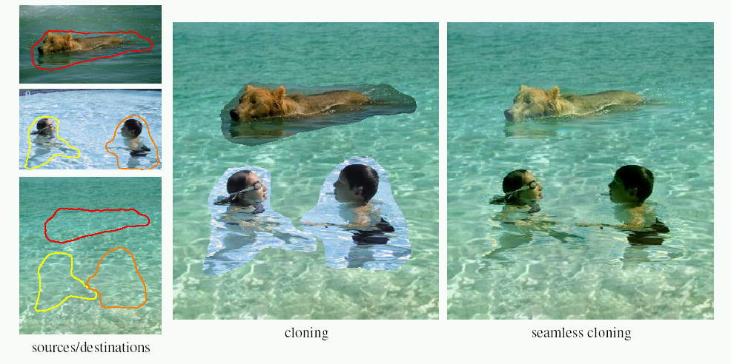
Poisson Image Editing
For more info: Perez et al, SIGGRAPH 2003
  http://research.microsoft.com/vision/cambridge/papers/perez_siggraph03.pdf

Slide 32
Poisson Image Editing/Blending
Gradient Domain
Smooths out color and intensity changes

Slide 33
Panoramas
What if you want a large field of view?

Slide 34
Large Field of View: Planar Projection

Slide 35
Panoramas
What if you want a 360° field of view?
mosaic Projection Sphere

Slide 36
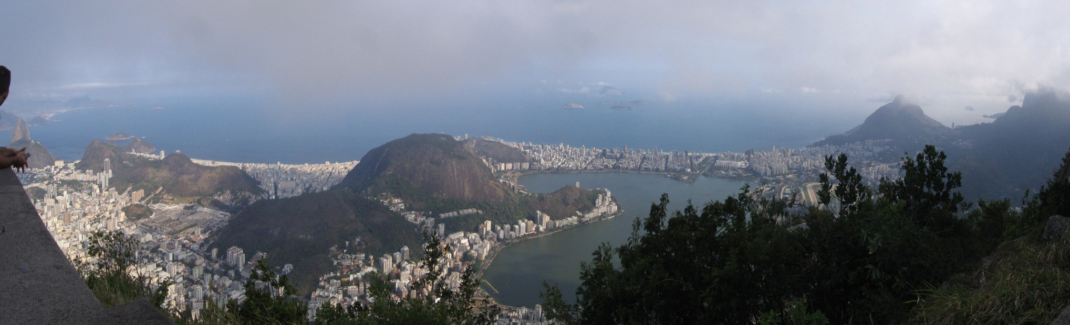
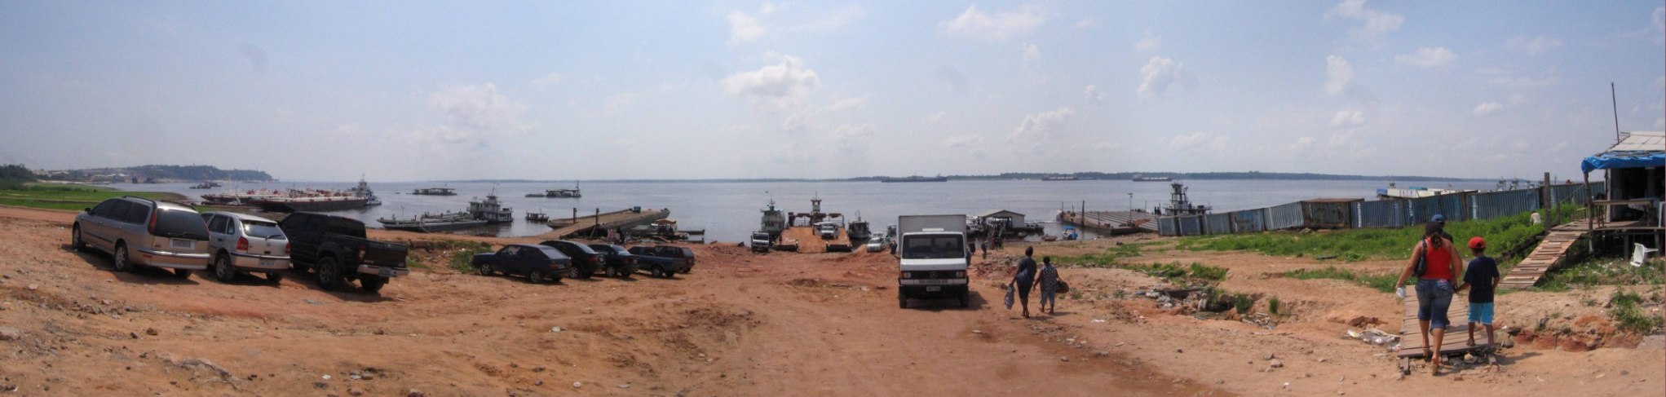
Examples

Slide 37


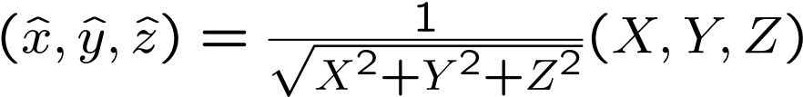





Spherical projection
  Map 3D point (X,Y,Z) onto sphere
Y
Z
X
  Convert to spherical coordinates
  Convert to spherical image coordinates
unit sphere
    s defines size of the final image
      Often set s = camera focal length
unwrapped sphere
Spherical image

Slide 38



Spherical reprojection
How to map sphere onto a flat image?
  to
Y
Z
X
side view
top-down view

Slide 39
Spherical reprojection
How to map sphere onto a flat image?
  to
  Use image projection matrix!
    or use the version of projection that properly accounts for radial distortion, as discussed in projection slides. This is what you’ll do for project 3.
Y
Z
X
side view
Project the point along the radius
top-down view

Slide 40
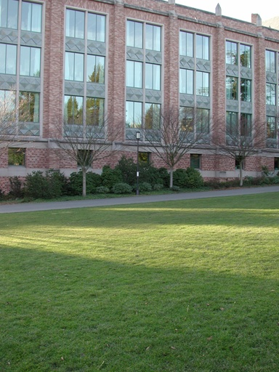
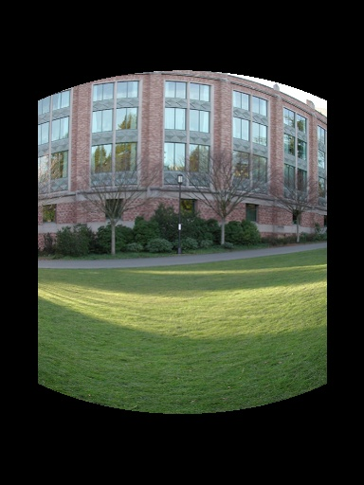
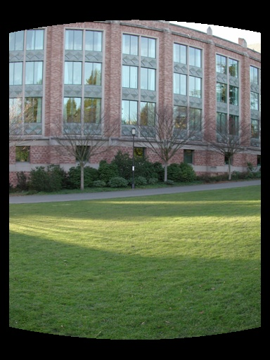
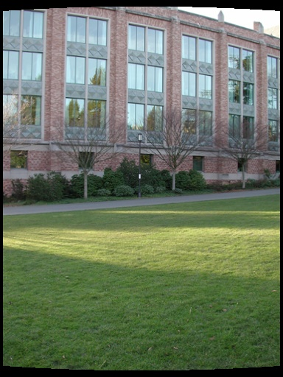
Spherical reprojection, before stiching
input
f = 200 (pixels)
f = 400
f = 800
Map image to spherical coordinates
  need to know the focal length
Notes:
Therefore, it is desirable if the global motion model we need to recover is translation, which has only two parameters. It turns out that for a pure panning motion, if we convert two images to their cylindrical maps with known focal length, the relationship between them can be represented by a translation.
Here is an example of how cylindrical maps are constructed with differently with f’s. Note how straight lines are curved.
Similarly, we can map an image to its longitude/latitude spherical coordinates as well if f is given.

Slide 41
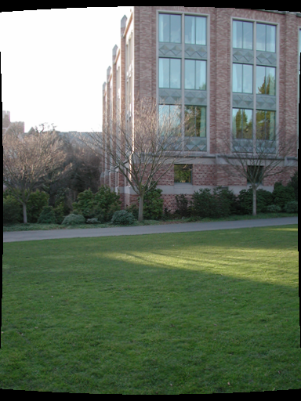
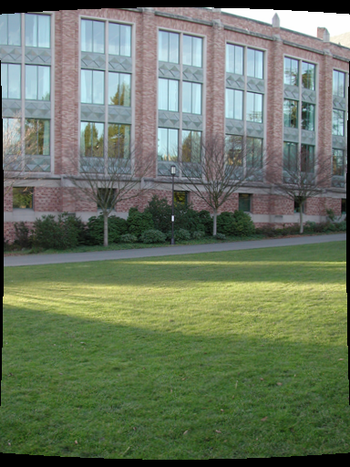
Aligning spherical images
Suppose we rotate the camera by θ about the vertical axis
  How does this change the spherical image?
Notes:
Therefore, it is desirable if the global motion model we need to recover is translation, which has only two parameters. It turns out that for a pure panning motion, if we convert two images to their cylindrical maps with known focal length, the relationship between them can be represented by a translation.
Here is an example of how cylindrical maps are constructed with differently with f’s. Note how straight lines are curved.
Similarly, we can map an image to its longitude/latitude spherical coordinates as well if f is given.

Slide 42
Aligning spherical images
Suppose we rotate the camera by θ about the vertical axis
  How does this change the spherical image?
    Translation by θ
  This means that we can align spherical images by translation
Notes:
Therefore, it is desirable if the global motion model we need to recover is translation, which has only two parameters. It turns out that for a pure panning motion, if we convert two images to their cylindrical maps with known focal length, the relationship between them can be represented by a translation.
Here is an example of how cylindrical maps are constructed with differently with f’s. Note how straight lines are curved.
Similarly, we can map an image to its longitude/latitude spherical coordinates as well if f is given.

Slide 43
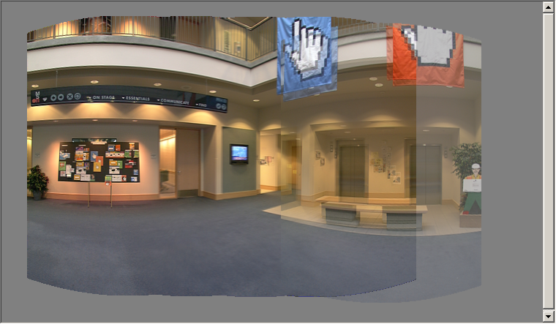
Spherical image stitching
What if you don’t know the camera rotation?
  Solve for the camera rotations
    Note that a pan (rotation) of the camera is a translation of the sphere!
    Use feature matching to solve for translations of spherical-warped images

Slide 44
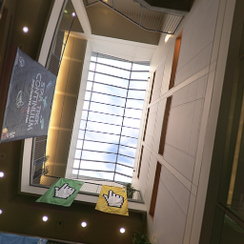
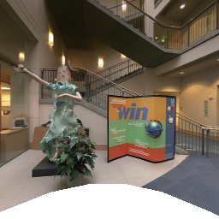
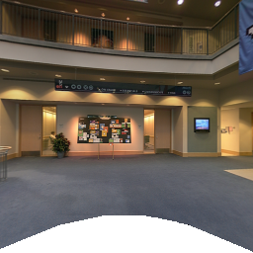
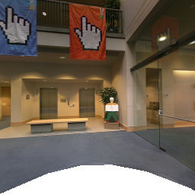
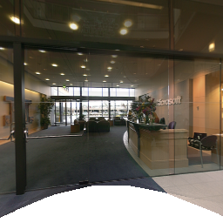
Different projections are possible

Slide 45

Other types of mosaics
Can mosaic onto any surface if you know the geometry
  See NASA’s Visible Earth project for some stunning earth mosaics
    http://earthobservatory.nasa.gov/Newsroom/BlueMarble/
    Click for images…

Slide 46
Project 3 (a+b)
Take pictures on a tripod (or handheld)
Warp to spherical coordinates
Extract features
Align neighboring pairs using RANSAC
Write out list of neighboring translations
Correct for drift
Read in warped images and blend them
Crop the result and import into a viewer
Roughly based on Autostitch
  By Matthew Brown and David Lowe
  http://www.cs.ubc.ca/~mbrown/autostitch/autostitch.html

Slide 47
Project 3
In pairs
Check out a Panorama Kit

