Slide 1
Mosaics con’t
CSE 455, Winter 2010
February 10, 2010

Slide 2
Announcements
The Midterm:
  Due this Friday, Feb 12, at the beginning of class
  Late exams will not be accepted
Additional Office Hour today:
  2:30 to 3:30 in CSE 212 (the normal place)

Slide 3
Review From Last Time

Slide 4
How to do it?
Similar to Structure from Motion, but easier
Basic Procedure
  Take a sequence of images from the same position
    Rotate the camera about its optical center
  Compute transformation between second image and first
  Transform the second image to overlap with the first
  Blend the two together to create a mosaic
  If there are more images, repeat

Slide 5
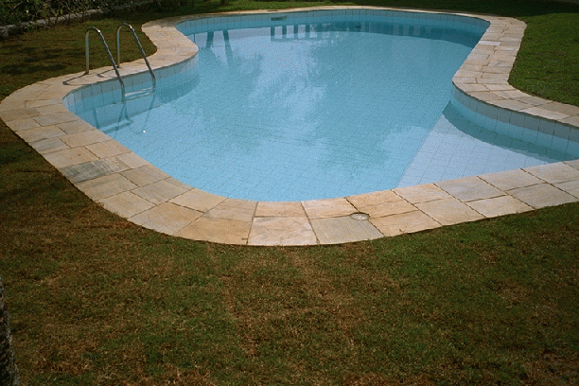
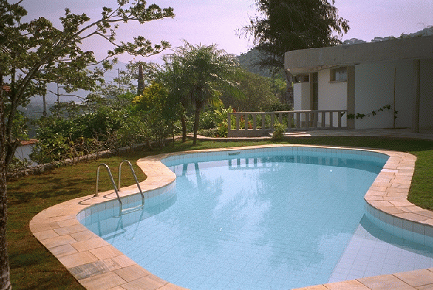
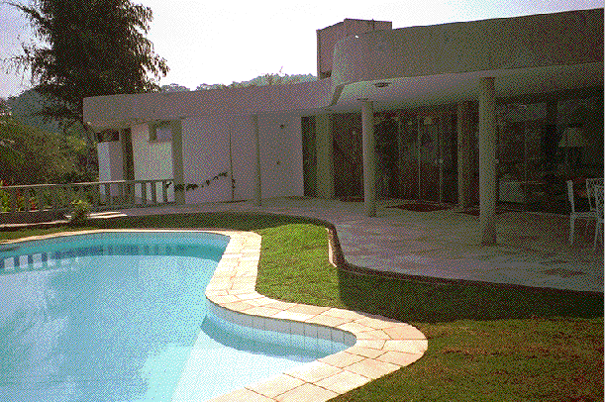
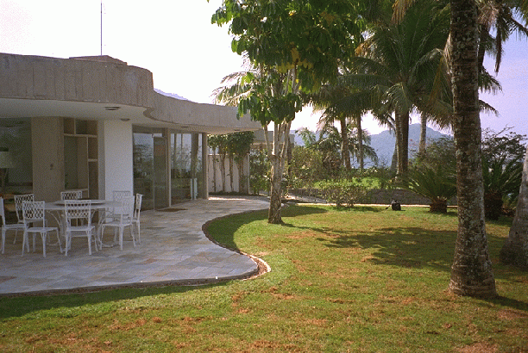
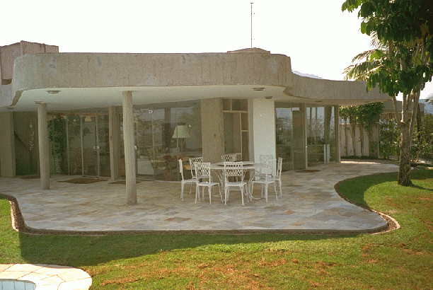
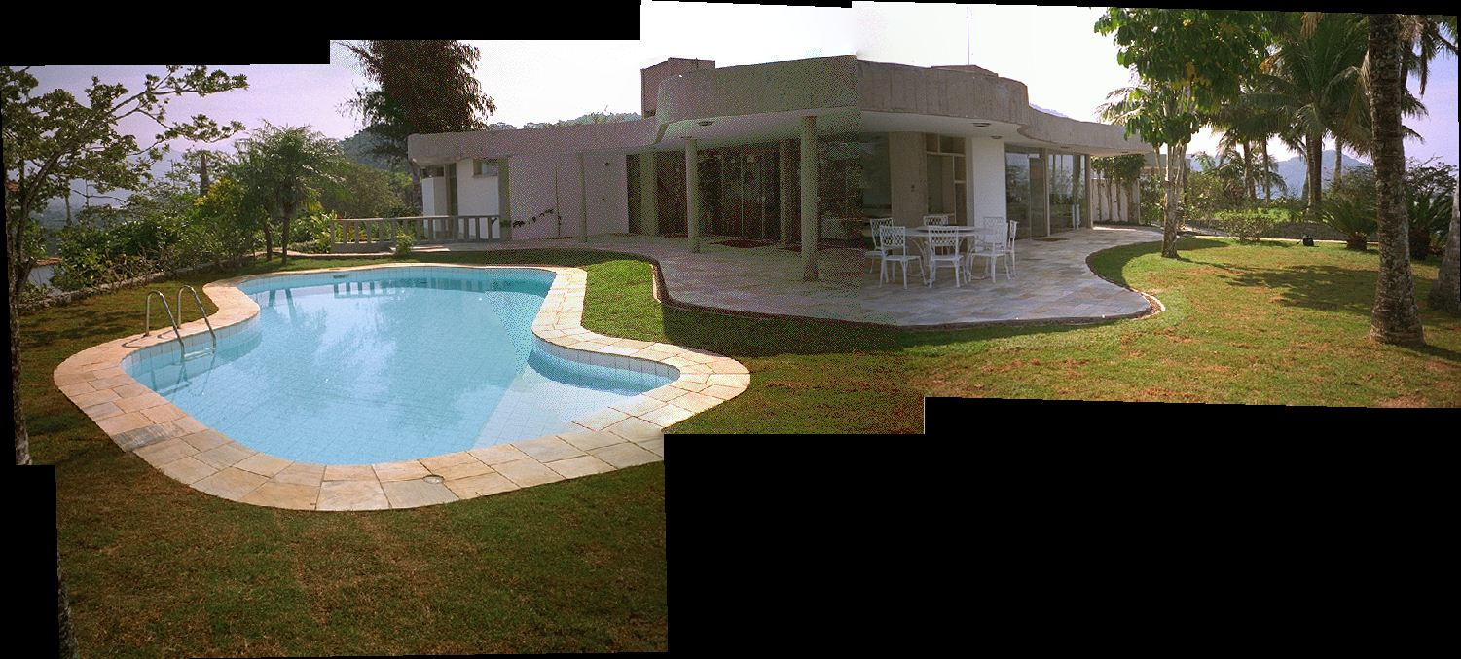
Panoramic Stitching
Input
Goal

Slide 6
Aligning images
How to account for warping?
  Translations are not enough to align the images
  Homographies!!!

Slide 7
Structure from Motion: Image reprojection
x₄
x₁
x₃
x₂
x₅
x₇
x₆
p_{1,1}
p_{1,2}
p_{1,3}
Image 1
Image 3
R₁,t₁
R₃,t₃
Image 2
R₂,t₂

Slide 8
Panoramas: Image reprojection
x₄
x₁
x₃
x₂
x₅
x₇
x₆
p_{1,2}
Image 1
Image 2
Image 3
R₁
R₂
R₃

Slide 9
Image reprojection
mosaic plane
The mosaic has a natural interpretation in 3D
  The images are reprojected onto a common plane
  The mosaic is formed on this plane

Slide 10
Image warping with homographies
image plane in front
image plane below
black area
where no pixel
maps to

Slide 11
Basic Procedure
Take a sequence of images from the same position
  Rotate the camera about its optical center
Compute correspondence between second image and first
Compute transformation between second image and first
Transform the second image to overlap with the first
Blend the two together to create a mosaic
If there are more images, repeat
ü

Slide 12
Basic Procedure
Take a sequence of images from the same position
  Rotate the camera about its optical center
Compute correspondence between second image and first
Compute transformation between second image and first
Transform the second image to overlap with the first
Blend the two together to create a mosaic
If there are more images, repeat
ü

Slide 13
Correspondence and Transformation
Compute correspondence between second image and first
Compute transformation between second image and first
What kind of transformation
  Homography!!!
Do we know the correspondence?

Slide 14
Let’s come up with an algorithm

Slide 15
Let’s come up with an algorithm
Guess some matches
Compute a transformation using those matches
Check if the transformation is good

Slide 16
RANSAC
  Randomly choose a set of K potential correspondences
    Typically K is the minimum size that lets you fit a model
    How many for a
      Translation
      rotation?
      Affine?
      Homography?
  Fit a model (e.g., translation, homography) to those correspondences
  Count the number of inliers that “approximately” fit the model
    Need a threshold on the error
  Repeat as many times as you can
  Choose the model that has the largest set of inliers
  Refine the model by doing a least squares fit using ALL of the inliers

Slide 17
Simple Case: Translation

Slide 18

Computing image translations
What do we do about the “bad” matches?

Slide 19
RAndom SAmple Consensus
Select one match, count inliers
(in this case, only one)

Slide 20
RAndom SAmple Consensus
Select one match, count inliers
(4 inliers)

Slide 21
Least squares fit
Find “average” translation vector
for largest set of inliers

Slide 22
RANSAC
Same basic approach works for any transformation
  Translation, rotation, homographies, etc.
  Very useful tool
General version
  Randomly choose a set of K correspondences
    Typically K is the minimum size that lets you fit a model
  Fit a model (e.g., homography) to those correspondences
  Count the number of inliers that “approximately” fit the model
    Need a threshold on the error
  Repeat as many times as you can
  Choose the model that has the largest set of inliers
  Refine the model by doing a least squares fit using ALL of the inliers

Slide 23
Homographies
Perspective projection of a plane
  Lots of names for this:
    homography, texture-map, colineation, planar projective map
  Modeled as a 2D warp using homogeneous coordinates
p’
H
p
To apply a homography H
  Compute p’ = Hp (regular matrix multiply)
  Convert p’ from homogeneous to image coordinates
    divide by w (third) coordinate
Notes:
Try examples: [2 0 0; 0 2 0; 0 0 2] does what?
How to scale by 2?
[1 0 10; 0 1 0; 0 0 1]

Slide 24
Basic Procedure
Take a sequence of images from the same position
  Rotate the camera about its optical center
Compute correspondence between second image and first
Compute transformation between second image and first
Transform the second image to overlap with the first
Blend the two together to create a mosaic
If there are more images, repeat
ü
ü

Slide 25
Basic Procedure
Take a sequence of images from the same position
  Rotate the camera about its optical center
Compute correspondence between second image and first
Compute transformation between second image and first
Transform the second image to overlap with the first
Blend the two together to create a mosaic
If there are more images, repeat
ü
ü

Slide 26
Assembling the panorama
Stitch pairs together, blend, then crop

Slide 27
Problem: Drift
Error accumulation
  small errors accumulate over time

Slide 28
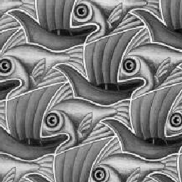
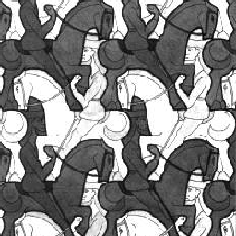
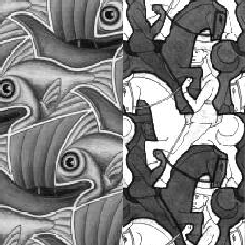
Image Blending

Slide 29
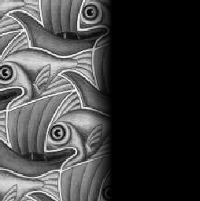
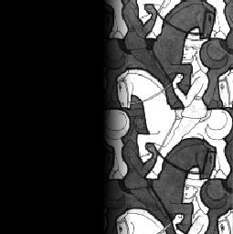

Feathering
+
1
1
0
0
=

Slide 30
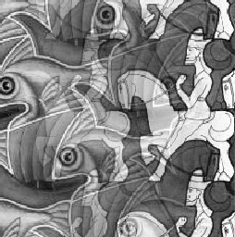
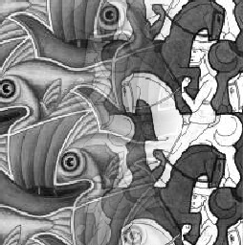
Effect of window size
1
left
1
right
0
0

Slide 31


Effect of window size
1
1
0
0

Slide 32

Good window size
1
0
“Optimal” window: smooth but not ghosted
  Doesn’t always work...

