Slide 1
Mosaics
CSE 455, Winter 2010
February 8, 2010

Slide 2
Announcements
The Midterm went out Friday
  See email to the class
  Also linked off the course colander
  Open-note, Open-book, Non Open-Friend
  Clarification questions only in office hours, over email, and on the forum
  You may still ask us general questions about the course material

Slide 3
Announcements
Professor office hours are M 2:30-3:30
6 TA hours during the week (WF 4-5:30 and TTh 10-11:30).
We’ve enjoyed interactive with those that have come
We would love to see more of you!
We are also available for questions over email or to meet by appointment outside of these times.
Late Days, the weekends don’t count

Slide 4
Announcements
Class forum: https://catalysttools.washington.edu/gopost/board/iansimon/15087/
Course reader:
http://www.cs.washington.edu/education/courses/455/10wi/reader.htm
Other resources:
Richard Szeliski's book Computer Vision: Algorithms and Applications. The book draft is currently available online.
R. Hartley, A.Zisserman. Multiple View Geometry in Computer Vision. Cambridge University Press, 2000.
R. Hartley, A.Zisserman., Multiple View Geometry - Tutorial. CVPR (1999).
D. A. Forsyth, J. Ponce. Computer Vision a Modern Approach. Prentice Hall, 2003.

Slide 5
Review From Last Time

Slide 6
Structure from Motion
Snavely, Seitz, Szeliski, Photo Tourism: Exploring Photo Collections in 3D. SIGGRAPH 2006.
  http://phototour.cs.washington.edu/Photo_Tourism.pdf

Slide 7
x₄
x₁
x₃
x₂
x₅
x₇
x₆
p_{1,1}
p_{1,2}
p_{1,3}
Image 1
Image 3
R₁,t₁
R₃,t₃
Image 2
R₂,t₂

Slide 8
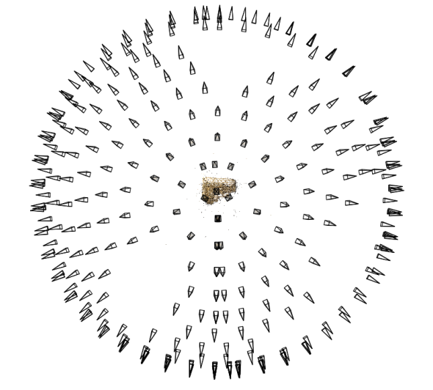
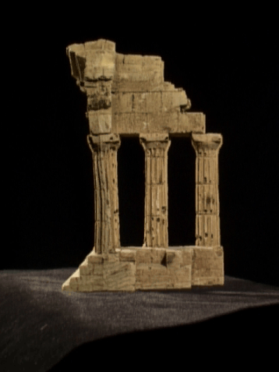
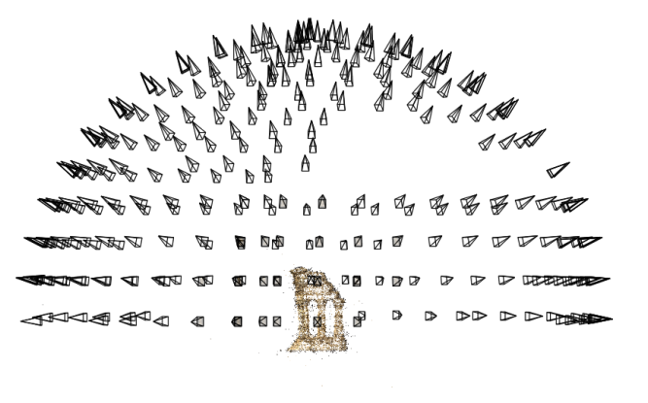
Structure from motion
Reconstruction (side)
(top)
Input: images with points in correspondence p_{i,j} = (u_{i,j},v_{i,j})
Output
  structure: 3D location x_{i} for each point p_{i}
  motion: camera parameters R_{j} , t_{j}
Objective function: minimize reprojection error

Slide 9
x₄
x₁
x₃
x₂
x₅
x₇
x₆
p_{1,1}
p_{1,2}
p_{1,3}
Image 1
Image 3
R₁,t₁
R₃,t₃
Image 2
R₂,t₂

Slide 10
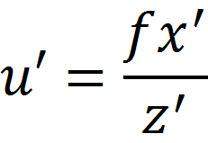
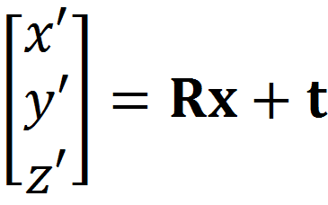
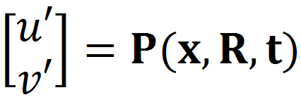
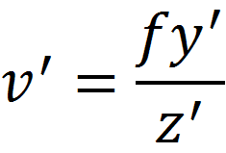
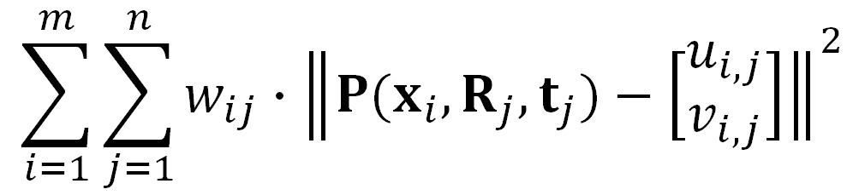

SfM objective function
Given point x and rotation and translation R, t
Minimize sum of squared reprojection errors:
predicted
image location
observed
image location

Slide 11
Solving structure from motion
Minimizing g is difficult:
  g is non-linear due to rotations, perspective division
  lots of parameters: 3 for each 3D point, 6 for each camera
  difficult to initialize
  gauge ambiguity: error is invariant to a similarity transform (translation, rotation, uniform scale)
Many techniques use non-linear least-squares (NLLS) optimization (bundle adjustment)
  Levenberg-Marquardt is one common algorithm for NLLS
  Lourakis, The Design and Implementation of a Generic Sparse Bundle Adjustment Software Package Based on the Levenberg-Marquardt Algorithm, http://www.ics.forth.gr/~lourakis/sba/
  http://en.wikipedia.org/wiki/Levenberg-Marquardt_algorithm

Slide 12
Scene reconstruction
Feature detection
Incremental structure from motion
Pairwise
feature matching
Correspondence estimation
Notes:
Again, the goal of the reconstruction procedure is to automatically estimate the relative positions and orientations, as well as the focal length or zoom, of each of the photographs in a connected component of the scene. The process consists of four steps: detecting features in each of the input photos; matching features between each pair of photos; grouping the matches into correspondences across multiple photos; and using the correspondences to estimate the geometry of the scene and the cameras in a technique known as structure from motion.
I’ll now describe each of these steps in more detail.
[Structure from motion techniques for unordered image collections have also been developed by others, such as Brown and Lowe and Schaffalitzky and Zisserman, and the basic pipeline of our system closely follows that of Brown and Lowe. To our knowledge, our system is the first to have been demonstrated on large collections of photos from the Internet.]

Slide 13
Mosaics
VR Seattle: http://www.vrseattle.com/
Full screen panoramas (cubic): http://www.panoramas.dk/
Mars: http://www.panoramas.dk/fullscreen3/f2_mars97.html
Today’s Readings
  Szeliski and Shum paper (sections 1 and 2, skim the rest)
    http://www.cs.washington.edu/education/courses/455/08wi/readings/szeliskiShum97.pdf

Slide 14
Image Mosaics
+ + … + =
Goal
  Stitch together several images into a seamless composite

Slide 15
How to do it?
Easier than Structure from Motion or Harder?
  Easier
Let’s Start on your next project right now in class
Basic Procedure
  Take a sequence of images from the same position
    Rotate the camera about its optical center
  Then what?
  In Class Exercise

Slide 16
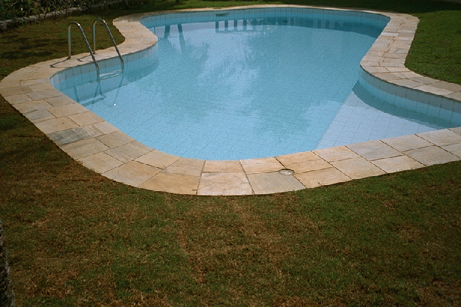
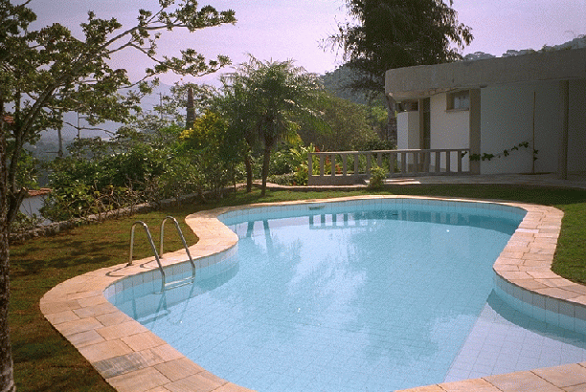
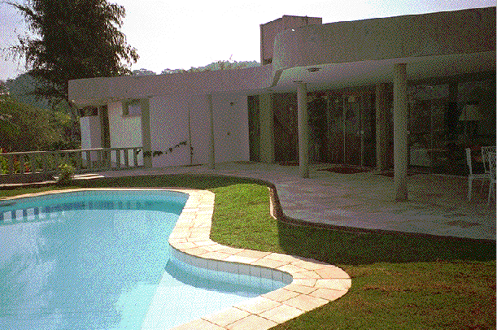
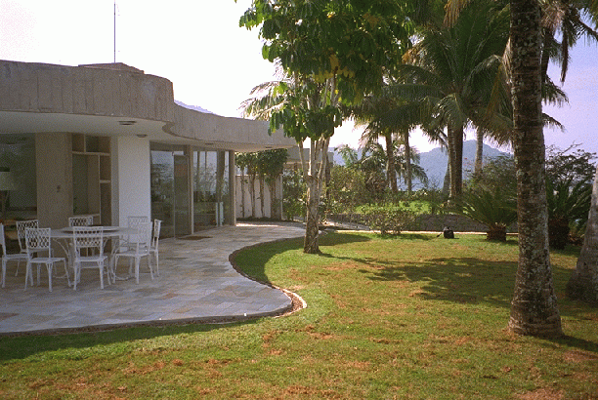
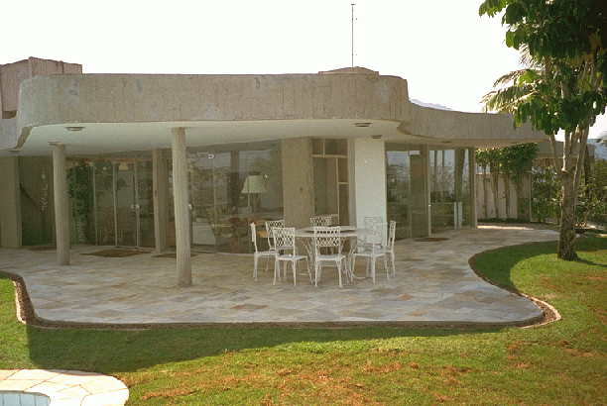
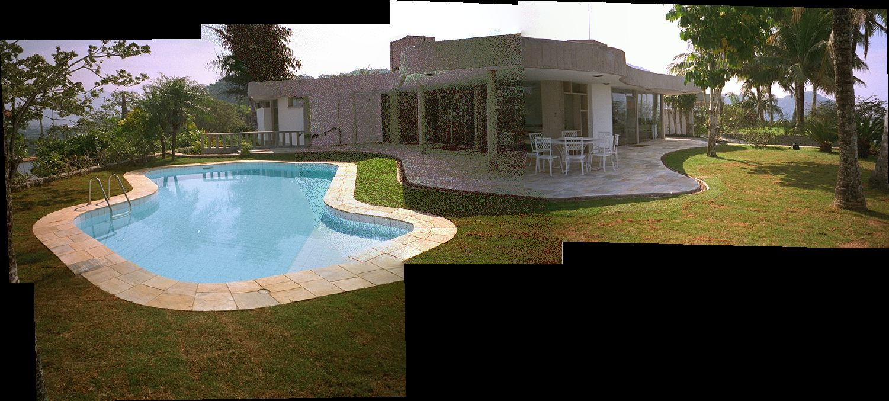
Panoramic Stitching
Input
Goal
  Try doing using your brain, eyes, and hands – Can you align the images?
  Write an rough algorithm
    What steps are there, what do you need to find, what things are tricky

Slide 17
How to do it?
Basic Procedure
  Take a sequence of images from the same position
    Rotate the camera about its optical center
  Compute transformation between second image and first
  Transform the second image to overlap with the first
  Blend the two together to create a mosaic
  If there are more images, repeat

Slide 18
Aligning images
How to account for warping?
  Translations are not enough to align the images
  Photoshop demo

Slide 19
x₄
x₁
x₃
x₂
x₅
x₇
x₆
p_{1,1}
p_{1,2}
p_{1,3}
Image 1
Image 3
R₁,t₁
R₃,t₃
Image 2
R₂,t₂

Slide 20
x₄
x₁
x₃
x₂
x₅
x₇
x₆
p_{1,2}
Image 1
Image 2
Image 3
R₁
R₂
R₃

Slide 21
Image reprojection
mosaic PP
The mosaic has a natural interpretation in 3D
  The images are reprojected onto a common plane
  The mosaic is formed on this plane

Slide 22
Image reprojection
Basic question
  How to relate two images from the same camera center?
    how to map a pixel from PP1 to PP2
PP2
Answer
  Cast a ray through each pixel in PP1
  Draw the pixel where that ray intersects PP2
PP1
Don’t need to know what’s in the scene!

Slide 23
Image reprojection
Observation
  Rather than thinking of this as a 3D reprojection, think of it as a 2D image warp from one image to another

Slide 24
Homographies
Perspective projection of a plane
  Lots of names for this:
    homography, texture-map, colineation, planar projective map
  Modeled as a 2D warp using homogeneous coordinates
p’
H
p
To apply a homography H
  Compute p’ = Hp (regular matrix multiply)
  Convert p’ from homogeneous to image coordinates
    divide by w (third) coordinate
Notes:
Try examples: [2 0 0; 0 2 0; 0 0 2] does what?
How to scale by 2?
[1 0 10; 0 1 0; 0 0 1]

Slide 25
Image warping with homographies
image plane in front
image plane below
black area
where no pixel
maps to

