Slide 1
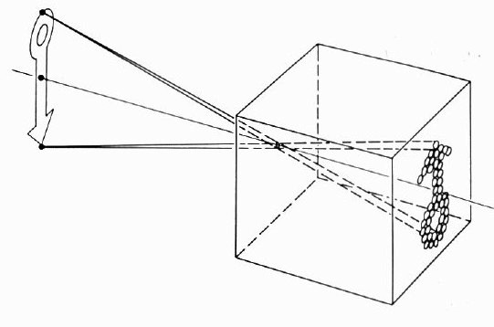
Cameras
CSE 455, Winter 2010
January 25, 2010

Slide 2

Announcements
New Lecturer!
Neel Joshi, Ph.D.
Post-Doctoral Researcher
Microsoft Research
neel@cs
Project 1b (seam carving) was due on Friday the 22nd
Project 2 (eigenfaces) went out on Friday the 22nd
  to be done individually

Slide 3
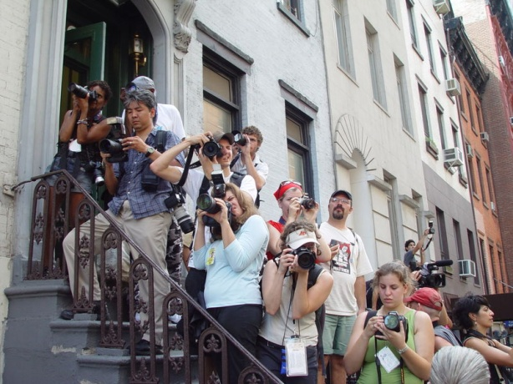
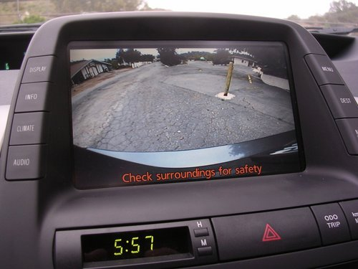


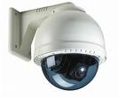
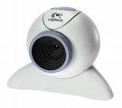
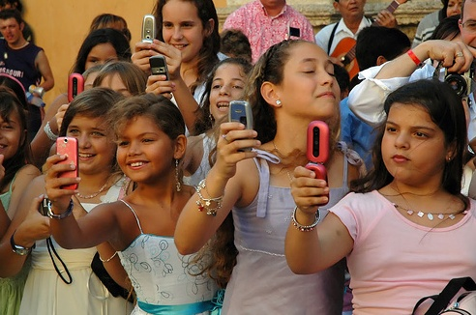
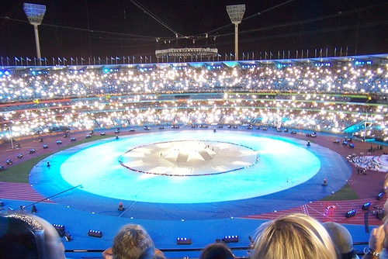
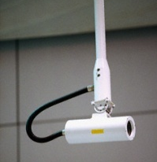

Cameras are Everywhere

Slide 4
Camera Trends
[Redrawn from The Mobile Imaging Report]

Slide 5
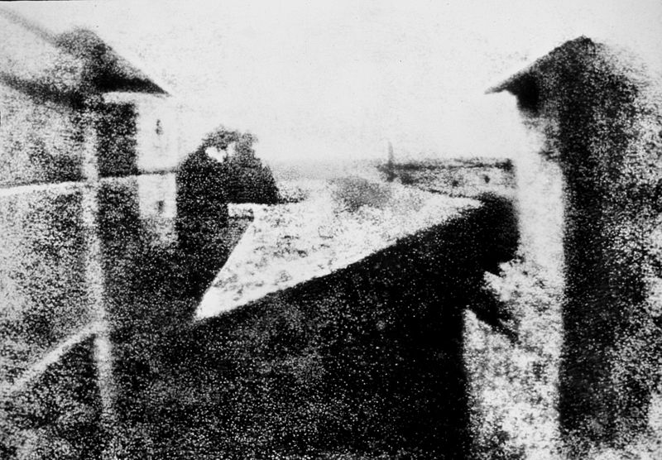
First Known Photograph
View from the Window at le Gras,
Joseph Nicéphore Niépce 1826

Slide 6
What is an image?
Notes:
a function from R2 to R (mapping space to light)
a set of pixels (what’s a pixel?)
an array of numbers
a JPEG file
a collection of regions, shapes, or features
a graph
→answer depends on what you want to *do* with it!

Slide 7
Images as functions
We can think of an image as a function, f, from R² to R:
  f( x, y ) gives the intensity at position ( x, y )
  Realistically, we expect the image only to be defined over a rectangle, with a finite range:
    f: [a,b]x[c,d] → [0,1]
A color image is just three functions pasted together. We can write this as a “vector-valued” function:
Notes:
As opposed to [0..255]

Slide 8
Images as functions
Notes:
demo with matlab

Slide 9

What is a digital image?
In computer vision we usually operate on digital (discrete) images:
  Sample the 2D space on a regular grid
  Quantize each sample (round to nearest integer)
If our samples are Δ apart, we can write this as:
f[i ,j] = Quantize{ f(i Δ, j Δ) }
The image can now be represented as a matrix of integer values

Slide 10
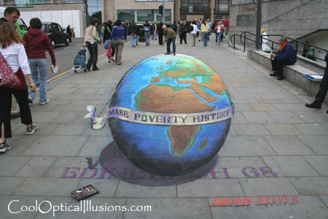
Projection

Slide 11
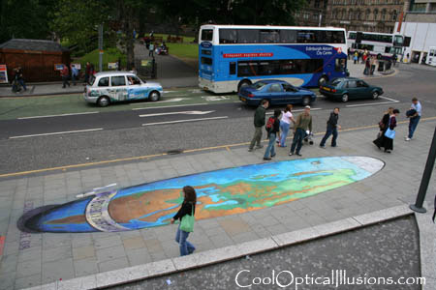
Projection

Slide 12
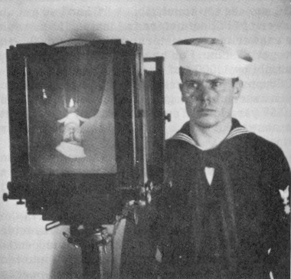
What is an image?
2D pattern of intensity values
2D projection of 3D objects
Figure from US Navy Manual of Basic Optics and Optical Instruments, prepared by Bureau of Naval Personnel. Reprinted by Dover Publications, Inc., 1969.
Notes:
a function from R2 to R (mapping space to light)
a set of pixels (what’s a pixel?)
an array of numbers
a JPEG file
a collection of regions, shapes, or features
a graph
→answer depends on what you want to *do* with it!

Slide 13
What is an camera?
Notes:
Lens, film
Eye, phone, slr, mouse

Slide 14
Image formation
Let’s design a camera
  Idea 1: put a piece of film in front of an object
  Do we get a reasonable image?

Slide 15
Pinhole camera
Add a barrier to block off most of the rays
  This reduces blurring
  The opening known as the aperture
  How does this transform the image?
Notes:
It gets inverted

Slide 16
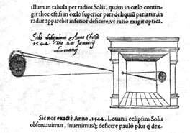
Camera Obscura
The first camera
  Known to Aristotle
  According to DaVinci “When images of illuminated objects ... penetrate through a small hole into a very dark room ... you will see [on the opposite wall] these objects in their proper form and color, reduced in size, in a reversed position, owing to the intersection of the rays".
  How does the aperture size affect the image?

Slide 17
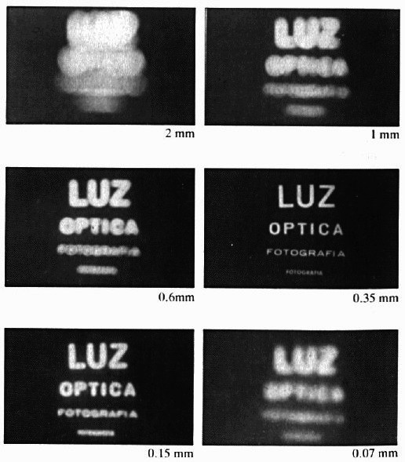
Shrinking the aperture
Why not make the aperture as small as possible?
  Less light gets through
  Diffraction effects...

Slide 18
Shrinking the aperture

Slide 19
Adding a lens
“circle of
confusion”
A lens focuses light onto the film
  There is a specific distance at which objects are “in focus”
    other points project to a “circle of confusion” in the image
  Changing the shape of the lens changes this distance

Slide 20

Lenses
F
focal point
optical center
(Center Of Projection)
A lens focuses parallel rays onto a single focal point
  focal point at a distance f beyond the plane of the lens
    f is a function of the shape and index of refraction of the lens
  Aperture of diameter D restricts the range of rays
    aperture may be on either side of the lens
  Lenses are typically spherical (easier to produce)

Slide 21
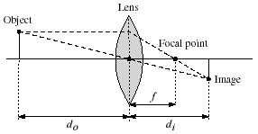
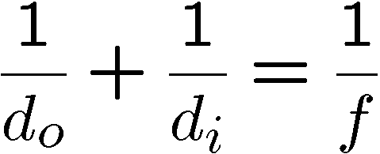
Thin lenses
Thin lens equation:
  Any object point satisfying this equation is in focus
  What is the shape of the focus region?
  How can we change the focus region?
  Thin lens applet: http://www.phy.ntnu.edu.tw/java/Lens/lens_e.html (by Fu-Kwun Hwang )

Slide 22

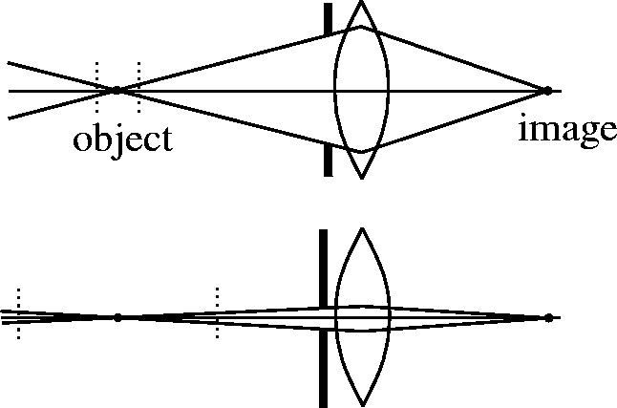

Depth of field
f / 5.6
f / 32
Changing the aperture size affects depth of field
  A smaller aperture increases the range in which the object is approximately in focus
Flower images from Wikipedia http://en.wikipedia.org/wiki/Depth_of_field

Slide 23
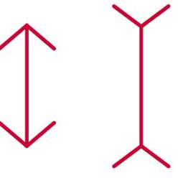

Back to Project: Müller-Lyer Illusion
Which line is longer?
http://www.michaelbach.de/ot/sze_muelue/index.html

Slide 24
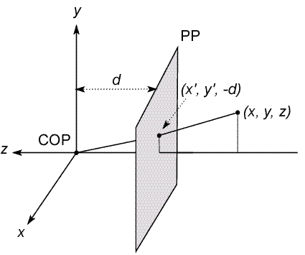
Modeling projection
The coordinate system
  We will use the pin-hole model as an approximation
  Put the optical center (Center Of Projection) at the origin
  Put the image plane (Projection Plane) in front of the COP
    Why?
  The camera looks down the negative z axis
    we need this if we want right-handed-coordinates
Notes:
This way the image is right-side-up

Slide 25
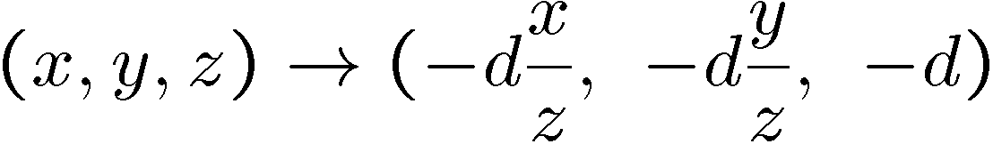
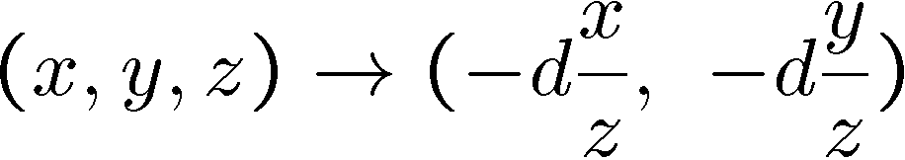
Modeling projection
Distant objects are smaller
Projection equations
  Compute intersection with PP of ray from (x,y,z) to COP
  Derived using similar triangles (on board)
  We get the projection by throwing out the last coordinate:

Slide 26




Homogeneous coordinates
Is this a linear transformation?
Trick: add one more coordinate:
  no—division by z is nonlinear
homogeneous image
coordinates
homogeneous scene
coordinates
Converting from homogeneous coordinates

Slide 27
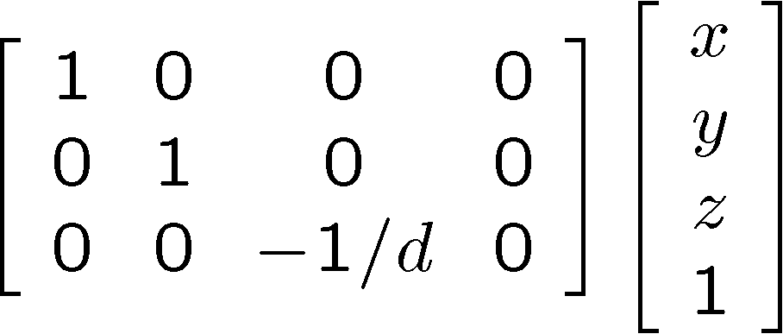
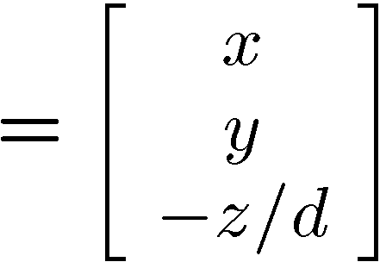
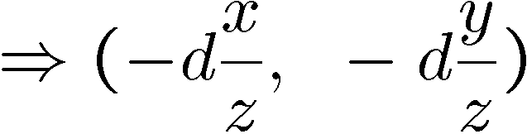
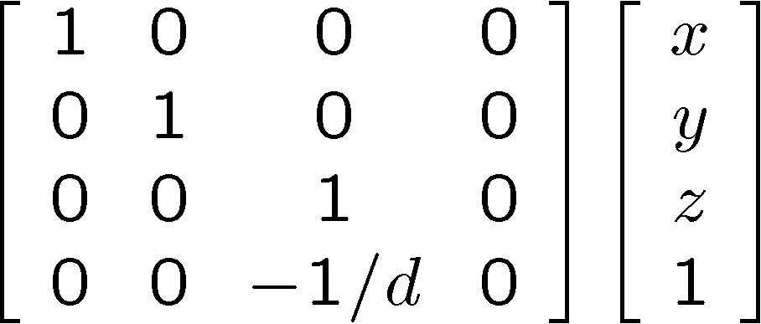
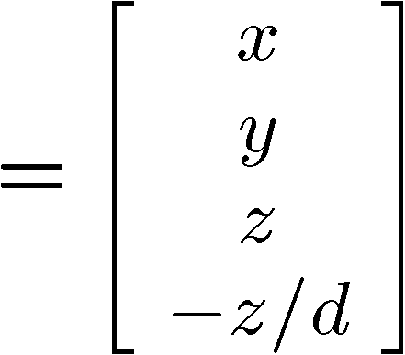
Perspective Projection
Projection is a matrix multiply using homogeneous coordinates:
divide by third coordinate
  This is known as perspective projection
  The matrix is the projection matrix
  Can also formulate as a 4x4 (today’s reading does this)
divide by fourth coordinate

Slide 28
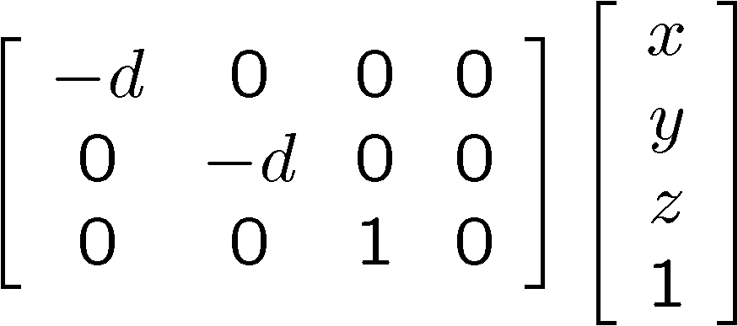
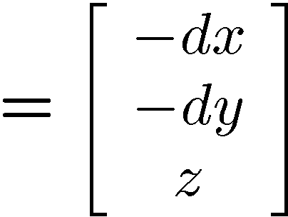
Perspective Projection
How does scaling the projection matrix change the transformation?
Projection matrix is defined “up to a scale”

Slide 29
Geometric properties of perspective projection
Geometric properties of perspective projection
  Points go to points
  Lines go to lines
  Planes go to whole image or half-plane
  Polygons go to polygons
  Angles & distances not preserved
Degenerate cases:
  line through focal point yields point
  plane through focal point yields line

Slide 30
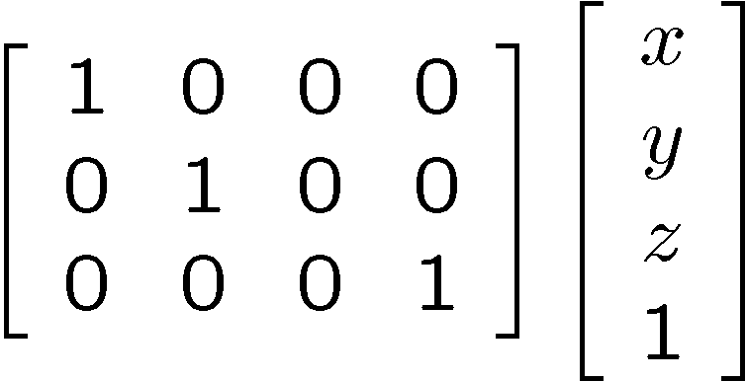
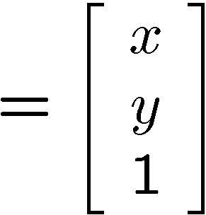

Orthographic projection
Special case of perspective projection
  Distance from the COP to the PP is infinite
  Good approximation for telephoto optics
  Also called “parallel projection”: (x, y, z) → (x, y)
  What’s the projection matrix?
Image
World

Slide 31
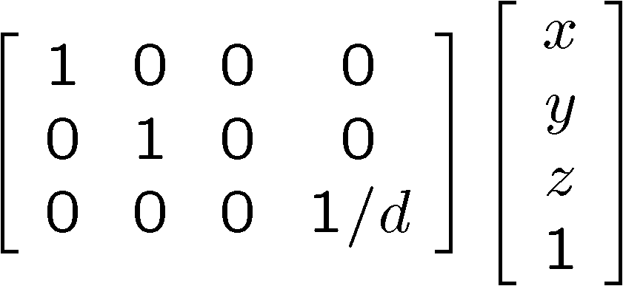
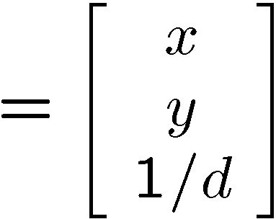

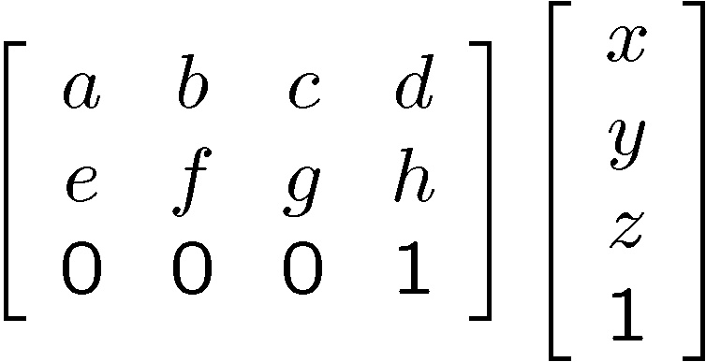
Other types of projection
Scaled orthographic
  Also called “weak perspective”
Affine projection
  Also called “paraperspective”

Slide 32
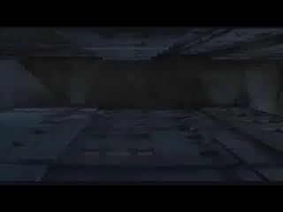
Changes in Perspective
“Dolly Zoom” Effect (Popularized by Alfred Hitchcock)

Slide 33





Camera parameters
A camera is described by several parameters
  Translation T of the optical center from the origin of world coords
  Rotation R of the image plane
  focal length f, principle point (x’_{c}, y’_{c}), pixel size (s_{x}, s_{y})
  blue parameters are called “extrinsics,” red are “intrinsics”
Projection equation
  The projection matrix models the cumulative effect of all parameters
  Useful to decompose into a series of operations
identity matrix
intrinsics
projection
rotation
translation
  The definitions of these parameters are not completely standardized
    especially intrinsics—varies from one book to another

Slide 34
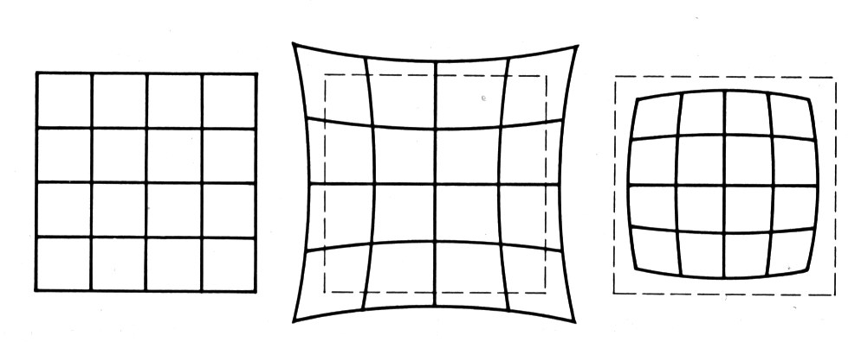
Distortion
No distortion
Pin cushion
Barrel
Radial distortion of the image
  Caused by imperfect lenses
  Deviations are most noticeable for rays that pass through the edge of the lens

Slide 35
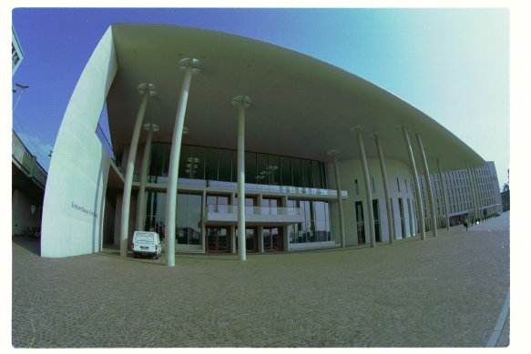
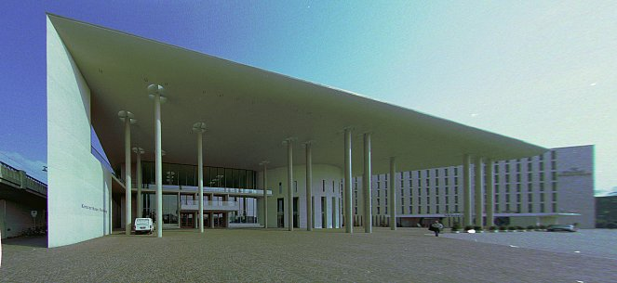
Correcting radial distortion
from Helmut Dersch

Slide 36
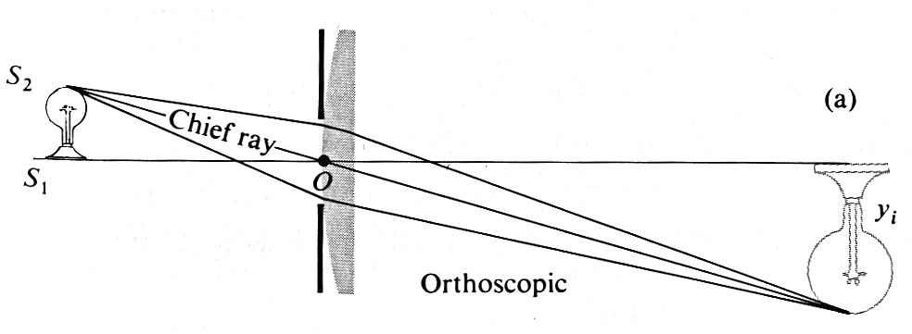
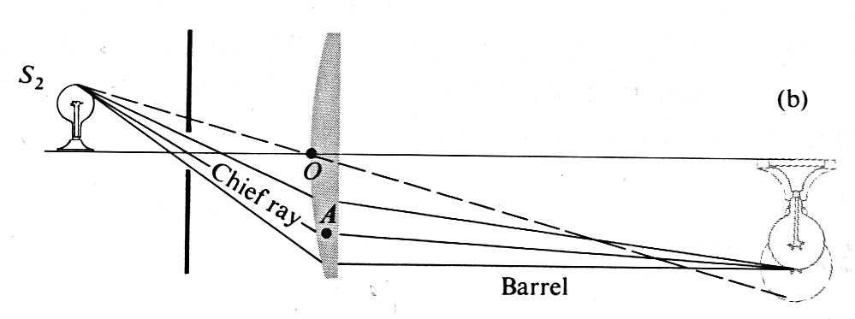
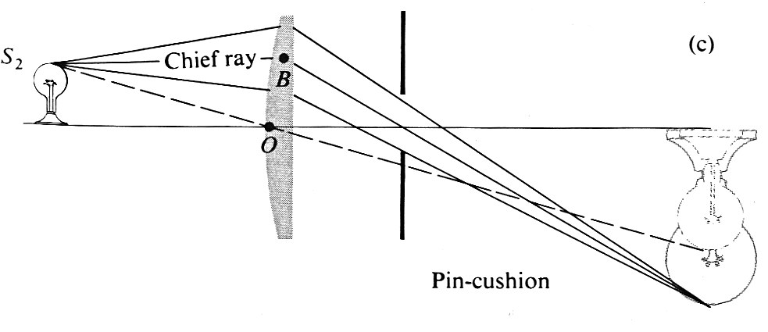
Distortion

Slide 37

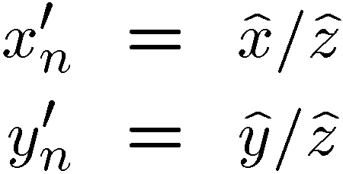
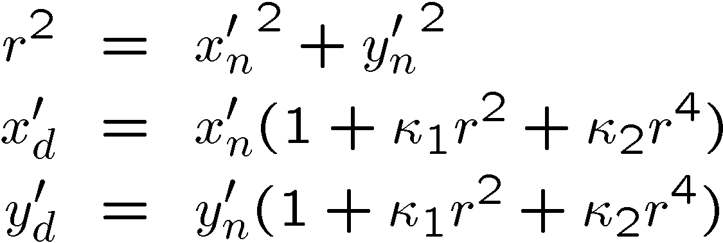
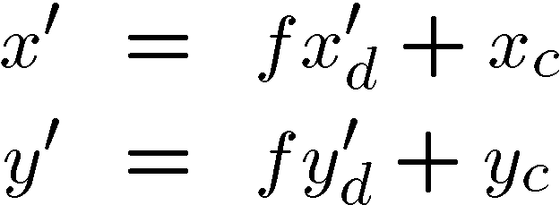
Modeling distortion
Project
to “normalized”
image coordinates
Apply radial distortion
Apply focal length
translate image center
To model lens distortion
  Use above projection operation instead of standard projection matrix multiplication

Slide 38
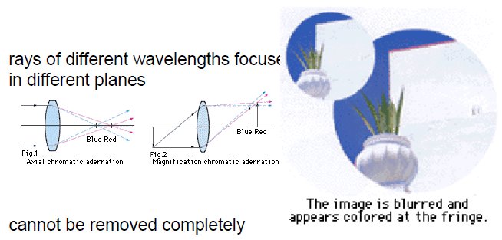
Chromatic Aberration
Rays of different wavelength focus in different planes

Slide 39
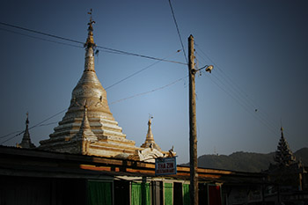
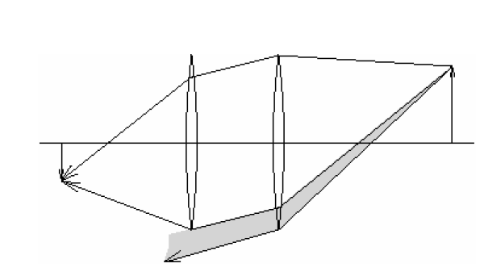
Vignetting
Some light misses the lens or is otherwise blocked by parts of the lens

Slide 40


Other types of lenses/cameras
Tilt-shift images from Vincent Laforet
More examples: http://www.smashingmagazine.com/2008/11/16/beautiful-examples-of-tilt-shift-photography/

Slide 41
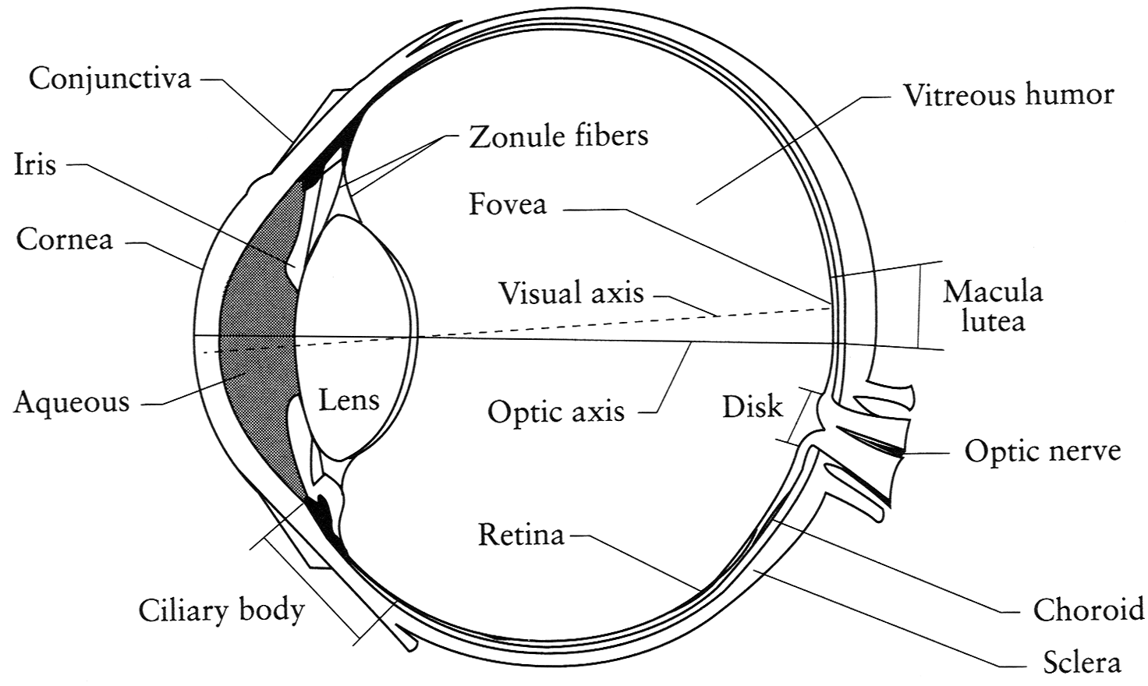
“Human Camera” (The eye)
The human eye is a camera
  Iris - colored annulus with radial muscles
  Pupil - the hole (aperture) whose size is controlled by the iris
  What’s the “film”?
    photoreceptor cells (rods and cones) in the retina
Notes:
Note that the retina is curved

Slide 42

Digital Camera
A digital camera replaces film with a sensor array
  Each cell in the array is a Charge Coupled Device
    light-sensitive diode that converts photons to electrons
    other variants exist: CMOS is becoming more popular
    http://electronics.howstuffworks.com/digital-camera.htm

Slide 43
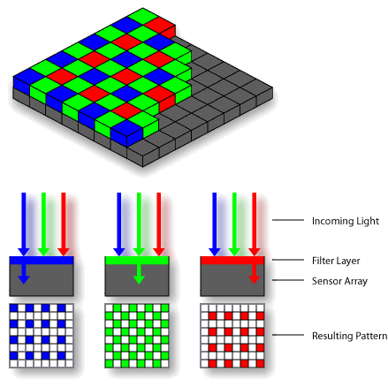
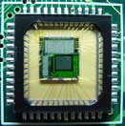

How do they work?
Basic process:
  photons hit a detector
  the detector becomes charged
  the charge is read out as brightness
Sensor types:
  CCD (charge-coupled device)
  CMOS

Slide 44
Issues with digital cameras
Noise
    big difference between consumer vs. SLR-style cameras
    low light is where you most notice noise
Compression
    creates artifacts except in uncompressed formats (tiff, raw)
Color
    color fringing artifacts from Bayer patterns
Blooming
    charge overflowing into neighboring pixels
In-camera processing
    oversharpening can produce halos
Interlaced vs. progressive scan video
    even/odd rows from different exposures
Are more megapixels better?
    requires higher quality lens
    noise issues
More info online, e.g.,
http://electronics.howstuffworks.com/digital-camera.htm
http://www.dpreview.com/

