Slide 1
Internet Advertising
UW CSE454
10/28/10
Mike Mathieu
mike@frontseat.org

Slide 2
I know I’m wasting half of my ad budget. I just don’t know which half.

Slide 3
2010 Global Ad Spend
$448 Billion

Slide 4
Industry Structure
$$$$$
Media
$$
Audience
Advertiser
$
$$$
Ad

Slide 5
The Great Divide
Brand
Direct Response
Emotions
Indirect benefits
Banners, TV, stadiums
Transactions
Gross profits
Search, coupons, 1-800, radio, mail

Slide 6
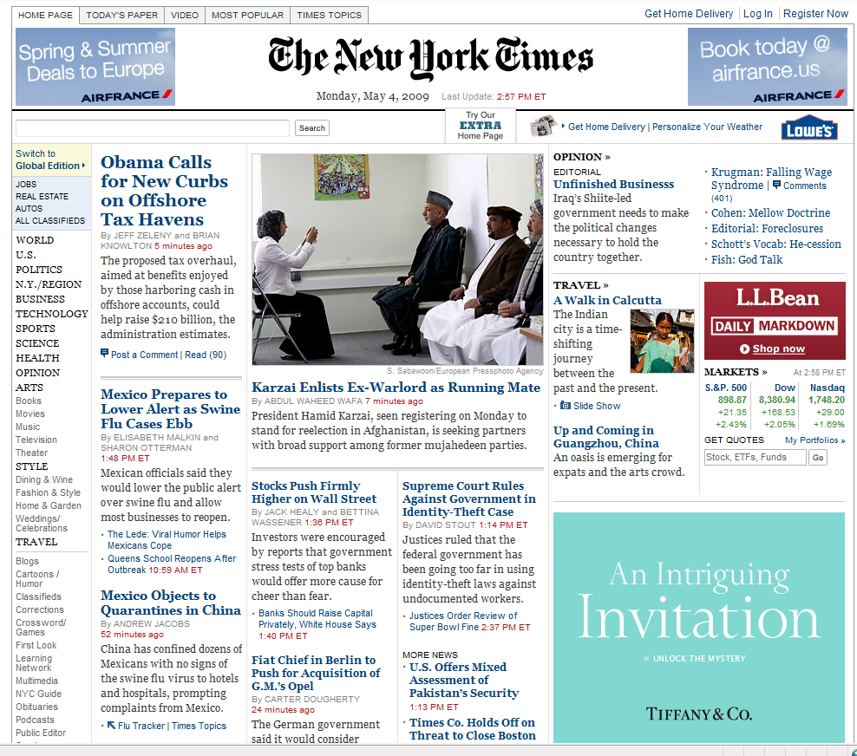
Notes:
Q: Where are the ads?

Slide 7
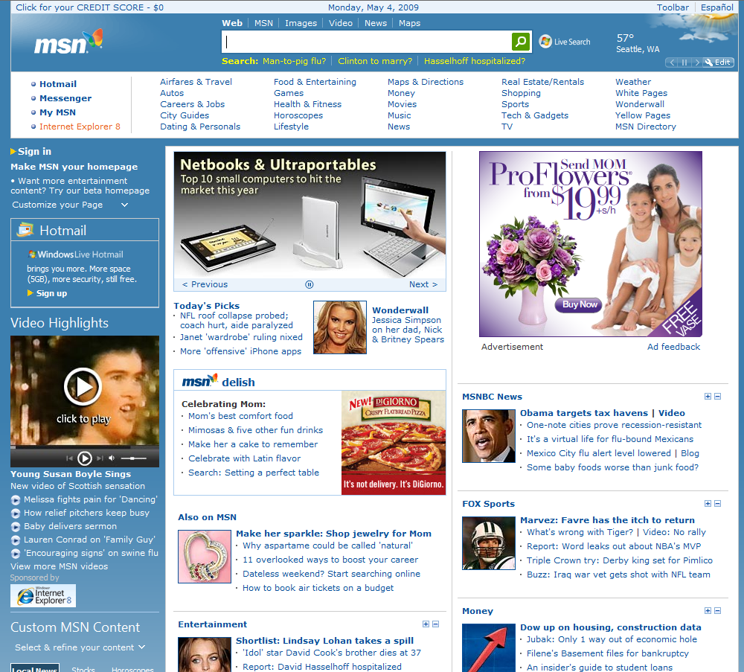
ü
ü
ü
ü
ü
ü
ü
ü
ü
ü
ü
ü
ü
ü
ü
ü
Notes:
Q: Where are the ads?
16 link ads – all direct response
27 more below the fold

Slide 8
Conversion Funnel
Ad Impressions
Clicks
Conversions
Revenue

Slide 9
Monetizing Traffic
TRAFFIC
LANDING PAGES
$ per Transaction
Conversion Rate
Search-Paid
Search-Free
Affiliates
Display Ads
Syndication
Email
Mobile
Offline
Gross Margin
CTR
CR x CPA = RPV

Slide 10
Share of Voice Costs $$$
Cost Per Action
0%
100%
Reach

Slide 11
Conversion Potential vs. Price

Slide 12
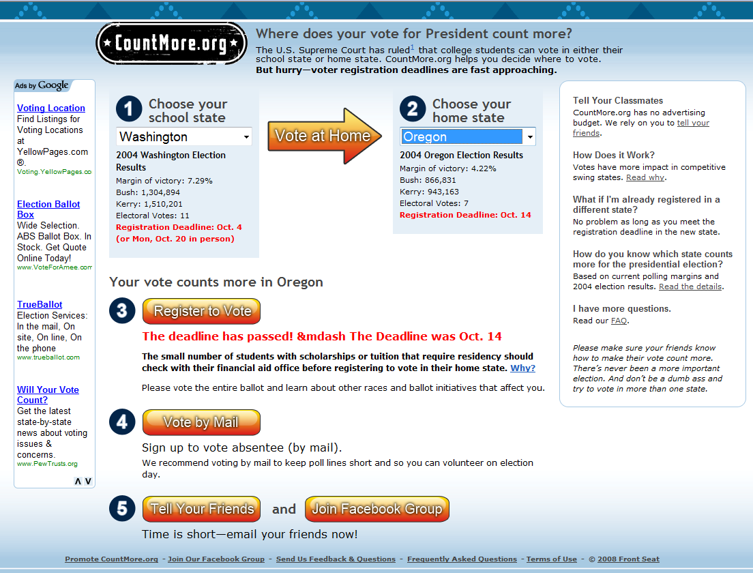
Real World Example

Slide 13

Real World Example
Impressions
4.4M
Clicks
2078
RefSrc on URL
Drop cookie
Pass RefSrc upon conversion
Match with ad spend
Calculate CPA
RegClick
69
Registrations
29
CTR=0.0469%
CPC=$0.65
eCPM=$0.31
CPRegClick=$19.69
CPReg=$46.76

Slide 14
Bid Management
Term | Clicks | CPC | Pos | CR | Leads | CPA | AvgPrice | Revenue | Spend | GM
Nursing School | 5,000 | $1.00 | 1 | 5% | 250 | $20.00 | $7.50 | $1,875 | $5,000 | -63%
Nursing Schools | 5,000 | $2.00 | 3 | 20% | 1,000 | $10.00 | $30.00 | $30,000 | $10,000 | 200%
Total | 10,000 | $1.50 | 2 | 12.5% | 1,250 | $12.00 | $25.50 | $31,875 | $15,000 | 113%
Optimized | 8,000 | $2.43 | 1 | 22% | 1,760 | $11.05 | $30.00 | $52,800 | $19,440 | 172%

Slide 15
Industry Structure
$$$$$
Media
$$
Audience
Advertiser
$
$$$
Ad

Slide 16
Online Advertising Risks
Revenue Share
Cost Per Action (CPA)
Cost Per Click (CPC)
Cost Per Impression (CPM)
Subscription / Sponsorship
Publisher
Balance of Risk
Advertiser
Notes:
GroupOn on the left
NYTimes on the right

Slide 17
RPV Optimization:
Problems with Sort by CPC
Example Term: "mba"
Ad Title | Univ. of Phx: Online MBA | Univ. of Washington MBA
Ad Body | 100% online university. Fully accredited. | Foster School of business. Top 30 ranked.
CPC | $10.00 | $0.50
CTR | 0.01% | 4%
Position | #1 | #10
RPV | $0.0010 | $0.0200

Slide 18
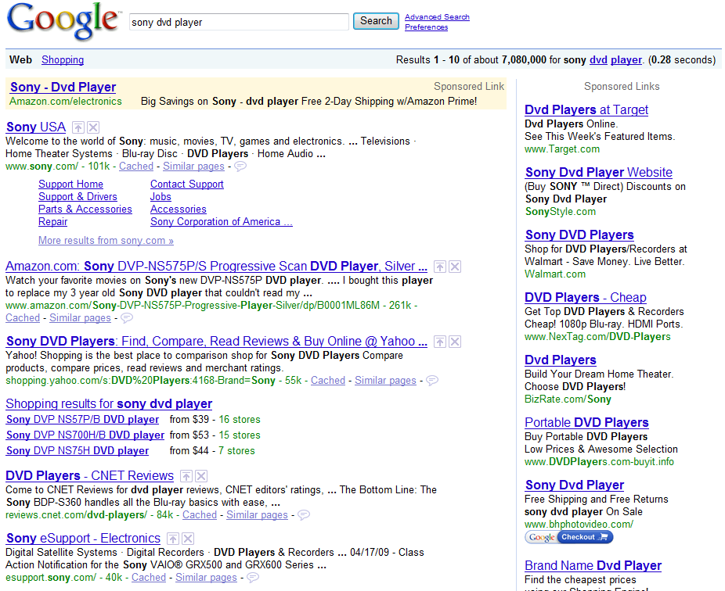
RPV Optimization
Sort by (CPC_Bid x CTR)
Notes:
Enables fully self-serve ads

Slide 19
Keyword Opacity
 | Impr | CTR | Clicks | CPC | CR | Leads | CPA | Spend
Nursing School | 100,000 | 5% | 5,000 | $1.00 | 5% | 250 | $20.00 | $5,000
Nursing Schools | 10,000 | 50% | 5,000 | $2.00 | 20% | 1,000 | $10.00 | $10,000
Total | 110,000 | 9% | 10,000 | $1.50 | 12.5% | 1,250 | $12.00 | $15,000
MatchDriver | 110,000 | 9% | 10,000 | $2.00 | 12.5% | 1,250 | $16.00 | $20,000

Slide 20
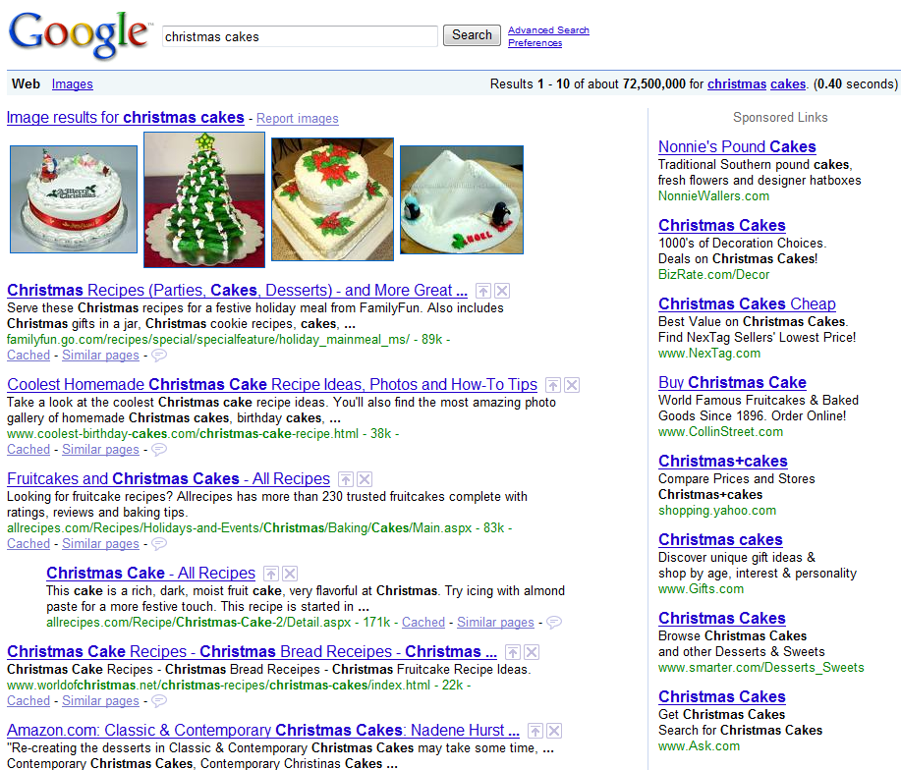
Landing Page Analysis
What?? No “Christmas”

Slide 21
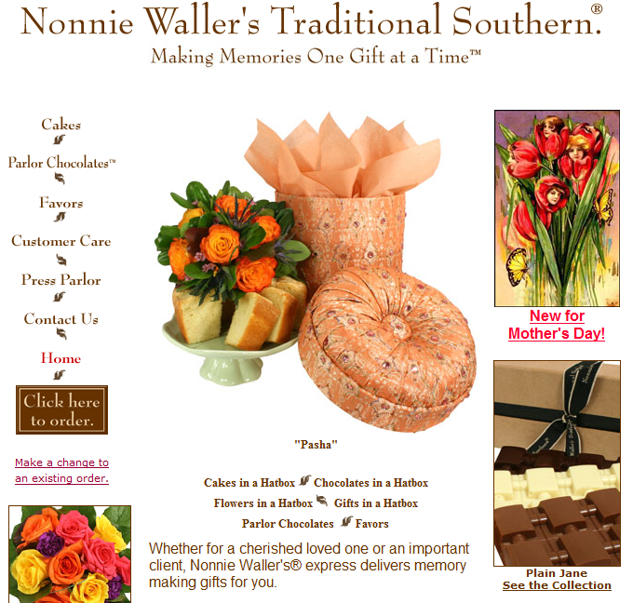
Landing Page Analysis
No “Christmas” here either!

Slide 22
Industry Structure
$$$$$
Media
$$
Audience
Advertiser
$
$$$
Ad

Slide 23
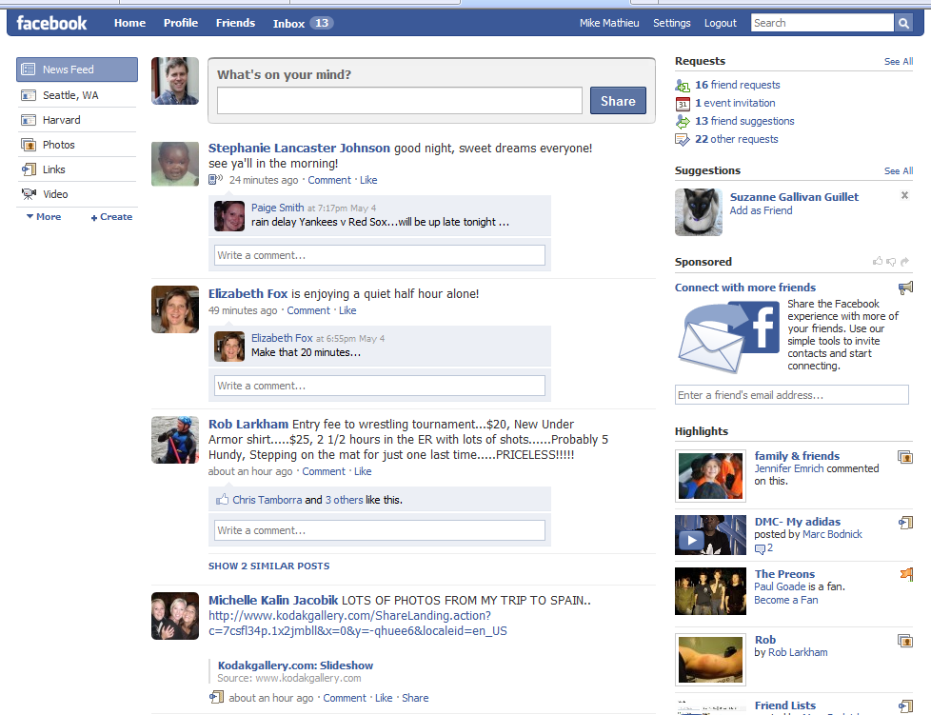
End Users
Don’t bug me
Unless I like what
you have to offer

Slide 24
Better Matching
Context detection
  GPS, location
  App vs. content
  In-game
  Info seeker vs. transactor
  Calendars/schedules/events
  Social networks/status
  Twitter - now
  Behavioral – esp. w/knowledge of specific site behaviors
  Contextual
Privacy
  Google “AOL search data”

Slide 25
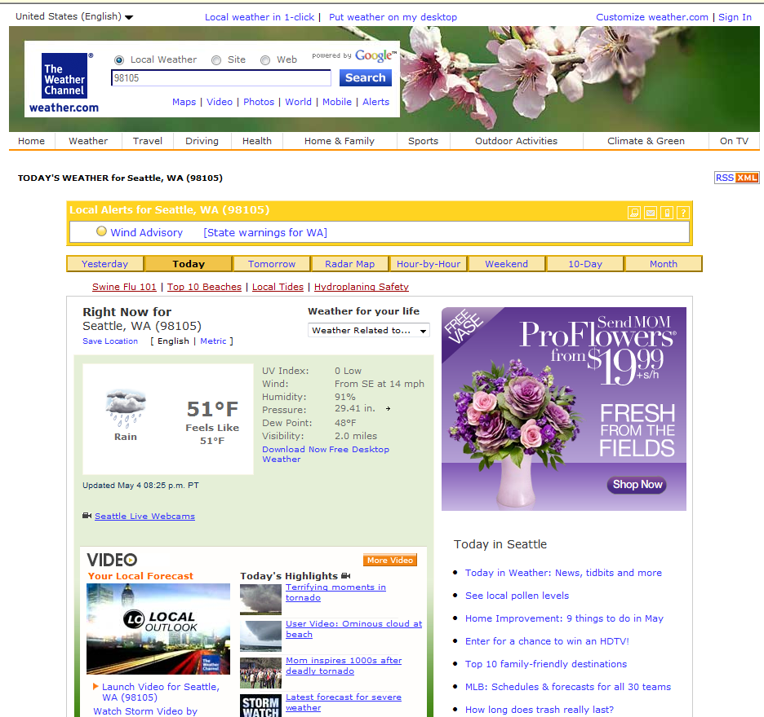
Context?
Flowers
Mentos gum
Trial Prep
Credit score
Cosmetics
Hampton Inns
WeightWatchers
Vacation Home Rentals
Home Depot
Web Hosting
WebMD
Colon Cleanse – Warning
My Teeth Aren’t Yellow
Classmates.com

Slide 26
Testing

Slide 27
Testing

Slide 28
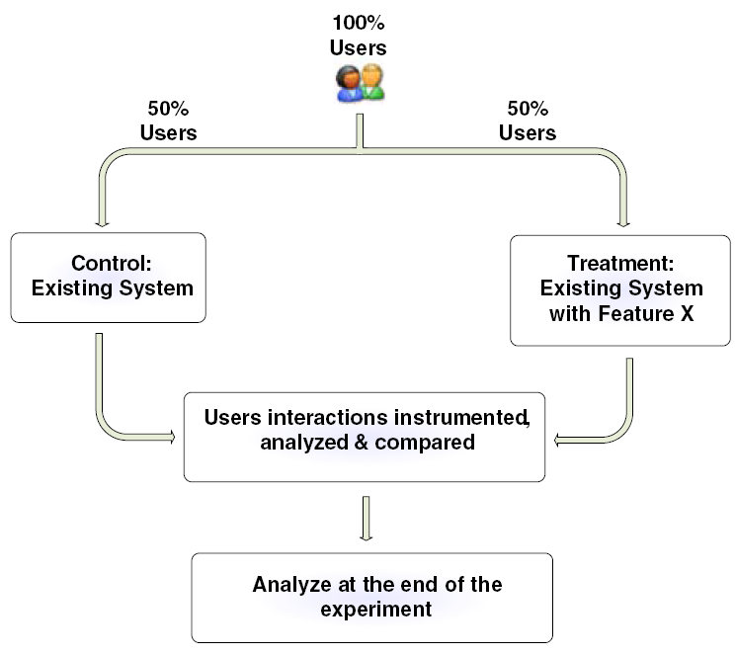
A/B Split Test

Slide 29
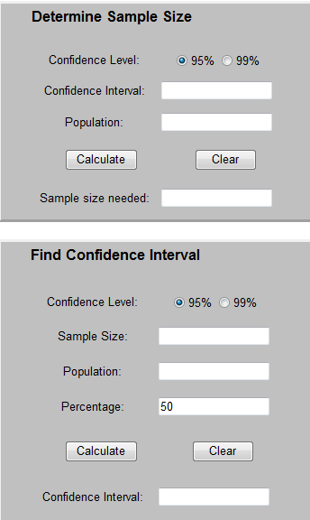
Testing
Sample Size, margin of error, confidence
x = Z(^{c}/₁₀₀)²r(100-r)
n = ^{N x}/_{((N-1)E}² _{+ x)}
E = Sqrt[^{(N - n)x}/_{n(N-1)}]

Slide 30
Sample Size Problems
So many ideas, so little to sample…
  Disproportionate advantage to scale
Multivariate testing
  Taguchi Method
    Method for calculating signal-to-noise ratio of different parameters in an experimental design
    Allows optimization with A/B test of each cross-product

Slide 31
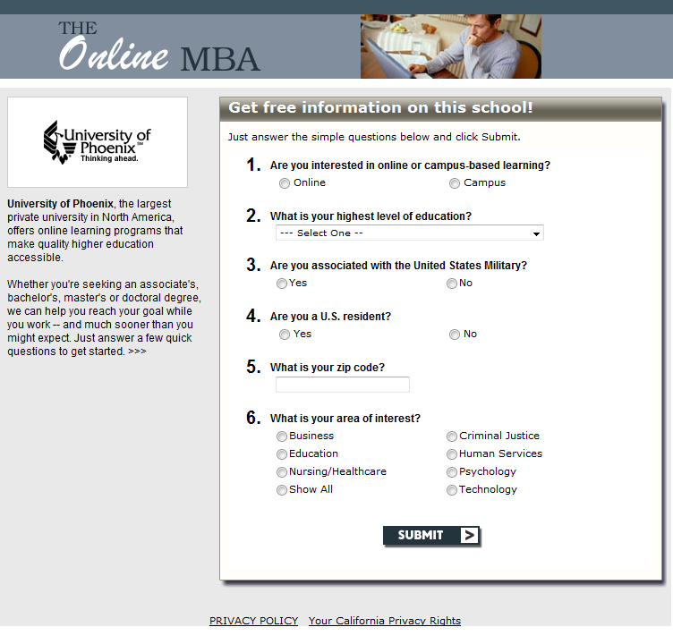
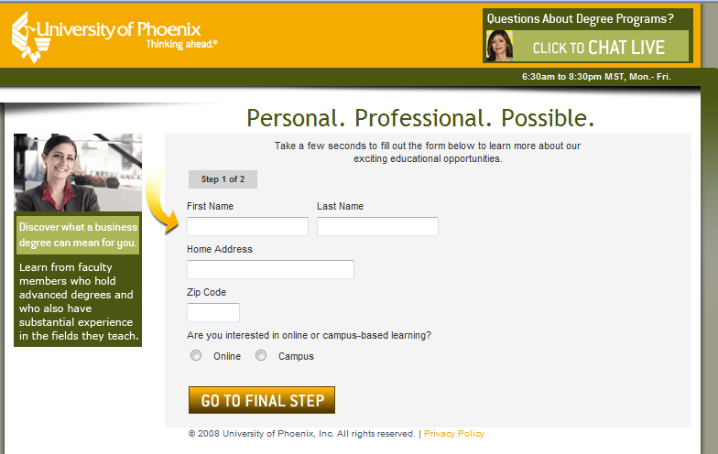
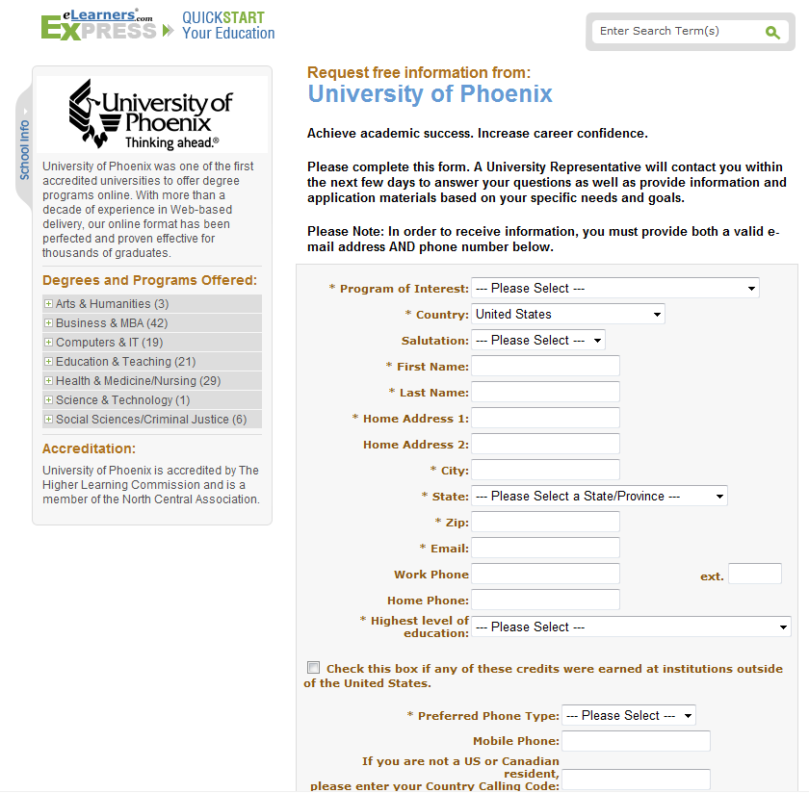

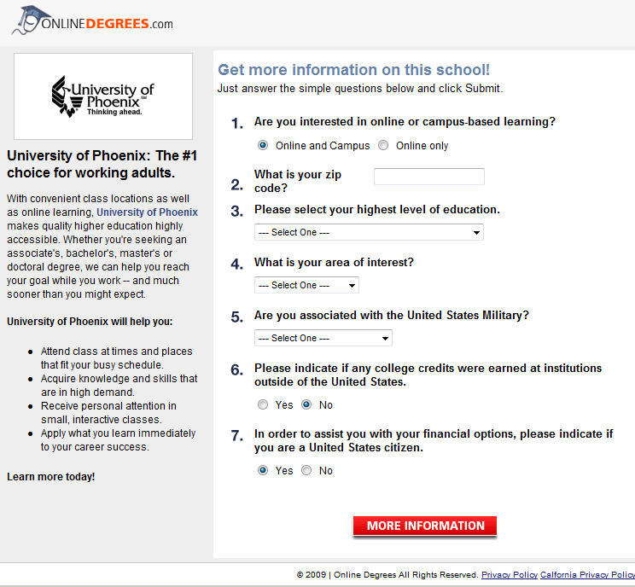
Testing

Slide 32
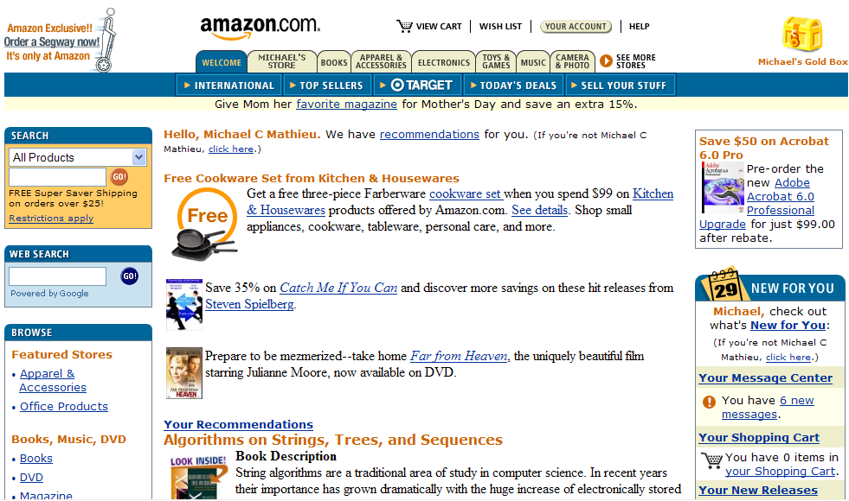
Repetition

Slide 34
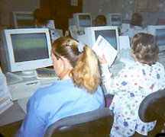


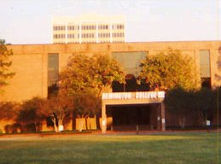
Professional Photos
Before
After
We observed an immediate 30% increase in conversion rates

Slide 35
Fact Sheet Design
Existing Schools (n=1,428) | CR
Best | 51.1%
Worst | 0.4%
Average | 11.6%
Test | # Schools | CR Lift
Professional photo | 1 | 30%
More RFI buttons | 3 | 21%
Marketing voice, more programs listed | 1 | 28%
Photos + Marketing voice, more programs | 1 | 50%

Slide 36
Opportunities Today
Conversions
  Low-RPV
  Waste
  Simplicity
Risk
  Scaling local, hyperlocal
  Data exchanges
  Under-monetized sites
Context

Slide 37
Summary
Conversions
Risk
Context
Testing

