Slide 1
CSE 451: Operating Systems Winter 2015 Module 25 Virtual Machine Monitors
Mark Zbikowski
mzbik@cs.washington.edu
Allen Center 476
Notes:
1

Slide 2
What do VMMs enable?
Running multiple operating systems (called “guest OS’s”) and their applications on a single physical computer, as if each were running on its own private virtual computer
Efficient – mostly direct execution, rather than simulation
Contemporary examples
VMware
Microsoft’s VirtualPC / VirtualServer
Parallels (Mac)
Xen

Slide 3
VMM structure
Virtual Machine = Guest OS + apps
Virtual Machine = Guest OS + apps
Windows
applications
applications
Linux
virtual machine monitor
hardware

Slide 4
Basic ideas
Guest OS runs in user mode
When any kind of interrupt / exception / trap occurs, we’ll end up in the VMM rather than the guest OS
VMM simulates state changes that would have been made by the hardware, then restarts VM at the guest OS handler address
E.g., stuffs the saved PC where the architecture says it should be
When the guest OS tries to execute a privileged instruction
VMM gets control, simulates effect of privileged instruction
VMM knows that guest OS was in virtual kernel mode so the attempted operation is OK

Slide 5
VMM History
Conceived by IBM in the late 1960’s
CP-40, CP-67, VM/360
Sold continuously since then
Used first for OS development and debugging, then for time sharing (multiple single-user OS’s, plus a few single-job batch OS’s), eventually for server consolidation
Batch processing
OS
Time sharing
OS
VM/370
System 370 Machine

Slide 6
VMMs Today
OS development and debugging
Software compatibility testing
Running software from another OS
Or, OS version
Virtual infrastructure for Internet services (server consolidation)
Examples
Run Windows on your Mac, or MacOS on your PC
VMware in CSE 451
Amazon’s Elastic Compute Cloud (EC2)

Slide 7
Comparing the Unix and VMM APIs
 | UNIX | VMM
Storage | File system | (virtual) disk
Networking | Sockets | (virtual) Ethernet
Memory | Virtual Memory | (virtual) Physical memory
Display | /dev/console | (virtual) Keyboard, display device

Slide 8
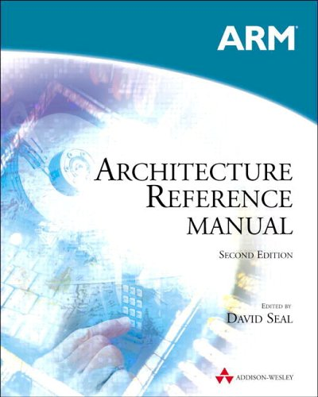
Possible Implementation Strategy: Complete machine emulation
The VMM implements the complete hardware architecture in software
while(true) {
Instruction instr = fetch();
// emulate behavior in software
instr.emulate();
}
Drawback: This is really slow

Slide 9
Practical alternative: VMM gets control on privileged instructions only
Treat guest operating systems (and their apps) like an application
Guest OS (and its apps) run in user mode
Most instructions execute natively on the CPU
Privileged instructions are trapped and emulated
OS + apps
OS + apps
OS + apps
V i r t u a l m a c h i n e s
. . .
loads,stores,
branches,
ALU operations
Physical hardware
machine halt,
I/O instructions,
MMU manipulation,
disabling interrupts
VMM
Notes:
Systems lore: make the common case fast, and the uncommon case correct

Slide 10
Virtualizing the User/Kernel Boundary
Both the guest OS and applications run in (physical) user-mode
For each virtual machine, the VMM keeps a software mode bit:
During a system call, switch to “kernel” mode
On system call return, switch to “user” mode
What does the VMM do if a VM executes a privileged instruction while in virtual user mode?
What does the VMM do if a VM executes a privileged instruction while in virtual kernel mode?

Slide 11
Tracing Through a File System Read
Application
Guest OS
VMM
Hardware
read() syscall
trap detected
trap handler;
change VM
to “kernel” mode
trap handler
handle read syscall
read from disk()
priv insc. detected
trap handler;
emulate I/O
.
.
.
.
Notes:
Use the layer of indirection to provide new services. For example, we could provide cryptographic storage, even if the OS/ file system do not implement this behavior

Slide 12
Questions, to clarify …
What if the I/O could be handled from the buffer cache?
Does the VMM handle a VM’s I/O request synchronously?
There are a zillion different types of disks (and networks and …) … Do the device drivers for these reside in the guest OS or in the VMM?

Slide 13
A possible “gotcha”
All instructions that modify hardware state must be privileged (so that VMM can get control, modify the virtual hardware state for that guest, and not modify the physical hardware state)
Example: Suppose the ERET instruction (return to a user process after handling an exception) is not privileged
ERET sets the PC to the saved PC, and sets CPU mode to user
There doesn’t seem to be a reason to prevent user processes from doing this (even if there’s no reason for them to want to)
Why would this be a problem for a VMM?

Slide 14
x86
Conditions for an architecture to be virtualizable were defined in 1974
x86 architecture did not satisfy these conditions!
Many reasons, but most of them stem from instructions that have different behavior in user mode and kernel mode, and that don’t trap when executed in user mode
Approach: binary re-writing
When a code page is loaded, scan it, looking for offending instructions
Patch these to cause a fault
Remember the instruction that used to be there

Slide 15
Other approaches
Hardware: Both Intel (VT-x) and AMD (AMD-V) have developed virtualization extensions to the architecture (starting ~2006)
Paravirtualization: Export a slight modification of the hardware; port the OS to this new hardware

Slide 16
Memory
VMM’s also utilize memory protection (in addition to privileged instructions) to do their job
Have not described how memory is virtualized by a VMM, creating “virtual physical memory” for the guest OS’s
Approach involves the VMM futzing with the page tables in the guest OS’s

