Slide 1
CSE 451: Operating Systems Winter 2015 Module 16 BSD UNIX Fast File System
Mark Zbikowski
mzbik@cs.washington.edu
Allen Center 476
Notes:
1

Slide 2
File system implementations
We’ve looked at disks
We’ve looked at file systems generically
We’ve looked in detail at the implementation of the original Bell Labs UNIX file system
a great simple yet practical design
exemplifies engineering tradeoffs that are pervasive in system design
Now we’ll look at some more advanced file systems
First, the Berkeley Software Distribution (BSD) UNIX Fast File System (FFS)
enhanced performance for the UNIX file system
at the heart of most UNIX file systems today

Slide 3
BSD UNIX FFS
Original (1970) UNIX file system was elegant but slow
poor disk throughput
far too many seeks, on average
Berkeley UNIX project did a redesign in the mid ’80’s
McKusick, Joy, Fabry, and Leffler
improved disk throughput, decreased average request response time
principal idea is that FFS is aware of disk structure
it places related things on nearby cylinders to reduce seeks

Slide 4
Recall the UNIX disk layout
Boot block
can boot the system by loading from this block
Superblock
specifies boundaries of next 3 areas, and contains head of freelists of inodes and file blocks
i-node area
contains descriptors (i-nodes) for each file on the disk; all i-nodes are the same size; head of freelist is in the superblock
File contents area
fixed-size blocks; head of freelist is in the superblock
Swap area
holds processes that have been swapped out of memory

Slide 5
Recall the UNIX block list / file content structure
directory entries point to i-nodes – file headers
each i-node contains a bunch of stuff including 13 block pointers
first 10 point to file blocks (i.e., 512B blocks of file data)
then single, double, and triple indirect indexes
0
…
1
…
…
10
…
11
12
…
…
…

Slide 6
UNIX FS data and i-node placement
Original UNIX FS had three major performance problems:
data blocks are allocated randomly in aging file systems
blocks for the same file allocated sequentially when FS is new
as FS “ages” and fills, it needs to allocate blocks freed up when other files are deleted
deleted files are essentially randomly placed
so, blocks for new files become scattered across the disk!
data blocks are relatively small
reduces fragmentation, but exacerbates the problem above
i-nodes are allocated far from blocks
all i-nodes at beginning of disk, far from data
traversing file name paths, manipulating files, directories requires going back and forth from i-nodes to data blocks
All three of these generate many long seeks!
gets worse as disks get bigger

Slide 7
FFS: Cylinder groups
FFS addressed the first and third problems using the notion of a cylinder group
disk is partitioned into groups of cylinders
data blocks from a file are all placed in the same cylinder group
files in same directory are placed in the same cylinder group
i-node for file placed in same cylinder group as file’s data
Introduces a free space requirement
to be able to allocate according to cylinder group, the disk must have free space scattered across all cylinders
in FFS, 10% of the disk is reserved just for this purpose!
good insight: keep disk partially free at all times!
this is why it may be possible for df to report >100% full!

Slide 8
FFS: Increased block size, fragments
The original UNIX FS had 512B blocks
even more seeking
small maximum file size ( ~1GB maximum file size)
Then a version had 1KB blocks
still pretty puny
FFS uses a 4KB blocksize
big improvement in disk throughput - fewer seeks when transferring large files
allows for very large files (4TB) – exponential impact of indirect index
but, introduces internal fragmentation
on average, each file wastes 2K!
why?
worse, the average Unix file size is only about 1K!
why?
fix: introduce “fragments”
1KB pieces of a block

Slide 9
FFS: Aggressive File Buffer Cache
9
Exploit locality by caching file blocks in memory
the cache is system wide, shared by all processes
even a small (4MB) cache can be very effective (why?)
many FS’s “read-ahead” into buffer cache
What about writes?
some apps assume data is on disk after write
either “write-through” the buffer cache
or “write-behind”
maintain queue of uncommitted blocks, periodically flush. Unreliable!
NVRAM: write into battery-backed RAM. Expensive!
LFS, JFS: we’ll talk about this soon!
Buffer cache issues:
competes with VM for physical frames
integrated VM/buffer cache?
need replacement algorithms here
LRU usually

Slide 10
FFS: Awareness of hardware characteristics
Original UNIX FS was unaware of disk parameters
FFS parameterizes the FS according to disk and CPU characteristics
e.g., account for CPU interrupt and processing time, plus disk characteristics, in deciding where to lay out sequential blocks of a file, to reduce rotational latency

Slide 11
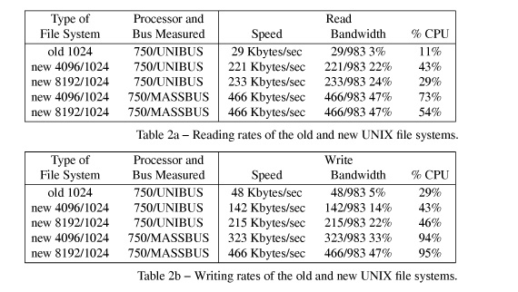
FFS: Performance
This was a long time ago – look at the relative performance, not the absolute performance!
(983KB/s is theoretical disk throughput)
(block size / fragment size)
(CPU maxed doing block allocation!)

Slide 12
FFS: Faster, but less elegant (warts make it faster but ugly)
Multiple cylinder groups
effectively, treat a single big disk as multiple small disks
additional free space requirement (this is cheap, though)
Bigger blocks
but fragments, to avoid excessive fragmentation
Aggressive File Buffer Cache
Aware of hardware characteristics
ugh!

