Slide 1
ARM Aarch64 JOS
Dylan Johnson
Notes:
What is ARM?
- Semiconductor and software design company
- Design processors that are used in
- phone
- fancy fridge
- car keys

Slide 2
What is Aarch64?
Notes:
What Aarch64 is to ARM what x86_64 is to Intel.
- CISC vs RISC
- Load-store arch
- Instructions conditionally executed
- 3 operands

Slide 3
Exception Levels

Slide 4
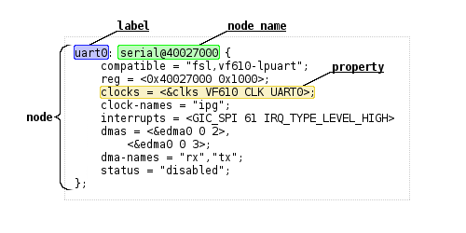
Booting - DTB
Notes:
X86_64 – Multiboot info
ARM – DTB
Libfdt – used for getting uart address

Slide 5
Virtual Memory
64KB Page Size
2 Translation Levels

