Slide 1
CSE 451: Operating Systems
Section 9:
Storage; networks

Slide 2
Outline
Virtual memory
Secondary storage
File systems
RPC
Networks

Slide 3
Virtual memory
Process’
page table
Process’ VM:
Physical memory:
Another process
page frame #
Disk
(slide from Chernyak Fall 2009)
Notes:
(Inspired from wikipedia)
Question: How can we use paging to set up sharing of memory between two processes?

Slide 4
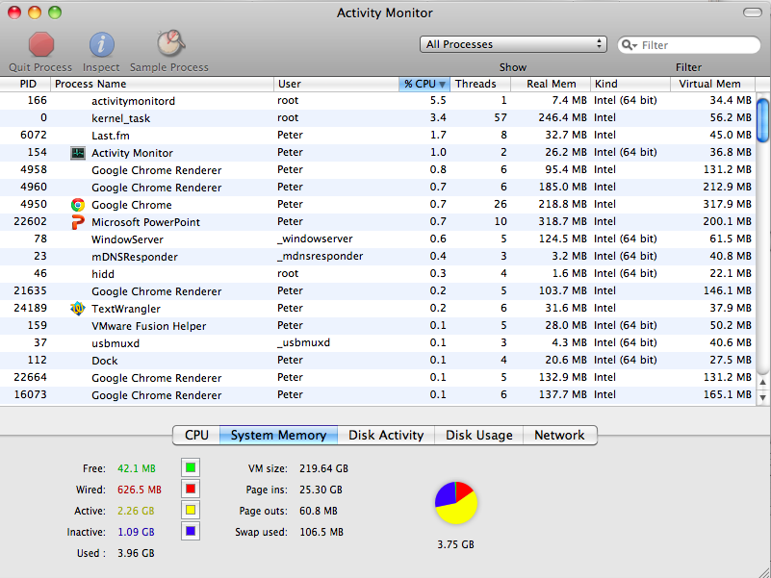
Notes:
Free: not being used
QUESTION: should I be concerned if I don’t have any free memory?
No; should be concerned if I do have a lot of free memory (O.S. isn’t utilizing it!)
Wired: can’t be moved to Mac’s hard drive; pinned in memory
Examples: operating system itself; virtual machines
Active: recently used, kept in-memory for active applications
Inactive: recently used, but available for other uses (e.g. from a closed application)

Slide 5
Page replacement algorithms
Belady’s algorithm
Replace the page that’s going to be needed farthest in the future
FIFO (First In/First Out)
Replace the oldest page with the one being paged in
Not very good in practice, suffers from Belady’s Anomaly
Second-chance (modified FIFO)
FIFO, but skip referenced pages
VAX/VMS used this
Random
Better than FIFO!
NFU (Not Frequently Used)
Replace the page used the least number of times
LRU (Least Recently Used)
Replace the least-recently used page
Works well but expensive to implement
LRU Clock (Modified LRU)
Replace the least recently used page, with a hard limit on the max time since used
Notes:
“Belady’s anomaly: there are reference strings for which the fault rate increases when the process is given more physical memory.”
Linux 2.4 kernel uses NFU with aging… http://www.surriel.com/system/files/linux24-vm-freenix01.pdf

Slide 6
Example of Belady’s anomaly
Sequence of page requests:
3 | 2 | 1 | 0 | 3 | 2 | 4 | 3 | 2 | 1 | 0 | 4
3 | 3 | 3 | 0 | 0 | 0 | 4 | 4 | 4 | 4 | 4 | 4
 | 2 | 2 | 2 | 3 | 3 | 3 | 3 | 3 | 1 | 1 | 1
 |  | 1 | 1 | 1 | 2 | 2 | 2 | 2 | 2 | 0 | 0
3 physical page frames:
Page faults (in red): 9
Notes:
“Belady’s anomaly: there are reference strings for which the fault rate increases when the process is given more physical memory.”

Slide 7
Example of Belady’s anomaly
Sequence of page requests:
3 | 2 | 1 | 0 | 3 | 2 | 4 | 3 | 2 | 1 | 0 | 4
3 | 3 | 3 | 3 | 3 | 3 | 4 | 4 | 4 | 4 | 0 | 0
 | 2 | 2 | 2 | 2 | 2 | 2 | 3 | 3 | 3 | 3 | 4
 |  | 1 | 1 | 1 | 1 | 1 | 1 | 2 | 2 | 2 | 2
 |  |  | 0 | 0 | 0 | 0 | 0 | 0 | 1 | 1 | 1
4 physical page frames:
Page faults (in red): 10
Notes:
“Belady’s anomaly: there are reference strings for which the fault rate increases when the process is given more physical memory.”

Slide 8
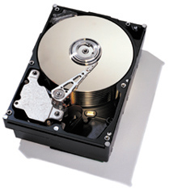
Linux file system layers
Application
User
Files, directories
Kernel
VFS
Inodes, direntries
ext2
ext4
XFS
NFS
Blocks
Buffer cache
Disk drivers
Network
Notes:
filesystem demo commands: cat /proc/filesystems; df -hT
Shows which file system modules are loaded and which file systems are mounted
ext2 and VFS: http://tldp.org/LDP/tlk/fs/filesystem.html

Slide 9
Linux buffer cache
Buffer cache: just an area of memory
cat /proc/meminfo
Caches disk blocks and buffers writes
File read() checks for block already in buffer cache
If not, brings block from disk into memory
File write() is performed in memory first
Data later written back to disk (when? By who?)
Kernel writes block back to disk at a convenient time (flush threads), or synchronously if user requests it
Notes:
Buffer cache: introduced in Berkeley FFS
Tricky question: what’s the difference between the buffer cache and the page cache??
http://www.quora.com/Is-pdflush-poorly-designed-in-Linux: “pdflush, short for page dirty flush, was replaced by the flusher threads in Linux kernel version 2.6.32.”
Also: http://lwn.net/Articles/326552/

Slide 10
Is flash the answer to all of our storage problems?
Do solid state flash drives obviate the need for the buffer cache?
NAND flash technology faces scaling challenges that may be insurmountable
As density / capacity increases, all other important characteristics are degraded: latency, write endurance, energy efficiency
http://www.theregister.co.uk/2012/02/21/nand_bleak_future/
http://cseweb.ucsd.edu/users/swanson/papers/FAST2012BleakFlash.pdf
Notes:
No: time to read/write flash is still orders of magnitude greater than DRAM
http://www.theregister.co.uk/2012/02/21/nand_bleak_future/
http://cseweb.ucsd.edu/users/swanson/papers/FAST2012BleakFlash.pdf

Slide 11
Project 3: tools
hexdump
dumpe2fs
valgrind
mkFilesysFile.sh

Slide 12
Project 3: tips
Use the ext2fs.h and ext2_types.h header files
Most structs are already defined for you
Don’t use absolute values in your code
Use constants from the header files
Look up values in the superblock, then calculate other values that you need
Notes:
Never, ever use absolute values in code. Use size constants defined in header file, or define them yourself in case they should be changed later.
How to perform bit operations??

Slide 13
Project 3: tips
fileIOExample.c
Notice that it checks the return value of every system/library call – you must do the same!
Don’t forget to set timestamps of recovered files
Follow the turnin instructions
Don’t change filenames, etc.
Disable debugging printfs before submission
Notes:
How to perform bit operations??

Slide 14
Bit operations
Remember how these operators work in C:
/ % & | << >>
Given an inode number, how do we find the right byte in the inode bitmap?
Hint: use /
Given a byte in the bitmap, how do we check if the inode’s bit is set?
Hint: use %, <<, &
Notes:
Tip: draw things out on paper to help visualize what these operations are doing

Slide 15
Project 3: testing
How will you test your undelete program?
Ideas:
Delete small / large files
Use small / large file systems
mkFilesysFile.sh: the mkfs.ext2 command inside takes many options; your undelete program should still work if basic options are changed!
Notes:
Obvious example of something to change in mkfs.ext2: block-size

Slide 16
Project 3
Questions?

Slide 17
RPC
Remote procedure call: causes a procedure to execute in some other address space
Usually an address space on some other machine
Interface description language (IDL) defines the interface that the server makes available to the client

Slide 18
RPC on Android
Android uses RPC for communication between applications and system components
All on the same device!
Uses all of the standard RPC components:
IDL file
Auto-generated stubs for client, server
Marshalling and unmarshalling of arguments…

Slide 19
Networking design principles
A few key principles:
Layering
Encapsulation
End-to-end principle
All of these apply to operating systems (and elsewhere!) as well
Notes:
Layering: a.k.a. encapsulation?

Slide 20
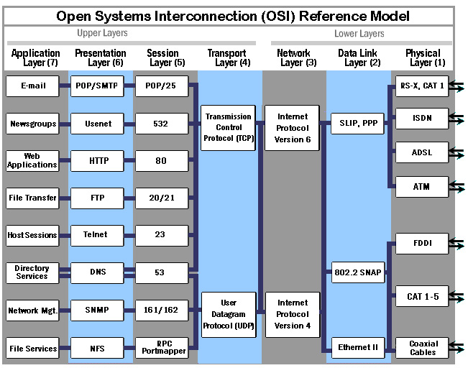

Slide 21
Layering
Internet designers didn’t get it all right the first time
Design for choice
Rigid designs will be broken

Slide 22
End-to-end principle
Danger of putting functionality at lower layers: upper layers won’t need it, but will pay cost anyway
Example: reliability checksums
E2E principle says to move functionality towards upper layers (closer to application)
Other ways of phrasing it:
Smart endpoints, dumb network
Application knows best what it needs

