Slide 1
CSE 451: Operating Systems
Section 7:
Project 2b; Virtual Memory

Slide 2
Project 2a grading
Grades will be sent out later tonight

Slide 3
Debugging threaded programs
What techniques have you used?
printf statements: macros are helpful
#define print_debug(f, a...) do { \
fprintf(stdout, "DEBUG: %lu: %s: " f, \ pthread_self(), __func__, ##a); \
fflush(stdout); \
} while(0)

Slide 4
Debugging threaded programs
Other tools:
gdb
Deadlock vs. corruption
To enable core dumps: ulimit -c unlimited
helgrind? DRD?
MS Visual Studio; Intel Inspector XE; …
What does the textbook say?
We’ve mostly discussed thread correctness; what about thread performance?

Slide 5
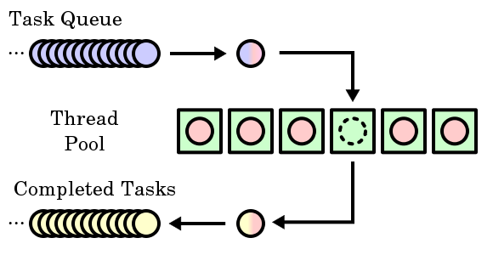
Thread pools
What is the “type” of a task?
What function do the threads run?
Can we make this abstract / generic?
Notes:
Image from http://en.wikipedia.org/wiki/Thread_pool_pattern More info: http://www.ibm.com/developerworks/java/library/j-jtp0730.html

Slide 6
sioux thread pool
struct thread_pool {
queue request_queue;
sthread_cond_t request_ready;
};
struct request {
int next_conn;
};
// New request arrives:
// enqueue request, signal request_ready
// Worker threads:
// dequeue, run: handle_request(request);

Slide 7
Generic thread pool
struct thread_pool {
queue task_queue;
sthread_cond_t work_to_do;
};
typedef void (*work_fn) (void *);
struct task {
work_fn work;
void *arg;
};
// New work arrives:
// enqueue new task, signal work_to_do
// Worker threads:
// dequeue, run: task->work(task->arg);

Slide 8
Thread performance
Where might there be performance bottlenecks with a thread pool?
Where are threads running?
What do threads have to do to access thread pool?
Where is the work queue stored?
Image from: http://www.cis.upenn.edu/~milom/cis501-Fall09/lectures/09_multicore.pdf
Notes:
Image from: http://www.cis.upenn.edu/~milom/cis501-Fall09/lectures/09_multicore.pdf

Slide 9
Synchronization is expensive
Explicit synchronization
Critical sections protected by mutexes, condition variables and queues
Strategies: reduce critical section size; atomic updates / lock-free data structures; RCU; …
Implicit synchronization
Through cache coherence / memory hierarchy
Strategies: partitioning / sharding

Slide 10
Debugging thread performance
How can we debug thread performance?
Intuition?
Profiling tools:
cachegrind / callgrind
Intel VTune Amplifier

Slide 11
sioux web server
Make the web server multithreaded
Create a thread pool
Suggestion: create separate thread_pool.h, thread_pool.c
Wait for a connection
Find an available thread to handle the request
Request waits if all threads busy
Once the request is handed to a thread, it uses the same processing code as before
Use pthreads for parts 4 and 6: we won’t test sioux with sthreads!

Slide 12
Preemption (part 5)
Remember this tip from previous section:
One way to think about preemption-safe thread library:
Disable/enable interrupts in “library” context
Use atomic locking in “application” context
Does locking / unlocking a mutex happen in “library context” or “application context”?

Slide 13
How not to implement mutexes
sthread_user_mutex_lock(mutex)
splx(HIGH);
if (mutex->held) {
enqueue(mutex->queue, current_thread);
schedule_next_thread();
} else {
mutex->held = true;
}
splx(LOW);

Slide 14
How not to implement mutexes
Don’t turn it into a spinlock:
sthread_user_mutex_lock(mutex)
while(atomic_test_and_set(
&(mutex->available))) { }
This is also wrong: where could we get preempted that could lead to deadlock?
sthread_user_mutex_lock(mutex)
while(atomic_test_and_set(
&(mutex->available))) {
enqueue(mutex->queue, current_thread);
schedule_next_thread();
}
Notes:
What if preempted immediately after atomic_test_and_set() returns 1, and other thread clears mutex->available before we enqueue?
For details about these, see cse451_10au_section09.pptx

Slide 15
So how does one implement mutexes?
Need to lock around the critical sections in the mutex functions themselves!
Your struct _sthread_mutex will likely need another member for this
For hints, re-read lecture slides:
Module 7: Synchronization (slide 20 forward)
Module 8: Semaphores
Similar hints apply for condition variables

Slide 16
Project 2b
Any more questions?

Slide 17
Virtual memory
Process’
page table
Process’ VM:
Physical memory:
Another process
page frame #
Disk
How can we use paging to set up sharing of memory between two processes?
(slides from Chernyak Fall 2009)
Notes:
(Inspired from wikipedia)

Slide 18
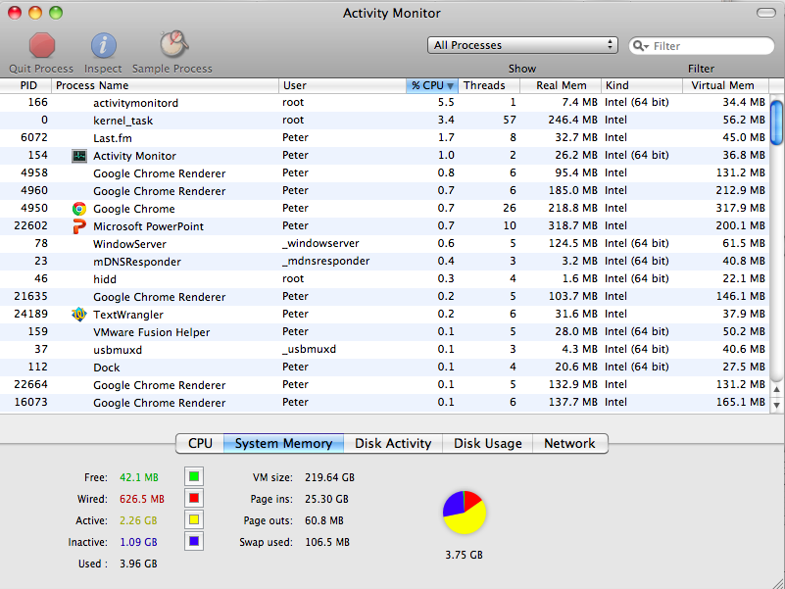

Slide 19
Page replacement algorithms
FIFO (First in/first out)
Replace the oldest page with the one being paged in
Not very good in practice, suffers from Belady’s Anomaly
Second-Chance (Modified FIFO)
FIFO, but skip referenced pages
VAX/VMS used this
Random
Better than FIFO!
NFU (Not Frequently Used)
Replace the page used the least number of times
Better variation: Aging ensures that pages that have not been used for a while go away.
NRU (Not Recently Used)
Replace a page not used since last clock cycle
LRU (Least Recently Used)
Replace the least recently used page
Works well but expensive to implement. (More efficient variants include LRU-K)
LRU Clock (Modified LRU)
Replace the least recently used page, with a hard limit on the max time since used
Clairvoyant
Replace the page that’s going to be needed farthest in the future.
Notes:
Linux 2.4 kernel uses NFU w/Aging
http://www.surriel.com/system/files/linux24-vm-freenix01.pdf

Slide 20
Example of Belady’s anomaly
Sequence of page requests:
3 | 2 | 1 | 0 | 3 | 2 | 4 | 3 | 2 | 1 | 0 | 4
3 | 3 | 3 | 0 | 0 | 0 | 4 | 4 | 4 | 4 | 4 | 4
 | 2 | 2 | 2 | 3 | 3 | 3 | 3 | 3 | 1 | 1 | 1
 |  | 1 | 1 | 1 | 2 | 2 | 2 | 2 | 2 | 0 | 0
3 physical page frames:
Page faults (in red): 9
Notes:
“Belady’s anomaly: there are reference strings for which the fault rate increases when the process is given more physical memory.”

Slide 21
Example of Belady’s anomaly
Sequence of page requests:
3 | 2 | 1 | 0 | 3 | 2 | 4 | 3 | 2 | 1 | 0 | 4
3 | 3 | 3 | 3 | 3 | 3 | 4 | 4 | 4 | 4 | 0 | 0
 | 2 | 2 | 2 | 2 | 2 | 2 | 3 | 3 | 3 | 3 | 4
 |  | 1 | 1 | 1 | 1 | 1 | 1 | 2 | 2 | 2 | 2
 |  |  | 0 | 0 | 0 | 0 | 0 | 0 | 1 | 1 | 1
4 physical page frames:
Page faults (in red): 10
Notes:
“Belady’s anomaly: there are reference strings for which the fault rate increases when the process is given more physical memory.”

