Slide 1
CSE 451: Operating Systems
Section 3:
Project 0 recap, Project 1

Slide 2
Project 0

Slide 3
Project 0: queue problems
Must check for empty queues before reversing or sorting

Slide 4
Project 0: common hash table problems
Linear probing misunderstandings
Must mark cells as vacated (different than free)
Consider hash table size of 10
Two inserts:
key1 -> hash = 5
key2 -> hash = 15
Linear probing: will occupy slots 5 and 6
Delete key1
Lookup key2: slot 5 is empty, but need to check 6!

Slide 5
Project 0: other hash table problems
Not improving the test code
Memory leaks

Slide 6
Coding style
Please indent consistently
man 1 indent
Let your text editor do it for you!
vi: press 1 G, then press = G
Add comments for complex code

Slide 7
Memory management
The problem of ownership:
void do_stuff(char *buf, int len) {
...
free(buf);
}
int main() {
char *mybuf =
(char *)malloc(LEN*sizeof(char));
do_stuff(mybuf, LEN);
...
free(mybuf); // Double free: undefined
// behavior!
}

Slide 8
Memory management
Always be explicit about who owns memory
If a function allocates some memory that the caller must free, say so!
If a function frees some memory that the caller should no longer use, say so!
Define pairs of allocate and free functions
Ideally, whoever calls the allocate function also calls the free function; if not, carefully consider usage

Slide 9
Advanced memory management
What if multiple processes or threads are accessing the same structure in memory?
When can we free?
What technique can we use to track who is using the memory?
Reference counting

Slide 10
Kernel memory management
How does memory management within the kernel differ?
Different pools of memory
e.g. for devices that use DMA
Different priority / reliability requirements
Can the kernel block/sleep when allocating memory?
Different performance requirements
Frequent allocations use “slab allocator” [Bonwick ’94]
Kernel memory allocation functions: kmalloc(), vmalloc()
Notes:
http://www.linuxjournal.com/article/6930
Slab allocator: a.k.a. memory pool
kmalloc() guaranteed to return physically contiguous pages; vmalloc() may not.

Slide 11
Project 1
Due Wednesday at 11:59pm!
Follow turnin instructions carefully
Only one group member needs to run turnin
The writeup is a critical component
Don’t forget to include your group number and everybody’s name in the writeup

Slide 12
Project 1: turnin
Preserve directories when submitting changed files
When we extract your changed files, they should go to the right directory, so it is unambiguous which file you changed
This is easy to do with the tar command
Recommendation: double-check your turnin on a clean copy of the kernel
Writeup requires a list of modified files (#7): please use full path name

Slide 13
Developing on forkbomb.cs.washington.edu
What’s a forkbomb?
How do you stop a forkbomb?
If you’re still logged in, try killall
If you can’t log in, e-mail support@cs!
The TAs can’t do anything about it

Slide 14
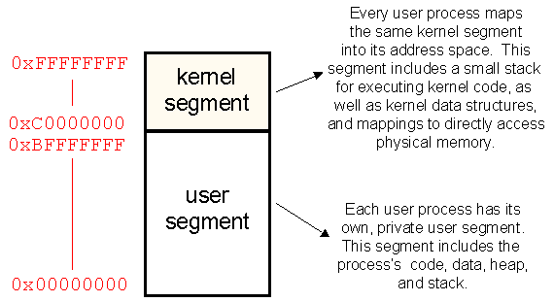
Project 1: system calls
Special functions must be used to copy data between user space and kernel. Why?

Slide 15
Linux kernel memory safety
copy_from_user(), copy_to_user(), access_ok(): look for example usage in kernel
Definition, gory details: arch/x86/lib/usercopy_32.c

Slide 16
Libraries
Linux has two types of executable programs:
Statically linked
Dynamically linked
What are the benefits of each?
Are these library calls or system calls?
strlen()
exec()
execvp()
execve()
fork()
What kind of executable are you creating for project 1?
Notes:
http://www.ibm.com/developerworks/linux/library/l-lpic1-v3-102-3/index.html?ca=drs-
http://www.ibm.com/developerworks/linux/library/l-dynamic-libraries/

Slide 17
Project 1: example Makefile
all: standalone linked
# Produces getexeccounts.o:
getexeccounts: getexeccounts.c getexeccounts.h
gcc -c getexeccounts.c
# Produces getcounts.a:
library: getexeccounts
ar r getcounts.a getexeccounts.o
standalone: getexeccounts
gcc -o getdriver_standalone getdriver.c \
getexeccounts.o
linked: getexeccounts library
gcc -o getdriver_linked getdriver.c getcounts.a
clean:
rm -f *.o *.a getdriver_standalone \
getdriver_linked
Notes:
Note: this Makefile doesn’t actually meet the project requirements, which say to put the library in a separate /lib directory, etc.

Slide 18
Useful commands for libraries & syscalls
strace: trace system calls
ltrace: trace library calls
ldd: list shared libraries program depends on
objdump: display info from object files
readelf: display info from executable files
strings: print strings found in a binary file

Slide 19
Project 1: debugging
How will you debug project 1?
Recommendation: implement and test one basic step at a time
Debug messages: printk()
Where does printk() output go?
Possibly to console (include/linux/kernel.h: defines KERN_XYZ log levels)
dmesg command
/var/log/messages
Notes:
Annoying: have to reboot every time!

Slide 20
Project 1: testing
How will you test project 1?
Check execcounts correctness by comparing its output to output from other tools
Test bad input: to shell, to system call
Shell must be able to read commands from a file: use this for testing!
What else?

Slide 21
Project 1 tips
Re-read the project description for hints
Read the man pages!
Navigating Linux kernel code: ctags, cscope
Use the discussion board

