Slide 1
CSE 451: Operating Systems
Section 8
Linux buffer cache; design principles

Slide 2
Outline
Thread preemption (project 2b)
RPC
Linux buffer cache
Networking design principles

Slide 3
Mutex: no preemption
mutex_lock(lock)
if (lock->held == 0)
lock->held = 1;
else
enqueue(
lock->waitq,
current);
schedule();
mutex_unlock(lock)
if (!is_empty(
lock->waitq))
next = dequeue(
lock->waitq);
enqueue(readyq,
next);
else
lock->held = 0;

Slide 4
Mutex: with preemption (wrong)
mutex_lock(lock)
while(test_and_set
(lock->held))
{}
mutex_unlock(lock)
atomic_clear(
lock->held);

Slide 5
Mutex: with preemption (wrong)
mutex_lock(lock)
while(test_and_set
(lock->held))
schedule();
mutex_unlock(lock)
atomic_clear(
lock->held);

Slide 6
Mutex: with preemption (wrong)
mutex_lock(lock)
while(test_and_set
(lock->held))
enqueue(
lock->waitq,
current);
schedule();
mutex_unlock(lock)
if (!is_empty(
lock->waitq))
splx(HIGH);
next = dequeue(
lock->waitq);
enqueue(readyq,
next);
splx(LOW);
atomic_clear(
lock->held);

Slide 7
Mutex: with preemption (wrong)
mutex_lock(lock)
while(test_and_set
(lock->held))
enqueue(
lock->waitq,
current);
schedule();
mutex_unlock(lock)
if (!is_empty(
lock->waitq))
splx(HIGH);
next = dequeue(
lock->waitq);
enqueue(readyq,
next);
splx(LOW);
atomic_clear(
lock->held);
What if prempted here?

Slide 8
Mutex: with preemption (right)
mutex_lock(lock)
while(test_and_set(
lock->codelock))
{}
if (lock->held == 0)
lock->held = 1;
atomic_clear(
lock->codelock)
else
enqueue(
lock->waitq,
current);
atomic_clear(
lock->codelock)
schedule();
mutex_unlock(lock)
while(test_and_set(
lock->codelock))
{}
if (!is_empty(
lock->waitq))
next = dequeue(
lock->waitq);
splx(HIGH);
enqueue(readyq,
next);
splx(LOW);
else
lock->held = 0;
atomic_clear(
lock->codelock)

Slide 9
RPC

Slide 10
RPC
Remote procedure call: causes a procedure to execute in some other address space
Usually an address space on some other machine
Interface description language (IDL) defines the interface that the server makes available to the client

Slide 11
RPC on Android
Android uses RPC for communication between applications and system components
All on the same device!
Uses all of the standard RPC components:
IDL file
Auto-generated stubs for client, server
Marshalling and unmarshalling of arguments…

Slide 12
Linux file system layers
Application
User
Files, directories
Kernel
VFS
Inodes, direntries
cse451fs
ext2
ext3
NFS
Blocks
Buffer cache
Disk drivers
Network

Slide 13
Linux buffer cache
Buffer cache: just an area of memory
cat /proc/meminfo
Caches disk blocks and buffers writes
File read() checks for block already in buffer cache
If not, brings block from disk into memory
File write() is performed in memory first
Data later written back to disk (when? By who?)

Slide 14
Linux buffer cache
Block is represented by a buffer_head
Actual data is in buffer_head->b_data
Cache manipulates buffer_head and its b_data separately

Slide 15
Buffer cache interface
include/linux/buffer_head.h
Read a block: FS uses sb_bread():
Find the corresponding buffer_head
Create it if it doesn’t exist
Make sure buffer_head->b_data is in memory (read from disk if necessary)

Slide 16
Buffer cache interface
Write a block: mark_buffer_dirty(), then brelse()
Mark buffer as changed and release to kernel
Kernel writes block back to disk at a convenient time
bdflush / pdflush threads
sync command

Slide 17
cse451fs functions
cse451_bread(struct buffer_head **pbh,
struct inode *inode, int block, int create)
Gets buffer_head for given disk block, ensuring its b_data is in memory and ready to use
Calls cse451_getblk()
cse451_getblk(struct buffer_head **pbh,
struct inode *inode, int block, int create)
Gets buffer_head for given disk block, creating it if it doesn’t exist
Doesn’t necessarily bring b_data into cache
Both of these functions increment the block’s refcount, so must be paired with a brelse()

Slide 18
Project 3
Questions?

Slide 19
Networking design principles
A few key principles:
Layering
End-to-end principle
Separation of mechanism and policy
All of these apply to operating systems (and elsewhere!) as well

Slide 20
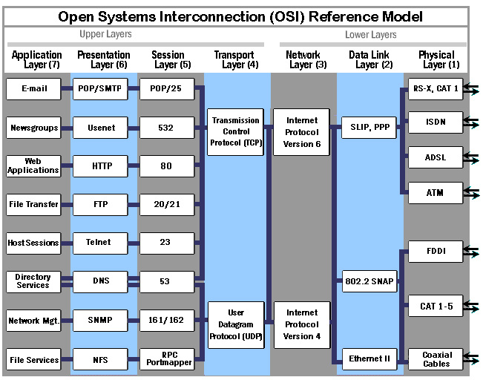

Slide 21
Layering
Internet designers didn’t get it all right the first time
Design for choice
Rigid designs will be broken

Slide 22
End-to-end principle
Danger of putting functionality at lower layers: upper layers won’t need it, but will pay cost anyway
Example: reliability checksums
E2E principle says to move functionality towards upper layers (closer to application)
Other ways of phrasing it:
Smart endpoints, dumb network
Application knows best what it needs

Slide 23
Mechanism vs. policy
Principle: design system so that mechanisms are separate from policy
Implement mechanisms that enable wide range of policies
Caveat: usability (“burden of choice”)
Notes:
Lower layers (mechanisms) should not try to predict how higher layers should use them (policy)

